Slide 1
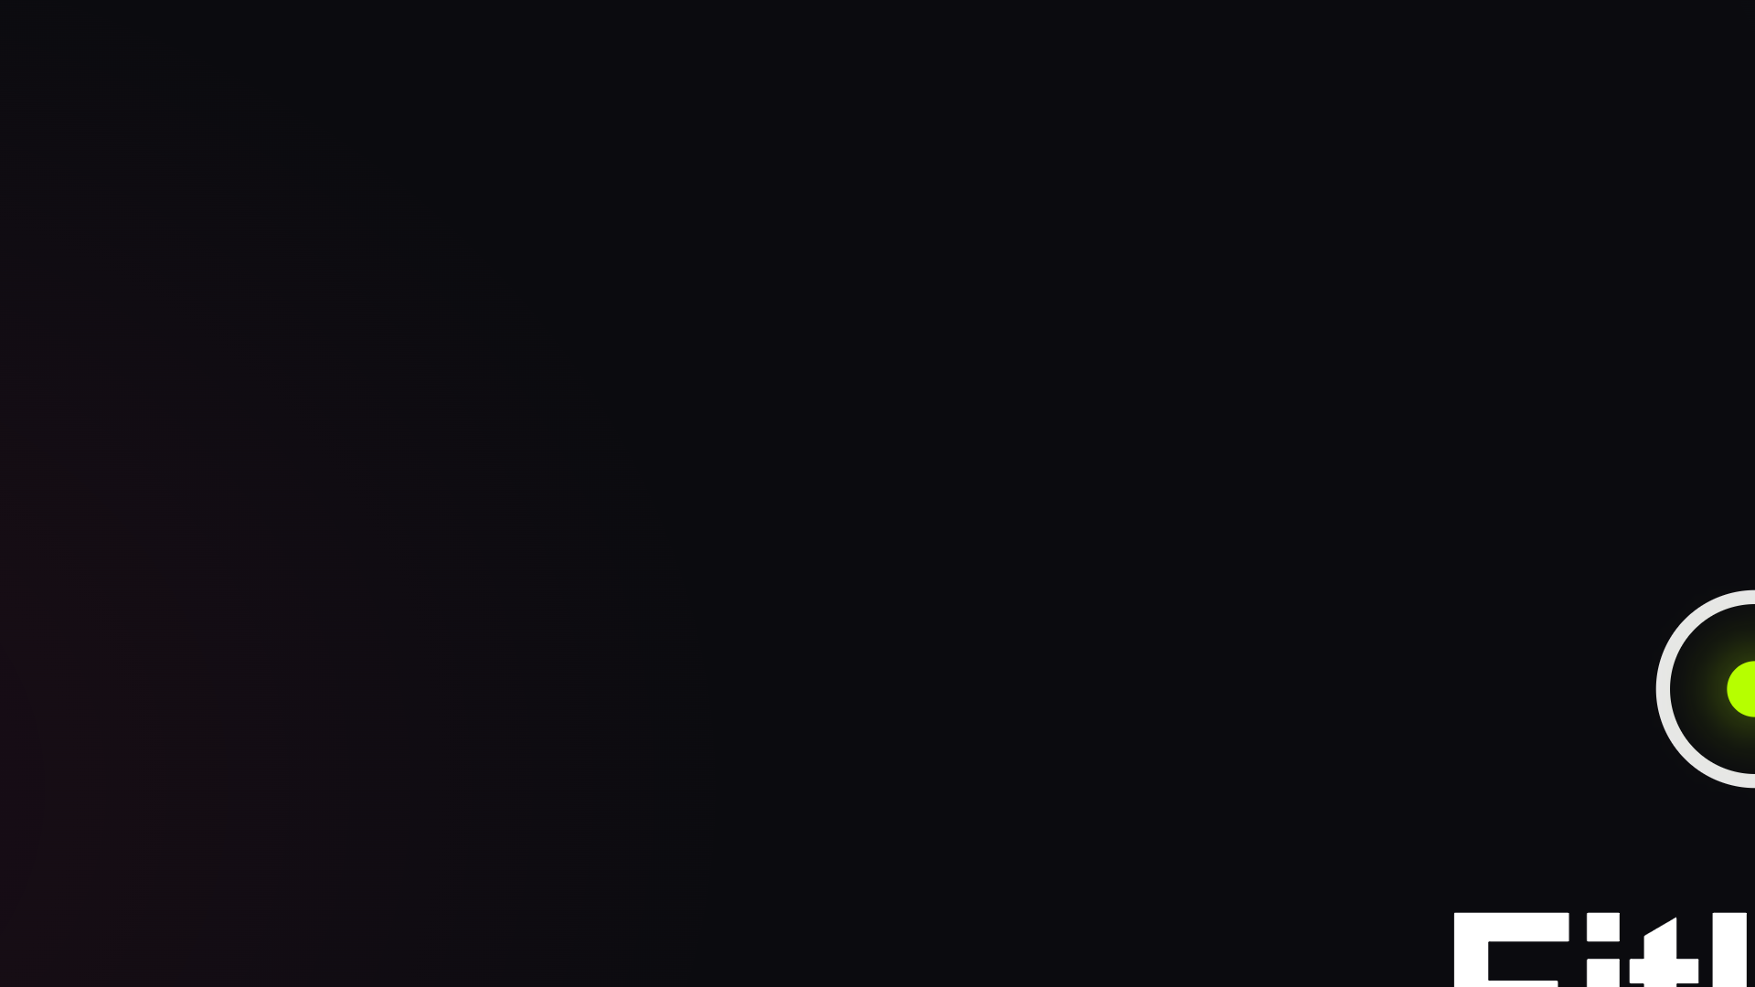

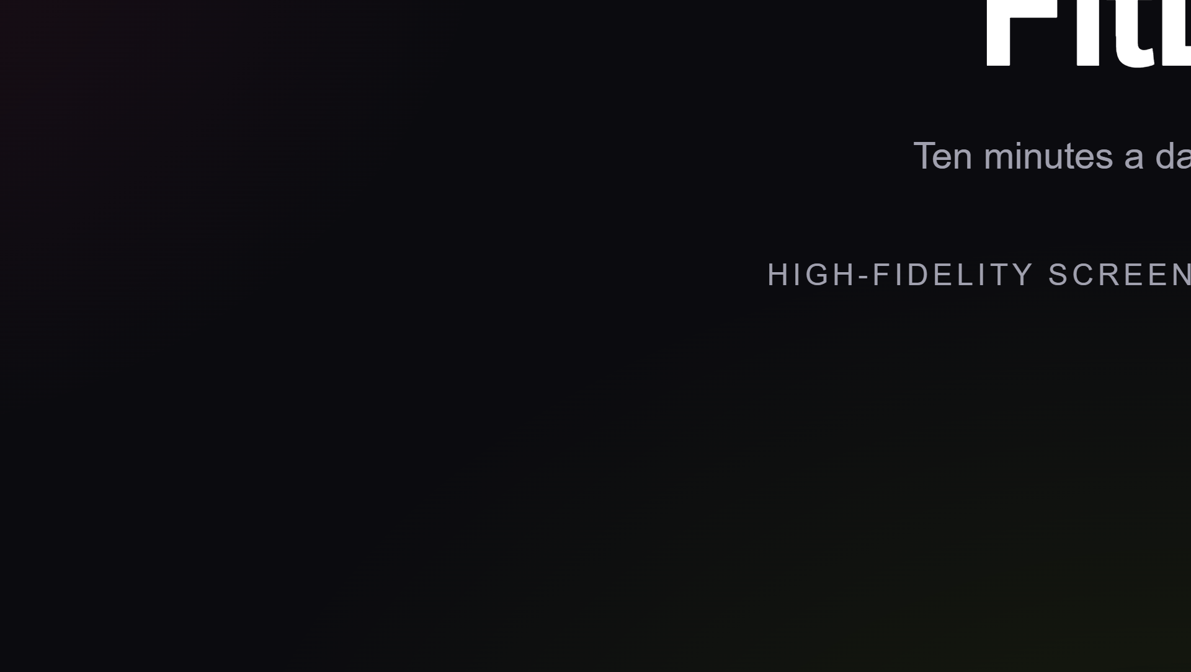
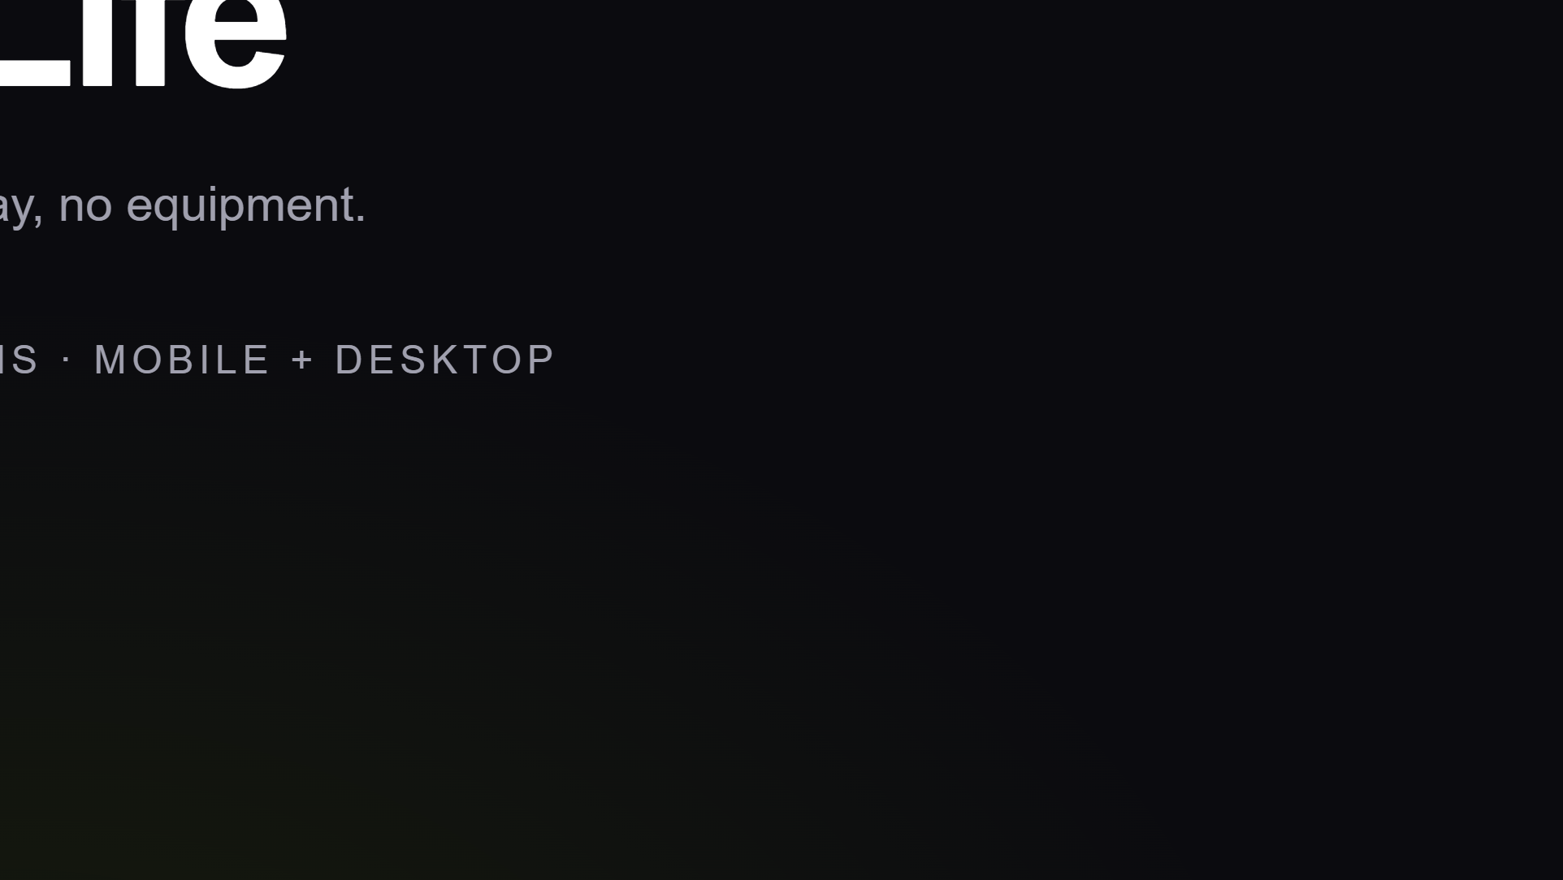
Notes:
FitLife — home workouts for time-poor beginners. Mobile-first at 390px plus a desktop set. Precision-instrument aesthetic: dark canvas, glow, glass.

Slide 2
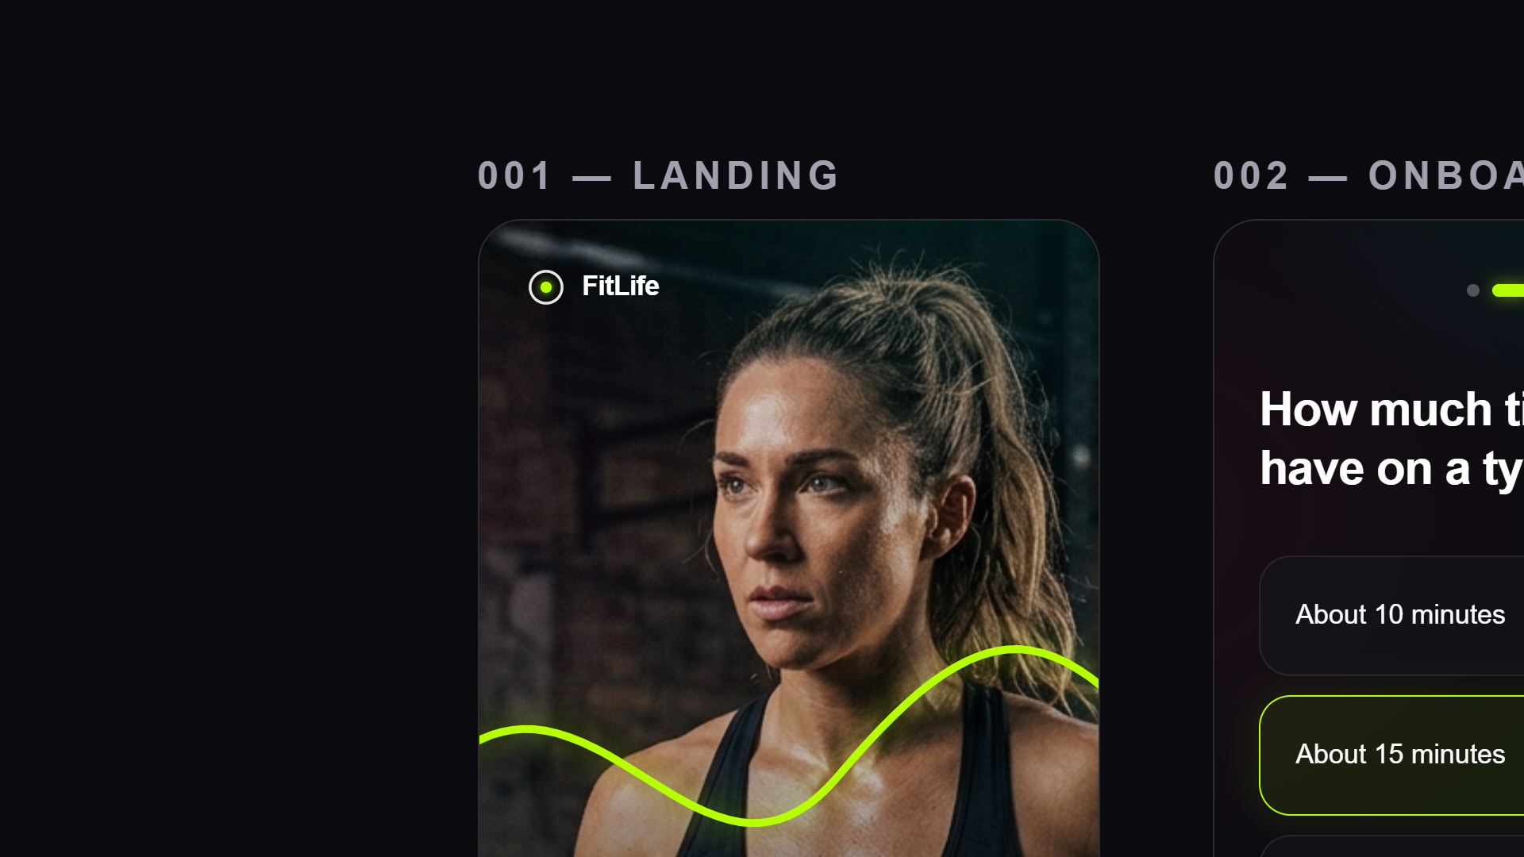
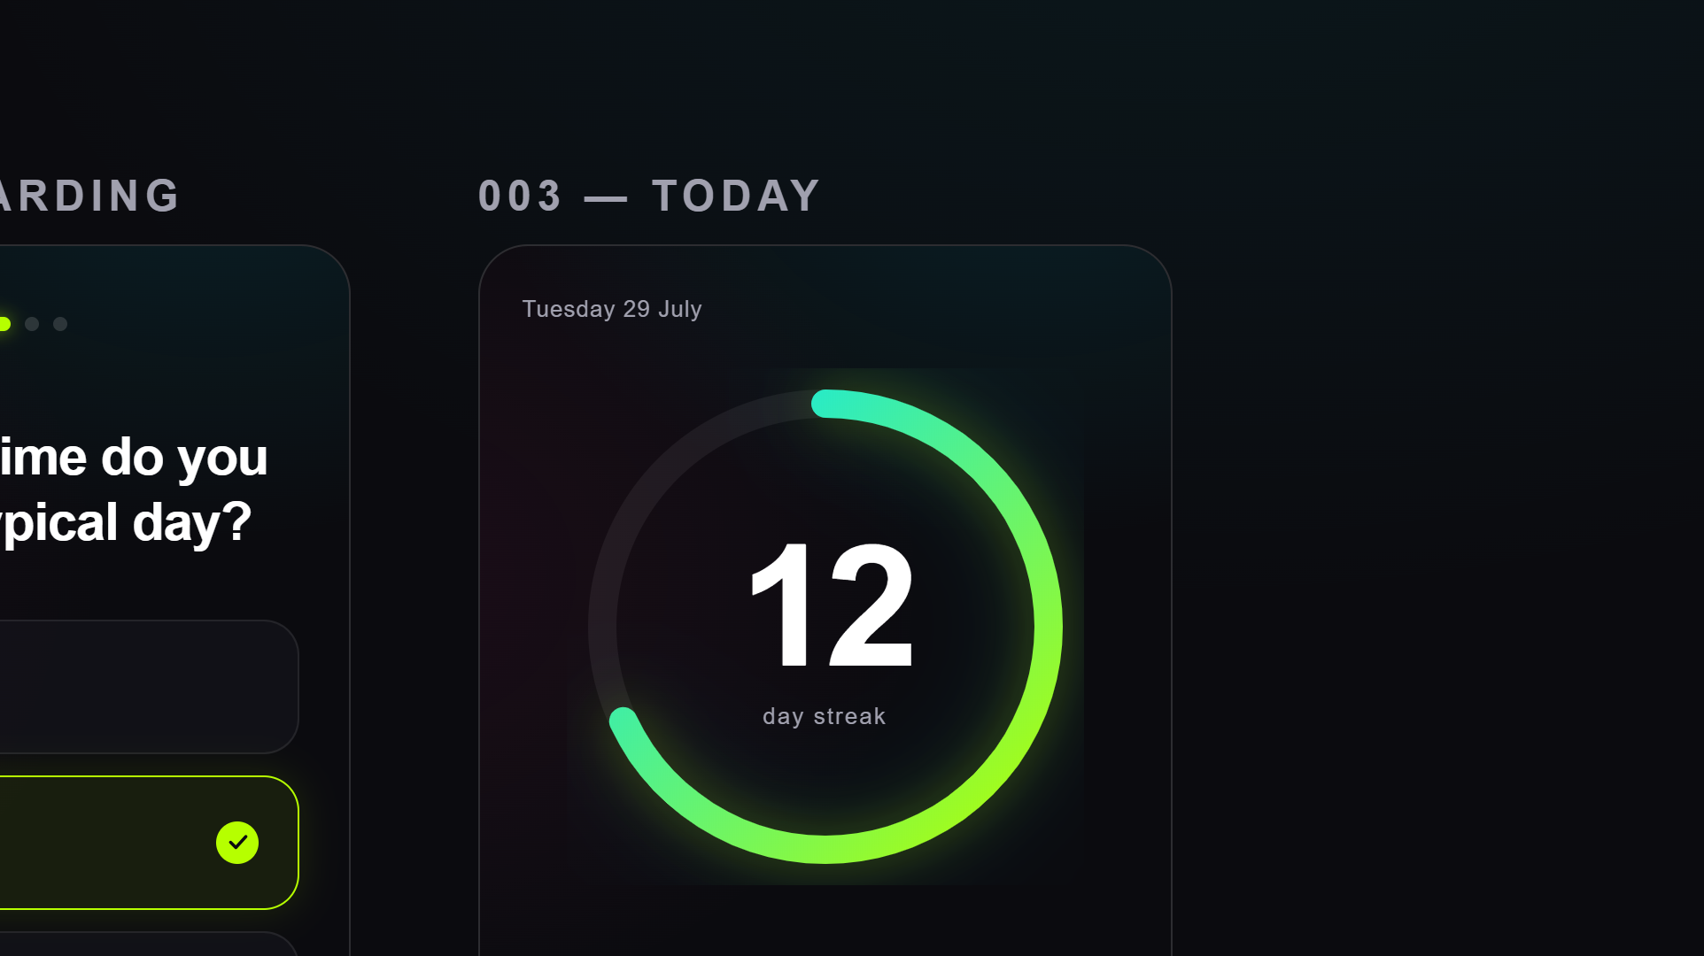
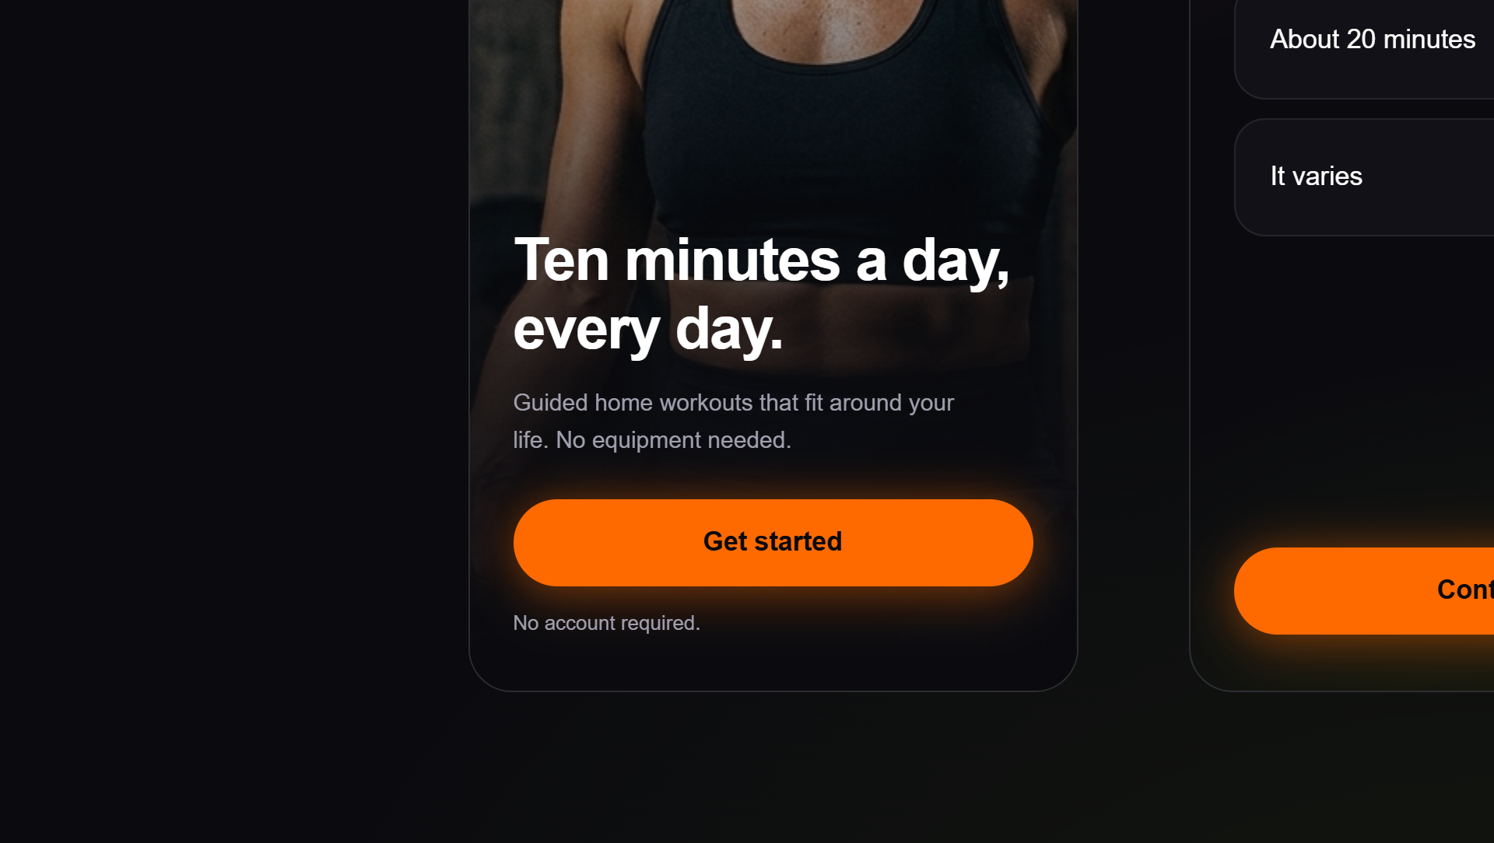
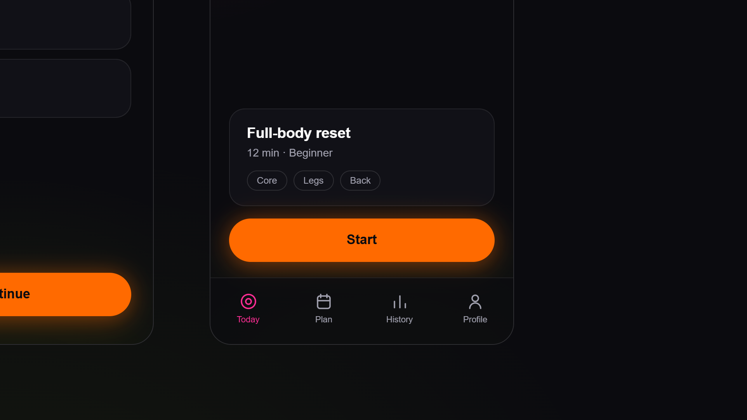
Notes:
The mobile core: Landing gets them started with one orange CTA. Onboarding asks one question per screen, lime selection. Today is the hero — the gradient progress ring with the streak at its centre.

Slide 3
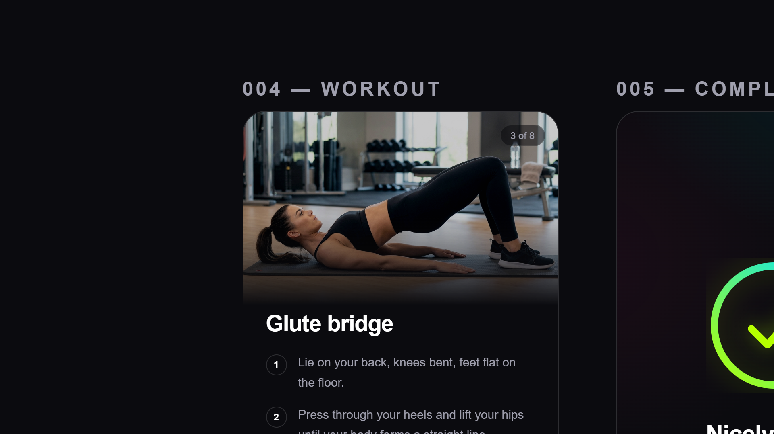
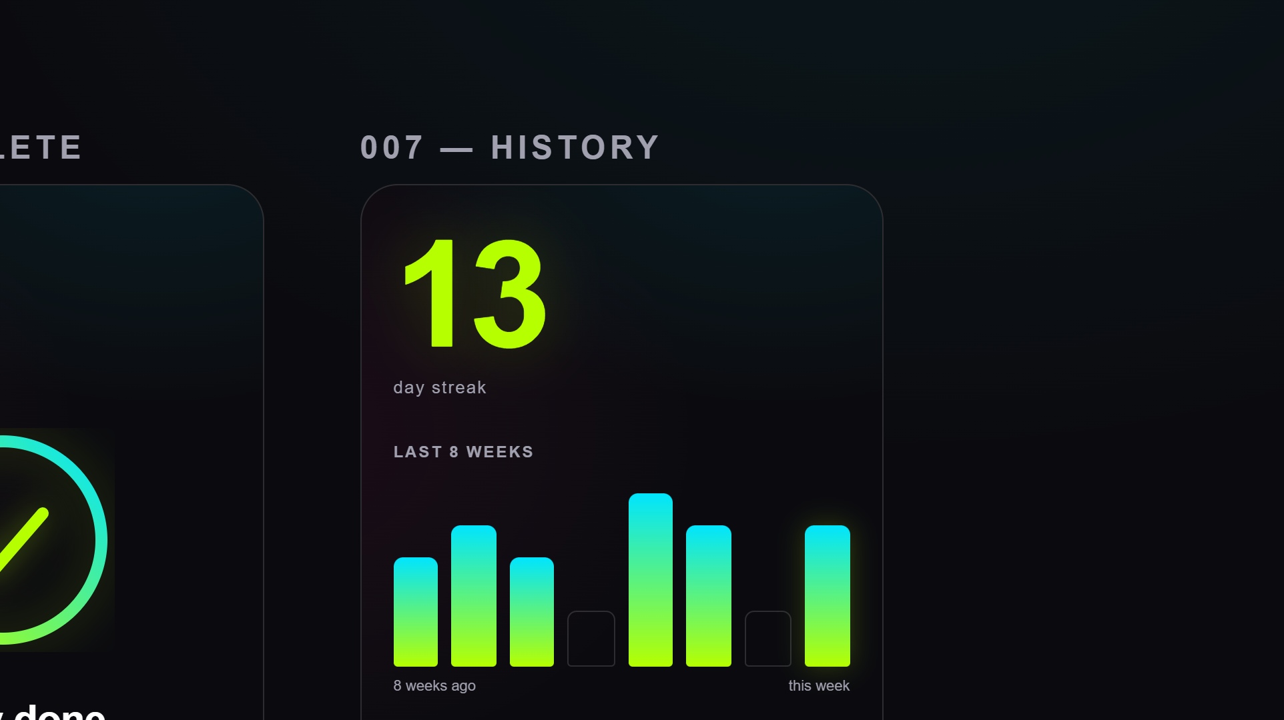
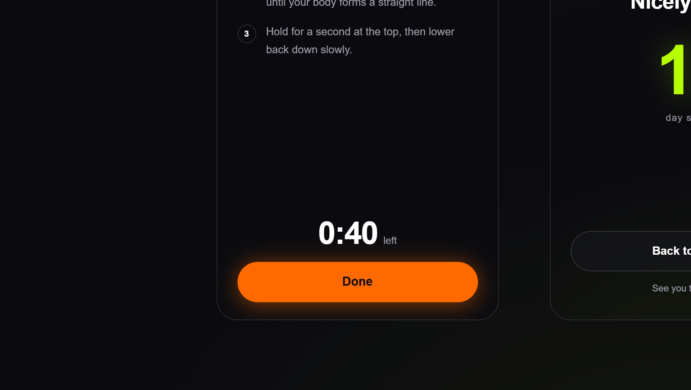
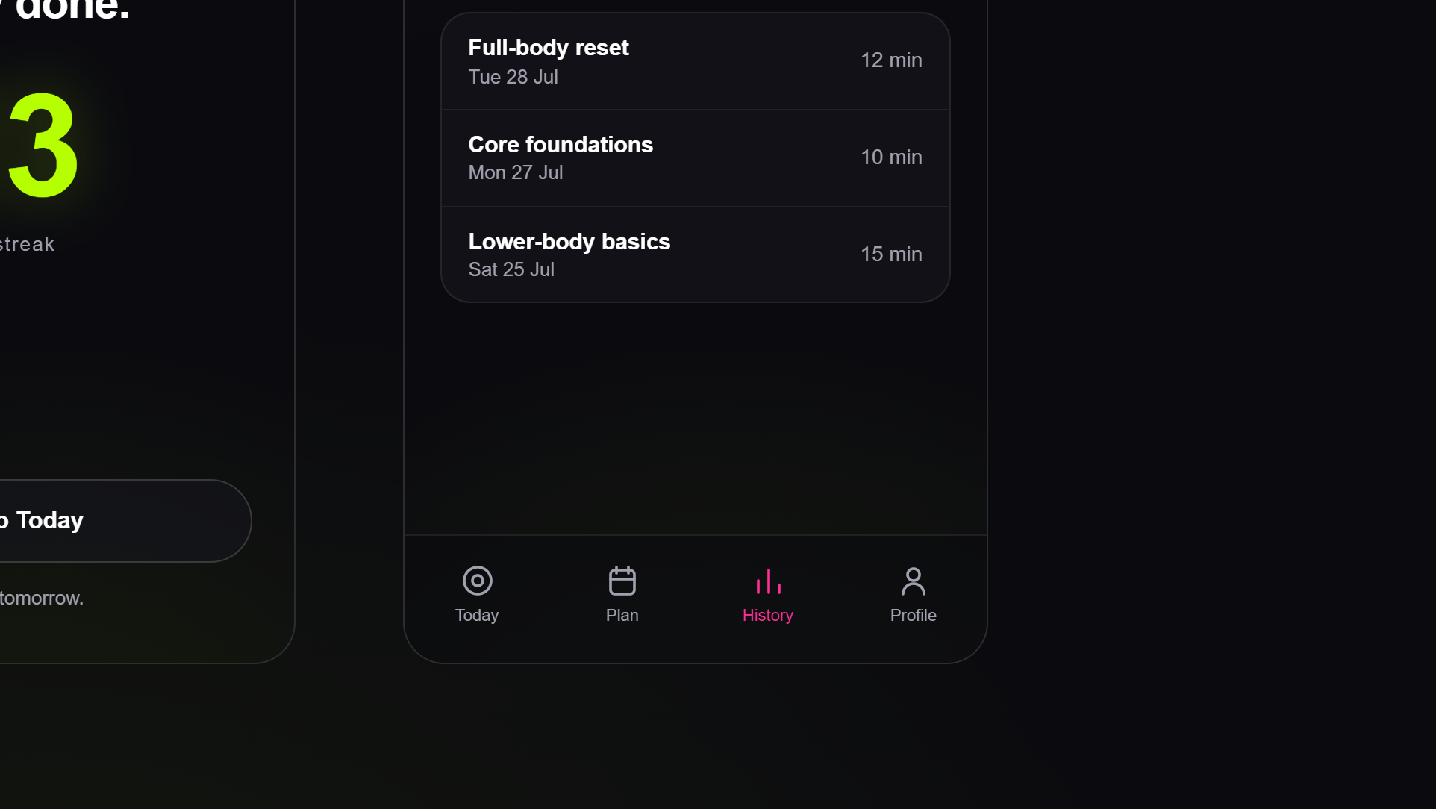
Notes:
Workout view is built for mid-exercise glances: big demo image, quiet numbered steps, one Done button. Complete is a quiet celebration. History shows the streak large with an eight-week chart.

Slide 4
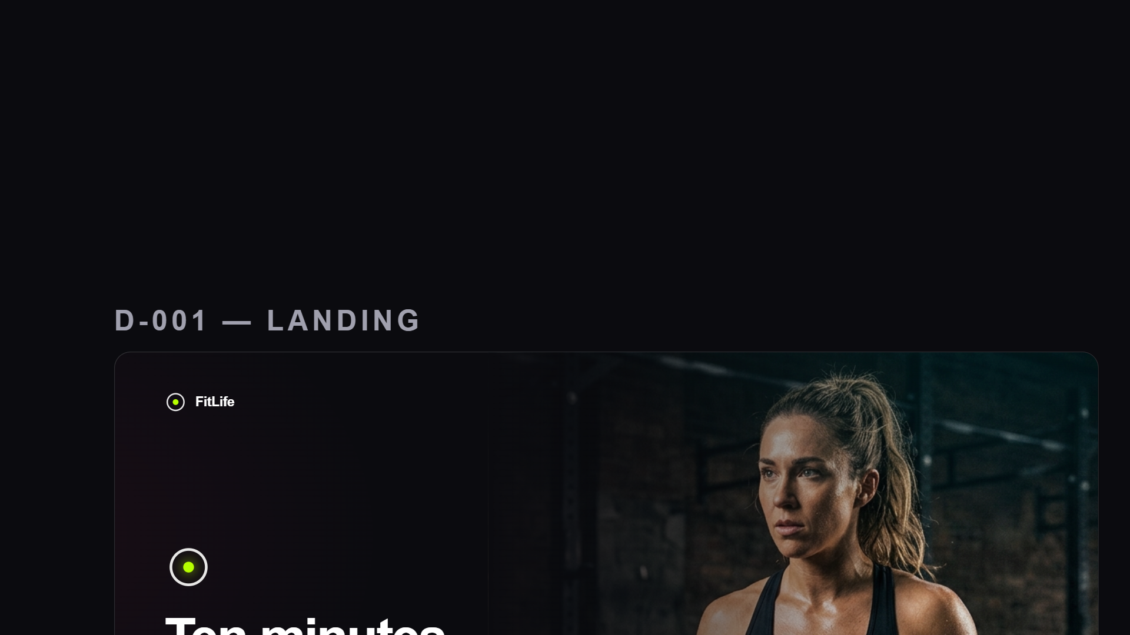
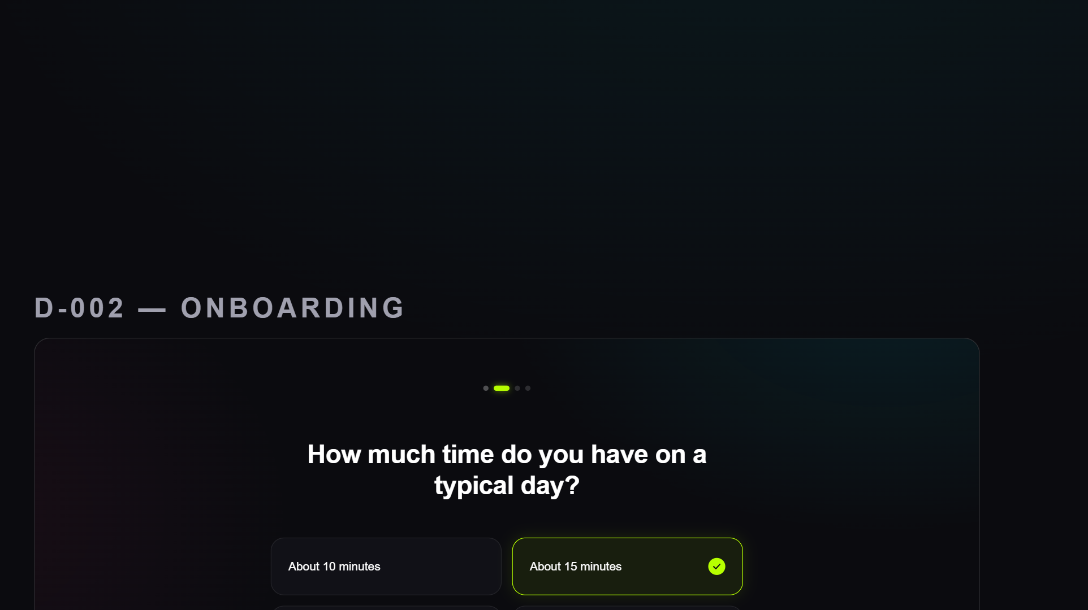
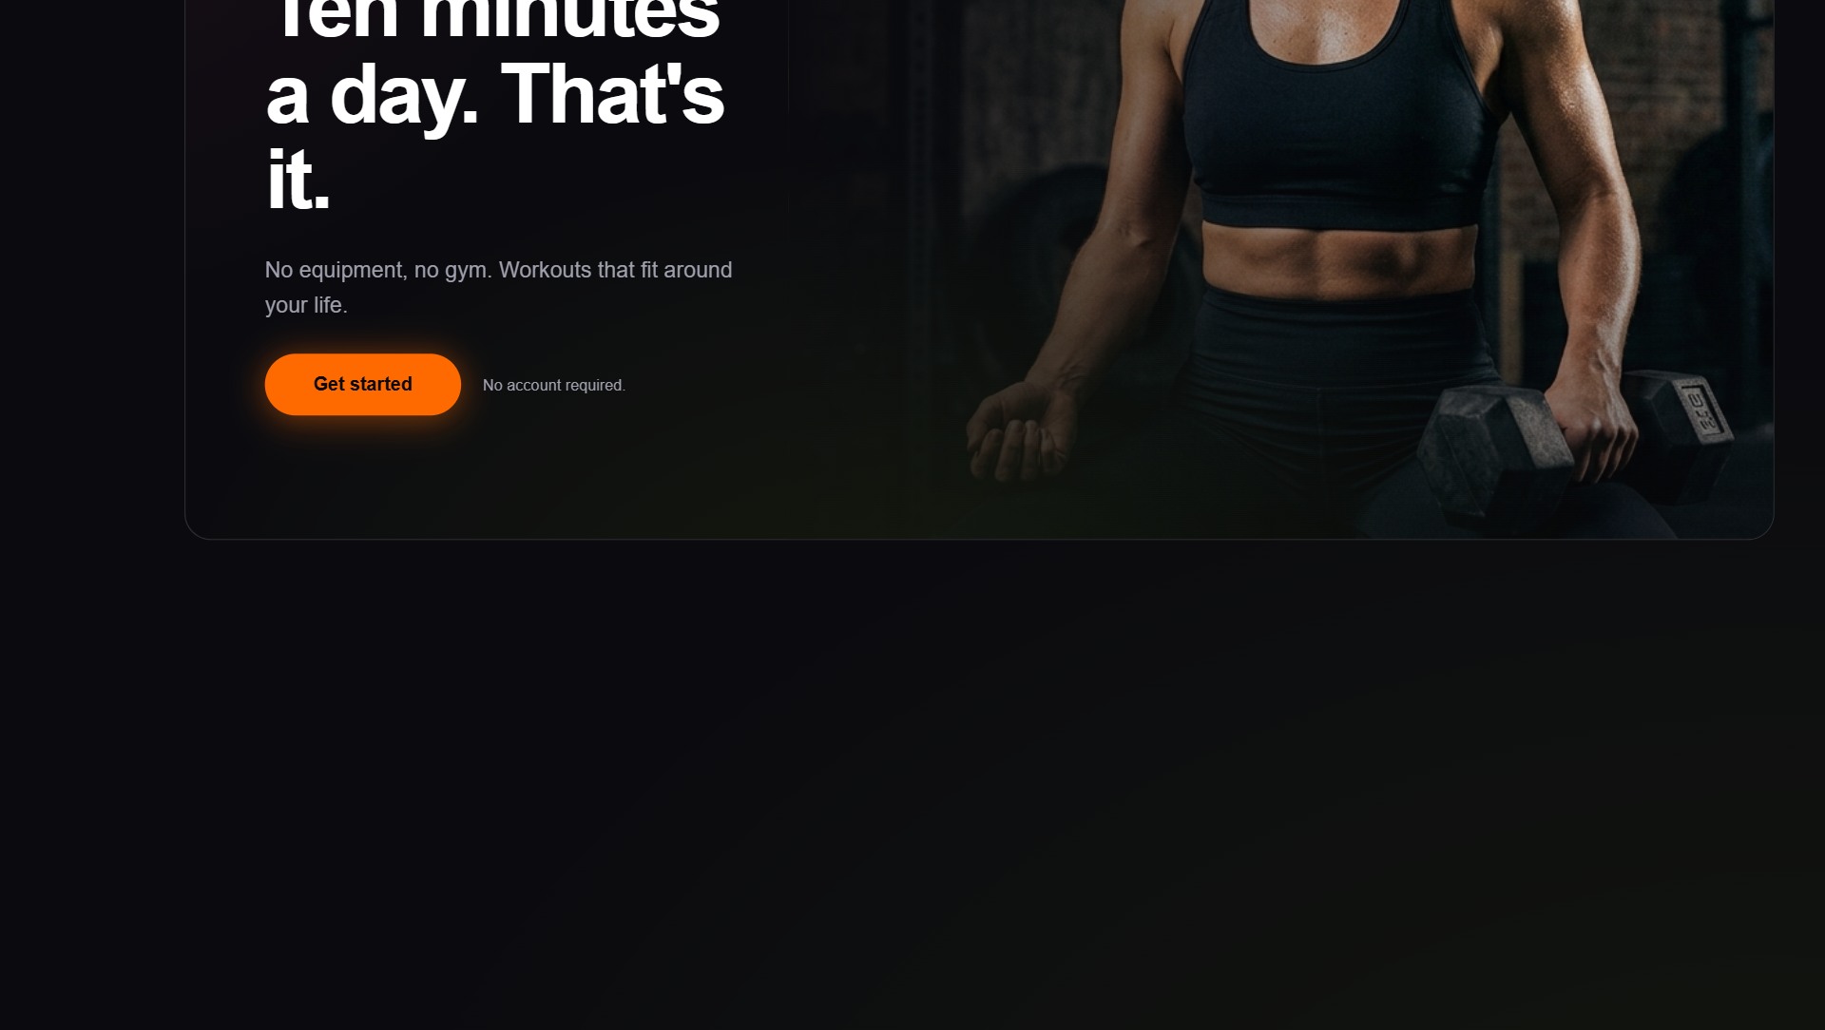
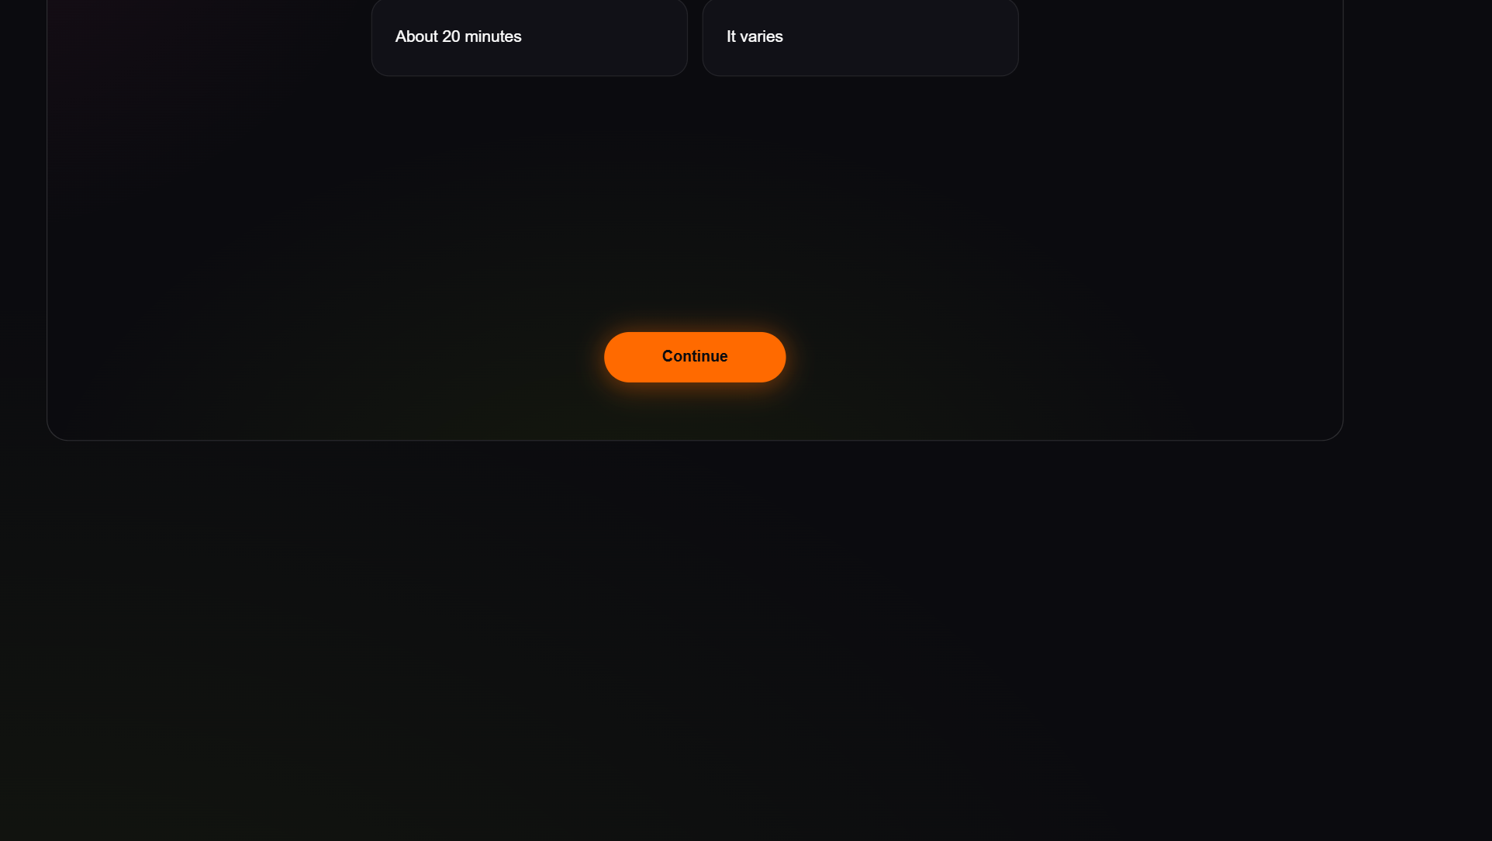
Notes:
The desktop set keeps the same system: split hero landing, centered onboarding with a 2x2 option grid.

Slide 5
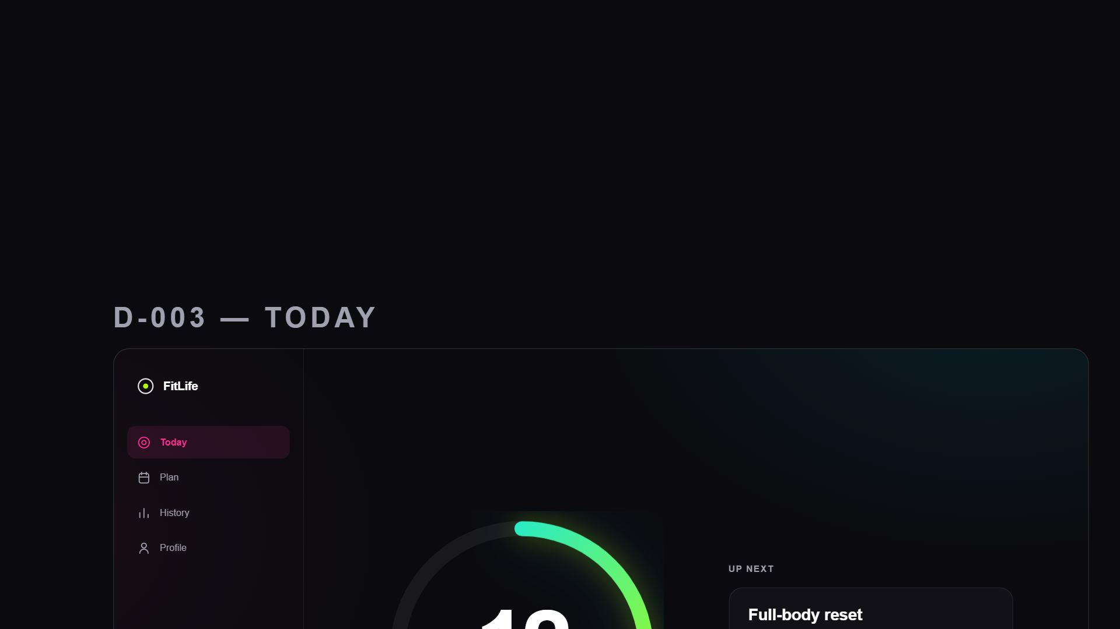
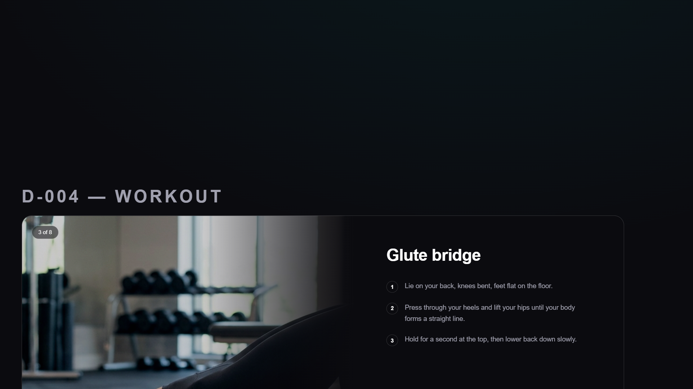
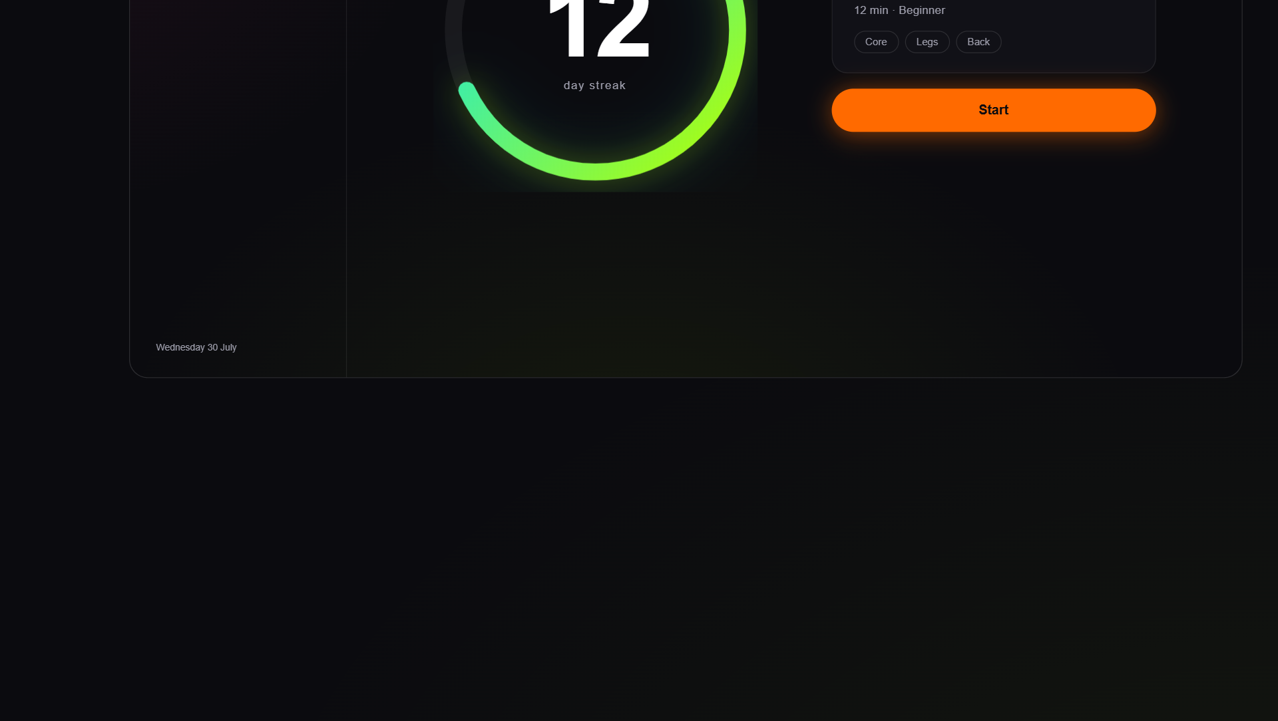
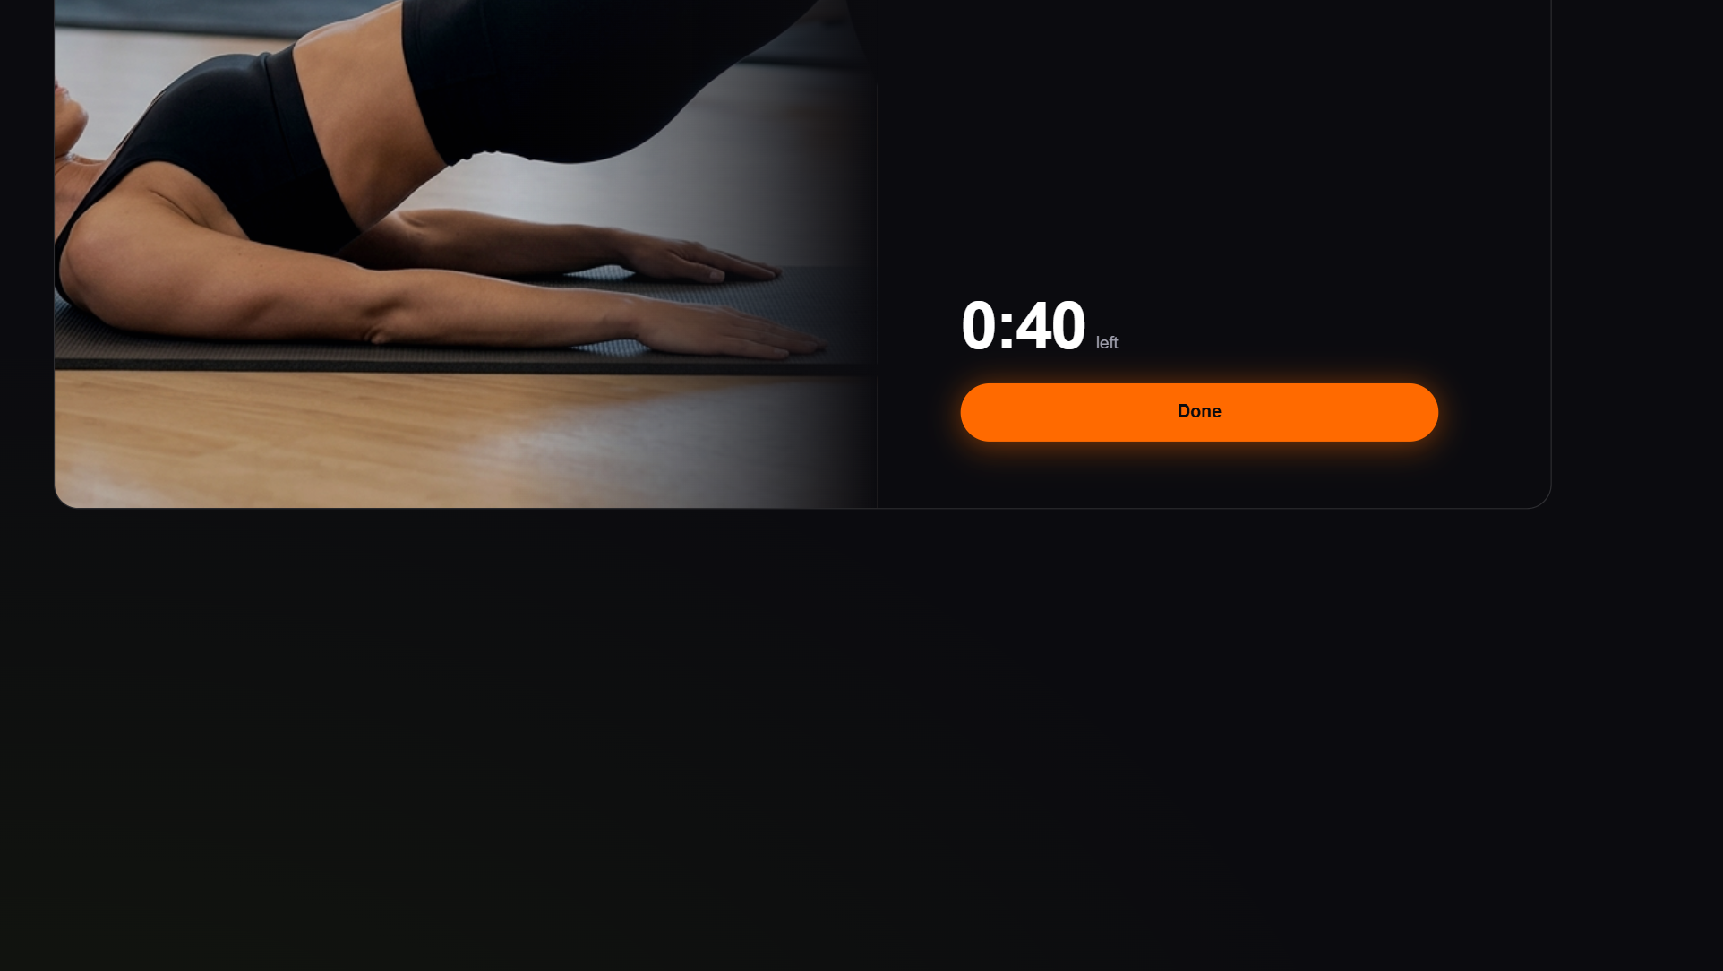
Notes:
Today gets a sidebar and puts the ring beside the workout card. Workout view splits: demo photo left, instructions right.

Slide 6
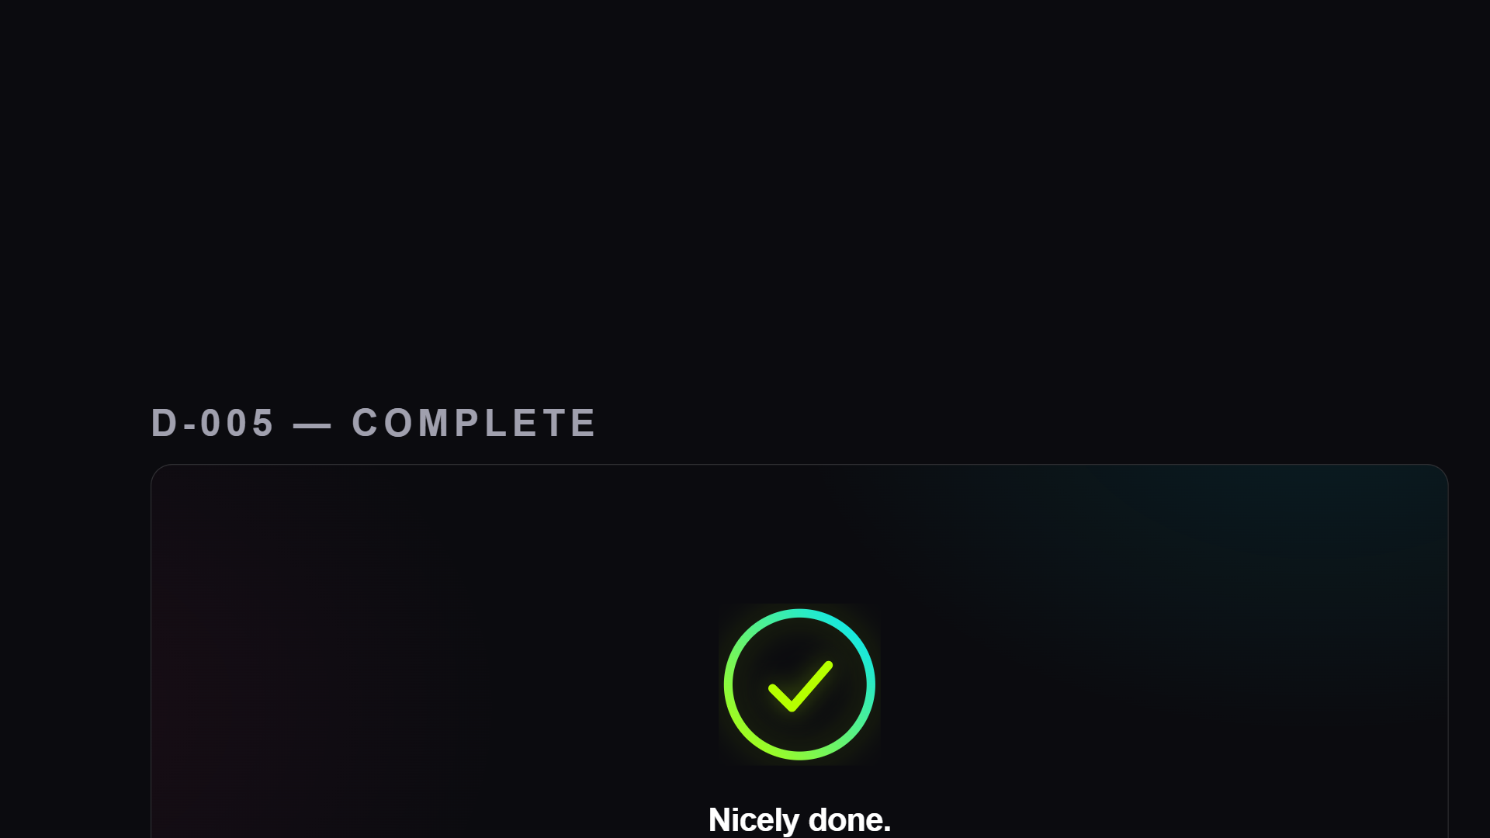
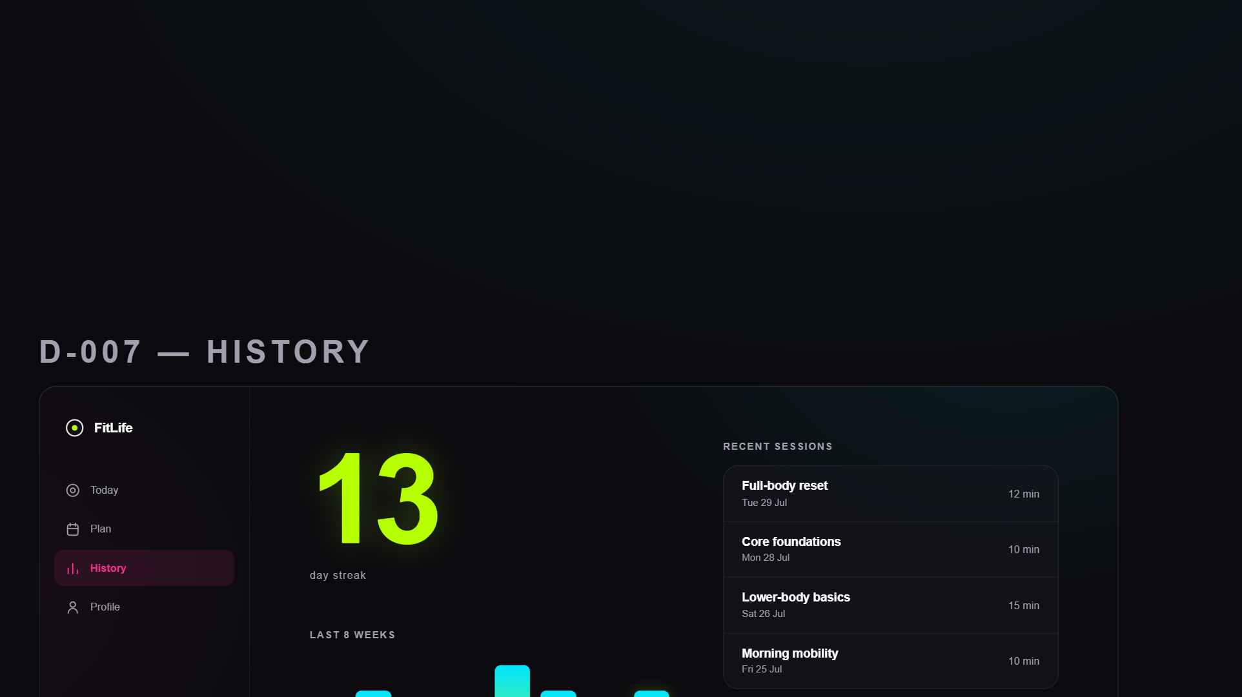
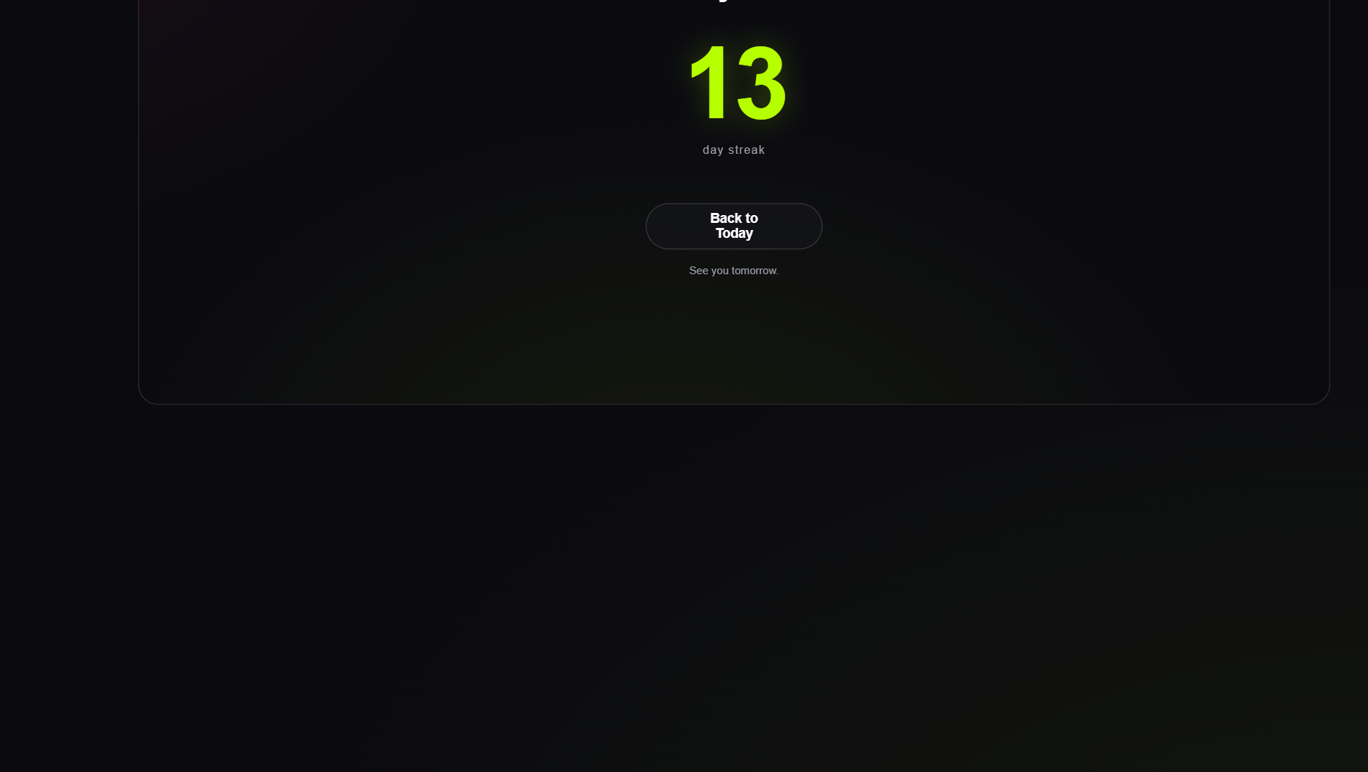
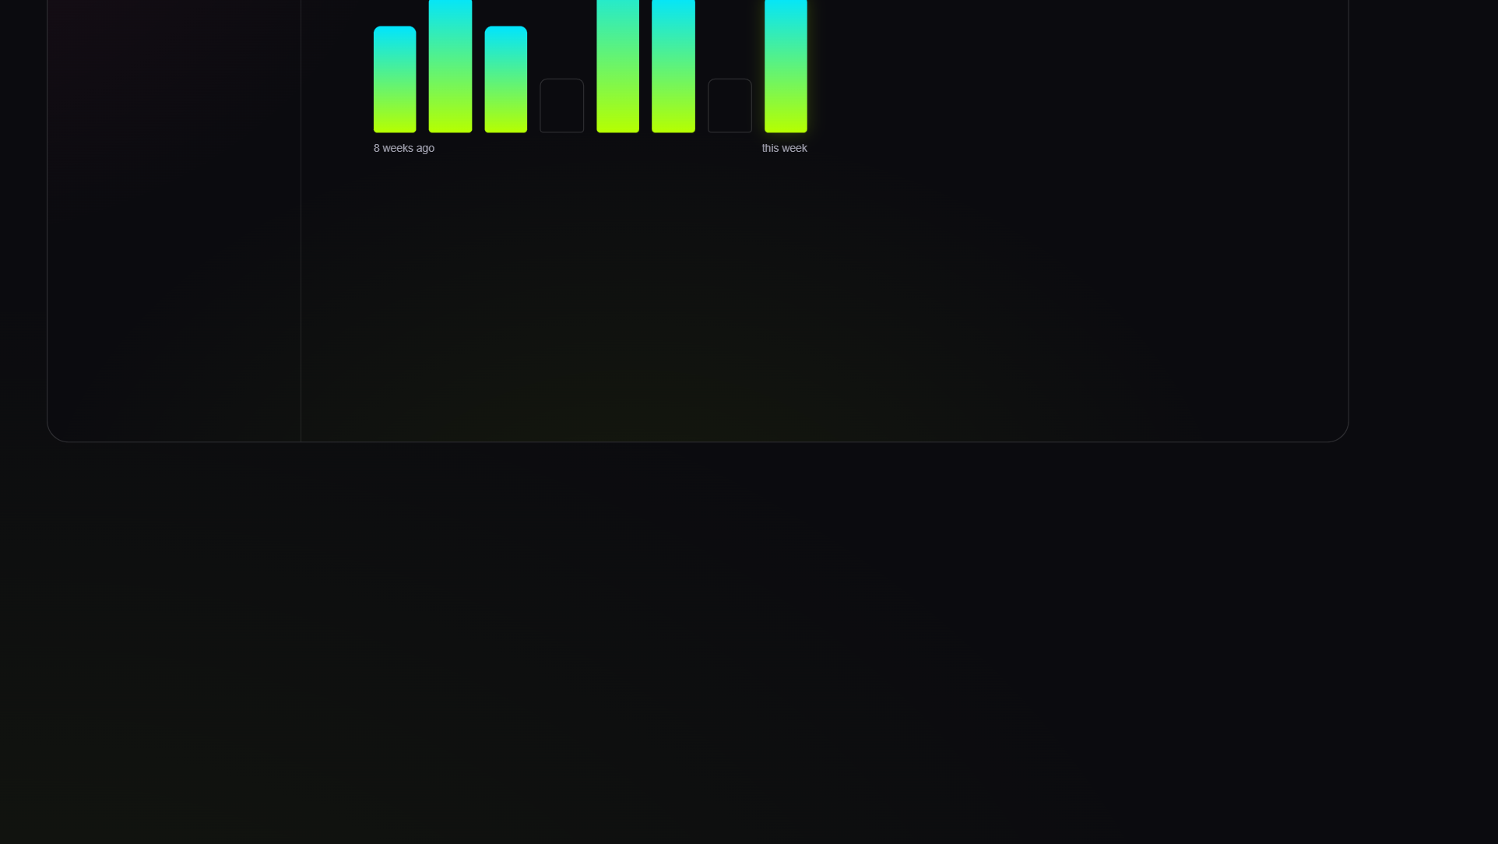
Notes:
Complete stays a quiet centered moment even at desktop width. History pairs the enormous lime streak and chart with the sessions list.

Slide 7
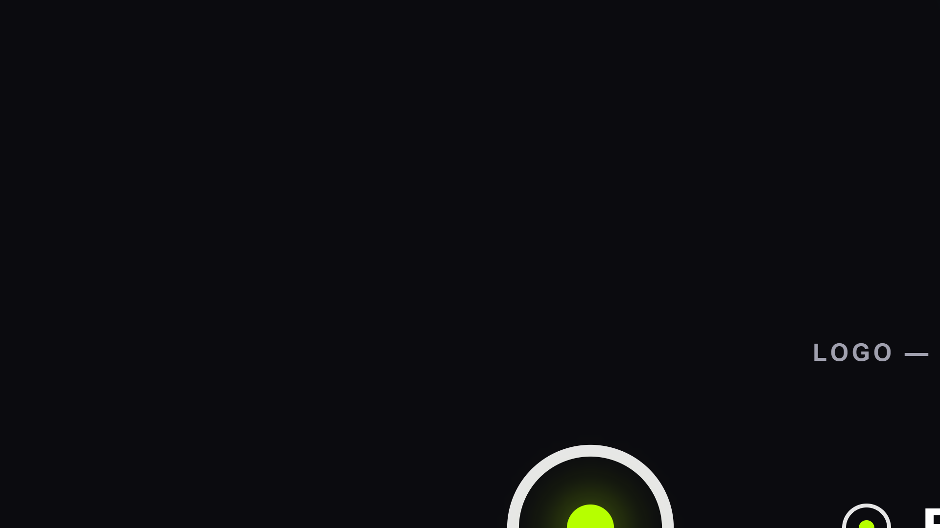
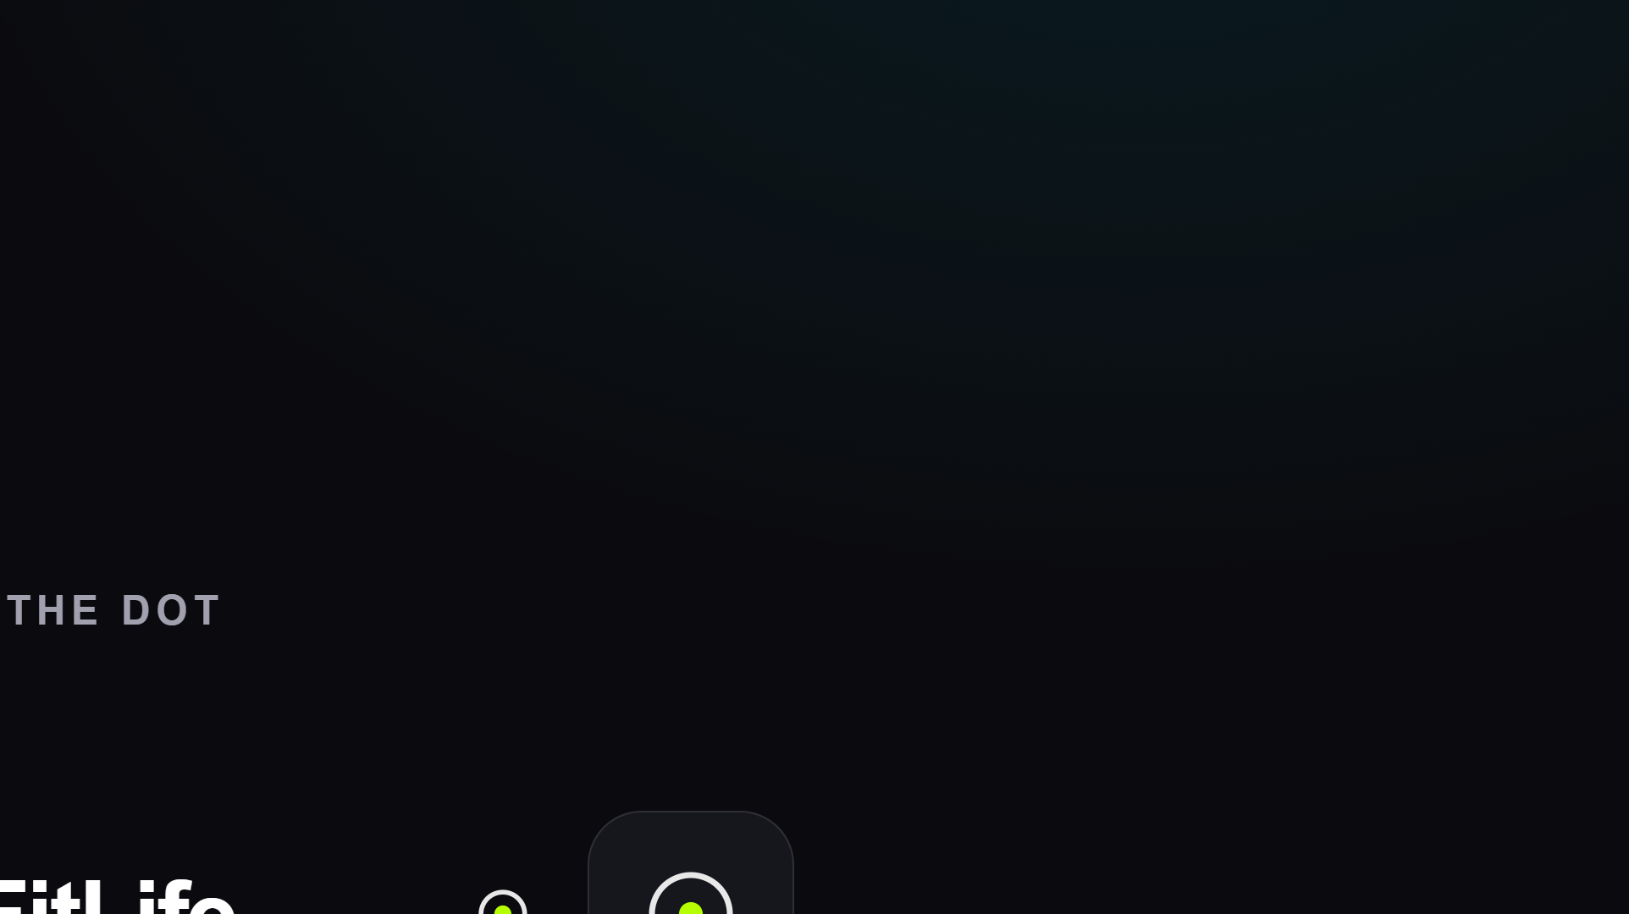
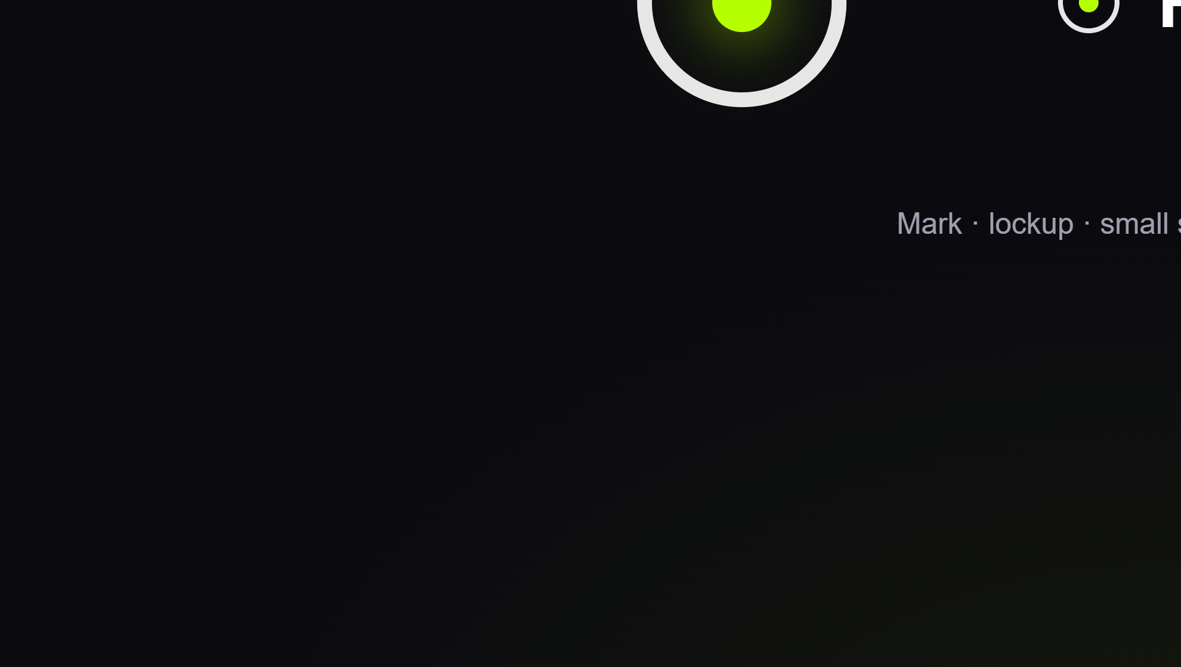
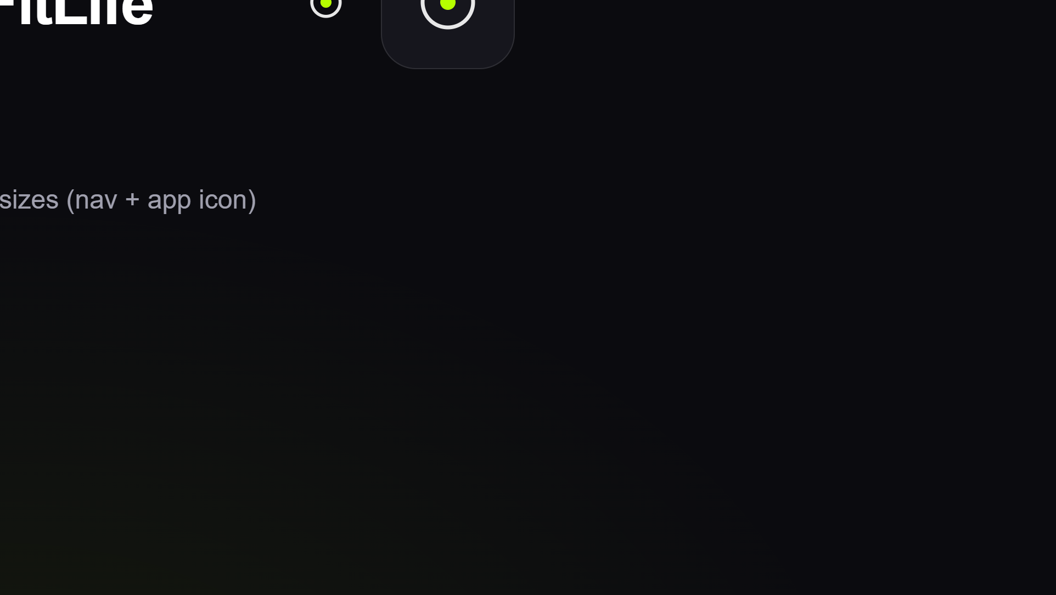
Notes:
The mark: a target ring with one luminous lime dot — today's target. Shown as mark, lockup, and small sizes.

