Slide 1
Two-Stack PDA
CS6800
Advance Theory of Computation
Spring 2016
Nasser Alsaedi

Slide 2
Outlines
Turing Machine as a Model of Computation
Two-Stack PDA is Equivalent to TM
Linear Bound Automata with One Stack
Linear Bound Automata with Two Stacks
TM Simulate Two-Stack PDA

Slide 3





Turing Machine
Turing Machine is a powerful computing model that can simulate any computer program.
Input string
Infinite Tape
Head moves left or right
Finite State
Control Unit

Slide 4
The Turing Machine
Hopcroft and Ullman [1] defined a one-tape Turing machine as sextuples (Q, Γ, ∑, δ, q₀, F) where:
Q is a finite set of states.
Γ is a finite set of the tape alphabet/symbols contain a special symbol B
that represent a blank.
Σ is a subset of Γ – {B} called input alphabet.
δ = Q x Γ → Q x Γ x {L,R} is a partial function called the transition function, where L is left shift, R is right shift.
q₀ is the initial state.
F is the set of final or accepting states.

Slide 5
Turing Machine as Model of Computation
Turing Machine is a model of computation.
Equivalent versions of Turing machine have the same power as the standard Turing machine.
    Two way Turing Machine
    Multitrack Turing Machine
    Multitape Turing Machine
    Non-deterministic Turing Machine
Any machine that simulates any computer program can be considered as model of computation.
Undecidable Problem can be apply to any computational model (not restricted to the Turing machine).

Slide 6
Two-Stack PDA
A Turing machine can accept languages not accepted by any PDA with one stack.
The strength of pushdown automata can be increased by adding additional (extra) stacks.
  Actually, a PDA with two stacks has the same computation power as a Turing Machine.

Slide 7
Two-Stack PDA
Input Tape
Tape Head
Head moves from left to write
Finite state control unit
Stack 1
Stack 2

Slide 8
Two-Stack PDA
k-Stack PDA is also called k-stack machine.
Adding more than two stacks to multistack machine does not increase the power of computation.
Theorem (8.13) (Hopcroft and Ullman [1]): If a language L is accepted by a Turing machine, then L is accepted by a two-stack machine.

Slide 9
Two-Stack PDA
Two-Stack PDA is a computational model based on the generalization of Pushdown Automata (PDA).
Non-deterministic Two-Stack PDA is equivalent to a deterministic Two-Stack PDA.
The move of the Two-Stack PDA is based on
    The state of the finite control.
    The input symbol read.
    The top stack symbol on each of its stacks.

Slide 10
Turing Machine | Two-Stack PDA Machine
A move of Turing machine includes: Change state Write a tape symbol in the cell scanned Move the head left or right. | A move of two-stack PDA includes: Change state The input symbol read Replace the symbol of each stack with a string of zero or more stack symbol
How does the Two-Stack PDA simulate the TM tape ?

Slide 11
Two-Stack PDA Simulate TM
How does the Two-Stack PDA simulate the TM tape ?
The idea is that the first stack can hold what is to the left of the head, while the second stack holds what is to the right of the head.
When we want to get a symbol which is in the first stack , we will pop all the content in the first stack above that symbol and push these content in the second stack.
In this way we can access any symbol stored in the stack without losing any content.
This allows to simulate the tape of TM M , where the TM head is corresponding to the heads of the two stacks of the Two-Stack PDA .

Slide 12
TM M
Two-Stack PDA S
M Tape
Stack1
Stack2

Slide 13


M replaces X by Y and moves right
M Tape
Move right
Pop
Push
Stack1
Stack2
S pop X from stack2 and push Y to stack1

Slide 14


M replaces X by Y and moves left
M Tape
Move left
push
Pop
push
Y
Pop
Stack1
Stack2
S pop X and Z from stack1 and push ZY to stack2

Slide 15
Pushdown Automata
Sudkamp [2] defined A pushdown automata (PDA) as a sextuple (Q, ∑, Γ, δ, q₀, F), where
  Q is a finite set of states
  ∑ is a finite set of input symbols, called input alphabet
  Γ is a finite set of stack symbols, called stack alphabet
  q₀ ∈ Q, is the start state
  F ⊆ Q, is the set of final states
  δ: Q × (∑ ∪ { λ }) × (Γ ∪ { λ }) → to the set of all subsets of Q × (Γ ∪ { λ }), a (partial) transition function

Slide 16
Pushdown Automata
Input Tape
Tape Head
Head moves from left to right
state control
Stack
PDA = FSA+ memory (stack)

Slide 17
PDA
The transition δ is of the form:
[q_{j}, B] ∈ δ(q_{i}, a, A),
where
  q_{i} is the current state
  a is the current input symbol
  A is the current top of the stack symbol
  q_{j} is the new state
  B is the new top of the stack symbol
q_{i}
a A/B
q_{j}
q_{i}
a A/λ
q_{j}
q_{i}
a λ /λ
q_{j}

Slide 18
Accepting Criteria
There are two criteria for string acceptance by PDA.
First Criteria (final state and empty stack)
An input string x is accepted by the PDA if the PDA stops at a
final state and the stack is empty. Otherwise, the input string is
rejected.
Second Criteria (final state only)
An input string x is accepted by the PDA if the PDA stops at a final
state no matter what symbols in the stacks.
Let L be a language accepted by a PDA M (Q, ∑, Γ, δ, q₀, F) with acceptance defined by final state. Then there is a PDA that accepts L by final state and empty stack.

Slide 19

Context-Free Grammar (CFG)
Productions
String of variables
and terminals
One variable
A language L is context-free if there exists a CFG G such that L = L(G).
Theorem:
Let L be a context-free language, then there is a PDA that accepts L.

Slide 20
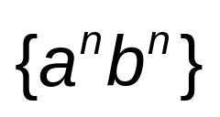
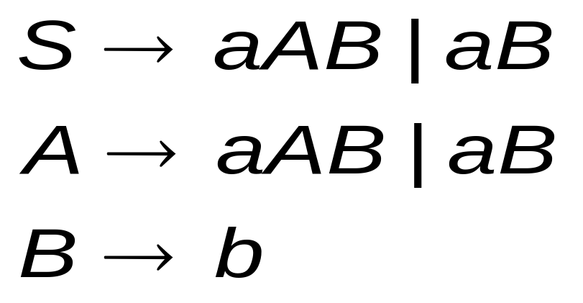
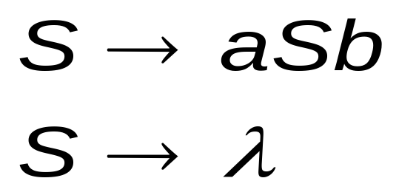
The language
is context-free:
If (n > 0) , the context-free grammar as follow:
If (n ≥ 0) , the context-free grammar as follow:

Slide 21
PDA
Example (Sudkamp [2]) PDA accepts the language L = { a^{n}b^{n} |n ≥ 0}. The stack is used to record the number of a’s
a λ/A
b A/λ
Computational Trace
[q₀, aaabbb , λ]
|- [q₀, aabbb, A]
|- [q₀, abbb, AA]
|- [q₀, bbb, AAA]
|- [q₁, bb, AA]
|- [q₁, b, A]
|- [q₁, λ, λ]
>
q₀
b A/λ
q₁
M = {q₀ , q₁ }
= {a, b }
= {A}
F = {q₀ , q₁ }
δ(q₀, a, λ) = { [q₀ , A] }
δ(q₀, b, A) = { [q₁ , λ] }
δ(q₁, b, A) = { [q₁ , λ] }

Slide 22
Pushdown Automata is non-deterministic
PDA accepts the language L = { a^{n}b^{n} |n ≥ 0}.
a λ/A
b A/λ
>
q₀
b A/λ
q₁
OR
a λ/A
b A/λ
>
q₀
λ λ /λ
q₁

Slide 23
PDA
Example 8.1.1 (Sudkamp [2]) A PDA accept the language L= {wcw^{R} |w ={a,b}*}. The stack is used to record the string w. stack symbols A and B represent the input a and b respectively.
δ(q₀, a, λ) = { [q₀ , A] }
δ(q₀, b, λ) = { [q₀ , B] }
δ(q₀, c, λ) = { [q₁ , λ] }
δ(q₁, a, A) = { [q₁ , λ] }
δ(q₁, b, b) = { [q₁ , λ] }
b λ/B
Q = {q₀ , q₁ }
= {a, b ,c }
= {A ,B}
F = { q₁ }
b B/λ
a λ/A
a A/λ
q₀
c λ /λ
>
q₁

Slide 24
Computational Power of PDA
PDA accepts only context sensitive languages.
Some languages can not be accepted by PDA.
Example of languages not accepted by PDA
Language | Machine | Grammar
L = { a^{i}b^{i}c^{i} | i > 0 } | LBA | Context sensitive
L = { a^{i}b^{i}c^{i}d^{i} | i ≥ 0 } | TM | Unrestricted
L = { a^{i}b^{i}c^{i}d^{i}e^{i} | i ≥ 0 } | TM | Unrestricted

Slide 25

Context-Sensitive Grammar (CSG)
Productions
String of variables
and terminals
String of variables
and terminals
and
A language L is context-sensitive if there exists a CSG G such that L = L(G).
Theorem:
Let L be a context-sensitive language, then there is a linear-bounded automata M with L(M)= L.

Slide 26

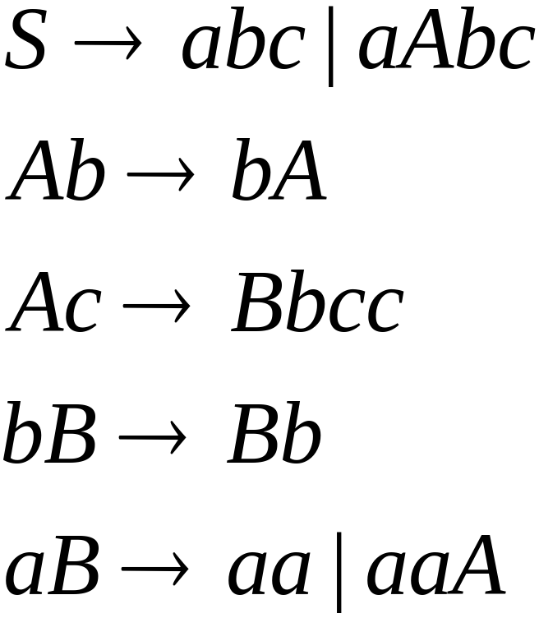
The language
is context-sensitive:
It can be generated by a context-sensitive grammar

Slide 27
Linear Bounded Automata
A linear bounded automata (LBA) is a nondeterministic Turing machine that restricts the tape to the length of the input with two boundary cells contain endmarkers.
LBA is the same as Turing Machines
with one difference:
The input string tape space
is the only tape space allowed to use

Slide 28
Linear Bounded Automaton (LBA)
Input string
Left-end
marker
Right-end
marker
Finite State
Control Unit
All computation is done between end markers

Slide 29
Unrestricted Grammars
Productions
String of variables
and terminals
String of variables
and terminals
Theorem:
A language L is recursively enumerable if and only if L is generated by an unrestricted grammar.

Slide 30
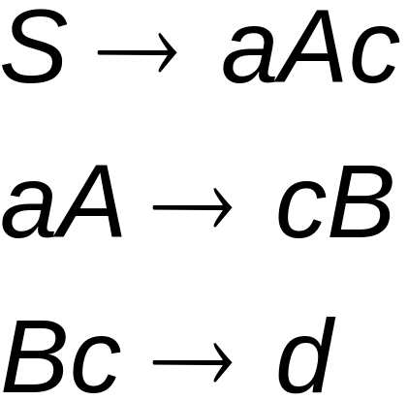
Example of unrestricted grammar

Slide 31
The Chomsky Hierarchy
Non-recursively enumerable
Recursively-enumerable
Recursive
Context-sensitive
Context-free
Regular

Slide 32
Two-Stack PDA
Definition 8.6.1 Sudkamp [2] A two-stack PDA is a sextuple (Q, ∑, Γ, δ, q₀, F), where Q, ∑, Γ, q₀, and F are the same as in a one-stack PDA. The transition function as follow:
  δ: Q × (∑ ∪ { λ }) × (Γ ∪ { λ }) × (Γ ∪ { λ }) → to the set of all subsets of Q × (Γ ∪ { λ }) × (Γ ∪ { λ })
The two stacks of the PDA are independent.
one stack: two stack:
Two-Stack PDA accepts any language that accepted by a Turing Machine.
q_{i}
a A/λ
q_{j}
q_{i}
a A/λ /B/C
q_{j}

Slide 33
Two-Stack PDAs
Two-Stack PDA accepts the language L= { a^{i}b^{i}c^{i} | i ≥ 0 }
a λ/A λ/λ
b A/λ λ/B
c λ/λ B/λ
>
q₀
q₁
q₂
b A/λ λ/B
c λ/λ B/λ
OR
a λ/A λ/λ
c λ/λ B/λ
>
q₀
λ λ/λ λ/λ
q₂
b A/λ λ/B
c λ/λ B/λ
q₁
b A/λ λ/B

Slide 34
Example 8.6.1 (Sudkamp [2]) A Two-Stack PDA M accepts L = { a^{i}b^{i}c^{i} | i ≥ 0 }
a λ/A λ/λ
c λ/λ B/λ
>
q₀
λ λ/λ λ/λ
q₂
b A/λ λ/B
c λ/λ B/λ
q₁
b A/λ λ/B
Computational Trace
Q = {q₀ , q_{1 ,} q₂}
= {a, b ,c }
= {A ,B}
F = { q₂ }
[q₀, aabbcc, λ, λ] |- [q₀, abbcc, A, λ]
|- [q₀, bbcc, AA, λ]
|- [q₁, bcc, A, B]
|- [q₁, cc, λ, BB]
|- [q₂, c, λ, B]
|- [q₂, λ, λ, λ]

Slide 35
Two-Stack PDAs
Example 8.6.2 (Sudkamp [2]) A Two-Stack PDA M accepts the language L = { a^{i}b^{i}c^{i}d^{i} | i ≥ 0 }
a λ/A λ/λ
d C/λ λ/λ
>
q₀
λ λ/λ λ/λ
q₃
b A/λ λ/B
d C/λ λ/λ
q₁
q₂
b A/λ λ/B
c λ/C B/λ
c λ/C B/λ
The computations of M process the strings of L in the following manner:
i) Processing a pushes A onto stack 1.
ii) Processing b pops A and pushes B onto stack 2.
iii) Processing c pops B and pushes C onto stack 1.
iv) Processing d pops C.

Slide 36
Two-Stack PDA
Theorem 8.13 (Hopcroft and Ullman [1])
If a language L is accepted by a Turing machine, L is accepted by a Two-Stack machine.

Slide 37
Theorem Proof
The idea is that the first stack can hold what is to the left of the head, while the second stack holds what is to the right of the head, neglecting all the infinite blank symbols beyond the leftmost and rightmost of the head.
The proof is taken from (Hopcroft and Ullman [1])

Slide 38
Proof Cont’d
Let’s L be L(M) for some one tape TM M, two-stack machine S, simulating a one-tape TM M as the following:
S begins with a bottom-of-stack marker
on each stack, this marker considered the
start symbol for the stacks, and must not
appear elsewhere on the stacks. The marker
indicates that the stack is empty.

Slide 39
Proof Cont’d
Suppose that w$ is on the input of S. S copies the input w onto its first stack, and stops to copy when reading the endmarker on the input.
S pops each symbol in turn from its first stack and pushes it onto its second stack. The first stack of S is empty. The second stack holds w, with the left end of w is at the top.

Slide 40
Proof Cont’d
S simulated the first state of M. The empty first stack indicates the fact that M has a blank to the left of cell scanned by the tape. S has a second stack holding w indicates the tape head point to the left most symbol in the string w ( see the following diagram).

Slide 41
M Tape
M Head
Marker
Marker
Stack1
Stack2
S push the input to stack1
S pop the input from stack1 and push it to stack2

Slide 42
Proof Cont’d
S simulates a move of M as follows:
    S knows the state of M, say q, because S simulates the state of M in its own finite control.
    S knows the symbol X scanned by the head of M; it’s at the top of the second stack. If the second stack contains only the bottom of stack marker , this means that M’s head has just scanned a blank.
    So, S knows the next move of M.

Slide 43
Proof Cont’d
    The next state of M is recorded in a component of S’s finite control, instead of the previous state.
    If M replaces X by Y and moves right, then S pushes Y onto its first stack, representing the fact that Y is now at the left of M’s head (see the following diagram).

Slide 44
M replaces X by Y and moves right
M Tape
Move right
Pop
Push
Stack1
Stack2
S pop X from stack2 and push Y to stack1

Slide 45
Proof Cont’d
  If M replace X by Y and moves left, S pops the top of the first stack , say Z, then replaces X by ZY on the second stack. This represents what used to be one position left of the head is now at the head (see the following diagram).

Slide 46
M replaces X by Y and moves left
M Tape
Move left
push
Pop
push
Y
Pop
Stack1
Stack2
S pop X and Z from stack1 and push ZY to stack2

Slide 47
Proof Cont’d
S accepts if the new state of M is accepting. Otherwise, S simulates another move of
M in the same manner.

Slide 48
TM can Simulate Two-Stack PDA
Pushdown automata is non-deterministic. Therefore, we choose a non-deterministic Turing machine M to simulate the Two-Stack PDA.
  We split the tape of the turing machine into two half.
  We place a marker symbol in the tape to indicate the border between the two half.
  The part of the tape left from the marker simulate one stack.
  The part of the tape right from the marker simulate the second stack.
  The bottom of the stack is the marker.
We can simulate the two stacks using two-tape Truing machine such that every tape simulates one stack.

Slide 49
M Tape
Marker indicates the two border of the tape
Stack 1
Stack 2

Slide 50
Question : Does the Two-Stack PDA simulate the computer?
Answer: yes
Since TM simulates a computer (proven in the course text book)
AND Two-Stack PDA simulates a TM (proven in Hopcroft and Ullman [1])
Thus , Two-Stack PDA can simulate the computer.

Slide 51
References
1- Hopcroft J , Motwani R, Ullman J , “Introduction to Automata Theory,
Languages and Computation”, Addison Wesley, 2nd edition , 2001.
2- T. A. Sudkamp , “Language and Machine: An Introduction to the
Theory of Computer Science” Addison-Wesley , 2nd edition , 1997.

