Slide 1
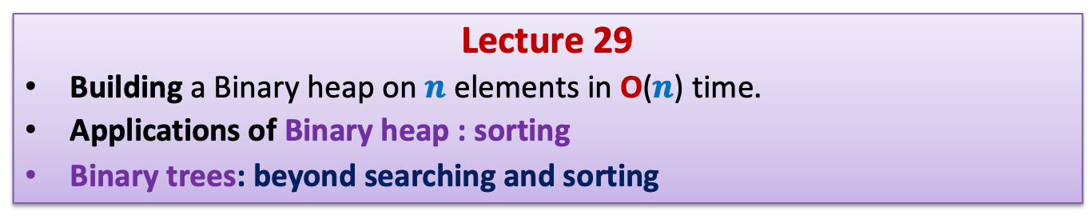
Data Structures and Algorithms (ESO207A)
Lecture 29
Building a Binary heap on $n$ elements in O($n$) time.
Applications of Binary heap : sorting
Binary trees: beyond searching and sorting

Slide 2
Recap from the last lecture

Slide 3
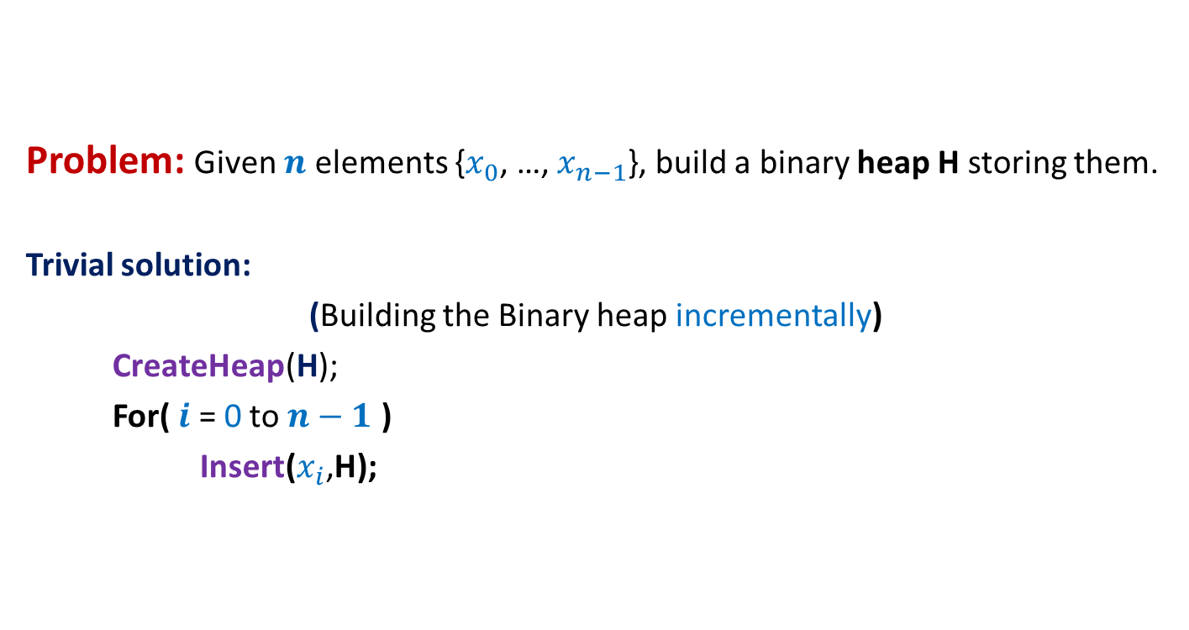
Building a Binary heap
Problem: Given $n$ elements {$x_{0}$, …, $x_{n−1}$}, build a binary heap H storing them.
Trivial solution:
(Building the Binary heap incrementally)
CreateHeap(H);
For( $i$ = 0 to $n−1$ )
Insert($x_{i}$,H);
What is the time complexity of this algorithm?

Slide 4
Building a Binary heap
Problem: Given $n$ elements {$x_{0}$, …, $x_{n−1}$}, build a binary heap H storing them.
Trivial solution:
(Building the Binary heap incrementally)
CreateHeap(H);
For( $i$ = 0 to $n−1$ )
Insert($x_{i}$,H);

Slide 5


Building a Binary heap incrementally
The time complexity for inserting a leaf node = ?
# leaf nodes = $\left\lceil n/2\right\rceil$,
➔ Theorem: Time complexity of building a binary heap incrementally is O($n$ log $n$).
What useful inference can you draw from this Theorem ?
Top-down
approach
O(log $n$)

Slide 6

Building a Binary heap incrementally
What useful inference can you draw from this Theorem ?
Top-down
approach
The O($n$) time algorithm must take O(1) time for each of the $\left\lceil n/2\right\rceil$ leaves.

Slide 7


Heap Property
key($v$) > key(parent($v$))
key($v$) < key(lchild($v$)) and key($v$) < key(rchild($v$))
Do you notice any redundancy here ?
$$v$$

Slide 8
In any complete binary tree, how many nodes satisfy heap property ?
Does it suggest a new approach to build binary heap ?
98
14
33
37
11
52
32
85
17
25
88
41
21
29
76
Bottom-up
approach
47
75
9
57
23
Heap Property holds for all leaf nodes since they have no children ☺

Slide 9
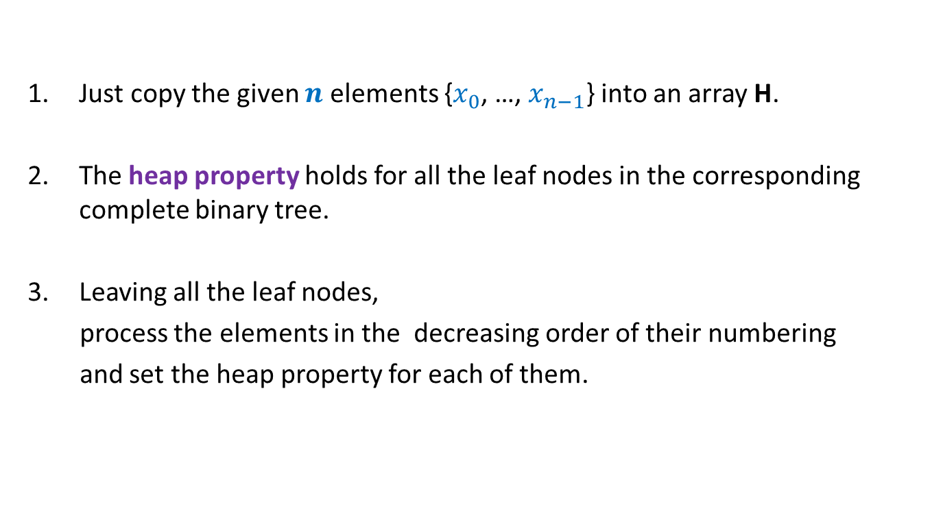
A new approach to build binary heap
Just copy the given $n$ elements {$x_{0}$, …, $x_{n−1}$} into an array H.
The heap property holds for all the leaf nodes in the corresponding complete binary tree.
Leaving all the leaf nodes,
process the elements in the decreasing order of their numbering
and set the heap property for each of them.

Slide 10
A new approach to build binary heap
98
54
33
37
11
52
32
85
17
25
88
41
21
29
76
The first node to be processed.
47
75
9
57
23
H
98 14 33 37 11 52 32 85 17 25 88 41 21 29 76 47 75 9 57 23

Slide 11
A new approach to build binary heap
98
54
33
37
11
52
32
85
17
23
88
41
21
29
76
47
75
9
57
25

Slide 12
A new approach to build binary heap
98
54
33
37
11
52
32
85
9
23
88
41
21
29
76
47
75
17
57
25

Slide 13
A new approach to build binary heap
98
54
33
37
11
52
32
47
9
23
88
41
21
29
76
85
75
17
57
25

Slide 14
A new approach to build binary heap
98
54
33
9
11
21
29
47
17
23
88
41
52
32
76
85
75
37
57
25

Slide 15


A new approach to build binary heap
Do you notice any thing at present ?
98
$$v$$
54
21
9
11
33
29
47
17
23
88
41
52
32
76
85
75
37
57
25
Heap Property holds for all elements that appear after $v$ in heap.

Slide 16
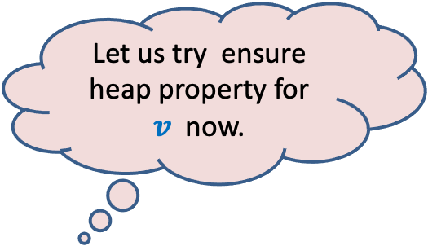
A new approach to build binary heap
Let us try ensure heap property for $v$ now.
98
Do you notice any thing at present ?
$$v$$
54
21
9
11
33
29
47
17
23
88
41
52
32
76
85
75
37
57
25
Heap Property holds for all elements that appear after $v$ in heap.

Slide 17
A new approach to build binary heap
98
$$v$$
9
21
54
11
33
29
47
17
23
88
41
52
32
76
85
75
37
57
25

Slide 18
A new approach to build binary heap
98
$$v$$
9
21
17
11
33
29
47
54
23
88
41
52
32
76
85
75
37
57
25

Slide 19
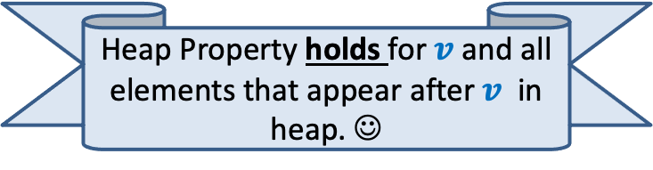
A new approach to build binary heap
98
$$v$$
9
21
17
11
33
29
47
37
23
88
41
52
32
76
85
75
54
57
25
Heap Property holds for $v$and all elements that appear after $v$ in heap. ☺

Slide 20

A new approach to build binary heap
98
$$v$$
9
21
17
11
33
29
47
37
23
88
41
52
32
76
85
75
54
57
25
Let $v$be a node corresponding to index $i$in H.
The process of ensuring heap property at $i$that we described is called Heapify($i,$H).

Slide 21
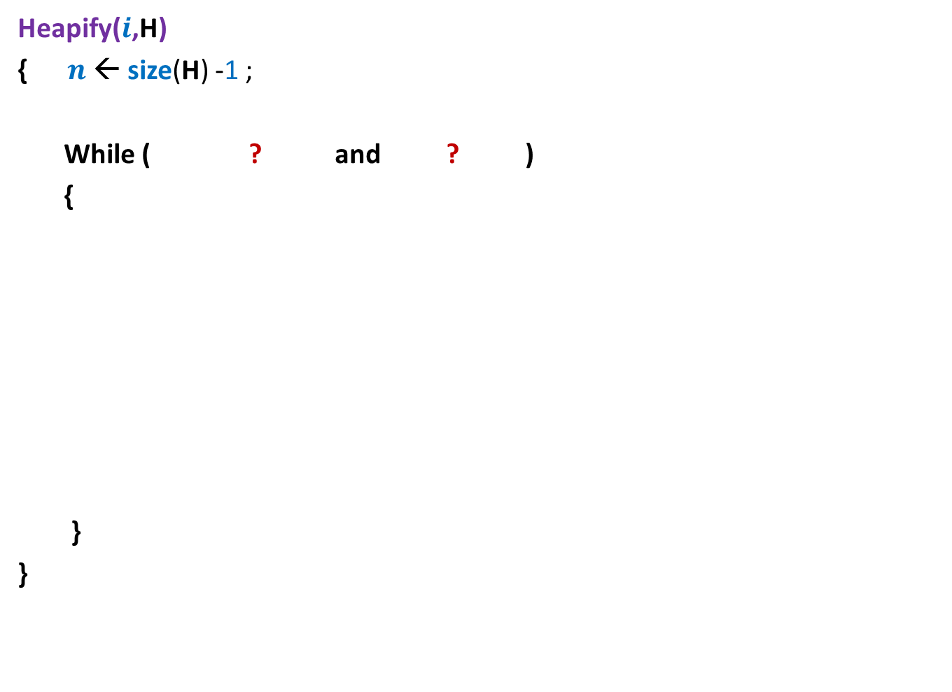

Heapify($i$,H)
Heapify($i$,H)
{ $n$← size(H) -1 ;
While ( ? and ? )
{
}
}
For node $i$, compare its value with those of its children
If it is smaller than any of its children
Swap it with smallest child
and move down …
Else stop !

Slide 22

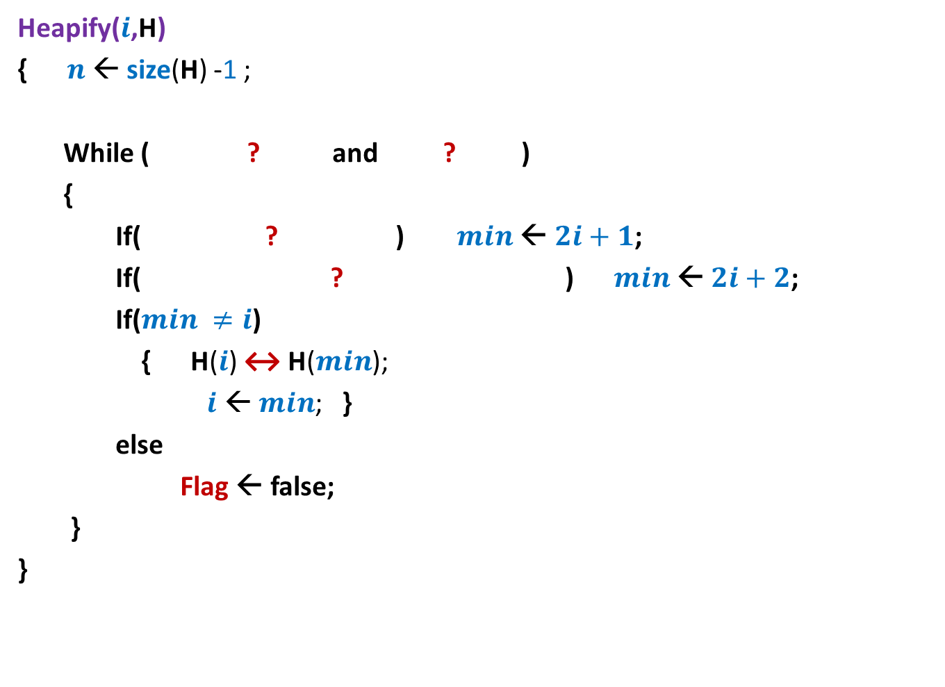



Heapify($i$,H)
Heapify($i$,H)
{ $n$← size(H) -1 ;
While ( ? and ? )
{
If( ? ) $min$← $2i+1$;
If( ? ) $min$← $2i+2$;
If($min ≠i$)
{ H($i$) ↔ H($min$);
$i$ ← $min$; }
else
Flag ← false;
}
}
Flag ← true;
$i$ ≤ $\left\lfloor (n\text{−}1)/2\right\rfloor$
Flag = true
$min$← $i$;
H[$i$] > H[$2i+1$]
$2i+2$≤ $n$ and H[$min$]>H[$2i+2$]

Slide 23



Building Binary heap in O($n$) time
Time complexity of algorithm = ?
98
Time complexity of heapifying node v ?
v
54
21
9
11
33
29
Height(v)
47
17
23
88
41
52
32
76
85
75
37
57
25
H
98 54 21 9 11 33 29 47 17 23 88 41 52 32 76 85 75 37 57 25
$$\sum_{h}{O(h) ∙N(h)}$$
No. of nodes of height $h$

Slide 24
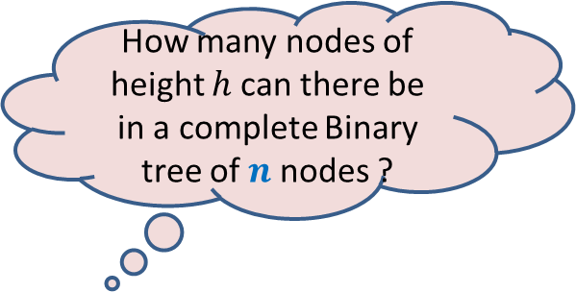

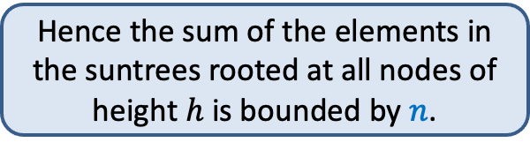
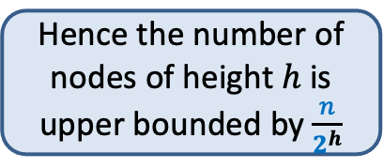
A complete binary tree
How many nodes of height $h$ can there be in a complete Binary tree of $n$ nodes ?
Hence the sum of the elements in the suntrees rooted at all nodes of height $h$ is bounded by $n$.
Each subtree of a complete binary tree is also a complete binary tree.
A subtree of height $h$ has at least $2^{h}$ nodes
Moreover, no two subtrees of height $h$ in the given tree have any element in common
Hence the number of nodes of height $h$ is upper bounded by $\frac{n}{2^{h}}$
Can you locate nodes with height 2.

Slide 25









Building Binary heap in O(n) time
Lemma: the number of nodes of height $h$is bounded by $\frac{n}{2^{h}}$ .
Hence Time complexity to build the heap = $\sum_{h=1}^{\log{n}}{\frac{n}{2^{h}} O(h)}$
= $n c \sum_{h=1}^{\log{n}}{\frac{h}{2^{h}}}$
= O($n$)
$$\frac{1}{2}$$
$$+\frac{2}{4}$$
$$+\frac{3}{8}$$
$$+\frac{4}{16}$$
$$+\frac{5}{32}$$
$$+\frac{6}{64}$$
$$+…$$
$$<2$$

Slide 26
Sorting
using a Binary Heap

Slide 27
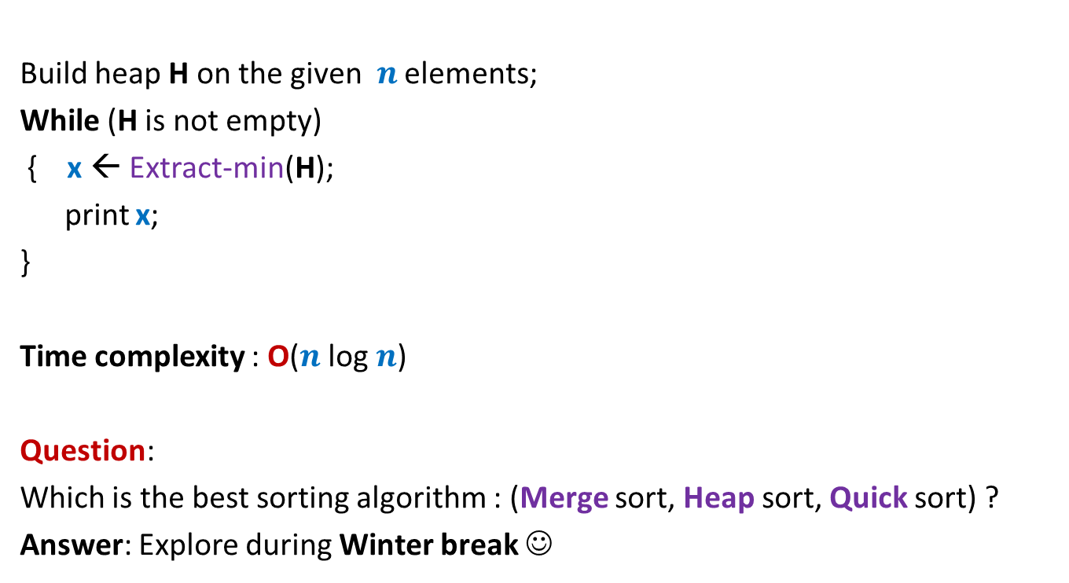
Heap Sort
Build heap H on the given $n$ elements;
While (H is not empty)
{ x ← Extract-min(H);
print x;
}
Time complexity : O($n$ log $n$)
Question:
Which is the best sorting algorithm : (Merge sort, Heap sort, Quick sort) ?
Answer: Explore during Winter break ☺

Slide 28
Binary trees beyond searching and sorting

Slide 29
Interesting problems on sequences

Slide 30

What is a sequence ?
A sequence S = ${≺x}_{0}$, …, $x_{n−1}≻$
Can be viewed as a mapping from [0, $n$].
Order does matter.

Slide 31
Problem 1
Multi-increment

Slide 32
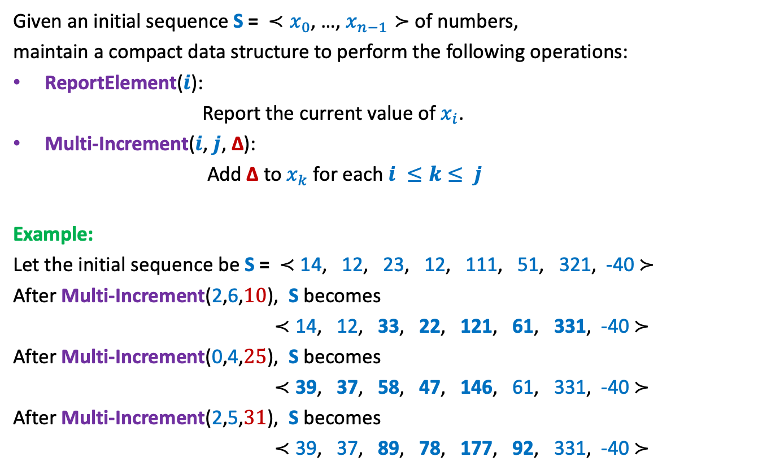
Problem 1
Given an initial sequence S = ${≺x}_{0}$, …, $x_{n−1}≻$ of numbers,
maintain a compact data structure to perform the following operations:
ReportElement($i$):
Report the current value of$x_{i}$.
Multi-Increment($i$, $j$, ∆):
Add ∆ to $x_{k}$ for each $i ≤k≤ j$
Example:
Let the initial sequence be S = $≺$ 14, 12, 23, 12, 111, 51, 321, -40 $≻$
After Multi-Increment(2,6,$10$), S becomes
$≺$ 14, 12, 33, 22, 121, 61, 331, -40 $≻$
After Multi-Increment(0,4,$25$), S becomes
$≺$ 39, 37, 58, 47, 146, 61, 331, -40 $≻$
After Multi-Increment(2,5,$31$), S becomes
$≺$ 39, 37, 89, 78, 177, 92, 331, -40 $≻$

Slide 33

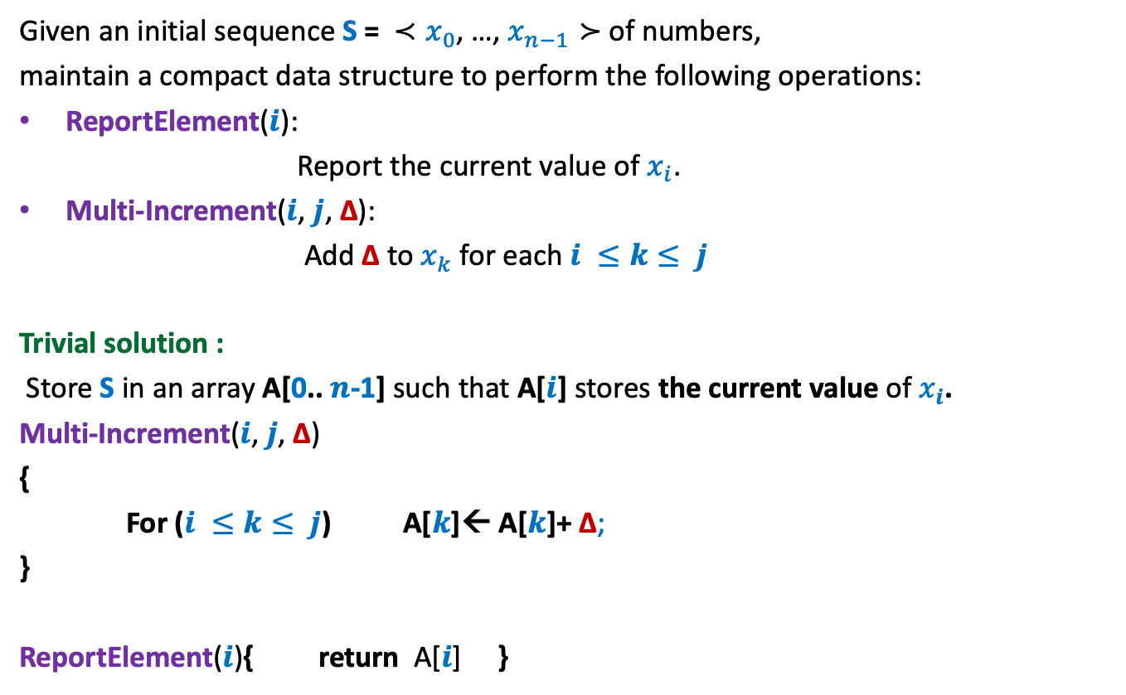

Problem 1
Given an initial sequence S = ${≺x}_{0}$, …, $x_{n−1}≻$ of numbers,
maintain a compact data structure to perform the following operations:
ReportElement($i$):
Report the current value of$x_{i}$.
Multi-Increment($i$, $j$, ∆):
Add ∆ to $x_{k}$ for each $i ≤k≤ j$
Trivial solution :
Store S in an array A[0.. $n$-1] such that A[$i$] stores the current value of $x_{i}$.
Multi-Increment($i$, $j$, ∆)
{
For ($i ≤k≤ j$) A[$k$]← A[$k$]+ ∆;
}
ReportElement($i$){ return A[$i$] }
O($j−i$) = O($n$)
O($1$)

Slide 34

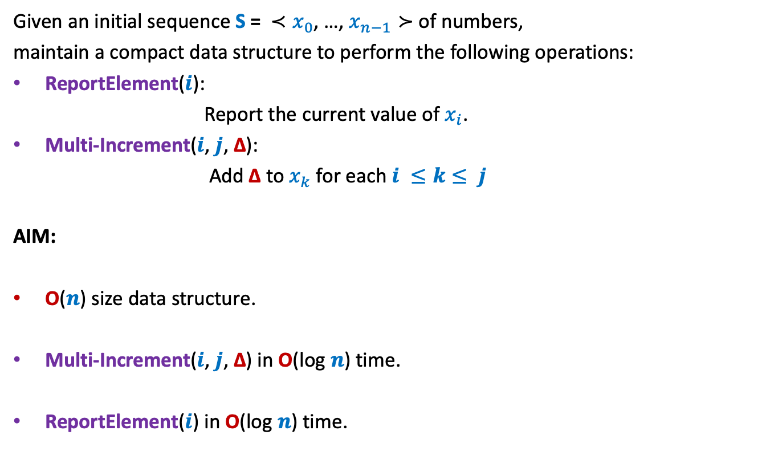
Problem 1
Given an initial sequence S = ${≺x}_{0}$, …, $x_{n−1}≻$ of numbers,
maintain a compact data structure to perform the following operations:
ReportElement($i$):
Report the current value of$x_{i}$.
Multi-Increment($i$, $j$, ∆):
Add ∆ to $x_{k}$ for each $i ≤k≤ j$
AIM:
O($n$) size data structure.
Multi-Increment($i$, $j$, ∆) in O(log $n$) time.
ReportElement($i\text{) }\text{in}$O(log $n$) time.
All data structure lovers must ponder over this problem ☺.
We shall discuss it in the next class.
Hint: Assume $n$ is power of $2$

