Slide 1
Design and Analysis of Algorithms
Algorithms-II : CS345A
Lecture 1
Overview and Motivation
Divide and Conquer Paradigm - I

Slide 2
The website of the course
moodle.cse.iitk.ac.in
CSE
CS345A: Design and Analysis of Algorithms
(guest login allowed)
This course will be taught differently.

Slide 3
What is an algorithm ?
Definition:
A finite sequence of well defined instructions
required to solve a given computational problem.

Slide 4
Design and analysis of efficient algorithm
The AIM of the Course

Slide 5

An example problem
Input:
Output:
in some order,
possibly with repetitions,
so that the result is a zero matrix ?
A set of six $3 × 3$ matrices with integer entries
Can we multiply the matrices
No algorithm exists

Slide 6
The world of Algorithms
Algorithms having
non-trivial design
non-trivial analysis
Efficiency

Slide 7

The world of Algorithms
Algorithms having
Real World Applications
non-trivial design
non-trivial analysis
Efficiency

Slide 8
Impact of an Algorithm
on
Future of thousands of students in India

Slide 9
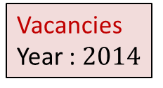


Technical Institutes in India
Entrance Exam
IITs
JEE Advanced
NITs
IIITs
GFTIs
JEE Main
CSAB institutes
DCE
BITS PILANI
ANNA University

Slide 10
A closer look at the problem
Ram
Allocation in
IITs
JEE Advanced
Allocation in
CSAB Institutes
JEE
(Mains)
Mohan
IITK Civil
NIT Warangal Electrical
IITM Metallurgy
NIT Surat Mechanical
Notes:
Let us take a close look at the problem. Suppose there are two candidates Ram and Mohan. Both study hard for JEE(Mains) and JEE(Advanced). It turns out that Ram outperforms Mohan in JEE Advanced
Ram prefers NIT Warangal Electrical.
Mohan prefers IITK Civil.
Unfortunately both these seats remain vacant and none of them get their desired programs.

Slide 11
A closer look at the problem
Ram
Allocation in
IITs
JEE Advanced
Allocation in
CSAB Institutes
JEE
(Mains)
Mohan
IITK Civil
NIT Warangal Electrical
IITM Metallurgy
NIT Surat Mechanical
Notes:
Shyam gets NIT Warangal Electrical though his rank is inferior to that of Ram.
The reason: On the date of spot round at NIT Warangal, Ram is unable to come physically to NIT Warangal but Shyam does.

Slide 12
A closer look at the problem
Ram
Allocation in
IITs
JEE Advanced
Allocation in
CSAB Institutes
JEE
(Mains)
Mohan
IITK Civil
NIT Warangal Electrical
SPOT round
IITM Metallurgy
NIT Surat Mechanical
Shyam
Notes:
Shyam gets NIT Warangal Electrical though his rank is inferior to that of Ram.
The reason: On the date of spot round at NIT Warangal, Ram is unable to come physically to NIT Warangal but Shyam does.

Slide 13
A closer look at the problem
Ram
Allocation in
IITs
JEE Advanced
Allocation in
CSAB Institutes
JEE
(Mains)
Mohan
IITK Civil
NIT Warangal Electrical
SPOT round
IITM Metallurgy
NIT Surat Mechanical
Shyam
Notes:
Shyam gets NIT Warangal Electrical though his rank is inferior to that of Ram.
The reason: On the date of spot round at NIT Warangal, Ram is unable to come physically to NIT Warangal but Shyam does.

Slide 14





Multiple Merit Lists
19 IITs
31 NITs
18 IIITs
33989 seats
1304127 candidates
18 OtherGFTIs

Slide 15
How to approach the problem
of Multiple Merit Lists ?
Part I

Slide 16
Fairness
Choice list of Mohan
p
q
p
Mohan
q
Ram
Merit list
of programme q
Ram
Mohan

Slide 17
Homework
The seat allocation algorithm for the single merit list.?
Can you now tackle the problem of multiple merit lists ?

Slide 18
Divide and Conquer paradigm

Slide 19
An Overview
Divide the problem instance into two or more instances of the same problem.
Solve each smaller instance recursively (base case suitably defined).
Combine the solutions of the smaller instances
to get the solution of the original instance.
Notes:
How do we solve any problem in this paradigm ?
The 3rd step (Combine step) is usually the main nontrivial step in the design of an algorithm using divide and conquer strategy

Slide 20

Example Problems
Merge Sort
Multiplication of two $n$-bit integers.
Counting the number of inversions in an array.
Finding median of $n$numbers in linear time.

Slide 21
Divide and Conquer Paradigm (Advanced Problems)
Geometric Problems:
Closest Pair Distance
Convex Hull
Non-dominated Points
Number theoretic Problem
Multiplication of 2 Polynomials

Slide 22
problem 1
Closest Pair Distance

Slide 23





Distance between 2 points
$$(x_{j},y_{j})$$
O($1$) time
$$(x_{i},y_{i})$$
$$y$$
$$x$$

Slide 24

The Closest Pair Distance Problem
$$δ$$
$$y$$
$$x$$

Slide 25
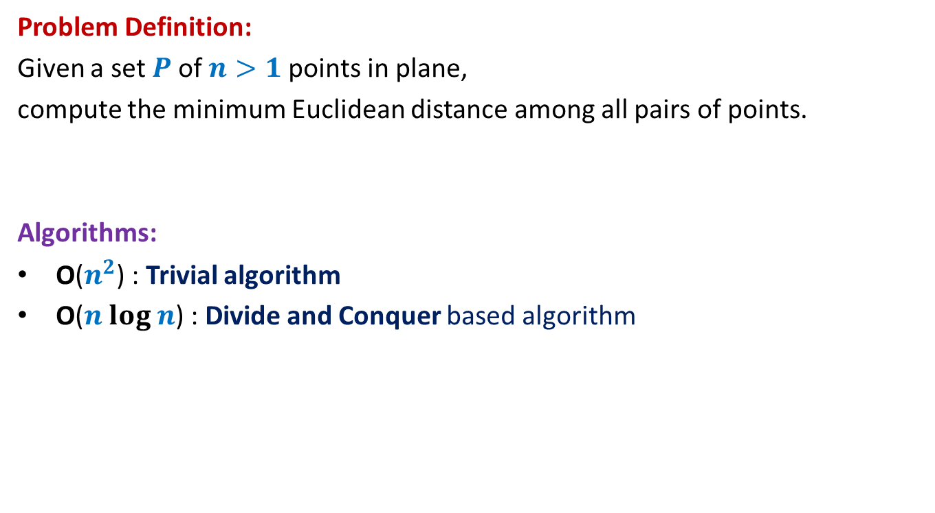
The Closest Pair Distance Problem
Problem Definition:
Given a set $P$of $n>1$points in plane,
compute the minimum Euclidean distance among all pairs of points.
Algorithms:
O($n^{2}$) : Trivial algorithm
O($n log n$) : Divide and Conquer based algorithm

Slide 26
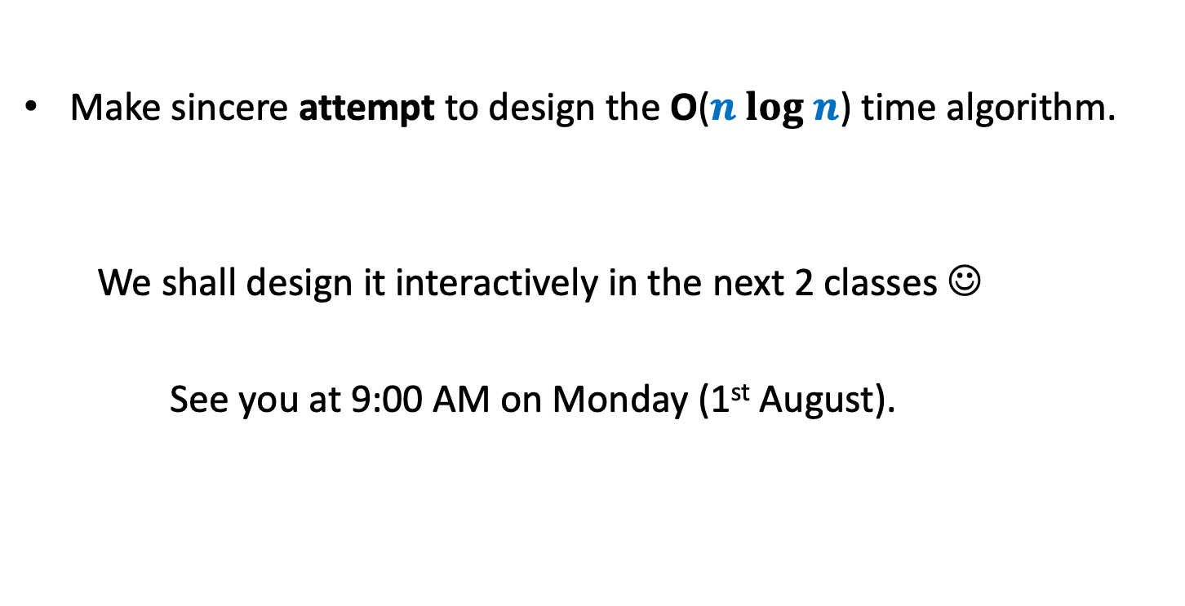
Homework
Make sincere attempt to design the O($n log n$) time algorithm.
We shall design it interactively in the next 2 classes ☺
See you at 9:00 AM on Monday (1st August).

