Slide 1
Design and Analysis of Algorithms
Algorithms-II : CS345A
Lecture 10
A generic way to design Greedy Algorithms (Final Lecture)

Slide 2
Recap of last lecture

Slide 3
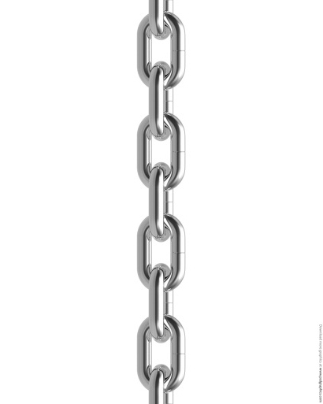




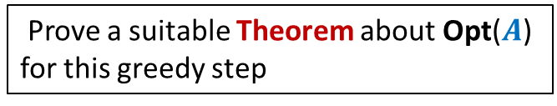


A generic way to design and analyse a greedy algorithm
P: a given optimization problem
1. Try to establish a relation between OPT($A$) and OPT($A′$);
2. Try to prove the relation formally by
deriving a solution of $A$ from OPT($A′$)
deriving a solution of $A′$ from OPT($A$)
If you succeed,
you have an algorithm
Opt($A$)
$$A$$
instance of size $n$of problem P
Greedy
step
Prove a suitable Theorem about Opt($A$) for this greedy step
Opt($A′$)
$$A′$$
instance of size $<n$of problem P
from construction
use Theorem

Slide 4
Finding the labeled binary tree for
the optimal prefix codes

Slide 5


The binary tree of the optimal prefix code
From this picture, can you design the greedy step that you will perform ?
0
1
0
1
0
1
. . .
1
0
1
Deepest level
$$a_{1}$$
$$a_{2}$$

Slide 6

The binary tree of the optimal prefix code
0
1
0
1
0
1
. . .
1
Deepest level
$a$’

Slide 7



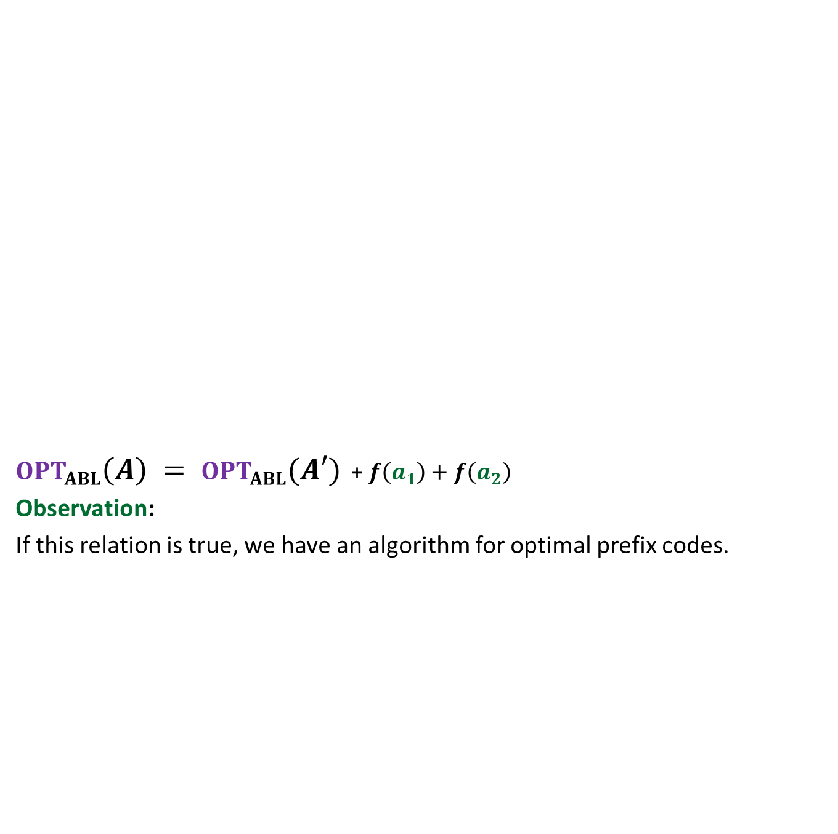





$OPT_{ABL}\left(A\right) = OPT_{ABL}(A′)$ + $f\left(a_{1}\right)+f\left(a_{2}\right)$
Observation:
If this relation is true, we have an algorithm for optimal prefix codes.
Opt($A$)
$$A$$
$a_{1}$, $a_{2}$, $a_{3}$ , … … $a_{n}$
Greedy
step
Relation ?
Opt($A′$)
$$A′$$
$a_{3}$ , … … $a_{n}$
$$a′$$
$f\left(a\text{’}\right)=$ $f\left(a_{1}\right)+f\left(a_{2}\right)$
?

Slide 8
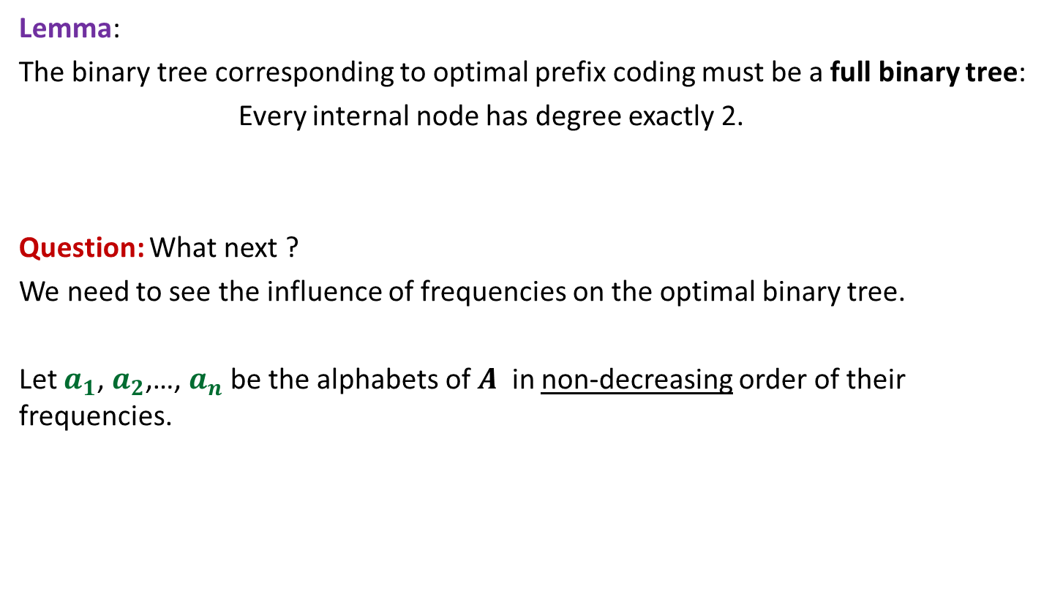
Proof for $OPT_{ABL}\left(A\right)=OPT_{ABL}(A′)$ + $f\left(a_{1}\right)+f\left(a_{2}\right)$
Spend some time thinking about the proof
before moving ahead.
☺

Slide 9

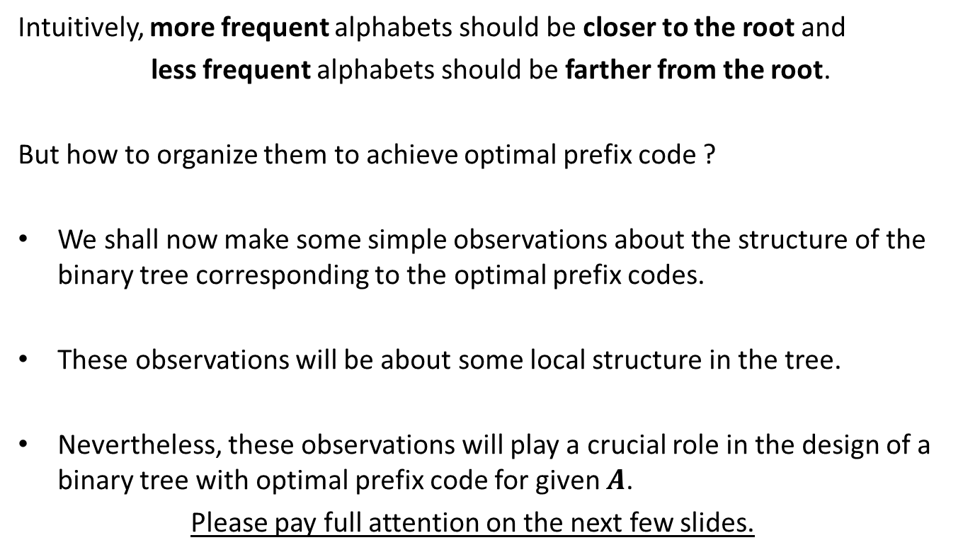
How to prove $OPT_{ABL}\left(A\right)=OPT_{ABL}(A′)$ + $f\left(a_{1}\right)+f\left(a_{2}\right)$ ?
Question: Can we derive a prefix coding for $A$from $OPT(A′)$ ?
Question: Can we derive a prefix coding for $A′$from $OPT(A)$ ?

Slide 10


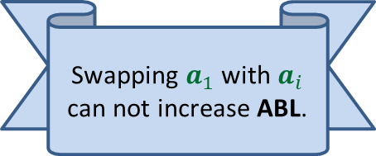

A prefix coding for $A$from $OPT\left(A^{′}\right)$
$T′$: the binary tree corresponding to $OPT_{ABL}(A′)$
0
1
0
1
0
1
$$T′$$
. . .
1
$a$’

Slide 11

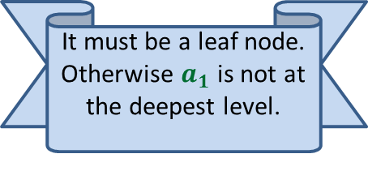

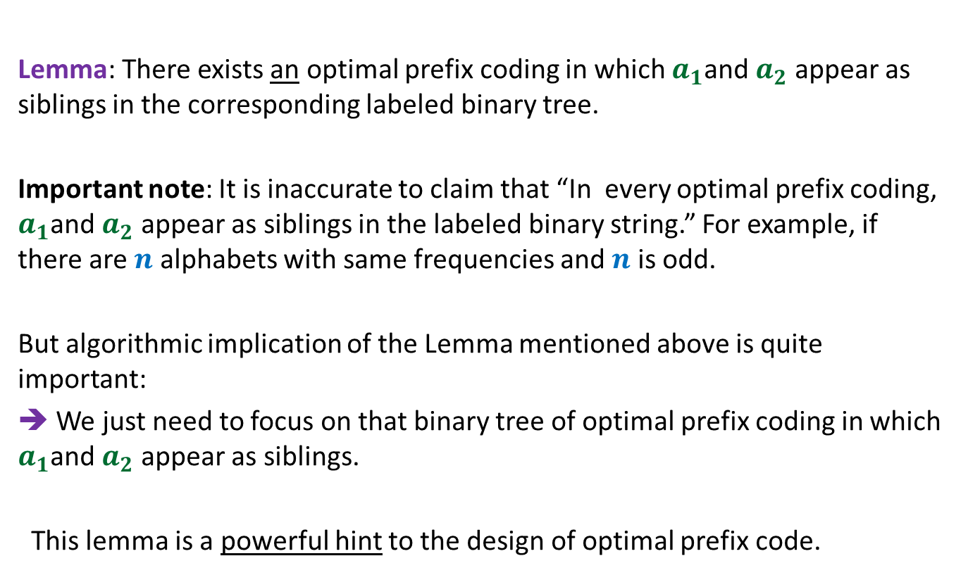


A prefix coding for $A$from $OPT\left(A^{′}\right)$
$T′$: the binary tree corresponding to $OPT_{ABL}(A′)$
This gives a prefix coding for $A$ with $ABL$ = ??
➔ $OPT_{ABL}\left(A\right)≤OPT_{ABL}(A′)$ + $f\left(a_{1}\right)+f\left(a_{2}\right)$
0
1
0
1
0
1
$$T′$$
. . .
1
0
1
$a$’
$$a_{1}$$
$$a_{2}$$
$OPT_{ABL}(A′)$ + $f\left(a_{1}\right)+f\left(a_{2}\right)$

Slide 12





A prefix coding for $A′$from $OPT(A)$
$T$: the binary tree corresponding to $OPT_{ABL}(A)$
0
1
Using Theorem 2
0
1
0
1
$$T$$
. . .
1
0
1
Deepest level
$$a_{1}$$
$$a_{2}$$

Slide 13

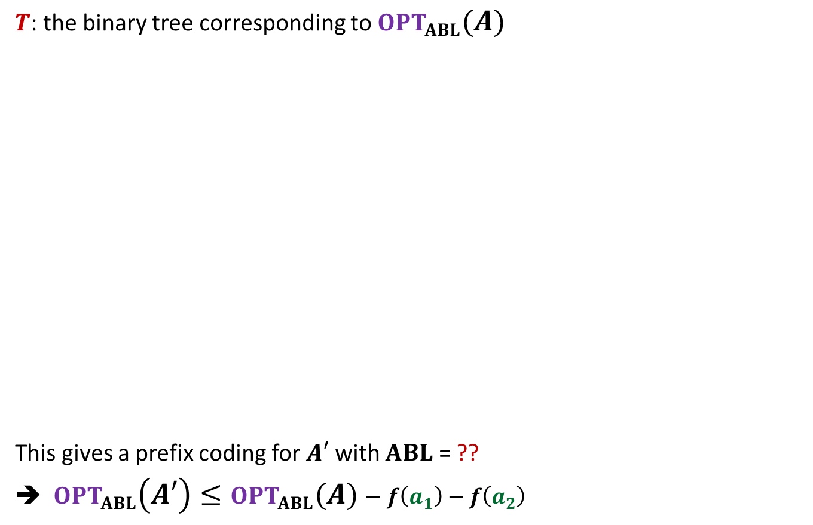

A prefix coding for $A′$from $OPT(A)$
$T$: the binary tree corresponding to $OPT_{ABL}(A)$
This gives a prefix coding for $A′$ with $ABL$ = ??
➔ $OPT_{ABL}\left(A′\right)≤OPT_{ABL}(A)−f\left(a_{1}\right)−f\left(a_{2}\right)$
0
1
Using Theorem 1
0
1
0
1
$$T$$
. . .
1
0
1
$a$’
Deepest level
$$a_{1}$$
$$a_{2}$$
$$OPT_{ABL}\left(A\right)−f\left(a_{1}\right)−f\left(a_{2}\right)$$

Slide 14
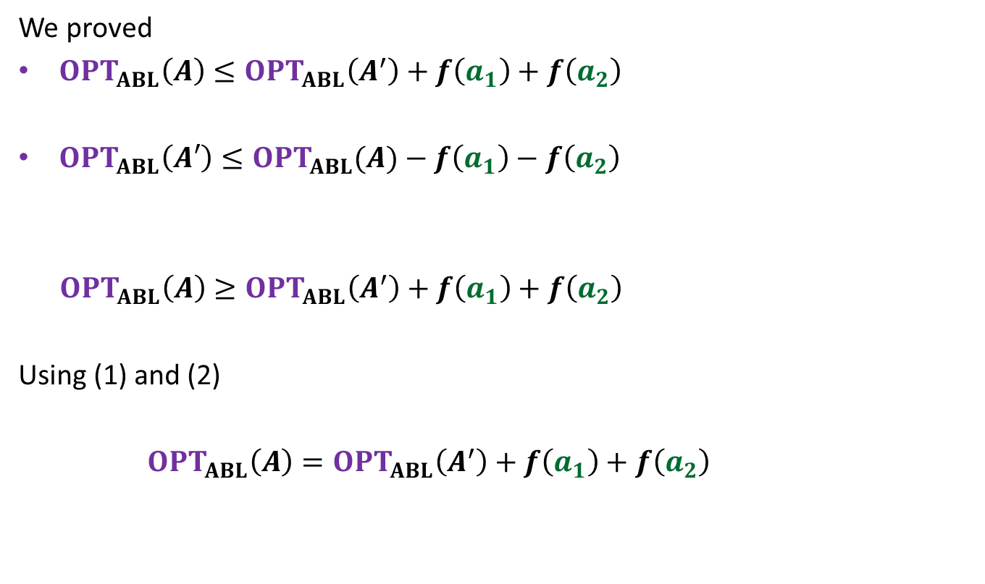
We proved
$OPT_{ABL}\left(A\right)≤OPT_{ABL}\left(A^{′}\right)+f\left(a_{1}\right)+f\left(a_{2}\right)$
$OPT_{ABL}\left(A′\right)≤OPT_{ABL}(A)−f\left(a_{1}\right)−f\left(a_{2}\right)$
$OPT_{ABL}\left(A\right)≥OPT_{ABL}\left(A^{′}\right)+f\left(a_{1}\right)+f\left(a_{2}\right)$
Using (1) and (2)
$OPT_{ABL}\left(A\right)=OPT_{ABL}\left(A^{′}\right)+f\left(a_{1}\right)+f\left(a_{2}\right)$
(1)
(2)

Slide 15

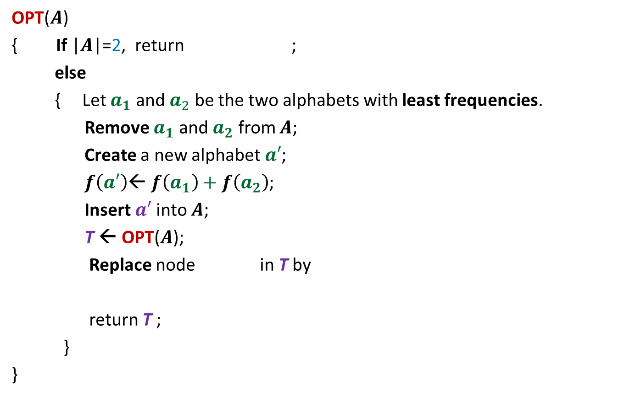






The algorithm based on $OPT_{ABL}\left(A\right)=OPT_{ABL}(A′)$ + $f\left(a_{1}\right)+f\left(a_{2}\right)$
OPT($A$)
{ If |$A$|=2, return ;
else
{ Let $a_{1}$ and $a_{2}$ be the two alphabets with least frequencies.
Remove $a_{1}$ and $a_{2}$ from $A$;
Create a new alphabet $a′$;
$f\left(a′\right)$← $f\left(a_{1}\right)+f\left(a_{2}\right)$;
Insert $a′$into $A$;
T ← OPT($A$);
Replace node in T by
return T ;
}
}
0
1
$$a_{1}$$
$$a_{2}$$
$O(n^{2})$ time complexity
Homework:
Achieve $O(n log n)$ time complexity
0
1
$a$’
$$a_{1}$$
$$a_{2}$$

Slide 16
More Homework

Slide 17

The 2 problems we discussed
Synchronizing the delays in a circuit
Scheduling jobs to minimize maximum lateness
Electric signal
6
5
3
2
4
2
$$0$$
time
2
1
6
2
1
2
3
2
Design and analyse a greed algorithm based on the generic technique.

Slide 18
Shortest pathS in a graph

Slide 19


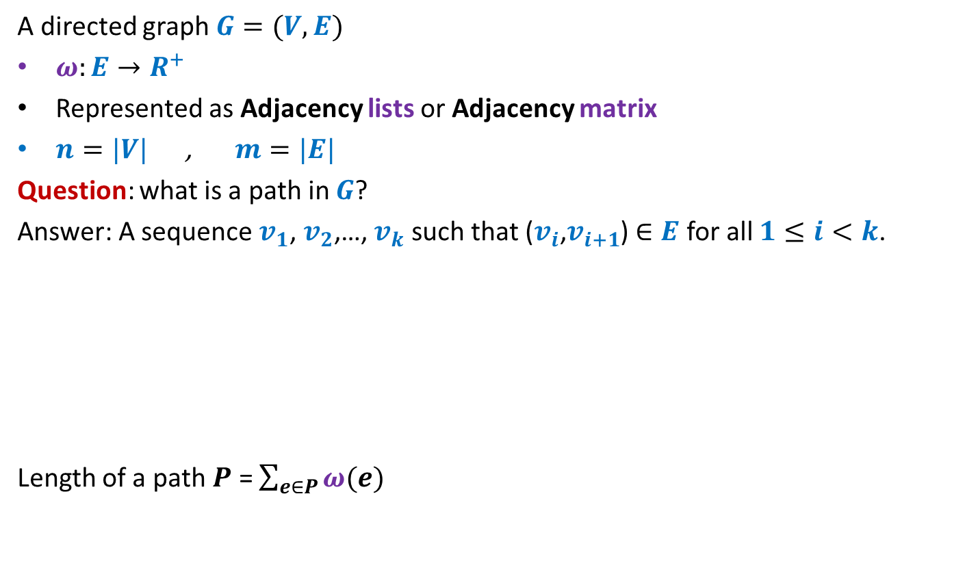



Notations and Terminologies
A directed graph $G=(V,E)$
$ω:E→R^{+}$
Represented as Adjacency lists or Adjacency matrix
$n=|V|$ , $m=|E|$
Question: what is a path in $G$?
Answer: A sequence $v_{1}$, $v_{2}$,…, $v_{k}$ such that ($v_{i}$,$v_{i+1}$) $∈E$ for all $1≤i<k$.
Length of a path $P$ = $\sum_{e∈P}{ω(e)}$
No vertex is repeated
12
3
…
29
$$v_{1}$$
$$v_{2}$$
$$v_{3}$$
$$v_{k−1}$$
$$v_{k}$$

Slide 20
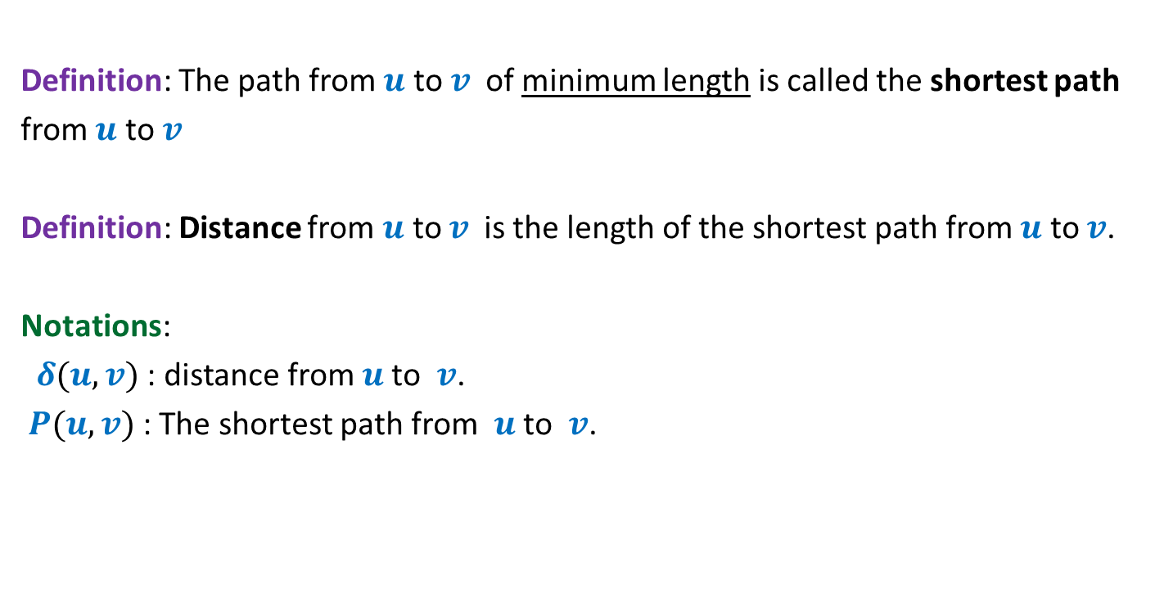
Notations and Terminologies
Definition: The path from $u$ to $v$of minimum length is called the shortest path
from $u$ to $v$
Definition: Distance from $u$ to $v$is the length of the shortest path from $u$ to $v$.
Notations:
$δ(u,v)$ : distance from $u$to $v$.
$P(u,v)$ : The shortest path from $u$to $v$.

Slide 21
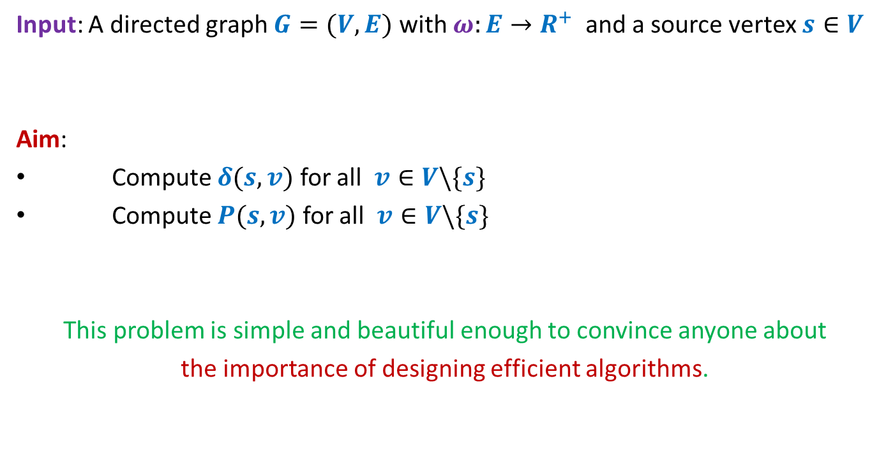
Problem Definition
Input: A directed graph $G=(V,E)$ with $ω:E→R^{+}$ and a source vertex $s∈V$
Aim:
Compute $δ(s,v)$ for all $v∈V\backslash \{s\}$
Compute $P(s,v)$ for all $v∈V\backslash \{s\}$
This problem is simple and beautiful enough to convince anyone about
the importance of designing efficient algorithms.

Slide 22


An example to get an insight into this problem
Inference:
The distance to any vertex depends upon global parameters.
$$q$$
5
7
6
12
G
$$s$$
16
4
9
11

Slide 23


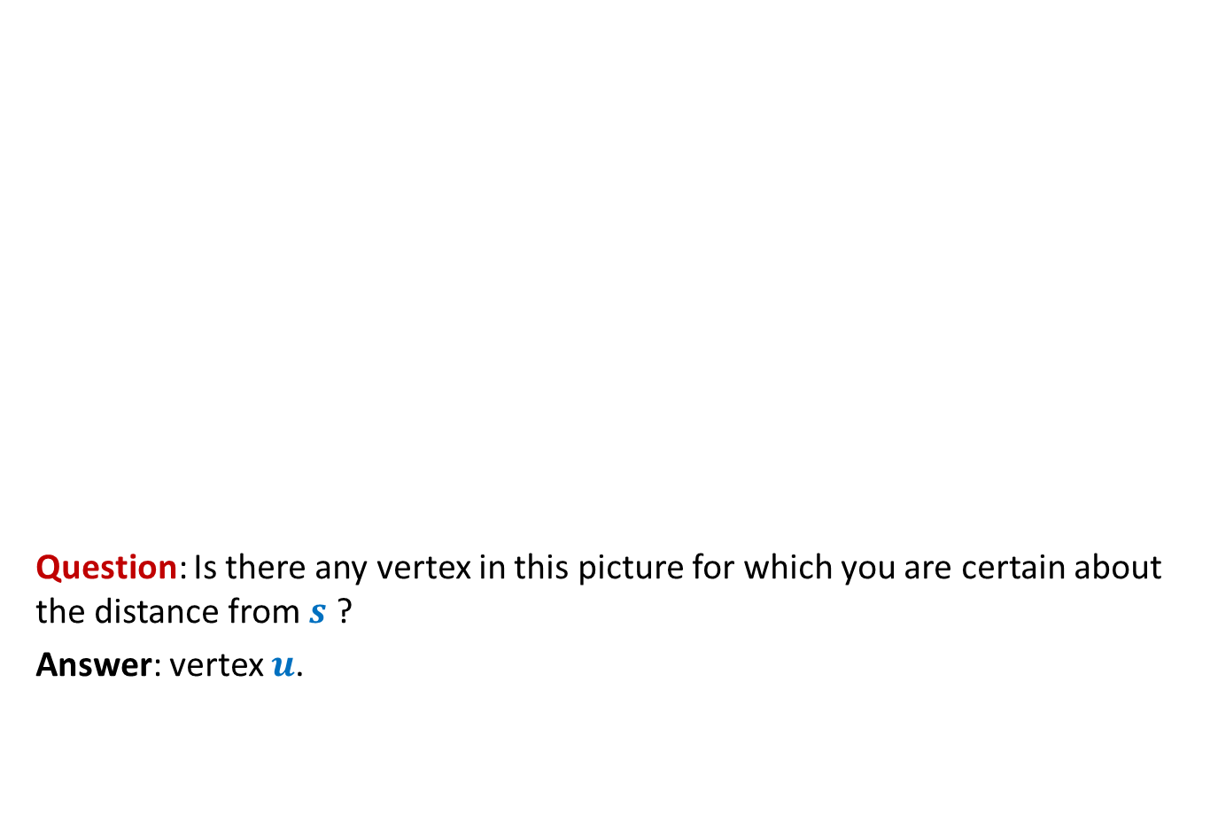



An example to get an insight into this problem
Question: Is there any vertex in this picture for which you are certain about the distance from $s$ ?
Answer: vertex $u$.
$$z$$
10
$$v$$
G
12
7
$$x$$
$$s$$
3
5
$$u$$
$$y$$
Give reasons.

Slide 24


An example to get an insight into this problem
➔ The shortest path to vertex $u$ is edge ($s$,$u$).
$$z$$
10
$$v$$
G
12
7
$$x$$
$$s$$
3
5
$$u$$
$$y$$
$$>0$$

Slide 25






Designing a greedy algorithm for shortest paths
Establish a relation between shortest paths in $G$
and
shortest paths in $G′$
$$G$$
instance of size $n$
Greedy
step
$$G′$$
instance of size $<n$
How will $G′$ look like ?
Do it as Homework

