Slide 1
Design and Analysis of Algorithms
Algorithms-II : CS345A
Lecture 11
Shortest paths in graphs with positive weights

Slide 2
Recap of last lecture

Slide 3

Problem Definition
Input: A directed graph $G=(V,E)$ with $ω:E→R^{+}$ and a source vertex $s∈V$
Aim:
Compute $δ(s,v)$ for all $v∈V\backslash \{s\}$
Compute $P(s,v)$ for all $v∈V\backslash \{s\}$

Slide 4


An example to get an insight into this problem
$$q$$
5
7
6
12
G
$$s$$
16
4
9
11

Slide 5






An example to get an insight into this problem
Let us look at the neighborhood of $s$
$$z$$
10
$$v$$
G
12
7
$$x$$
$$s$$
3
5
$$u$$
$$y$$

Slide 6


An example to get an insight into this problem
➔ The shortest path to vertex $u$ is edge ($s$,$u$).
$$z$$
10
$$v$$
G
12
7
$$x$$
$$s$$
3
5
$$u$$
$$y$$
$$>0$$

Slide 7





Designing a greedy algorithm for shortest paths
Establish a relation between shortest paths in $G$
and
shortest paths in $G′$
$$G$$
instance of size $n$
Greedy
step
$$G′$$
instance of size $<n$

Slide 8



An example to get an insight into this problem
Question: Can you remove vertex $u$ without affecting the distance from $s$ ?
$$z$$
10
$$v$$
G
12
7
2
$$x$$
$$s$$
21
$$t$$
3
5
$$u$$
3
8
$$y$$
$$r$$

Slide 9

An example to get an insight into this problem
$$z$$
10
$$v$$
12
7
+3
G’
2
+3
$$x$$
21
$$t$$
$$s$$
5
+3
+3
8
3
$$y$$
$$r$$

Slide 10
An example to get an insight into this problem
$$z$$
10
$$v$$
G’
12
7
5
$$x$$
24
$$t$$
$$s$$
5
6
11
$$y$$
$$r$$

Slide 11
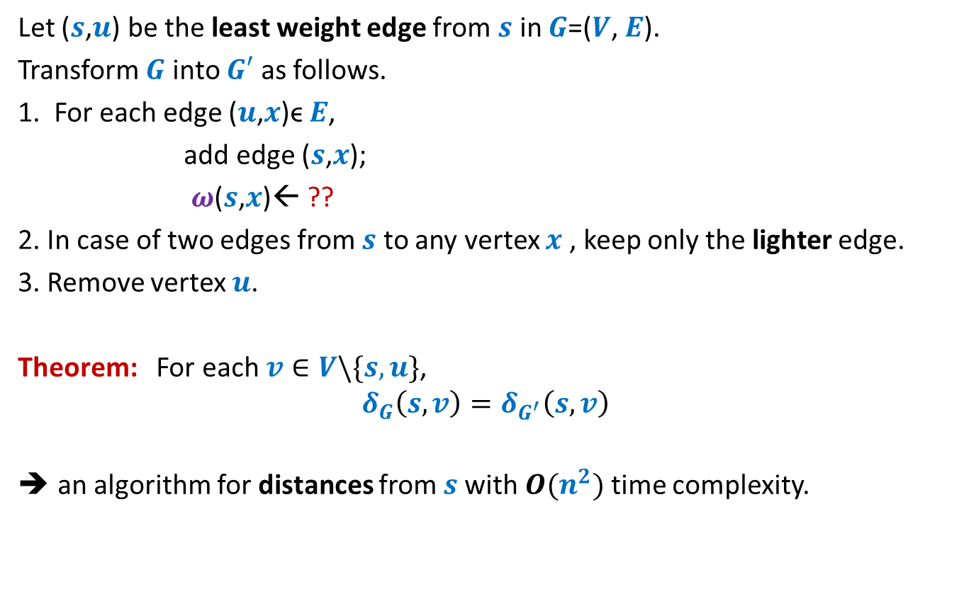


How to compute instance $G′$
Let ($s$,$u$) be the least weight edge from $s$ in $G$=($V$, $E$).
Transform $G$ into $G′$ as follows.
1. For each edge ($u$,$x$)ϵ $E$,
add edge ($s$,$x$);
$ω$($s$,$x$)← ??
2. In case of two edges from $s$ to any vertex $x$ , keep only the lighter edge.
3. Remove vertex $u$.
Theorem: For each $v∈V\backslash \{s,u\}$,
$$δ_{G}\left(s,v\right)=δ_{G^{′}}\left(s,v\right)$$
an algorithm for distances from $s$with $O(n^{2})$ time complexity.
$ω$($s$,$u$) + $ω$($u$,$x$);
Can you see some negative points of this algorithm ?

Slide 12
Shortcomings of the algorithm
No insight into the (beautiful) structure of shortest paths.
Just convinces that we can solve the shortest paths problem in polynomial time.
Very few options to improve the time complexity.
Silent about a compact data structure for storing all shortest paths from the source.
We shall now design a very insightful algorithm based on properties of shortest paths.

Slide 13
Properties of a shortest path

Slide 14



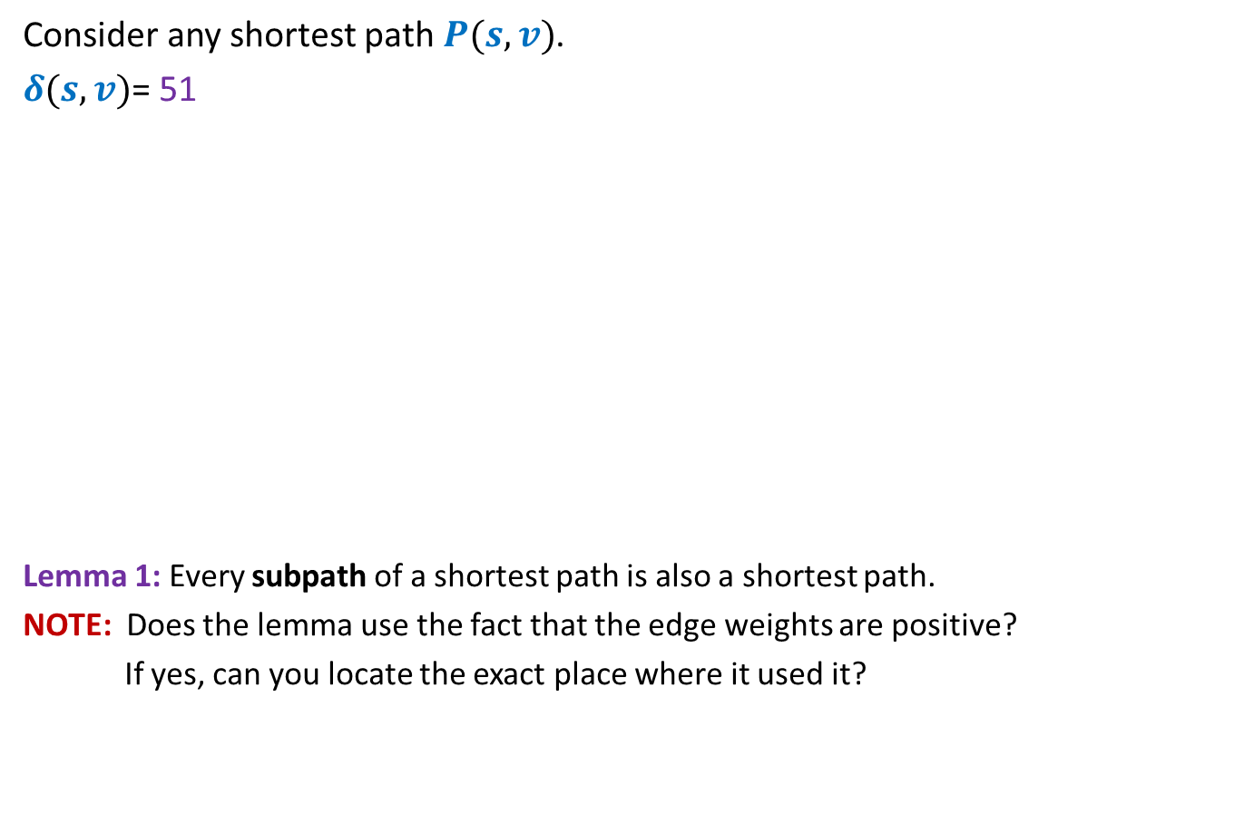




Optimal subpath property
Consider any shortest path $P(s,v)$.
$δ(s,v)$= 51
Lemma 1: Every subpath of a shortest path is also a shortest path.
NOTE: Does the lemma use the fact that the edge weights are positive?
If yes, can you locate the exact place where it used it?
< 27
12
3
7
5
15
9
$$s$$
$$a$$
$$g$$
$$y$$
$$u$$
$$x$$
$v$
Can you realize an assumption in your proof ?
?
Homework: Write a complete and formal proof for Lemma 1

Slide 15




Exploiting the positive weight on edges
Consider once again a shortest path $P(s,v)$.
➔ $δ\left(s,a\right)<δ\left(s,g\right)<δ\left(s,y\right)<δ\left(s,u\right)<δ(s,x)<δ(s,v)$
The nearest vertex of $s$ must be its neighbor.
$$>0$$
$$>0$$
$$>0$$
$$>0$$
$$>0$$
$$>0$$
$$s$$
$$a$$
$$g$$
$$y$$
$$u$$
$$x$$
$v$
(1)

Slide 16




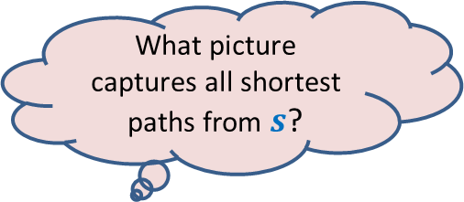


More insights …
What can we say about $x$ ?
Let $s_{i}$ : $i$th nearest vertex from $s$.
$s_{0}$ = $s$.
Consider the shortest path $P\left(s,s_{i}\right)$.
Lemma 2: $P\left(s,s_{i}\right)$ must be of the form $s ⇝$ $s_{j} →s_{i}$ for some $j<i$.
$x$ must be $s_{j}$ for some $j<i$.
$$s$$
$$x$$
$s_{i}$
What picture captures all shortest paths from $s$?

Slide 17








Complete picture of all shortest paths ?
Shortest paths tree
$$s$$
$$s_{4}$$
$$s_{1}$$
$$s_{7}$$
$$s_{5}$$
$$s_{2}$$
$$s_{3}$$
$$s_{6}$$

Slide 18
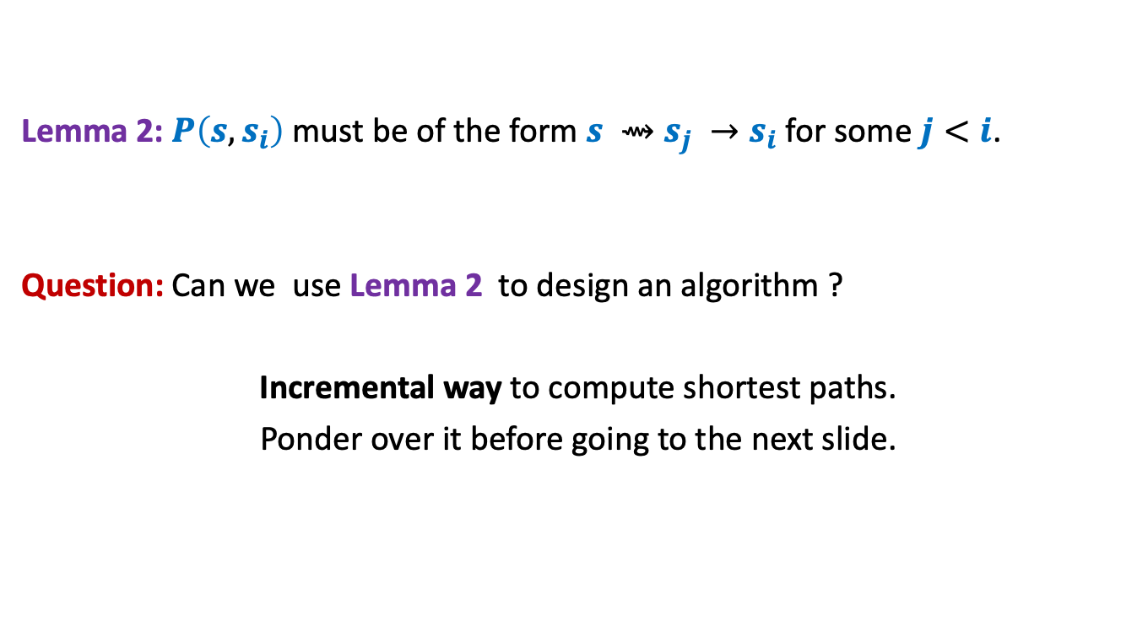
Designing the algorithm …
Lemma 2: $P\left(s,s_{i}\right)$ must be of the form $s ⇝$ $s_{j} →s_{i}$ for some $j<i$.
Question: Can we use Lemma 2 to design an algorithm ?
Incremental way to compute shortest paths.
Ponder over it before going to the next slide.
shortest

Slide 19
Suppose we have computed $s_{1}$, $s_{2}$,…, $s_{i−1}$.
We can compute $s_{i}$ as follows.
For each $v∈V \backslash \{s_{1}\text{,} s_{2}\text{,…,} s_{i−1}\}$
$$L\left(v\right)=$$
$s_{i}$ is ??
$$s$$
G
$$s_{1}$$
$$s_{4}$$
$$v$$
$$s_{2}$$
$$s_{3}$$
$$\left(δ\left(s,s_{j}\right)+ω\left(s_{j},v\right)\right)$$
$$\min_{\left({(s}_{j},v\right)∈E)}{ ? }$$
the vertex with minimum value of $L$.

Slide 20
Dijkstra’s algorithm
Dijkstra-algo($s$,$G$)
{ $U$ ← $V \backslash \left\{s\right\}$;
$S$← $\left\{s\right\}$;
For $i$ = 1 to $n−1$ do
{ For each $v∈U$ do
{ $L\left(v\right)$← $∞$;
For each $(x,v)∈E$ with $x∈S$do
$L\left(v\right) \text{←}$ min( $L\left(v\right)$, $δ\left(s,x\right)+ω\left(x,v\right)$ )
}
$y$← vertex from $U$ with minimum value of $L$;
$δ\left(s,y\right)\text{←}L\left(y\right)$;
move $y$ from $U$ to $S$;
}

Slide 21
In this algorithm, we first compute $L(v)$ for each $v∈U$ and then find the vertex with the least $L$value.
Try to rearrange its statements so that in the beginning of each iteration, we have $L$ values computed already.
This rearrangement will be helpful for improving the running time.
So please try it on your own first before viewing the next slide.

Slide 22
Dijkstra’s algorithm
Dijkstra-algo($s$,$G$)
{ $U$ ← $V$;
$L\left(s\right)$← $0$;
For $i$ = 0 to $n−1$ do
{ $y$← vertex from $U$ with minimum value of $L$;
$δ\left(s,y\right)\text{←}L\left(y\right)$;
move $y$ from $U$ to $S$;
For each $v∈U$ do
{ $L\left(v\right)$← $∞$;
For each $(x,v)∈E$ with $x∈S$do
$L\left(v\right) \text{←}$ min( $L\left(v\right)$, $δ\left(s,x\right)+ω\left(x,v\right)$ )
}
}
$L\left(v\right)$← $∞$ for all $v∈U$ ;
a lot of re-computation

Slide 23
Dijkstra’s algorithm
Dijkstra-algo($s$,$G$)
{ $U$ ← $V$;
$L\left(s\right)$← $0$;
For $i$ = 0 to $n−1$ do
{ $y$← vertex from $U$ with minimum value of $L$;
$δ\left(s,y\right)\text{←}L\left(y\right)$;
move $y$ from $U$ to $S$;
For each $v∈U$ do
{
For each $(x,v)∈E$ with $x∈S$do
$L\left(v\right) \text{←}$ min( $L\left(v\right)$, $δ\left(s,x\right)+ω\left(x,v\right)$ )
}
}
Only neighbors of $y$
$L\left(v\right)$← $∞$ for all $v∈U$ ;
What are the vertices
whose $L$ value may change
in this iteration ?

Slide 24
Dijkstra’s algorithm
Dijkstra-algo($s$,$G$)
{ $U$ ← $V$;
$L\left(s\right)$← $0$;
For $i$ = 0 to $n−1$ do
{ $y$← vertex from $U$ with minimum value of $L$;
$δ\left(s,y\right)\text{←}L\left(y\right)$;
move $y$ from $U$ to $S$;
For each $(y,v)∈E$ with $v∈U$do
{
$L\left(v\right) \text{←}$ min( $L\left(v\right)$, $δ\left(s,y\right)+ω\left(y,v\right)$ )
}
}
$L\left(v\right)$← $∞$ for all $v∈U$ ;
1 extract-min operation
deg($y$) Decrease-key operations

Slide 25
Quiz 1 problem

Slide 26





Solving the 2 smaller instances
$$p_{L}$$
$$p_{R}$$
Left half set
$⌈\frac{n}{2}⌉$points
$δ$ ← min($δ_{L}{,δ}_{R}$)
$⌊\frac{n}{2}⌋$points
Right half set
Notes:
1. Compute the closest pair distance of the left half set
2. Let it be Delta_L.
3.Compute the closest pair distance of the right half set
4. Let it be Delta_R.

Slide 27



The combine step
$$\frac{p}{2}$$
$$\frac{p}{2}$$
$p$ ← min($p_{L}{,p}_{R}$)
Notes:
But there may still be $Θ(n)$ points in each of these strips.
So what to do ?

Slide 28

The combine step
$$\frac{p}{2}$$
$$\frac{p}{2}$$
$p$ ← min($p_{L}{,p}_{R}$)
Notes:
But there may still be $Θ(n)$ points in each of these strips.
So what to do ?

Slide 29

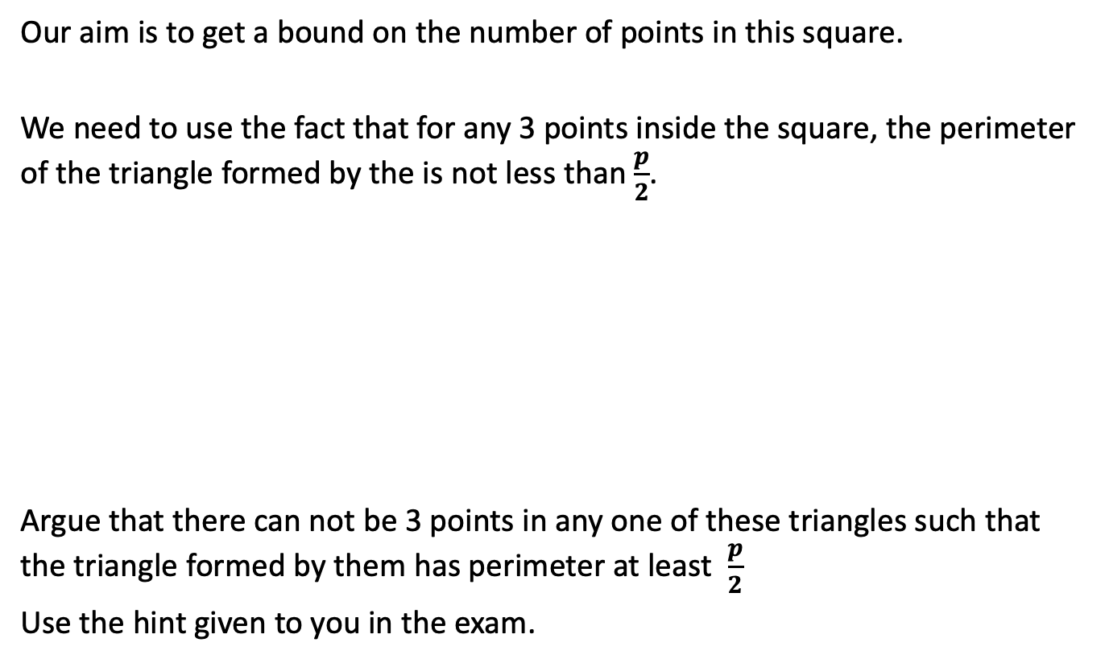
Our aim is to get a bound on the number of points in this square.
We need to use the fact that for any 3 points inside the square, the perimeter of the triangle formed by the is not less than $\frac{p}{2}$.
Argue that there can not be 3 points in any one of these triangles such that the triangle formed by them has perimeter at least $\frac{p}{2}$
Use the hint given to you in the exam.
$$\frac{p}{2}$$

