Slide 1
Design and Analysis of Algorithms
CS345A
Lecture 13
A new algorithm paradigm
Dynamic Programming

Slide 2

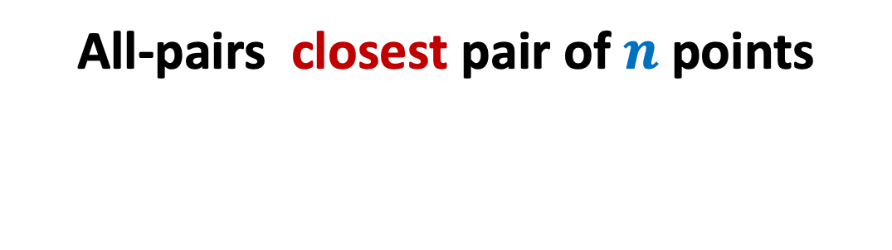
Problem
All-pairs closest pair of $n$points
farthest
in O($n$ log $n$) time

Slide 3

Observation:
Farthest pair of points must lie on the boundary of the convex hull of all points.
Compute convex hull in O($n$ log $n$) time
Compute farthest pair of points of the convex hull in O($n$ log $n$) time
Can you locate the farthest pair of points ?
Can you see some structure on which these points must be lying ?
Convex hull ☺

Slide 4

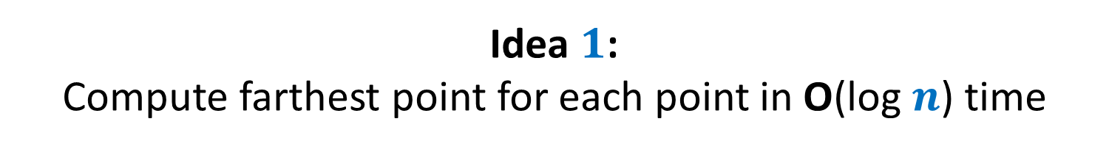

Idea $1$: Compute farthest point for each point in O(log $n$) time
If we scan in clockwise or anticlockwise order ,
distance from $p_{i}$ seems to increase monotonically and then decrease monotonically.
But is it true for all convex polygons ?
No ☹
➔ Use binary search …☺
$$p_{i}$$

Slide 5
Idea $1$: Compute farthest point for each point in O(log $n$) time
Distance first increases
It then decreases
It increases again
Finally it decreases.
Ponder over the problem. We shall discuss it interactively in the next lecture.
But is it true for all convex polygons ?
No ☹
$$p_{i}$$

Slide 6
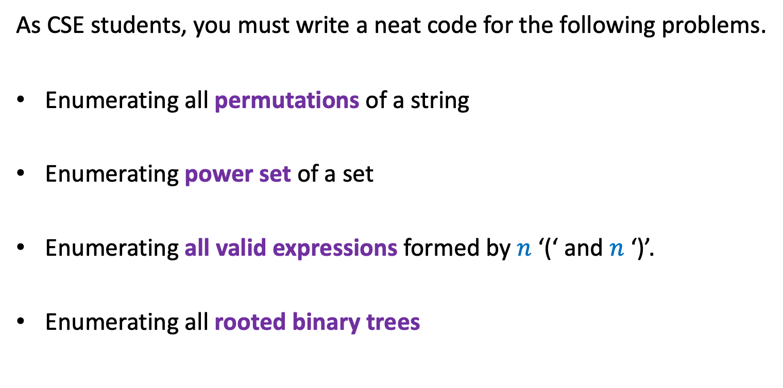
Recursion
As CSE students, you must write a neat code for the following problems.
Enumerating all permutations of a string
Enumerating power set of a set
Enumerating all valid expressions formed by $n$ ‘(‘ and $n$ ‘)’.
Enumerating all rooted binary trees

Slide 7
Longest common subsequence

Slide 8


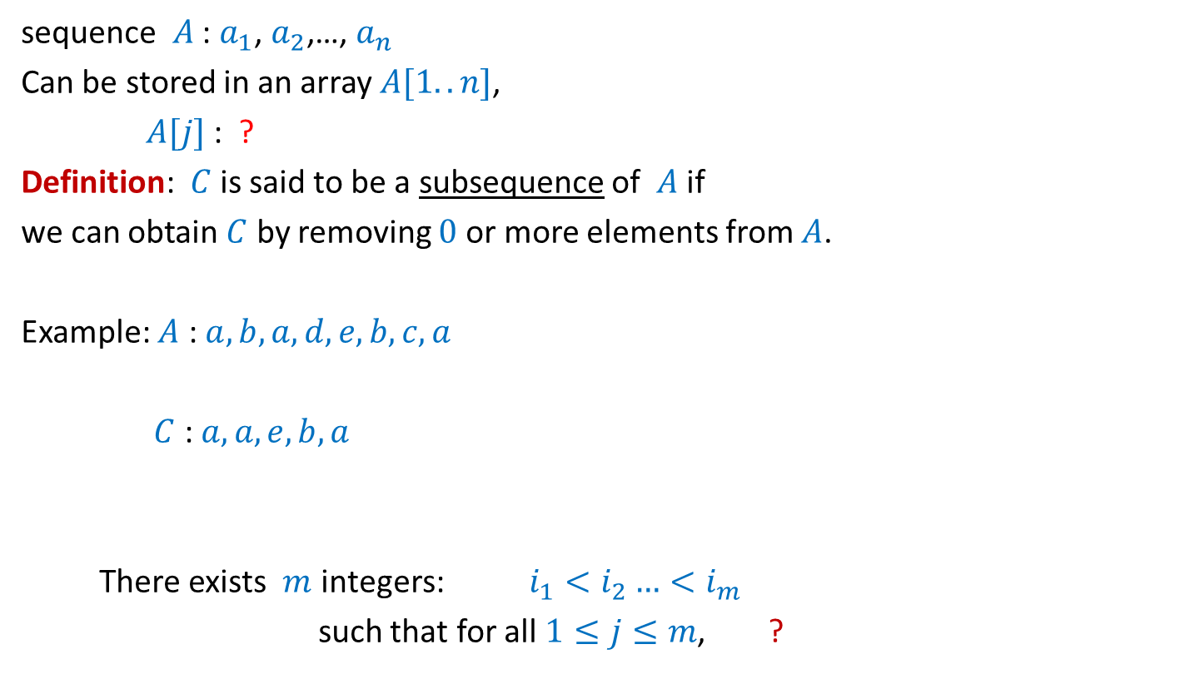





What is a subsequence ?
sequence $A$ : $a_{1}$, $a_{2}$,…, $a_{n}$
Can be stored in an array $A[1..n]$,
$A[j]$ : ?
Definition: $C$ is said to be a subsequence of $A$ if
we can obtain $C$ by removing $0$ or more elements from $A$.
Example: $A$ : $a,b,a,d,e,b,c,a$
$C$ : $a,a,e,b,a$
There exists $m$ integers: $i_{1}<i_{2}…<i_{m}$
such that for all $1≤j≤m$, ?
$$a_{j}$$
$A[1..k]$ : ?
$a_{1}$, $a_{2}$,…, $a_{k}$
A more formal definition ?
$$C[1..m]$$
$$1≤$$
$$≤n$$
$C\left[j\right]=A[i_{j}]$

Slide 9
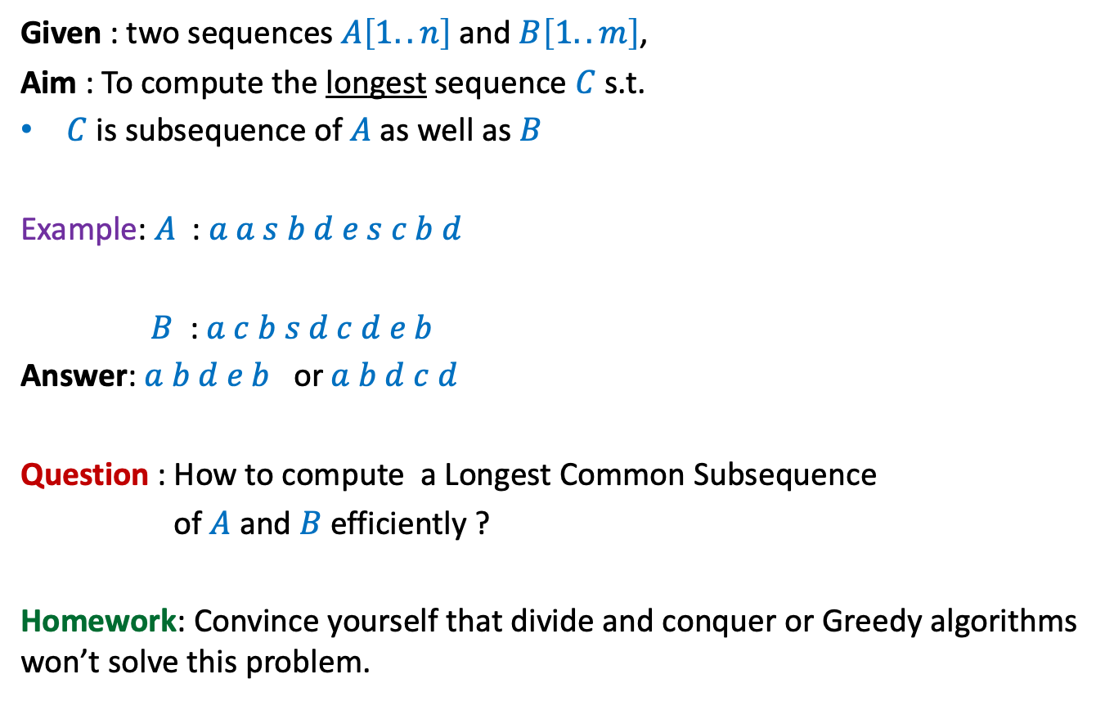
Problem Definition
Given : two sequences $A\left[1..n\right]$ and $B\left[1..m\right]$,
Aim : To compute the longest sequence $C$ s.t.
$C$ is subsequence of $A$ as well as $B$
Example: $A$ : $a a s b d e s c b d$
$B$ : $a c b s d c d e b$
Answer: $a b d e b$ or $a b d c d$
Question : How to compute a Longest Common Subsequence
of $A$ and $B$ efficiently ?
Homework: Convince yourself that divide and conquer or Greedy algorithms won’t solve this problem.

Slide 10
Observations

Slide 11


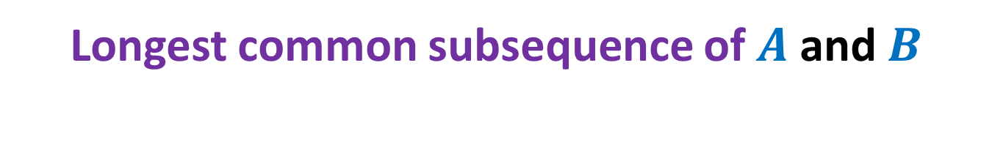



Longest common subsequence of $A$ and $B$
An element of $A$ may be matched with many elements of $B$.
Where to start from ☹
$a_{1}$ $a_{2}$ $a_{3}$ … $a_{n−1}{ a}_{n}$
$$A$$
$$B$$
$b_{1}$ $b_{2}$ $b_{3}$ … $b_{m−1}{ b}_{m}$

Slide 12


Longest common subsequence of $A$ and $B$
when $a_{n}=b_{m}$
$a_{1}$ $a_{2}$ $a_{3}$ … $a_{n−1}{ a}_{n}$
$$A$$
$$B$$
$b_{1}$ $b_{2}$ $b_{3}$ … $b_{m−1}{ b}_{m}$

Slide 13

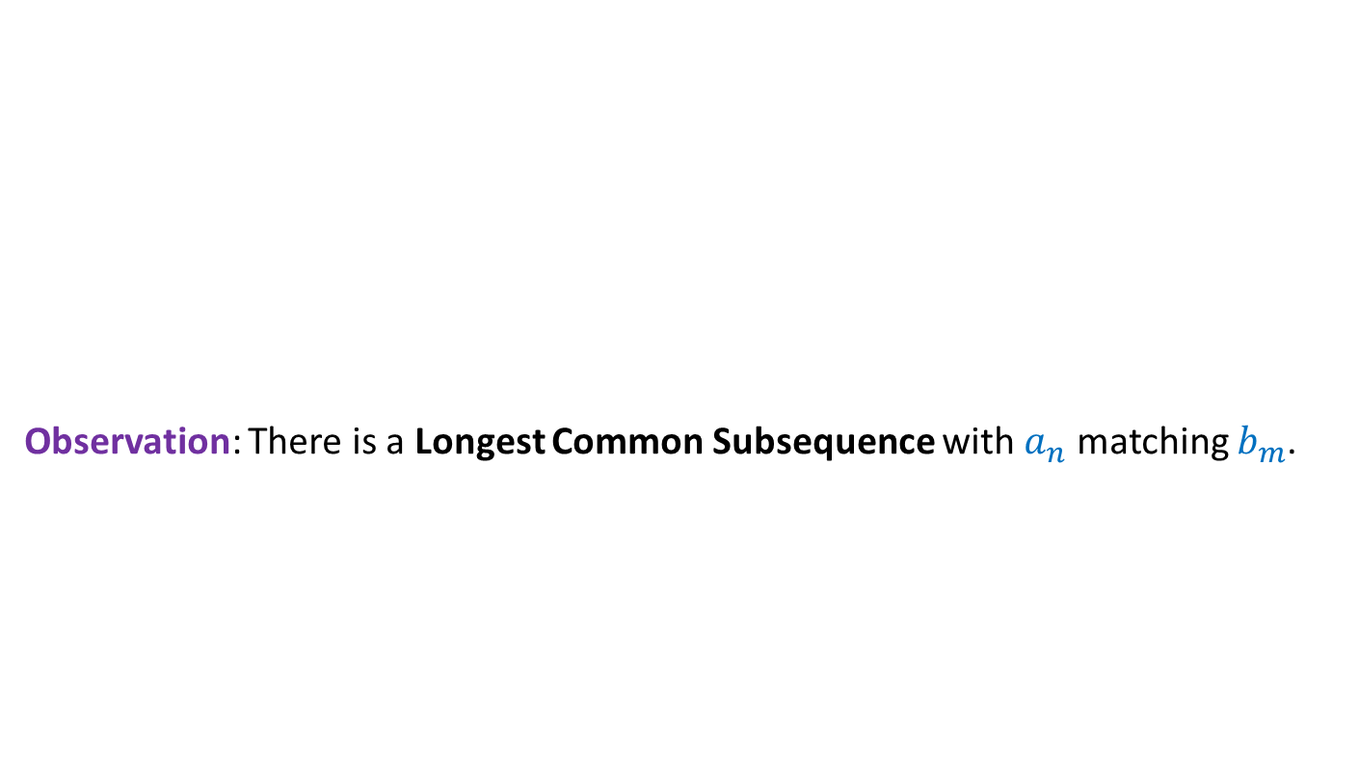


Longest common subsequence of $A$ and $B$
when $a_{n}=b_{m}$
Observation: There is a Longest Common Subsequence with $a_{n}$ matching $b_{m}$.
Otherwise, $b_{m}$ is matched with $a_{i}$ for some $i<n$. Since $b_{m}$ is the last symbol of $B$, we can as well match $b_{m}$ with $a_{n}$ to get the desired LCS.
Otherwise, we can append $a_{n}$ at the end of such LCS to get a longer LCS.
A contradiction !
$a_{1}$ $a_{2}$ $a_{3}$ … $a_{n−1}{ a}_{n}$
$$A$$
$$B$$
$b_{1}$ $b_{2}$ $b_{3}$ … $b_{m−1}{ b}_{m}$
Last symbol of Longest Common Subsequence must be $a_{n}$.
We can even make a stronger observation.
What kind of picture emerge for the LCS in this case ?

Slide 14


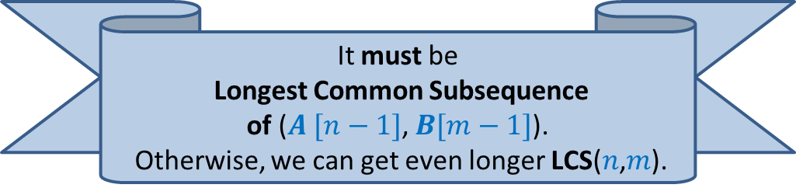

Longest common subsequence of $A$ and $B$
when $a_{n}=b_{m}$
Observation: There is a Longest Common Subsequence with $a_{n}$ matching $b_{m}$.
Lemma: If $a_{n}=b_{m}$then
Longest Common Subsequence =
?
$a_{1}$ $a_{2}$ $a_{3}$ … $a_{n−1}{ a}_{n}$
What can you say about the Longest Common Subsequence excluding the last (red) symbol ?
$$A$$
$$B$$
$b_{1}$ $b_{2}$ $b_{3}$ … $b_{m−1}{ b}_{m}$
LCS($n$,$m$)
LCS($n−1$,$m−1$) ::${ a}_{n}$
Longest Common Subsequence of $A [n−1]$, $B[m−1]$::${ a}_{n}$
It must be
Longest Common Subsequence
of ($A [n−1]$, $B[m−1]$).
Otherwise, we can get even longer LCS($n$,$m$).
LCS($i$, $j$): Longest common subsequence of $A\left[1..i\right]$ and $B\left[1..j\right]$

Slide 15

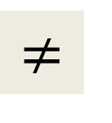
Longest common subsequence of $A$ and $B$
when $a_{n}=b_{m}$
$$≠$$
Observation: Either $a_{n}$or $b_{m}$is not the last symbol of LCS($n$,$m$).
Observation: If $a_{n}$is not the last symbol of LCS($n$,$m$)
$a_{1}$ $a_{2}$ $a_{3}$ … $a_{n−1}{ a}_{n}$
$$A$$
$$B$$
$b_{1}$ $b_{2}$ $b_{3}$ … $b_{m−1}{ b}_{m}$

Slide 16

Longest common subsequence of $A$ and $B$
when $a_{n}=b_{m}$
$$≠$$
Observation: Either $a_{n}$or $b_{m}$is not the last symbol of LCS($n$,$m$).
Observation: If $a_{n}$is not the last symbol of LCS($n$,$m$)
$a_{1}$ $a_{2}$ $a_{3}$ … $a_{n−1}{ a}_{n}$
$$A$$
$$B$$
$b_{1}$ $b_{2}$ $b_{3}$ … $b_{m−1}{ b}_{m}$

Slide 17


Longest common subsequence of $A$ and $B$
when $a_{n}=b_{m}$
$$≠$$
Observation: Either $a_{n}$or $b_{m}$is not the last symbol of LCS($n\text{,}m$).
Observation: If $a_{n}$is not the last symbol of LCS($n$,$m$)
➔ LCS($n$,$m$) is ?
$a_{1}$ $a_{2}$ $a_{3}$ … $a_{n−1}{ a}_{n}$
$$A$$
$$B$$
$b_{1}$ $b_{2}$ $b_{3}$ … $b_{m−1}{ b}_{m}$
LCS($n−1$,$m$)

Slide 18
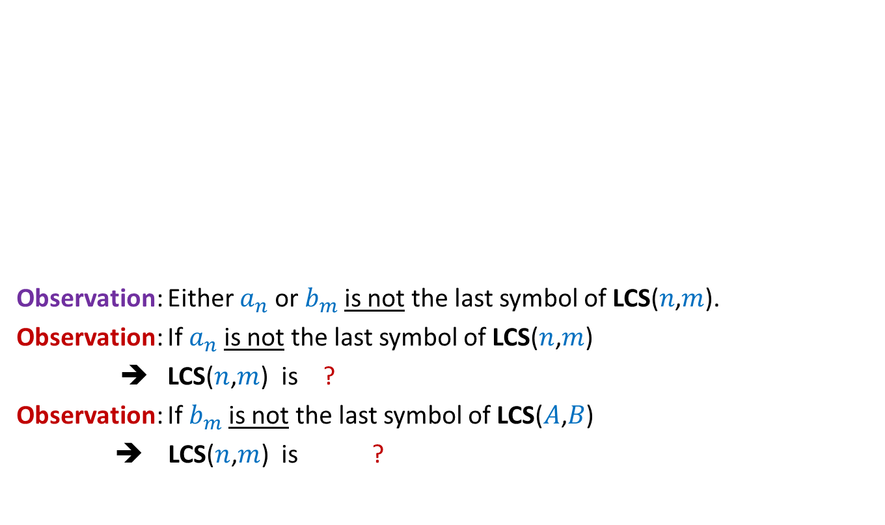

Longest common subsequence of $A$ and $B$
when $a_{n}=b_{m}$
$$≠$$
Observation: Either $a_{n}$or $b_{m}$is not the last symbol of LCS($n\text{,}m$).
Observation: If $a_{n}$is not the last symbol of LCS($n$,$m$)
➔ LCS($n$,$m$) is ?
Observation: If $b_{m}$is not the last symbol of LCS($A$,$B$)
➔ LCS($n$,$m$) is ?
$a_{1}$ $a_{2}$ $a_{3}$ … $a_{n−1}{ a}_{n}$
$$A$$
$$B$$
$b_{1}$ $b_{2}$ $b_{3}$ … $b_{m−1}{ b}_{m}$
LCS($n−1$,$m$)
LCS($n$,$m−1$)

Slide 19

Longest common subsequence of $A$ and $B$
when $a_{n}=b_{m}$
$$≠$$
Observation: Either $a_{n}$or $b_{m}$is not the last symbol of LCS($n$,$m$).
Lemma: If $a_{n}≠b_{m}$then
LCS($n\text{,}m$) is either LCS($n$,$m−1$) or LCS($n−1$,$m$)
$a_{1}$ $a_{2}$ $a_{3}$ … $a_{n−1}{ a}_{n}$
$$A$$
$$B$$
$b_{1}$ $b_{2}$ $b_{3}$ … $b_{m−1}{ b}_{m}$

Slide 20
Recursive formulation
LCS($i$, $j$): Longest common subsequence of $A\left[1..i\right]$ and $B\left[1..j\right]$

Slide 21
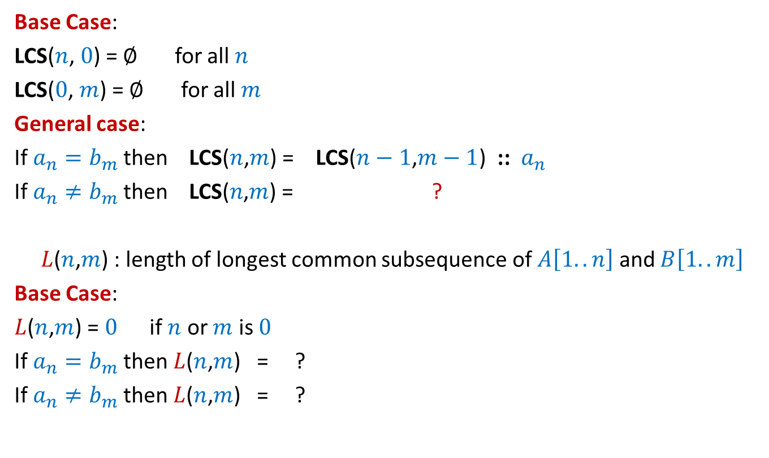




Recursive formulation for LCS($n$,$m$)
Base Case:
LCS($n$, $0$) = $∅$ for all $n$
LCS($0$, $m$) = $∅$ for all $m$
General case:
If $a_{n}=b_{m}$then LCS($n$,$m$) = LCS($n−1$,$m−1$) ::${ a}_{n}$
If $a_{n}≠b_{m}$then LCS($n\text{,}m$) = ?
$L$($n$,$m$) : length of longest common subsequence of $A\left[1..n\right]$ and $B\left[1..m\right]$
Base Case:
$L$($n$,$m$) = $0$ if $n$ or $m$ is $0$
If $a_{n}=b_{m}$then $L$($n$,$m$) = ?
If $a_{n}≠b_{m}$then $L$($n$,$m$) = ?
bigger of LCS($n$,$m−1$) or LCS($n−1$,$m$)
$L$($n−1$,$m−1$) + 1
Max( $L$($n−1$,$m$) , $L$($n$,$m−1$))

Slide 22
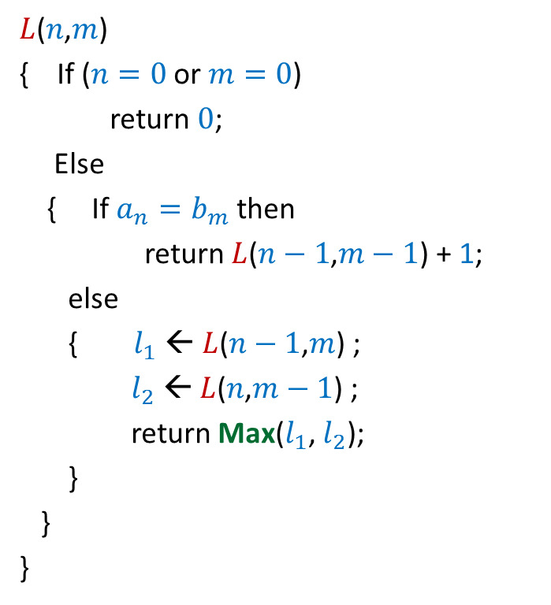

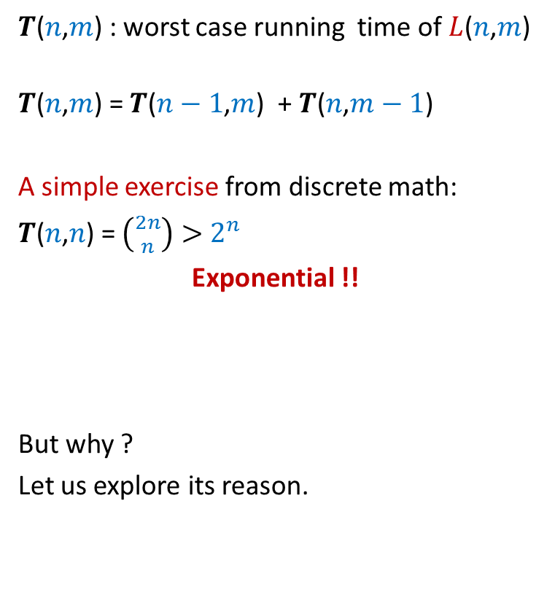
Recursive algorithm for $L$($n$,$m$)
$L$($n$,$m$)
{ If ($n=0$ or $m=0$)
return $0$;
Else
{ If $a_{n}=b_{m}$then
return $L$($n−1$,$m−1$) + 1;
else
{ $l_{1}$ ← $L$($n−1$,$m$) ;
$l_{2}$ ← $L$($n$,$m−1$) ;
return Max($l_{1}$, $l_{2}$);
}
}
}
$T$($n$,$m$) : worst case running time of $L$($n$,$m$)
$T$($n$,$m$) = $T$($n−1$,$m$) + $T$($n$,$m−1$)
A simple exercise from discrete math:
$T$($n$,$n$) = $\left({2n \atop n}\right)>$ $2^{n}$
Exponential !!
But why ?
Let us explore its reason.

Slide 23








Recursive algorithm for $L$($n$,$m$)
Recursion tree
$L$($n$,$m$)
$L$($n$,$m$)
{ If ($n=0$ or $m=0$)
return $0$;
Else
{ If $a_{n}=b_{m}$then
return $L$($n−1$,$m−1$) + 1;
else
{ $l_{1}$ ← $L$($n−1$,$m$) ;
$l_{2}$ ← $L$($n$,$m−1$) ;
return Max($l_{1}$, $l_{2}$);
}
}
}
Solving same sub-problem multiple times !!
But how many sub-problems are there ?
only ($n+1$)*($m+1$).
Can we compute them efficiently ?
$L$($n−1$,$m$)
$L$($n$,$m−1$)
$L$($n−1$,$m−1$)
$L$($n$,$m−2$)
$L$($n−2$,$m$)
$L$($n−1$,$m−1$)
The answer lies in the exercise on Fibonacci numbers we did in the previous lecture. ☺

Slide 24









Recursive algorithm for $F$($n$)
Recursion tree
$F$($n$)
$F$($n−1$)
$F$($n−2$)
$F$($n−3$)
$F$($n−4$)
$F$($n−2$)
$F$($n−3$)
F
0 1
0 | 1 | 2 | …
$$i$$

Slide 25







Recursive algorithm for $L$($n$,$m$)
$T$[$i$,$j$] = $L$($i$,$j$)
$L$($n$,$m$)
{ If ($n=0$ or $m=0$)
return $0$;
Else
{ If $a_{n}=b_{m}$then
return $L$($n−1$,$m−1$) + 1;
else
{ $l_{1}$ ← $L$($n−1$,$m$) ;
$l_{2}$ ← $L$($n$,$m−1$) ;
return Max($l_{1}$, $l_{2}$);
}
}
}
$$n$$
0
$$i$$
…
…
1
0
0
0 0 0 ... 0
0 1 ... $m$
$$j$$
$$T$$

Slide 26
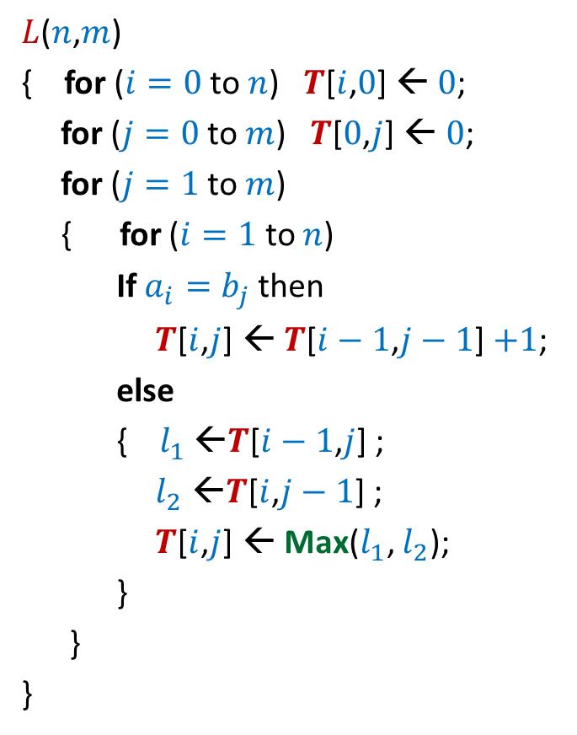


Iterative algorithm for $L$($n$,$m$)
$L$($n$,$m$)
{ for ($i=0$ to $n$) $T$[$i$,$0$] ← $0$;
for ($j=0$ to $m$) $T$[$0$,$j$] ← $0$;
for ($j=1$ to $m$)
{ for ($i=1$ to $n$)
If $a_{i}=b_{j}$then
$T$[$i$,$j$] ← $T$[$i−1$,$j−1$] $+1$;
else
{ $l_{1}$ ←$T$[$i−1$,$j$] ;
$l_{2}$ ←$T$[$i$,$j−1$] ;
$T$[$i$,$j$] ← Max($l_{1}$, $l_{2}$);
}
}
}
$$n$$
0
$$i$$
…
…
1
0
0
0 0 0 ... 0
0 1 ... $m$
$$j$$
Time complexity: O($nm$)
$$T$$

Slide 27
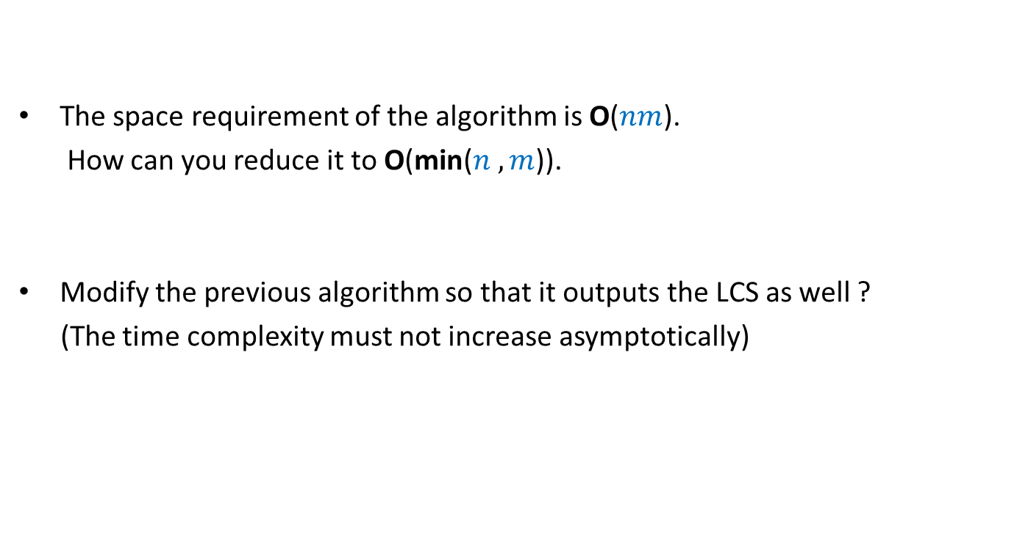
Homework
The space requirement of the algorithm is O($nm$).
How can you reduce it to O(min($n ,m$)).
Modify the previous algorithm so that it outputs the LCS as well ?
(The time complexity must not increase asymptotically)

Slide 28
Dynamic Programming algorithm paradigm
Expressing the solution recursively.
Overall there are only Polynomial number of subproblems.
But there is a huge overlap among the subproblems.
➔ So the recursive algorithm takes exponential time
(solving same subproblem multiple times).
So we compute the recursive solution iteratively in a bottom-up fashion
(like in case of Fibonacci numbers).
This avoids wastage of computation and leads to efficient implementation.

Slide 29
Steps of dynamic programming based algorithm
Recursive Formulation
Recursive Algorithm
Exponential time
Cause:
Overlap in subProblems
Polynomial no. of distinct subproblems
Bottom up approach to compute solution
A Polynomial time algorithm

Slide 30
OPTMAL Triangulation of a CONVEX POLYGON
Problem for the next lecture

Slide 31












Convex polygon
Representation: ?
How to store: ?
< $p_{i}$,…, $p_{j}$> : ?
< $p_{1}$,…, $p_{n}$>
Array
$$p_{i}$$
$$q$$
$$p_{n−2}$$
$$p_{3}$$
$$r$$
$$p_{2}$$
$$p_{n−1}$$
$$p_{n}$$
$$p_{1}$$
Polygon consisting of points $p_{i}$,…, $p_{j}$

Slide 32
Triangulation of a CONVEX POLYGON
Partitioning the polygon into triangles
$$p_{i}$$
$$p_{3}$$
$$p_{2}$$
$$p_{n−1}$$
$$p_{n}$$
$$p_{1}$$
, each defined by 3 points on the polygon

Slide 33
OPTMAL Triangulation of a CONVEX POLYGON

Slide 34


$ω$($i$,$j$,$k$) : weight of triangle formed by $p_{i}$, $p_{j}$, $p_{k}$.
Assumption: It takes O(1) time to compute $ω$($i$,$j$,$k$)
Cost of a triangulation : sum of the weight of $n−2$ triangles formed.
$$p_{i}$$
$$p_{3}$$
$$p_{2}$$
$$p_{n−1}$$
$$p_{n}$$
$$p_{1}$$

Slide 35

$ω$($i$,$j$,$k$) : weight of triangle formed by $p_{i}$, $p_{j}$, $p_{k}$.
Assumption: It takes O(1) time to compute $ω$($i$,$j$,$k$)
Problem: Design an efficient algorithm for computing an optimal triangulation (minimum weight triangulation) of a convex polygon on $n$ vertices.
$$p_{i}$$
$$p_{3}$$
$$p_{2}$$
$$p_{n−1}$$
$$p_{n}$$
$$p_{1}$$

Slide 36
Homework
Make sincere attempt to solve the optimal triangulation problem using Dynamic Programming paradigm. It will be very helpful for you even if you fail to solve it.
We shall solve it interactively in the next class.

