Slide 1
Design and Analysis of Algorithms
Algorithms-II : CS345A
Lecture 14
Dynamic Programming - II

Slide 2
Overview
From Longest common subsequence problem
Recursive Formulation
Recursive Algorithm
Exponential time
Polynomial no. of
distinct subproblems
Cause of exponential time:
Overlap in subProblems
Bottom up approach
A Polynomial time algorithm

Slide 3
OPTMAL Triangulation of a CONVEX POLYGON

Slide 4












Convex polygon
Representation: ?
How to store: ?
< $p_{i}$,…, $p_{j}$> : ?
< $p_{1}$,…, $p_{n}$>
Array
$$p_{i}$$
$$q$$
$$p_{n−2}$$
$$p_{3}$$
$$r$$
$$p_{2}$$
$$p_{n−1}$$
$$p_{n}$$
$$p_{1}$$
Polygon consisting of points $p_{i}$,…, $p_{j}$

Slide 5
Triangulation of a CONVEX POLYGON
Partitioning the polygon into disjoint triangles
$$p_{i}$$
$$p_{3}$$
$$p_{2}$$
$$p_{n−1}$$
$$p_{n}$$
$$p_{1}$$
, each defined by 3 points on the polygon

Slide 6
Triangulation of a CONVEX POLYGON
Partitioning the polygon into disjoint triangles
$$p_{i}$$
$$p_{3}$$
$$p_{2}$$
$$p_{n−1}$$
$$p_{n}$$
$$p_{1}$$
, each defined by 3 points on the polygon

Slide 7
OPTMAL Triangulation of a CONVEX POLYGON

Slide 8


$ω$($i$,$j$,$k$) : weight of triangle formed by $p_{i}$, $p_{j}$, $p_{k}$.
Assumption: It takes O(1) time to compute $ω$($i$,$j$,$k$)
Cost of a triangulation : sum of the weight of $n−2$ triangles formed.
$$p_{i}$$
$$p_{3}$$
$$p_{2}$$
$$p_{n−1}$$
$$p_{n}$$
$$p_{1}$$

Slide 9


$ω$($i$,$j$,$k$) : weight of triangle formed by $p_{i}$, $p_{j}$, $p_{k}$.
Assumption: It takes O(1) time to compute $ω$($i$,$j$,$k$)
Cost of a triangulation : sum of the weight of $n−2$ triangles formed.
$$p_{k}$$
$$p_{3}$$
$$p_{2}$$
$$p_{n−1}$$
$$p_{n}$$
$$p_{1}$$

Slide 10






How to compute optimal triangulation ?
$$p_{k}$$
$$p_{3}$$
$$p_{2}$$
$$p_{n−1}$$
$$p_{n}$$
$$p_{1}$$

Slide 11

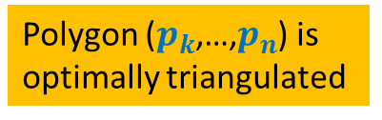
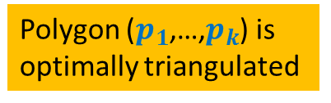
How to compute optimal triangulation ?
Question: If the opt. triangulation has triangle ($p_{1}$, $p_{k}$, $p_{n}$), what can we infer ?
$$p_{k}$$
$$p_{3}$$
Polygon ($p_{k}$,…,$p_{n}$) is
optimally triangulated
Polygon ($p_{1}$,…,$p_{k}$) is
optimally triangulated
$$p_{2}$$
$$p_{n−1}$$
$$p_{n}$$
$$p_{1}$$

Slide 12
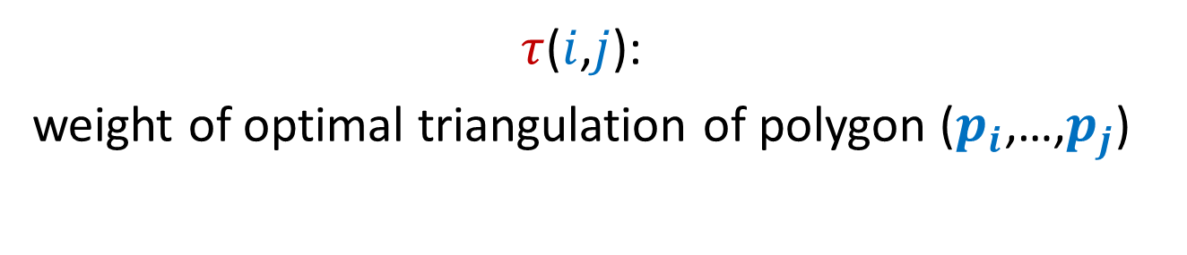
Recursive formulation of OPTMAL Triangulation
$τ$($i$,$j$):
weight of optimal triangulation of polygon ($p_{i}$,…,$p_{j}$)

Slide 13








Recursive formulation for $τ$($i$,$j$)
Base case:
$τ$($i$,$i+1$) = 0
For $j>i+1$
$τ$($i$,$j$) =
$$\min_{?}{? }$$
$$p_{k}$$
Generic case:
$$p_{j}$$
($τ$($i$,$k$) $+τ\text{(}k,j\text{)+}ω\text{(}i,k,j\text{)}$ )
$i$<$k$< $j$
$$p_{i+1}$$
$$p_{i}$$

Slide 14
Recursive ALGORITHM of OPTMAL Triangulation

Slide 15
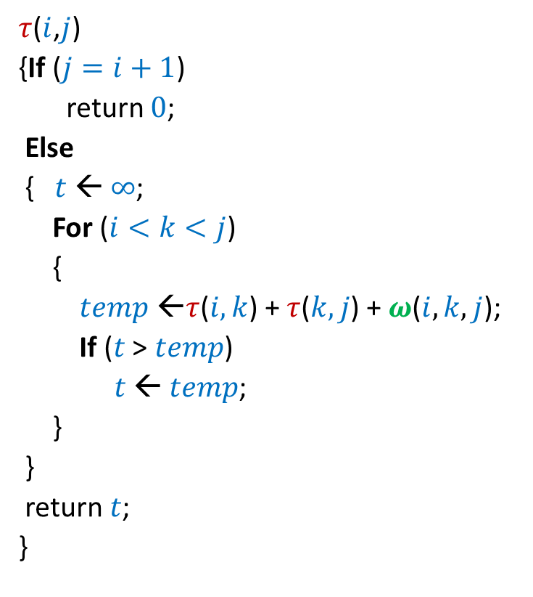

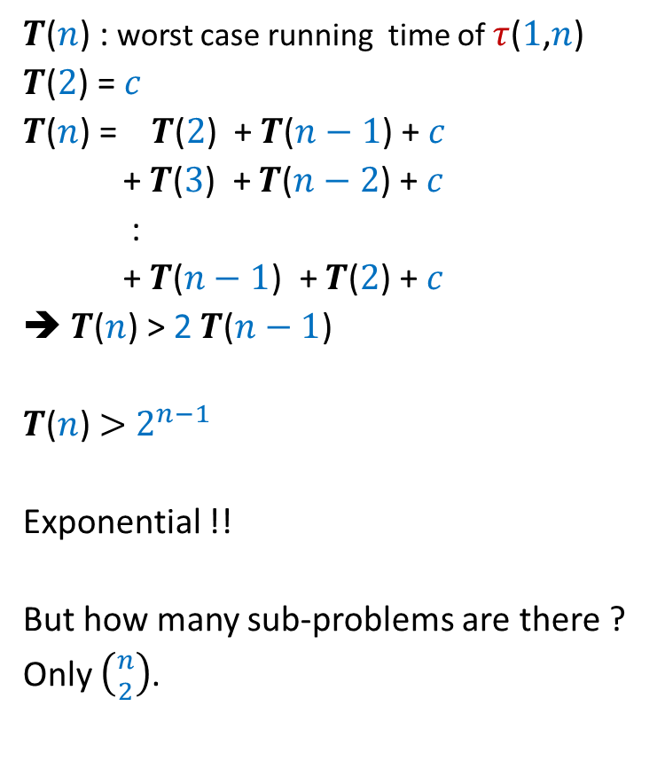
Recursive algorithm for $τ$($i$,$j$)
$τ$($i$,$j$)
{If ($j=i+1$)
return $0$;
Else
{$t$ ← $∞$;
For ($i<k<j$)
{
$temp$ ←$τ$($i,k$) + $τ$($k,j$) + $ω$($i,k,j$);
If ($t$ > $temp$)
$t$ ← $temp$;
}
}
return $t$;
}
$T$($n$) : worst case running time of $τ$($1$,$n$)
$T$($2$) = $c$
$T$($n$) = $T$($2$) + $T$($n−1$) + $c$
+ $T$($3$) + $T$($n−2$) + $c$
:
+ $T$($n−1$) + $T$($2$) + $c$
➔ $T$($n$) > 2 $T$($n−1$)
$T$($n$) $>$ $2^{n−1}$
Exponential !!
But how many sub-problems are there ?
Only $\left({n \atop 2}\right)$.

Slide 16
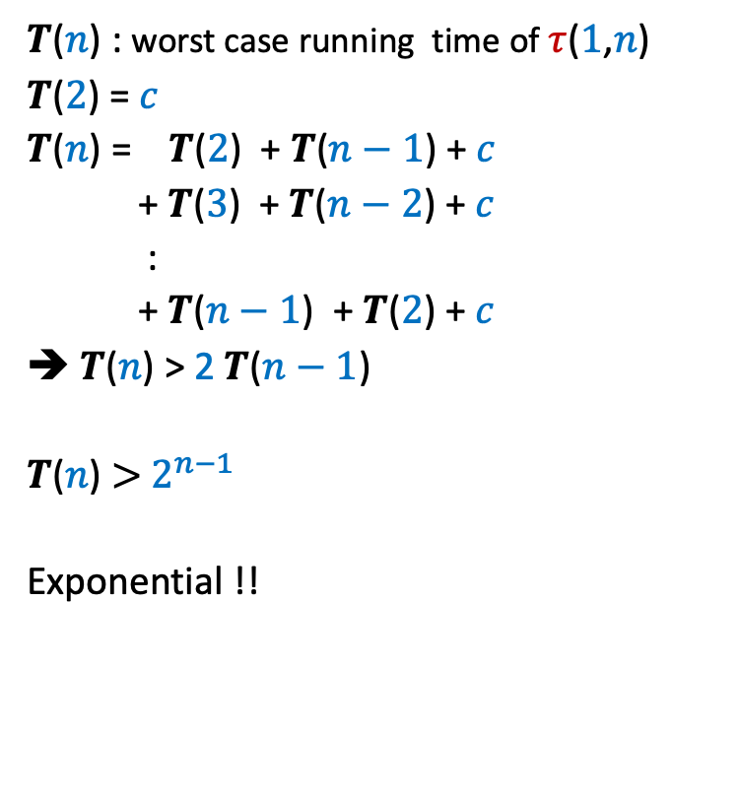
Recursive algorithm for $τ$($i$,$j$)
$τ$($i$,$j$)
{If ($j=i+1$)
return $0$;
Else
{$t$ ← $∞$;
For ($i<k<j$)
{
$temp$ ←$τ$($i,k$) + $τ$($k,j$) + $ω$($i,k,j$);
If ($t$ > $temp$)
$t$ ← $temp$;
}
}
return $t$;
}
$T$($n$) : worst case running time of $τ$($1$,$n$)
$T$($2$) = $c$
$T$($n$) = $T$($2$) + $T$($n−1$) + $c$
+ $T$($3$) + $T$($n−2$) + $c$
:
+ $T$($n−1$) + $T$($2$) + $c$
➔ $T$($n$) > 2 $T$($n−1$)
$T$($n$) $>$ $2^{n−1}$
Exponential !!

Slide 17






Recursive algorithm for $τ$($i$,$j$)
$T$[$i$,$j$] = $τ$($i$,$j$)
$τ$($i$,$j$)
{If ($j=i+1$)
return $0$;
Else
{$t$ ← $∞$;
For ($i<k<j$)
{
$temp$ ←$τ$($i,k$) + $τ$($k,j$) + $ω$($i,k,j$);
If ($t$ > $temp$)
$t$ ← $temp$;
}
}
return $t$;
}
$$n$$
0
0
0
0
0
0
0
0
0
$$i$$
0
…
0
2
0
1
0
1 2 ... $n$
$$j$$
$$T$$

Slide 18
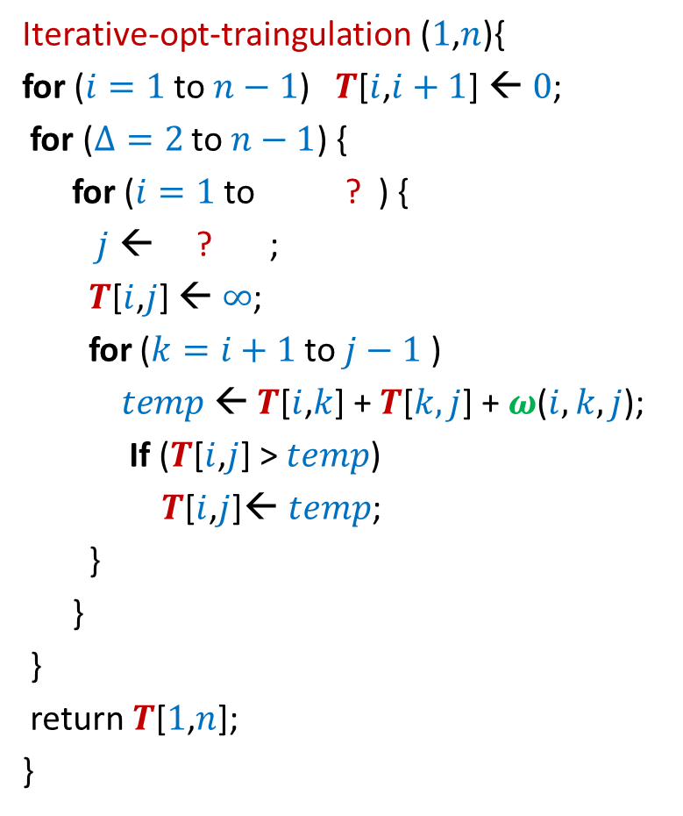





Iterative algorithm for $τ$($i$,$j$)
Iterative-opt-traingulation ($1$,$n$){
for ($i=1$ to $n−1$) $T$[$i$,$i+1$] ← $0$;
for ($Δ=2$ to $n−1$) {
for ($i=1$ to ? ) {
$j$ ← ? ;
$T$[$i$,$j$] ← $∞$;
for ($k=i+1$ to $j−1$ )
$temp$← $T$[$i$,$k$] + $T$[$k,j$] + $ω$($i,k,j$);
If ($T$[$i$,$j$] > $temp$)
$T$[$i$,$j$]← $temp$;
}
}
}
return $T$[$1$,$n$];
}
$T$[$i$,$j$] = $τ$($i$,$j$)
$$n$$
$$n−Δ$$
0
0
$$i+Δ$$
0
0
0
0
{
0
0
0
$$i$$
0
…
0
2
0
1
0
$$Δ$$
1 2 ... $n$
$$j$$
$$T$$

Slide 19
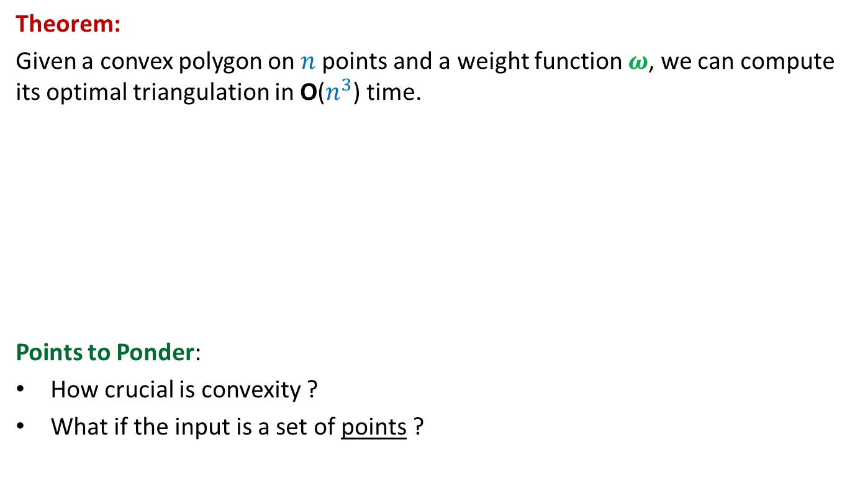
Iterative algorithm for $τ$($i$,$j$)
Theorem:
Given a convex polygon on $n$points and a weight function $ω$, we can compute its optimal triangulation in O($n^{3}$) time.
Points to Ponder:
How crucial is convexity ?
What if the input is a set of points ?
Not much.
No polynomial time algorithm till date ☹

Slide 20
OPTIMAL SUBSTRUCTURE PROPERTY
A PROPERTY
underlying every
Dynamic Programming based algorithm

Slide 21

Longest Common Subsequence
Lemma1: If $a_{n}=b_{m}$then
LCS($n$,$m$) = LCS($n−1$,$m−1$) ::${ a}_{n}$
Lemma2: If $a_{n}≠b_{m}$then
LCS($n\text{,}m$) is either LCS($n$,$m−1$) or LCS($n−1$,$m$)

Slide 22
Optimal triangulation of a convex polygon
$τ$($i$,$i+1$) = 0
For $j>i+1$
$τ$($i$,$j$) =
$$\min_{?}{? }$$
$$p_{k}$$
$$p_{j}$$
($τ$($i$,$k$) $+τ\text{(}k,j\text{)+}ω\text{(}i,k,j\text{)}$ )
$i$<$k$< $j$
$$p_{i+1}$$
$$p_{i}$$

Slide 23
OPTIMAL SUBSTRUCTURE PROPERTY
“Optimal solution of a problem contains within it
optimal solution for its smaller instances as well”.
Note:
Essential for every dynamic programming based algorithm
2. This property is also shared by Greedy algorithms.

Slide 24
Bitonic tour

Slide 25




Bitonic tour
There are $n$ points in a plane.
$δ(p_{i},p_{j})$: distance between $p_{i}$ and $p_{j}$
Cost of a tour: Total distance traveled.
$$p_{6}$$
$$p_{2}$$
$$p_{4}$$
$$p_{7}$$
$$p_{10}$$
$$p_{1}$$
$$p_{9}$$
$$p_{11}$$
$$p_{3}$$
$$p_{5}$$
$$p_{8}$$

Slide 26

Bitonic tour
There are $n$ points in a plane.
$δ(p_{i},p_{j})$: distance between $p_{i}$ and $p_{j}$
Cost of a tour: Total distance traveled.
Not bitonic
$$p_{6}$$
$$p_{2}$$
$$p_{4}$$
$$p_{7}$$
$$p_{10}$$
$$p_{1}$$
$$p_{9}$$
$$p_{11}$$
$$p_{3}$$
$$p_{5}$$
$$p_{8}$$

Slide 27

Bitonic tour
There are $n$ points in a plane.
$δ(p_{i},p_{j})$: distance between $p_{i}$ and $p_{j}$
Cost of a tour: Total distance traveled.
Problem: Given $n$ points <$p_{1}$,$p_{2}$,…,$p_{n}$> in increasing $x$-coordinates,
compute their least cost Bitonic tour.
Bitonic
$$p_{6}$$
$$p_{2}$$
$$p_{4}$$
$$p_{7}$$
$$p_{10}$$
$$p_{1}$$
$$p_{9}$$
$$p_{11}$$
$$p_{3}$$
$$p_{5}$$
$$p_{8}$$

Slide 28

Attempt 1
Try to relate
$T[n]$ and $T[n−1]$.
$T[i]$: The least cost of reaching $p_{1}$ by two paths from $p_{i}$
while traversing each intermediate point exclusively once.
Aim: To compute $T[n]$.
$$p_{6}$$
$$p_{2}$$
$$p_{4}$$
$$p_{7}$$
$$p_{10}$$
$$p_{1}$$
$$p_{9}$$
$$p_{11}$$
$$p_{3}$$
$$p_{5}$$
$$p_{8}$$
No obvious way !

Slide 29


New Idea: Generalize the problem
$$p_{6}$$
$$p_{2}$$
$$p_{4}$$
$$p_{7}$$
$$p_{10}$$
$$p_{1}$$
$$p_{n}$$
$$p_{9}$$
$$p_{n+1}$$
$$p_{3}$$
$$p_{5}$$
$$p_{8}$$

Slide 30
New Idea: Generalize the problem
Problem: Given $n+1$ points <$p_{1}$,…,$p_{n+1}$> in increasing $x$-coordinates,
We need to travel from $p_{n}$and $p_{n+1}$ to $p_{1}$
What is the least distance traveled ?
$$p_{6}$$
$$p_{2}$$
$$p_{4}$$
$$p_{7}$$
$$p_{10}$$
$$p_{1}$$
$$p_{n}$$
$$p_{9}$$
$$p_{3}$$
$$p_{8}$$
$$p_{n+1}$$
$$p_{5}$$
traversing each point exclusively once.

Slide 31
Homework
Make sincere attempts to design a recursive formulation of the problem described in the previous slide.
We shall discuss it in the next class.

