Slide 1
Design and Analysis of Algorithms
Algorithms-II : CS345A
Lecture 17
Shortest paths
in presence of negative weights
Dynamic Programming – (Final lecture)

Slide 2

Detecting negative cycle in $G$

Slide 3




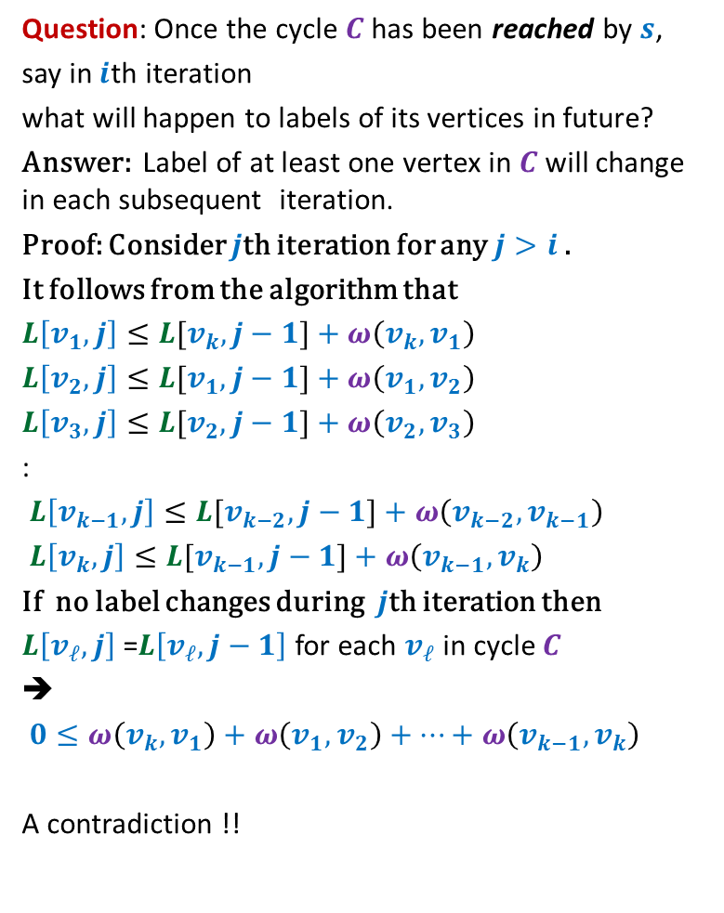

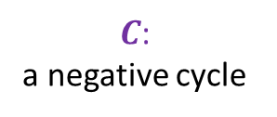

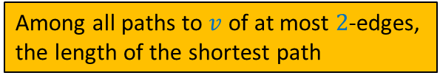

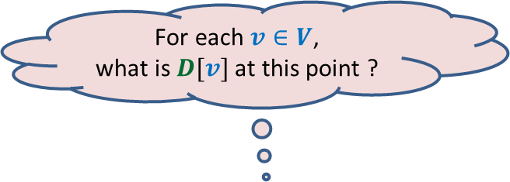
Question: Once the cycle $C$ has been reached by $s$,
say in $i$th iteration
what will happen to labels of its vertices in future?
Answer: Label of at least one vertex in $C$will change in each subsequent iteration.
Proof: Consider $j$th iteration for any $j>i$.
It follows from the algorithm that
$L\left[v_{1},j\right]≤L[v_{k},j−1]+ω\left(v_{k},v_{1}\right)$
$L\left[v_{2},j\right]≤L[v_{1},j−1]+ω\left(v_{1},v_{2}\right)$
$L\left[v_{3},j\right]≤L[v_{2},j−1]+ω\left(v_{2},v_{3}\right)$
:
$L\left[v_{k−1},j\right]≤L[v_{k−2},j−1]+ω\left(v_{k−2},v_{k−1}\right)$
$L\left[v_{k},j\right]≤L[v_{k−1},j−1]+ω\left(v_{k−1},v_{k}\right)$
If no label changes during $j$th iteration then
$L\left[v_{ℓ},j\right]$ =$L\left[v_{ℓ},j−1\right]$ for each $v_{ℓ}$ in cycle $C$
➔
$0≤ω\left(v_{k},v_{1}\right)+ω\left(v_{1},v_{2}\right)+…+ω\left(v_{k−1},v_{k}\right)$
A contradiction !!
$$v_{1}$$
$$v_{k}$$
$$v_{2}$$
$C$:
a negative cycle
$$v_{3}$$
$$s$$
$$v_{4}$$
$$v_{6}$$
$$v_{5}$$
Weight of $C$

Slide 4
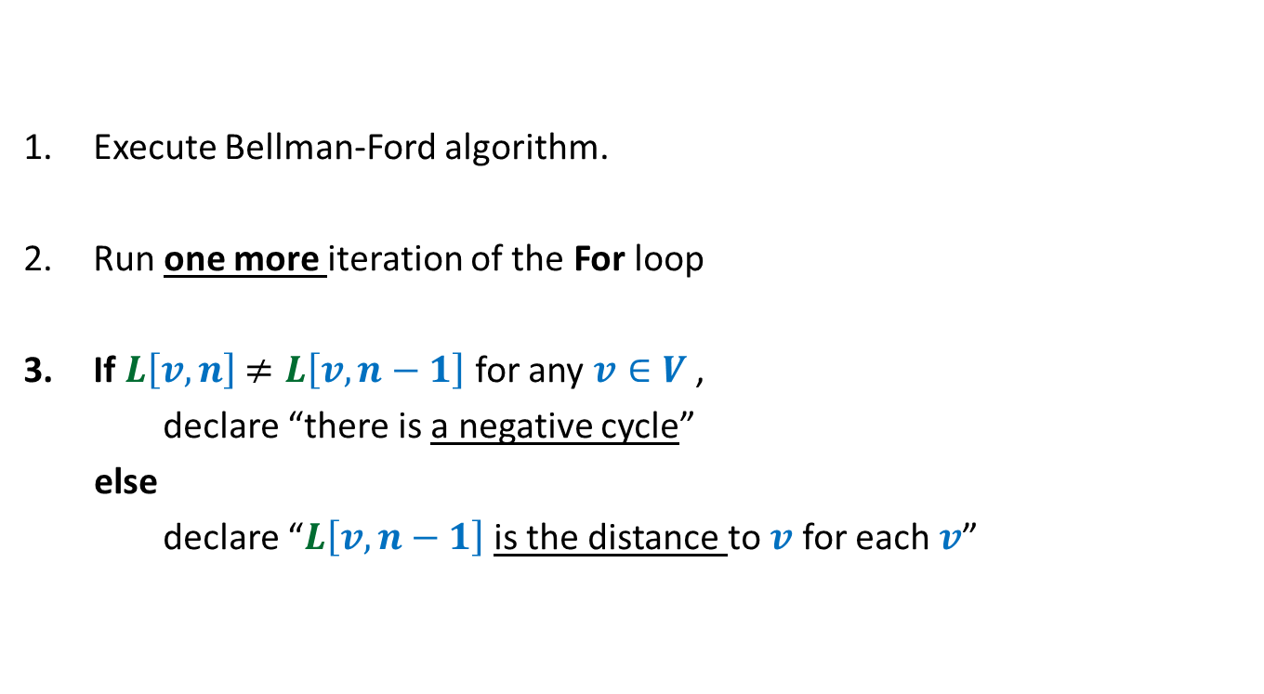
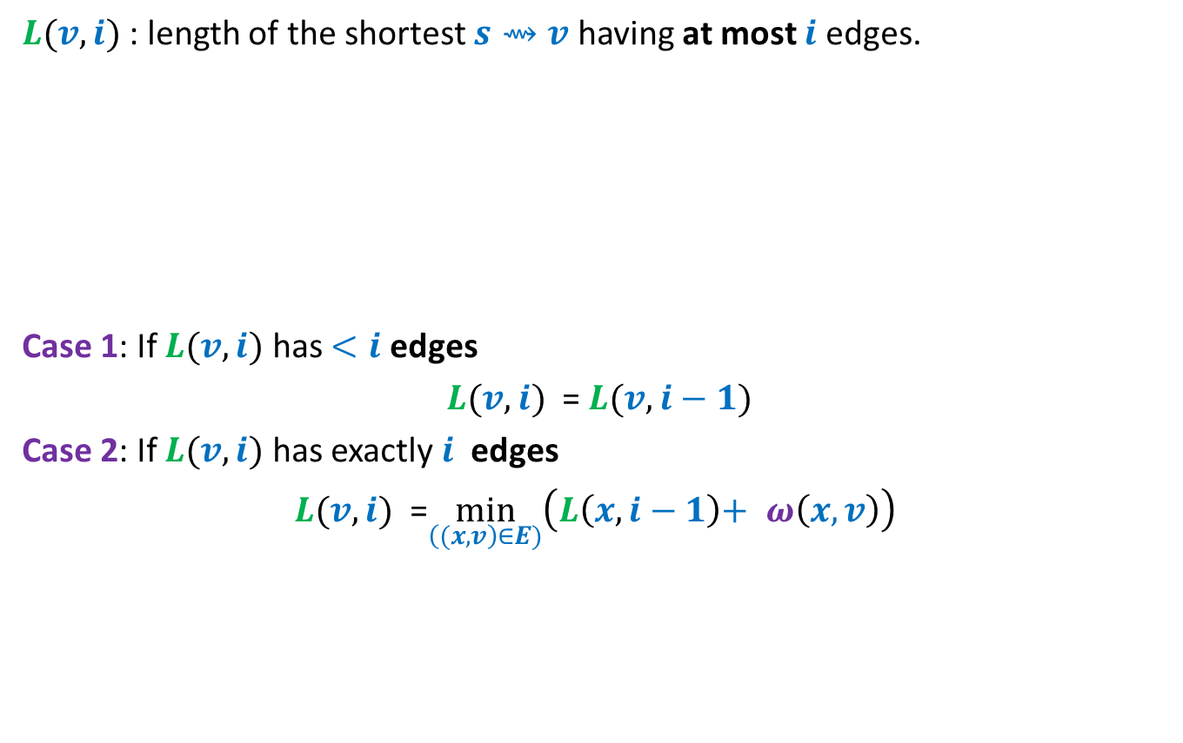
Detecting negative cycle in $G$
Execute Bellman-Ford algorithm.
Run one more iteration of the For loop
If $L\left[v,n\right]$ $≠L\left[v,n−1\right]$ for any $v∈V$ ,
declare “there is a negative cycle”
else
declare “$L\left[v,n−1\right]$is the distance to $v$ for each $v$”

Slide 5
shortest paths in a graph
Having Negative weight cycle

Slide 6
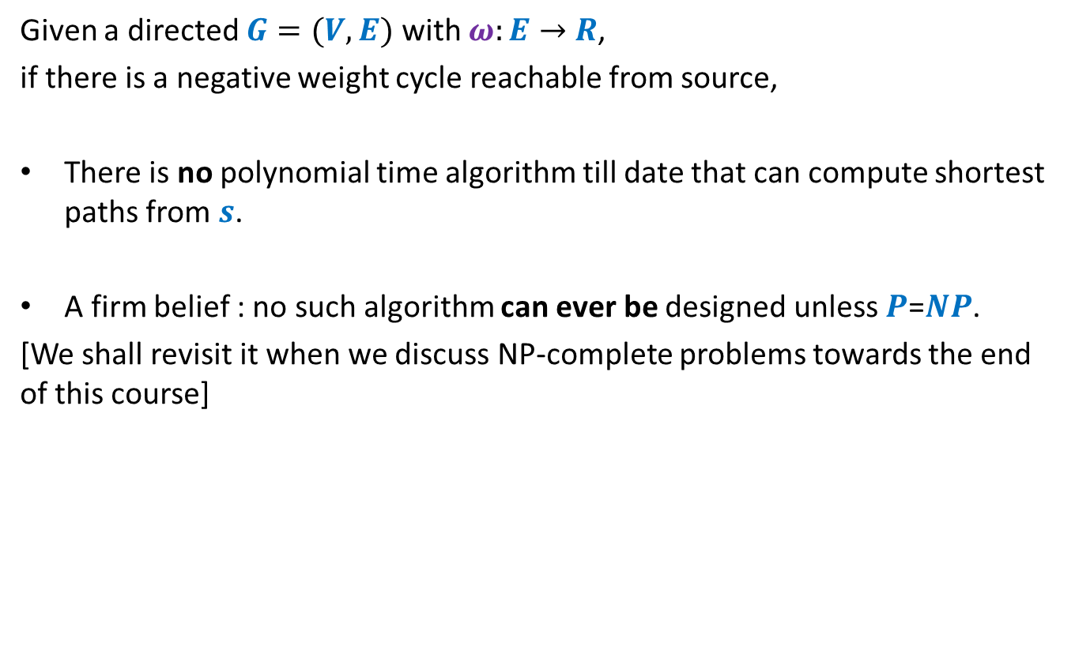
Shortest paths in presence of negative weight cycles
Given a directed $G=(V,E)$ with $ω:E→$ $R$,
if there is a negative weight cycle reachable from source,
There is no polynomial time algorithm till date that can compute shortest paths from $s$.
A firm belief : no such algorithm can ever be designed unless $P$=$NP$.
[We shall revisit it when we discuss NP-complete problems towards the end of this course]

Slide 7
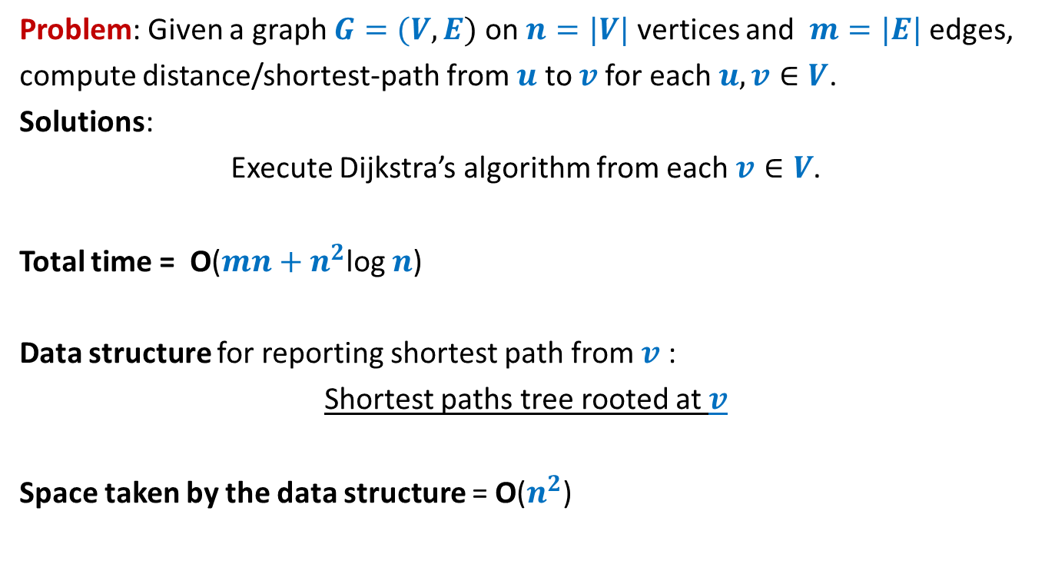
All-pairs shortest paths in a graph with positive edge weights
Problem: Given a graph $G=(V,E)$ on $n=|V|$ vertices and $m=|E|$ edges,
compute distance/shortest-path from $u$ to $v$for each $u,v∈V$.
Solutions:
Execute Dijkstra’s algorithm from each $v∈V$.
Total time = O($mn+n^{2}$log $n$)
Data structure for reporting shortest path from $v$ :
Shortest paths tree rooted at $v$
Space taken by the data structure = O($n^{2}$)

Slide 8

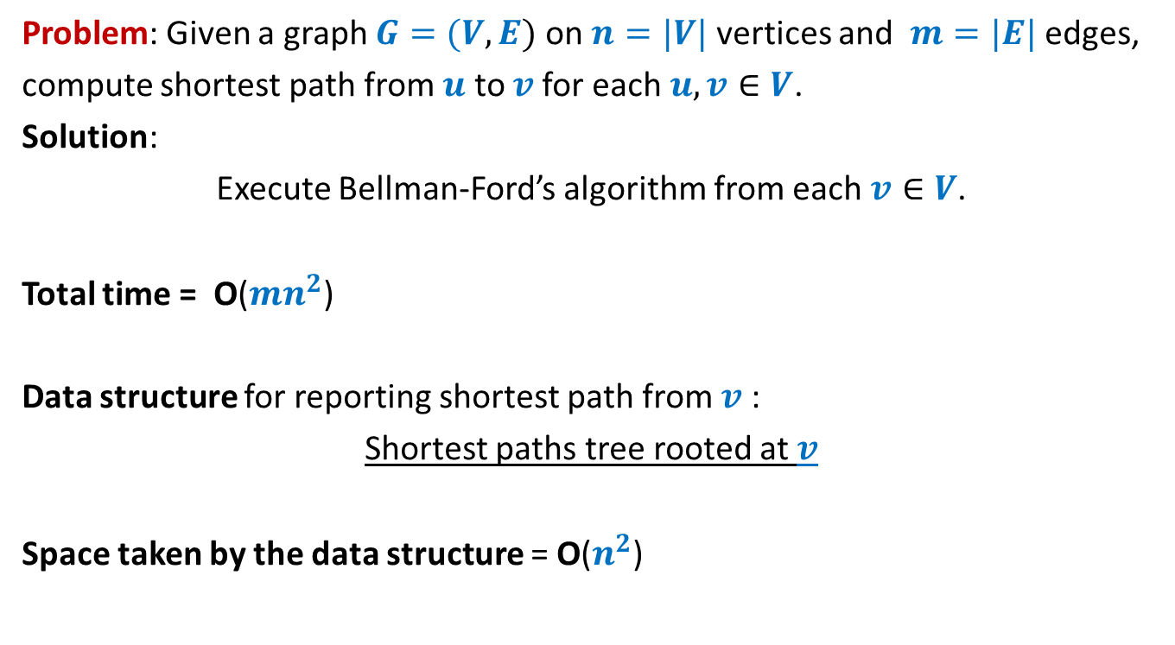
All-pairs shortest paths in a graph with negative edge weights but no negative cycle
Problem: Given a graph $G=(V,E)$ on $n=|V|$ vertices and $m=|E|$ edges,
compute shortest path from $u$ to $v$for each $u,v∈V$.
Solution:
Execute Bellman-Ford’s algorithm from each $v∈V$.
Total time = O($mn^{2}$)
Data structure for reporting shortest path from $v$ :
Shortest paths tree rooted at $v$
Space taken by the data structure = O($n^{2}$)
How to improve it to O($n^{3}$) ?

Slide 9

All-pairs shortest paths in O($n^{3}$) time
In graphs with negative edge weights
but no negative cycle

Slide 10






The Optimal substructure property
Consider any shortest path $P(u,v)$.
We used “no. of edges” for a recursive formulation of $δ(s,v)$. [Bellman Ford algo]
$L(v,i)$ : length of the shortest $s⇝v$ having at most $i$ edges.
$δ(s,v)$ =$L(v,n−1)$
Expressed $L(v,i+1)$ recursvely in terms of $L(x,i)$ for all ($x,v$) $∈E$
Base case: $L(v,1)$ = $ω(s,v)$ if ($s,v$) $∈E$, and $∞$ otherwise.
$i$edges
$$u$$
$$x$$
$v$
$i−1$edges

Slide 11

The Optimal substructure property
Consider any shortest path $P(u,v)$.
Question: Can we use “vertices” for recursive formulation of $δ(u,v)$ ?
$$u$$
$v$

Slide 12










The Optimal substructure property
Consider any shortest path $P(u,v)$.
For a recursive formulation of $δ(u,v)$,
We can use max-index of intermediate vertices on $P(u,v)$.
$$24$$
$$11$$
$$3$$
$$35$$
$$9$$
$$17$$
$$9$$
$$u$$
$v$
?
max-index
?
<$35$
<$35$

Slide 13

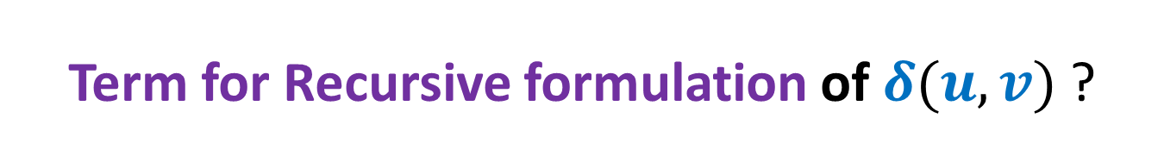


Term for Recursive formulation of $δ(u,v)$ ?
: the shortest path from $i$ to $j$with intermediate vertices of index $≤k$
$D_{k}(i,j)$: length of $P_{k}(i,j)$.
Question: How can we express $δ(i,j)$ in terms of $D_{k}(i,j)$?
Answer: $δ(i,j)$ = $D_{n}(i,j)$:
Base Case:
$D_{0}(i,j)$ = ?
Question: What is recursive formulation of $D_{k}(i,j)$ ?
$$P_{k}(i,j)$$
$$\left\{\begin{aligned}ω\left(i,j\right) if (i,j)∈E \\ ∞ otherwise\end{aligned}\right.$$

Slide 14



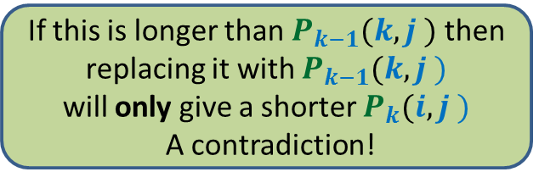







Recursive formulation of $D_{k}(i,j)$
Consider the path $P_{k}(i,j)$
There are two cases:
Case 1 : $P_{k}(i,j)$ does not pass through $k$
Case 2 : $P_{k}(i,j)$ indeed passes through $k$
➔ $D_{k}(i,j)$ = $D_{k−1}(i,j)$
➔ $?$
$$k$$
$$i$$
$j$
?
?
$P_{k−1}(i,k)$
$P_{k−1}(k,j)$
If this is longer than $P_{k−1}(i,k )$ then
replacing it with $P_{k−1}(i,k )$
will only give a shorter $P_{k}(i,j )$
A contradiction!
If this is longer than $P_{k−1}(k,j )$ then
replacing it with $P_{k−1}(k,j )$
will only give a shorter $P_{k}(i,j )$
A contradiction!

Slide 15
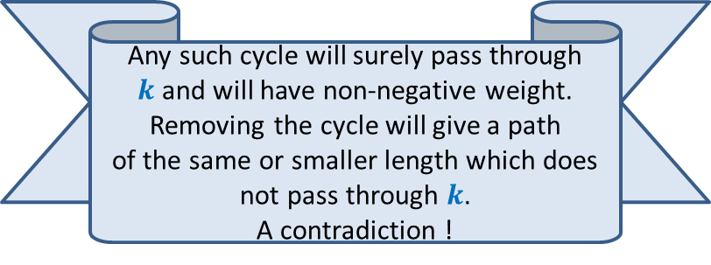
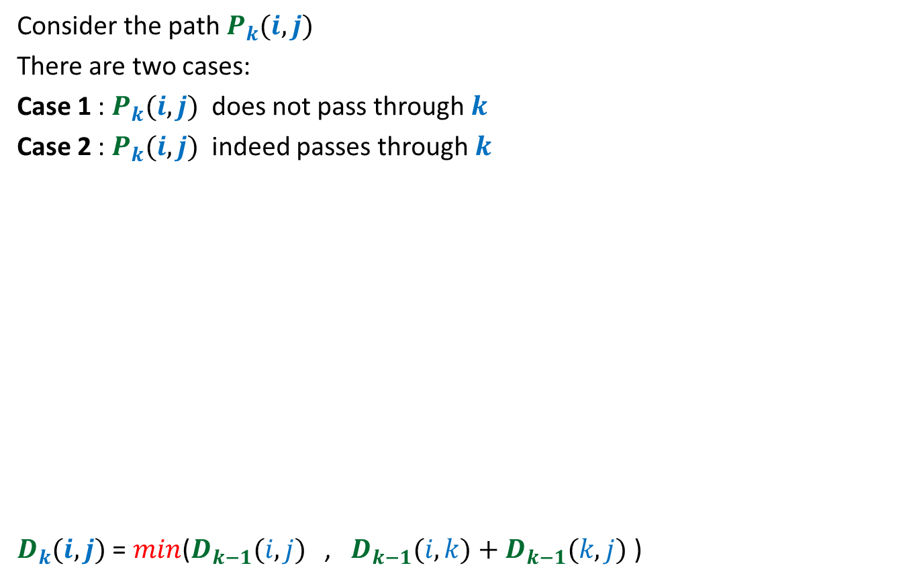
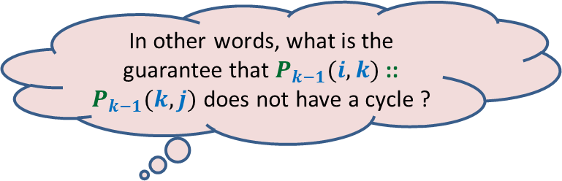

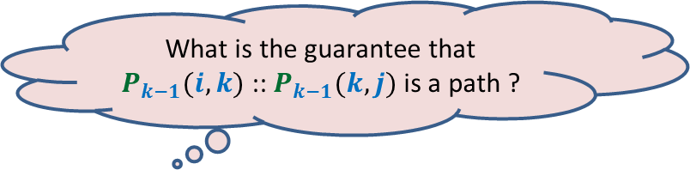
Recursive formulation of $D_{k}(i,j)$
Consider the path $P_{k}(i,j)$
There are two cases:
Case 1 : $P_{k}(i,j)$ does not pass through $k$
Case 2 : $P_{k}(i,j)$ indeed passes through $k$
$D_{k}(i,j)$ = $min$($D_{k−1}(i,j)$ , $D_{k−1}(i,k)+D_{k−1}(k,j)$ )
➔ $D_{k}(i,j)$ = $D_{k−1}(i,j)$
➔ $D_{k}(i,j)$ = $D_{k−1}(i,k)+D_{k−1}(k,j)$
$$k$$
$$i$$
$j$
?
?
$P_{k−1}(i,k)$
$P_{k−1}(k,j)$
Any such cycle will surely pass through $k$and will have non-negative weight.
Removing the cycle will give a path
of the same or smaller length which does
not pass through $k$.
A contradiction !
In other words, what is the guarantee that $P_{k−1}(i,k)$ :: $P_{k−1}(k,j)$ does not have a cycle ?
What is the guarantee that $P_{k−1}(i,k)$ :: $P_{k−1}(k,j)$ is a path ?

Slide 16

Floyd Warshal Algorithm for All Pairs Shortest Paths
in O($n^{3}$) time
and O($n^{3}$) space

Slide 17






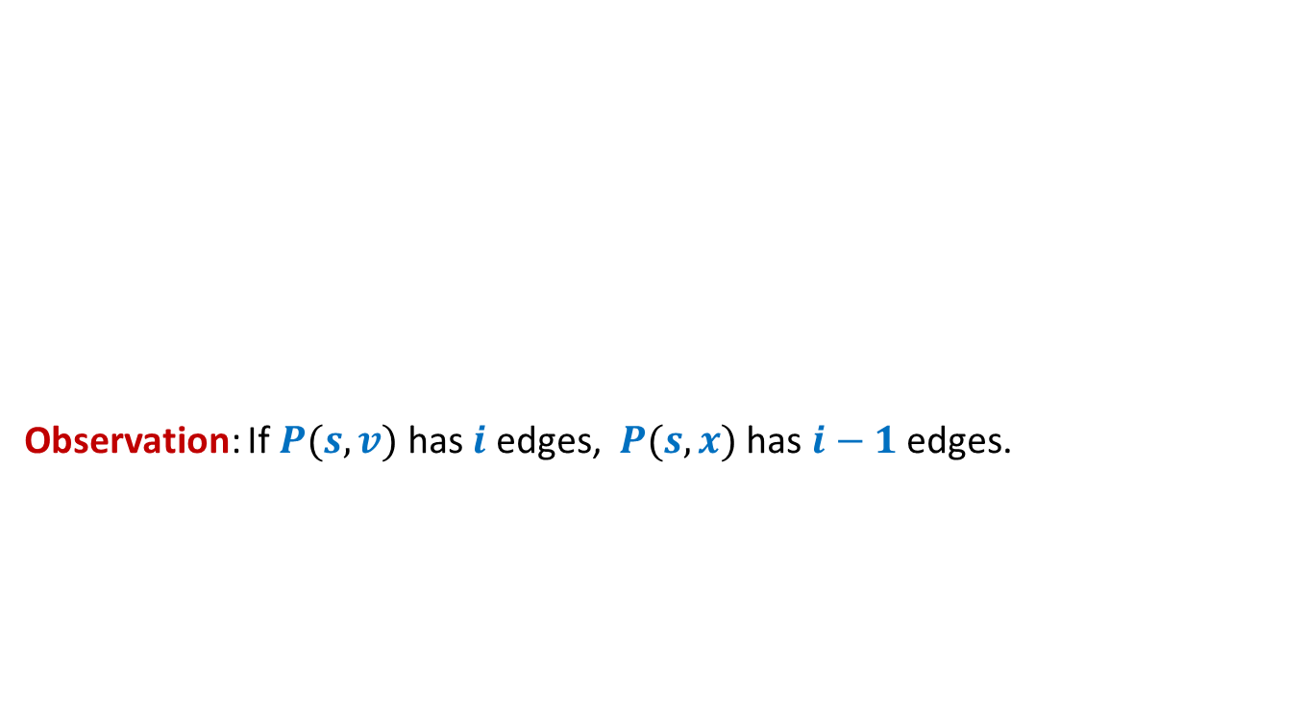

Floyd and Warshal’s algorithm
Floyd-Warshal-algo($G$)
{ For each $i$ do
For each $j$ do
If $(i,j)∈E$ then $D_{0}[i,j]$← ?
else $D_{0}[i,j]$← ?
For each $i$ do $D_{0}[i,i]$← ?
For $k$ = $1$ to $n$ do
For each $i$ do
For each $j$ do
$D_{k}[i,j]$←$D_{k−1}[i,j]$;
$D_{k}[i,j]\text{←}$ min( ? , ? )
}
Lemma: $D_{k}[i,j]$ = length of the shortest path from $i$ to $j$ with all intermediate vertices of indices $≤k$
$ω\left(i,j\right)$
$∞$;
Computing $D_{0}[∗,∗]$
$0$;
{
Computing$D_{k}[i,j]$
$$D_{k}[i,j]$$
$D_{k−1}[i,k]+$ $D_{k−1}[k,j]$
}

Slide 18

Floyd Warshal Algorithm for All Pairs Shortest Paths
in O($n^{3}$) time
and O($n^{2}$) space

Slide 19








$$D^{k−1}$$
$D_{k}(i,j)$ = $min$($D_{k−1}(i,j)$ , $D_{k−1}(i,k)+D_{k−1}(k,j)$ )
$$k$$
$$D^{k−1}$$
$$i$$
$$D^{k}$$
$$k$$
$$j$$

Slide 20

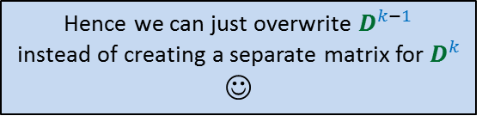
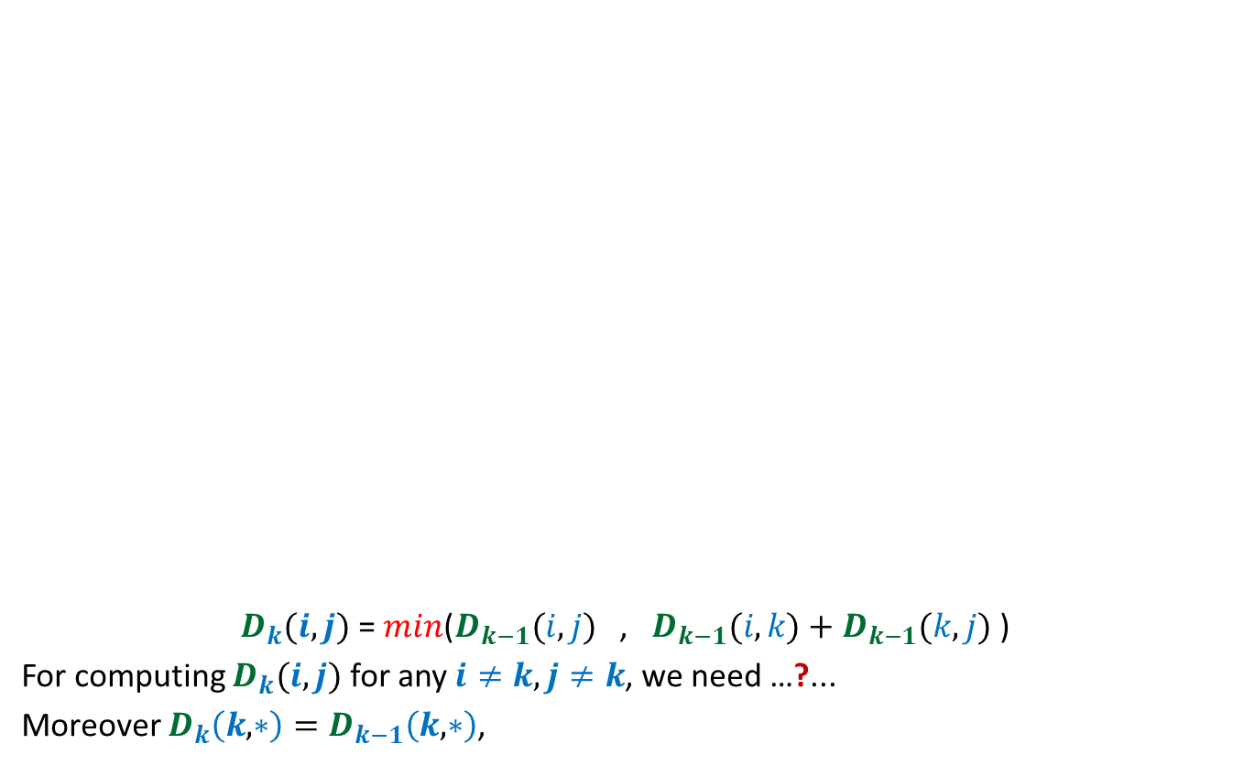



Hence we can just overwrite $D^{k−1}$
instead of creating a separate matrix for $D^{k}$
☺
$$D^{k−1}$$
$D_{k}(i,j)$ = $min$($D_{k−1}(i,j)$ , $D_{k−1}(i,k)+D_{k−1}(k,j)$ )
For computing $D_{k}(i,j)$ for any $i≠k,j≠k$, we need …?...
Moreover $D_{k}\left(k,∗\right)=D_{k−1}\left(k,∗\right)$,
$$k$$
$$D^{k−1}$$
$$D^{k}$$
$$k$$
$$i$$
$$j$$
only $k$th column and $k$th row of $D_{k−1}$.
and $D_{k}\left(∗,k\right)=D_{k−1}\left(∗,k\right)$

Slide 21

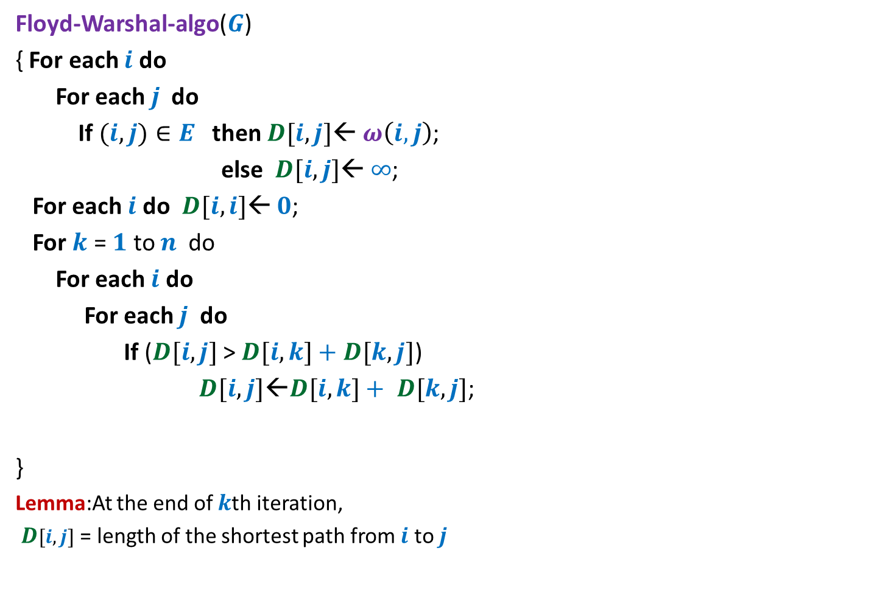
Floyd and Warshal’s algorithm
Floyd-Warshal-algo($G$)
{ For each $i$ do
For each $j$ do
If $(i,j)∈E$ then $D[i,j]$← $ω\left(i,j\right)$;
else $D[i,j]$← $∞$;
For each $i$ do $D[i,i]$← $0$;
For $k$ = $1$ to $n$ do
For each $i$ do
For each $j$ do
If ($D[i,j]$ > $D[i,k]+$ $D[k,j]$)
$D[i,j]\text{←}D[i,k]+ D[k,j]$;
}
Lemma:At the end of $k$th iteration,
$D[i,j]$ = length of the shortest path from $i$ to $j$
{
}
with all intermediate vertices of indices $≤k$

Slide 22
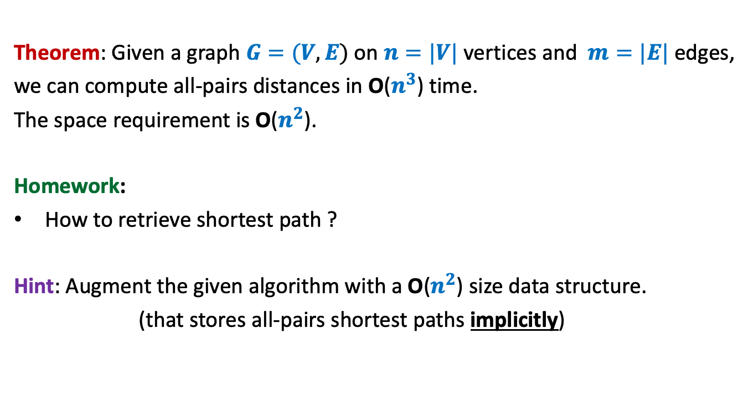
All-pairs shortest paths in a digraph with negative edge weights but no negative cycle
Theorem: Given a graph $G=(V,E)$ on $n=|V|$ vertices and $m=|E|$ edges,
we can compute all-pairs distances in O($n^{3}$) time.
The space requirement is O($n^{2}$).
Homework:
How to retrieve shortest path ?
Hint: Augment the given algorithm with a O($n^{2}$) size data structure.
(that stores all-pairs shortest paths implicitly)

Slide 23


Problem from the past lecture
All-pairs closest pairs of $n$points
farthest
in O($n$ log $n$) time

Slide 24

Observation:
Farthest pair of points must lie on the boundary of the convex hull of all points.
Compute convex hull in O($n$ log $n$) time
Compute farthest pair of points of the convex hull in O($n$ log $n$) time
Can you locate the farthest pair of points ?
Can you see some structure on which these points must be lying ?
Convex hull ☺

Slide 25


Idea $2$: Roll the convex polygon on the floor ☺

Slide 26
Idea $2$: Roll the convex polygon on the floor ☺

Slide 27
Idea $2$: Roll the convex polygon on the floor ☺

Slide 28
Idea $2$: Roll the convex polygon on the floor ☺

Slide 29
Idea $2$: Roll the convex polygon on the floor ☺
Did you notice the journey of farthest pair of points ?

Slide 30

Idea $2$: Roll the convex polygon on the floor ☺
The maximum height attained by the polygon
is indeed the distance between its farthest points.

Slide 31

Idea $2$:
At the moment the maximum height is achieved,
one of the two points is the pivot point.
Make use of this hint to design an efficient algorithm for the problem …

