Slide 1
Design and Analysis of Algorithms
Algorithms-II : CS345A
Lecture 19
Depth First Search in Directed Graph - II

Slide 2
Recap of the last lecture

Slide 3
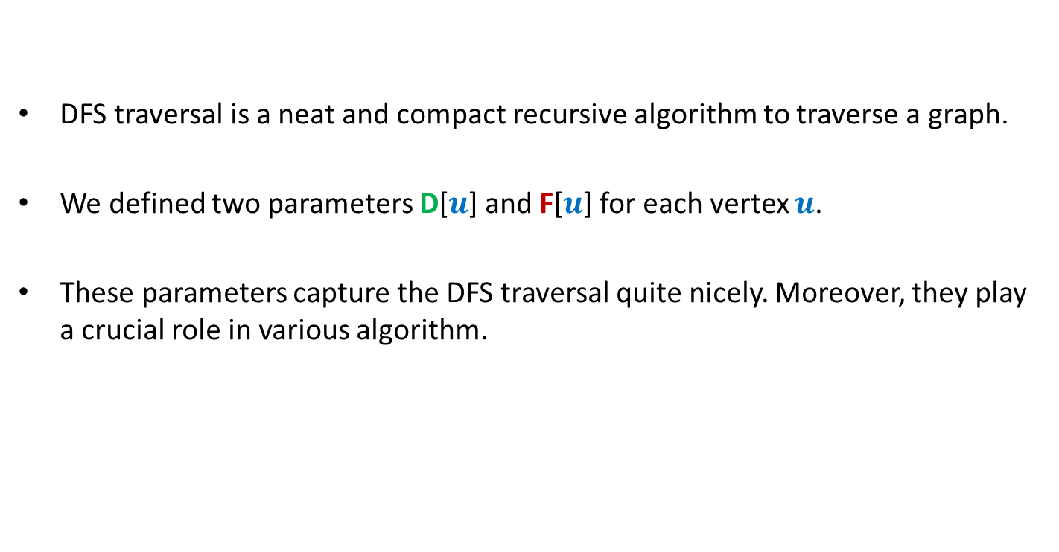
DFS traversal is a neat and compact recursive algorithm to traverse a graph.
We defined two parameters D[$u$] and F[$u$] for each vertex $u$.
These parameters capture the DFS traversal quite nicely. Moreover, they play a crucial role in various algorithm.

Slide 4





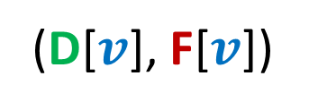
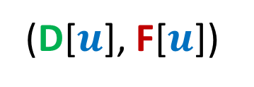








Relation between
(D[$u$], F[$u$])
and
(D[$v$], F[$v$])
Disjoint
One enclosing another
What about
D[$u$]
F[$u$]
D[$v$]
F[$v$]
D[$u$]
F[$u$]
D[$v$]
F[$v$]
D[$u$]
F[$u$]
D[$u$] < D[$v$] <F[$u$] < F[$v$] ?
D[$v$]
F[$v$]

Slide 5

There seems to be many different types of non-tree edges.
x
y
u
s
q
Can we classify the non-tree edges ?
w
j
r
p
v
t
b
d
h
c

Slide 6
Classification of non-tree edges
using
(D[$u$], F[$u$])
and
(D[$v$], F[$v$])

Slide 7







($u$,$v$) is Forward edge
$$u$$
$$s$$
$$w$$
$$v$$
D[$u$]
F[$u$]
D[$v$]
F[$v$]

Slide 8

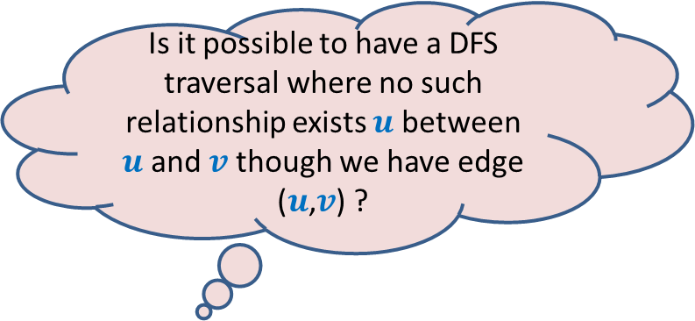









($u$,$v$) is Backward edge
Till now, we considered the situations in which either $u$ is ancestor of $v$ or vice versa.
$$v$$
$$s$$
Is it possible to have a DFS traversal where no such relationship exists $u$ between $u$and $v$ though we have edge ($u$,$v$) ?
$$w$$
$$u$$
Yes, indeed.
Think over it before moving to the next slide
D[$v$]
F[$v$]
D[$u$]
F[$u$]

Slide 9











($u$,$v$) is Cross edge
$$y$$
$$u$$
$$v$$
Is there any other type of non-tree edge ?
Think over it …
$$s$$
$$w$$
In the following slide, we shall show that these are the only possibilities of a non-tree edge.
$$x$$
D[$v$]
F[$v$]
D[$u$]
F[$u$]

Slide 10
($u$,$v$) is Cross edge
$$y$$
$$u$$
$$v$$
$$s$$
$$w$$
$$x$$
D[$v$]
F[$v$]
D[$u$]
F[$u$]

Slide 11







Classification of non-tree edges
Consider an edge ($u$,$v$)
Case 1: ancestor to descendant
Case 2: descendant to ancestor
Case 3:
Tree edge or Forward edge
D[$u$]
F[$u$]
D[$v$]
F[$v$]
D[$v$]
F[$v$]
Backward edge
D[$u$]
F[$u$]
Cross edge
D[$v$]
F[$v$]
D[$u$]
F[$u$]
D[$u$]
F[$u$]
D[$v$]
F[$v$]

Slide 12
Classification of non-tree edges
x
Forward edges
(u,w)
(b,c)
y
u
s
q
w
j
r
p
v
t
b
d
h
c

Slide 13
Classification of non-tree edges
x
Forward edges
(u,w)
(b,c)
Backward edges
(t,u)
(j,u)
(r,q)
(c,b)
y
u
s
q
w
j
r
p
v
t
b
d
h
c

Slide 14
Classification of non-tree edges
x
Forward edges
(u,w)
(b,c)
Backward edges
(t,u)
(j,u)
(r,q)
(c,b)
Cross edges
(x,u)
(j,t)
(y,u)
(y,q)
y
u
s
q
w
j
r
p
v
t
b
d
h
c

Slide 15
Application - I
Checking if a directed graph is a unique-path graph

Slide 16
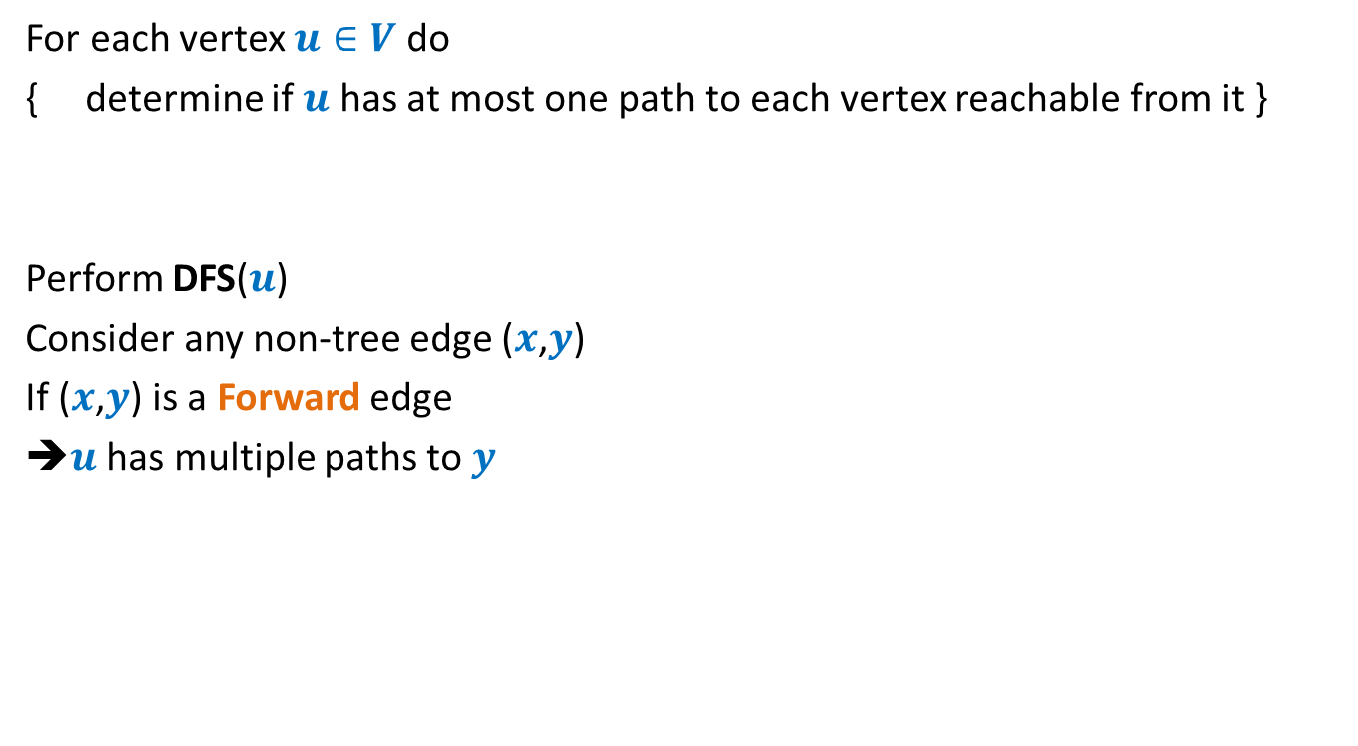

An O($mn$) time algorithm
For each vertex $u∈V$ do
{ determine if $u$ has at most one path to each vertex reachable from it }
Perform DFS($u$)
Consider any non-tree edge ($x$,$y$)
If ($x$,$y$) is a Forward edge
➔$u$ has multiple paths to $y$
a
b
u
s
q
w
j
r
p
v
t

Slide 17
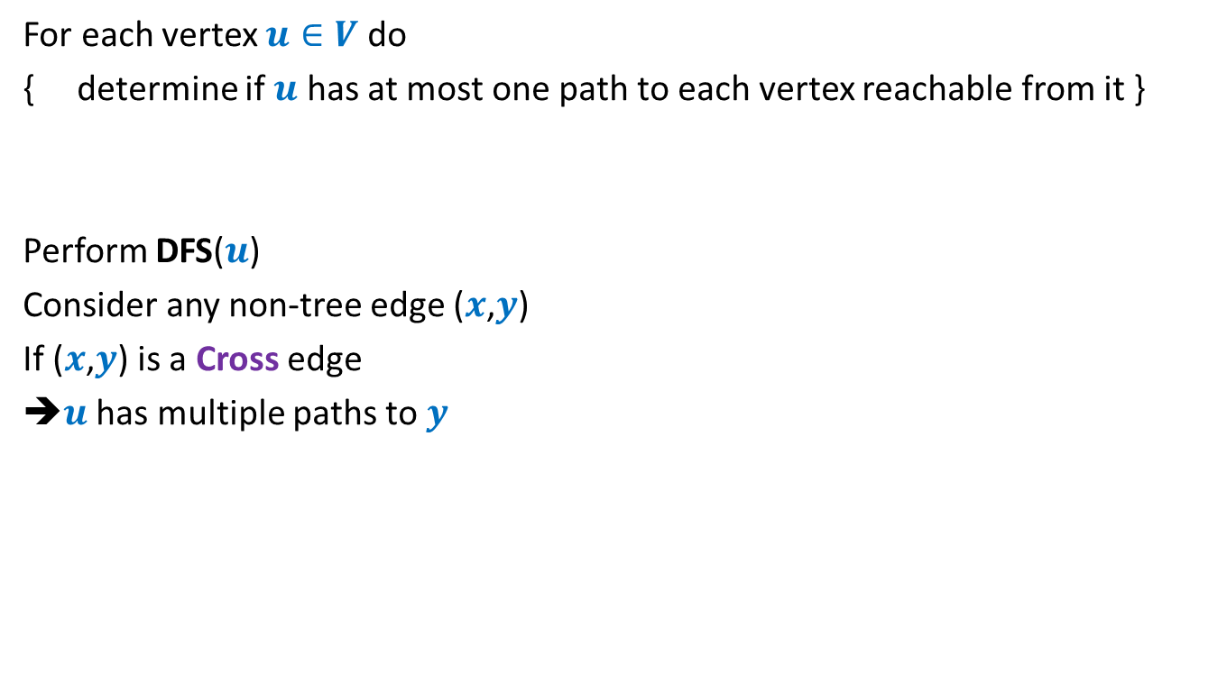
An O($mn$) time algorithm
For each vertex $u∈V$ do
{ determine if $u$ has at most one path to each vertex reachable from it }
Perform DFS($u$)
Consider any non-tree edge ($x$,$y$)
If ($x$,$y$) is a Cross edge
➔$u$ has multiple paths to $y$
u
s
q
w
j
r
p
v
t

Slide 18

An O($mn$) time algorithm
For each vertex $u∈V$ do
{ determine if $u$ has at most one path to each vertex reachable from it }
Perform DFS($u$)
Consider any non-tree edge ($x$,$y$)
If ($x$,$y$) is a Backward edge
u
s
q
w
j
r
p
v
t

Slide 19
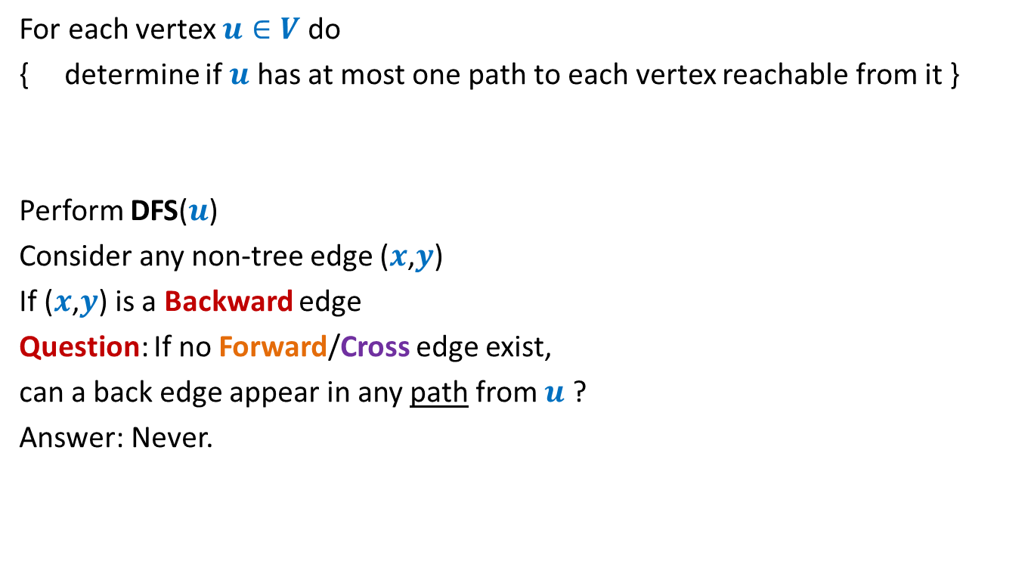
An O($mn$) time algorithm
For each vertex $u∈V$ do
{ determine if $u$ has at most one path to each vertex reachable from it }
Perform DFS($u$)
Consider any non-tree edge ($x$,$y$)
If ($x$,$y$) is a Backward edge
Question: If no Forward/Cross edge exist,
can a back edge appear in any path from $u$ ?
Answer: Never.
u
s
q
w
j
r
p
v
t

Slide 20
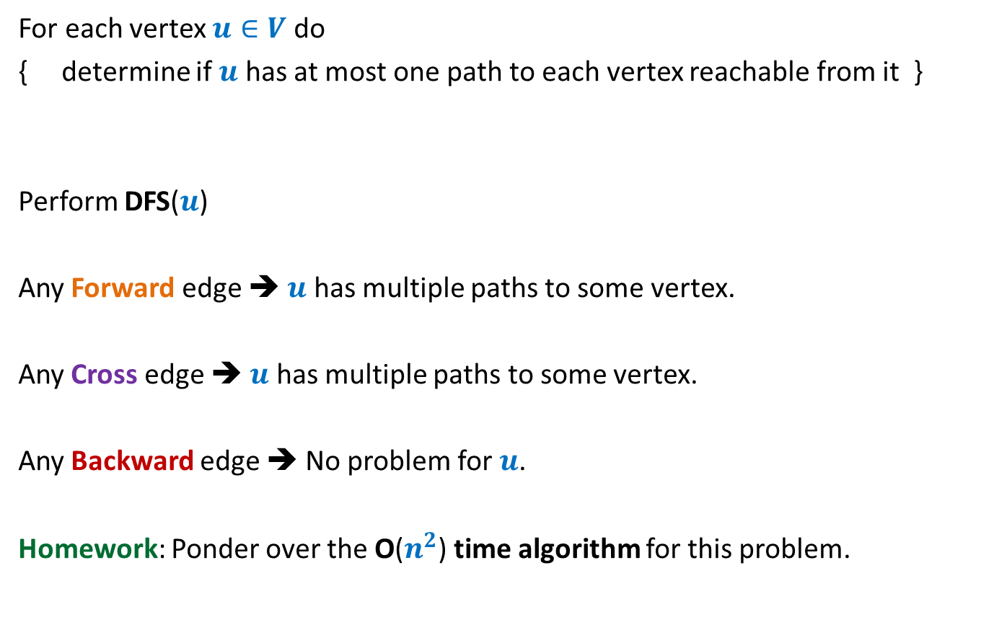
An O($mn$) time algorithm
For each vertex $u∈V$ do
{ determine if $u$ has at most one path to each vertex reachable from it }
Perform DFS($u$)
Any Forward edge ➔ $u$ has multiple paths to some vertex.
Any Cross edge ➔ $u$ has multiple paths to some vertex.
Any Backward edge ➔ No problem for $u$.
Homework: Ponder over the O($n^{2}$) time algorithm for this problem.

Slide 21
Application - II
Computing Strongly connected components of a directed graph.

Slide 22


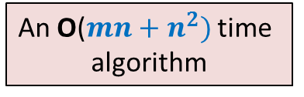
Strongly connected components
Definition: Two vertices $u$ and $v$ are said to be strongly connected if
$u$ is reachable from $v$
$v$ is reachable from $u$
A strongly connected component:
a maximal subset of “strongly connected vertices”
x
An O($m+n)$ time algorithm
An O($mn+n^{2})$ time
algorithm
y
u
v
q
b
d
w
j
r
p
h
c
t
k

Slide 23

Computing SCCs efficiently
An O$(m+n)$ time algorithm

Slide 24




A simple yet powerful idea
$G$ : the given directed graph
$G^{r}$: the graph $G$ after reversing edge directions;
Let us see where and how you will apply this idea for solving this problem ☺
SCCs of $G$
SCCs of $G^{r}$
How are SCCs of $G$
related to SCCs of $G^{r}$?

Slide 25
x
x
y
y
u
u
Lemma 1: An SCC will appear in exactly one tree in the forest of DFS trees .
v
q
v
q
w
j
w
j
r
p
r
p
k
t
k
t
b
b
d
d
h
h
c

Slide 26
x
x
x
y
y
u
u
Lemma 2: An SCC appears contiguously within its DFS tree.
v
q
y
v
q
w
j
w
j
r
p
r
p
z
k
t
k
t
b
b
d
d
h
h
c

Slide 27
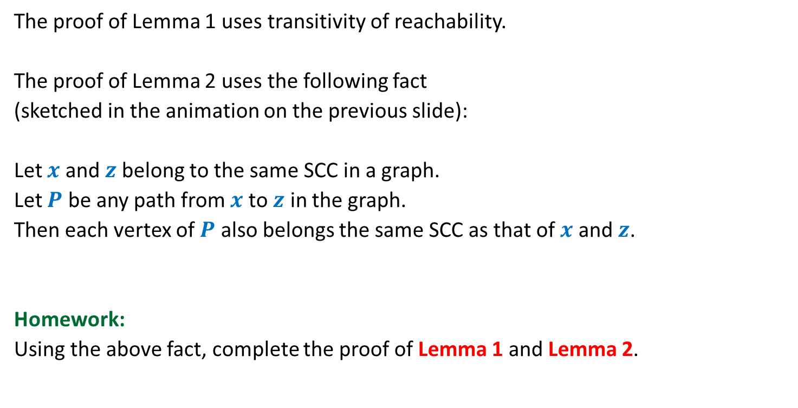
Proof of Lemma 1 and Lemma 2
The proof of Lemma 1 uses transitivity of reachability.
The proof of Lemma 2 uses the following fact
(sketched in the animation on the previous slide):
Let $x$ and $z$belong to the same SCC in a graph.
Let $P$ be any path from $x$ to $z$ in the graph.
Then each vertex of $P$ also belongs the same SCC as that of $x$ and $z$.
Homework:
Using the above fact, complete the proof of Lemma 1 and Lemma 2.

Slide 28
x
y
Try to spot the roots of SCC in the DFS forest.
u
Notation (root of an SCC):
the vertex of the SCC
which is visited first during the DFS
v
q
w
j
r
p
k
t
Having seen nice structure of SCCs in the DFS forest, we feel motivated to design an efficient algorithm based on DFS.
But how should we start with ?
b
d
h
c

Slide 29
Study Finish time
u
u
There does not appear to be any order ☹.
v
v
q
q
w
j
w
j
r
p
r
p
t
k
t
k
t w k j v r p q u
Increasing order of F[]

Slide 30
Searching for an order using Finish time
It looks too complex !
SCC A
SCC D
Increasing order of F[]
SCC B
Have some perseverance, buddy !
SCC C
Where might be
the roots of each SCC ?

Slide 31
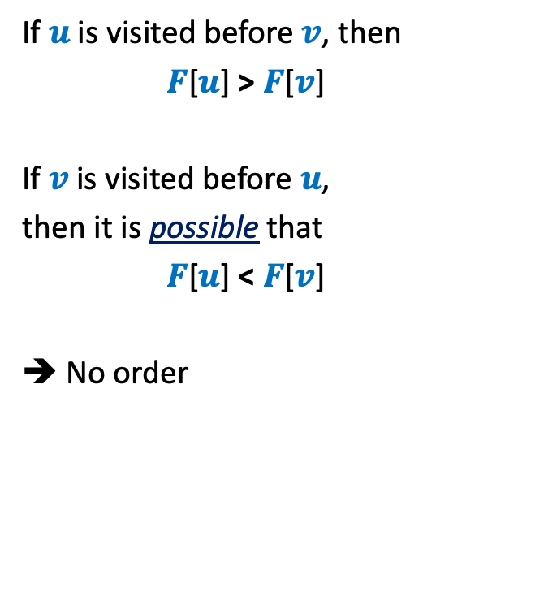



DFS on Directed Graph: analyzing the finish time
Case 1: $u$ and $v$ belong to same SCC.
If $u$is visited before $v$, then
$F$[$u$] > $F$[$v$]
If $v$is visited before $u$,
then it is possible that
$F$[$u$] < $F$[$v$]
➔ No order
$$u$$
$$v$$
Is there any relation between $F$[$u$] and $F$[$v$] ?

Slide 32
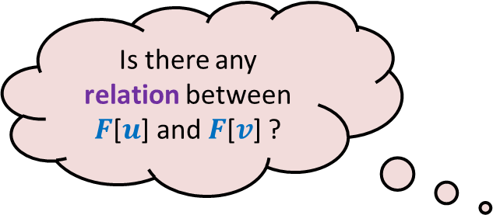
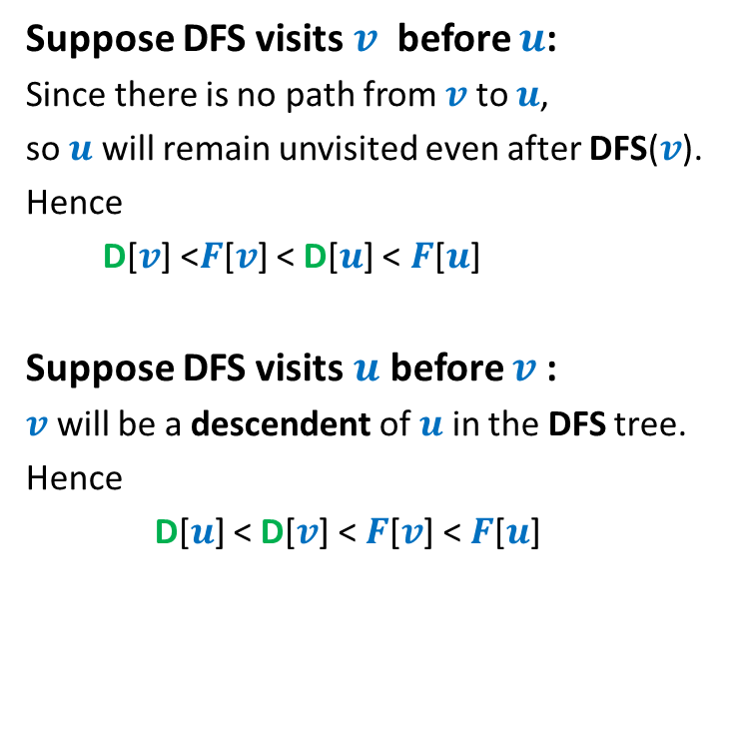


DFS on Directed Graph: analyzing the finish time
Case 2: $u$ and $v$ belong to different SCC.
Suppose DFS visits $v$ before $u$:
Since there is no path from $v$ to $u$,
so $u$ will remain unvisited even after DFS($v$).
Hence
D[$v$] <$F$[$v$] < D[$u$] < $F$[$u$]
Suppose DFS visits $u$ before $v$:
$v$ will be a descendent of $u$ in the DFS tree.
Hence
D[$u$] < D[$v$] < $F$[$v$] < $F$[$u$]
$$u$$
$$v$$
Is there any relation between $F$[$u$] and $F$[$v$] ?
F[$u$] > F[$v$] always !!

Slide 33
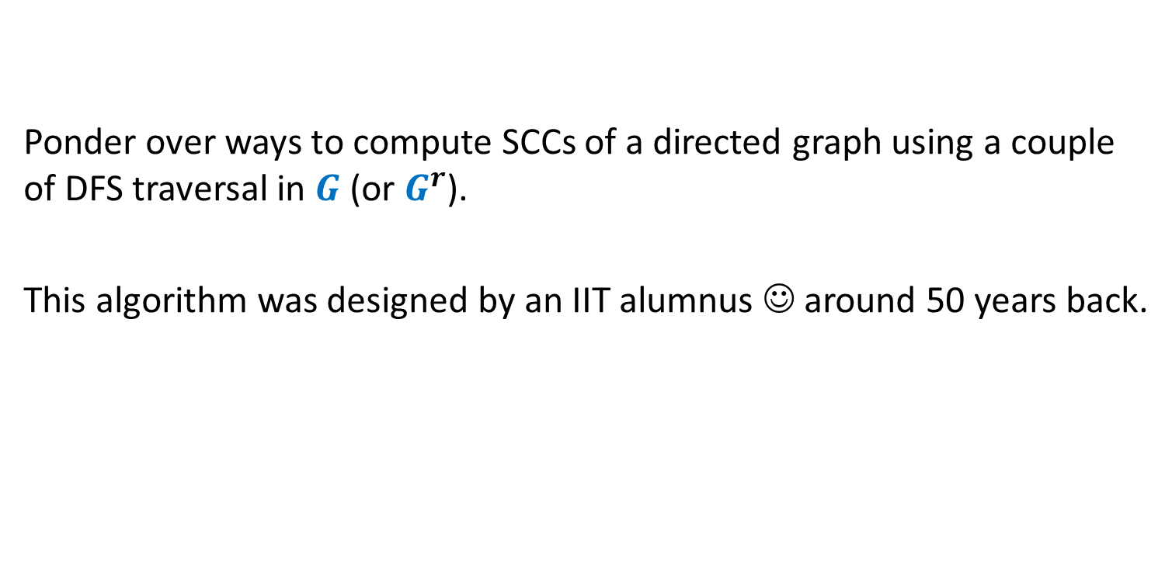
Homework
Ponder over ways to compute SCCs of a directed graph using a couple of DFS traversal in $G$ (or $G^{r}$).
This algorithm was designed by an IIT alumnus ☺ around 50 years back.

