Slide 1
Design and Analysis of Algorithms
Algorithms-II : CS345A
Lecture 3
Algorithm for Joint Seat Allocation contd.
Divide and Conquer Paradigm - I

Slide 2
Homework from last class
The seat allocation algorithm for the single merit list.?
Can you now tackle the problem of multiple merit lists ?

Slide 3





Multiple Merit Lists
19 IITs
31 NITs
18 IIITs
33989 seats
1304127 candidates
18 OtherGFTIs

Slide 4
Fairness
Choice list of Mohan
p
q
p
Mohan
q
Ram
Merit list
of programme q
Ram
Mohan

Slide 5
How to tackle Multiple Merit Lists using “Single Merit list algorithm”

Slide 6









A common man’s algorithm
Allocation
IITs
Allocation
NITs
No
Should we remove from NITs for future ?
$r$ →
Repeat
$q$ →
I prefer $p$to $q$.
$p$ or $q$ ?
$p$ →
$$p$$
$$r$$
$$q$$
Choice list for IITs
Choice list for NITs

Slide 7

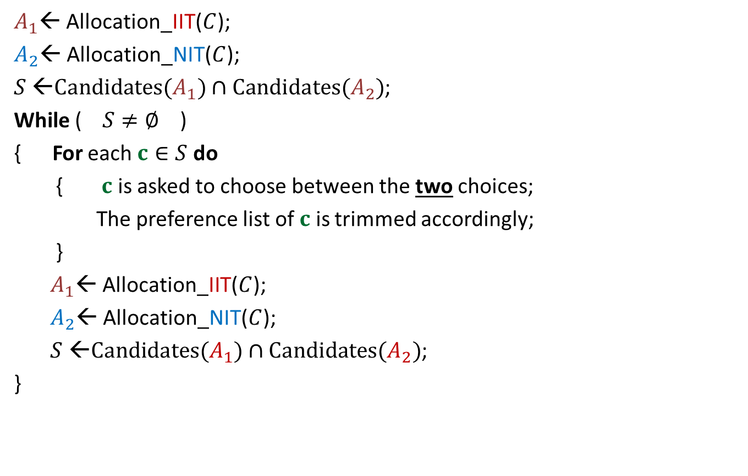


A common man’s algorithm
$A_{1}$← Allocation_IIT($C$);
$A_{2}$← Allocation_NIT($C$);
$S$ ←$Candidates(A_{1})∩Candidates(A_{2})$;
While ( $S≠∅$ )
{ For each $c∈S$ do
{ $c$ is asked to choose between the two choices;
The preference list of $c$ is trimmed accordingly;
}
$A_{1}$← Allocation_IIT($C$);
$A_{2}$← Allocation_NIT($C$);
$S$ ←$Candidates(A_{1})∩Candidates(A_{2})$;
}
Round ← $1$
and
Round $≤5$
)
Round ← Round + $1$

Slide 8
Homework
Transform the common man’s algorithm to just 1 round ?

Slide 9
problem 1
Closest Pair Distance

Slide 10





Distance between 2 points
$$(x_{j},y_{j})$$
O($1$) time
$$(x_{i},y_{i})$$
$$y$$
$$x$$

Slide 11

The Closest Pair Distance Problem
$$δ$$
$$y$$
$$x$$

Slide 12
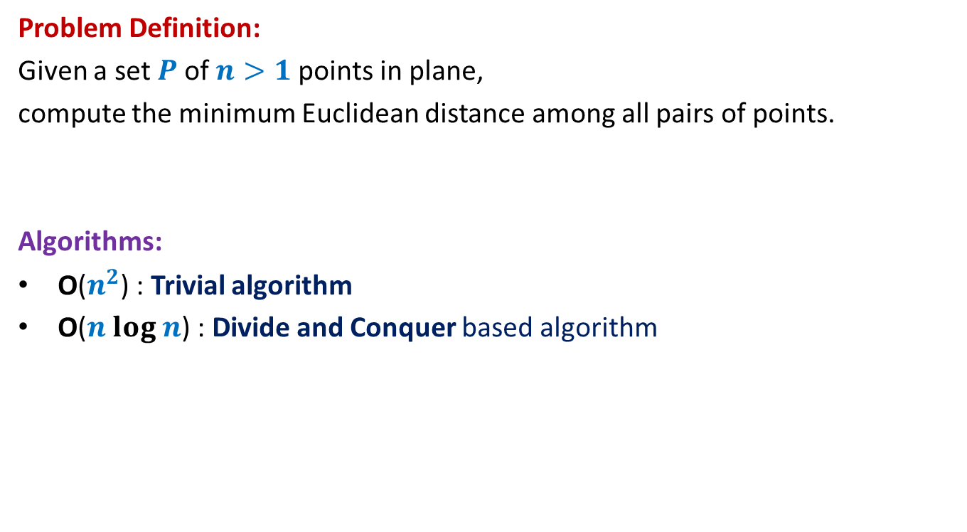
The Closest Pair Distance Problem
Problem Definition:
Given a set $P$of $n>1$points in plane,
compute the minimum Euclidean distance among all pairs of points.
Algorithms:
O($n^{2}$) : Trivial algorithm
O($n log n$) : Divide and Conquer based algorithm

Slide 13

Question 1
Tool 1
A fact from high school geometry
Fact :
Let $p=(x_{1},y_{1})$ and $q=(x_{2},y_{2})$ be any two points.
If $\left|x_{1}−x_{2}\right|>δ$, distance($p,q$) $>δ$
If $\left|y_{1}−y_{2}\right|>δ$, distance($p,q$) $>δ$

Slide 14
Question 2
Tool 2
A fundamental question about data structure ?
Question:
While solving an algorithmic problem, when do we feel the need of an
efficient data structure ?
Answer:
when the algorithm involves “many” operations of same type on a given data.
Notes:
For example, it is worth sorting an array only if there are going to be many search queries on it.
Let us see if you can use this principle to solve this problem.

Slide 15
a Divide and Conquer algorithm for
Closest Pair Distance

Slide 16


The divide step
$$y$$
$$x$$

Slide 17


Solving the problem in 1-dimension
$$y$$
$$x$$
Left half set
$⌈\frac{n}{2}⌉$points
$⌊\frac{n}{2}⌋$points
Right half set

Slide 18


Solving the problem in 1-dimension
$$δ_{L}$$
$$δ_{R}$$
$$x$$
Left half set
$⌈\frac{n}{2}⌉$points
$⌊\frac{n}{2}⌋$points
Right half set

Slide 19
How to extend to 2-dimensions
$$x$$

Slide 20
The divide step
$$y$$
$$x$$

Slide 21



Solving the 2 smaller instances
$$δ_{L}$$
$$δ_{R}$$
Left half set
$⌈\frac{n}{2}⌉$points
$δ$ ← min($δ_{L}{,δ}_{R}$)
$⌊\frac{n}{2}⌋$points
Right half set
Notes:
1. Compute the closest pair distance of the left half set
2. Let it be Delta_L.
3.Compute the closest pair distance of the right half set
4. Let it be Delta_R.

Slide 22



The combine step
Tool 1
$$>δ$$
$$δ_{L}$$
$$δ_{R}$$
$$δ$$
$$δ$$
$δ$ ← min($δ_{L}{,δ}_{R}$)
Notes:
Which points do we need to focus on for the closest pairs ?
The total number of these pairs are Theta(n^2).
How to do it efficiently ?
Exploit the geometric aspect of the problem.
Time to use Hint 1.
For a point in the left half set, if its distance to any point in the right set is less than delta, can we infer anything about its x-coordinate.
: Its x-coordinate can not be less than the x-coordinate of the other point by more than delta.

Slide 23


The combine step
Potentially $Θ(n)$ points in each strip
$$δ_{L}$$
$$δ_{R}$$
$$δ$$
$$δ$$
$δ$ ← min($δ_{L}{,δ}_{R}$)
Notes:
But there may still be $Θ(n)$ points in each of these strips.
So what to do ?

Slide 24

The combine step
$$δ_{L}$$
$$p$$
$$δ_{R}$$
$$δ$$
$$δ$$
$δ$ ← min($δ_{L}{,δ}_{R}$)
Notes:
1. Only the points lying in these 2 red squares are relevant as far as $p$ is concerned.
2. Time to use Hint 2
3. Surely not more than 8.
-----------------------------
1. How to find the points in these red square for point $p$?

Slide 25

The combine step
Tool 1
$$δ_{L}$$
$$δ$$
$$p$$
$$δ$$
$$δ_{R}$$
$$δ$$
$$δ$$
$δ$ ← min($δ_{L}{,δ}_{R}$)
Notes:
1. Only the points lying in these 2 red squares are relevant as far as $p$ is concerned.
2. Time to use Hint 2
3. Surely not more than 8.
-----------------------------
1. How to find the points in these red square for point $p$?

Slide 26




A discrete math exercise
Tool 3
Exercise:
What is the maximum number of points that can be placed in a unit square
such that each pair of them is separated by distance at least 1 ?
Answer: 4.
$$δ−$$
$$δ$$
$$\frac{1}{\sqrt{2}}$$
1
$$δ$$
Notes:
If there are more than 4 points in the unit square,
at least one of the four small squares will have more than 1 points.

Slide 27


The combine step
$$δ_{L}$$
It will take $O(n)$time for a given $p$.
$O(1)$points only
$$δ$$
$$p$$
$$δ$$
$$δ_{R}$$
$$δ$$
$$δ$$
$δ$ ← min($δ_{L}{,δ}_{R}$)
Notes:
1. Only the points lying in these 2 red squares are relevant as far as $p$ is concerned.
2. Time to use Hint 2
3. Surely not more than 8.
-----------------------------
1. How to find the points in these red square for point $p$?

Slide 28
Homework
Try to make use of Tool 2 to design an efficient algorithm ?
Remember:
It is only through sincere attempt of homework that
one can internalize an algorithm.

Slide 29
Break here

Slide 30
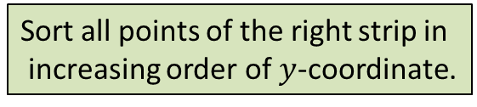






The combine step
Tool 2
$$δ$$
$$δ$$
$$δ$$
$$δ$$
Sort all points of the right strip in
increasing order of $y$-coordinate.
$$δ_{L}$$
$$δ$$
$$δ$$
$$δ$$
$$(x^{′},y^{′})$$
Binary search for ($y^{′}+δ$)
$$p$$
$$δ$$
Binary search for ($y^{′}−δ$)
$$δ_{R}$$
$$δ$$
$$δ$$
$δ$ ← min($δ_{L}{,δ}_{R}$)

Slide 31


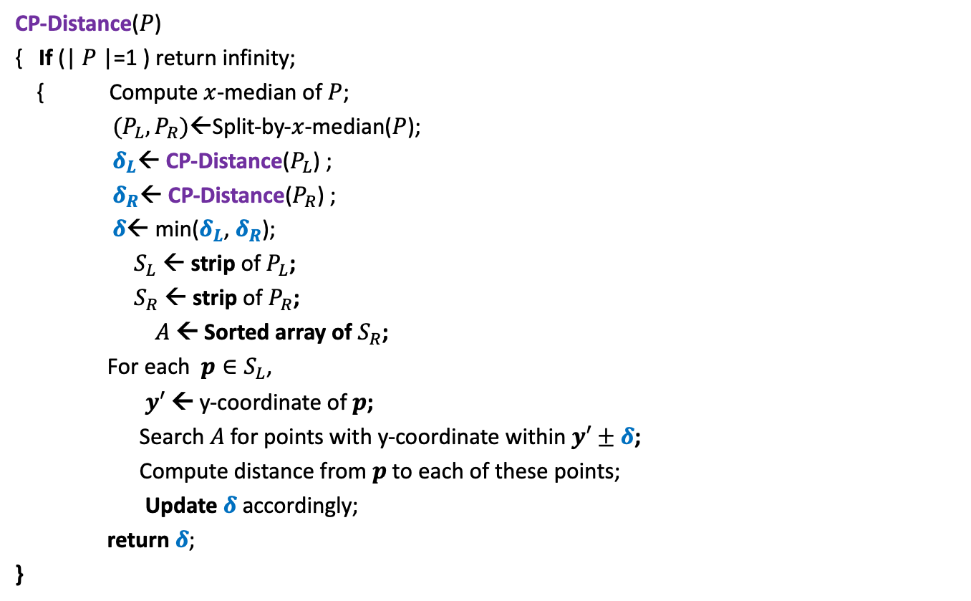
Divide and Conquer based algorithm
CP-Distance($P$)
{ If (| $P$|=1 ) return infinity;
{ Compute $x$-median of $P$;
$(P_{L},P_{R})$←Split-by-$x$-median($P$);
$δ_{L}$← CP-Distance($P_{L}$) ;
$δ_{R}$← CP-Distance($P_{R}$) ;
$δ$← min($δ_{L}$, $δ_{R}$);
$S_{L}$ ← strip of $P_{L}$;
$S_{R}$ ← strip of $P_{R}$;
$A$← Sorted array of $S_{R}$;
For each $p∈S_{L}$,
$y′$ ← y-coordinate of $p$;
Search $A$for points with y-coordinate within $y′±δ$;
Compute distance from $p$to each of these points;
Update $δ$ accordingly;
return $δ$;
}
$O(\left|P\right|)$ + 2 T(|$P$|/2) time
Divide step
$O(\left|P\right| \log{|P|})$ time
Combine/conquer step

Slide 32


Running time of the algorithm
What is the recurrence for running time?
T($n$) = c $n$ log $n$ + 2 T($n$/2)
➔
T($n$) = O( $n$ $\log^{2}n$)
Theorem:
There exists an O( $n$ $\log^{2}n$) time algorithm to compute the closest pair distance of $n$points in plane.
c $n$

Slide 33




The conquer step in O($n$) time
If the two strips are already sorted
$$δ_{L}$$
$$δ_{R}$$
$$δ$$
$$δ$$
$δ$ ← min($δ_{L}{,δ}_{R}$)

Slide 34





The conquer step in O($n$) time
If the two strips are already sorted
$$δ$$
$$p$$
$$δ_{L}$$
$δ$
$$q$$
$$δ_{R}$$
$$δ$$
$$δ$$
$δ$ ← min($δ_{L}{,δ}_{R}$)
Notes:
For each point in one strip, we need to find distance to points
in the upper red- square in the other strip.
2. How to do it efficiently using the fact that the strips are sorted ?

Slide 35


The conquer step in O($n$) time
Fact : At most 4 consecutive points need to be considered.
?
Tool 3
$$p$$
Homework: Prove this claim formally using Tool 3.

Slide 36
The conquer step in O($n$) time
If the two strips are already sorted
$$δ_{L}$$
$$δ_{R}$$
$$δ$$
$$δ$$
$δ$ ← min($δ_{L}{,δ}_{R}$)

Slide 37
The conquer step in O($n$) time
If the two strips are already sorted
$$δ_{L}$$
$$δ_{R}$$
$$δ$$
$$δ$$
$δ$ ← min($δ_{L}{,δ}_{R}$)

Slide 38
Inspiration from Merge sort
Merge
Notes:
In merge sort, the two recursive calls return sorted lists.
So creating the sorted list requires only merging them.

Slide 39


The conquer step in O($n$) time
$$δ_{L}$$
$$δ_{R}$$
$$δ_{L}$$
$$δ_{L}$$
Notes:
If $P_{L}$ and $P_{R}$ are sorted according to y-coordinate,
Getting the strips sorted according to y-coordinate
Getting $P$sorted by merging them
takes O($n$) time. ☺

Slide 40
Homework
Make sincere attempts to write a neat pseudocode of the algorithm.
One such pseudocode is given on the following slide.

Slide 41


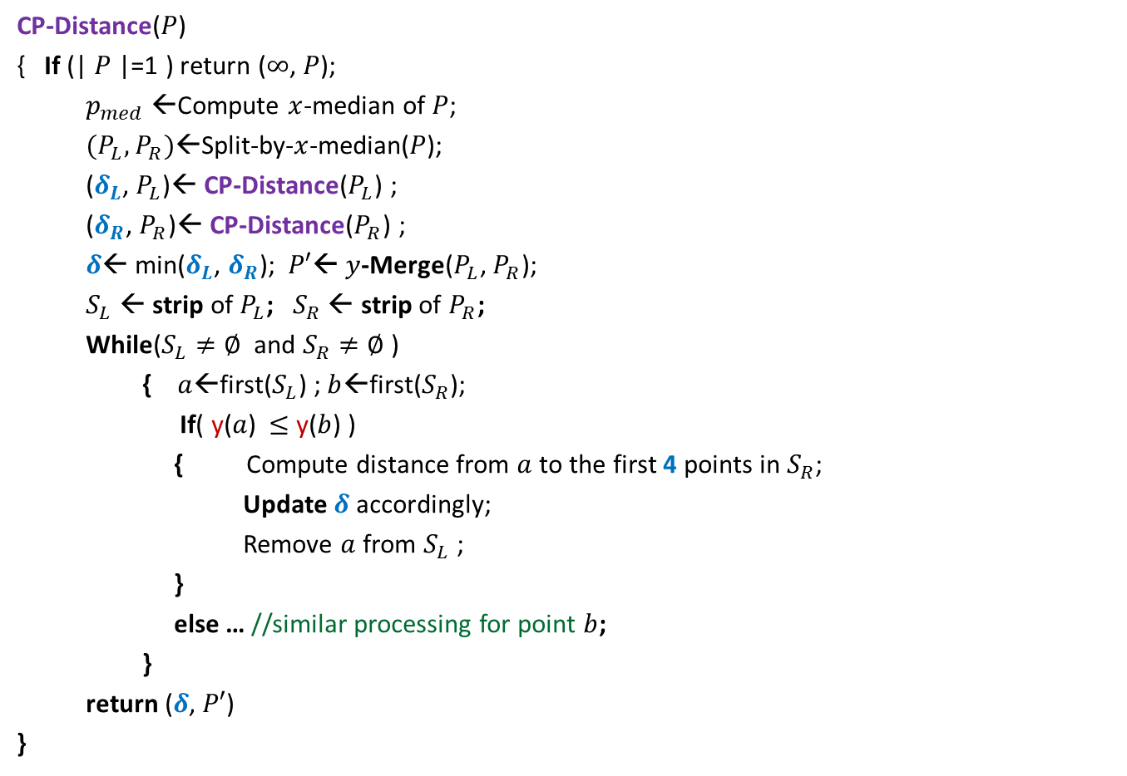
Divide and Conquer based algorithm
CP-Distance($P$)
{ If (| $P$|=1 ) return ($∞$, $P$);
$p_{med}$←Compute $x$-median of $P$;
$(P_{L},P_{R})$←Split-by-$x$-median($P$);
($δ_{L}$, $P_{L}$)← CP-Distance($P_{L}$) ;
($δ_{R}$, $P_{R}$)← CP-Distance($P_{R}$) ;
$δ$← min($δ_{L}$, $δ_{R}$); $P′$← $y$-Merge($P_{L}$, $P_{R}$);
$S_{L}$ ← strip of $P_{L}$; $S_{R}$ ← strip of $P_{R}$;
While($S_{L}≠∅$ and $S_{R}≠∅$ )
{ $a$←first($S_{L}$) ; $b$←first($S_{R}$);
If( y($a$) $≤$ y($b$) )
{ Compute distance from $a$to the first 4 points in $S_{R}$;
Update $δ$ accordingly;
Remove $a$ from $S_{L}$ ;
}
else … //similar processing for point $b$;
}
return ($δ$, $P′$)
}
$O(\left|P\right|)$ + 2 T(|$P$|/2) time
Divide step
$O(\left|P\right|)$ time
conquer step

Slide 42

Conclusion
Theorem:
There exists an O( $n$ $\log{n}$) time algorithm to compute the closest pair distance of $n$points in plane.
Note: There exists a randomized algorithm with O($n$) expected time.

Slide 43
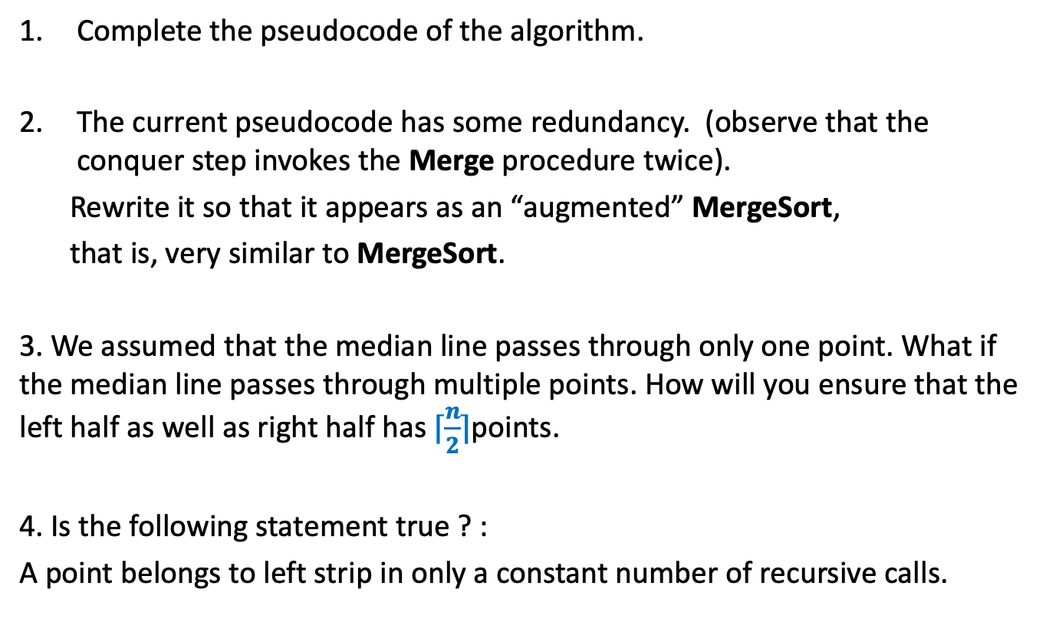
Homework
Complete the pseudocode of the algorithm.
The current pseudocode has some redundancy. (observe that the conquer step invokes the Merge procedure twice).
Rewrite it so that it appears as an “augmented” MergeSort,
that is, very similar to MergeSort.
3. We assumed that the median line passes through only one point. What if the median line passes through multiple points. How will you ensure that the left half as well as right half has $⌈\frac{n}{2}⌉$points.
4. Is the following statement true ? :
A point belongs to left strip in only a constant number of recursive calls.

