Slide 1
Design and Analysis of Algorithms
Algorithms-II : CS345A
Lecture 20
Depth First Search in Directed Graph - III

Slide 2
Recap of the last lecture

Slide 3
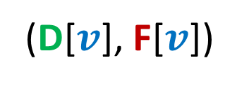
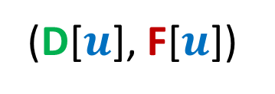
Classification of non-tree edges
using
(D[$u$], F[$u$])
and
(D[$v$], F[$v$])

Slide 4
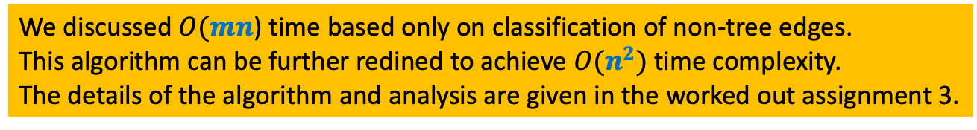
Application - I
Checking if a directed graph is a unique-path graph
We discussed $O(mn$) time based only on classification of non-tree edges.
This algorithm can be further redined to achieve $O(n^{2})$time complexity.
The details of the algorithm and analysis are given in the worked out assignment 3.

Slide 5
Application - II
Computing Strongly connected components of a directed graph.

Slide 6



A simple yet powerful idea
$G$ : the given directed graph
$G^{r}$: the graph $G$ after reversing edge directions;
Let us see whether you can use it in today’s lecture ☺
SCCs of $G$
SCCs of $G^{r}$

Slide 7

x
x
y
y
u
u
Lemma 1: An SCC will appear in exactly one tree in the forest of DFS trees .
v
q
v
q
w
j
w
j
r
p
r
p
k
t
k
t
b
b
d
d
h
h
c

Slide 8
x
x
x
y
y
u
u
Lemma 2: An SCC appears contiguously within its DFS tree.
v
q
y
v
q
w
j
w
j
r
p
r
p
z
k
t
k
t
b
b
d
d
h
h
c

Slide 9
x
y
Try to spot the roots of SCC in the DFS forest.
u
Notation (root of an SCC):
the vertex of the SCC
which is visited first during the DFS
v
q
w
j
r
p
k
t
Having seen nice structure of SCCs in the DFS forest, we feel motivated to design an efficient algorithm based on DFS.
But how should we start with ?
b
d
h
c

Slide 10
Study Finish time
u
u
There does not appear to be any order ☹.
v
v
q
q
w
j
w
j
r
p
r
p
t
k
t
k
t w k j v r p q u
Increasing order of F[]

Slide 11
Searching for an order using Finish time
It looks too complex !
SCC A
SCC D
Increasing order of F[]
SCC B
Have some perseverance, buddy !
SCC C
Where might be
the roots of each SCC ?

Slide 12





DFS on Directed Graph: analyzing the finish time
Lemma3: If ($u$,$v$) is an edge and, $u$ & $v$ belong to different SCCs, then F[$u$] > F[$v$]
F[root($S_{2}$)] ? F[root($S_{1}$)]
$$u$$
$$v$$
$$S_{2}$$
$$S_{1}$$
>

Slide 13
Searching for an order using Finish time
SCC A
SCC B
Increasing order of F[]
Can there be an edge from some vertex of A to some vertex of B ?
NEVER

Slide 14
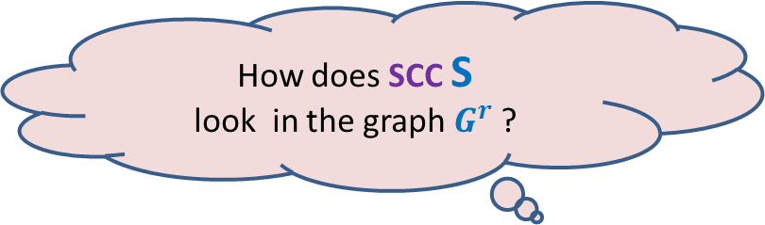



Searching for an order using Finish time
What can we infer for the vertex with max finish time ?
$$u$$
SCC S
$$u$$
SCC S
There won’t be any edge from some vertex outside S into S in $G$.
How does SCC S
look in the graph $G^{r}$ ?
Time to use the !dea of $G^{r}$.
Get ready.

Slide 15


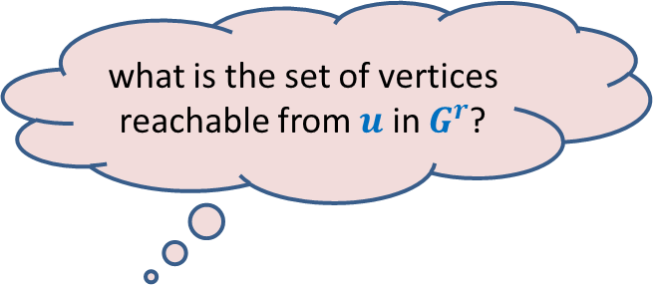
what is the set of vertices reachable from $u$ in $G^{r}$?
$$u$$
Answer: SCC of $u$.
Can you see an algorithm for computing SCCs now ?
It is just here … ☺
SCC S
$$u$$
SCC S
There won’t be any edge from any vertex in S to any vertex outside S in $G^{r}$.

Slide 16
Algorithm for computing SCCs
SCC A
SCC D
SCC B
SCC C
How should we compute SCCs ?

Slide 17


Algorithm for computing SCCs
Execute BFS or DFS on $x$ in $G^{r}$
Remove SCC C
$$x$$
SCC C

Slide 18


Algorithm for computing SCCs
Execute BFS or DFS on $x$ in $G^{r}$
Remove SCC C
Execute BFS or DFS on $y$ in $G^{r}$
Remove SCC D
SCC D
$$y$$

Slide 19


Algorithm for computing SCCs
Execute BFS or DFS on $x$ in $G^{r}$
Remove SCC C
Execute BFS or DFS on $y$ in $G^{r}$
Remove SCC D
Execute BFS or DFS on $z$ in $G^{r}$
Remove SCC B
$$z$$
SCC B

Slide 20

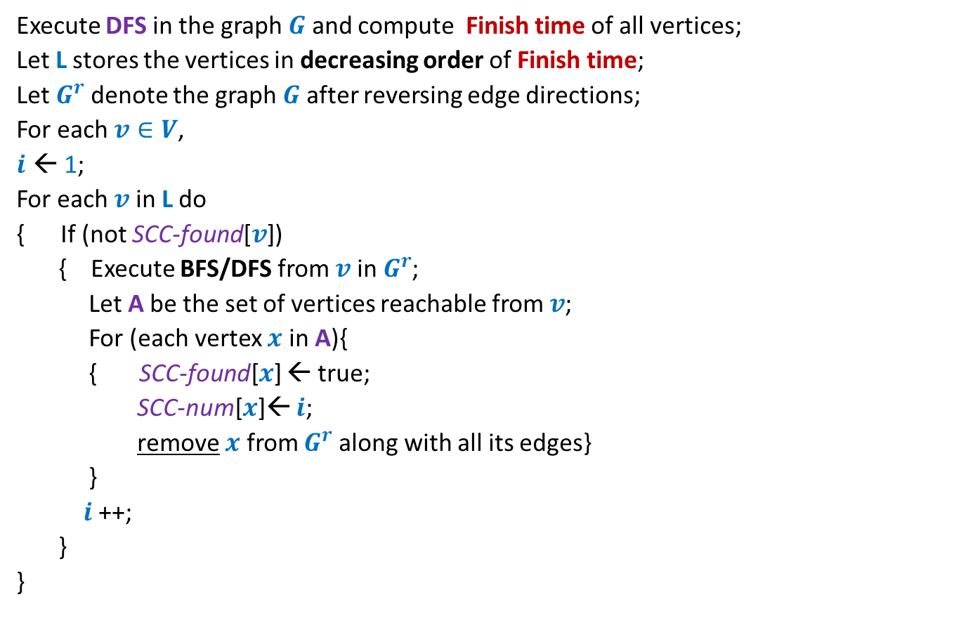
Algorithm for computing SCCs
Execute DFS in the graph $G$ and compute Finish time of all vertices;
Let L stores the vertices in decreasing order of Finish time;
Let $G^{r}$denote the graph $G$ after reversing edge directions;
For each $v∈V$,
$i$ ← 1;
For each $v$ in L do
{ If (not SCC-found[$v$])
{ Execute BFS/DFS from $v$ in $G^{r}$;
Let A be the set of vertices reachable from $v$;
For (each vertex $x$ in A){
{ SCC-found[$x$] ← true;
SCC-num[$x$]← $i$;
remove $x$ from $G^{r}$along with all its edges}
}
$i$ ++;
}
}
SCC-found[$v$]
← false ;

Slide 21
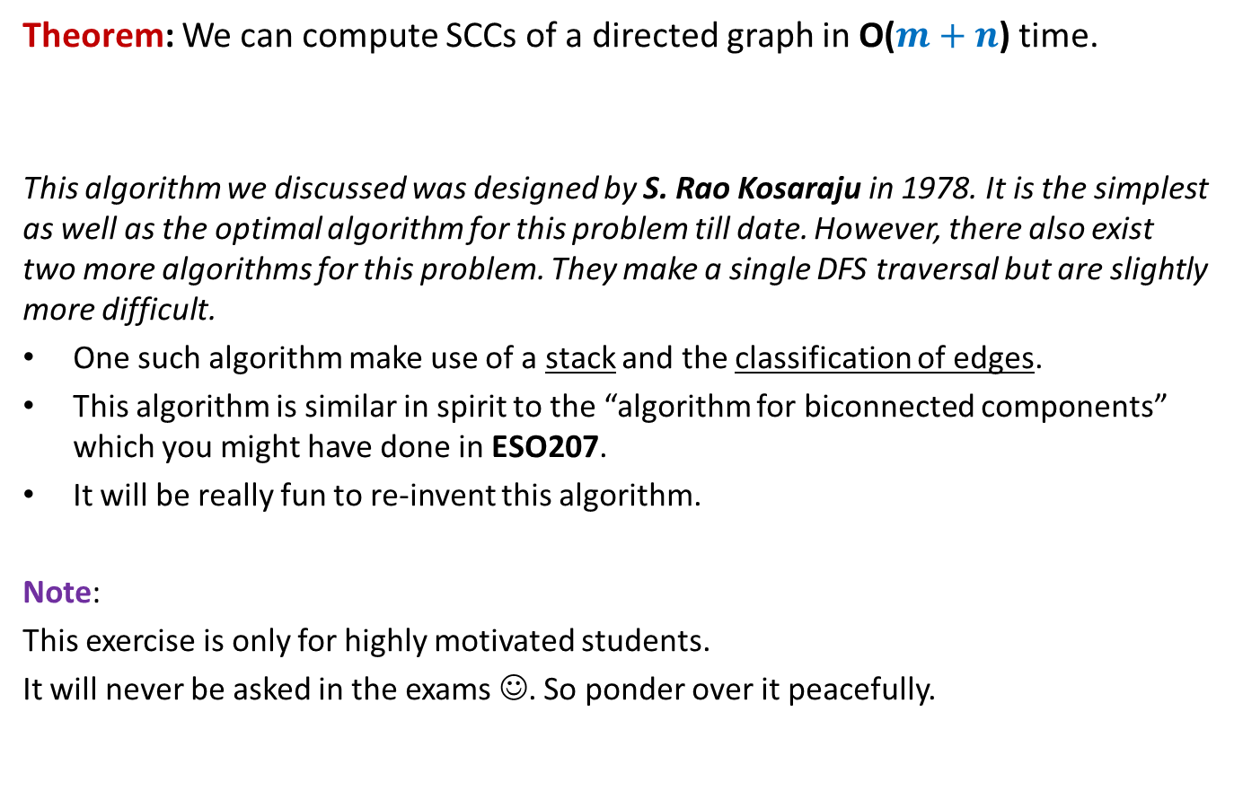
Conclusion
Theorem: We can compute SCCs of a directed graph in O($m+n$) time.
This algorithm we discussed was designed by S. Rao Kosaraju in 1978. It is the simplest as well as the optimal algorithm for this problem till date. However, there also exist two more algorithms for this problem. They make a single DFS traversal but are slightly more difficult.
One such algorithm make use of a stack and the classification of edges.
This algorithm is similar in spirit to the “algorithm for biconnected components” which you might have done in ESO207.
It will be really fun to re-invent this algorithm.
Note:
This exercise is only for highly motivated students.
It will never be asked in the exams ☺. So ponder over it peacefully.

Slide 22
S. Rao Kosaraju is an alumnus of IIT Kharagpur,
and currently at John Hopkins university.
I am sure there will at least a few students
among you who will do some equally fundamental
work in algorithms in the years to come … Best wishes ☺

Slide 23
SCC graph of $G$

Slide 24


SCC graph
x
{x,y}
y
u
v
q
{u,v,w,j}
{p,q,r}
w
j
r
p
{t}
{k}
t
k
{b,c,d}
b
d
h
{h}
c
$$G$$
SCC graph of $G$

Slide 25
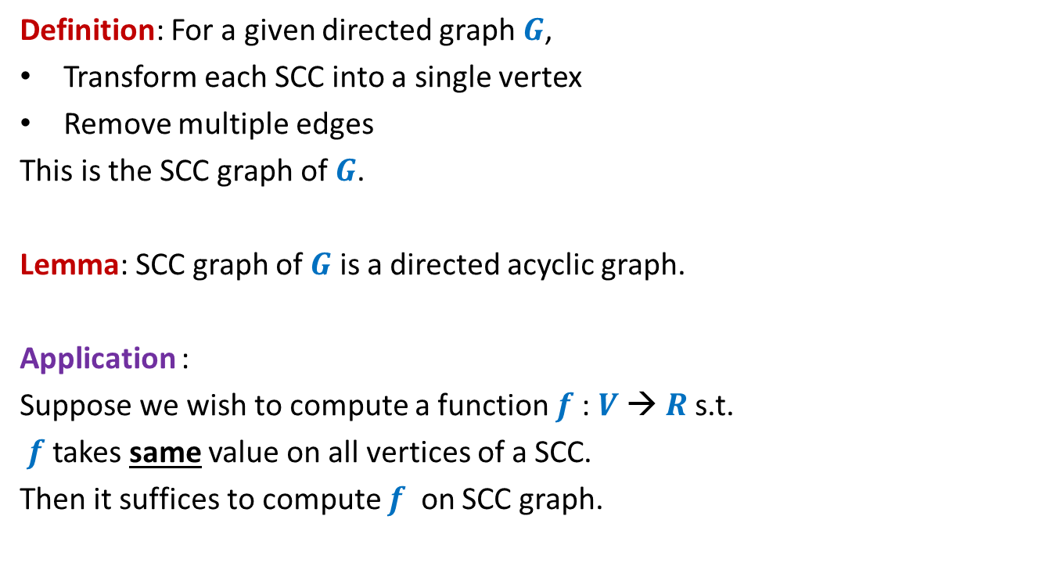
SCC graph
Definition: For a given directed graph $G$,
Transform each SCC into a single vertex
Remove multiple edges
This is the SCC graph of $G$.
Lemma: SCC graph of $G$ is a directed acyclic graph.
Application :
Suppose we wish to compute a function $f$: $V$→ $R$s.t.
$f$ takes same value on all vertices of a SCC.
Then it suffices to compute $f$ on SCC graph.

Slide 26
Amazing Applications of
Fast Matrix Multiplication

Slide 27

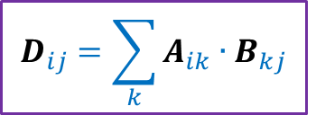
Multiplication of Matrices
2 | 3 | 0 | 3 | 7
8 | 0 | 9 | 7 | 1
0 | 0 | 4 | 0 | 0
0 | 8 | 0 | 1 | 0
5 | 3 | 0 | 5 | 0
6 | 0 | 7 | 0 | 0
0 | 9 | 8 | 0 | 7
3 | 2 | 9 | 1 | 0
6 | 1 | 8 | 9 | 0
1 | 0 | 4 | 6 | 0
A
B
D
$$D_{ij}=\sum_{k}{A_{ik}{∙B}_{kj}}$$
Time complexity: O$(n^{3})$ time .
But faster algorithms exist for more than 50 years.

Slide 28

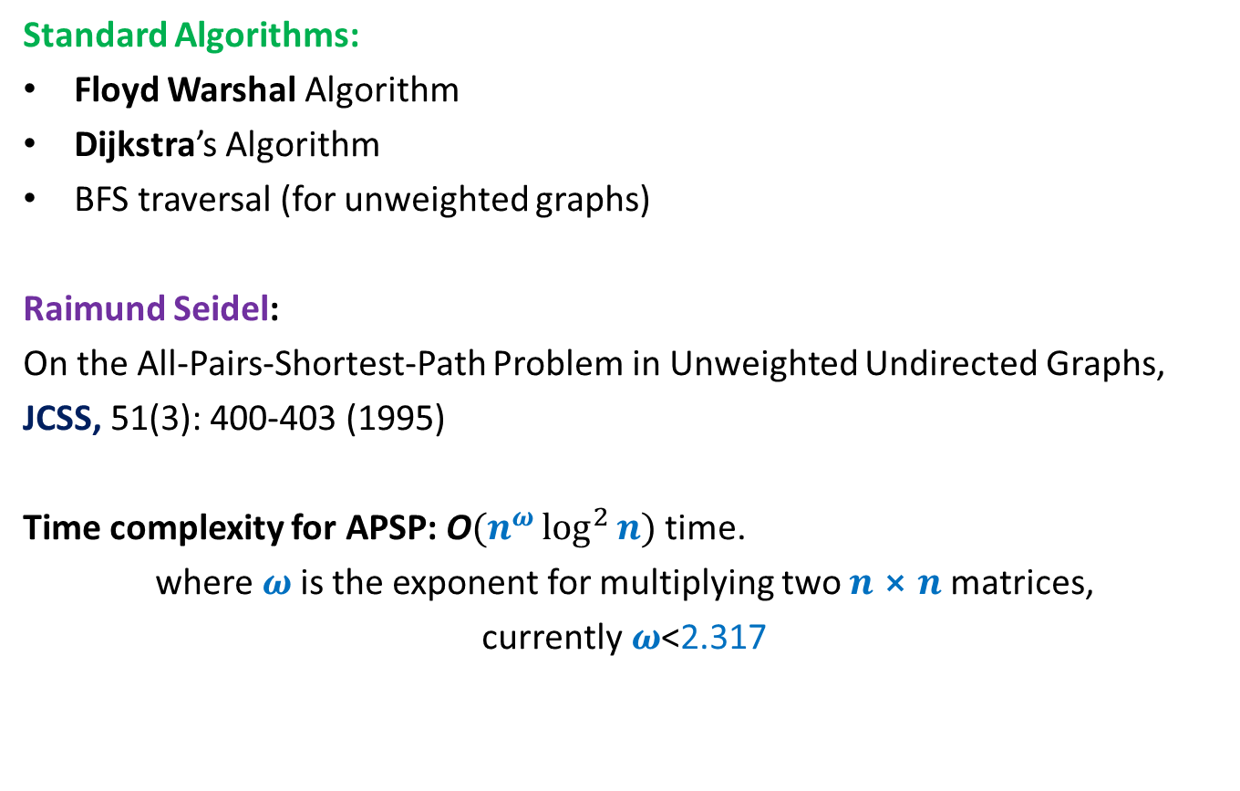
All Pairs Shortest Paths (APSP)
Matrix Multiplication
Standard Algorithms:
Floyd Warshal Algorithm
Dijkstra’s Algorithm
BFS traversal (for unweighted graphs)
Raimund Seidel:
On the All-Pairs-Shortest-Path Problem in Unweighted Undirected Graphs,
JCSS, 51(3): 400-403 (1995)
Time complexity for APSP: O$(n^{ω}\log^{2}{n})$ time.
where $ω$is the exponent for multiplying two $n⨯n$matrices,
currently$ω$<2.317
O$(n^{3})$ time in the worst case

Slide 29

All Pairs Reachability
BFS or DFS
➔ O$(n^{3})$ in the worst case time.
Time complexity for APR: O$(n^{ω})$ time.

Slide 30
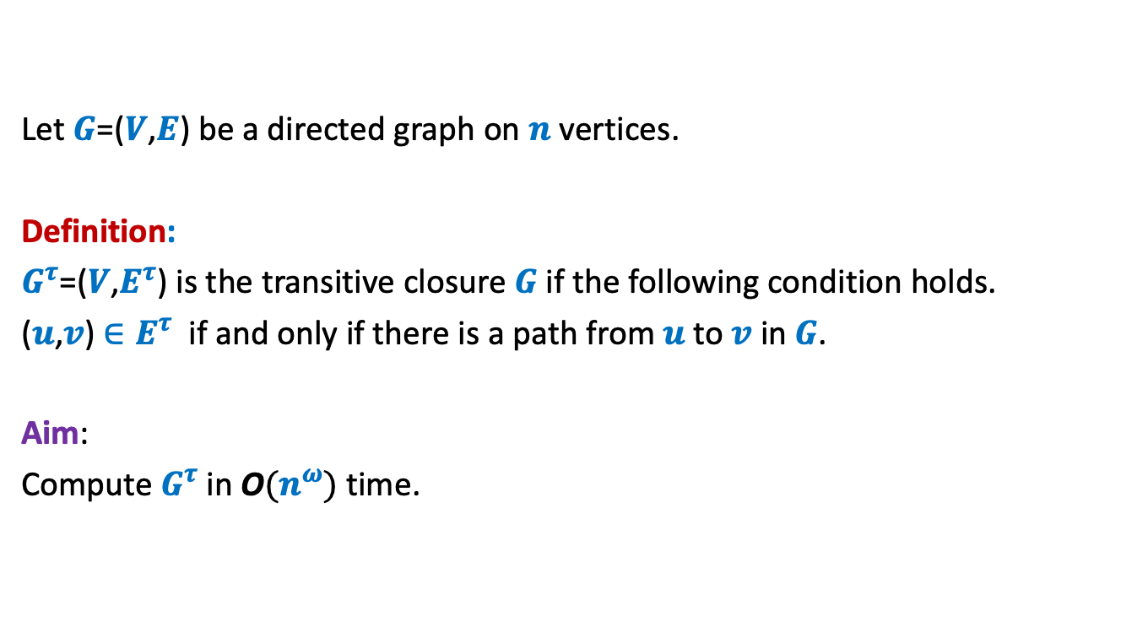
Transitive Closure of Graph
Let $G$=($V$,$E$) be a directed graph on $n$ vertices.
Definition:
$G^{τ}$=($V$,$E^{τ}$) is the transitive closure $G$if the following condition holds.
($u$,$v$) $∈E^{τ}$ if and only if there is a path from $u$to $v$ in $G$.
Aim:
Compute $G^{τ}$in O$(n^{ω})$ time.

Slide 31







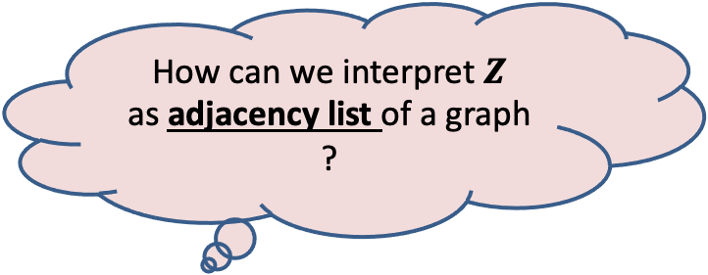
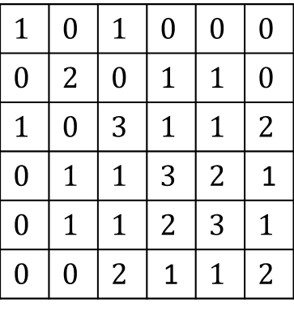




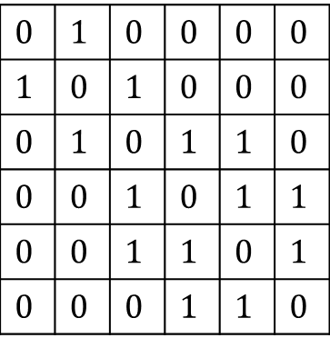

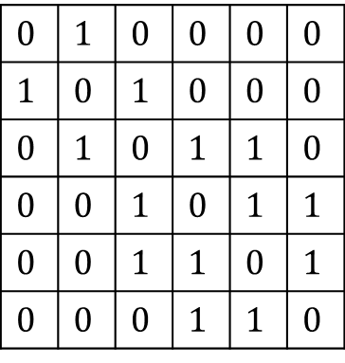


$$1$$ | $$2$$ | $$3$$ | $$4$$ | $$5$$ | $$6$$
$$1$$
$$2$$
$$3$$
$$4$$
$$5$$
$$6$$
$$0$$ | $$1$$ | $$0$$ | $$0$$ | $$0$$ | $$0$$
$$1$$ | $$0$$ | $$1$$ | $$0$$ | $$0$$ | $$0$$
$$0$$ | $$1$$ | $$0$$ | $$1$$ | $$1$$ | $$0$$
$$0$$ | $$0$$ | $$1$$ | $$0$$ | $$1$$ | $$1$$
$$0$$ | $$0$$ | $$1$$ | $$1$$ | $$0$$ | $$1$$
$$0$$ | $$0$$ | $$0$$ | $$1$$ | $$1$$ | $$0$$
$$0$$ | $$1$$ | $$0$$ | $$0$$ | $$0$$ | $$0$$
$$1$$ | $$0$$ | $$1$$ | $$0$$ | $$0$$ | $$0$$
$$0$$ | $$1$$ | $$0$$ | $$1$$ | $$1$$ | $$0$$
$$0$$ | $$0$$ | $$1$$ | $$0$$ | $$1$$ | $$1$$
$$0$$ | $$0$$ | $$1$$ | $$1$$ | $$0$$ | $$1$$
$$0$$ | $$0$$ | $$0$$ | $$1$$ | $$1$$ | $$0$$
$$1$$ | $$0$$ | $$1$$ | $$0$$ | $$0$$ | $$0$$
$$0$$ | $$2$$ | $$0$$ | $$1$$ | $$1$$ | $$0$$
$$1$$ | $$0$$ | $$3$$ | $$1$$ | $$1$$ | $$2$$
$$0$$ | $$1$$ | $$1$$ | $$3$$ | $$2$$ | 1
$$0$$ | $$1$$ | $$1$$ | $$2$$ | $$3$$ | $$1$$
$$0$$ | $$0$$ | $$2$$ | 1 | $$1$$ | $$2$$
$$0$$
$$0$$
$$0$$
$$1$$
$$0$$
$$1$$
$$1$$
$$0$$
$$1$$
$$0$$
$$A$$
$$A$$
$$B$$
$$Z$$
How can we interpret $Z$
as adjacency list of a graph ?
Homework: Try to answer this question. It is not very difficult.

