Slide 1
Design and Analysis of Algorithms
Algorithms-II : CS345A
Lecture 21
Amazing Applications of Fast Matrix Multiplication

Slide 2
Recap of the last lecture

Slide 3

Computing SCCs of a Directed Graph
Theorem:
We can compute SCCs of a directed graph in O($m+n$) time.

Slide 4
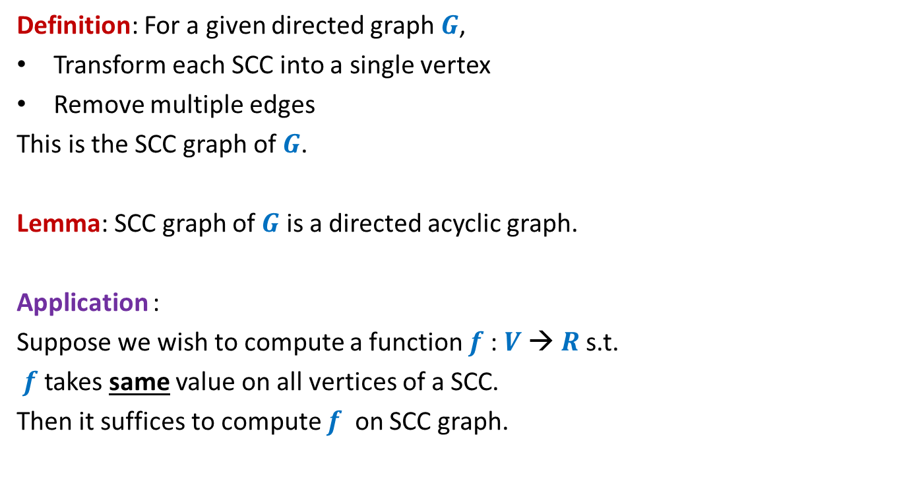
SCC graph
Definition: For a given directed graph $G$,
Transform each SCC into a single vertex
Remove multiple edges
This is the SCC graph of $G$.
Lemma: SCC graph of $G$ is a directed acyclic graph.
Application :
Suppose we wish to compute a function $f$: $V$→ $R$s.t.
$f$ takes same value on all vertices of a SCC.
Then it suffices to compute $f$ on SCC graph.

Slide 5
Amazing Applications of
Fast Matrix Multiplication

Slide 6

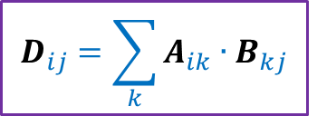
Multiplication of Matrices
2 | 3 | 0 | 3 | 7
8 | 0 | 9 | 7 | 1
0 | 0 | 4 | 0 | 0
0 | 8 | 0 | 1 | 0
5 | 3 | 0 | 5 | 0
6 | 0 | 7 | 0 | 0
0 | 9 | 8 | 0 | 7
3 | 2 | 9 | 1 | 0
6 | 1 | 8 | 9 | 0
1 | 0 | 4 | 6 | 0
A
B
D
$$D_{ij}=\sum_{k}{A_{ik}{∙B}_{kj}}$$
Time complexity: O$(n^{3})$ time .
But faster algorithms exists for more than 50 years.

Slide 7
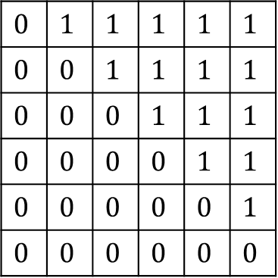







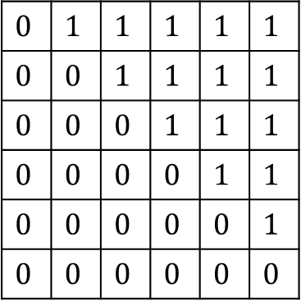

Fast Matrix Multiplication
Divide each matrix into four n/2 $×$ n/2 matrices
C11 = A11 $×$ B11 + A12 $×$ B21
C12 = A11 $×$ B12 + A12 $×$ B22
C21 = A21 $×$ B11 + A22 $×$ B21
C22 = A21 $×$ B12 + A22 $×$ B22
$$T\left(n\right)= 8 T(n/2) + c n^{2}$$
$$0$$ | $$1$$ | $$1$$ | $$1$$ | $$1$$ | $$1$$
$$0$$ | $$0$$ | $$1$$ | $$1$$ | $$1$$ | $$1$$
$$0$$ | $$0$$ | $$0$$ | $$1$$ | $$1$$ | $$1$$
$$0$$ | $$0$$ | $$0$$ | $$0$$ | $$1$$ | $$1$$
$$0$$ | $$0$$ | $$0$$ | $$0$$ | $$0$$ | $$1$$
$$0$$ | $$0$$ | $$0$$ | $$0$$ | $$0$$ | $$0$$
A11
A12
$$0$$ | $$1$$ | $$1$$ | $$1$$ | $$1$$ | $$1$$
$$0$$ | $$0$$ | $$1$$ | $$1$$ | $$1$$ | $$1$$
$$0$$ | $$0$$ | $$0$$ | $$1$$ | $$1$$ | $$1$$
$$0$$ | $$0$$ | $$0$$ | $$0$$ | $$1$$ | $$1$$
$$0$$ | $$0$$ | $$0$$ | $$0$$ | $$0$$ | $$1$$
$$0$$ | $$0$$ | $$0$$ | $$0$$ | $$0$$ | $$0$$
B11
B12
$$0$$ | $$1$$ | $$1$$ | $$1$$ | $$1$$ | $$1$$
$$0$$ | $$0$$ | $$1$$ | $$1$$ | $$1$$ | $$1$$
$$0$$ | $$0$$ | $$0$$ | $$1$$ | $$1$$ | $$1$$
$$0$$ | $$0$$ | $$0$$ | $$0$$ | $$1$$ | $$1$$
$$0$$ | $$0$$ | $$0$$ | $$0$$ | $$0$$ | $$1$$
$$0$$ | $$0$$ | $$0$$ | $$0$$ | $$0$$ | $$0$$
C11
C12
A21
A22
B21
B22
C21
C22
A
B
C
$8$ multiplications & $4$ additions of $\frac{n}{2}×\frac{n}{2}$ matrices
Volker Strassen, 1969
$7$ multiplications & $18$ additions/subtractions of $\frac{n}{2}×\frac{n}{2}$ matrices
$$7$$
$$=Θ(n^{\log_{2} 8})$$
$$=Θ(n^{3})$$
$$=Θ(n^{\log_{2} 7})$$
$$=Θ(n^{2.81})$$

Slide 8



Fast Matrix Multiplication
Volker Strassen, 1969
$$=Θ(n^{2.81})$$
Virginia Vassilevska Williams, 2020
$$=Θ(n^{2.37286})$$
$ω=2.37286$

Slide 9

All Pairs Reachability
BFS or DFS
➔ O$(n^{3})$ in the worst case time.
Time complexity for APR: O$(n^{ω})$ time.

Slide 10
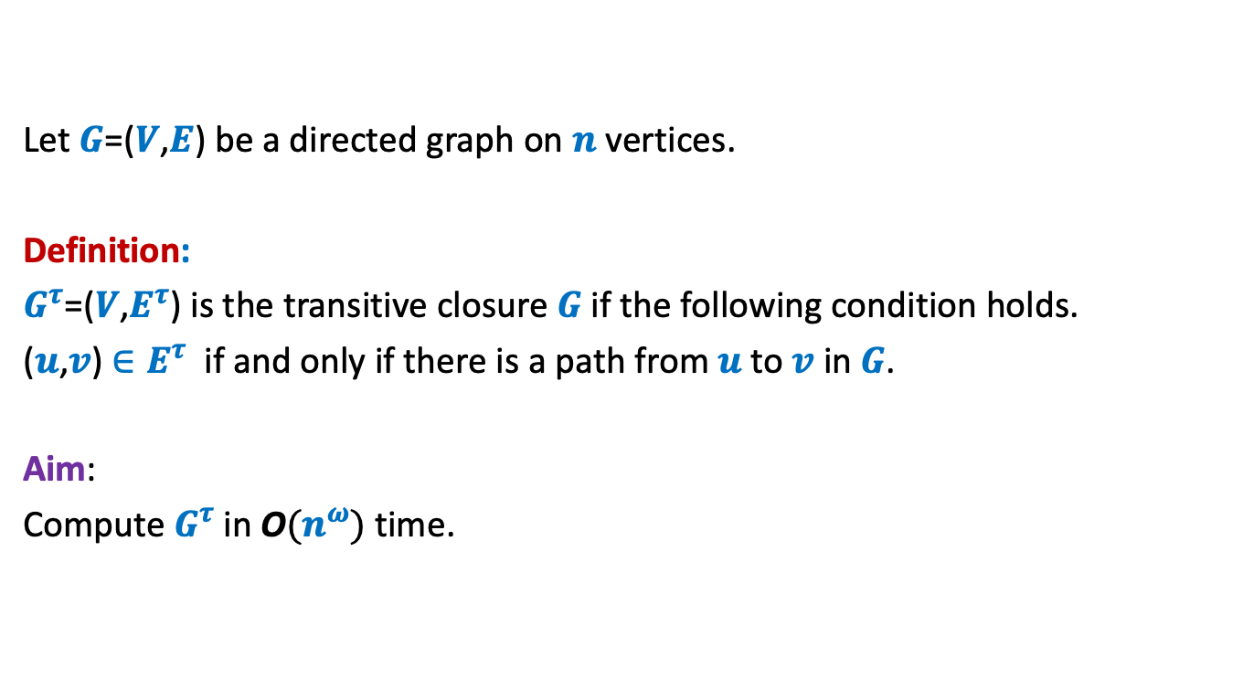
Transitive Closure of Graph
Let $G$=($V$,$E$) be a directed graph on $n$ vertices.
Definition:
$G^{τ}$=($V$,$E^{τ}$) is the transitive closure $G$if the following condition holds.
($u$,$v$) $∈E^{τ}$ if and only if there is a path from $u$to $v$ in $G$.
Aim:
Compute $G^{τ}$in O$(n^{ω})$ time.

Slide 11






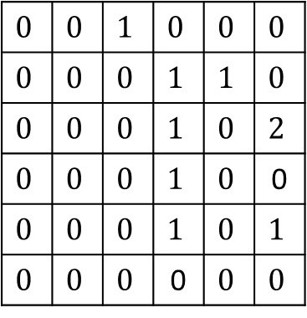
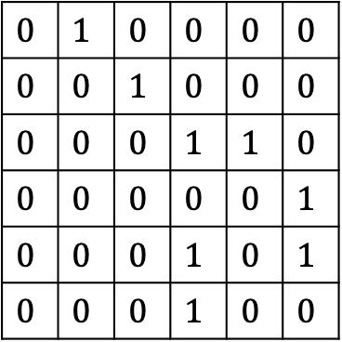


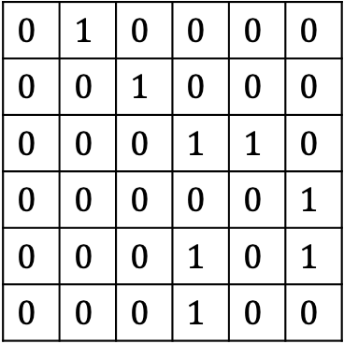







$$1$$ | $$2$$ | $$3$$ | $$4$$ | $$5$$ | $$6$$
$$1$$ | $$2$$ | $$3$$ | $$4$$ | $$5$$ | $$6$$
$$1$$
$$2$$
$$3$$
$$4$$
$$5$$
$$6$$
$$0$$ | $$1$$ | $$0$$ | $$0$$ | $$0$$ | $$0$$
$$0$$ | $$0$$ | $$1$$ | $$0$$ | $$0$$ | $$0$$
$$0$$ | $$0$$ | $$0$$ | $$1$$ | $$1$$ | $$0$$
$$0$$ | $$0$$ | $$0$$ | $$0$$ | $$0$$ | $$1$$
$$0$$ | $$0$$ | $$0$$ | $$1$$ | $$0$$ | $$1$$
$$0$$ | $$0$$ | $$0$$ | $$1$$ | $$0$$ | $$0$$
$$0$$ | $$1$$ | $$0$$ | $$0$$ | $$0$$ | $$0$$
$$0$$ | $$0$$ | $$1$$ | $$0$$ | $$0$$ | $$0$$
$$0$$ | $$0$$ | $$0$$ | $$1$$ | $$1$$ | $$0$$
$$0$$ | $$0$$ | $$0$$ | $$0$$ | $$0$$ | $$1$$
$$0$$ | $$0$$ | $$0$$ | $$1$$ | $$0$$ | $$1$$
$$0$$ | $$0$$ | $$0$$ | $$1$$ | $$0$$ | $$0$$
$$1$$
$$2$$
$$3$$
$$4$$
$$5$$
$$6$$
$$0$$ | $$0$$ | $$1$$ | $$0$$ | $$0$$ | $$0$$
$$0$$ | $$0$$ | $$0$$ | $$1$$ | $$1$$ | $$0$$
$$0$$ | $$0$$ | $$0$$ | $$1$$ | $$0$$ | $$2$$
$$0$$ | $$0$$ | $$0$$ | $$1$$ | $$0$$ | 0
$$0$$ | $$0$$ | $$0$$ | $$1$$ | $$0$$ | $$1$$
$$0$$ | $$0$$ | $$0$$ | 0 | $$0$$ | $$0$$
$$A$$
$$A$$
$$Z$$
$$4$$
$$6$$
$$1$$
$$2$$
$$3$$
$$5$$
$$G$$

Slide 12

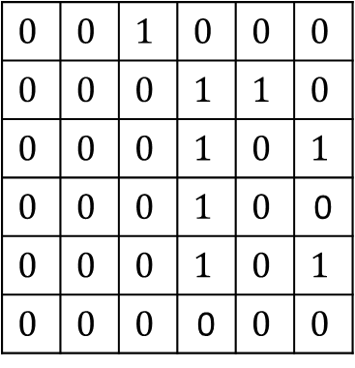
$$1$$ | $$2$$ | $$3$$ | $$4$$ | $$5$$ | $$6$$
$$1$$ | $$2$$ | $$3$$ | $$4$$ | $$5$$ | $$6$$
$$1$$
$$2$$
$$3$$
$$4$$
$$5$$
$$6$$
$$0$$ | $$1$$ | $$0$$ | $$0$$ | $$0$$ | $$0$$
$$0$$ | $$0$$ | $$1$$ | $$0$$ | $$0$$ | $$0$$
$$0$$ | $$0$$ | $$0$$ | $$1$$ | $$1$$ | $$0$$
$$0$$ | $$0$$ | $$0$$ | $$0$$ | $$0$$ | $$1$$
$$0$$ | $$0$$ | $$0$$ | $$1$$ | $$0$$ | $$1$$
$$0$$ | $$0$$ | $$0$$ | $$1$$ | $$0$$ | $$0$$
$$0$$ | $$1$$ | $$0$$ | $$0$$ | $$0$$ | $$0$$
$$0$$ | $$0$$ | $$1$$ | $$0$$ | $$0$$ | $$0$$
$$0$$ | $$0$$ | $$0$$ | $$1$$ | $$1$$ | $$0$$
$$0$$ | $$0$$ | $$0$$ | $$0$$ | $$0$$ | $$1$$
$$0$$ | $$0$$ | $$0$$ | $$1$$ | $$0$$ | $$1$$
$$0$$ | $$0$$ | $$0$$ | $$1$$ | $$0$$ | $$0$$
$$1$$
$$2$$
$$3$$
$$4$$
$$5$$
$$6$$
$$0$$ | $$0$$ | $$1$$ | $$0$$ | $$0$$ | $$0$$
$$0$$ | $$0$$ | $$0$$ | $$1$$ | $$1$$ | $$0$$
$$0$$ | $$0$$ | $$0$$ | $$1$$ | $$0$$ | $$1$$
$$0$$ | $$0$$ | $$0$$ | $$1$$ | $$0$$ | 0
$$0$$ | $$0$$ | $$0$$ | $$1$$ | $$0$$ | $$1$$
$$0$$ | $$0$$ | $$0$$ | 0 | $$0$$ | $$0$$
$$A$$
$$A$$
$$B$$
$$4$$
$$6$$
$$1$$
$$2$$
$$3$$
$$5$$
$$G$$

Slide 13





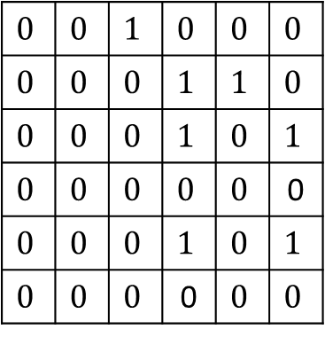




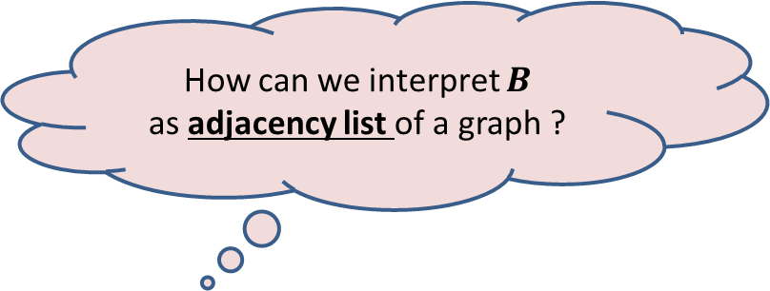
$$1$$ | $$2$$ | $$3$$ | $$4$$ | $$5$$ | $$6$$
$$1$$ | $$2$$ | $$3$$ | $$4$$ | $$5$$ | $$6$$
$$1$$
$$2$$
$$3$$
$$4$$
$$5$$
$$6$$
$$0$$ | $$1$$ | $$0$$ | $$0$$ | $$0$$ | $$0$$
$$0$$ | $$0$$ | $$1$$ | $$0$$ | $$0$$ | $$0$$
$$0$$ | $$0$$ | $$0$$ | $$1$$ | $$1$$ | $$0$$
$$0$$ | $$0$$ | $$0$$ | $$0$$ | $$0$$ | $$1$$
$$0$$ | $$0$$ | $$0$$ | $$1$$ | $$0$$ | $$1$$
$$0$$ | $$0$$ | $$0$$ | $$1$$ | $$0$$ | $$0$$
$$0$$ | $$1$$ | $$0$$ | $$0$$ | $$0$$ | $$0$$
$$0$$ | $$0$$ | $$1$$ | $$0$$ | $$0$$ | $$0$$
$$0$$ | $$0$$ | $$0$$ | $$1$$ | $$1$$ | $$0$$
$$0$$ | $$0$$ | $$0$$ | $$0$$ | $$0$$ | $$1$$
$$0$$ | $$0$$ | $$0$$ | $$1$$ | $$0$$ | $$1$$
$$0$$ | $$0$$ | $$0$$ | $$1$$ | $$0$$ | $$0$$
$$1$$
$$2$$
$$3$$
$$4$$
$$5$$
$$6$$
$$0$$ | $$0$$ | $$1$$ | $$0$$ | $$0$$ | $$0$$
$$0$$ | $$0$$ | $$0$$ | $$1$$ | $$1$$ | $$0$$
$$0$$ | $$0$$ | $$0$$ | $$1$$ | $$0$$ | $$1$$
$$0$$ | $$0$$ | $$0$$ | $$0$$ | $$0$$ | 0
$$0$$ | $$0$$ | $$0$$ | $$1$$ | $$0$$ | $$1$$
$$0$$ | $$0$$ | $$0$$ | 0 | $$0$$ | $$0$$
There is an edge ($i,j$) in the graph corresponding to $B$
if and only if there is a path of length 2 from $i$ to $j$ in $G$.
$$A$$
$$A$$
$$B$$
$$4$$
$$4$$
How can we interpret $B$
as adjacency list of a graph ?
$$6$$
$$6$$
$$1$$
$$2$$
$$3$$
$$1$$
$$2$$
$$3$$
What if we add the missing edges from $G$ ?
$$5$$
$$5$$
$$G$$

Slide 14

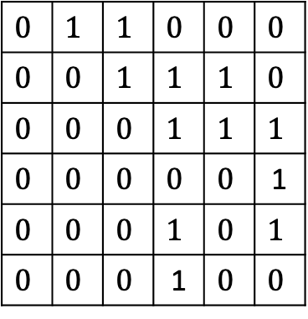


$$1$$ | $$2$$ | $$3$$ | $$4$$ | $$5$$ | $$6$$
$$1$$ | $$2$$ | $$3$$ | $$4$$ | $$5$$ | $$6$$
$$1$$
$$2$$
$$3$$
$$4$$
$$5$$
$$6$$
$$0$$ | $$1$$ | $$0$$ | $$0$$ | $$0$$ | $$0$$
$$0$$ | $$0$$ | $$1$$ | $$0$$ | $$0$$ | $$0$$
$$0$$ | $$0$$ | $$0$$ | $$1$$ | $$1$$ | $$0$$
$$0$$ | $$0$$ | $$0$$ | $$0$$ | $$0$$ | $$1$$
$$0$$ | $$0$$ | $$0$$ | $$1$$ | $$0$$ | $$1$$
$$0$$ | $$0$$ | $$0$$ | $$1$$ | $$0$$ | $$0$$
$$0$$ | $$1$$ | $$0$$ | $$0$$ | $$0$$ | $$0$$
$$0$$ | $$0$$ | $$1$$ | $$0$$ | $$0$$ | $$0$$
$$0$$ | $$0$$ | $$0$$ | $$1$$ | $$1$$ | $$0$$
$$0$$ | $$0$$ | $$0$$ | $$0$$ | $$0$$ | $$1$$
$$0$$ | $$0$$ | $$0$$ | $$1$$ | $$0$$ | $$1$$
$$0$$ | $$0$$ | $$0$$ | $$1$$ | $$0$$ | $$0$$
$$1$$
$$2$$
$$3$$
$$4$$
$$5$$
$$6$$
$$0$$ | $$1$$ | $$1$$ | $$0$$ | $$0$$ | $$0$$
$$0$$ | $$0$$ | $$1$$ | $$1$$ | $$1$$ | $$0$$
$$0$$ | $$0$$ | $$0$$ | $$1$$ | $$1$$ | $$1$$
$$0$$ | $$0$$ | $$0$$ | $$0$$ | $$0$$ | 1
$$0$$ | $$0$$ | $$0$$ | $$1$$ | $$0$$ | $$1$$
$$0$$ | $$0$$ | $$0$$ | 1 | $$0$$ | $$0$$
There is an edge ($i,j$) in the graph corresponding to $B$
if and only if there is a path of length 2 from $i$ to $j$ in $G$.
$$A$$
$$A$$
$$B$$
at most 2 from $i$ to $j$ in $G$.
$$4$$
$$4$$
$$6$$
$$6$$
$$1$$
$$2$$
$$3$$
$$1$$
$$2$$
$$3$$
$$5$$
$$5$$
$$G$$
$$G^{2}$$

Slide 15











$$1$$ | $$2$$ | $$3$$ | $$4$$ | $$5$$ | $$6$$
$$1$$ | $$2$$ | $$3$$ | $$4$$ | $$5$$ | $$6$$
$$1$$
$$2$$
$$3$$
$$4$$
$$5$$
$$6$$
$$0$$ | $$1$$ | $$0$$ | $$0$$ | $$0$$ | $$0$$
$$0$$ | $$0$$ | $$1$$ | $$0$$ | $$0$$ | $$0$$
$$0$$ | $$0$$ | $$0$$ | $$1$$ | $$1$$ | $$0$$
$$0$$ | $$0$$ | $$0$$ | $$0$$ | $$0$$ | $$1$$
$$0$$ | $$0$$ | $$0$$ | $$1$$ | $$0$$ | $$1$$
$$0$$ | $$0$$ | $$0$$ | $$1$$ | $$0$$ | $$0$$
$$0$$ | $$1$$ | $$0$$ | $$0$$ | $$0$$ | $$0$$
$$0$$ | $$0$$ | $$1$$ | $$0$$ | $$0$$ | $$0$$
$$0$$ | $$0$$ | $$0$$ | $$1$$ | $$1$$ | $$0$$
$$0$$ | $$0$$ | $$0$$ | $$0$$ | $$0$$ | $$1$$
$$0$$ | $$0$$ | $$0$$ | $$1$$ | $$0$$ | $$1$$
$$0$$ | $$0$$ | $$0$$ | $$1$$ | $$0$$ | $$0$$
$$1$$
$$2$$
$$3$$
$$4$$
$$5$$
$$6$$
$$0$$ | $$1$$ | $$1$$ | $$0$$ | $$0$$ | $$0$$
$$0$$ | $$0$$ | $$1$$ | $$1$$ | $$1$$ | $$0$$
$$0$$ | $$0$$ | $$0$$ | $$1$$ | $$1$$ | $$1$$
$$0$$ | $$0$$ | $$0$$ | $$0$$ | $$0$$ | 1
$$0$$ | $$0$$ | $$0$$ | $$1$$ | $$0$$ | $$1$$
$$0$$ | $$0$$ | $$0$$ | 1 | $$0$$ | $$0$$
Question:
How to compute $G^{3}$ ?
Question:
How to compute $G^{4}$ ?
Question:
How to compute Transitive Closure ?
$$A$$
$$A$$
$$B$$
Compute $A × B$
and take union with $B$
Let $B′$ be the Adjacency Matrix of $G^{3}$
Compute $B × B$
and take union with $B$
Compute $A × B′$
and take union with $B′$
Compute $G^{n−1}$
$n−1$ Matrix Multiplications ☹
Hint: Can we compute $G^{4}$ from $G^{2}$ in a single matrix multiplication than 2 multiplications ?

Slide 16





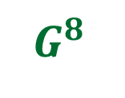
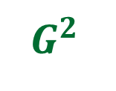
Theorem:
We can compute transitive closure of graph $G$ in O$(n^{ω} log n)$ time.
$$G$$
$\log{n}$ Matrix Multiplications ☺
$G^{2}$
$G^{4}$
$G^{8}$
…
$$G^{n−1}$$
How to eliminate the $log n$ factor ?

Slide 17
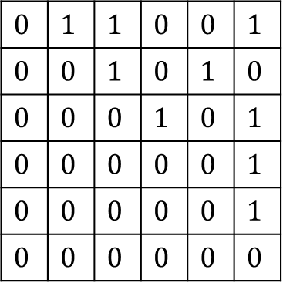
Make use of the SCC graph
SCC graph is a DAG.
Question: How does its Adjacency Matrix look like ?
Answer: Nothing special ☹
Question: What if you relabel the vertices according to topological ordering?
Answer: Upper Triangular Matrix
0
$$0$$ | $$1$$ | $$1$$ | $$0$$ | $$0$$ | $$1$$
$$0$$ | $$0$$ | $$1$$ | $$0$$ | $$1$$ | $$0$$
$$0$$ | $$0$$ | $$0$$ | $$1$$ | $$0$$ | $$1$$
$$0$$ | $$0$$ | $$0$$ | $$0$$ | $$0$$ | $$1$$
$$0$$ | $$0$$ | $$0$$ | $$0$$ | $$0$$ | $$1$$
$$0$$ | $$0$$ | $$0$$ | $$0$$ | $$0$$ | $$0$$

Slide 18
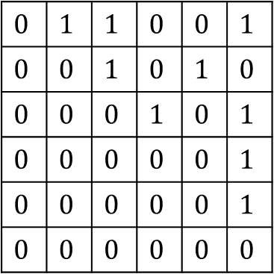

This is how the Adjacency Matrix of SCC graph looks
Hint is :
Homework:
Ponder over efficient ways to compute transitive closure of $G$ in O$(n^{ω})$ time.
Note:
Never mind if you can not find O$(n^{ω})$ time algorithm.
The homework is just to spend some time making use of the hint.
This will NOT be part of the mid semester exam ☺
0
$$0$$ | $$1$$ | $$1$$ | $$0$$ | $$0$$ | $$1$$
$$0$$ | $$0$$ | $$1$$ | $$0$$ | $$1$$ | $$0$$
$$0$$ | $$0$$ | $$0$$ | $$1$$ | $$0$$ | $$1$$
$$0$$ | $$0$$ | $$0$$ | $$0$$ | $$0$$ | $$1$$
$$0$$ | $$0$$ | $$0$$ | $$0$$ | $$0$$ | $$1$$
$$0$$ | $$0$$ | $$0$$ | $$0$$ | $$0$$ | $$0$$
A12
A11
0
A22

