Slide 1
Design and Analysis of Algorithms
Algorithms-II : CS345A
Lecture 23
Network Flow – II

Slide 2
A quick recap from the last lecture

Slide 3

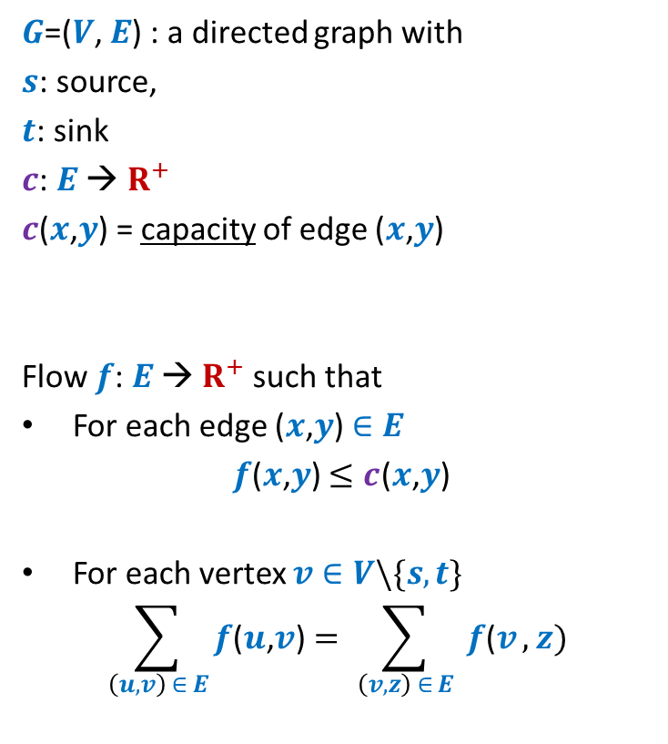





Formal Description of Flow
2
$G$=($V$, $E$) : a directed graph with
$s$: source,
$t$: sink
$c$: $E$ → $R^{+}$
$c$($x$,$y$) = capacity of edge ($x$,$y$)
Flow $f$: $E$ → $R^{+}$ such that
For each edge ($x$,$y$) $∈E$
$f$($x$,$y$) $≤c$($x$,$y$)
For each vertex $v∈V\backslash \{s,t\}$
$$\sum_{\left(u,v\right) ∈ E}{f\text{(}u\text{,}v\text{)}}=\sum_{ \left(v,z\right) ∈ E }{f\text{(}v},z)$$
$$v$$
$$x$$
5
6
15
8
$$t$$
$$s$$
6
7
14
7
17
$$u$$
4
$$y$$
Capacity constraint
Conservation constraint

Slide 4

Formal Description of Flow
2
$\text{value}\text{(}f\text{)=}$ flow leaving $s$
$$=\sum_{\left(s,v\right) ∈ E}{f\text{(}u\text{,}v\text{)}}$$
$G$=($V$, $E$) : a directed graph with
$s$: source,
$t$: sink
$c$: $E$ → $R^{+}$
$c$($x$,$y$) = capacity of edge ($x$,$y$)
Flow $f$: $E$ → $R^{+}$ such that
For each edge ($x$,$y$) $∈E$
$f$($x$,$y$) $≤c$($x$,$y$)
For each vertex $v∈V\backslash \{s,t\}$
$$\sum_{\left(u,v\right) ∈ E}{f\text{(}u\text{,}v\text{)}}=\sum_{ \left(v,z\right) ∈ E }{f\text{(}v},z)$$
$$v$$
$$x$$
4
5
5
11
6
1
15
8
$$t$$
$$s$$
6
7
1
7
7
14
7
17
$$u$$
4
$$y$$

Slide 5
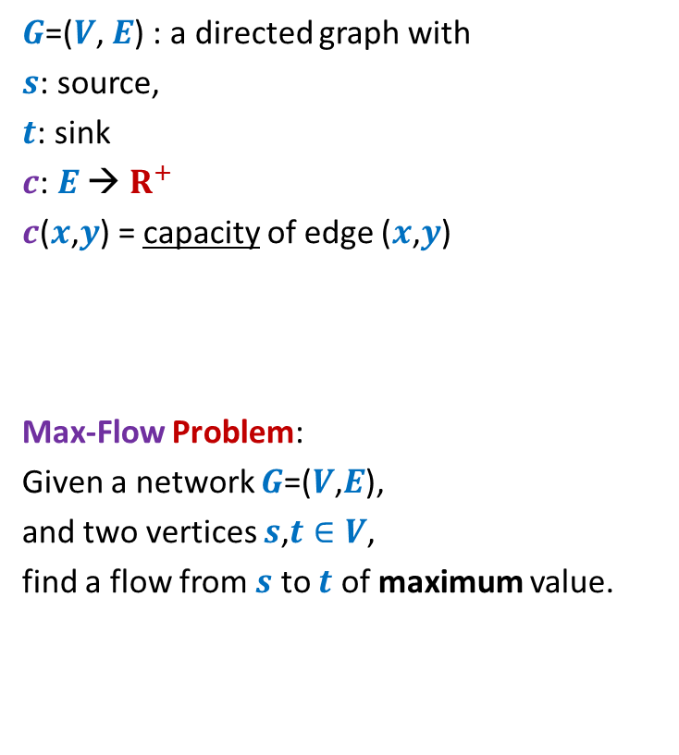
Formal Description of Flow
2
$\text{value}\text{(}f\text{)=}$ flow leaving $s$
$$=\sum_{\left(s,v\right) ∈ E}{f\text{(}u\text{,}v\text{)}}$$
$G$=($V$, $E$) : a directed graph with
$s$: source,
$t$: sink
$c$: $E$ → $R^{+}$
$c$($x$,$y$) = capacity of edge ($x$,$y$)
Max-Flow Problem:
Given a network $G$=($V$,$E$),
and two vertices $s$,$t∈V$,
find a flow from $s$ to $t$ of maximum value.
$$v$$
$$x$$
5
6
15
8
$$t$$
$$s$$
6
7
14
7
17
$$u$$
4
$$y$$

Slide 6

Towards designing max flow algorithm
A natural approach
2
Find some $s−t$ path,
Send flow along the path,
Update capacities,
Find some $s−t$ path,
…and so on ☺
$$v$$
$$x$$
5
6
5
5
+1
5
12
+7
6
15
What is the most natural approach to solve this problem ?
8
$$t$$
$$s$$
6
7
1
1
7
7
14
7
17
$$u$$
4
$$y$$

Slide 7
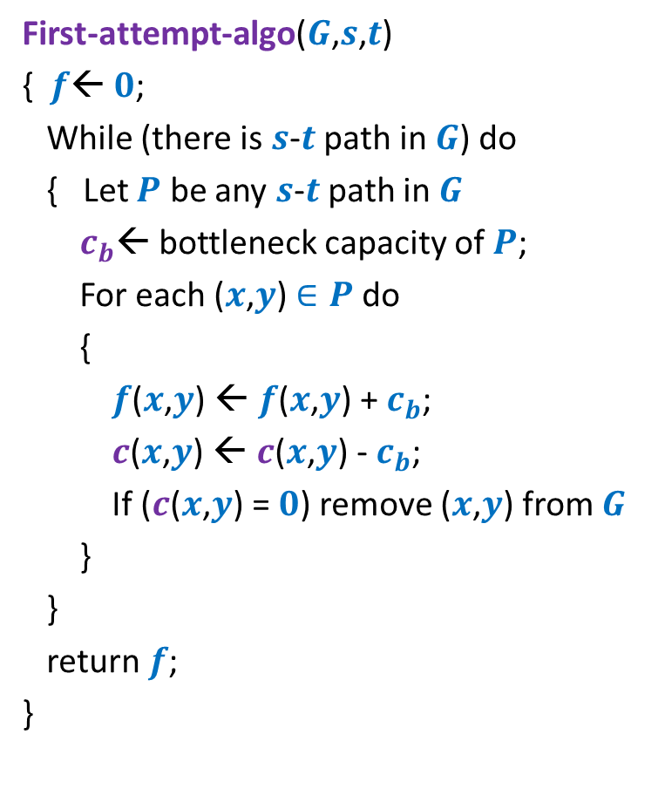
Towards designing a max flow algorithm
First-attempt-algo($G$,$s$,$t$)
{ $f$← $0$;
While (there is $s$-$t$ path in $G$) do
{ Let $P$ be any $s$-$t$ path in $G$
$c_{b}$← bottleneck capacity of $P$;
For each ($x$,$y$) $∈P$ do
{
$f$($x$,$y$) ← $f$($x$,$y$) + $c_{b}$;
$c$($x$,$y$) ← $c$($x$,$y$) - $c_{b}$;
If ($c$($x$,$y$) = $0$) remove ($x$,$y$) from $G$
}
}
return $f$;
}
Is the algorithm correct ?

Slide 8
A counterexample for First-attempt-algo

Slide 9

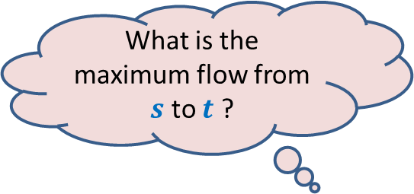



$$x$$
What is the maximum flow from $s$ to $t$ ?
20
10
$$s$$
50
$$t$$
30
10
20
$$y$$

Slide 10




Executing our first attempt algorithm
$$x$$
$$x$$
20
20
10
10
$$s$$
20
50
$$t$$
$$s$$
30
$$t$$
20
10
20
10
$$y$$
$$y$$
No $s−t$ path

Slide 11


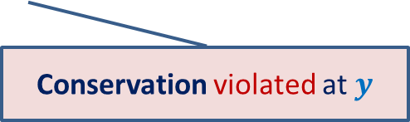

$$x$$
20
20
10
How to send extra 10 units of flow from $s$to $t$ ?
$$s$$
20
50
$$t$$
10
10
20
10
20
$$y$$
Conservation violated at $y$

Slide 12
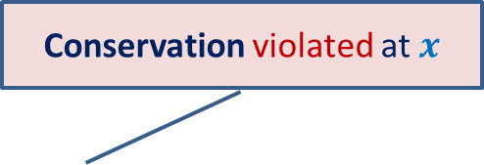
Finding a solution with scientific spirit
Conservation violated at $x$
Patience and perseverance paid ☺
$$x$$
20
10
20
10
$$s$$
10
50
$$t$$
10
20
10
20
$$y$$

Slide 13
Conservation violated at $x$
$$x$$
20
10
20
10
$$s$$
10
50
$$t$$
10
20
10
20
$$y$$

Slide 14


Insights gained from the example
Patience and perseverance paid ☺
Redistribution of a flow may help.
$$x$$
$$x$$
20
10
20
20
10
20
10
$$s$$
10
50
$$t$$
$$s$$
20
50
$$t$$
10
20
20
10
20
10
20
$$y$$
$$y$$

Slide 15


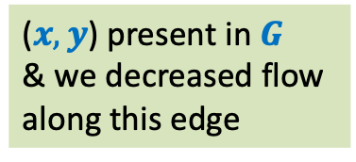




Insights gained from the example
But how did we accomplish this redistribution ?
$$x$$
By traversing a strange path
20
10
20
($s,y$)
Present in $G$
We increased flow
along this edge
10
$$s$$
10
50
$$t$$
($x,y$) present in $G$
& we decreased flow
along this edge
($y,x$)
Not present in $G$
10
20
10
20
($x,t$)
Present in $G$
We increased flow
along this edge
$$y$$
Think for a while about the structure that will facilitate all this.

Slide 16
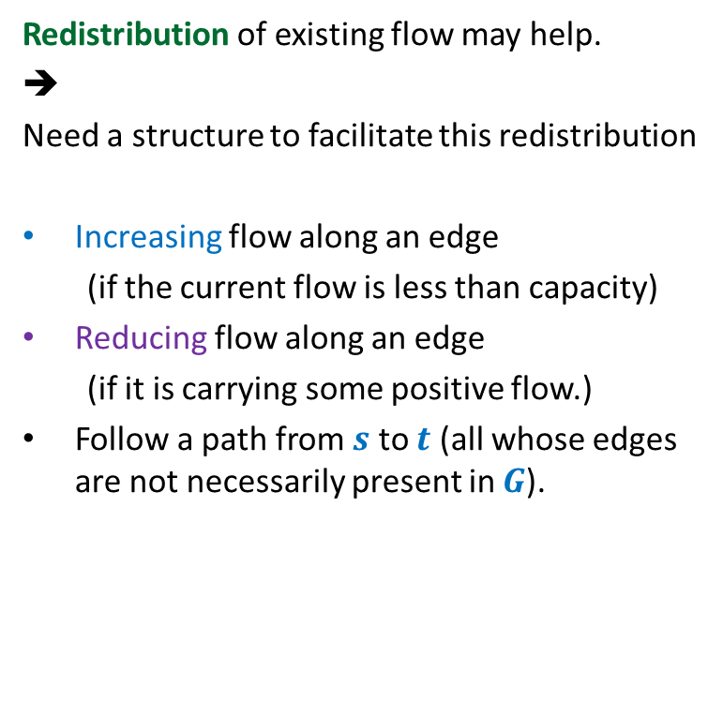
Insight gained from the example
Redistribution of existing flow may help.
➔
Need a structure to facilitate this redistribution
Increasing flow along an edge
(if the current flow is less than capacity)
Reducing flow along an edge
(if it is carrying some positive flow.)
Follow a path from $s$ to $t$ (all whose edges are not necessarily present in $G$).
Patience and perseverance paid ☺
$$x$$
20
10
20
10
$$s$$
10
50
$$t$$
10
20
10
20
Think for a while about the structure that will facilitate these operations.
$$y$$

Slide 17

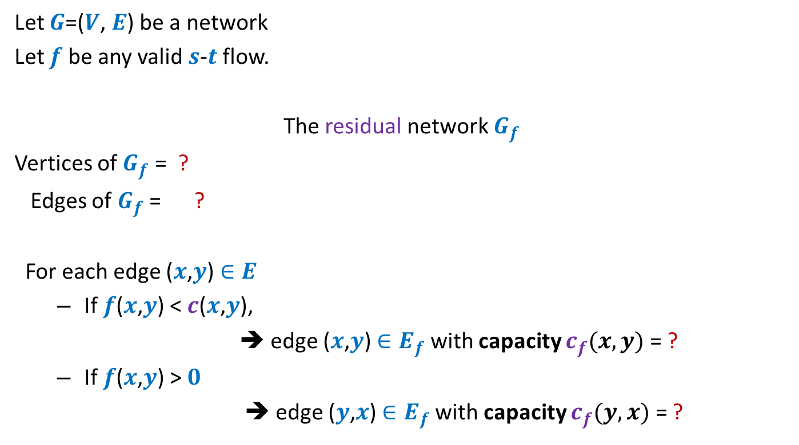



Residual network
Let $G$=($V$, $E$) be a network
Let $f$ be any valid $s$-$t$ flow.
The residual network $G_{f}$
Vertices of $G_{f}$ = ?
Edges of $G_{f}$ = ?
For each edge ($x$,$y$) $∈E$
If $f$($x$,$y$) < $c$($x$,$y$),
➔ edge ($x$,$y$) $∈E_{f}$ with capacity $c_{f}(x,y)$= ?
If $f$($x$,$y$) > $0$
➔ edge ($y$,$x$) $∈E_{f}$with capacity $c_{f}(y,x)$ = ?
$$V$$
$$E_{f}$$
Forward edge
$c$($x$,$y$) - $f$($x$,$y$)
Backward edge
$f$($x$,$y$)

Slide 18


Example of Residual Network
$$G$$
$$G_{f}$$
$$x$$
$$x$$
20
20
20
10
10
$$s$$
20
50
$$t$$
$$s$$
30
20
$$t$$
20
10
20
10
20
$$y$$
$$y$$

Slide 19
Example of Residual Network
$$G$$
$$G_{f}$$
$$x$$
$$x$$
20
20
10
20
10
10
$$s$$
20
50
$$t$$
$$s$$
30
20
$$t$$
10
10
20
10
20
10
20
$$y$$
$$y$$

Slide 20

Example of Residual Network
$$G$$
$$G_{f}$$
$$x$$
$$x$$
20
20
10
20
10
10
$$s$$
10
50
$$t$$
$$s$$
40
10
$$t$$
10
20
10
20
10
20
$$y$$
$$y$$
No $s−t$ path exists in $G_{f}$.

Slide 21












A generic step of increasing flow
Find a $s−t$ path $P$in $G_{f}$;
If edge ($x$, $y$) on the path is a forward edge
➔ Increase flow along ($x$, $y$) by $c′$ in $G$.
$$s$$
$$t$$
$$x$$
$$y$$
$$G$$
$$≥c′$$
$$≥c′$$
$$≥c′$$
$$s$$
$$t$$
$$x$$
$$y$$
$$P$$
$$G_{f}$$

Slide 22

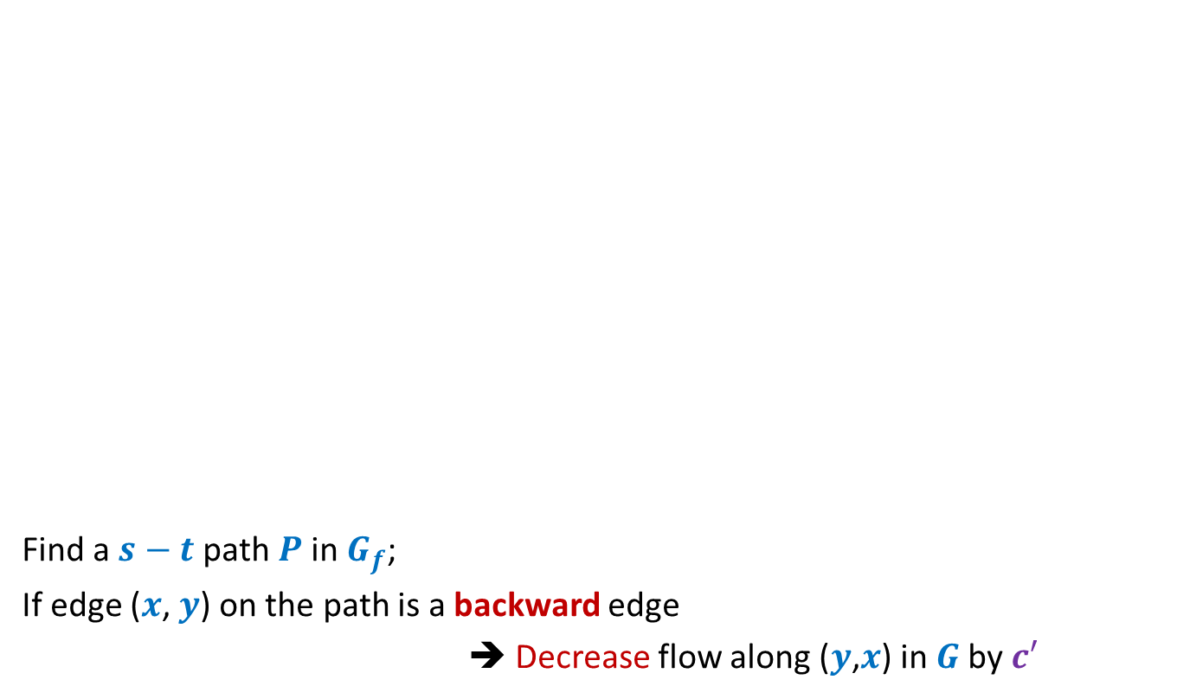
A generic step of increasing flow
Find a $s−t$ path $P$in $G_{f}$;
If edge ($x$, $y$) on the path is a backward edge
➔ Decrease flow along ($y$,$x$) in $G$by $c′$
$$s$$
$$t$$
$$x$$
$$y$$
$$G$$
This reduction of flow along ($y$,$x$) is a part of redistribution: we divert a part of $f$($y$,$x$) along some other outgoing edge of $y$, and increase flow along some edge entering $x$. Recall our example.
$$≥c′$$
$$≥c′$$
$$≥c′$$
$$s$$
$$t$$
$$x$$
$$y$$
$$P$$
$$G_{f}$$

Slide 23
Ford Fulkerson algorithm
A simple path based algorithm
+
Residual Network

Slide 24

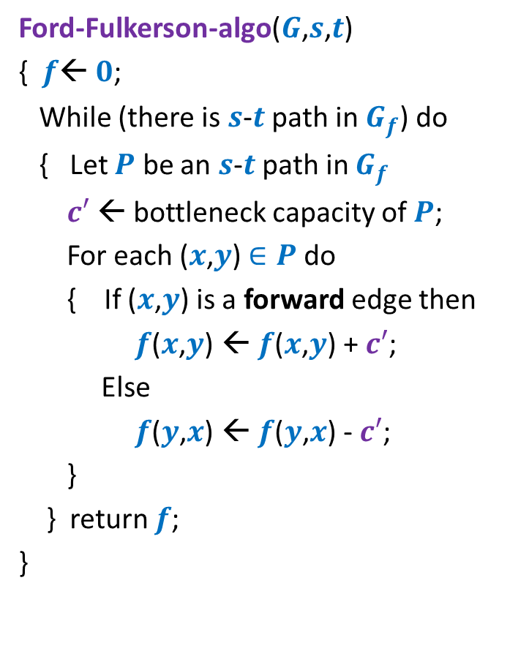
Ford Fulkerson algorithm
Ford-Fulkerson-algo($G$,$s$,$t$)
{ $f$← $0$;
While (there is $s$-$t$ path in $G_{f}$) do
{ Let $P$ be an $s$-$t$ path in $G_{f}$
$c′$ ← bottleneck capacity of $P$;
For each ($x$,$y$) $∈P$ do
{ If ($x$,$y$) is a forward edge then
$f$($x$,$y$) ← $f$($x$,$y$) + $c′$;
Else
$f$($y$,$x$) ← $f$($y$,$x$) - $c′$;
}
} return $f$;
}
Note that the flow changes in each iteration and so $G_{f}$ also changes. However, for the sake of compactness, we have not shown the code for updation of $G_{f}$.
As a homework, write the code for the same.

Slide 25









Ford Fulkerson algorithm
Ford-Fulkerson-algo($G$,$s$,$t$)
{ $f$← $0$;
While (there is $s$-$t$ path in $G_{f}$) do
{ Let $P$ be an $s$-$t$ path in $G_{f}$
$c′$ ← bottleneck capacity of $P$;
For each ($x$,$y$) $∈P$ do
{ If ($x$,$y$) is a forward edge then
$f$($x$,$y$) ← $f$($x$,$y$) + $c′$;
Else
$f$($y$,$x$) ← $f$($y$,$x$) - $c′$;
}
} return $f$;
}
Question:
Does the algorithm compute a valid flow ?
Capacity constraint is satisfied
Conservation ?
$$x∈P$$
$$G$$
$$u$$
$$x$$
$$y$$
$$G_{f}$$
$$u$$
$$x$$
$$y$$

Slide 26





Ford Fulkerson algorithm
Ford-Fulkerson-algo($G$,$s$,$t$)
{ $f$← $0$;
While (there is $s$-$t$ path in $G_{f}$) do
{ Let $P$ be an $s$-$t$ path in $G_{f}$
$c′$ ← bottleneck capacity of $P$;
For each ($x$,$y$) $∈P$ do
{ If ($x$,$y$) is a forward edge then
$f$($x$,$y$) ← $f$($x$,$y$) + $c′$;
Else
$f$($y$,$x$) ← $f$($y$,$x$) - $c′$;
}
} return $f$;
}
Question:
Does the algorithm compute a valid flow ?
Capacity constraint is satisfied
Conservation ?
$$x∈P$$
$$G$$
$$u$$
$$x$$
$$y$$
$$G_{f}$$
$$u$$
$$x$$
$$y$$

Slide 27
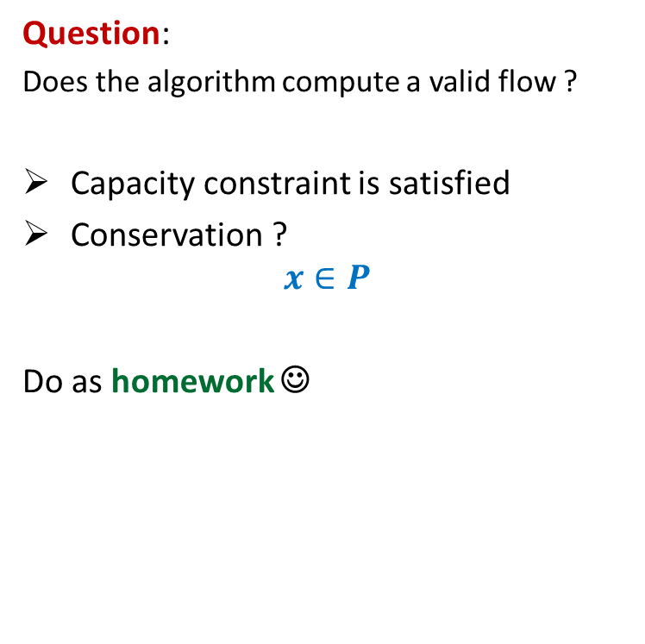
Ford Fulkerson algorithm
Ford-Fulkerson-algo($G$,$s$,$t$)
{ $f$← $0$;
While (there is $s$-$t$ path in $G_{f}$) do
{ Let $P$ be an $s$-$t$ path in $G_{f}$
$c′$ ← bottleneck capacity of $P$;
For each ($x$,$y$) $∈P$ do
{ If ($x$,$y$) is a forward edge then
$f$($x$,$y$) ← $f$($x$,$y$) + $c′$;
Else
$f$($y$,$x$) ← $f$($y$,$x$) - $c′$;
}
} return $f$;
}
Question:
Does the algorithm compute a valid flow ?
Capacity constraint is satisfied
Conservation ?
$$x∈P$$
Do as homework ☺
$$G_{f}$$
$$u$$
$$x$$
$$y$$
$$G_{f}$$
$$u$$
$$x$$
$$y$$

Slide 28
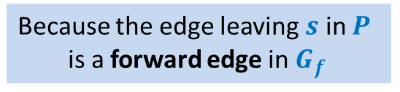
Ford Fulkerson algorithm
Ford-Fulkerson-algo($G$,$s$,$t$)
{ $f$← $0$;
While (there is $s$-$t$ path in $G_{f}$) do
{ Let $P$ be an $s$-$t$ path in $G_{f}$
$c′$ ← bottleneck capacity of $P$;
For each ($x$,$y$) $∈P$ do
{ If ($x$,$y$) is a forward edge then
$f$($x$,$y$) ← $f$($x$,$y$) + $c′$;
Else
$f$($y$,$x$) ← $f$($y$,$x$) - $c′$;
}
} return $f$;
}
Does the value of flow increase in every iteration ?
Yes.
Because the edge leaving $s$ in $P$
is a forward edge in $G_{f}$
Correctness of the algorithm ?

Slide 29
A useful exercise to internalize Ford Fulkerson algorithm
Execute Ford Fulkersion algorithm on this example when
The first path selected for sending the flow is <$s$, $x$, $v$, $t$>.
Show the execution of the iterations of the algorithm along with the residual network.
What if the first path selected is <$s$, $y$, $v$, $t$>.
Internalize the entire algorithm fully through this example.
$$x$$
10
3
9
5
$$s$$
$$t$$
8
$$u$$
10
$$v$$
10
3
3
6
5
$$y$$

Slide 30





Correctness ?
Suppose you find a flow of value $19$ using FF algorithm.
$$x$$
Is $19$ the max flow ?
10
3
9
14
$$s$$
$$t$$
$$≤27$$
8
$$u$$
2
$$v$$
10
$≤2$5
3
3
1
9
$$≤37$$
$$≤19$$
$$y$$

Slide 31
$s$-$t$Cuts

Slide 32


$s$-$t$cut
$A⊂V$, with
$s∈A$, $t∈\overline{A}$
$$s$$
$$t$$
$$A$$
$$\overline{A}$$
$$G$$

Slide 33
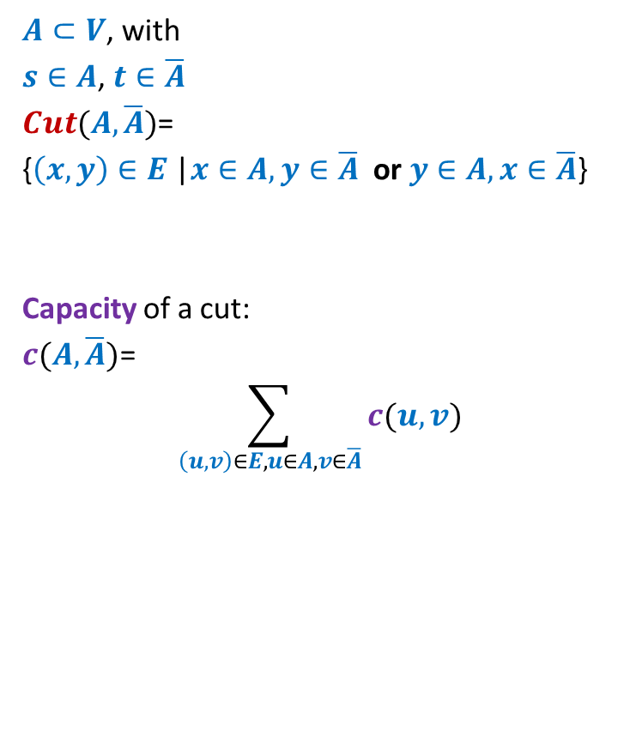



$s$-$t$cut
$A⊂V$, with
$s∈A$, $t∈\overline{A}$
$Cut(A,\overline{A})$=
{$\left(x,y\right)∈E$ |$x∈A,y∈\overline{A}$ or $y∈A,x∈\overline{A}$}
Capacity of a cut:
$c(A,\overline{A})$=
$$\sum_{\left(u,v\right)∈E,u∈A, v∈\overline{A}}{c(u,v)}$$
$$s$$
$$t$$
$$A$$
$$\overline{A}$$
$$G$$
Note: capacity of only outgoing edges is considered in capacity of a cut. Think over the reason for this before coming to the next class.

