Slide 1
Design and Analysis of Algorithms
Algorithms-II : CS345A
Lecture 26
Network Flow – V
Polynomial time algorithms for Maximum Flow

Slide 2
Recap of the last lecture

Slide 3
Polynomial Time algorithms for max-flow
Algorithm 1 For Networks with integer capacities

Slide 4

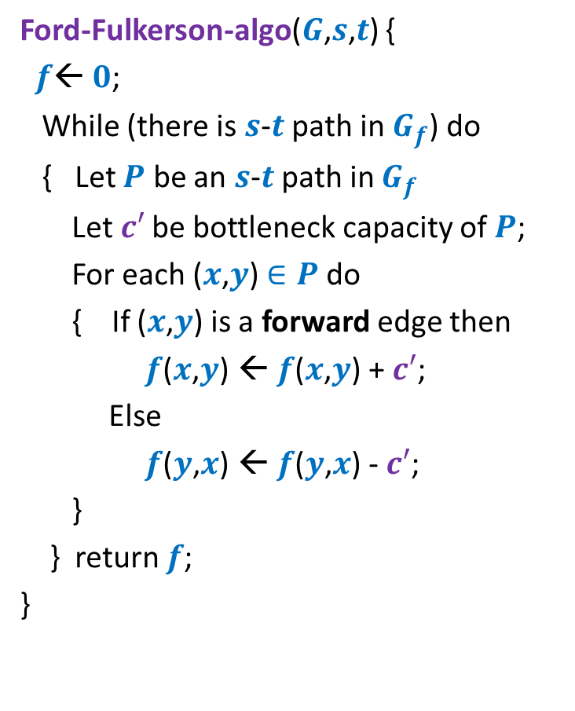

Algorithm 1
Algorithm-1($G$,$s$,$t$) {
Ford-Fulkerson-algo($G$,$s$,$t$) {
$f$← $0$;
While (there is $s$-$t$ path in $G_{f}$) do
{ Let $P$ be an $s$-$t$ path in $G_{f}$
Let$c′$ be bottleneck capacity of $P$;
For each ($x$,$y$) $∈P$ do
{ If ($x$,$y$) is a forward edge then
$f$($x$,$y$) ← $f$($x$,$y$) + $c′$;
Else
$f$($y$,$x$) ← $f$($y$,$x$) - $c′$;
}
} return $f$;
}
Let $P$ be the max-capacity $s$-$t$ path in $G_{f}$;

Slide 5
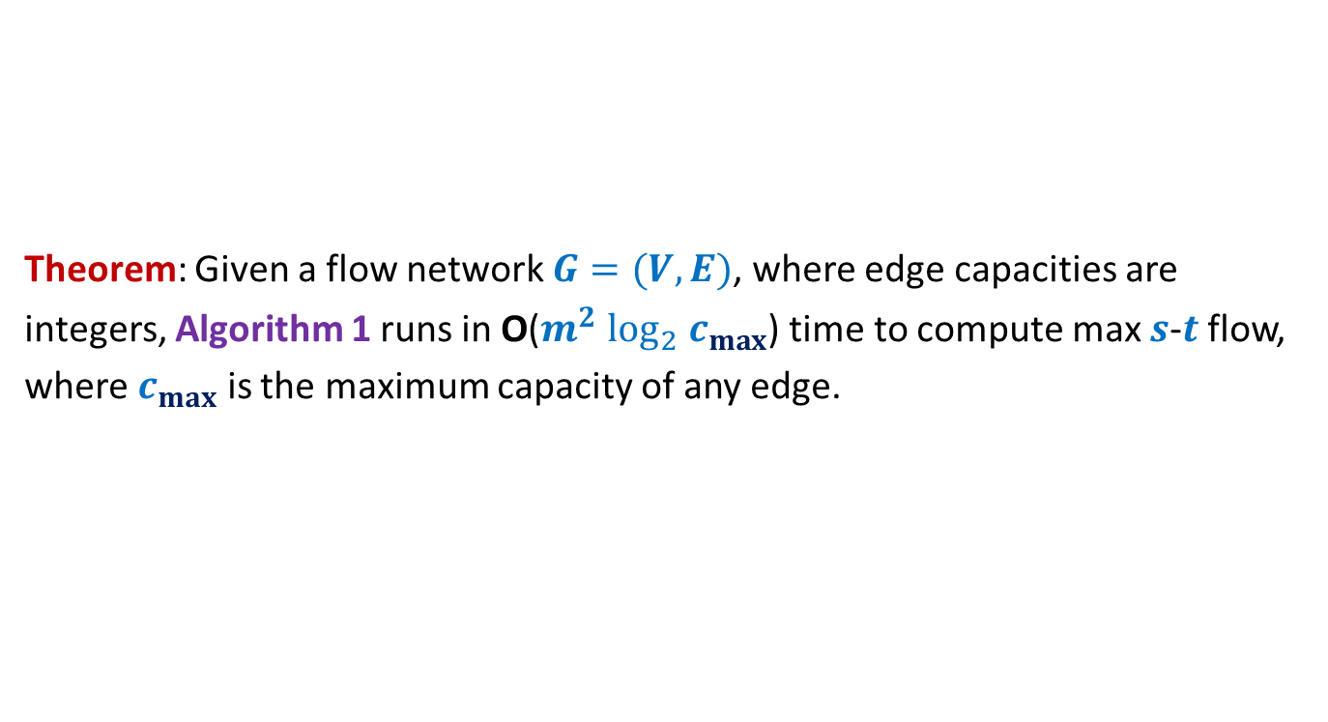
Algorithm 1
Theorem: Given a flow network $G=(V,E)$, where edge capacities are
integers, Algorithm 1 runs in O($m^{2} \log_{2} c_{max}$) time to compute max $s$-$t$ flow,
where $c_{max}$ is the maximum capacity of any edge.

Slide 6

Polynomial Time algorithm for max-flow
Algorithm 2
For Networks with edge capacities $∈R^{+}$

Slide 7
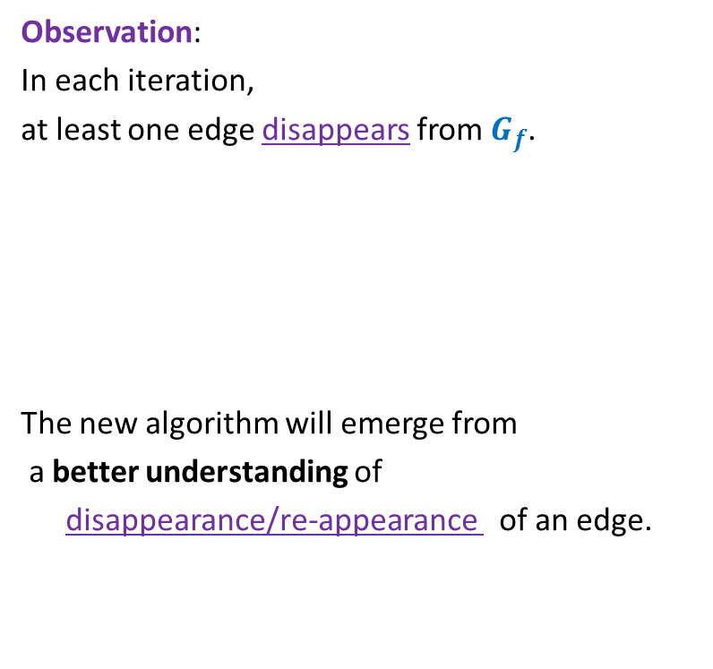

Ford Fulkerson Algorithm
Ford-Fulkerson-algo($G$,$s$,$t$) {
$f$← $0$;
While (there is $s$-$t$ path in $G_{f}$) do
{ Let $P$ be an $s$-$t$ path in $G_{f}$
Let$c′$ be bottleneck capacity of $P$;
For each ($x$,$y$) $∈P$ do
{ If ($x$,$y$) is a forward edge then
$f$($x$,$y$) ← $f$($x$,$y$) + $c′$;
Else
$f$($y$,$x$) ← $f$($y$,$x$) - $c′$;
}
} return $f$;
}
Observation:
In each iteration,
at least one edge disappears from $G_{f}$.
The new algorithm will emerge from
a better understanding of
disappearance/re-appearance of an edge.
But it may appear in $G_{f}$ again.

Slide 8

Disappearance of an edge in $G_{f}$

Slide 9














Disappearance of a forward edge
Flow must have increased along edge ($x$,$y$) up to $c$($x$,$y$).
➔ ($x$,$y$) must belong to the path $P$ selected during $i$th Iteration.
$$x$$
$$y$$
$$s$$
$$t$$
$$G_{f}$$
$$x$$
$$y$$
After $i$th Iteration
$$x$$
$$y$$
$$s$$
$$t$$
$$G_{f′}$$
$$x$$
$$y$$

Slide 10







Disappearance of a backward edge
Flow must have decreased along edge ($y$,$x$) to 0.
➔ ($x$,$y$) must belong to the path $P$ selected during $i$th Iteration.
$$y$$
$$x$$
$$s$$
$$t$$
$$G_{f}$$
$$x$$
$$y$$
After $i$th Iteration
$$y$$
$$x$$
$$s$$
$$t$$
$$G_{f′}$$
$$x$$
$$y$$

Slide 11
the (RE-)appearance of an edge

Slide 12










(Re)-Appearance of a forward edge
Flow must have reduced along edge ($x$,$y$) to less than $c$($x$,$y$).
➔ ($y$,$x$) must belong to the path $P$ selected during $i$th Iteration.
$$x$$
$$y$$
$$s$$
$$t$$
$$G_{f}$$
$$x$$
$$y$$
After $i$th Iteration
$$x$$
$$y$$
$$s$$
$$t$$
$$G_{f′}$$
$$x$$
$$y$$

Slide 13


(Re)-appearance of a backward edge
Flow must have increased along edge ($y$,$x$) after ith iteration.
➔ ($y$,$x$) must belong to the path $P$ selected during $i$th Iteration.
$$y$$
$$x$$
$$s$$
$$t$$
$$G_{f}$$
$$x$$
$$y$$
After $i$th Iteration
$$y$$
$$x$$
$$s$$
$$t$$
$$G_{f′}$$
$$x$$
$$y$$

Slide 14
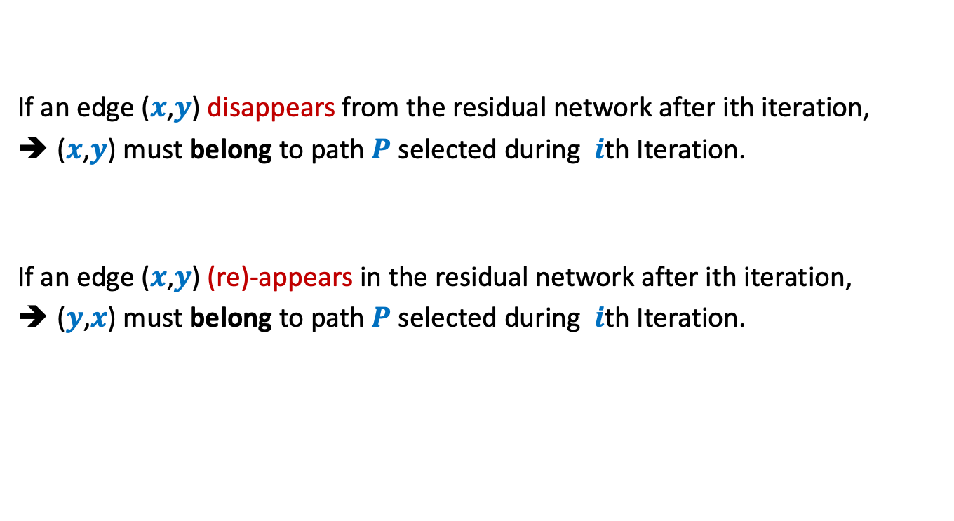
Disappearance/Reappearance of an edge in residual network
If an edge ($x$,$y$) disappears from the residual network after ith iteration,
($x$,$y$) must belong to path $P$ selected during $i$th Iteration.
If an edge ($x$,$y$) (re)-appears in the residual network after ith iteration,
($y$,$x$) must belong to path $P$ selected during $i$th Iteration.

Slide 15



Algorithm 2
Ford-Fulkerson-algo($G$,$s$,$t$) {
$f$← $0$;
While (there is $s$-$t$ path in $G_{f}$) do
{ Let $P$ be an $s$-$t$ path in $G_{f}$
Let$c′$ be bottleneck capacity of $P$;
For each ($x$,$y$) $∈P$ do
{ If ($x$,$y$) is a forward edge then
$f$($x$,$y$) ← $f$($x$,$y$) + $c′$;
Else
$f$($y$,$x$) ← $f$($y$,$x$) - $c′$;
}
} return $f$;
}
Algorithm-2($G$,$s$,$t$) {
In each iteration, at least one edge disappears from $G_{f}$.
This algorithm ensures that an edge can disappear and re-appear O($n$) times.
Let $P$ be the shortest $s$-$t$ path in $G_{f}$;
How to modify the FF algorithm so that the number of times an edge disappears has a polynomial bound ?

Slide 16

Algorithm 2
Ford-Fulkerson-algo($G$,$s$,$t$) {
$f$← $0$;
While (there is $s$-$t$ path in $G_{f}$) do
{ Let $P$ be an $s$-$t$ path in $G_{f}$
Let$c′$ be bottleneck capacity of $P$;
For each ($x$,$y$) $∈P$ do
{ If ($x$,$y$) is a forward edge then
$f$($x$,$y$) ← $f$($x$,$y$) + $c′$;
Else
$f$($y$,$x$) ← $f$($y$,$x$) - $c′$;
}
} return $f$;
}
Algorithm-2($G$,$s$,$t$) {
Let $P$ be the shortest $s$-$t$ path in $G_{f}$;
How to prove:
An edge can disappear and re-appear O($n$) times.

Slide 17







A crucial Insight
Lemma : Distance from $s$ to each vertex increases monotonically in $G_{f}$.
$$δ_{f′}\left(s,x\right)≥δ_{f}\left(s,x\right)$$
$$δ_{f}(s,x)$$
$$s$$
$$t$$
$$x$$
$$G_{f}$$
After $i$th Iteration
$$δ_{f′}(s,x)$$
$$s$$
$$t$$
$$G_{f′}$$
$$x$$

Slide 18


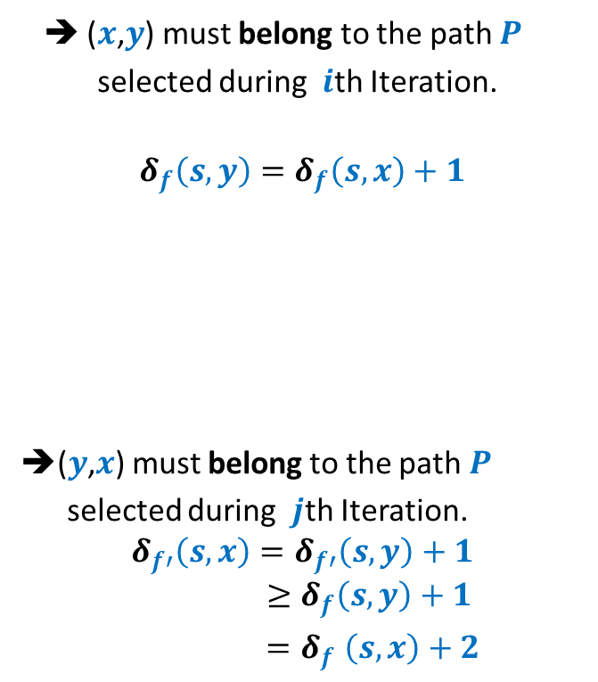



Bounding the disappearing/re-appearing of an edge
$$G_{f}$$
$$s$$
$$t$$
$$x$$
$$y$$
➔ ($x$,$y$) must belong to the path $P$
selected during $i$th Iteration.
$$δ_{f}\left(s,y\right)=δ_{f}\left(s,x\right)+1$$
➔($y$,$x$) must belong to the path $P$
selected during $j$th Iteration.
$$δ_{f′}\left(s,x\right)=δ_{f′}\left(s,y\right)+1$$
$$≥δ_{f}\left(s,y\right)+1$$
${=δ}_{f}\left(s,x\right)+2$
After $i$th Iteration
$$s$$
$$t$$
$$x$$
$$y$$
$$δ_{f′}\left(s,y\right)≥δ_{f}\left(s,y\right)$$
$$G_{f′}$$
After $j$th Iteration
$$s$$
$$t$$
$$x$$
$$y$$

Slide 19
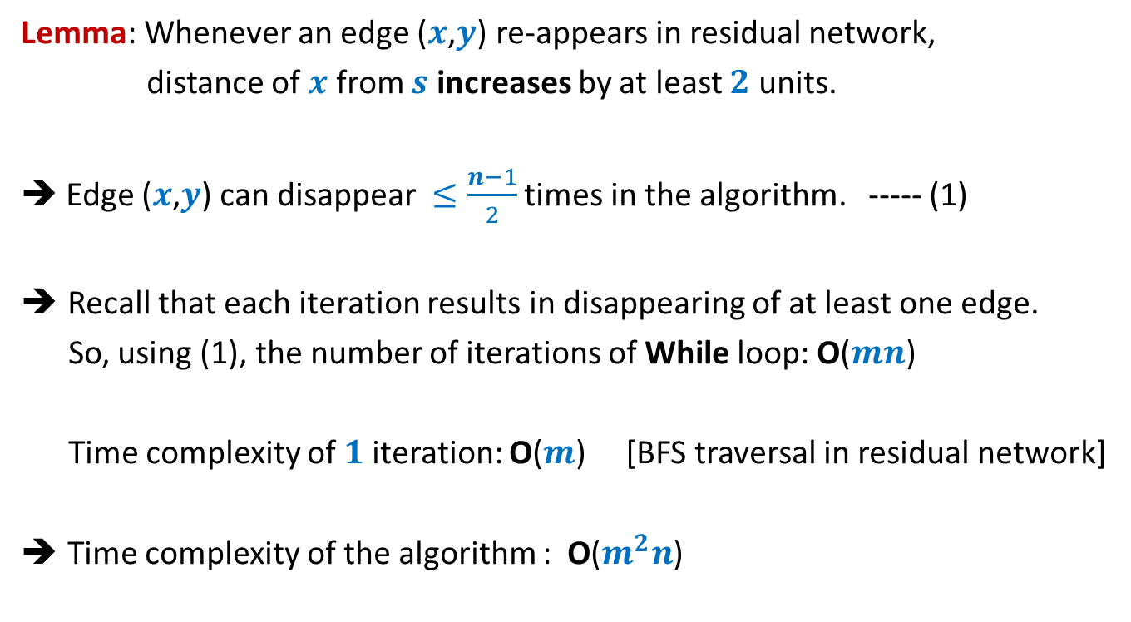
Analysis of Algorithm 2
Lemma: Whenever an edge ($x$,$y$) re-appears in residual network,
distance of $x$ from $s$ increases by at least $2$ units.
➔ Edge ($x$,$y$) can disappear $≤\frac{n−1}{2}$ times in the algorithm. ----- (1)
Recall that each iteration results in disappearing of at least one edge.
So, using (1), the number of iterations of While loop: O($mn$)
Time complexity of $1$iteration: O($m$) [BFS traversal in residual network]
Time complexity of the algorithm : O($m^{2}n$)

Slide 20
Proof of the monotonic increase of distanceS in residual network

Slide 21




Proof by contradiction
$δ_{f′}\left(s,x\right)<δ_{f}\left(s,x\right)$
Let $x$be the nearest “defaulter”.
➔ For each vertex $v$in $G_{f′}$ with $δ_{f^{′}}\left(s,v\right)<δ_{f′}(s,x)$,
$δ_{f}\left(s,v\right)≤δ_{f′}\left(s,v\right)$
$$δ_{f}(s,x)$$
$$s$$
$$t$$
$$G_{f}$$
$$x$$
$i$th Iteration
$$δ_{f′}(s,x)$$
$$G_{f′}$$
$$s$$
$$t$$
$$x$$

Slide 22








Proof by contradiction
Definitely $δ_{f}\left(s,u\right)≤δ_{f′}\left(s,u\right)$
➔Edge $\left(u,x\right)$ must have appeared in residual network after $i$th iteration.
➔Edge $\left(x,u\right)∈P$ (the path selected during $i$th Iteration)
➔ $δ_{f}\left(s,u\right)=δ_{f}\left(s,x\right)+1$
$$δ_{f}(s,x)$$
$$P$$
$$s$$
$$t$$
$$G_{f}$$
$$u$$
$$x$$
$$u$$
$i$th Iteration
$$s$$
$$t$$
$$G_{f′}$$
$$u$$
$$x$$
contradiction
$>δ_{f′}\left(s,x\right)+1$
$=(δ_{f^{′}}\left(s,u\right)+1)+1$
$δ_{f}\left(s,u\right)>δ_{f′}\left(s,u\right)$

Slide 23
Applications of Max-Flow
Bipartite Matching

Slide 24
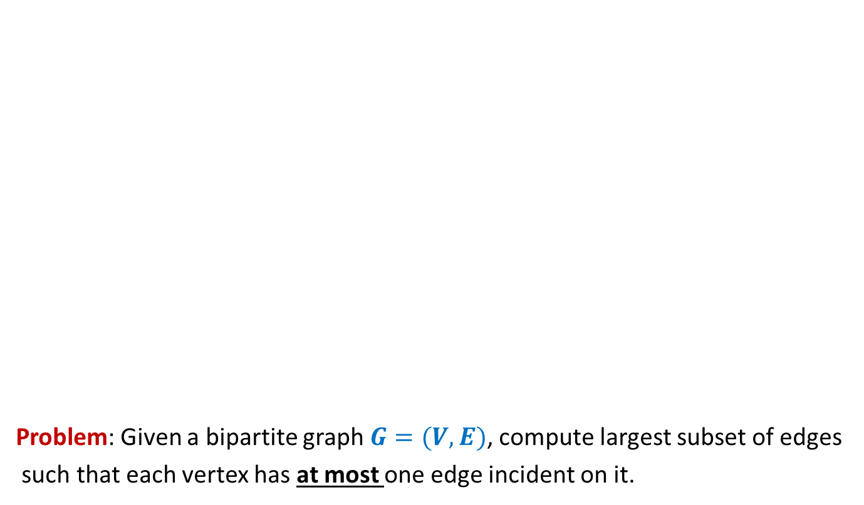
Bipartite matching
Problem: Given a bipartite graph $G=(V,E)$, compute largest subset of edges
such that each vertex has at most one edge incident on it.
applicants
jobs
Matching of size 5
Matching of size 3

Slide 25
Generalization of max-flow Problem
Extending the conservation constraint

Slide 26
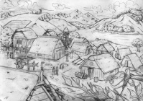
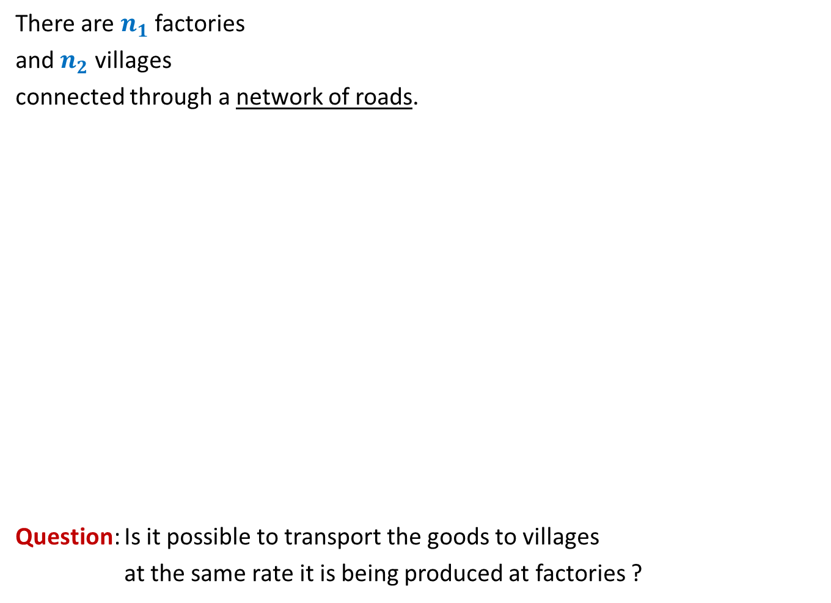
There are $n_{1}$ factories
and $n_{2}$ villages
connected through a network of roads.
Question: Is it possible to transport the goods to villages
at the same rate it is being produced at factories ?
600
400
300
No
Yes
What if roads have capacities ?
200
200
200
500

Slide 27
600
800
500
400
900
300
200
No
?
100
600
What if roads have capacities ?
200
700
200
700
300
50
200
500

Slide 28
We shall discuss these problems in the next lecture.
You are strongly advised to ponder over algorithm for these problem.

