Slide 1
Design and Analysis of Algorithms
CS345A
Lecture 28
Mincuts
Amortized analysis
(A powerful tool to analyse algorithm)

Slide 2







$s$-$t$cut
$A⊂V$, with
$s∈A$, $t∈\overline{A}$
$$s$$
$$t$$
$$A$$
$$\overline{A}$$
$$G$$

Slide 3
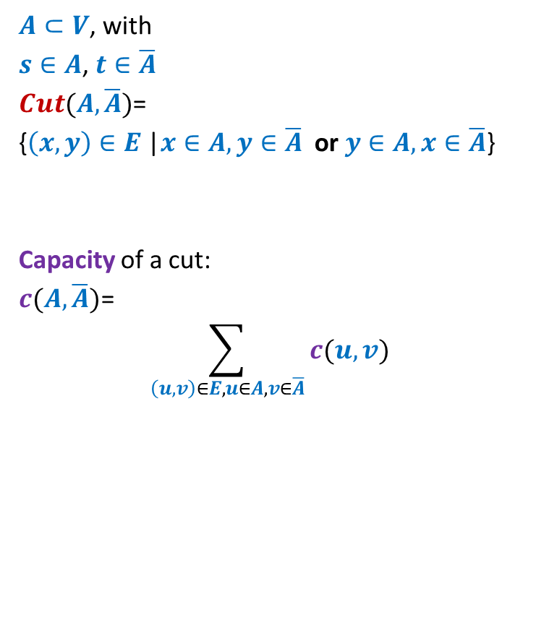
$s$-$t$cut
$A⊂V$, with
$s∈A$, $t∈\overline{A}$
$Cut(A,\overline{A})$=
{$\left(x,y\right)∈E$ |$x∈A,y∈\overline{A}$ or $y∈A,x∈\overline{A}$}
Capacity of a cut:
$c(A,\overline{A})$=
$$\sum_{\left(u,v\right)∈E,u∈A, v∈\overline{A}}{c(u,v)}$$
$$s$$
$$t$$
$$A$$
$$\overline{A}$$
$$G$$

Slide 4
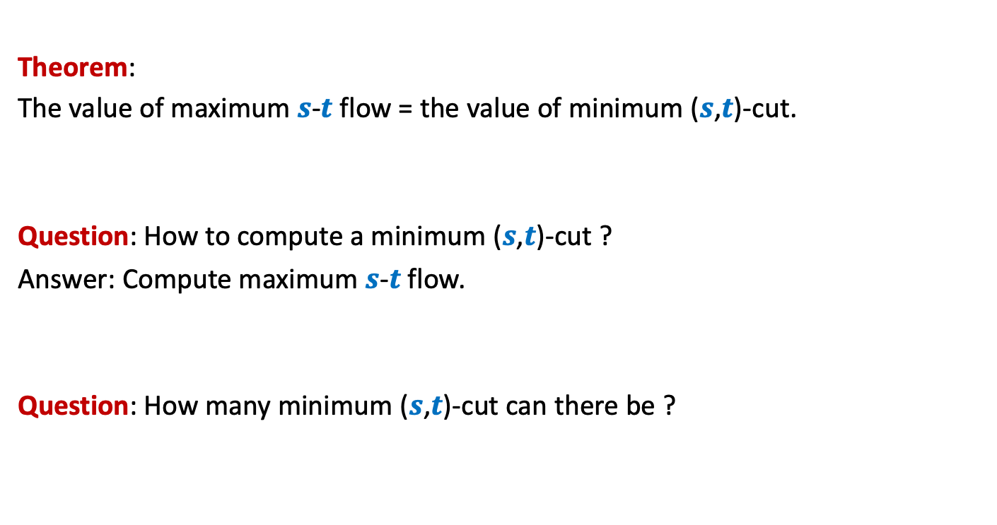

Minimum ($s$,$t$)-cuts
Theorem:
The value of maximum $s$-$t$ flow = the value of minimum ($s$,$t$)-cut.
Question: How to compute a minimum ($s$,$t$)-cut ?
Answer: Compute maximum $s$-$t$ flow.
Question: How many minimum ($s$,$t$)-cut can there be ?

Slide 5


Minimum ($s$,$t$)-cuts
$$A$$
$$s$$
$$t$$

Slide 6

Minimum ($s$,$t$)-cuts
$$A$$
$$2^{n−2}$$
$$s$$
$$t$$

Slide 7

Minimum ($s$,$t$)-cuts
Theorem:
There can be $2^{n−2}$ minimum ($s$,$t$)-cuts in a graph.
Question: How does a minimum ($s$,$t$)-cut look like in $G_{f}$?
Homework:
Ponder over it ☺

Slide 8
Amortized Analysis

Slide 9

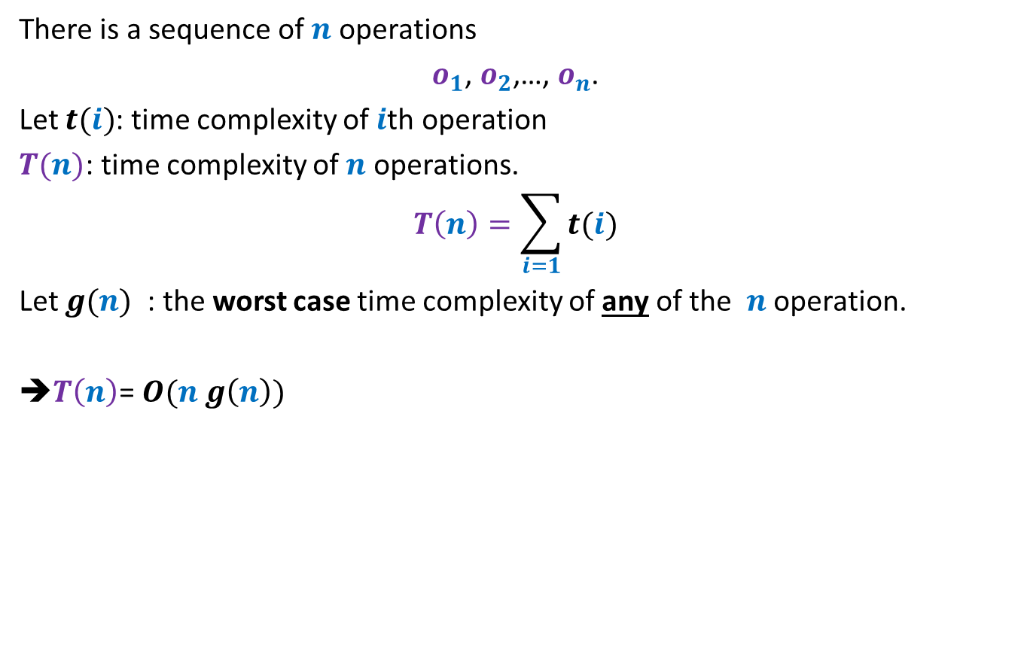


When there is a huge variation in the time complexity of
$o_{1}$, $o_{2}$,…, $o_{n}$
There is a sequence of $n$ operations
$o_{1}$, $o_{2}$,…, $o_{n}$.
Let $t(i)$: time complexity of $i$th operation
$T(n)$: time complexity of $n$ operations.
$$T\left(n\right)=\sum_{i=1}{t(i)}$$
Let $g(n)$ : the worst case time complexity of any of the $n$ operation.
➔$T\left(n\right)$= $O(n g\left(n\right))$
$$g(n)$$
This may be
grossly wrong.
$$t(i)$$
operations

Slide 10
Problem 1
Bit Flips in a binary Counter

Slide 11
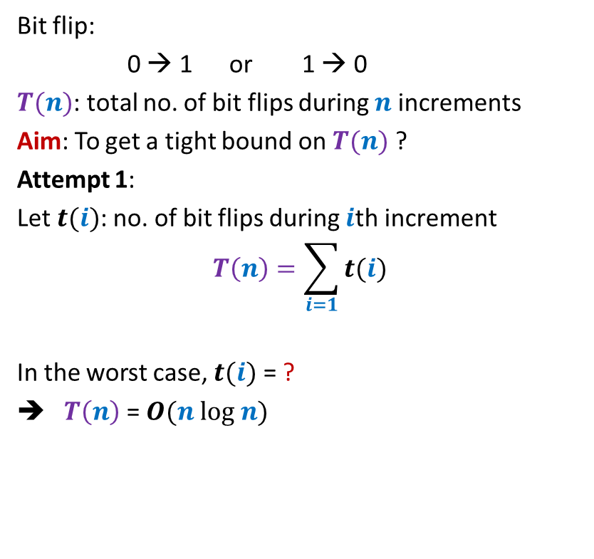


Bit flips during $n$ increment operation
Bit flip:
0 → 1 or 1 → 0
$T(n)$: total no. of bit flips during $n$ increments
Aim: To get a tight bound on $T(n)$ ?
Attempt 1:
Let $t(i)$: no. of bit flips during $i$th increment
$$T\left(n\right)=\sum_{i=1}{t(i)}$$
In the worst case, $t(i)$ = ?
➔ $T\left(n\right)$ = $O(n log n)$
0 0 0 0 1 0 0 1
0 0 0 0 1 0 0 0
0 0 0 0 0 1 1 1
0 0 0 0 0 1 1 0
0 0 0 0 0 1 0 1
0 0 0 0 0 1 0 0
$$1+\log_{2} i$$
0 0 0 0 0 0 1 1
0 0 0 0 0 0 1 0
0 0 0 0 0 0 0 1
0 0 0 0 0 0 0 0

Slide 12







Bit flips during $n$ increment operation
Bit flip:
0 → 1 or 1 → 0
$T(n)$: total no. of bit flips during $n$ increments
Aim: To get a tight bound on $T(n)$ ?
Attempt 2:
$f(i)$:
$$T\left(n\right)=\sum_{i=0}{f(i)}$$
$f(0)$ = ?
$f(1)$ = ?
$f(2)$ = ?
$f(i)$ = ?
➔
$$T\left(n\right)=n\sum_{i=0}{2^{−i}}$$
0 0 0 0 1 0 0 1
0 0 0 0 1 0 0 0
no. of times $i$th bit flips during $n$increments
0 0 0 0 0 1 1 1
0 0 0 0 0 1 1 0
0 0 0 0 0 1 0 1
$$n$$
$$n/2$$
0 0 0 0 0 1 0 0
$$n/4$$
0 0 0 0 0 0 1 1
$$n/2^{i}$$
0 0 0 0 0 0 1 0
0 0 0 0 0 0 0 1
$$<2n$$
0 0 0 0 0 0 0 0
7 6 5 4 3 2 1 0

Slide 13
Problem 2
STACK with multi-pop

Slide 14


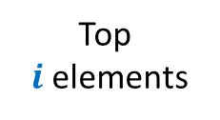





Stack with multi-pop
Push($S$,$x$)
Multi-pop($S$,$i$)
Time complexity = $c$
$$S$$
$$S$$
Top
$i$ elements
Time complexity = $i$ $c$
$$S$$
$$S$$

Slide 15

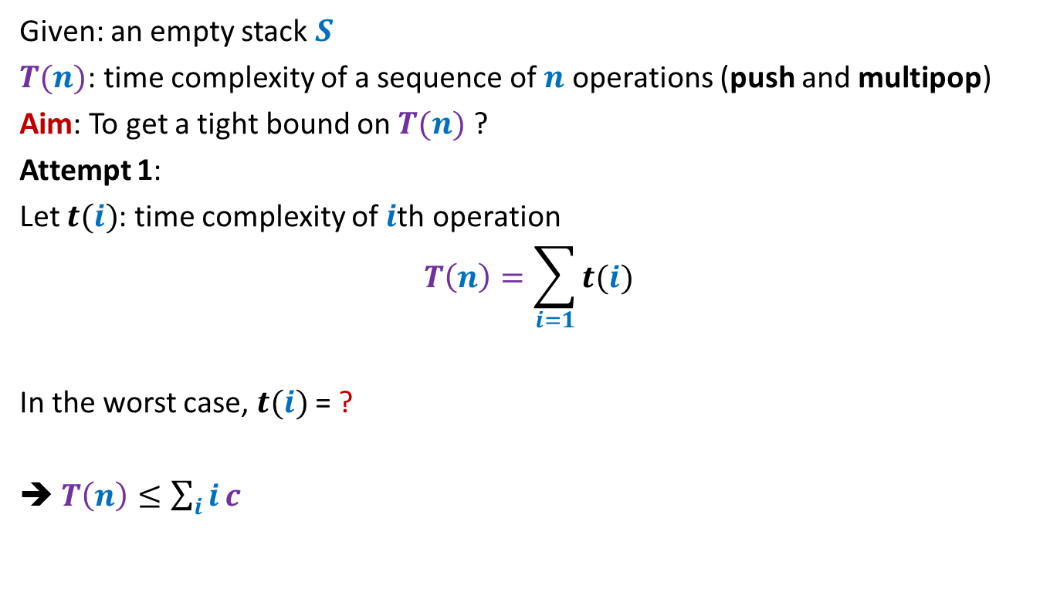

Stack with multi-pop
Given: an empty stack $S$
$T(n)$: time complexity of a sequence of $n$ operations (push and multipop)
Aim: To get a tight bound on $T(n)$ ?
Attempt 1:
Let $t(i)$: time complexity of $i$th operation
$$T\left(n\right)=\sum_{i=1}{t(i)}$$
In the worst case, $t(i)$ = ?
➔ $T\left(n\right)≤\sum_{i}{i}c$
$$(i−1) c$$
$$=O(n^{2})$$

Slide 16

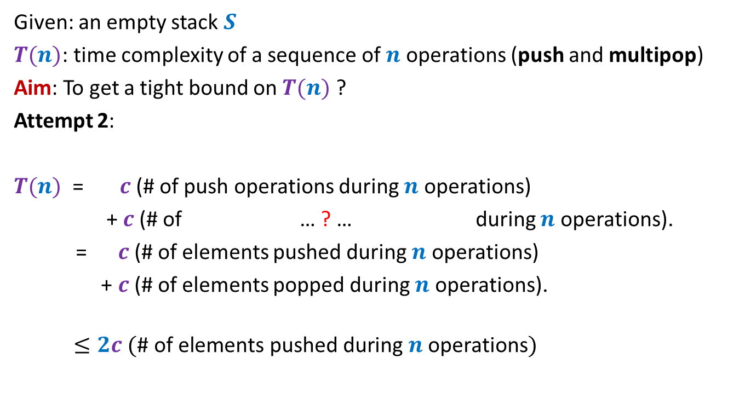
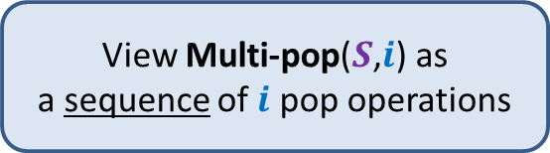

Stack with multi-pop
Given: an empty stack $S$
$T(n)$: time complexity of a sequence of $n$ operations (push and multipop)
Aim: To get a tight bound on $T(n)$ ?
Attempt 2:
$T(n)$ = $c$(# of push operations during $n$ operations)
+ $c$(# of … ? … during $n$ operations).
= $c$(# of elements pushed during $n$ operations)
+ $c$(# of elements popped during $n$ operations).
$$≤2c (\text{\# }\text{of} \text{elements} \text{pushed} \text{during} n \text{operations})$$
pop operations of all multipops
View Multi-pop($S$,$i$) as
a sequence of $i$ pop operations
$$≤2cn$$
$$=O(n)$$

Slide 17
Amortized COST
Inspiration from potential energy

Slide 18

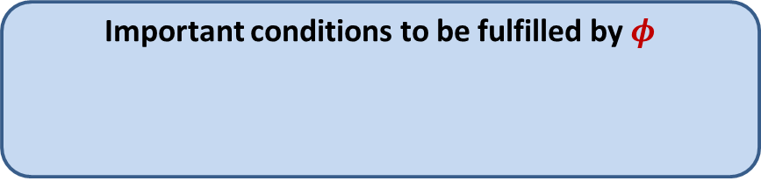




Amortized Cost
$φ$: potential function associated with the algorithm/data-structure
$φ(i)$: Potential at the end of $i$th operation
Amortized cost of $i$th operation $≝$ Actual cost of $i$th operation
Amortized cost of $n$ operations $≝$ $\sum_{i}{\text{Amortized} \text{cost} \text{of} i\text{th} \text{operation}}$
= Actual cost of $n$ operations
= Actual cost of $n$operations + $φ\left(n\right)$
$≥$ Actual cost of $n$operations
Important conditions to be fulfilled by $φ$
$φ(0)$ = $0$
$φ\left(i\right)≥0$ for all $i$
+ $\left(φ\left(i\right)−φ\left(i−1\right)\right)$
+ $\left(φ\left(n\right)−φ\left(0\right)\right)$

Slide 19
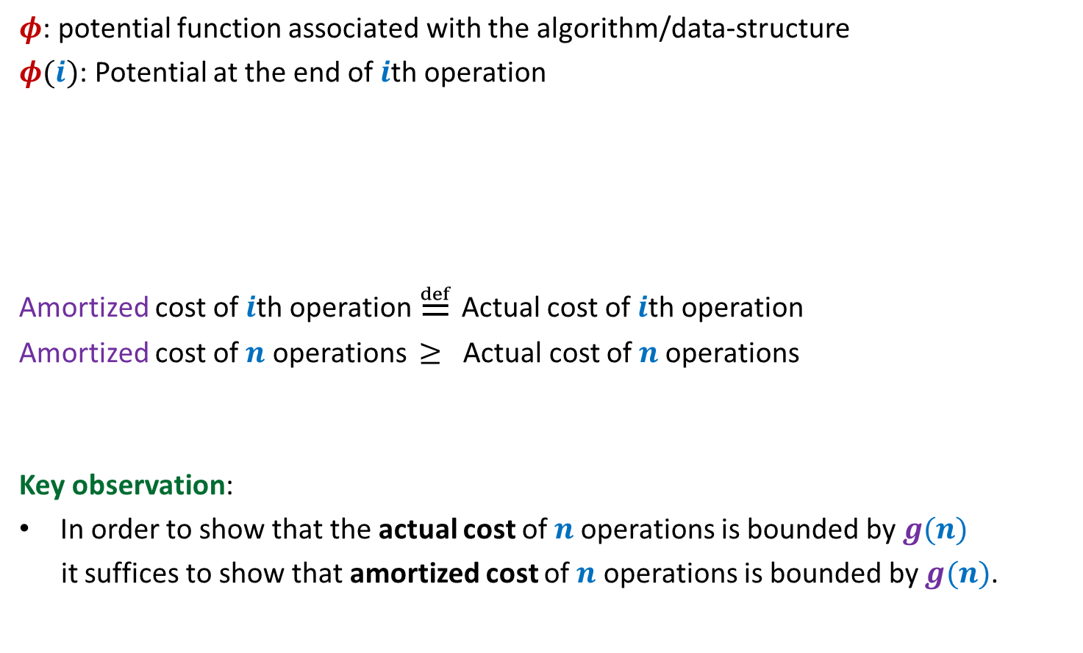
Amortized Cost
$φ$: potential function associated with the algorithm/data-structure
$φ(i)$: Potential at the end of $i$th operation
Amortized cost of $i$th operation $≝$ Actual cost of $i$th operation
Amortized cost of $n$ operations $≥$ Actual cost of $n$operations
Key observation:
In order to show that the actual cost of $n$operations is bounded by $g(n)$
it suffices to show that amortized cost of $n$ operations is bounded by $g(n)$.
Important conditions to be fulfilled by $φ$
$φ(0)$ = $0$
$φ\left(i\right)≥0$ for all $i$
+ $\left(φ\left(i\right)−φ\left(i−1\right)\right)$
?

Slide 20


This is how it may work out
Actual cost
Amortized cost
Operations
$$−$$
$$Δφ$$

Slide 21
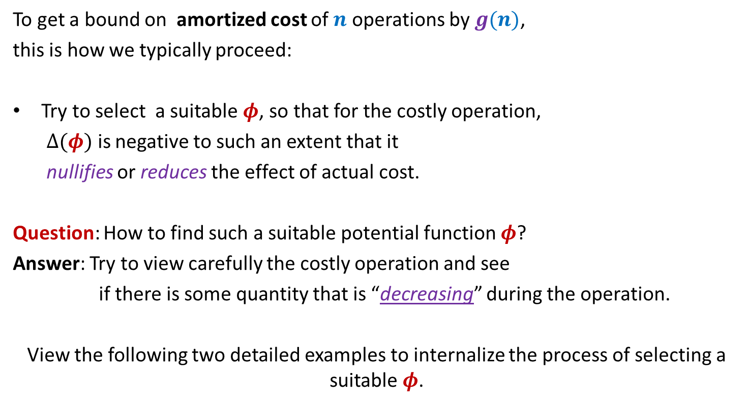
Amortized Cost
To get a bound on amortized cost of $n$ operations by $g(n)$,
this is how we typically proceed:
Try to select a suitable $φ$, so that for the costly operation,
$Δ(φ)$ is negative to such an extent that it
nullifies or reduces the effect of actual cost.
Question: How to find such a suitable potential function $φ$?
Answer: Try to view carefully the costly operation and see
if there is some quantity that is “decreasing” during the operation.
View the following two detailed examples to internalize the process of selecting a suitable $φ$.

Slide 22
amortized analysis of bit flips of a binary counter

Slide 23
A careful insight into increment
Algorithm for increment:
Keep scanning from right to left till we get the first 0
Flip all the scanned bits.
0 | 0 | 1 | 1 | 0 | 1 | 1 | 0 | 0 | 0 | 0 | 0
0 | 0 | 1 | 1 | 0 | 1 | 0 | 0 | 0 | 0 | 1 | 0
0 | 0 | 1 | 1 | 0 | 1 | 0 | 1 | 1 | 1 | 1 | 1
0 | 0 | 1 | 1 | 0 | 1 | 0 | 0 | 0 | 0 | 0 | 1

Slide 24

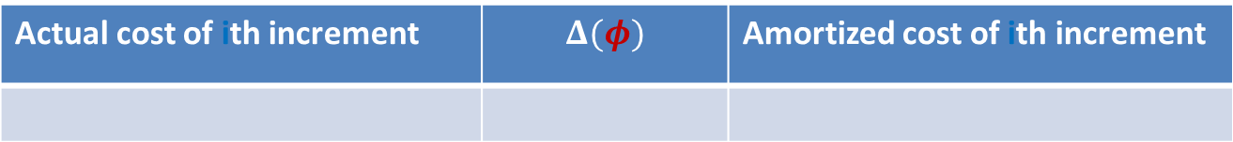








A careful insight into increment
Actual cost of $i$th increment =
0 | 0 | 1 | 1 | 0 | 1 | 1 | 0 | 0 | 0 | 0 | 0
0 | 0 | 1 | 1 | 0 | 1 | 0 | 0 | 0 | 0 | 1 | 0
0 | 0 | 1 | 1 | 0 | 1 | 0 | 1 | 1 | 1 | 1 | 1
0 | 0 | 1 | 1 | 0 | 1 | 0 | 0 | 0 | 0 | 0 | 1
$$k=5$$
$$k=1$$
1 + Length of longest suffix with all 1’s
Actual cost of ith increment | $$Δ(φ)$$ | Amortized cost of ith increment
$$k+1$$
$$−k+1$$
$$2$$
$φ$($i$): # of 1’s in the counter after $i$th increment
Amortized cost of $i$th increment $=2$
Amortized cost of $n$ increments $=2n=O(n)$
Actual cost of $n$ increments $=O(n)$

Slide 25

Homework
Question: What if we had used
$φ$: Length of longest suffix of 1’s

Slide 26
amortized analysis of Stack with multi-pop

Slide 27



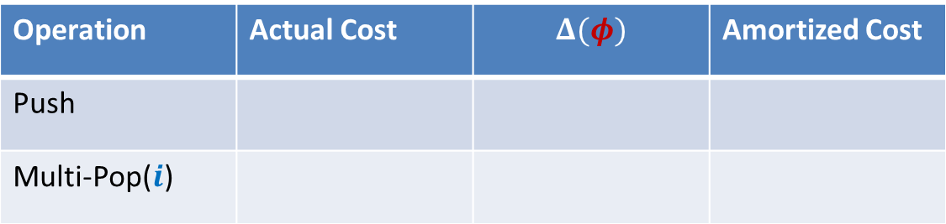






Stack with multi-pop
Multi-pop($S$,$i$)
Top
$i$ elements
$$S$$
$$S$$
Operation | Actual Cost | $$Δ(φ)$$ | Amortized Cost
Push
Multi-Pop($i$)
$$c$$
$$i c$$
$$−i c$$
$$0$$
$φ$($i$): $c$ (# elements in stack after $i$th operation)

Slide 28





Stack with multi-pop
Push($S$,$x$)
$$S$$
$$S$$
Operation | Actual Cost | $$Δ(φ)$$ | Amortized Cost
Push
Multi-Pop($i$)
$$c$$
$$c$$
$$2c$$
$$i c$$
$$−i c$$
$$0$$
$φ$($i$): $c$ (# elements in stack after $i$th operation)
Amortized cost of each operation $≤2c$
Amortized cost of $n$ operations $≤2nc=O(n)$
Actual cost of $n$ operations $=O(n)$

Slide 29

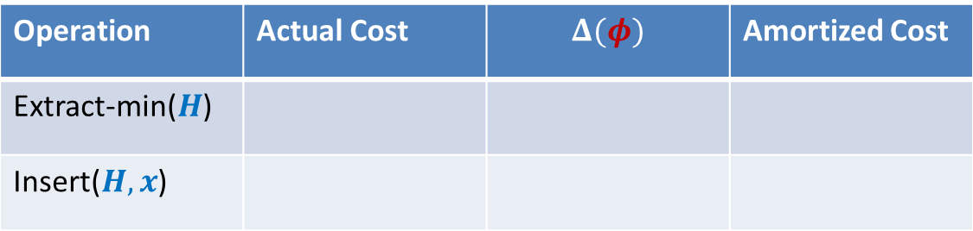
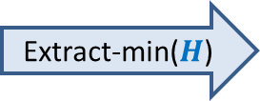





A simple exercise
What is “decreasing” ?
Exercise 1: (Binary heap)
Find a suitable potential function such that
the amortized cost of Extract-min operation = $0$
the amortized cost of insert operation is still O(log $n$).
Extract-min($H$)
Operation | Actual Cost | $$Δ(φ)$$ | Amortized Cost
Extract-min($H$)
Insert($H,x$)
$c$height($H$)
$$0$$
$c$height($H$)
$2c$height($H$)
$φ$($i$): $c$ $\sum_{v∈H}{depth(v)}$

Slide 30
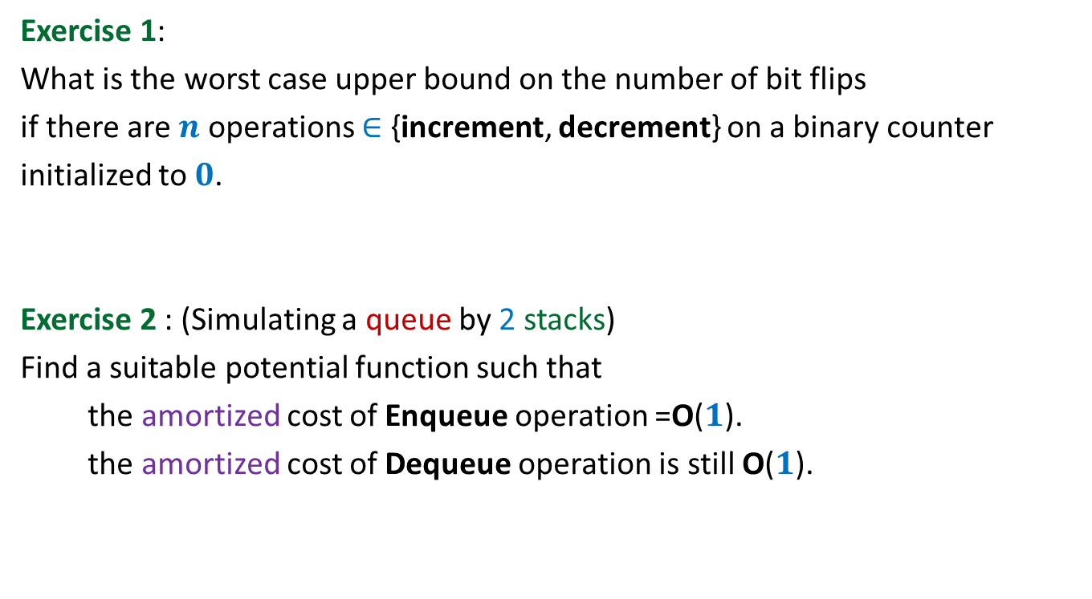
Home work Exercises
Exercise 1:
What is the worst case upper bound on the number of bit flips
if there are $n$ operations $∈$ {increment, decrement} on a binary counter
initialized to $0$.
Exercise 2 : (Simulating a queue by 2 stacks)
Find a suitable potential function such that
the amortized cost of Enqueue operation =O($1$).
the amortized cost of Dequeue operation is still O($1$).

