Slide 1
Design and Analysis of Algorithms
CS345A
Lecture 29
Amortized Analysis – II
(Application: Dynamic Table)

Slide 2
RECAP of the Previous Lecture

Slide 3


Minimum ($s$,$t$)-cuts
Theorem:
There can be $2^{n−2}$ minimum ($s$,$t$)-cuts in a graph.
Question: How does a minimum ($s$,$t$)-cut look like in $G_{f}$?
Homework:
Ponder over it ☺

Slide 4


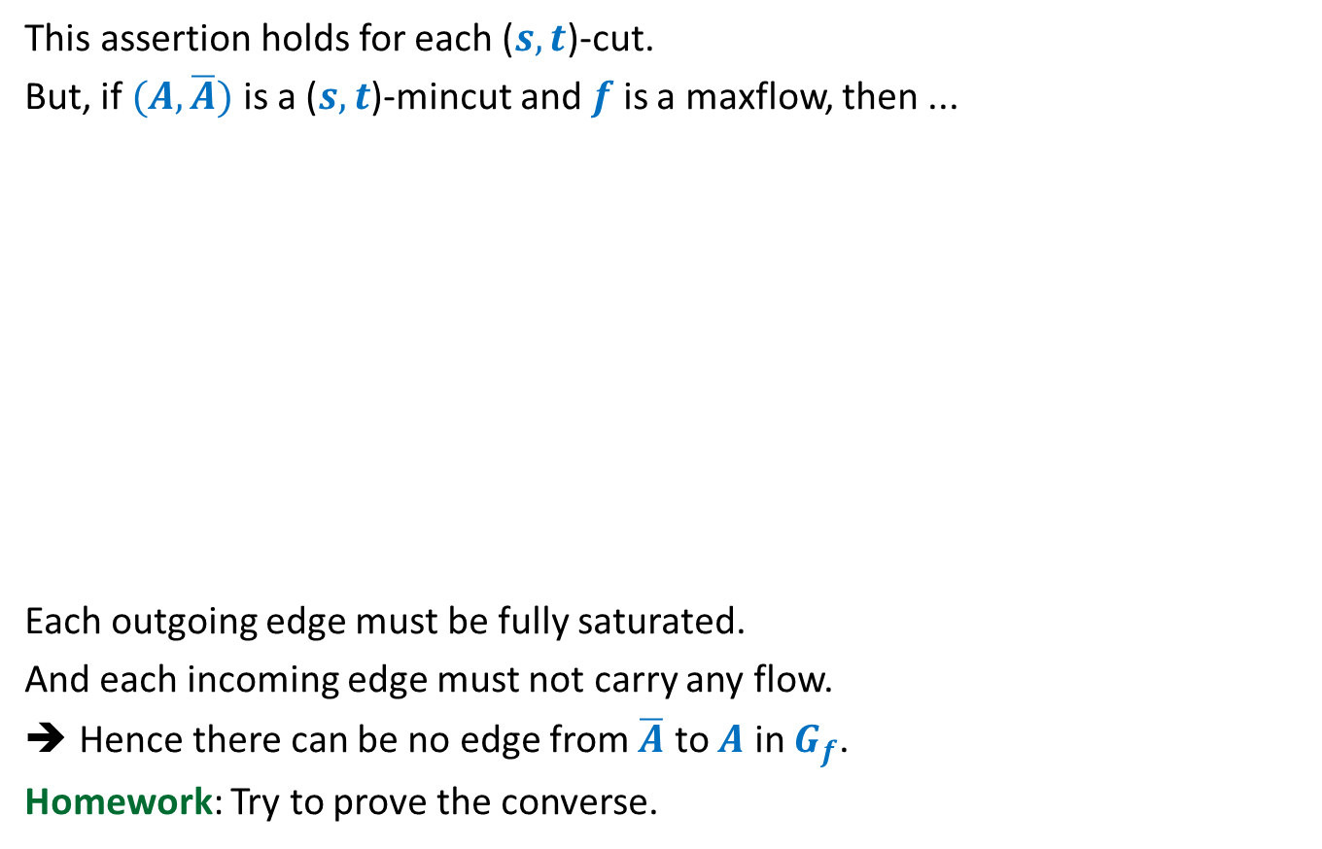










$f_{out}\left(A\right)−f_{in}(A)$ $≤c(A,\overline{A})$
=$c(A,\overline{A})$
=$0$
This assertion holds for each ($s,t$)-cut.
But, if $(A,\overline{A})$ is a ($s,t$)-mincut and $f$ is a maxflow, then ...
Each outgoing edge must be fully saturated.
And each incoming edge must not carry any flow.
Hence there can be no edge from $\overline{A}$ to $A$ in $G_{f}$.
Homework: Try to prove the converse.
$$s$$
$$t$$
$$s$$
$$t$$
$$A$$
$$\overline{A}$$
$$A$$
$$\overline{A}$$
$$G$$
$$G_{f}$$

Slide 5
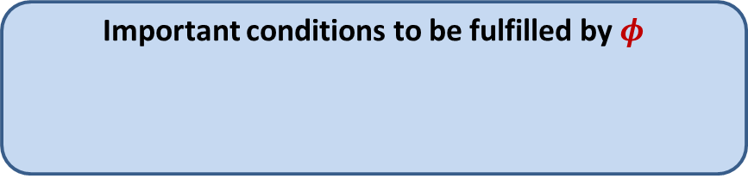




Amortized Cost
$φ$: potential function associated with the algorithm/data-structure
$φ(i)$: Potential at the end of $i$th operation
Amortized cost of $i$th operation $≝$ Actual cost of $i$th operation
Amortized cost of $n$ operations $≥$ Actual cost of $n$operations
Important conditions to be fulfilled by $φ$
$φ(0)$ = $0$
$φ\left(i\right)≥0$ for all $i$
+ $\left(φ\left(i\right)−φ\left(i−1\right)\right)$

Slide 6
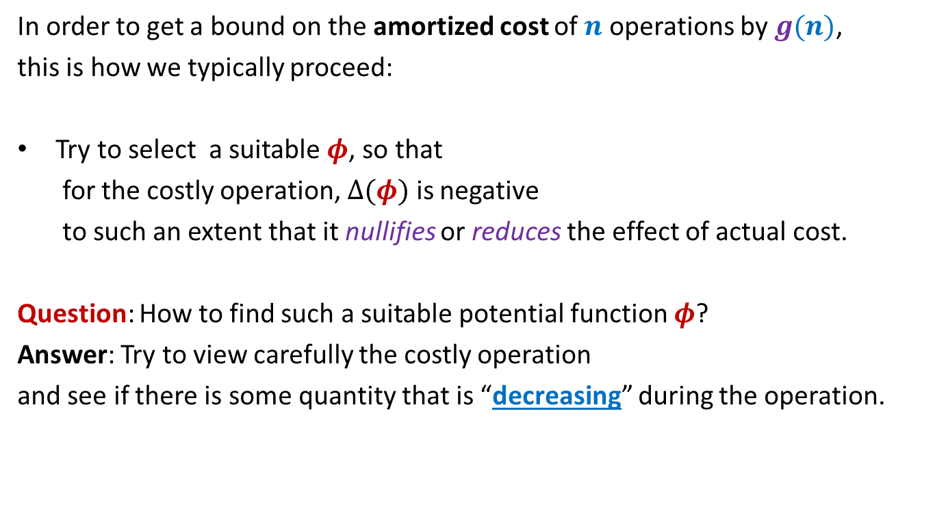
Amortized Cost
In order to get a bound on the amortized cost of $n$ operations by $g(n)$,
this is how we typically proceed:
Try to select a suitable $φ$, so that
for the costly operation, $Δ(φ)$ is negative
to such an extent that it nullifies or reduces the effect of actual cost.
Question: How to find such a suitable potential function $φ$?
Answer: Try to view carefully the costly operation
and see if there is some quantity that is “decreasing” during the operation.

Slide 7
Application 1
Dynamic Tables

Slide 8
Memory Management
What happens if more space is needed by table ?
Table T
Free space
Memory

Slide 9
SPACE and TIME Efficient Dynamic Table
For Insertions Only

Slide 10




Some notations
$n$
createTable($k$):
A system-call that creates a table of size $k$
size($T$)
copy($T$,$T′$)
free($T$)
: number of elements in the table $T$.
and returns its pointer.
: the size of table $T$.
: copies the contents of table $T$ into $T′$.
: free the space (return the space to OS) occupied by table $T$.
The max number of elements to be inserted into Table is not known in advance.

Slide 11
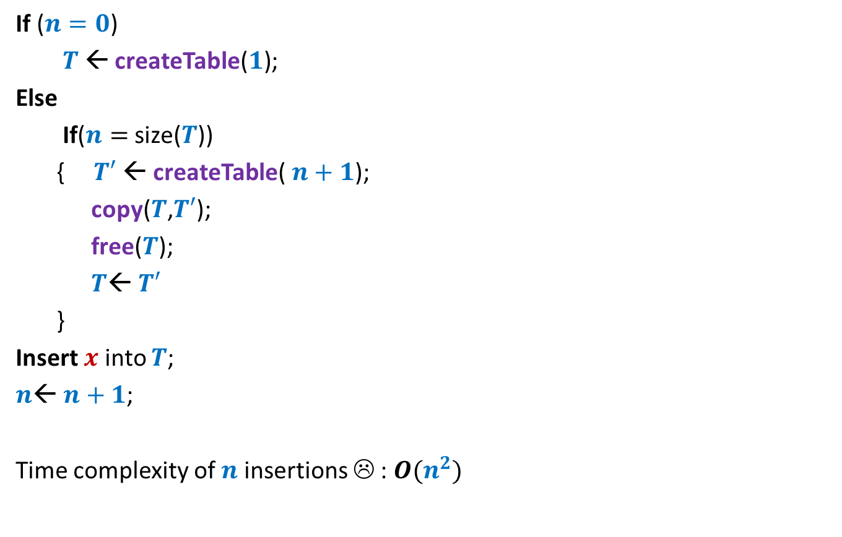




A trivial way to perform Insert($x$)
If ($n=0$)
$T$← createTable($1$);
Else
If($n=$ size($T$))
{ $T′$← createTable($n+1$);
copy($T$,$T′$);
free($T$);
$T$← $T′$
}
Insert $x$ into $T$;
$n$← $n+1$;
Time complexity of $n$ insertions ☹ : $O(n^{2})$
// Table is full !
O($1$)
O($n$)
O($1$)
Idea:
Every time a table is full, create a new table of double the size.

Slide 12






An efficient way to perform Insert($x$)
Space utilization ?
If ($n=0$)
$T$← createTable($1$);
Else
If($n=$ size($T$))
{ $T′$← createTable($n+1$);
copy($T$,$T′$);
free($T$);
$T$← $T′$
}
Insert $x$ into $T$;
$n$← $n+1$;
($2$);
// Table is full !
$$2n$$
O($1$)
O($n$)
O($1$)
Observation:
The table is at least half-full always.
So space utilization is at least 50%.

Slide 13





An efficient way to perform Insert($x$)
Actual cost per insertion
$$17$$
$$9$$
$$5$$
$$3$$
$$1$$
1 | 2 | 3 | 4 | 5 | 6 | 7 | 8 | 9 | 10 | 11 | 12 | 13 | 14 | 15 | 16 | 17 | 18
insertions

Slide 14
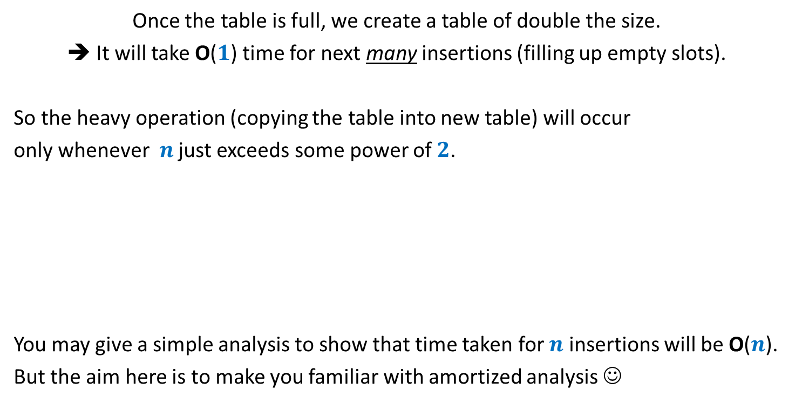

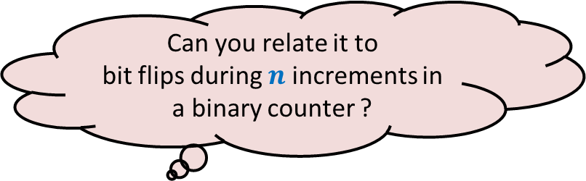
Intuition underlying efficiency of Insert($x$)
Once the table is full, we create a table of double the size.
➔ It will take O($1$) time for next many insertions (filling up empty slots).
So the heavy operation (copying the table into new table) will occur
only whenever $n$ just exceeds some power of $2$.
You may give a simple analysis to show that time taken for $n$ insertions will be O($n$).
But the aim here is to make you familiar with amortized analysis ☺
Can you relate it to
bit flips during $n$ increments in a binary counter ?

Slide 15
















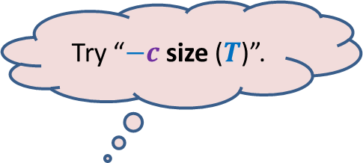
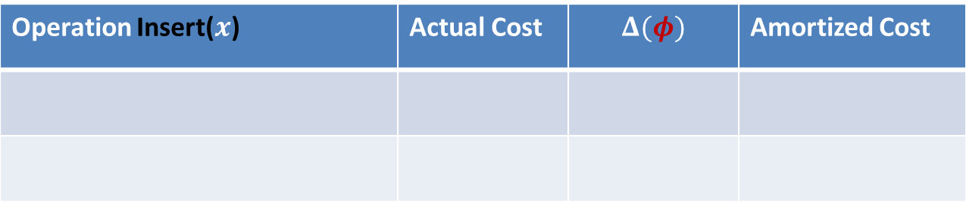


Amortized Analysis of Insert($x$)
$$m$$
$φ$ = $c$ ($m$)
Before Insert($x$)
$$2m$$
$φ$ = $c$ ($2$)
$$x$$
After Insert($x$)
$$m+1$$
Operation Insert($x$) | Actual Cost | $$Δ(φ)$$ | Amortized Cost
Case 1: when table is not full
$$c$$
Case 2: when table is already full
$$cn$$
$$c(2−m)$$
$$c(3−n)$$
$$3c$$
$φ$ at any stage = $c$ ($2n−$ size($T$))
Try “$−c$ size ($T$)”.
It ensures $Δ(φ)$ = $−c(n−1)$ ☺
But $φ$is not non-negative ☹
How to make it non-negative?
Add some positive quantity to make it non-negative.
But what should it be ?
Hint: Use the fact that
the table is at least half-full always.
What should be $φ$ ?
Apparently everything (size or $n$) seems to have increased.☹
Is there anything that has decreased ?
Look carefully the Case 2.

Slide 16



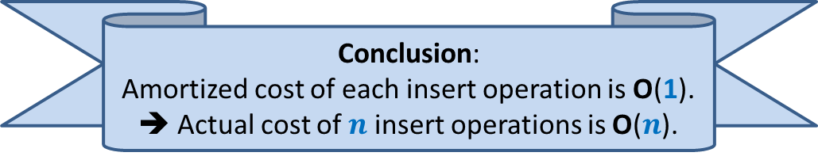
Amortized Analysis of Insert($x$)
Before Insert($x$)
After Insert($x$)
$$x$$
Operation Insert($x$) | Actual Cost | $$Δ(φ)$$ | Amortized Cost
Case 1: when table is not full
$$c$$
$$c(2)$$
$$3c$$
Case 2: when table is already full
$$cn$$
$$c(3−n)$$
$$3c$$
$φ$ at any stage = $c$ ($2n−$ size($T$))
Conclusion:
Amortized cost of each insert operation is O(1).
➔ Actual cost of $n$ insert operations is O($n$).
Analyze Case 1 now.

Slide 17
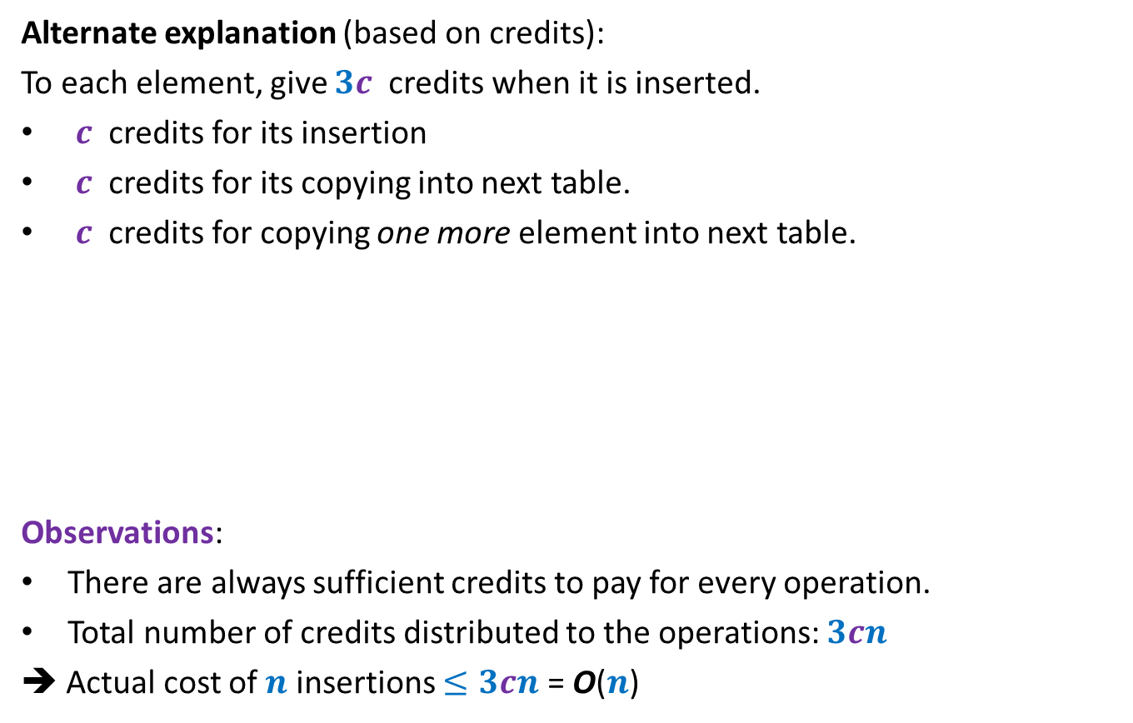
Amortized Analysis of Insert($x$)
Alternate explanation (based on credits):
To each element, give $3c$ credits when it is inserted.
$c$ credits for its insertion
$c$ credits for its copying into next table.
$c$ credits for copying one more element into next table.
Observations:
There are always sufficient credits to pay for every operation.
Total number of credits distributed to the operations: $3cn$
➔ Actual cost of $n$ insertions $≤3cn$ = O($n$)
Operation Insert($x$) | Actual Cost | $$Δ(φ)$$ | Amortized Cost
Case 1: when table is not full
$$c$$
$$c(2)$$
$$3c$$
Case 2: when table is already full
$$cn$$
$$c(3−n)$$
$$3c$$

Slide 18
SPACE and TIME Efficient Dynamic Table
For handling deletions only

Slide 19
Sequence of Deletions
Wastage of space !!

Slide 20



An efficient way to perform delete($x$)
Delete $x$ from $T$;
$n$← $n−1$;
If ($n=0$)
free($T$);
Else
If($n=$ size($T$)/2)
{ $T′$← createTable($n$);
copy($T$,$T′$);
free($T$);
$T$← $T′$;
}
// Table is half full !
O($1$)
O($n$)
O($1$)
Observation:
The table is at least half-full always.
So space utilization is at least 50%.

Slide 21
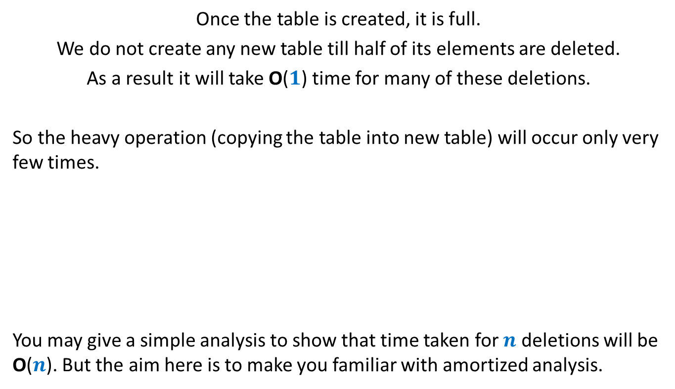
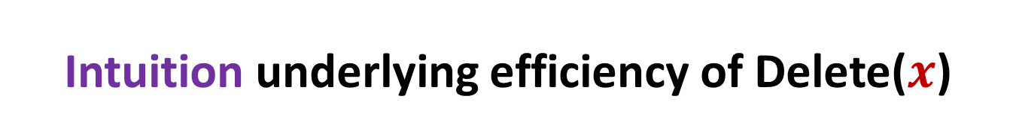
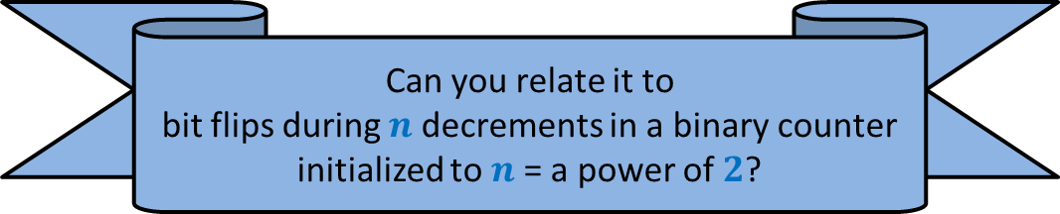
Intuition underlying efficiency of Delete($x$)
Once the table is created, it is full.
We do not create any new table till half of its elements are deleted.
As a result it will take O($1$) time for many of these deletions.
So the heavy operation (copying the table into new table) will occur only very few times.
You may give a simple analysis to show that time taken for $n$ deletions will be O($n$). But the aim here is to make you familiar with amortized analysis.
Can you relate it to
bit flips during $n$ decrements in a binary counter initialized to $n$= a power of $2$?

Slide 22
















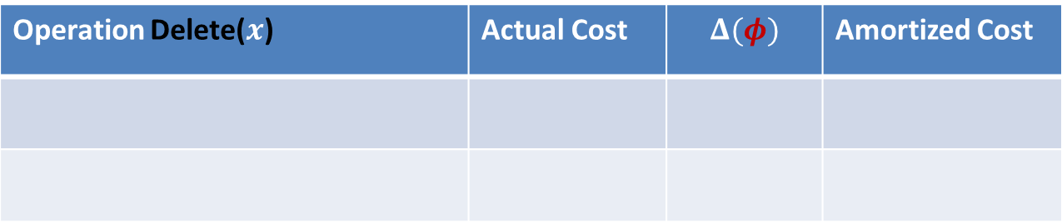



Amortized Analysis of Delete($x$)
$$2m$$
$φ$ = $c$ ($m−1$)
$$x$$
Before Delete($x$)
$$m+1$$
$φ$ = $0$
After Delete($x$)
$$m$$
Operation Delete($x$) | Actual Cost | $$Δ(φ)$$ | Amortized Cost
Case 1: when table does not shrink
$$c$$
$$c$$
$$2c$$
Case 2: when table shrinks to half
$$cn+c$$
$$c(1−n)$$
$$c(1−m)$$
$$2c$$
$φ$ at any stage = $c$ (size($T$)$−n$)
Yes, the number of empty slots has decreased in the table. ☺
So try it as a $φ$.
How can you express number of empty slots in terms of size and $n$ ?
Look carefully at the Case 2.
Is there anything that has decreased ?
What should be $φ$ ?

Slide 23
Attention
A student suggested “size of Table” as a potential function. For the deletion operation, it leads to change in potential which nullify the actual cost. But it is not a valid potential function. This is because …
It is not 0 in the beginning.
[There is way to relax the condition “value 0 in the beginning” and arrive at an analysis of O(n) bound on n deletion operations. Basically you need to express the amortized cost of n operations in terms of the initial potential. You may think over it. However, it will not be considered as part of the syllabus. In all our analysis, we shall stick to the properties of the potential function defined in the previous class.]

Slide 25

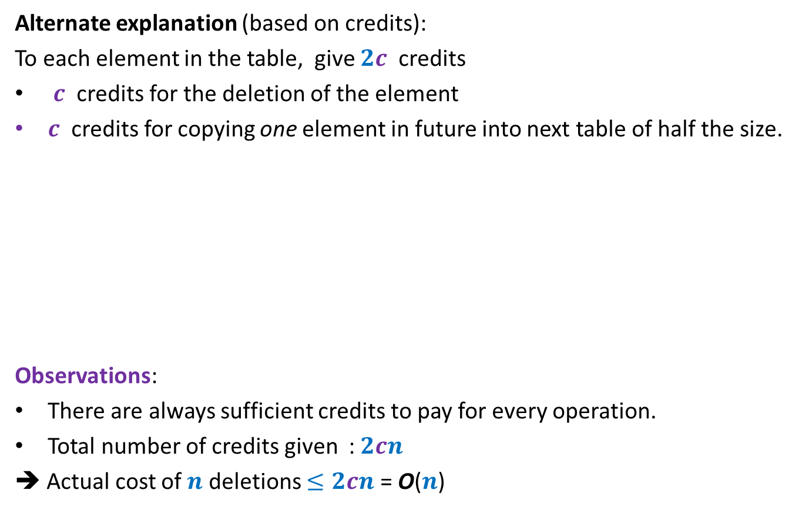
Amortized Analysis of Delete($x$)
Alternate explanation (based on credits):
To each element in the table, give $2c$ credits
$c$ credits for the deletion of the element
$c$ credits for copying one element in future into next table of half the size.
Observations:
There are always sufficient credits to pay for every operation.
Total number of credits given : $2cn$
➔ Actual cost of $n$ deletions $≤2cn$ = O($n$)
Operation Delete($x$) | Actual Cost | $$Δ(φ)$$ | Amortized Cost
Case 1: when table does not shrink
$$c$$
$$c$$
$$2c$$
Case 2: when table shrinks to half
$$cn+c$$
$$c(1−n)$$
$$2c$$

Slide 26
SPACE and TIME Efficient Dynamic Table
For handling insertions and deletions both

Slide 27






Attempt 1
“just use the insertion/deletion procedures since we spent so much time on them”.
there is a serious problem in this combination
$$2m$$
$$x$$
$$m+1$$
Delete($x$)
Each operation requires $Θ(m)$ time ☹
Insert($x$)
$$m$$

Slide 28
Homework
Think of an efficient algorithm
Carry out amortized analysis

