Slide 1
Design and Analysis of Algorithms
Algorithms-II : CS345A
Lecture 3
Algorithm for Joint Seat Allocation contd.
Divide and Conquer Paradigm - I

Slide 2
How to tackle Multiple Merit Lists using “Single Merit list algorithm”

Slide 3

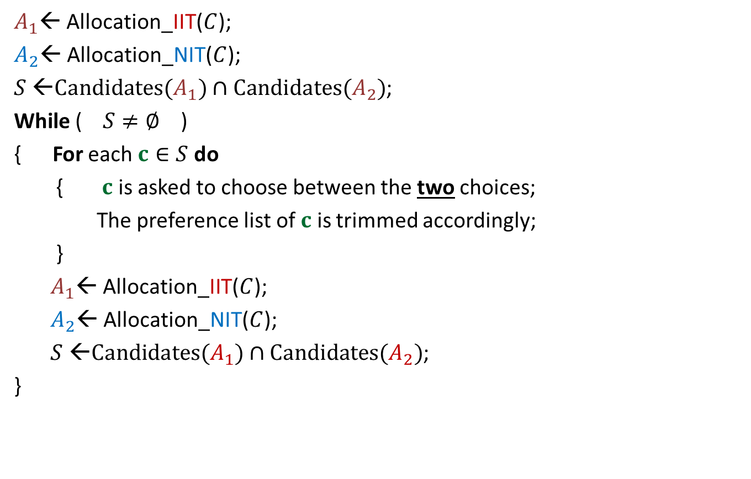


A common man’s algorithm
$A_{1}$← Allocation_IIT($C$);
$A_{2}$← Allocation_NIT($C$);
$S$ ←$Candidates(A_{1})∩Candidates(A_{2})$;
While ( $S≠∅$ )
{ For each $c∈S$ do
{ $c$ is asked to choose between the two choices;
The preference list of $c$ is trimmed accordingly;
}
$A_{1}$← Allocation_IIT($C$);
$A_{2}$← Allocation_NIT($C$);
$S$ ←$Candidates(A_{1})∩Candidates(A_{2})$;
}
Round ← $1$
and
Round $≤5$
)
Round ← Round + $1$

Slide 4
Homework from last class
Transform the common man’s algorithm to just 1 round ?

Slide 5




A Software Industry’s algorithm
Allocation
IITs
Allocation
NITs
How many iterations ?
Repeat
$q$ →
$p$ →
$$p$$
$$q$$
Combined choice list for NITs and IITs

Slide 6

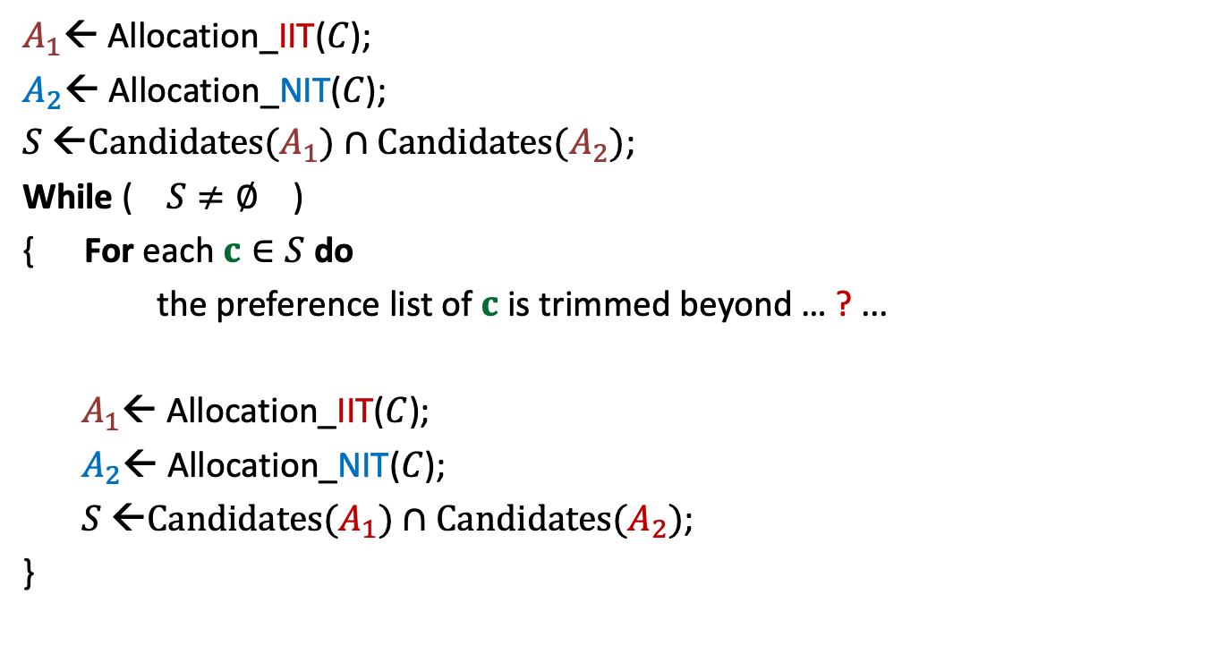
Software Industry’s algorithm
$A_{1}$← Allocation_IIT($C$);
$A_{2}$← Allocation_NIT($C$);
$S$ ←$Candidates(A_{1})∩Candidates(A_{2})$;
While ( $S≠∅$ )
{ For each $c∈S$ do
the preference list of $c$ is trimmed beyond … ? ...
$A_{1}$← Allocation_IIT($C$);
$A_{2}$← Allocation_NIT($C$);
$S$ ←$Candidates(A_{1})∩Candidates(A_{2})$;
}
Min($A_{1}(c)$, $A_{2}(c)$)

Slide 7
Homework
Can there be multiple fair allocations ?
Ponder over it

Slide 8
a Divide and Conquer algorithm for
Closest Pair Distance

Slide 9









The combine step
$$δ_{L}$$
It will take $O(n)$time for a given $p$.
$O(1)$points only
$$δ$$
$$p$$
$$δ$$
$$δ_{R}$$
$$δ$$
$$δ$$
$δ$ ← min($δ_{L}{,δ}_{R}$)
Notes:
1. Only the points lying in these 2 red squares are relevant as far as $p$ is concerned.
2. Time to use Hint 2
3. Surely not more than 8.
-----------------------------
1. How to find the points in these red square for point $p$?

Slide 10
Homework from the last class
Try to make use of Tool 2 to design an efficient algorithm ?

Slide 11
Question 2
Tool 2
A fundamental question about data structure ?
Question:
While solving an algorithmic problem, when do we feel the need of an
efficient data structure ?
Answer:
when the algorithm involves “many” operations of same type on a given data.
Notes:
For example, it is worth sorting an array only if there are going to be many search queries on it.
Let us see if you can use this principle to solve this problem.

Slide 12
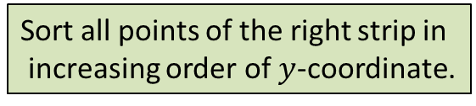







The combine step
Tool 2
$$δ$$
$$δ$$
$$δ$$
$$δ$$
Sort all points of the right strip in
increasing order of $y$-coordinate.
$$δ_{L}$$
$$δ$$
$$δ$$
$$δ$$
$$(x^{′},y^{′})$$
Binary search for ($y^{′}+δ$)
$$p$$
$$δ$$
Binary search for ($y^{′}−δ$)
$$δ_{R}$$
$$δ$$
$$δ$$
$δ$ ← min($δ_{L}{,δ}_{R}$)

Slide 13


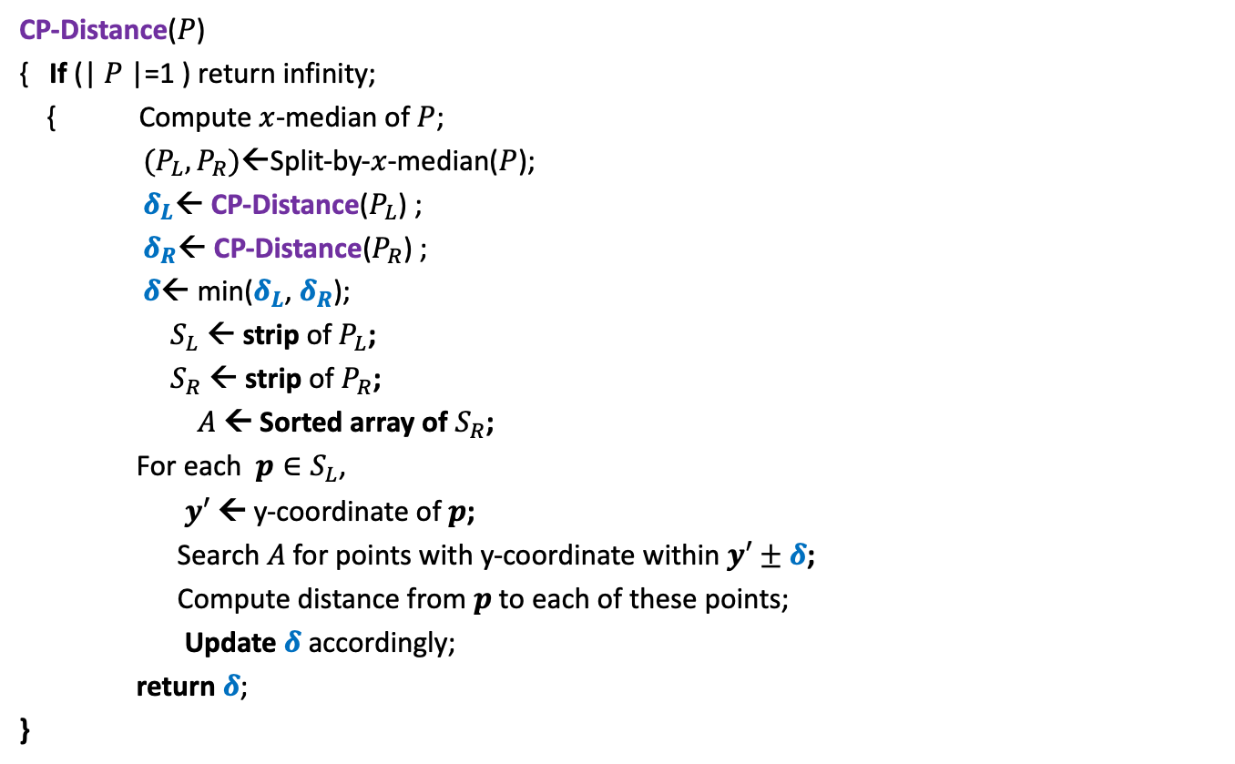
Divide and Conquer based algorithm
CP-Distance($P$)
{ If (| $P$|=1 ) return infinity;
{ Compute $x$-median of $P$;
$(P_{L},P_{R})$←Split-by-$x$-median($P$);
$δ_{L}$← CP-Distance($P_{L}$) ;
$δ_{R}$← CP-Distance($P_{R}$) ;
$δ$← min($δ_{L}$, $δ_{R}$);
$S_{L}$ ← strip of $P_{L}$;
$S_{R}$ ← strip of $P_{R}$;
$A$← Sorted array of $S_{R}$;
For each $p∈S_{L}$,
$y′$ ← y-coordinate of $p$;
Search $A$for points with y-coordinate within $y′±δ$;
Compute distance from $p$to each of these points;
Update $δ$ accordingly;
return $δ$;
}
$O(\left|P\right|)$ + 2 T(|$P$|/2) time
Divide step
$O(\left|P\right| \log{|P|})$ time
Combine/conquer step

Slide 14


Running time of the algorithm
What is the recurrence for running time?
T($n$) = c $n$ log $n$ + 2 T($n$/2)
➔
T($n$) = O( $n$ $\log^{2}n$)
Theorem:
There exists an O( $n$ $\log^{2}n$) time algorithm to compute the closest pair distance of $n$points in plane.
c $n$

Slide 15








The conquer step in O($n$) time
If the two strips are already sorted
$$δ$$
$$p$$
$$δ_{L}$$
$δ$
$$q$$
$$δ_{R}$$
$$δ$$
$$δ$$
$δ$ ← min($δ_{L}{,δ}_{R}$)
Notes:
For each point in one strip, we need to find distance to points
in the upper red- square in the other strip.
2. How to do it efficiently using the fact that the strips are sorted ?

Slide 16


The conquer step in O($n$) time
Fact : At most 4 consecutive points need to be considered.
?
Tool 3
$$p$$
Homework: Prove this claim formally.

Slide 17
The conquer step in O($n$) time
If the two strips are already sorted
$$δ_{L}$$
$$δ_{R}$$
$$δ$$
$$δ$$
$δ$ ← min($δ_{L}{,δ}_{R}$)

Slide 18
The conquer step in O($n$) time
If the two strips are already sorted
$$δ_{L}$$
$$δ_{R}$$
$$δ$$
$$δ$$
$δ$ ← min($δ_{L}{,δ}_{R}$)

Slide 19
Inspiration from Merge sort
Merge
Notes:
In merge sort, the two recursive calls return sorted lists.
So creating the sorted list requires only merging them.

Slide 20


The conquer step in O($n$) time
$$δ_{L}$$
$$δ_{R}$$
$$δ_{L}$$
$$δ_{L}$$
Notes:
If $P_{L}$ and $P_{R}$ are sorted according to y-coordinate,
Getting the strips sorted according to y-coordinate
Getting $P$sorted by merging them
takes O($n$) time. ☺

Slide 21


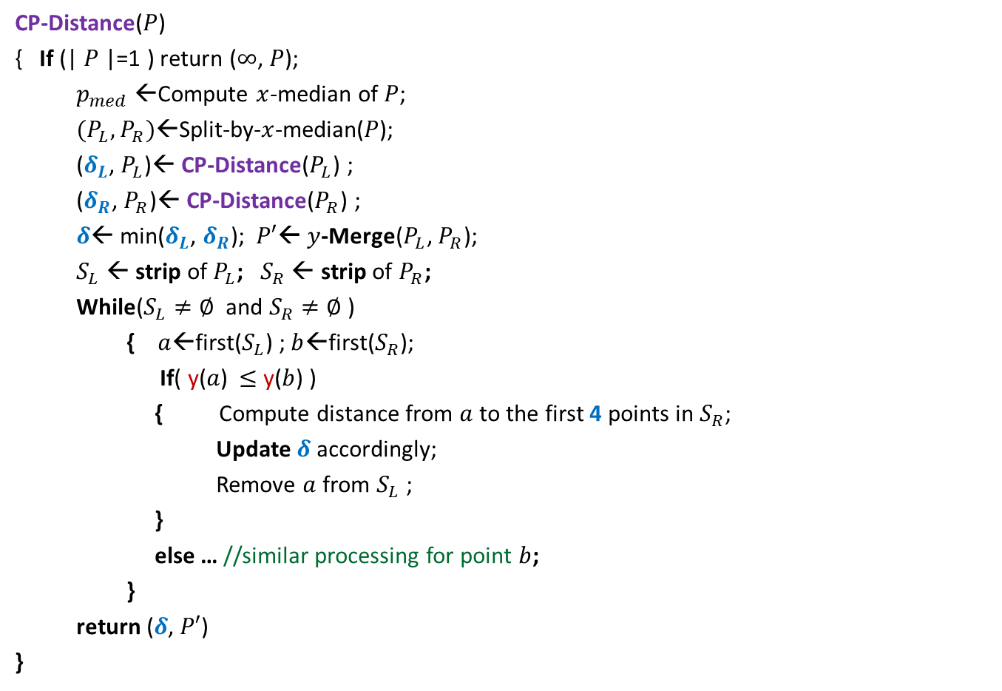
Divide and Conquer based algorithm
CP-Distance($P$)
{ If (| $P$|=1 ) return ($∞$, $P$);
$p_{med}$←Compute $x$-median of $P$;
$(P_{L},P_{R})$←Split-by-$x$-median($P$);
($δ_{L}$, $P_{L}$)← CP-Distance($P_{L}$) ;
($δ_{R}$, $P_{R}$)← CP-Distance($P_{R}$) ;
$δ$← min($δ_{L}$, $δ_{R}$); $P′$← $y$-Merge($P_{L}$, $P_{R}$);
$S_{L}$ ← strip of $P_{L}$; $S_{R}$ ← strip of $P_{R}$;
While($S_{L}≠∅$ and $S_{R}≠∅$ )
{ $a$←first($S_{L}$) ; $b$←first($S_{R}$);
If( y($a$) $≤$ y($b$) )
{ Compute distance from $a$to the first 4 points in $S_{R}$;
Update $δ$ accordingly;
Remove $a$ from $S_{L}$ ;
}
else … //similar processing for point $b$;
}
return ($δ$, $P′$)
}
$O(\left|P\right|)$ + 2 T(|$P$|/2) time
Divide step
$O(\left|P\right|)$ time
conquer step

Slide 22

Conclusion
Theorem:
There exists an O( $n$ $\log{n}$) time algorithm to compute the closest pair distance of $n$points in plane.
Note: There exists a randomized algorithm with O($n$) expected time.

Slide 23
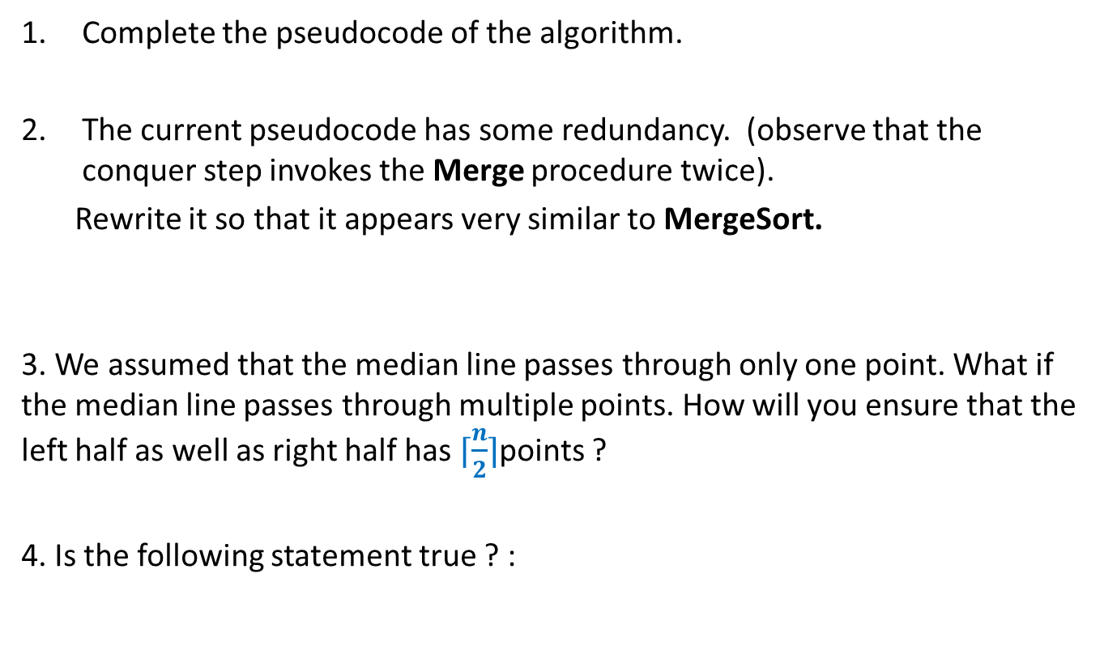
Homework
Complete the pseudocode of the algorithm.
The current pseudocode has some redundancy. (observe that the conquer step invokes the Merge procedure twice).
Rewrite it so that it appears very similar to MergeSort.
3. We assumed that the median line passes through only one point. What if the median line passes through multiple points. How will you ensure that the left half as well as right half has $⌈\frac{n}{2}⌉$points ?
4. Is the following statement true ? :
A point belongs to the left strip in only a constant number of recursive calls.

Slide 24
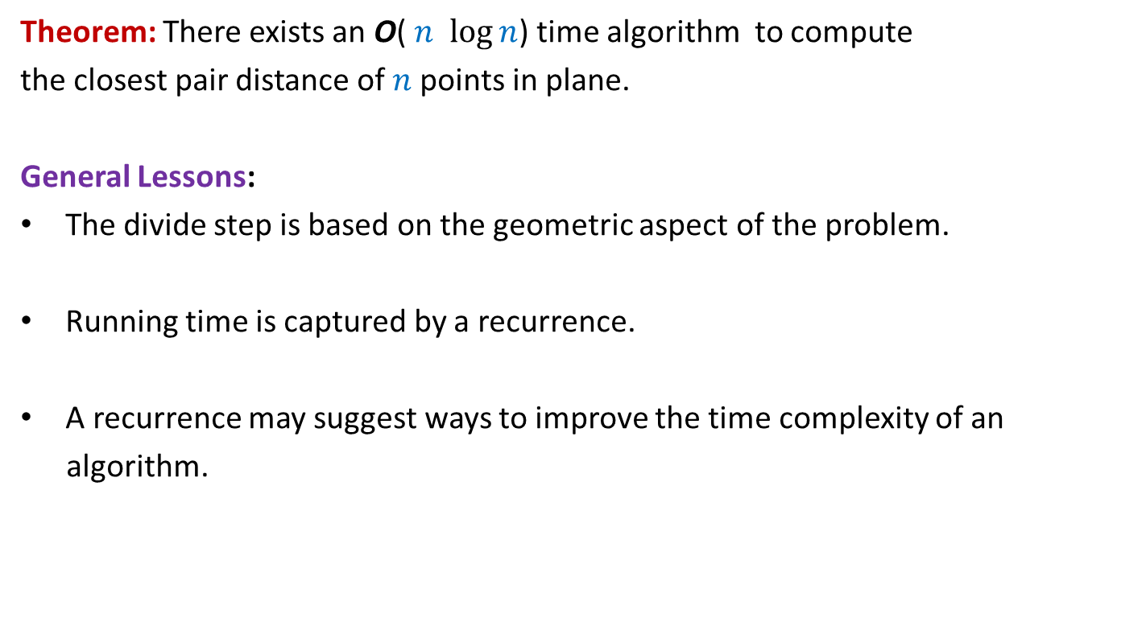
Theorem: There exists an O( $n$ $\log{n}$) time algorithm to compute
the closest pair distance of $n$points in plane.
General Lessons:
The divide step is based on the geometric aspect of the problem.
Running time is captured by a recurrence.
A recurrence may suggest ways to improve the time complexity of an
algorithm.

Slide 25
problem 2
Non-dominated Points

Slide 26





The Non-Dominated Points
y
Definition: point $p$ is said to dominate point $q$ if
x($p$) > x($q$)
and y($p$) > y($q$)
$$p$$
$$q$$
$$q$$
$$(0,0)$$
x

Slide 27
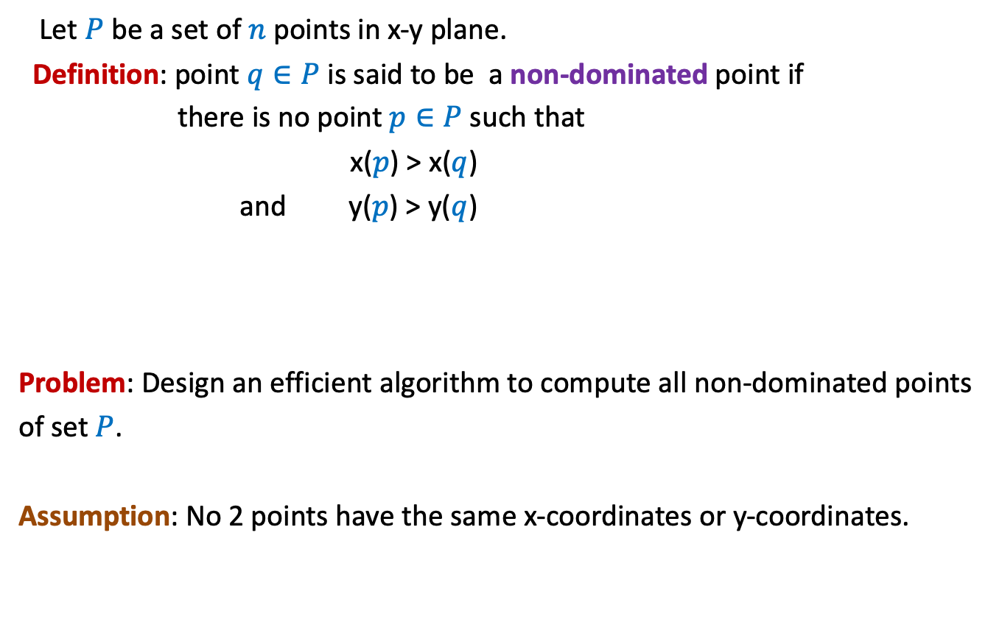
The Non-Dominated Points
Let $P$ be a set of $n$ points in x-y plane.
Definition: point $q∈P$ is said to be a non-dominated point if
there is no point $p∈P$ such that
x($p$) > x($q$)
and y($p$) > y($q$)
Problem: Design an efficient algorithm to compute all non-dominated points
of set $P$.
Assumption: No 2 points have the same x-coordinates or y-coordinates.

Slide 28


The Non-Dominated Points
y
$$q$$
$$p$$
$$(0,0)$$
x

Slide 29
The Non-Dominated Points
y
A staircase structure ☺
$$(0,0)$$
x

Slide 30

The Non-Dominated Points
Let $P$ be a set of $n$ points in x-y plane.
A simpler problem:
Design an efficient algorithm to report any non-dominated point from $P$.

Slide 31

The Non-Dominated Points
y
O($n$) time
$$(0,0)$$
x

Slide 32
A simple algorithm for all non-dominated points

Slide 33
A Simple Algorithm
y
$$(0,0)$$
x

Slide 34



A Simple Algorithm
y
$h$ : no. of non-dominated points
Time complexity =
O($n^{2}$) ?
O($nh$)
$$(0,0)$$
x

Slide 35
A Divide and Conquer algorithm

Slide 36



The Divide step
y
O($n$) time
$$(0,0)$$
x
Left half set
$⌈\frac{n}{2}⌉$points
$⌊\frac{n}{2}⌋$points
Right half set

Slide 37

Solving the Subproblems recursively
y
2 T($\frac{n}{2}$) time
$$(0,0)$$
x
Left half set
$⌈\frac{n}{2}⌉$points
$⌊\frac{n}{2}⌋$points
Right half set

Slide 38

The conquer step
y
O($n$) time
$$p$$
$$(0,0)$$
x
Left half set
$⌈\frac{n}{2}⌉$points
$⌊\frac{n}{2}⌋$points
Right half set

Slide 39


The time complexity of the algorithm
y
T($n$) = c $n$ + 2 T($n$/2)
Time complexity =
O($n$ $\log{ n}$)
$$p$$
$$(0,0)$$
x
Left half set
$⌈\frac{n}{2}⌉$points
$⌊\frac{n}{2}⌋$points
Right half set

Slide 40
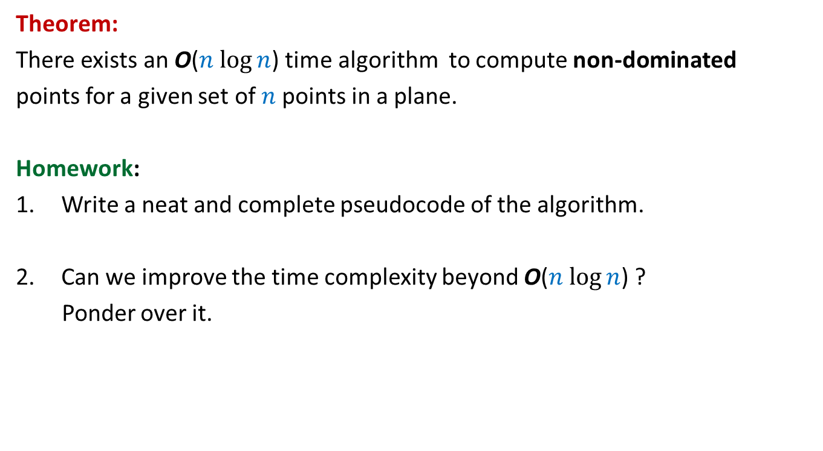
Theorem:
There exists an O($n$ $\log{n}$) time algorithm to compute non-dominated
points for a given set of $n$points in a plane.
Homework:
Write a neat and complete pseudocode of the algorithm.
Can we improve the time complexity beyond O($n$ $\log{n}$) ?
Ponder over it.

Slide 41
problem 3
Convex Hull

Slide 42


A Convex Polygon
Definition: A polygon is convex if for any two points belonging to the polygon,
the line segment joining them is inside the polygon.
$p$
$q$

Slide 43
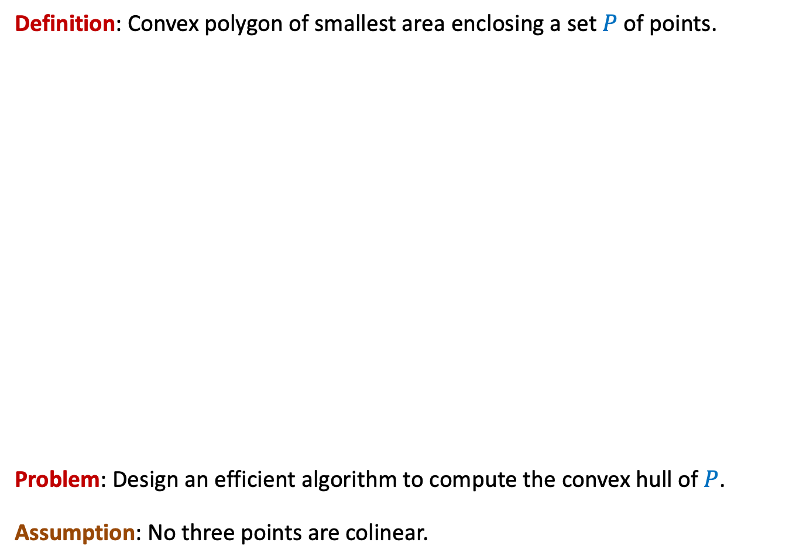
Convex hull
Definition: Convex polygon of smallest area enclosing a set $P$ of points.
Problem: Design an efficient algorithm to compute the convex hull of $P$.
Assumption: No three points are colinear.

Slide 44

Tool 1
Let $A⊆P$.
Convex Hull of $A$ must be fully contained inside the convex hull of $P$.

Slide 45



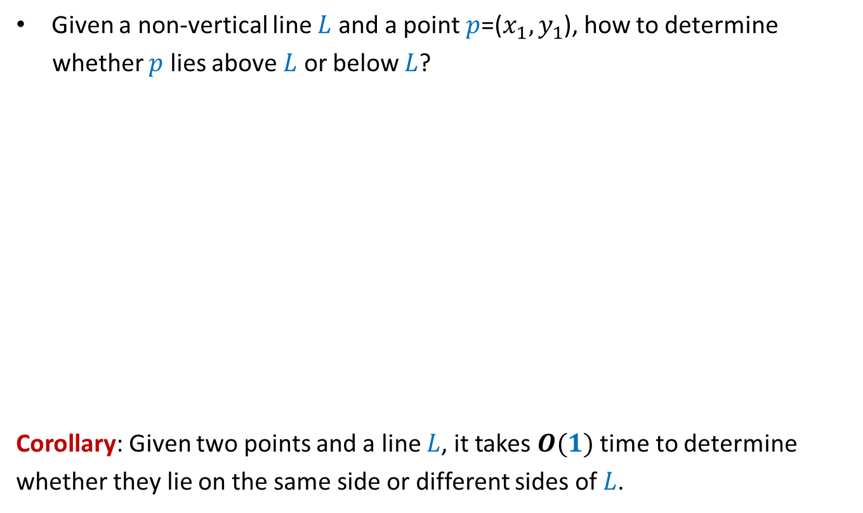

Tool 2
Given a non-vertical line $L$ and a point $p$=($x_{1},y_{1}$), how to determine
whether $p$ lies above $L$ or below $L$?
Corollary: Given two points and a line $L$, it takes $O(1)$ time to determine
whether they lie on the same side or different sides of $L$.
$O(1)$ time
$$q=(a_{1},b_{1})$$
$$y=mx+c$$
$$r=(a_{2},b_{2})$$

Slide 46

Homework
Try to design an O($n$ $\log{n}$) algorithm to compute the convex hull.

