Slide 1
Design and Analysis of Algorithms
CS345A
Lecture 31
Amortized Analysis – IV
(The magical application continued.)

Slide 2
RECAP of the Previous lecture

Slide 3
Self Organizing LIST

Slide 4
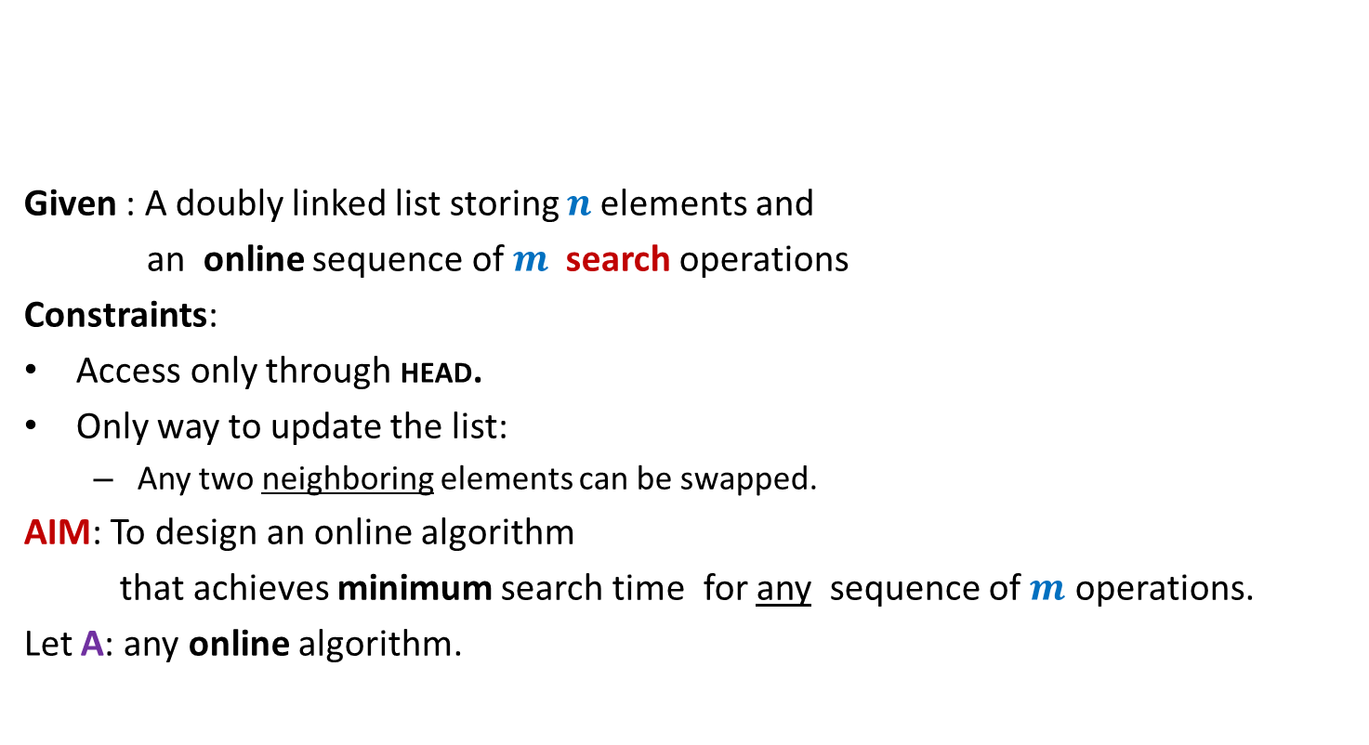
Problem : Online list search
HEAD
Given : A doubly linked list storing $n$elements and
an online sequence of $m$ search operations
Constraints:
Access only through HEAD.
Only way to update the list:
Any two neighboring elements can be swapped.
AIM: To design an online algorithm
that achieves minimum search time for any sequence of $m$ operations.
Let A: any online algorithm.
P
A
N
K
R
U
I
How to judge the efficiency of algorithm A ?

Slide 5
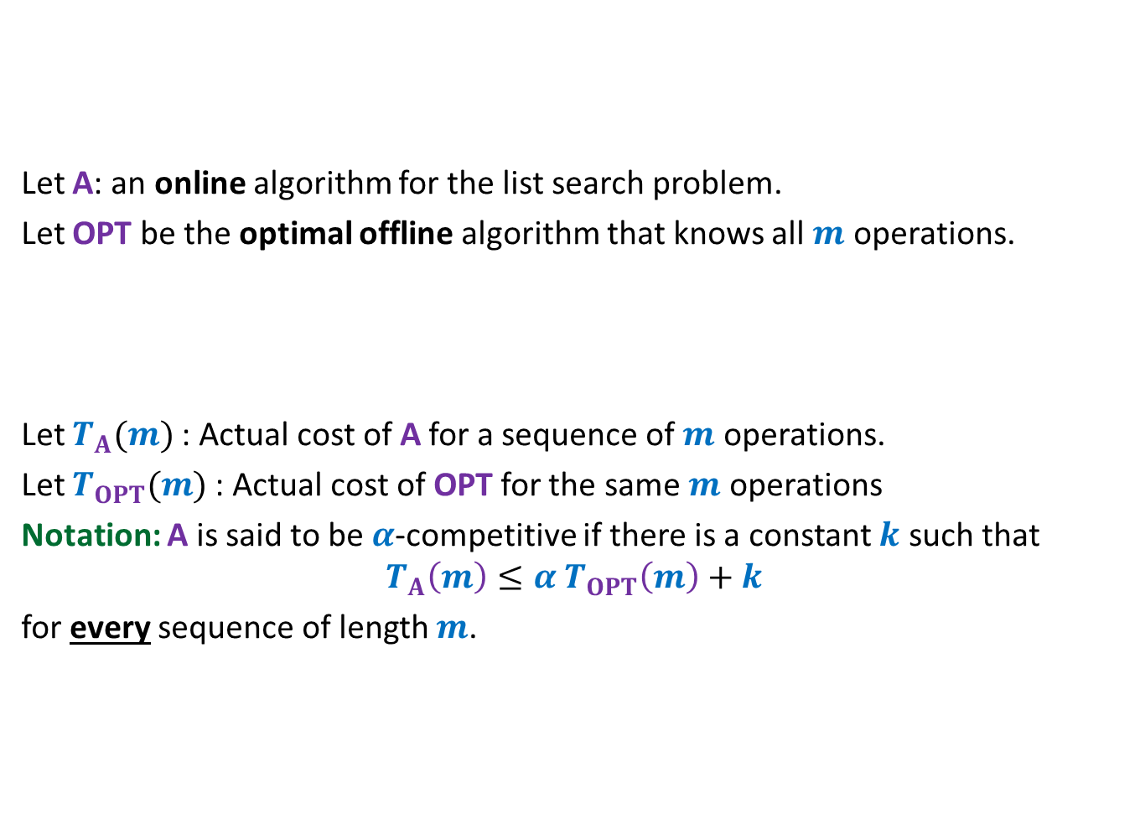
Competitive ratio
A tool to analyze any online algorithm
HEAD
Let A: an online algorithm for the list search problem.
Let OPT be the optimal offline algorithm that knows all $m$ operations.
Let $T_{A}(m)$: Actual cost of A for a sequence of $m$ operations.
Let $T_{OPT}(m)$: Actual cost of OPT for the same $m$ operations
Notation: A is said to be $α$-competitive if there is a constant $k$ such that
$$T_{A}\left(m\right)≤{α T}_{OPT}\left(m\right)+k$$
for every sequence of length $m$.
P
A
N
K
R
U
I
How well does A compete with OPT
for any sequence ?

Slide 6
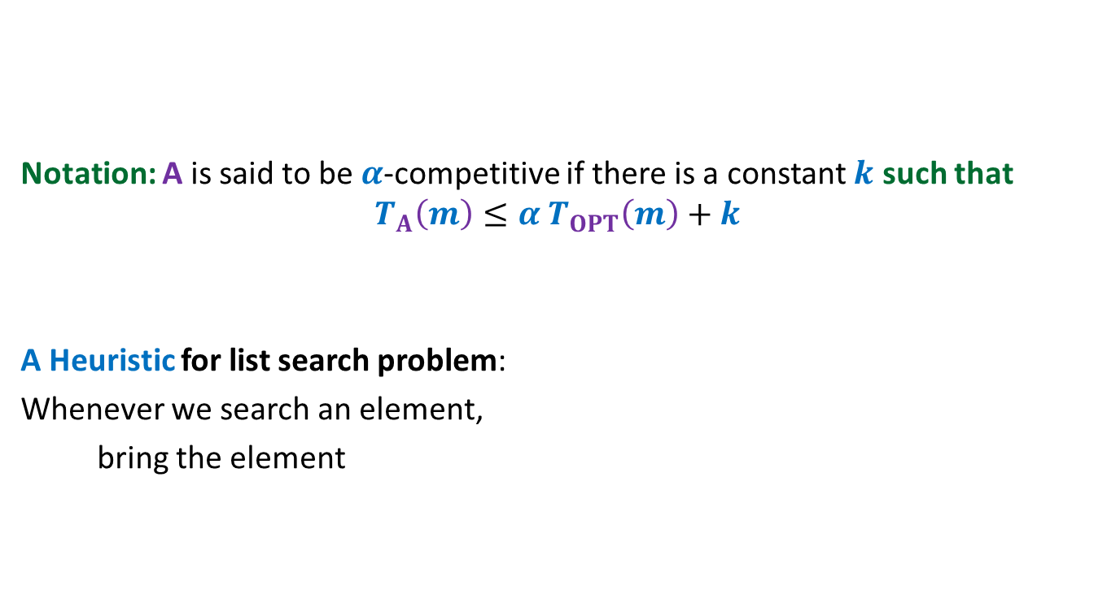
HEAD
Notation: A is said to be $α$-competitive if there is a constant $k$ such that
$$T_{A}\left(m\right)≤{α T}_{OPT}\left(m\right)+k$$
A Heuristic for list search problem:
Whenever we search an element,
bring the element
P
A
N
K
R
U
I
to the front of the list
after the search.

Slide 7
Move to Front Algorithm
Caution :
For a better understanding, please go slow
and take long pauses in the remaining slides.

Slide 8

Move-to-Front algorithm
HEAD
Search(e):
Starting from HEAD pointer, scan linearly till we find element e;
Bring the node storing e to the front of list
A notation:
$r$(e): rank of element e in the list.
P
A
N
K
R
U
I
by a sequence of swaps.
Example: Search(R)

Slide 9


Move-to-Front algorithm Execution of Search(R)
$r$(R) steps for locating R
$r$(R) $−1$ swaps
HEAD
P
A
N
K
R
U
I
HEAD
P
A
N
R
K
U
I
HEAD
P
A
R
N
K
U
I
HEAD
P
R
A
N
K
U
I
HEAD
R
P
A
N
K
U
I

Slide 10
How good is MTF Algorithm ?
MTF versus OPT
Let us focus on a query.

Slide 11







$i$th query operation of MTF and OPT
Let $i$th query operation be Search(x)
Actual cost of Search(x) in MTF algorithm : ?
Actual cost of Search(x) in OPT algorithm : ?
Our aim: To show that
the amortized cost of Search(x) in MTF algorithm is bounded in terms of $r^{∗}$(x) and$t_{i}$
➔ $φ$ should be such that $Δφ$must have “$−2r$(x)” term to nullify the actual cost.
HEAD
…
MTF list
1
2
…
$r$(x)$−1$
$r$(x)
…
x
What should be the potential function with this feature?
HEAD
OPT list
…
…
x
…
1
$r^{∗}$(x)
$2r$(x)$−$1
$r^{∗}$(x)$+ t_{i}$
No. of swaps by OPT

Slide 12


the potential function $φ$
The potential of the MTF algorithm after $i$ steps
$φ$($i$) = 2. # inversions
Inversions: {(E,C) , (E,A) , (E,D) , (E,B) , (D,B)}
$φ$($i$) = 10
Note: $φ$($0$)= $0$since two lists are same in the beginning.
and $φ$($i$) $≥0$ always.
➔ $φ$ is a valid potential function.
HEAD
E
C
A
D
B
MTF list
HEAD
C
A
B
D
E
OPT list

Slide 13



$i$th query operation of MTF and OPT
Let $i$th query operation be Search(x)
HEAD
…
MTF list
1
2
…
$r$(x)$−1$
$r$(x)
…
x
Case 1
$r$(x)$≫$ $r^{∗}$(x)
HEAD
OPT list
…
…
x
…
1
$r^{∗}$(x)

Slide 14

$i$th query operation of MTF and OPT
Let $i$th query operation be Search(x)
HEAD
…
MTF list
1
2
…
$r$(x)$−1$
$r$(x)
…
x
Case 1
$r$(x)$≫$ $r^{∗}$(x)
HEAD
OPT list
…
…
x
…
1
$r^{∗}$(x)

Slide 15


$i$th query operation of MTF and OPT
Let $i$th query operation be Search(x)
HEAD
…
MTF list
1
2
…
$r$(x)$−1$
$r$(x)
…
x
Case 2
$r$(x)$≤$ $r^{∗}$(x)
HEAD
OPT list
…
…
x
…
1
$r^{∗}$(x)
Case 1 looks more challenging.

Slide 16

$i$th query operation of MTF and OPT
Let $i$th query operation be Search(x)
HEAD
…
MTF list
1
2
…
$r$(x)$−1$
$r$(x)
…
x
Case 1
$r$(x)$≫$ $r^{∗}$(x)
HEAD
OPT list
…
…
x
…
1
$r^{∗}$(x)
How to analyse this case ?

Slide 17
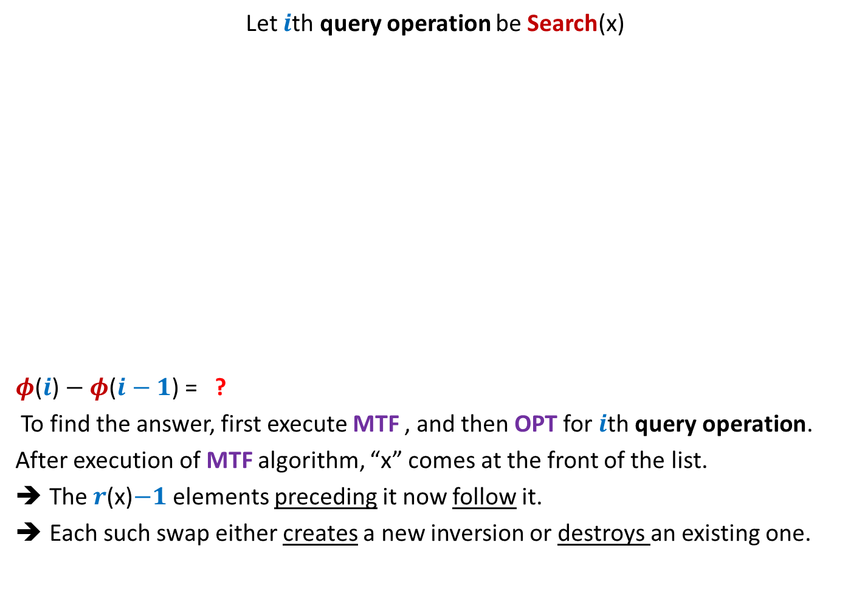

Change in potential during $i$th query operation
Let $i$th query operation be Search(x)
$φ$($i$) $− φ$($i−1$) = ?
To find the answer, first execute MTF , and then OPT for $i$th query operation.
After execution of MTF algorithm, “x” comes at the front of the list.
The $r$(x)$−1$ elements preceding it now follow it.
Each such swap either creates a new inversion or destroys an existing one.
HEAD
…
MTF list
1
2
…
$r$(x)$−1$
$r$(x)
…
x
HEAD
OPT list
…
…
x
…
1
$r^{∗}$(x)
$2$ (No. of new inversions created – No. of old inversions destroyed)

Slide 18
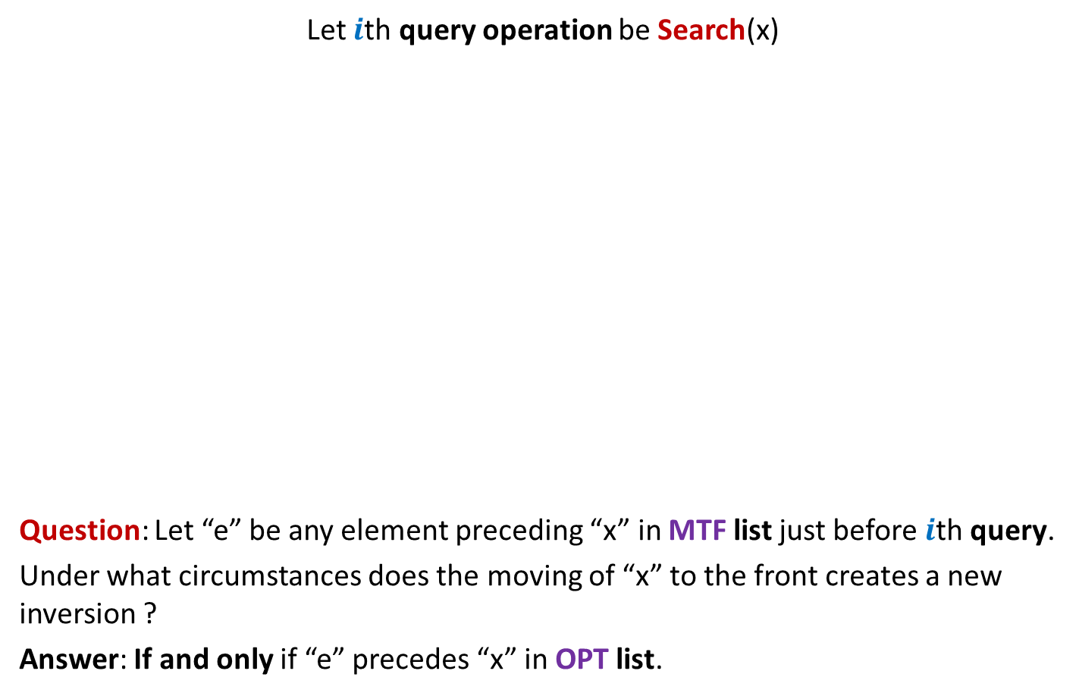
Change in potential during $i$th query operation
Let $i$th query operation be Search(x)
Question: Let “e” be any element preceding “x” in MTF list just before $i$th query.
Under what circumstances does the moving of “x” to the front creates a new inversion ?
Answer: If and only if “e” precedes “x” in OPT list.
HEAD
…
MTF list
1
2
…
$r$(x)$−1$
$r$(x)
…
e
x
Inversion (x,e) gets created
Inversion (x,e) gets destroyed
HEAD
OPT list
…
…
e
x
e
…
1
$r^{∗}$(x)

Slide 19
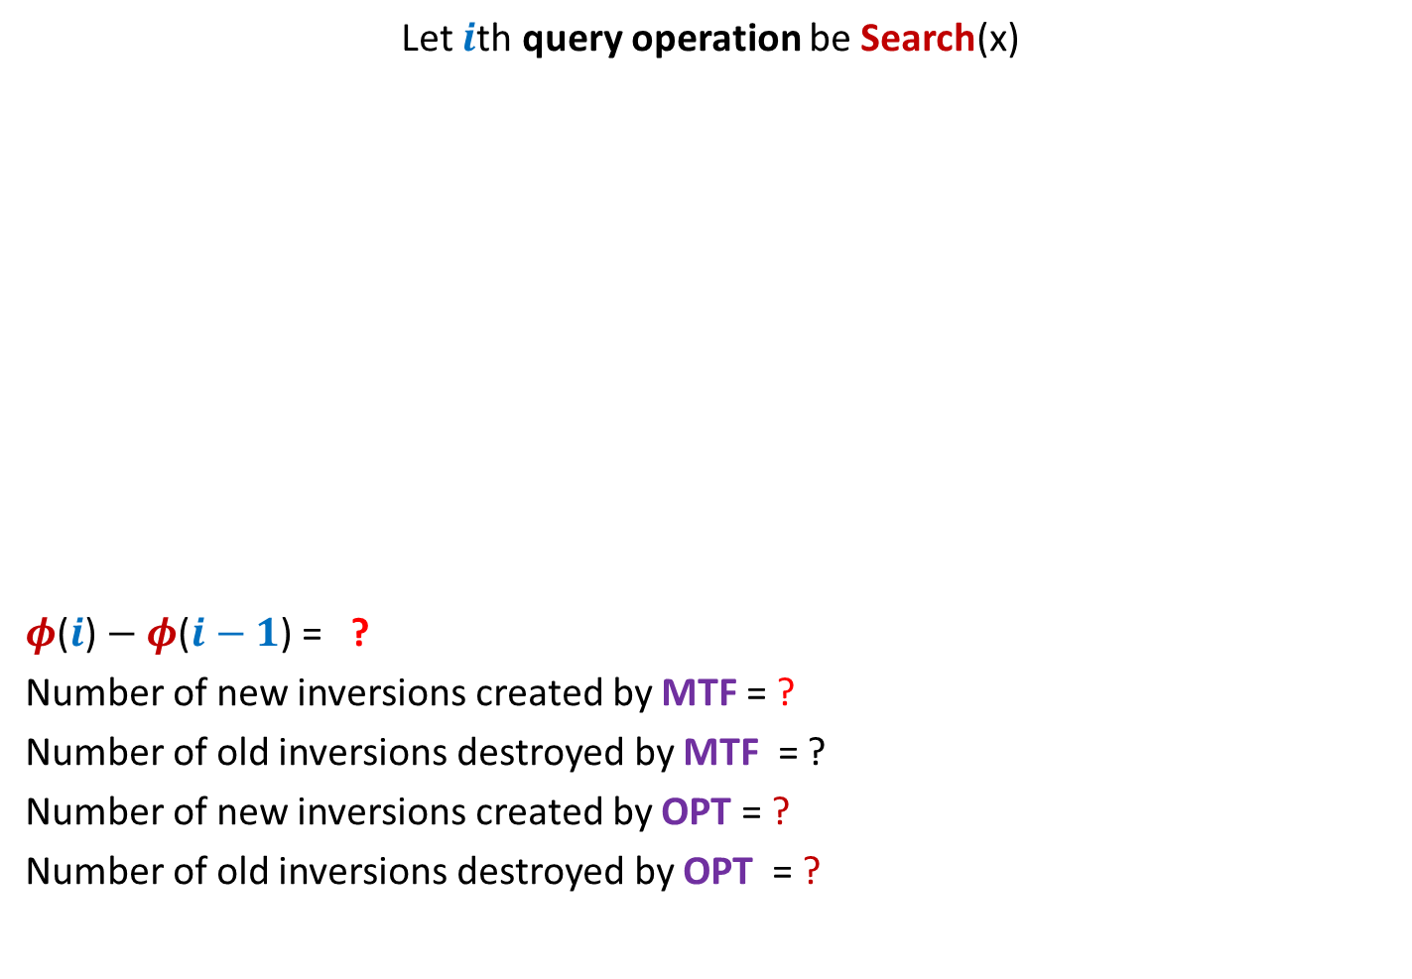




Change in potential during $i$th query operation
Let $i$th query operation be Search(x)
$φ$($i$) $− φ$($i−1$) = ?
Number of new inversions created by MTF = ?
Number of old inversions destroyed by MTF = ?
Number of new inversions created by OPT = ?
Number of old inversions destroyed by OPT = ?
HEAD
…
MTF list
1
2
…
$r$(x)$−1$
$r$(x)
…
x
HEAD
OPT list
…
…
x
…
1
$r^{∗}$(x)
$2$ (No. of new inversions created – No. of old inversions destroyed)
$≤2$ ($r^{∗}$(x)$+ t_{i}−1$ $−$ (($r$(x)$− r^{∗}\text{(}\text{x}\text{)}$) )
$≤r^{∗}$(x)$−1$
$≥r$(x)$−r^{∗}$(x)
$$≤ t_{i}$$
No. of swaps by OPT
$$≥0$$

Slide 20

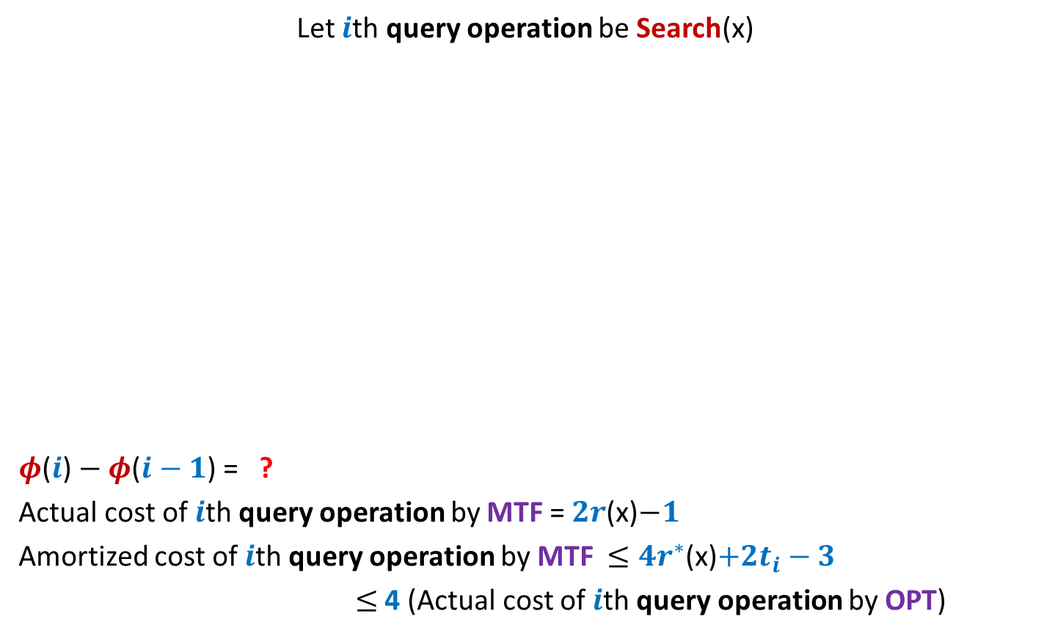



Amortized cost of $i$th query operation by MTF
Let $i$th query operation be Search(x)
$φ$($i$) $− φ$($i−1$) = ?
Actual cost of $i$th query operation by MTF = $2r$(x)$−1$
Amortized cost of $i$th query operation by MTF $≤4r^{∗}$(x)$+2t_{i}−3$
$≤$4 (Actual cost of $i$th query operation by OPT)
HEAD
…
MTF list
1
2
…
$r$(x)$−1$
$r$(x)
…
x
HEAD
OPT list
…
…
x
…
1
$r^{∗}$(x)
$≤{4r}^{∗}$(x)$+ {2t}_{i}−2$ $−$ $2r$(x)
$≤2$ ($r^{∗}$(x)$+ t_{i}−1$ $−$ (($r$(x)$− r^{∗}\text{(}\text{x}\text{)}$) )
$≤2$ (${2r}^{∗}$(x)$+ t_{i}−1$ $−$ $r$(x) )
$≤{4r}^{∗}$(x)$+{2t}_{i}$
$≤{4r}^{∗}$(x)$+{4t}_{i}$
$≤{4(r}^{∗}$(x)$+t_{i})$

Slide 21



Change in potential during $i$th query operation
Let $i$th query operation be Search(x)
$φ$($i$) $− φ$($i−1$) = ?
Actual cost of $i$th query operation by MTF = $2r$(x)$−1$
Amortized cost of $i$th query operation by MTF $≤4r$(x)$+2t_{i}−3$
$≤$4 (Actual cost of $i$th query operation by OPT)
HEAD
…
MTF list
1
2
…
$r$(x)$−1$
$r$(x)
…
x
Case 2
$r$(x)$≤$ $r^{∗}$(x)
HEAD
OPT list
…
…
x
…
1
$r^{∗}$(x)
$≤2(r$(x)$−1+t_{i})$

Slide 22
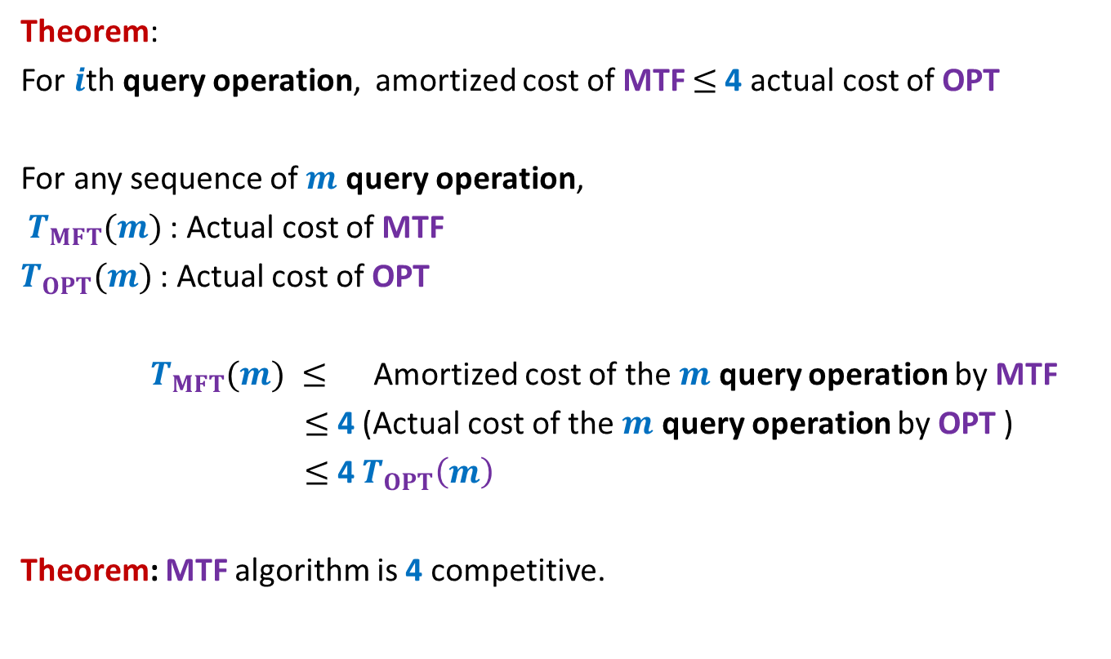
Analysis of MTF versus OPT
Theorem:
For $i$th query operation, amortized cost of MTF $≤$4 actual cost of OPT
For any sequence of $m$ query operation,
$T_{MFT}(m)$: Actual cost of MTF
$T_{OPT}(m)$: Actual cost of OPT
$T_{MFT}(m) ≤$ Amortized cost of the $m$ query operation by MTF
$≤$ 4 (Actual cost of the $m$ query operation by OPT )
$≤$ 4 $T_{OPT}\left(m\right)$
Theorem: MTF algorithm is 4 competitive.

Slide 23

Binary Search Trees
Examples:
AVL tree
Red-Black tree
Strength:
Achieve worst case O(log $n$) time for all operations.
Weakness:
Very difficult to implement.
Splay tree
Can we have a simpler BST ?

Slide 24
Binary Search Trees
Examples:
AVL tree
Red-Black tree
Strength:
Achieve worst case O(log $n$) time for all operations.
Weakness:
Very difficult to implement.
Splay tree

Slide 25
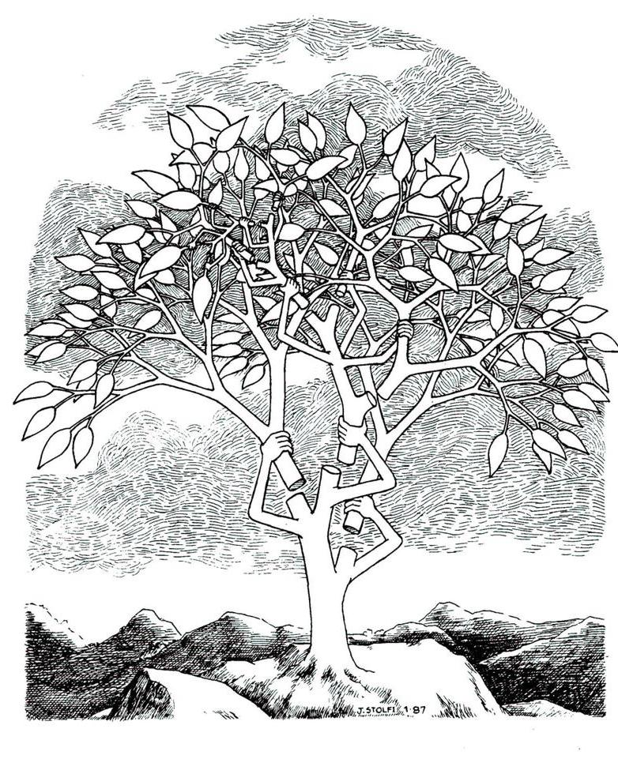

Splay tree: A self organizing Binary search trees.
Daniel Sleator
&
Robert Tarjan
JACM $1985$

Slide 26
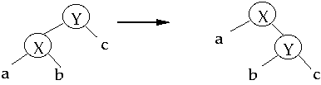
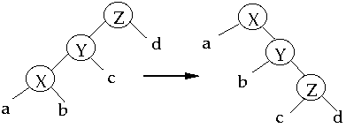
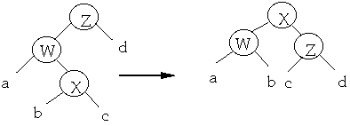
Splay operation
Splay(x)
Single rotation
Zig
Zig-zig
Double rotation
Zig-zag

Slide 27
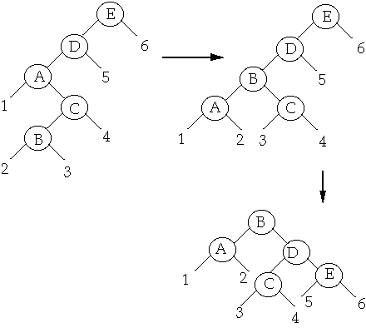
Splay operation
Splay(B)

Slide 28


Search($x$) on a Splay Tree
Perform ordinary search for $x$ on the BST.
Bring the element $x$ to the root by a sequence of splaying.

Slide 29



A magic
Insertion ?
Deletion ?
Any arbitrary BST on $n$ keys
Any arbitrary $m$search operations
Time taken : ??????
O(($m+n$) log $(m+n)$).
EQUALLY SIMPLE

Slide 30
Question : How would anyone have come up with such a magical analysis ?
Answer:
perhaps a persistent meditation on the problem
for a few months would have led the researcher to come up with this analysis.
I hope some of you are also inspired by such magical and elegant analysis.
You might like to study analysis of Splay tree on you tube ☺

