Slide 1
Design and Analysis of Algorithms
CS345A
Lecture 34
Fibonacci Heap
Stable Matching Problem
Final Analysis

Slide 2
Recap of the previous lecture

Slide 3
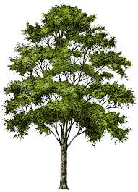
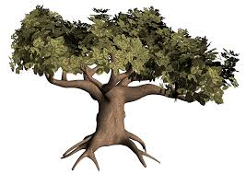
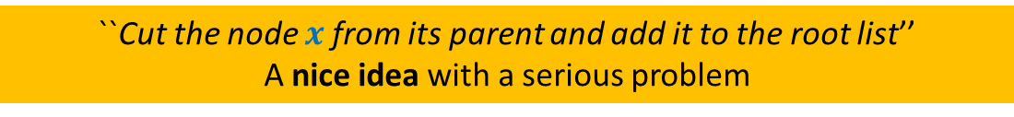

Decrease-key($H$,$x$,$y$) in O(1) time
``Cut the node $x$from its parent and add it to the root list’’
A nice idea with a serious problem
Binomial Tree☺
A bushy tree ☹

Slide 4
The novel idea of Cascaded cuts

Slide 5
Decrease-key($H$,$x$,$Δ$) in Fibonacci heap (using Cascaded-cuts)
If a marked node $v$ loses its second child, the subtrees rooted at the entire chain of marked ancestors starting from $v$ will be added to the root list.
Recall that a marked node becomes unmarked as soon as it joins the root list.
How to show that the amortized cost of Decrease-key($H$,$x$,$Δ$) is O($1$) ?

Slide 6


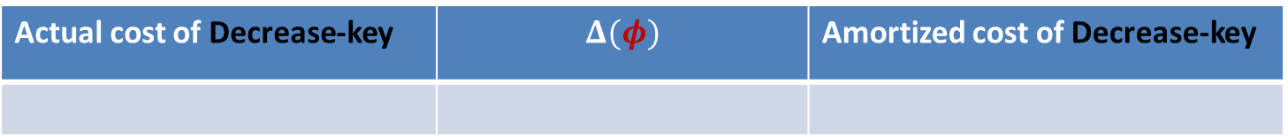



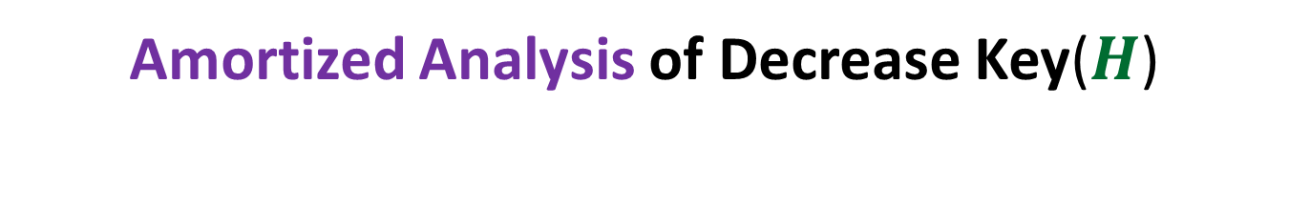





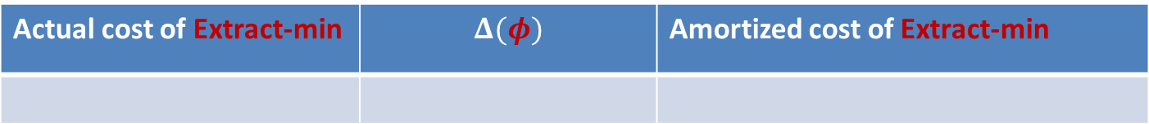



Amortized Analysis of Decrease Key($H$)
Convince yourself that the revised potential function works for Extract-min as well.
The existing Potential function
Are we done ?
$φ$($H$): $c$ $t(H)$
$$+ c m(H)$$
$$2$$
$m(H)$: the number of marked nodes
No
Actual cost of Decrease-key | $$Δ(φ)$$ | Amortized cost of Decrease-key
$c m\left(H_{old}\right)−c m(H_{new})$ + $c$
$$c m(H_{new})−c m(H_{old})$$
$$c$$
$$c m\left(H_{new}\right)−c m(H_{old})$$
$$0$$
Actual cost of Extract-min | $$Δ(φ)$$ | Amortized cost of Extract-min
$$c t(H_{old})$$
$$≤c(log n − t\left(H_{old}\right))$$
$$c(log n)$$
We need to show that the maximum degree of a tree in a Heap of size $n$= O($log n$)
Ponder over it… We shall discuss it in the next lecture.

Slide 7

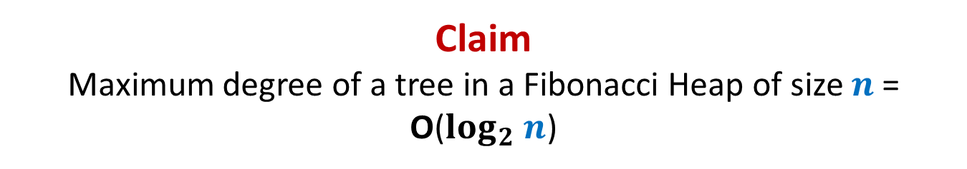
Claim Maximum degree of a tree in a Fibonacci Heap of size $n$= O($log_{2} n$)
“For a node $x$of degree $k$ , size($x$) is $Ω(a^{k})$ always”

Slide 8
Fibonacci Numbers
Revising Discrete math

Slide 9








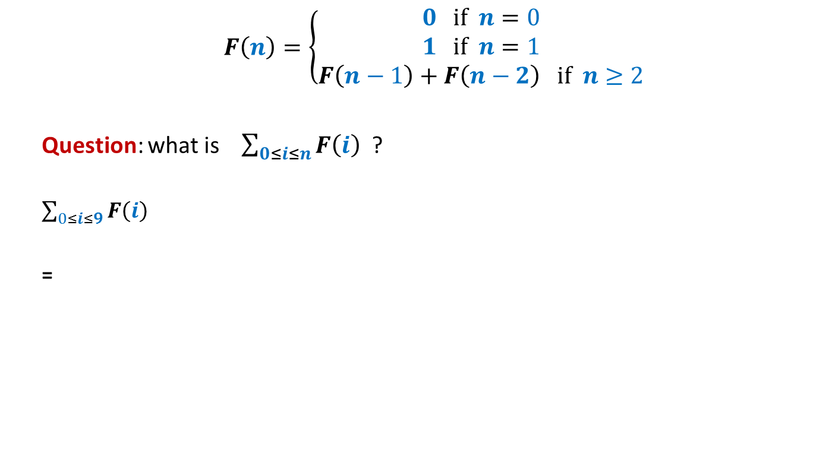













$$F\left(n\right)=\left\{\begin{aligned}0 if n=0 \\ 1 if n=1 \\ F\left(n−1\right)+F\left(n−2\right) if n≥2\end{aligned}\right.$$
Question: what is $\sum_{0≤i≤n}{F\left(i\right)}$ ?
$\sum_{0≤i≤9}{F\left(i\right)}$
=
$$=F\left(n+2\right)−1$$
$1$+
$$F\left(10\right)$$
+ $F\left(8\right)$
+ $F\left(7\right)$
+ $F\left(6\right)$
+ $F\left(5\right)$
+ $F\left(4\right)$
+ $F\left(3\right)$
+ $F\left(2\right)$
+ $F\left(1\right)$
$$F\left(11\right)$$
$$F\left(9\right)$$
+ $F\left(9\right)$
+ $F\left(8\right)$
+ $F\left(7\right)$
+ $F\left(6\right)$
+ $F\left(5\right)$
+ $F\left(4\right)$
+ $F\left(3\right)$
+ $F\left(2\right)$
We can use this to get an alternate expression for Fibonacci numbers ☺

Slide 10

$$F\left(n\right)=\left\{\begin{aligned}0 if n=0 \\ 1 if n=1 \\ 1+\sum_{0≤i≤n−2}{F\left(i\right)} if n≥2\end{aligned}\right.$$

Slide 11

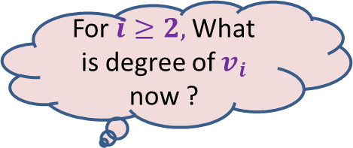















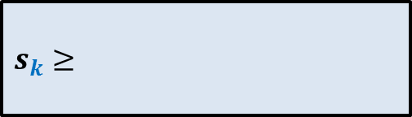

Claim Maximum degree of a tree in a Fibonacci Heap of size $n$= O($log_{2} n$)
This is equivalent to …
$s_{k}$ : the minimum size of a tree rooted at node of degree $k$
Recurrence for $s_{k}$ = ?
“For a node $x$of degree $k$ , size($x$) is $Ω(a^{k})$ always”
For $i≥2,$What is degree of $v_{i}$ now ?
What is degree of $v_{1}$ now?
$$≥i−2$$
$$≥0$$
$$x$$
Arrange the children of $x$ in the increasing order of time of becoming children of $x$.
At the time of becoming child of $x$, degree of $v_{i}≥i−1$. From that moment till now, $v_{i}$can lose at most one child.
…
…
$$k i 2 1$$
$$v_{k}$$
$$v_{i}$$
$$v_{2}$$
$$v_{1}$$
$s_{k}≥$
$$s_{0}=1$$
$$+ \sum_{2≤i≤k}{s_{i−2}}$$
$$1$$
$$+ 1$$
$$s_{1}=2$$

Slide 12
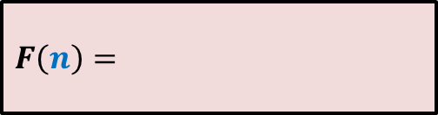


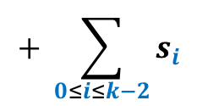








$$s_{0}=1$$
$$F(0)=0$$
$$s_{1}=2$$
$$F(1)=1$$
$F\left(n\right)=$
$s_{k}≥$
$$1+\sum_{0≤i≤n−2}{F\left(i\right)}$$
$$+ \sum_{0≤i≤k−2}{s_{i}}$$
$$1$$
$$+ 1$$
$$s_{k} ≥ F(k)$$
In fact, …
Obvious
$$F(k+2)$$

Slide 13


















Mission accomplished ☺
 | Binary heap
Binomial heap
Binomial heap
Fibonacci heap
Find-min($H$)
O($1$)
O($\log{n}$)
O($1$)
O($1$)
Insert($H$, $x$)
O($\log{n}$)
O($\log{n}$)
O($1$)
O($1$)
Extract-min($H$)
O($\log{n}$)
O($\log{n}$)
O($\log{n}$)
O($\log{n}$)
amortized
amortized
Decrease-key($H$,$x$,$y$)
O($\log{n}$)
O($\log{n}$)
O($\log{n}$)
O($1$)
amortized
Merge-heaps($H_{1}$,$H_{2}$)
O($n$)
O($\log{n}$)
O($1$)
O($1$)
Fibonacci Heaps were invented in 1985 by Fredman and Tarjan.
In 2012, Brodal, Lagogiannis & Tarjan got rid of “amortized bound” as well.
Tarjan made great contribution to the area of algorithms and data structures.
He is 75+ years old, and is still so active …(truly inspiring ☺)

Slide 14
Mission accomplished ☺
 | Binary heap
Binomial heap
Binomial heap
Fibonacci heap
Find-min($H$)
O($1$)
O($\log{n}$)
O($1$)
O($1$)
Insert($H$, $x$)
O($\log{n}$)
O($\log{n}$)
O($1$)
O($1$)
Extract-min($H$)
O($\log{n}$)
O($\log{n}$)
O($\log{n}$)
O($\log{n}$)
amortized
amortized
Decrease-key($H$,$x$,$y$)
O($\log{n}$)
O($\log{n}$)
O($\log{n}$)
O($1$)
amortized
Merge-heaps($H_{1}$,$H_{2}$)
O($n$)
O($\log{n}$)
O($1$)
O($1$)

Slide 15
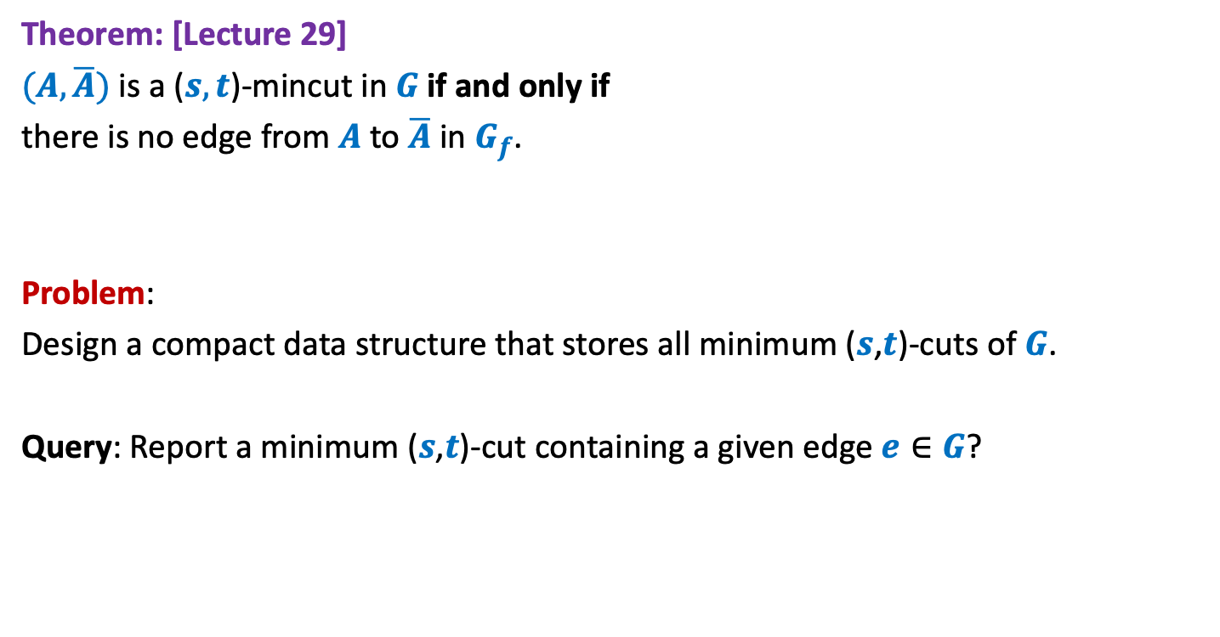

Minimum ($s$,$t$)-cuts
Theorem: [Lecture 29]
$(A,\overline{A})$ is a ($s,t$)-mincut in $G$if and only if
there is no edge from $A$ to $\overline{A}$ in $G_{f}$.
Problem:
Design a compact data structure that stores all minimum ($s$,$t$)-cuts of $G$.
Query: Report a minimum ($s$,$t$)-cut containing a given edge $e∈G$?

Slide 16
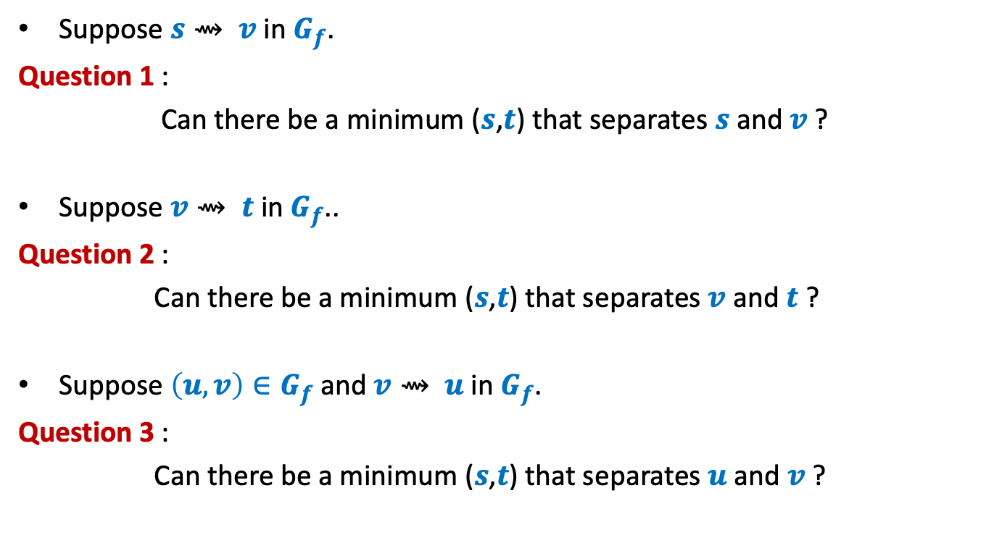
Pointers
Suppose $s⇝ v$ in $G_{f}$.
Question 1 :
Can there be a minimum ($s$,$t$) that separates $s$ and $v$ ?
Suppose $v⇝ t$ in $G_{f}$..
Question 2 :
Can there be a minimum ($s$,$t$) that separates $v$ and $t$ ?
Suppose $\left(u,v\right)∈G_{f}$ and $v⇝ u$ in $G_{f}$.
Question 3 :
Can there be a minimum ($s$,$t$) that separates $u$ and $v$ ?

Slide 17
Stable Marriage Problem

Slide 18







Stable Marriage Problem
Women
Men
$$w_{1}$$
$$m_{1}$$
$$3$$
…
$$w_{2}$$
$$m_{2}$$
$$1$$
…..
$$w_{3}$$
$$m_{3}$$
$$2$$
$$w_{i}$$
$$m_{j}$$
$$w_{n}$$
$$m_{n}$$

Slide 19



Stable Marriage Problem
Women
Men
$$w_{1}$$
$$m_{1}$$
$$3$$
$$w_{2}$$
$$m_{2}$$
…
…
$$1$$
$$w_{3}$$
$$m_{3}$$
…..
$$2$$
$$k$$
$$w_{i}$$
$$m_{j}$$
$$w_{n}$$
$$m_{n}$$

Slide 20
Stable Marriage Problem
Women
Men
Marriage : ?
$$w_{1}$$
$$m_{1}$$
$$w_{2}$$
$$m_{2}$$
$$w_{3}$$
$$m_{3}$$
…
…
$$w_{i}$$
$$m_{j}$$
…
…
$$w_{n}$$
$$m_{n}$$
a bijection between Women and Men

Slide 21

Stable Marriage Problem
Meaning of unstability
Women
Men
$w_{l}$ prefers $m_{j}$ to $m_{k}$
$m_{j}$ prefers $w_{l}$ to $w_{i}$
Definition:
A marriage is said to be stable if there is no unstable pair in the society.
($w_{l}$, $m_{j}$) : an unstable pair
$$w_{l}$$
divorce
$$m_{k}$$
$$w_{i}$$
divorce
$$m_{j}$$

Slide 22
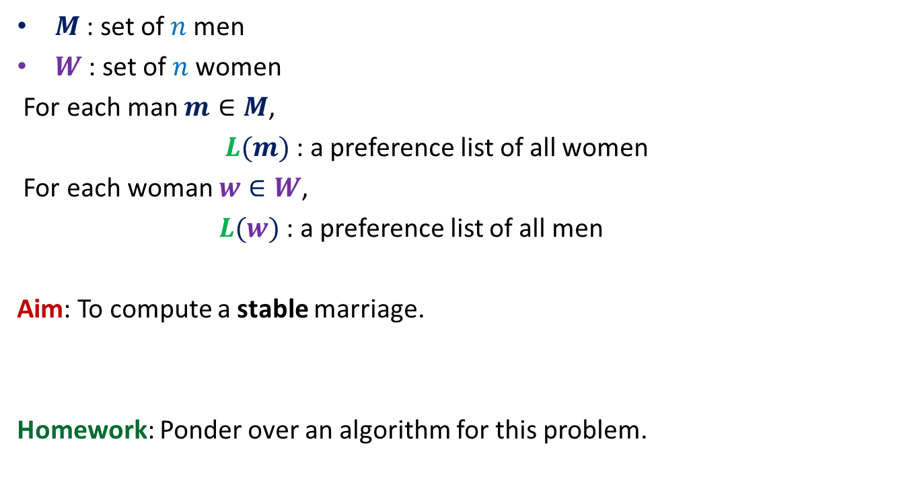
Stable Marriage Problem
$M$ : set of $n$men
$W$ : set of $n$women
For each man $m∈M$,
$L(m)$: a preference list of all women
For each woman $w∈W$,
$L(w)$: a preference list of all men
Aim: To compute a stable marriage.
Homework: Ponder over an algorithm for this problem.

