Slide 1
Design and Analysis of Algorithms
CS345A
Lecture 35
Stable Matching Problem

Slide 2
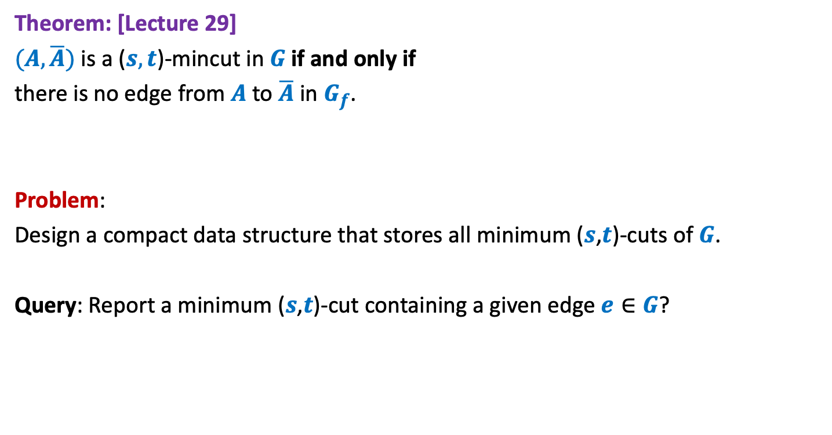

Minimum ($s$,$t$)-cuts
Theorem: [Lecture 29]
$(A,\overline{A})$ is a ($s,t$)-mincut in $G$if and only if
there is no edge from $A$ to $\overline{A}$ in $G_{f}$.
Problem:
Design a compact data structure that stores all minimum ($s$,$t$)-cuts of $G$.
Query: Report a minimum ($s$,$t$)-cut containing a given edge $e∈G$?

Slide 3

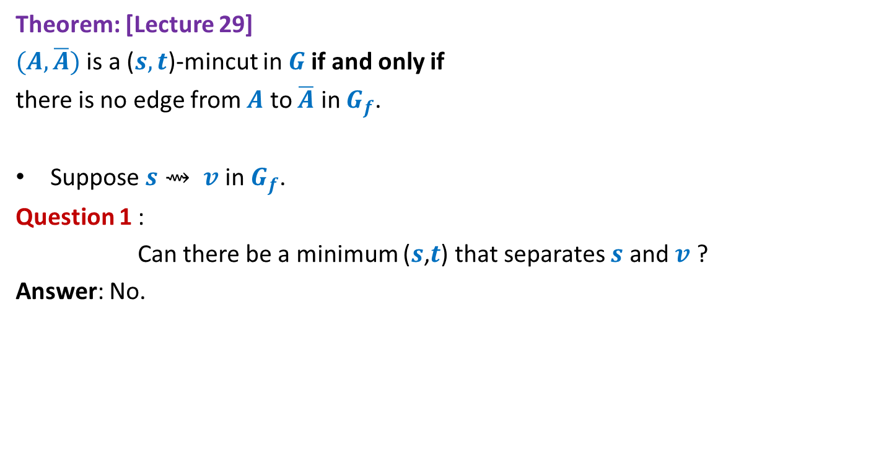




Minimum ($s$,$t$)-cuts
Theorem: [Lecture 29]
$(A,\overline{A})$ is a ($s,t$)-mincut in $G$if and only if
there is no edge from $A$ to $\overline{A}$ in $G_{f}$.
Suppose $s⇝ v$ in $G_{f}$.
Question 1 :
Can there be a minimum ($s$,$t$) that separates $s$ and $v$ ?
Answer: No.
$$A$$
$$\overline{A}$$
$$v$$
$$s$$
$$t$$

Slide 4


Minimum ($s$,$t$)-cuts
Theorem: [Lecture 29]
$(A,\overline{A})$ is a ($s,t$)-mincut in $G$if and only if
there is no edge from $A$ to $\overline{A}$ in $G_{f}$.
Suppose $v⇝ t$ in $G_{f}$..
Question 2 :
Can there be a minimum ($s$,$t$) that separates $v$ and $t$ ?
Answer: No.
$$A$$
$$\overline{A}$$
$$v$$
$$s$$
$$t$$

Slide 5
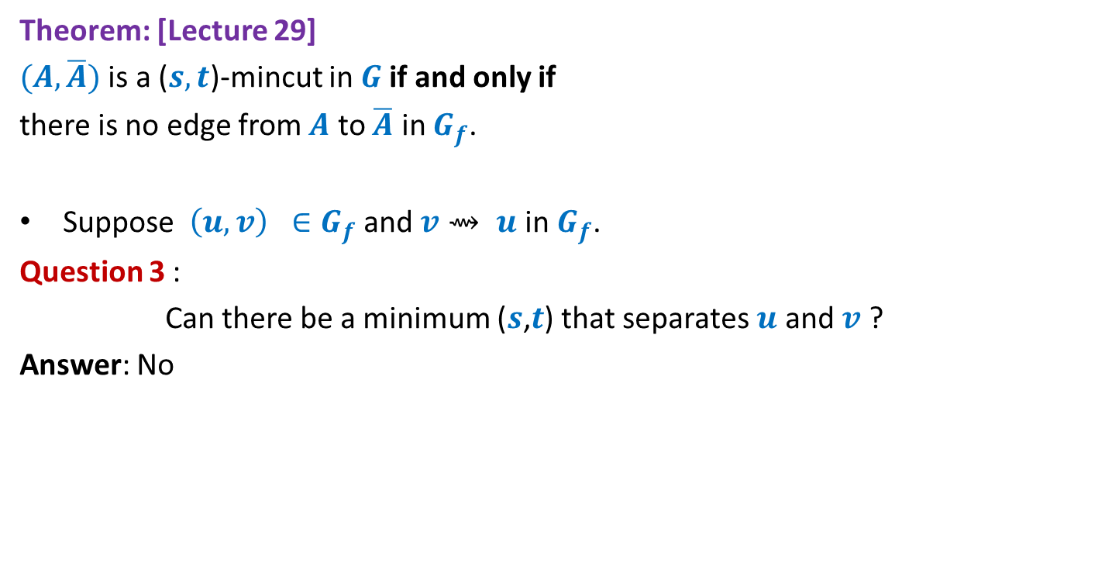


Minimum ($s$,$t$)-cuts
Theorem: [Lecture 29]
$(A,\overline{A})$ is a ($s,t$)-mincut in $G$if and only if
there is no edge from $A$ to $\overline{A}$ in $G_{f}$.
Suppose $\left(u,v\right) ∈G_{f}$ and $v⇝ u$ in $G_{f}$.
Question 3 :
Can there be a minimum ($s$,$t$) that separates $u$ and $v$ ?
Answer: No
$$A$$
$$\overline{A}$$
$$u$$
$$v$$
$$s$$
$$t$$

Slide 6

Minimum ($s$,$t$)-cuts
Theorem: [Lecture 29]
$(A,\overline{A})$ is a ($s,t$)-mincut in $G$if and only if
there is no edge from $A$ to $\overline{A}$ in $G_{f}$.
Suppose $\left(u,v\right) ∈G_{f}$ and $v⇝ u$ in $G_{f}$.
Question 3 :
Can there be a minimum ($s$,$t$) that separates $u$ and $v$ ?
Answer: No
$$u⇝ v$$
$$A$$
$$\overline{A}$$
$$u$$
$$v$$
$$s$$
$$t$$

Slide 7
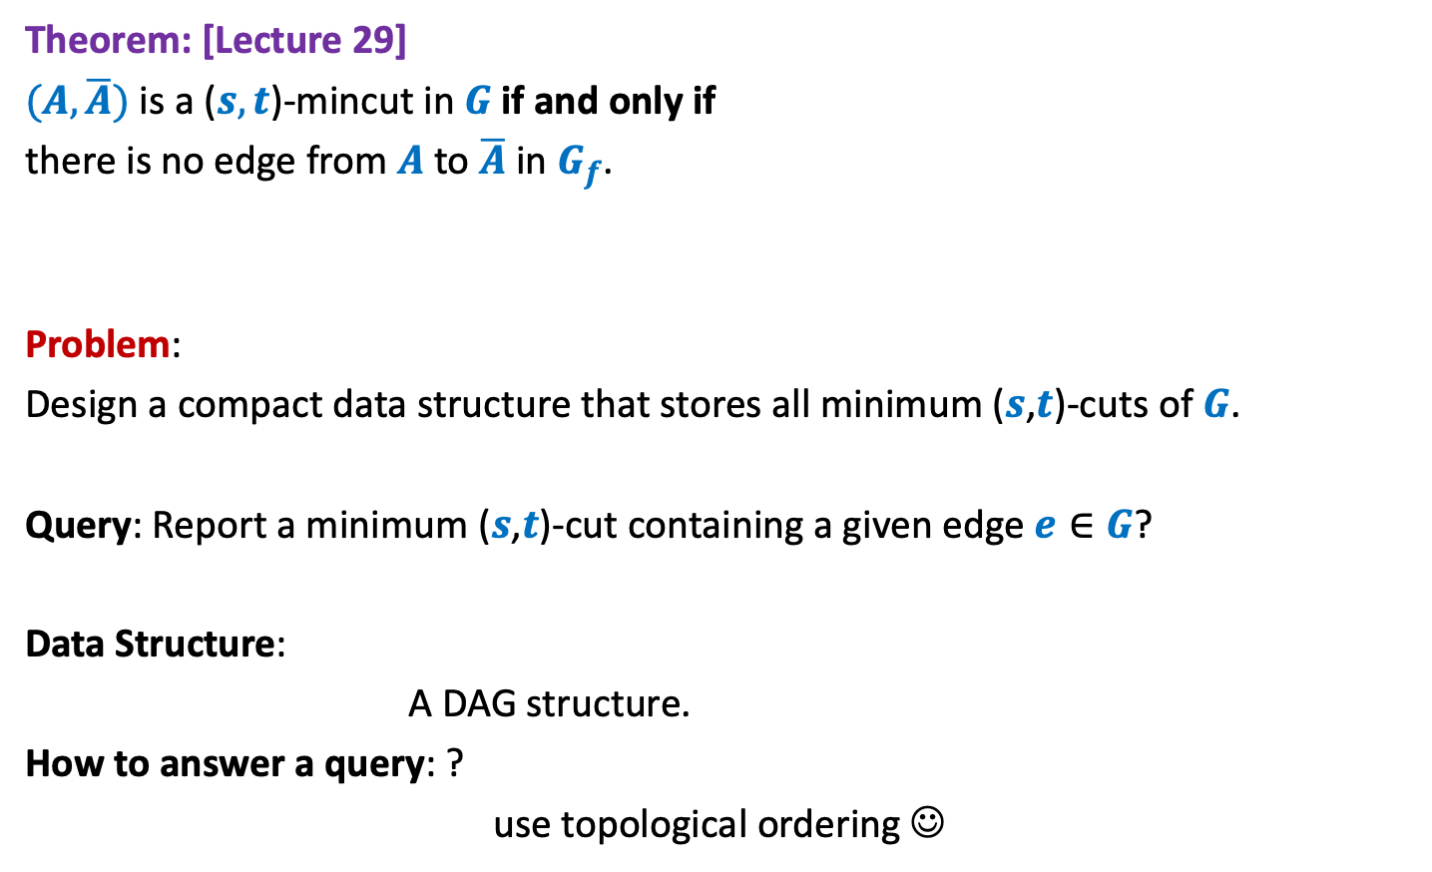
Minimum ($s$,$t$)-cuts
Theorem: [Lecture 29]
$(A,\overline{A})$ is a ($s,t$)-mincut in $G$if and only if
there is no edge from $A$ to $\overline{A}$ in $G_{f}$.
Problem:
Design a compact data structure that stores all minimum ($s$,$t$)-cuts of $G$.
Query: Report a minimum ($s$,$t$)-cut containing a given edge $e∈G$?
Data Structure:
A DAG structure.
How to answer a query: ?
use topological ordering ☺

Slide 8
Stable Marriage Problem

Slide 9
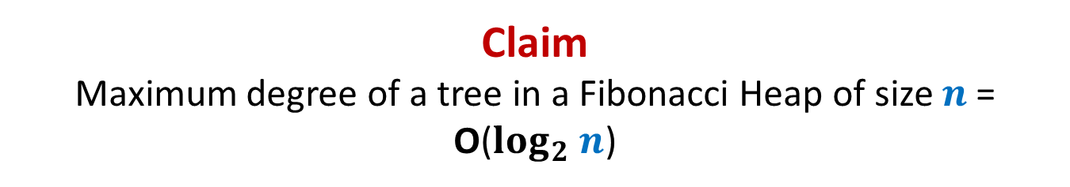












Stable Marriage Problem
Women
Men
$$w_{1}$$
$$m_{1}$$
$$3$$
…
$$w_{2}$$
$$m_{2}$$
$$1$$
…..
$$w_{3}$$
$$m_{3}$$
$$2$$
$$w_{i}$$
$$m_{j}$$
$$w_{n}$$
$$m_{n}$$

Slide 10




Stable Marriage Problem
Women
Men
$$w_{1}$$
$$m_{1}$$
$$3$$
$$w_{2}$$
$$m_{2}$$
…
…
$$1$$
$$w_{3}$$
$$m_{3}$$
…..
$$2$$
$$k$$
$$w_{i}$$
$$m_{j}$$
$$w_{n}$$
$$m_{n}$$

Slide 11
Stable Marriage Problem
Women
Men
Marriage : ?
$$w_{1}$$
$$m_{1}$$
$$w_{2}$$
$$m_{2}$$
$$w_{3}$$
$$m_{3}$$
…
…
$$w_{i}$$
$$m_{j}$$
…
…
$$w_{n}$$
$$m_{n}$$
a bijection between Women and Men

Slide 12




Stable Marriage Problem
Meaning of unstability
Women
Men
$w_{l}$ prefers $m_{j}$ to $m_{k}$
$m_{j}$ prefers $w_{l}$ to $w_{i}$
Definition:
A marriage is said to be stable if there is no unstable pair in the society.
($w_{l}$, $m_{j}$) : an unstable pair
$$w_{l}$$
divorce
$$m_{k}$$
$$w_{i}$$
divorce
$$m_{j}$$

Slide 13

Stable Marriage Problem
$M$ : set of $n$men
$W$ : set of $n$women
For each man $m∈M$,
$L(m)$: a preference list of all women
For each woman $w∈W$,
$L(w)$: a preference list of all men
Aim: To compute a stable marriage.

Slide 14
Algorithm for Stable Marriage
1962, David Gale and Lloyd Shapley
Man proposes
Woman disposes

Slide 15



Stable Marriage Problem
Women
Men
$$w_{1}$$
$$m_{1}$$
$$2$$
$$w_{2}$$
$$m_{2}$$
$$1$$
$$w_{3}$$
$$m_{3}$$
$$1$$
$$1$$
$$w_{i}$$
$$m_{j}$$
$$w_{n}$$
$$m_{n}$$

Slide 16
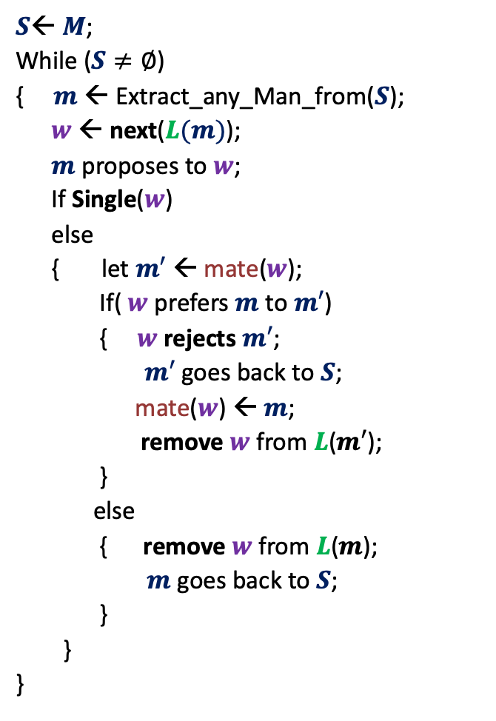



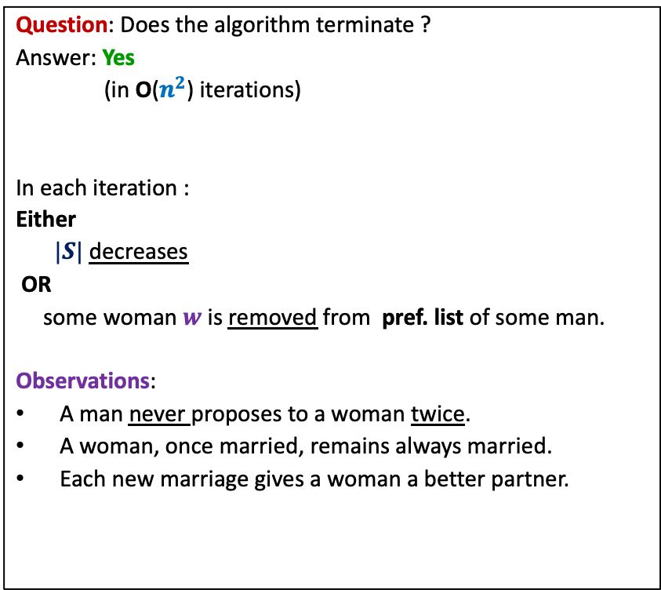
GaleShapley($M$, $W$)
$S$← $M$;
While ($S≠∅$)
{ $m$← Extract_any_Man_from($S$);
$w$ ← next($L(m)$);
$m$ proposes to $w$;
If Single($w$)
else
{ let $m′$ ← mate($w$);
If( $w$ prefers $m$ to $m′$)
{ $w$rejects $m′$;
$m′$ goes back to $S$;
mate($w$) ← $m$;
remove $w$from $L$($m′$);
}
else
{ remove $w$from $L$($m$);
$m$ goes back to $S$;
}
}
}
Question: Does the algorithm terminate ?
Answer: Yes
(in O($n^{2}$) iterations)
In each iteration :
Either
$|S|$ decreases
OR
some woman $w$is removed from pref. list of some man.
Observations:
A man never proposes to a woman twice.
A woman, once married, remains always married.
Each new marriage gives a woman a better partner.
mate($w$) ← $m$;
Any measure of progress ?
in list $L(w)$, $m$precedes $m′$)

Slide 17


GaleShapley($M$, $W$) (Proof of stability)
Lemma : If $m_{j}$ prefers $w_{l}$ to $w_{i}$
➔ $w_{l}$ prefers $m_{k}$ to $m_{j}$.
Proof: (a sketch (the details emerged from the interaction in the class))
$m_{j}$ must have proposed to $w_{l}$.
At the moment of the proposal, $w_{l}$ was either married or unmarried.
If unmarried, $w_{l}$ would have accepted the offer at that time but divorced later.
But a woman divorces her present husband only when she gets a better partner .
So $w_{l}$ would have surely got a better partner than $m_{j}$.
Since the partner of a woman only improves in future rounds, $m_{k}$would indeed be preferred to $m_{j}$.
If married, …
$$w_{l}$$
$$m_{k}$$
$$w_{i}$$
$$m_{j}$$

Slide 18

GaleShapley($M$, $W$)
Theorem:
GaleShapley($M$, $W$) indeed computes a stable marriage.
Question : Does there exist a unique stable marriage ?
Answer: No.

Slide 19


Gale Shapley Algorithm
Man proposing
Woman pessimal
Man Optimal

Slide 20
Gale Shapley Algorithm
Woman proposing
Woman Optimal
Man Pessimal

Slide 21






Gale Shapley Algorithm
Women
Men
$$w_{1}$$
$$m_{1}$$
$$w_{2}$$
$$m_{2}$$
$$w_{3}$$
$$m_{3}$$
$$w_{i}$$
$$m_{j}$$
$$w_{n}$$
$$m_{n}$$

Slide 22







Gale Shapley Algorithm
Programs
Men
$$P_{1}$$
$$m_{1}$$
$$P_{2}$$
$$m_{2}$$
$$P_{3}$$
$$m_{3}$$
$$P_{i}$$
$$m_{j}$$
$$P_{n}$$
$$m_{n}$$

Slide 23






Gale Shapley Algorithm
Deferred Acceptance Algorithm
Programs
Candidates
$$P_{1}$$
$$c_{1}$$
$$P_{2}$$
$$c_{2}$$
Preference lists
Unstability
$$P_{3}$$
$$c_{3}$$
Unfairness
Merit lists
$$P_{i}$$
$$c_{j}$$
$$P_{n}$$
$$c_{m}$$

Slide 24
Deferred Acceptance Algorithm
Programs
Candidates
$$P_{1}$$
$$c_{1}$$
$$P_{2}$$
$$c_{2}$$
$$P_{3}$$
$$c_{3}$$
$$P_{i}$$
$$c_{j}$$
$$P_{n}$$
$$c_{m}$$

Slide 25

$3$Algorithms
Gale Shapley
algorithm
Limited rounds
Programme proposing
Programme proposing
Candidate proposing
Common man’s algorithm
Software Industry’s algorithm
Deferred Acceptance algorithm
Candidate Pessimal
Candidate Pessimal
Candidate Optimal

Slide 26
Merits of Deferred Acceptance Algorithm
Any number of merit lists
Candidate optimality guaranteed
Efficient Algorithm
Joint Seat Allocation
Deferred Acceptance Algorithm

Slide 27
Business rules of admissions
Affirmative action rules
Freeze/Float/Slide/withdraw
Supernumerary Seats for Female Candidates [’18 - ]
No increase in male seats
No adverse affect on chances for the male candidates
Create supernumerary seats (not reservation at all !)

Slide 28

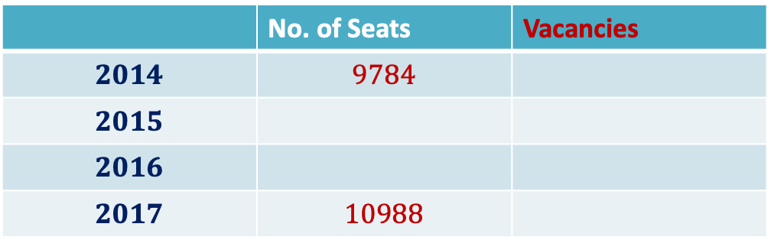



Impact of Joint Seat Allocation
Vacancies in IITs
 | No. of Seats | Vacancies
$$2014$$ | $$9784$$
$$2015$$
$$2016$$
$$2017$$ | $$10988$$
$$587$$
$$308$$
$$190$$
$$198$$

Slide 29

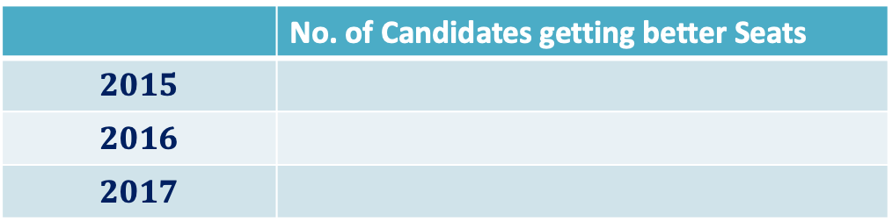



Impact of Joint Seat Allocation
 | No. of Candidates getting better Seats
$$2015$$
$$2016$$
$$2017$$
$$1890$$
$$1767$$
$$1↔300$$
$$3672$$

Slide 30
Impact of Joint Seat Allocation
INFORMS J. Appl. Anal., 49(5) 338-354 (2019)
The above research paper is available on the homepage of the instructor.
Read it to see the role of algorithms in your journey to IITK ☺
Not meant for exam or quizzes ☺
Centralized Admissions for Engineering Colleges in India
S. Baswana, P. P. Chakrabarti, S. Chandran, Y. Kanoria, U. Patange

