Slide 1
Design and Analysis of Algorithms
CS345A
Lecture 39
Approximation Algorithms

Slide 2
How to handle NP-complete Problems
Approximation Algorithms

Slide 3
Vertex Cover Problem
2-Approximate algorithm

Slide 4

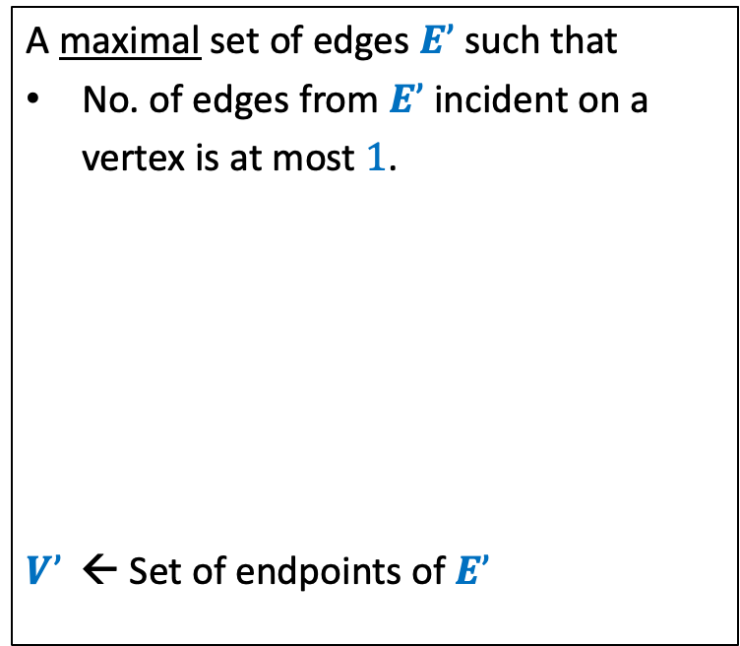

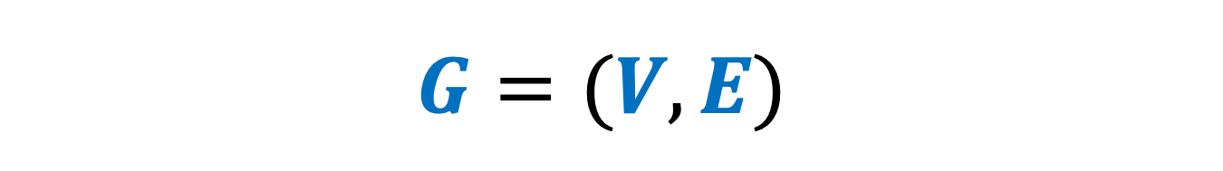



$$G=(V,E)$$
Vertex Cover
Maximal Matching
A set of vertices that cover all edges.
A maximal set of edges $E’$such that
No. of edges from $E’$incident on a
vertex is at most $1$.
$V’$ ← Set of endpoints of $E’$
…
…
$$x$$
$$y$$
$$x$$
$$y$$
$V’$ is a vertex cover of $G$

Slide 5





$$G=(V,E)$$
Vertex Cover
Maximal Matching
A set of vertices that cover all edges.
A maximal set of edges $E’$such that
No. of edges from $E’$incident on a
vertex is at most $1$.
$V’$ ← Set of endpoints of $E’$
…
…
$$x$$
$$y$$
$$x$$
$$y$$
$$E’$$
Vertex cover of $G$must cover each edge of $E$
$E’$ is a matching.
$$|V’\left|=2\right|E′|$$
➔ Optimal vertex cover has size at least $|E’|$.

Slide 6
Set Cover Problem

Slide 7

Set Cover Problem
a set $A$= {$e_{1}$, $e_{2}$,…,$e_{n}$}
$S_{1}$, $S_{2}$,…, $S_{k}$, with $S_{i}⊆A$
Optimization version: Compute least number of sets that can cover $A$.
Decision version: Does there exist $j$subsets that can cover all elements ?

Slide 8
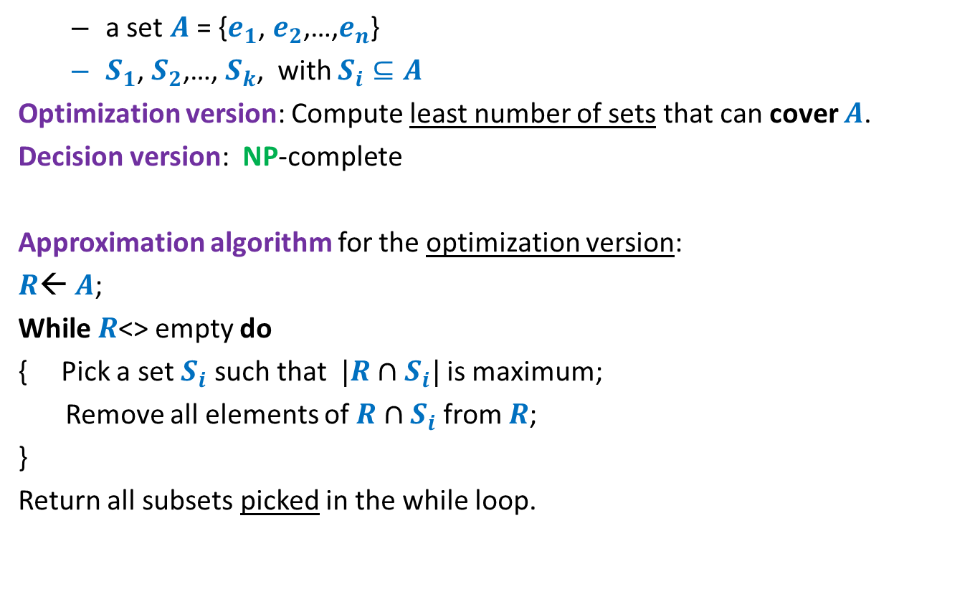
Set Cover Problem
a set $A$= {$e_{1}$, $e_{2}$,…,$e_{n}$}
$S_{1}$, $S_{2}$,…, $S_{k}$, with $S_{i}⊆A$
Optimization version: Compute least number of sets that can cover $A$.
Decision version: NP-complete
Approximation algorithm for the optimization version:
$R$← $A$;
While $R$<> empty do
{ Pick a set $S_{i}$ such that $|R∩S_{i}|$ is maximum;
Remove all elements of $R∩S_{i}$ from $R$;
}
Return all subsets picked in the while loop.
Homework of previous class
Think simple.
Follow your intuition

Slide 9

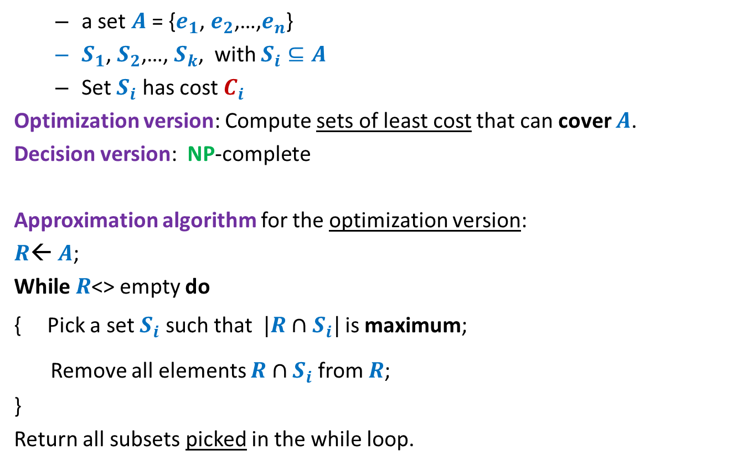

Set Cover Problem
Generic
a set $A$= {$e_{1}$, $e_{2}$,…,$e_{n}$}
$S_{1}$, $S_{2}$,…, $S_{k}$, with $S_{i}⊆A$
Set $S_{i}$ has cost $C_{i}$
Optimization version: Compute sets of least cost that can cover $A$.
Decision version: NP-complete
Approximation algorithm for the optimization version:
$R$← $A$;
While $R$<> empty do
{ Pick a set $S_{i}$ such that $|R∩S_{i}|$ is maximum;
Remove all elements $R∩S_{i}$ from $R$;
}
Return all subsets picked in the while loop.
$$\frac{|R∩S_{i}|}{C_{i}}$$
$$\frac{C_{i}}{|R∩S_{i}|}$$
is minimum;

Slide 10
A discrete Math Gem

Slide 11


A discrete math gem
Let $j_{1}$, $j_{2}$,…, $j_{ℓ}$ be any arbitrary $ℓ$positive integers such that
$$\sum_{t=1}^{t=ℓ}{j_{t}}≤m$$
What is a bound on
$$\frac{j_{1}}{m}+ \frac{j_{2}}{m−j_{1}}+\frac{j_{3}}{m−j_{1}−j_{2}}+…+\frac{j_{ℓ}}{m−j_{1}−j_{2}−…−j_{ℓ−1}}$$
$$≤1$$

Slide 12





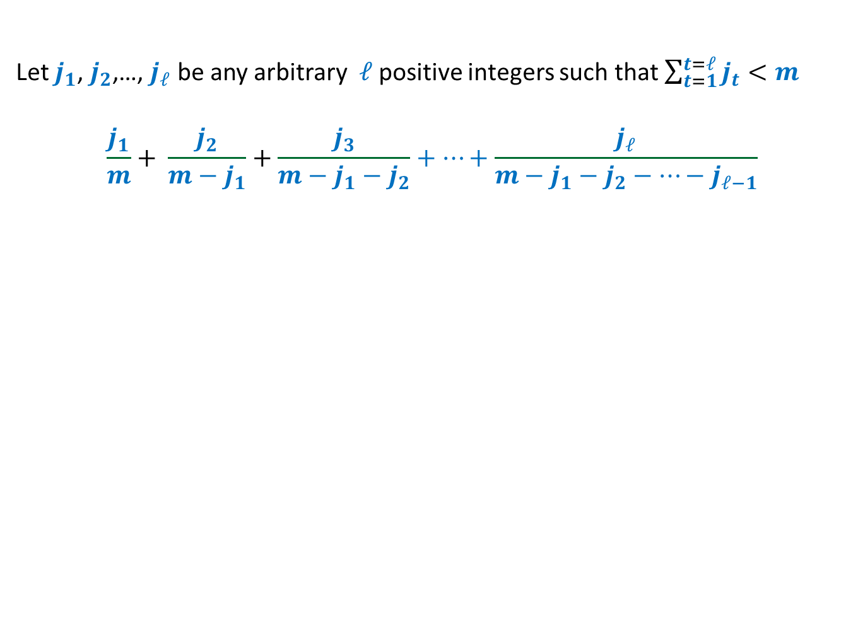








Let $j_{1}$, $j_{2}$,…, $j_{ℓ}$ be any arbitrary $ℓ$positive integers such that $\sum_{t=1}^{t=ℓ}{j_{t}}<m$
$$\frac{j_{1}}{m}+ \frac{j_{2}}{m−j_{1}}+\frac{j_{3}}{m−j_{1}−j_{2}}+…+\frac{j_{ℓ}}{m−j_{1}−j_{2}−…−j_{ℓ−1}}$$
$$≤log m$$
Relate the pink rectangles with the terms in the expression.
$$f\left(x\right)=1/x$$
$$\frac{1}{m−j_{1}−j_{2}−j_{3}}$$
$$\frac{1}{m−j_{1}−j_{2}}$$
$$\frac{1}{m−j_{1}}$$
$$\frac{1}{m}$$
$$j_{3}$$
$$j_{2}$$
$$j_{1}$$
$$m−j_{1}−j_{2}−j_{3}$$
$$m−j_{1}−j_{2}$$
$$m−j_{1}$$
$$m$$

Slide 13
How to analyze the greedy algorithm ?
The challenge:
No knowledge of the optimal solution.
Aim to get a worst case guarantee for all possible instances.
Conquering the challenge:
Pick any arbitrary instance
“Compare” greedy solution with its optimal solution.

Slide 14













How to analyze the greedy algorithm ?
Question: How to account for the sets $s_{2}$, $s_{6}$, $s_{11}$in the greedy algorithm ?
the sets belonging to “Optimal” solution
Optimal solution
$$s_{1}$$
$$s_{2}$$
$$s_{3}$$
$$s_{4}$$
$$s_{5}$$
$$s_{6}$$
$$s_{7}$$
$$s_{8}$$
$$s_{9}$$
$$s_{10}$$
$$s_{11}$$
$$s_{12}$$
Greedy solution
but absent in “Greedy” solution

Slide 15
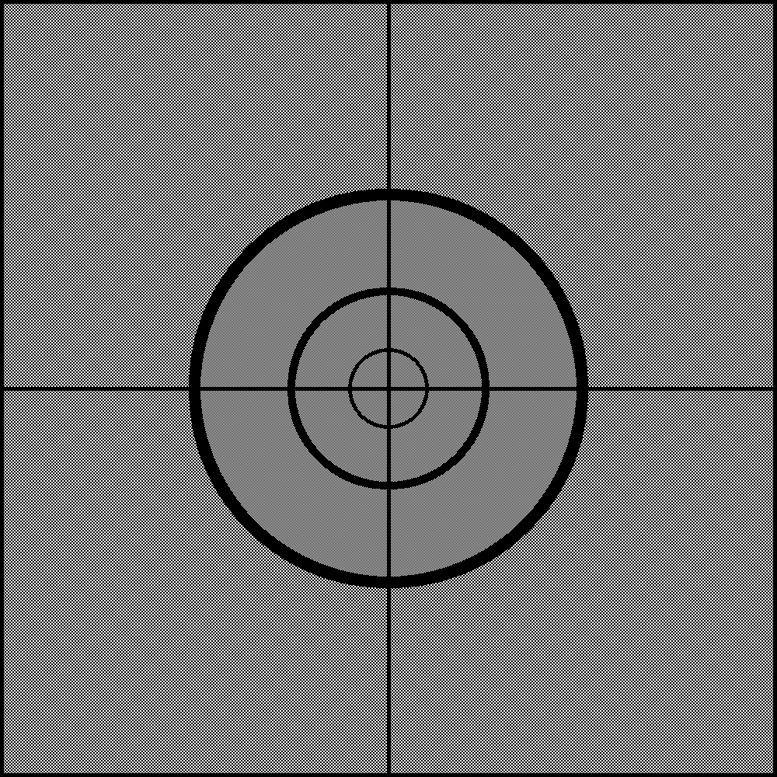
How to analyze the greedy algorithm ?
The key to analysis :
Cost of Sets
Cost of Elements

Slide 16

















Cost of each set ➔ cost of each element
Cost
Sets
Elements
$$e_{1}$$
$C_{1}$= $5$
$$s_{1}$$
$$e_{2}$$
$$e_{3}$$
$C_{2}$= $8$
$$s_{2}$$
$$e_{4}$$
$$e_{5}$$
$C_{3}$= $7$
$$s_{3}$$
$$e_{6}$$
$$e_{7}$$
$$e_{8}$$
$C_{4}$= $11$
$$s_{4}$$
$$e_{9}$$

Slide 17









Cost of each set ➔ cost of each element
Viewing any algorithm
Sum of cost of sets selected = sum of cost paid for each element.
Greedy algorithm: Select the set with ?
Cost
Sets
Elements
Cost/element
$$e_{1}$$
$$\frac{5}{4}$$
$C_{1}$= $5$
$$s_{1}$$
$$e_{2}$$
$$\frac{5}{4}$$
$$e_{3}$$
$$\frac{5}{4}$$
$C_{2}$= $8$
$$s_{2}$$
$$e_{4}$$
$$\frac{5}{4}$$
$$e_{5}$$
$$4$$
$C_{3}$= $7$
$$s_{3}$$
$$e_{6}$$
$$4$$
$$e_{7}$$
$$\frac{7}{3}$$
$$e_{8}$$
$$\frac{7}{3}$$
$C_{4}$= $11$
$$s_{4}$$
$$e_{9}$$
$$\frac{7}{3}$$
least cost per element

Slide 18



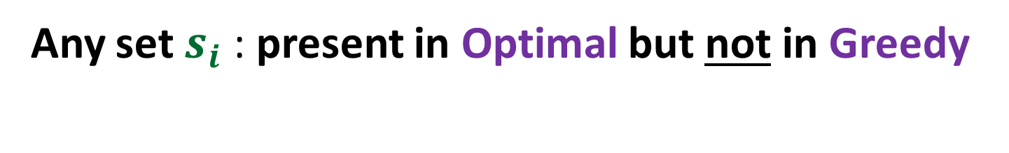
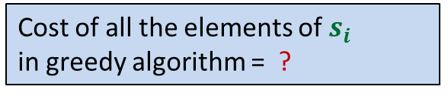


Any set $s_{i}$ : present in Optimal but not in Greedy
Cost =$C_{i}$
$$s_{i}$$
$|s_{i}|$ =$m_{i}$
Cost of these elements
in optimal algorithm = ?
Cost of all the elements of $s_{i}$
in greedy algorithm = ?
Cost of these elements
in greedy algorithm = ?
$$C_{i}$$
$${≤C}_{i} log m_{i}$$

Slide 19
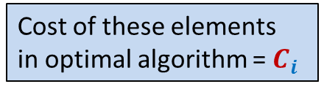

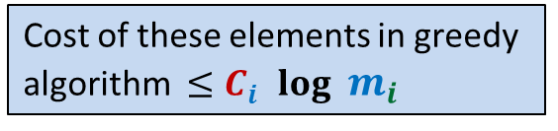
Any sequence of selecting the Optimal set cover
…
…
$$s_{i}$$
Cost of these elements
in optimal algorithm = $C_{i}$
Cost of these elements in greedy
algorithm ${≤C}_{i} log m_{i}$

Slide 20

The core of the analysis
Visualize the Greedy algorithm
from perspective of $s_{i}$

Slide 21
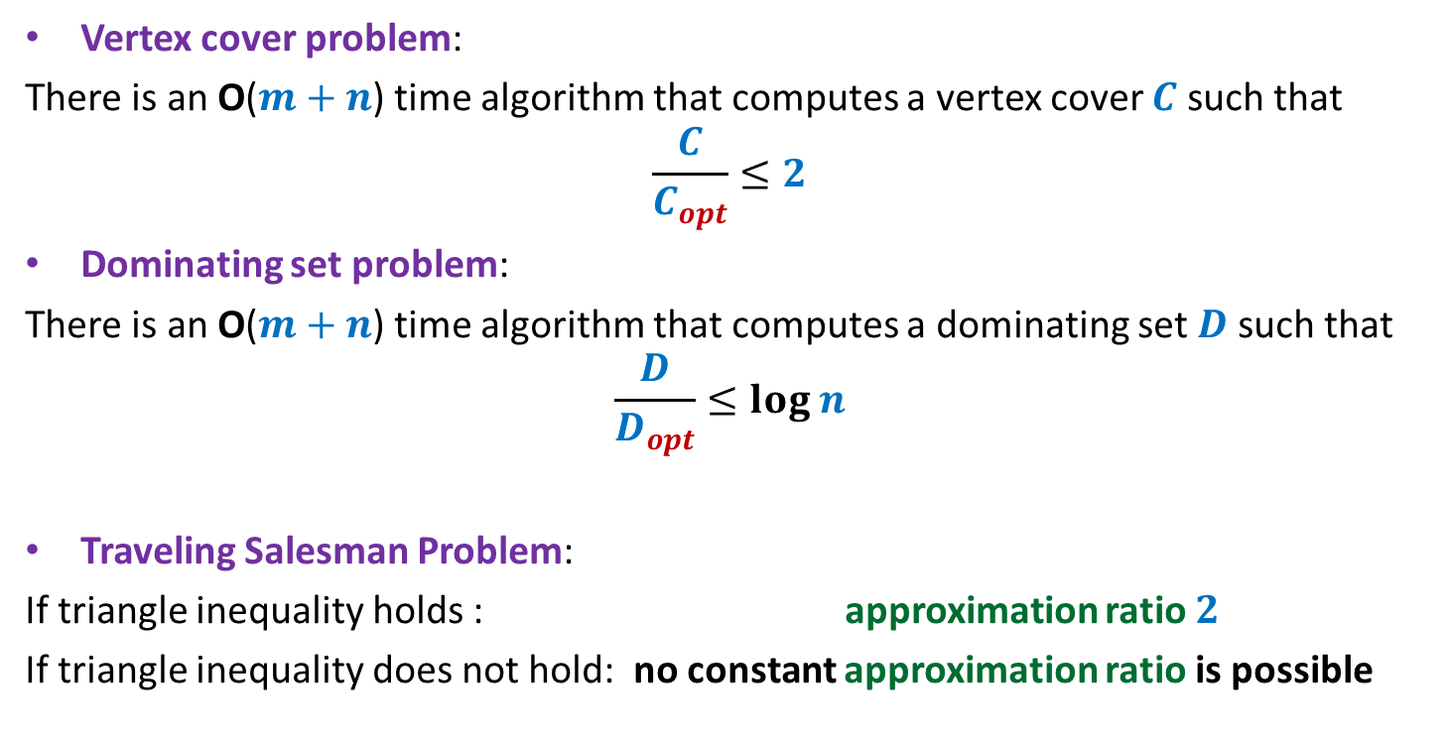


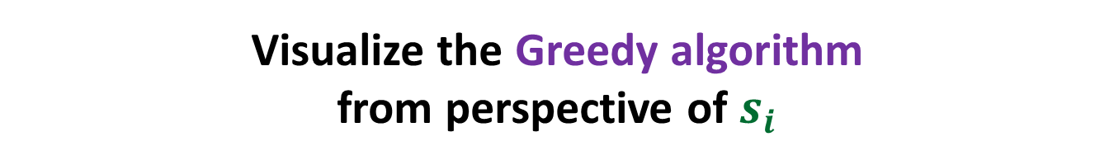

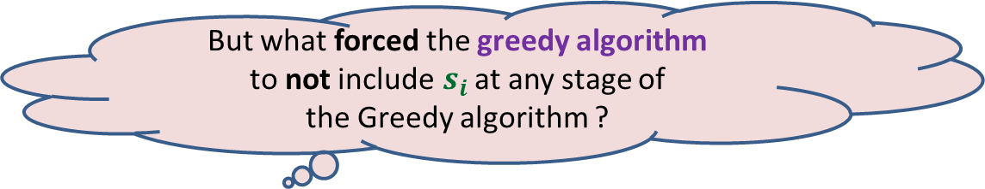




Visualize the Greedy algorithm from perspective of $s_{i}$
$$\sum_{k=1}^{k=ℓ}{j_{k}}=m_{i}$$
$$j_{1}$$
$$j_{2}$$
Cost =$C_{i}$
$$s_{i}$$
$$j_{3}$$
$|s_{i}|$ =$m_{i}$
…
…
$$j_{ℓ}$$
But what forced the greedy algorithm
to not include$s_{i}$ at any stage of
the Greedy algorithm ?
There was always another set that offered
“same or better cost per element” ☺

Slide 22
Visualize the Greedy algorithm from perspective of $s_{i}$
$$\sum_{k=1}^{k=ℓ}{j_{k}}=m_{i}$$
$$j_{1}$$
$$j_{2}$$
Cost =$C_{i}$
$$s_{i}$$
$$j_{3}$$
$|s_{i}|$ =$m_{i}$
…
…
$$j_{ℓ}$$
There was always another set that offered
“same or better cost per element” ☺

Slide 23





$$\sum_{k=1}^{k=ℓ}{j_{k}}=m_{i}$$
Cost of first $j_{1}$elements covered by greedy = ?
Cost of next $j_{2}$elements covered by greedy = ?
Cost of next $j_{3}$elements covered by greedy = ?
Cost of last $j_{ℓ}$elements covered by greedy = ?
$$j_{1}$$
$$j_{2}$$
Cost =$C_{i}$
$$s_{i}$$
$$j_{3}$$
$|s_{i}|$ =$m_{i}$
…
…
$$j_{ℓ}$$
$$≤\frac{C_{i}}{m_{i}}j_{1}$$
$$≤\frac{C_{i}}{m_{i}−j_{1}}j_{2}$$
$$≤\frac{C_{i}}{m_{i}−j_{1}−j_{2}}j_{3}$$
$$≤\frac{C_{i}}{m_{i}−j_{1}−j_{2}−…−j_{ℓ−1}}j_{ℓ}$$

Slide 24

$$\sum_{k=1}^{k=ℓ}{j_{k}}=m_{i}$$
Cost of covering all elements of $s_{i}$ by greedy =
$$≤\frac{C_{i}}{m_{i}}j_{1}+ \frac{C_{i}}{m_{i}−j_{1}}j_{2}+\frac{C_{i}}{m_{i}−j_{1}−j_{2}}j_{3}+…+\frac{C_{i}}{m_{i}−j_{1}−j_{2}−…−j_{ℓ−1}}j_{ℓ}$$
$$≤C_{i}\left(\frac{j_{1}}{m_{i}}+ \frac{j_{2}}{m_{i}−j_{1}}+\frac{j_{3}}{m_{i}−j_{1}−j_{2}}+…+\frac{j_{ℓ}}{m_{i}−j_{1}−j_{2}−…−j_{ℓ−1}}\right)$$
$≤C_{i} log m_{i}$
$$j_{1}$$
$$j_{2}$$
Cost =$C_{i}$
$$s_{i}$$
$$j_{3}$$
…
…
$$j_{ℓ}$$

Slide 25
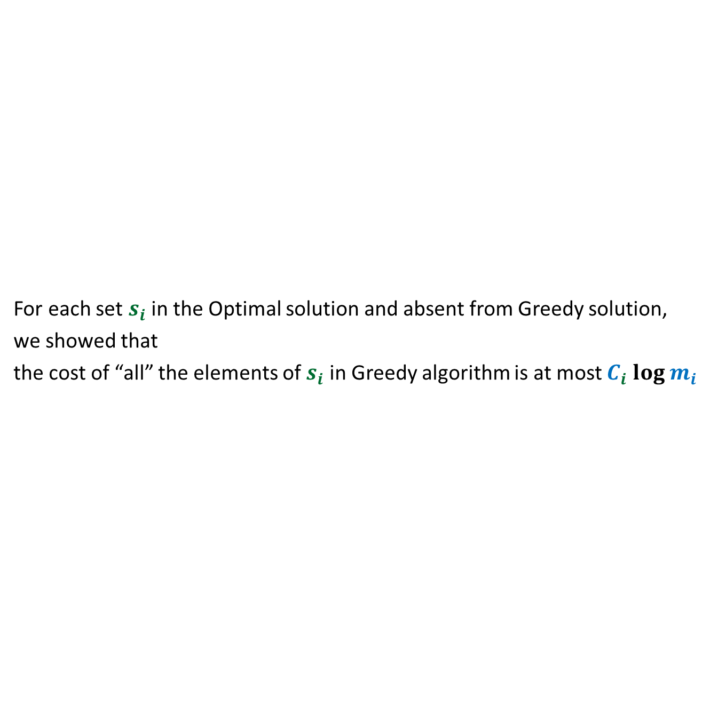
What have we established ?
For each set $s_{i}$in the Optimal solution and absent from Greedy solution,
we showed that
the cost of “all” the elements of $s_{i}$ in Greedy algorithm is at most $C_{i} log m_{i}$
Optimal solution
$$s_{1}$$
$$s_{2}$$
$$s_{3}$$
$$s_{4}$$
$$s_{5}$$
$$s_{6}$$
$$s_{7}$$
$$s_{8}$$
$$s_{9}$$
$$s_{10}$$
$$s_{11}$$
$$s_{12}$$
Greedy solution

Slide 26
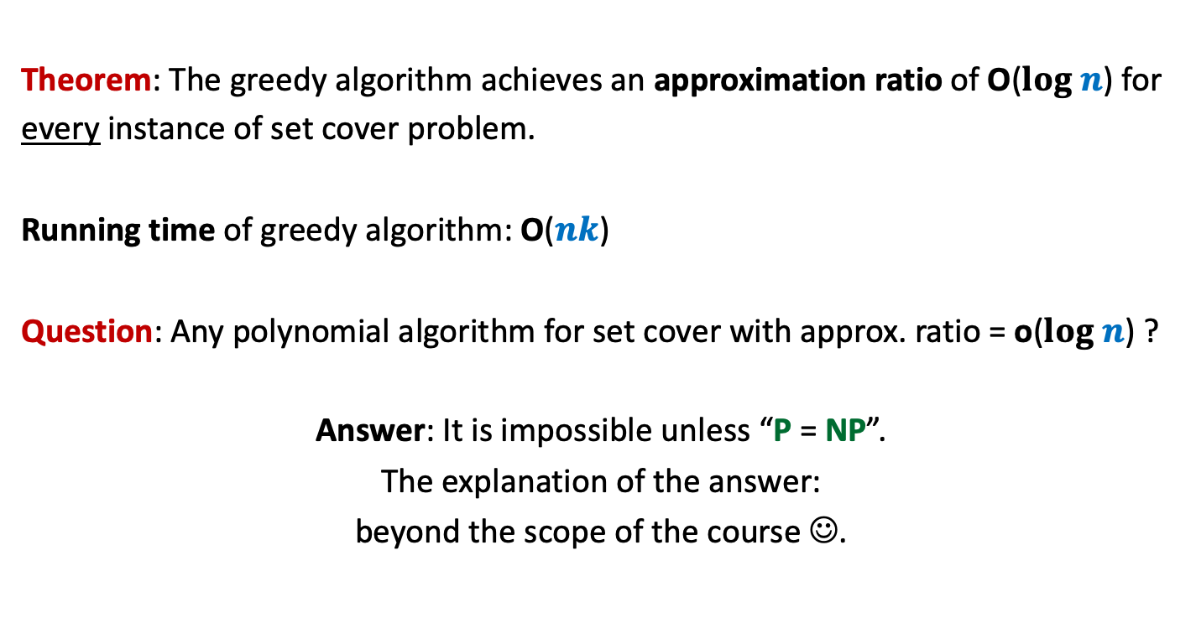
Conclusion
Theorem: The greedy algorithm achieves an approximation ratio of O($log n$) for
every instance of set cover problem.
Running time of greedy algorithm: O($nk$)
Question: Any polynomial algorithm for set cover with approx. ratio = o($log n$) ?
Answer: It is impossible unless “P = NP”.
The explanation of the answer:
beyond the scope of the course ☺.

Slide 27
Beyond course,… beyond grades…,
For those few of you who have interest in algorithms,
you might like to study a milestone result in the area of algorithms.
I could not cover it due to lack of time.
The problem and citation of the algorithm is mentioned on the following slide.
This is totally optional. Nothing related to this course, of course ☺

Slide 28

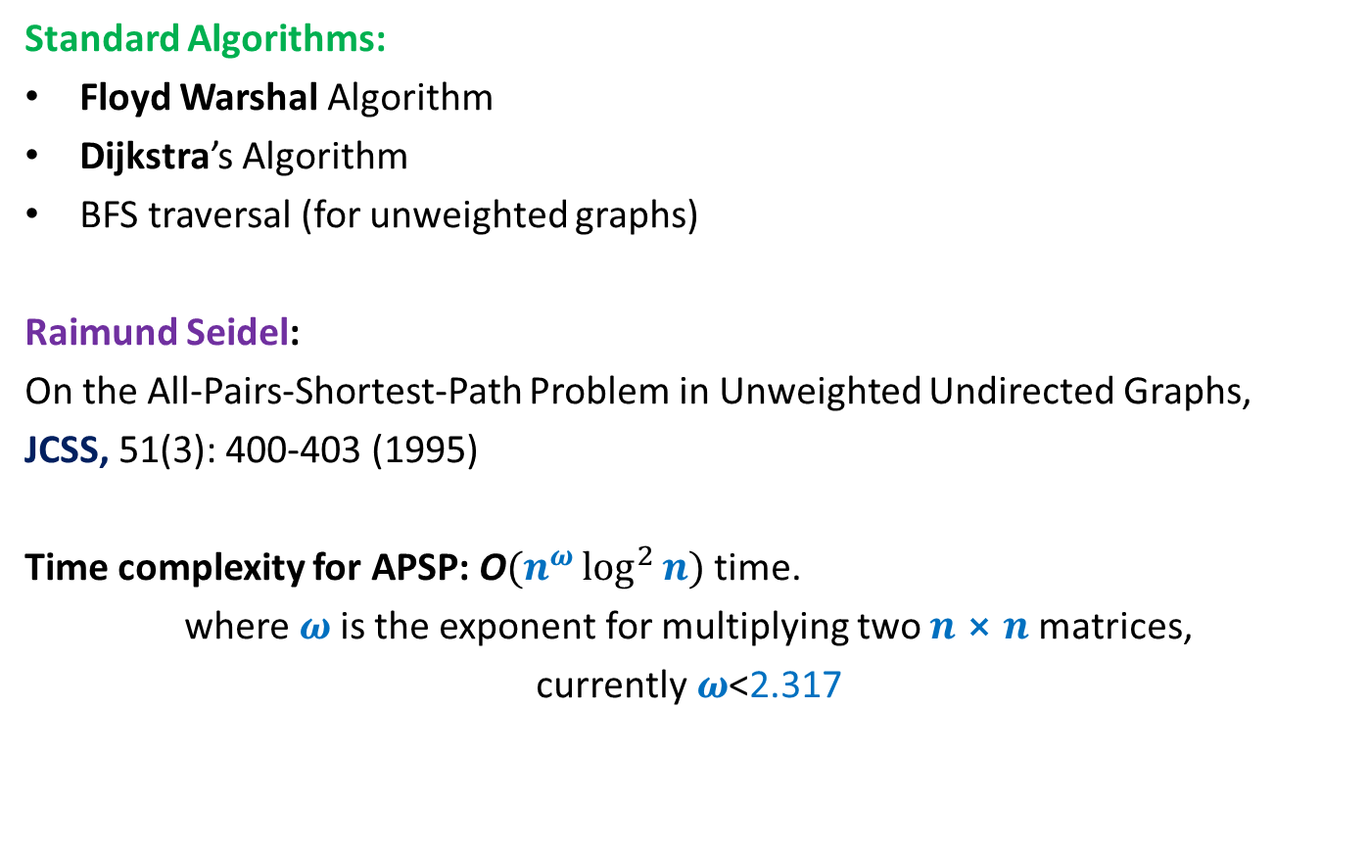
All Pairs Shortest Paths (APSP)
Matrix Multiplication
Standard Algorithms:
Floyd Warshal Algorithm
Dijkstra’s Algorithm
BFS traversal (for unweighted graphs)
Raimund Seidel:
On the All-Pairs-Shortest-Path Problem in Unweighted Undirected Graphs,
JCSS, 51(3): 400-403 (1995)
Time complexity for APSP: O$(n^{ω}\log^{2}{n})$ time.
where $ω$is the exponent for multiplying two $n⨯n$matrices,
currently$ω$<2.317
O$(n^{3})$ time in the worst case

Slide 29


