Slide 1
Design and Analysis of Algorithms
Algorithms-II : CS345A
Website: hello.iitk.ac.in
Lecture 4
Algorithm for Joint Seat Allocation (final discussion)
Divide and Conquer Paradigm - III
Convex Hull

Slide 2
Homework from the last class
Are there multiple fair allocations if there are multiple merit lists ?
Ponder over it …

Slide 3

Multiple merit lists
 | $$1$$ | $$2$$ | $$3$$
IIT
NIT
ARCH
 | $$1$$ | $$2$$ | $$3$$
A
B
C
C B A
IIT
ARCH
NIT
A C B
NIT
IIT
ARCH
B A C
ARCH
NIT
IIT
Merit Lists
Choice Lists
A
B
C
Allocation $1$
Allocation $2$
Allocation $3$
IIT
NIT
ARCH
IIT
NIT
ARCH
IIT
NIT
ARCH
C
A
B
A
B
C
B
C
A
Candidate Pessimal
Candidate Optimal

Slide 4
Homework
Which allocation does the software industry’s algorithm output ?
Candidate Optimal
Candidate Pessimal
None of the above
Ponder over it …
Design an algorithm that outputs the candidate optimal allocation.
Does such an allocation even exist ?

Slide 5
problem 3
Convex Hull

Slide 6
A Convex Polygon
Definition: A polygon is convex if for any two points belonging to the polygon,
the line segment joining them is inside the polygon.
$p$
$q$

Slide 7
Convex hull
Definition: Convex polygon of smallest area enclosing a set $P$ of points.
Problem: Design an efficient algorithm to compute the convex hull of $P$.
Assumption: No three points are colinear.

Slide 8
Tool 1
Let $A⊆P$.
Convex Hull of $A$ must be fully contained inside the convex hull of $P$.

Slide 9
Tool 2
Given a non-vertical line $L$ and a point $p$=($x_{1},y_{1}$), how to determine
whether $p$ lies above $L$ or below $L$?
Corollary: Given two points and a line $L$, it takes $O(1)$ time to determine
whether they lie on the same side or different sides of $L$.
$O(1)$ time
$$q=(a_{1},b_{1})$$
$$y=mx+c$$
$$r=(a_{2},b_{2})$$

Slide 10
Divide and Conquer algorithm
Convex Hull

Slide 11



The Divide Step
O($n$) time
Left half set
$⌈\frac{n}{2}⌉$points
$⌊\frac{n}{2}⌋$points
Right half set

Slide 12

Solving the subproblems recursively
2 T($\frac{n}{2}$) time
Left half set
$⌈\frac{n}{2}⌉$points
$⌊\frac{n}{2}⌋$points
Right half set

Slide 13
The Conquer step
Left half set
$⌈\frac{n}{2}⌉$points
$⌊\frac{n}{2}⌋$points
Right half set

Slide 14
The Conquer step
Left half set
$⌈\frac{n}{2}⌉$points
$⌊\frac{n}{2}⌋$points
Right half set

Slide 15
A simpler problem
The right half set is a point

Slide 16

The right half set is a point
$$p$$

Slide 17


The right half set is a point
Tool 1
$$q$$
Upper tangent
$$p$$
Lower tangent
$$r$$

Slide 18
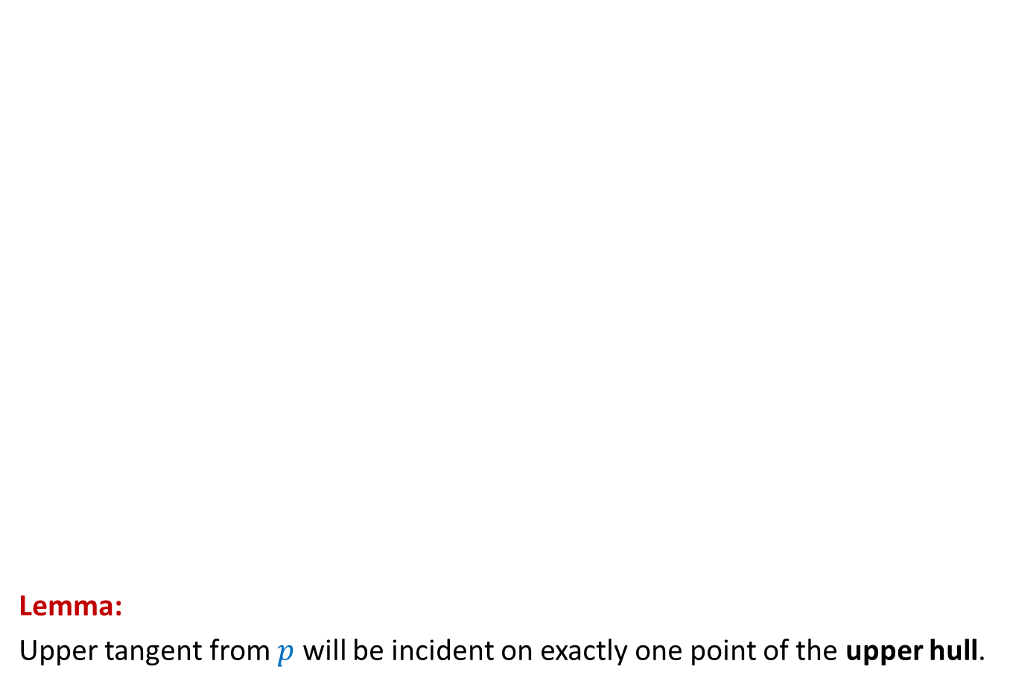
The right half set is a point
Lemma:
Upper tangent from $p$ will be incident on exactly one point of the upper hull.
Upper Hull
Upper tangent
$$p$$
$$p$$

Slide 19
The right half set is a point
Lemma:
Lower tangent from 𝑝 will be incident on exactly one point of the Lower hull.
$$p$$
$$p$$
Lower tangent
Lower Hull

Slide 20
How to compute the upper tangent ?
$$p$$

Slide 21






How to compute the upper tangent ?
Worst case time complexity for finding upper tangent: O($n$) time.
We need better time complexity.
Tool 2
$$s$$
$$w$$
$$q$$
$$t$$
$$p$$
$$r$$

Slide 22

How to compute the upper tangent ?
$$r$$ | $$q$$ | $$s$$ | $$w$$ | $$t$$
$$s$$
$$w$$
$$q$$
$$t$$
$$p$$
$$r$$

Slide 23
How to compute the upper tangent ?
$$r$$ | $$q$$ | $$s$$ | $$w$$ | $$t$$
$$s$$
$$w$$
$$q$$
$$t$$
$$p$$
$$r$$

Slide 24



How to compute the upper tangent ?
$$r$$ | $$q$$ | $$s$$ | $$w$$ | $$t$$
$$s$$
$$w$$
$$q$$
O(log $n$) time
Upper tangent
binary search
$$t$$
$$p$$
$$r$$

Slide 25
Going back to the original problem
Conquer Step

Slide 26

The Conquer step
Upper tangent
Lower tangent
$\frac{n}{2}$points
$\frac{n}{2}$points

Slide 27






How to compute the upper tangent ?
O($n$log $n$) time
$$w$$
$$x$$
$$v$$
$$u$$
$$y$$
$\frac{n}{2}$points
$\frac{n}{2}$points

Slide 28

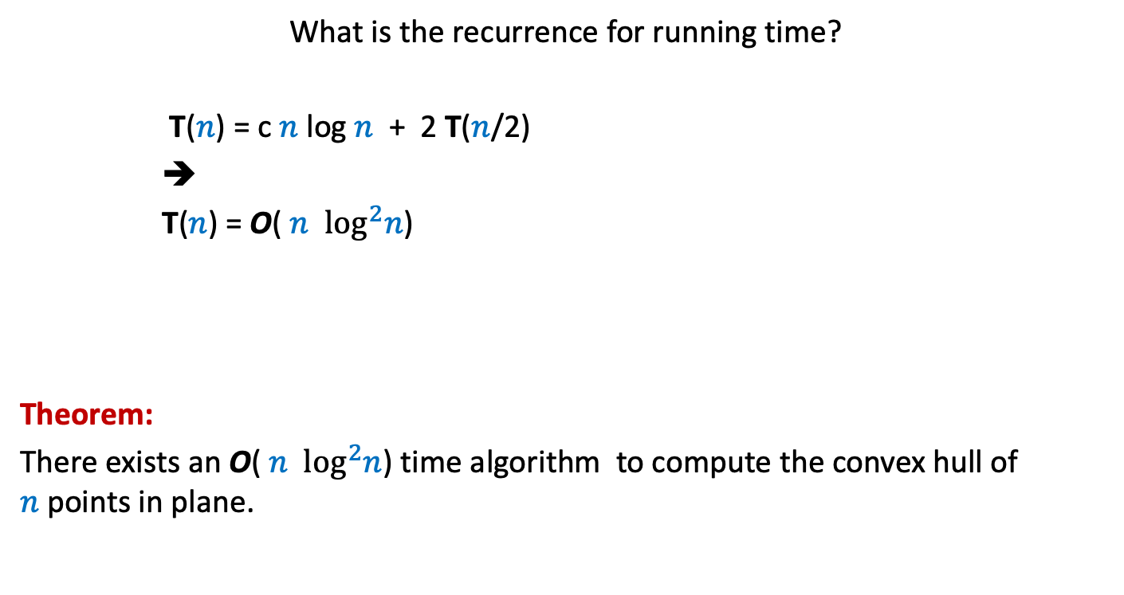
Running time of the algorithm
What is the recurrence for running time?
T($n$) = c $n$ log $n$ + 2 T($n$/2)
➔
T($n$) = O( $n$ $\log^{2}n$)
Theorem:
There exists an O( $n$ $\log^{2}n$) time algorithm to compute the convex hull of $n$points in plane.
c $n$

Slide 29
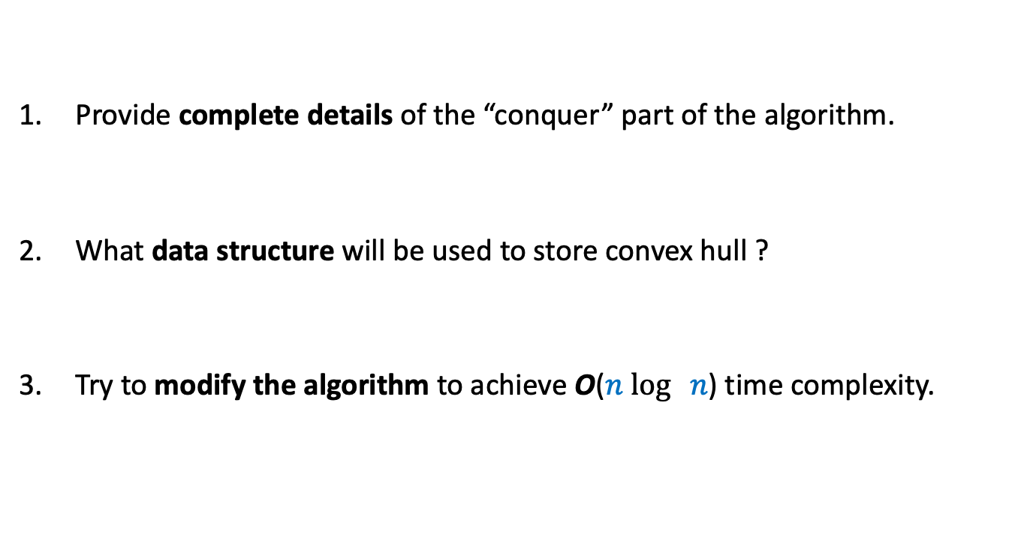
Homework
Provide complete details of the “conquer” part of the algorithm.
What data structure will be used to store convex hull ?
Try to modify the algorithm to achieve O($n$ $\log{ n}$) time complexity.

