Slide 1
Design and Analysis of Algorithms
Algorithms-II : CS345A
Lecture 5
Worked out assignment
Divide and Conquer Paradigm - IV
Polynomial Multiplication

Slide 2
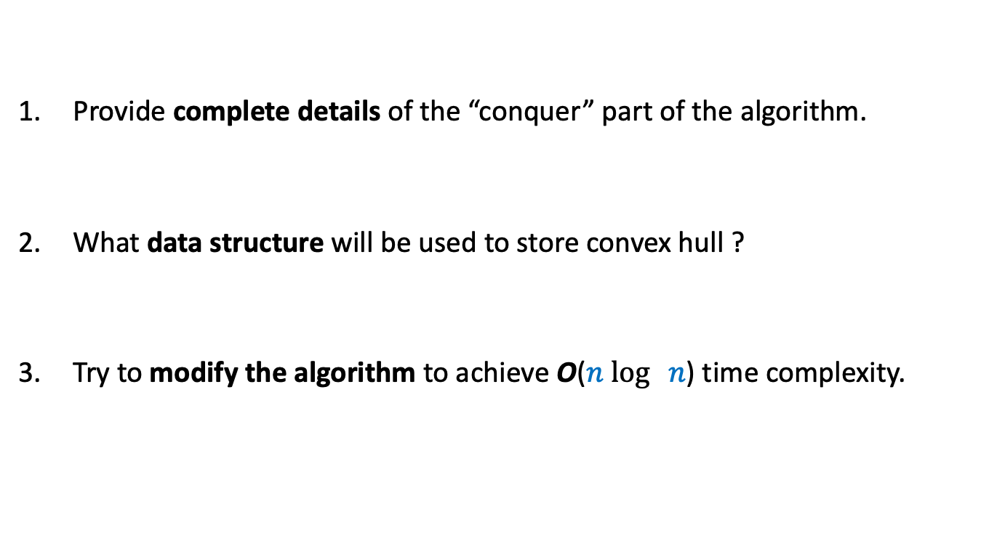
Homework from last class
Provide complete details of the “conquer” part of the algorithm.
What data structure will be used to store convex hull ?
Try to modify the algorithm to achieve O($n$ $\log{ n}$) time complexity.

Slide 3
Worked out assignment 1
Faster algorithm for
Non-dominated Points

Slide 4

A Simple Algorithm
y
$$(0,0)$$
x

Slide 5


A Simple Algorithm
y
$h$ : no. of non-dominated points
Time complexity =
O($nh$)
$$(0,0)$$
x

Slide 6
The Divide and Conquer based algorithm

Slide 7




The Conquer step
y
O($n$) time
$$p$$
$$(0,0)$$
x
Left half set
$⌈\frac{n}{2}⌉$points
$⌊\frac{n}{2}⌋$points
Right half set

Slide 8


The time complexity of the algorithm
y
T($n$) = c $n$ + 2 T($n$/2)
Time complexity =
O($n$ $\log{ n}$)
$$p$$
$$(0,0)$$
x
Left half set
$⌈\frac{n}{2}⌉$points
$⌊\frac{n}{2}⌋$points
Right half set

Slide 9

Worked out Assignment 1
Design and analyse an O($n$ $\log{ h}$) time algorithm for
nondominated points.
Visit the course website for the sequence of hints …

Slide 10
An algorithm for multiplying two polynomials
Problem 3

Slide 11
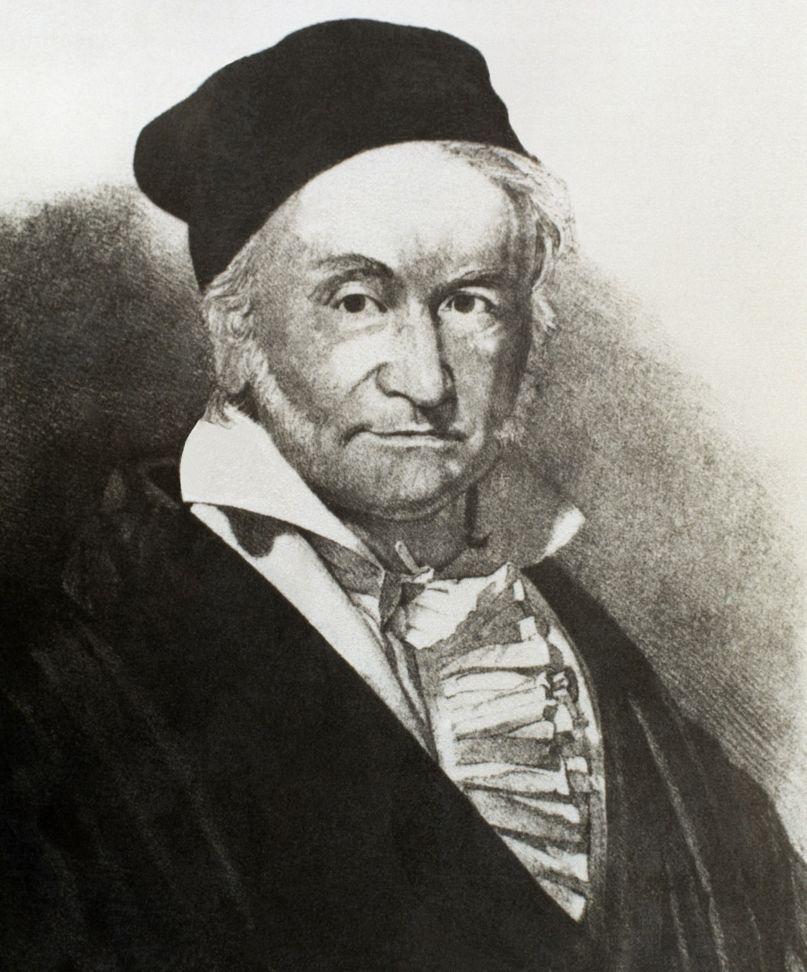
Carl Friedrich Gauss (1777-1855)
This algorithm was mentioned as a casual observation by him at a time when
the area of algorithm did not even exist … ☺

Slide 12
Multiplying two polynomials
Definition (polynomial of degree less than $n$)
$$A\left(x\right)=a_{0}+a_{1}x+a_{2}x^{2}+ …a_{n−1}x^{n−1}$$
Problem : Given two polynomial of degree less than $n$,
$$A\left(x\right)=a_{0}+a_{1}x+a_{2}x^{2}+ …a_{n−1}x^{n−1}$$
$$B\left(x\right)=b_{0}+b_{1}x+b_{2}x^{2}+ …b_{n−1}x^{n−1}$$
Compute $C=A × B$
$$C\left(x\right)=\sum_{0≤i<2n−1}{c_{i}x^{i}}$$
where $c_{i}$ =
Trivial algorithm: O( $n^{2}$)
Aim: O( $n$ $\log{n}$)
Applications:
Signal processing (Discrete Fourier Transform)
As practical as sorting and searching
Multiplication of two integers.
$$a_{0}b_{i}+a_{1}b_{i−1}+a_{2}b_{i−2}+ …+a_{i−1}b_{1}+a_{i}b_{0}$$
O($i$) time

Slide 13

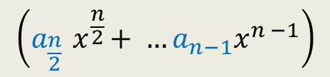


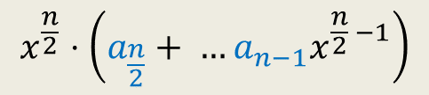

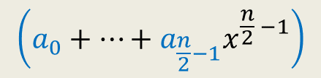

Divide Step
Attempt 1
$$A\left(x\right)=a_{0}+a_{1}x+a_{2}x^{2}+ …a_{n−1}x^{n−1}$$
$$A\left(x\right)= ? + ?$$
$$A\left(x\right)=A_{first}\left(x\right)+{ x}^{\frac{n}{2}} A_{second}\left(x\right)$$
$$\left(a_{0}+…+a_{\frac{n}{2}−1}x^{\frac{n}{2} −1}\right)$$
$$x^{\frac{n}{2}}⋅\left(a_{\frac{n}{2}}+ …a_{n−1}x^{\frac{n}{2} −1}\right)$$
$$\left(a_{\frac{n}{2}}{ x}^{\frac{n}{2}}+ …a_{n−1}x^{n −1}\right)$$
First $\frac{n}{2}$ terms of $A\left(x\right)$
Last $\frac{n}{2}$ terms of $A\left(x\right)$
$$A_{first}\left(x\right)$$
$$A_{second}\left(x\right)$$
Notes:
We can evaluate x^{n/2} in log n time for any given value of x: by repeated squaring:
For example, to compute x^1024, we compute and square x^512.
To compute x^512, we compute and square x^128.
To compute x^128, we copute and square x^64
…
To compute x^2, we square x.
So just O(log n) arithmetic operations are needed.

Slide 14
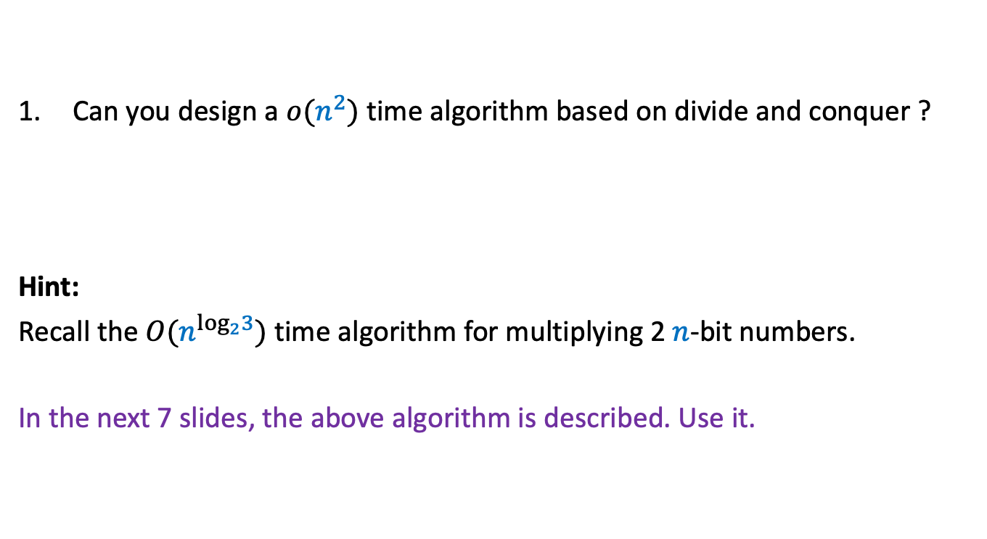
Homework
Can you design a $o(n^{2})$ time algorithm based on divide and conquer ?
Hint:
Recall the $O(n^{\log_{2}3})$ time algorithm for multiplying 2 $n$-bit numbers.
In the next 7 slides, the above algorithm is described. Use it.

Slide 15
A Fast algorithm for
multiplying two integers

Slide 16

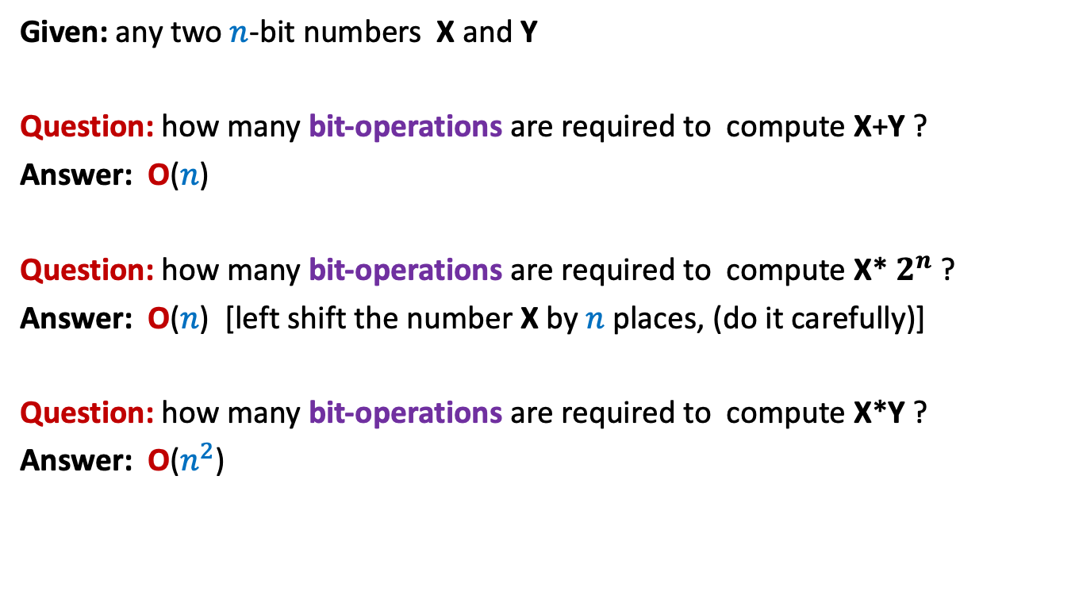
Addition is faster than multiplication
Given: any two $n$-bit numbers X and Y
Question: how many bit-operations are required to compute X+Y ?
Answer: O($n$)
Question: how many bit-operations are required to compute X* $2^{n}$ ?
Answer: O($n$) [left shift the number X by $n$places, (do it carefully)]
Question: how many bit-operations are required to compute X*Y ?
Answer: O($n^{2}$)
Can we compute X*Y faster ??
 |  |  |  | 0
 |  |  |  | 0 | 0
 |  |  |  | 0 | 0 | 0

Slide 17

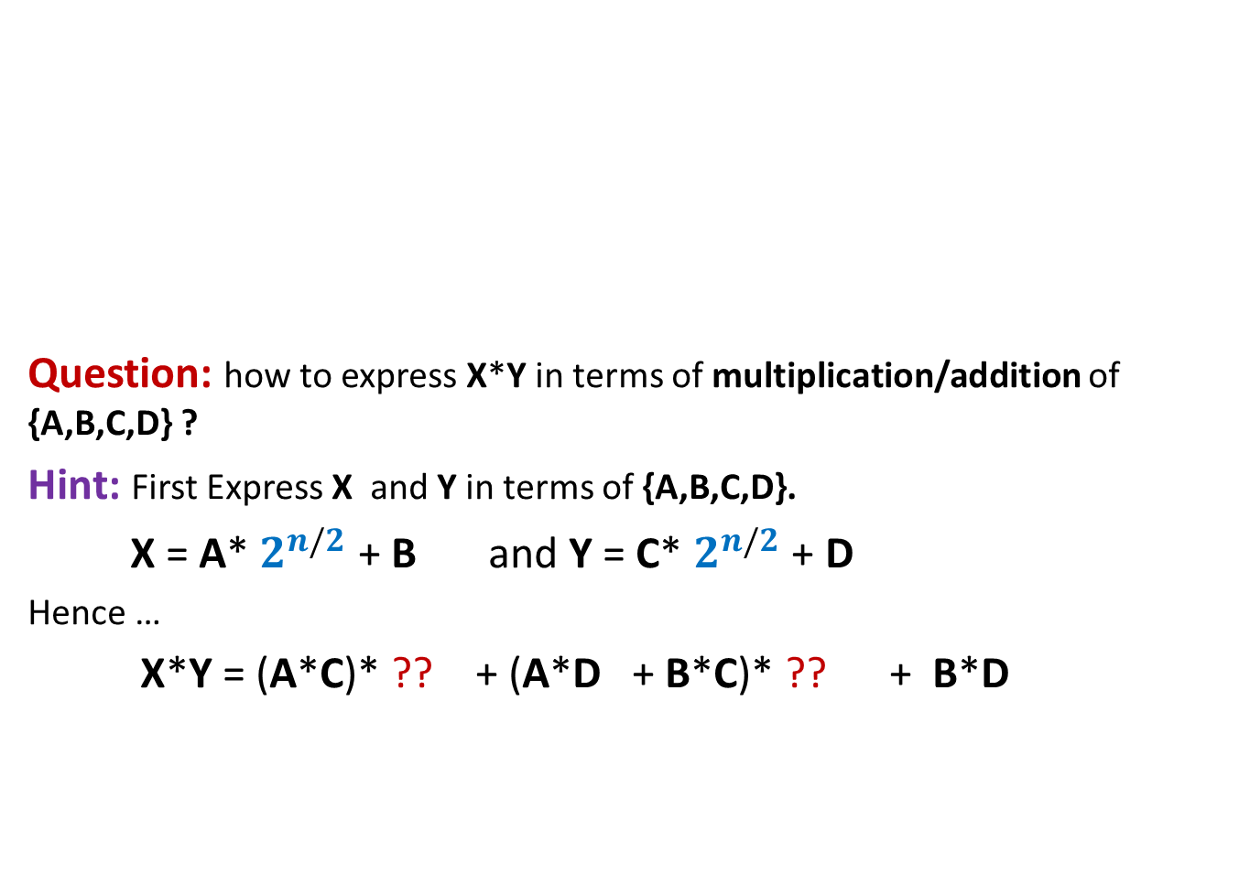

Pursuing Divide and Conquer approach
MSB
LSB
Question: how to express X*Y in terms of multiplication/addition of {A,B,C,D} ?
Hint: First Express X and Y in terms of {A,B,C,D}.
X = A* $2^{n/2}$ + B and Y = C* $2^{n/2}$ + D
Hence …
X*Y = (A*C)* ?? + (A*D + B*C)* ?? + B*D
A
B
X
n-1 n-2…......………………n/2.............................2 1 0
4 multiplications
C
D
Y
$$2^{n}$$
$$2^{n/2}$$

Slide 18

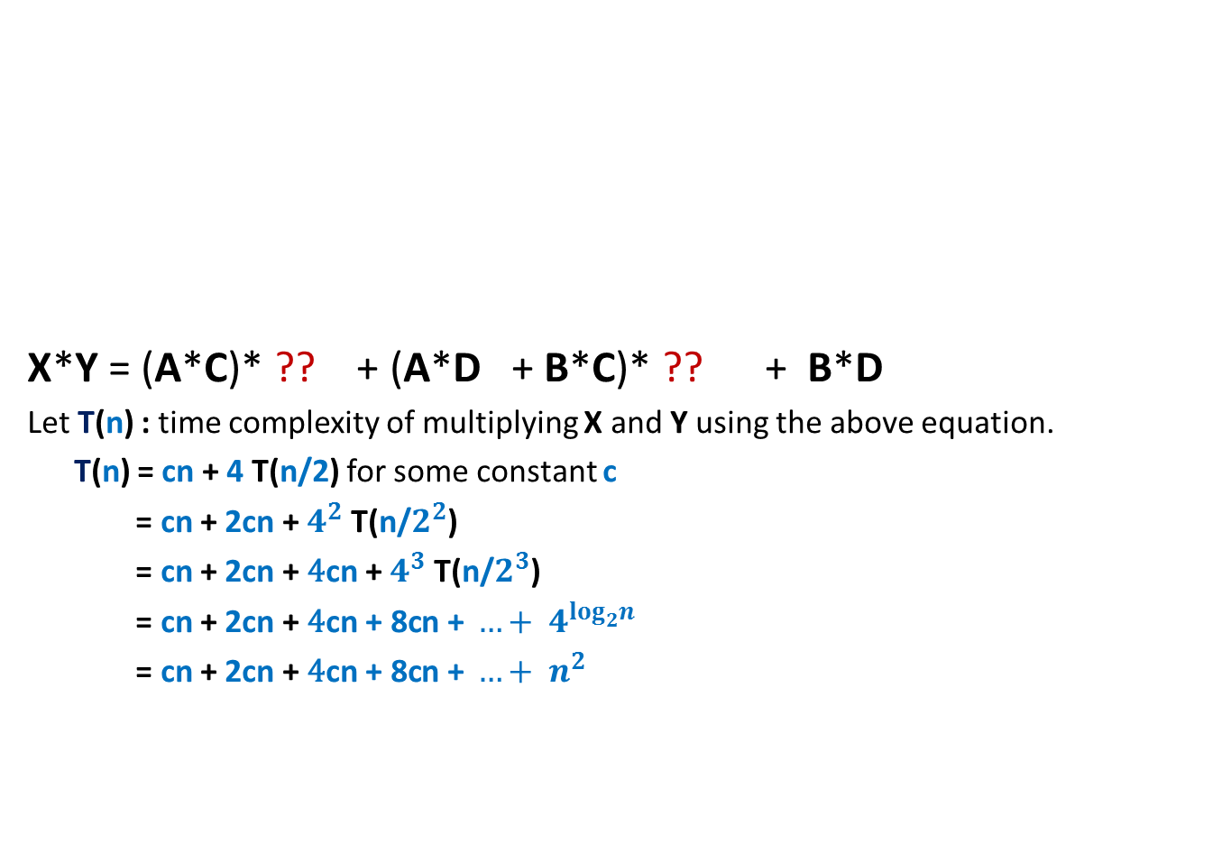


Pursuing Divide and Conquer approach
MSB
LSB
X*Y = (A*C)* ?? + (A*D + B*C)* ?? + B*D
Let T(n) : time complexity of multiplying X and Y using the above equation.
T(n) = cn + 4 T(n/2) for some constant c
= cn + 2cn + $4^{2}$ T(n/$2^{2}$)
= cn + 2cn + ${\text{4}\text{cn} \text{+} 4}^{3}$ T(n/$2^{3}$)
= cn + 2cn + ${\text{4}\text{cn}\text{ + 8}\text{cn}\text{ + }…+ 4}^{\log_{2}^{}n}$
= cn + 2cn + ${\text{4}\text{cn}\text{ + 8}\text{cn}\text{ + }…+ n}^{2 }$
A
B
X
n-1 n-2…......………………n/2.............................2 1 0
C
D
Y
$$2^{n}$$
$$2^{n/2}$$
O($n^{2}$) time algo

Slide 19
Pursuing Divide and Conquer approach
MSB
LSB
X*Y = (A*C)* ?? + (A*D + B*C)* ?? + B*D
Observation: A*D + B*C = (A-B)*(D-C) + A*C + B*D
Question: How many multiplications do we need now to compute X*Y ?
Answer: 3 multiplications :
A*C
B*D
(A-B)*(D-C) .
A
B
X
n-1 n-2…......………………n/2.............................2 1 0
C
D
Y
$$2^{n}$$
$$2^{n/2}$$

Slide 20


Pursuing Divide and Conquer approach
MSB
LSB
X*Y = (A*C)* ?? + ((A-B)*(D-C) + A*C + B*D)* ?? + B*D
Let T(n) : time complexity of the new algo for multiplying two n-bit numbers
T(n) = cn + 3 T(n/2) for some constant c
= cn + 3/2cn + $3^{2}$ T(n/$2^{2}$)
= cn + 3/2cn + ${\text{(9/}\text{4}\text{)}\text{cn}\text{ + }…+3}^{\log_{2}^{}n}$
= O($n^{\log_{2}^{}3}$) = O($n^{1.58}$)
A
B
X
n-1 n-2…......………………n/2.............................2 1 0
C
D
Y
$$2^{n}$$
$$2^{n/2}$$

Slide 21
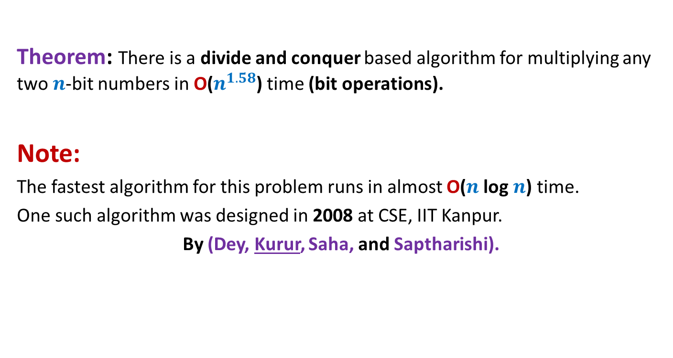
Conclusion

Slide 22
Representation of a polynomial ?
Coefficient representation:
$$A\left(x\right)=a_{0}+a_{1}x+a_{2}x^{2}+ …a_{n−1}x^{n−1}$$
$<a_{0}, a_{1},a_{2},…,a_{n−1}>$

Slide 23
Representation of a polynomial ?
Alternate representation of polynomial
“$A\left(x\right)=a_{0}+a_{1}x$”
{$(r_{0}, A\left(r_{0}\right)),(r_{1}, A\left(r_{1}\right))$}
for any distinct $r_{0}$ and $r_{1}$uniquely define $A\left(x\right)$.
Alternate representation of polynomial “$A\left(x\right)=a_{0}+a_{1}x+a_{2}x^{2}$”
{$(r_{0}, A\left(r_{0}\right)),(r_{1}, A\left(r_{1}\right))$, $(r_{2}, A\left(r_{2}\right))$}
for any distinct $r_{0}$,$r_{1}$, and $r_{2}$ uniquely define $A\left(x\right)$.
$$(r_{1}, A\left(r_{1}\right))$$
$$(r_{2}, A\left(r_{2}\right))$$
$$(r_{0}, A\left(r_{0}\right))$$
$$(r_{1}, A\left(r_{1}\right))$$
$$(r_{0}, A\left(r_{0}\right))$$

Slide 24
Representation of a polynomial ?
Theorem:
Let {$(r_{0},t_{0}),(r_{1},t_{1})$, …, $(r_{m−1}, t_{m−1})$} be $m$ pairs of numbers with all $r_{i}$’s distinct.
There exists a unique polynomial $A$ of degree less than $m$ such that
$A\left(r_{i}\right)=t_{i}$ $∀ i$
Proof: Elementary matrix theory.
Do it as a Homework.
(point,value) representation of a polynomial

Slide 25



Questions
$A$ and $B$: two polynomial of degree less than $n$,
and
$C=A × B$
and
{$r_{0},r_{1}, r_{m−1}$}: any $m$ distinct numbers
If we are given {$A\left(r_{0}\right),A\left(r_{1}\right),…$ ,$A\left(r_{m−1}\right)$} and {$B\left(r_{0}\right),B\left(r_{1}\right),…$ ,$B\left(r_{m−1}\right)$}
Question 1 : How efficiently can we compute {$C\left(r_{0}\right),C\left(r_{1}\right),…$ ,$C\left(r_{m−1}\right)$} ?
Question 2 : What should be the smallest value of $m$ such that
{$\left(r_{0}, C\left(r_{0}\right)\right),…,(r_{m−1}, C\left(r_{m−1}\right)$} is a (point,value) representation of $C$ ?
O($m$) time
$$2n−1$$

Slide 26

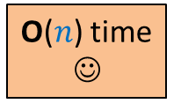

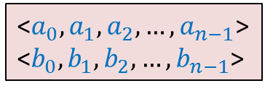
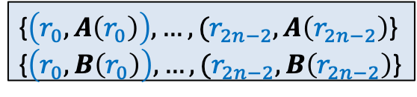
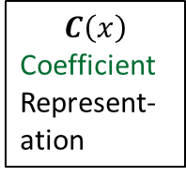


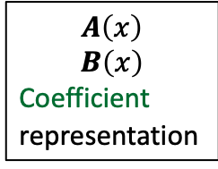

$C=A × B$
☹
$$C\left(x\right)$$
Coefficient
Represent-ation
$$A\left(x\right)$$
$$B\left(x\right)$$
Coefficient
representation
<$a_{0}, a_{1},a_{2},…,a_{n−1}$>
<$b_{0}, b_{1},b_{2},…,b_{n−1}$>
<$c_{0}, c_{1},c_{2},…,c_{2n−2}$>
O($n$ log $n$) time
O($n$ log $n$) time
Polynomial Evaluation
Polynomial Interpolation
{$\left(r_{0}, A\left(r_{0}\right)\right),…,(r_{2n−2}, A\left(r_{2n−2}\right)$}
{$\left(r_{0}, B\left(r_{0}\right)\right),…,(r_{2n−2}, B\left(r_{2n−2}\right)$}
{$\left(r_{0}, C\left(r_{0}\right)\right),…,(r_{2n−2}, C\left(r_{2n−2}\right)$}
O($n$) time
☺

Slide 27

Polynomial Evaluation Problem
Given a polynomial $A$ of degree less than $n$in coefficient representation,
Choose any set $S$ of $n$ numbers
Compute $A\left(v\right)$ for all $v∈S$.
Assumption:
$n$ is a power of 2.

Slide 28
a Divide and Conquer algorithm for
Polynomial Evaluation Problem

Slide 29


Divide Step
Idea ?
$$A\left(x\right)=a_{0}+a_{1}x+a_{2}x^{2}+ …a_{n−1}x^{n−1}$$
$$S$$
Try to express $A\left(x\right)$ as 2 polynomials of degree less than $\frac{n}{2}$.

Slide 30







Divide Step
Attempt 1
$$A\left(x\right)=a_{0}+a_{1}x+a_{2}x^{2}+ …a_{n−1}x^{n−1}$$
$$S$$
$$A\left(x\right)= ? + ?$$
Evaluating $A$ at $S$ =
$$\left(a_{0}+…+a_{\frac{n}{2}−1}x^{\frac{n}{2} −1}\right)$$
$$x^{\frac{n}{2}}⋅\left(a_{\frac{n}{2}}+ …a_{n−1}x^{\frac{n}{2} −1}\right)$$
$$\left(a_{\frac{n}{2}}{ x}^{\frac{n}{2}}+ …a_{n−1}x^{n −1}\right)$$
First $\frac{n}{2}$ terms of $A\left(x\right)$
Last $\frac{n}{2}$ terms of $A\left(x\right)$
$$A_{first}\left(x\right)$$
$$A_{second}\left(x\right)$$
Evaluating $A_{first}$ at $S$
Evaluating $A_{second}$ at $S$
Evaluating $x^{\frac{n}{2}}$ at $S$
$+$ O($n log n$) time
O($n log n$) time
$+$ O($n$) time
Notes:
We can evaluate x^{n/2} in log n time for any given value of x: by repeated squaring:
For example, to compute x^1024, we compute and square x^512.
To compute x^512, we compute and square x^128.
To compute x^128, we copute and square x^64
…
To compute x^2, we square x.
So just O(log n) arithmetic operations are needed.

Slide 31
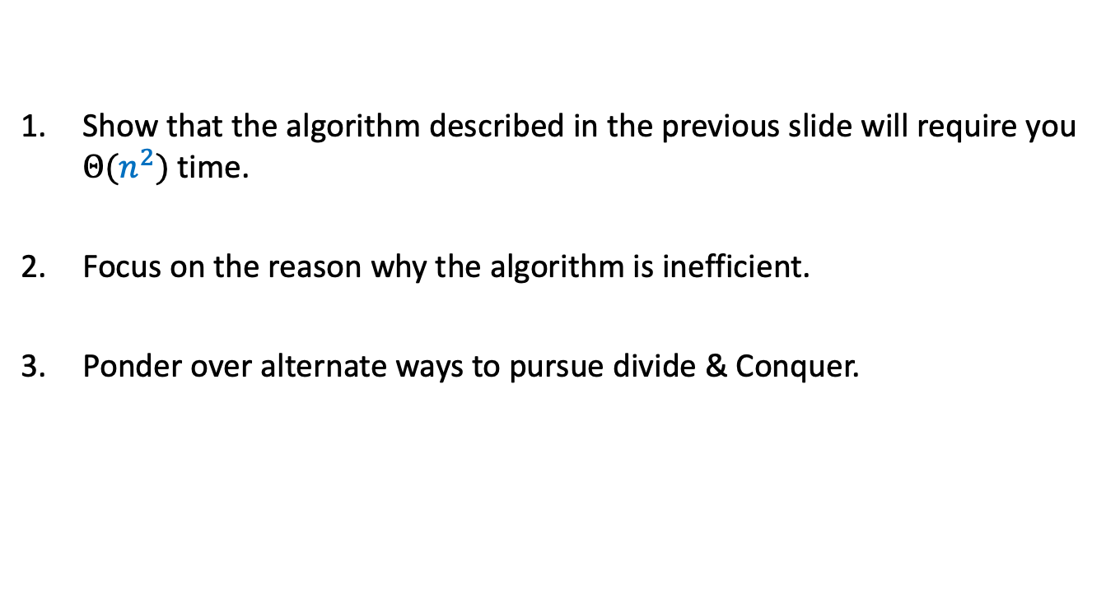
Homework
Show that the algorithm described in the previous slide will require you $Θ(n^{2})$ time.
Focus on the reason why the algorithm is inefficient.
Ponder over alternate ways to pursue divide & Conquer.

