Slide 1
Design and Analysis of Algorithms
Algorithms-II : CS345A
Lecture 6
Divide and Conquer Paradigm - V

Slide 2
Recap from Lecture 1
An algorithm for multiplying two polynomials

Slide 3

Polynomial Evaluation Problem
Given a polynomial $A$ of degree less than $n$in coefficient representation,
Choose any set $S$ of $n$ numbers
Compute $A\left(v\right)$ for all $v∈S$.
Assumption:
$n$ is a power of 2.

Slide 4
a Divide and Conquer algorithm for
Polynomial Evaluation Problem

Slide 5


Divide Step
Idea ?
$$A\left(x\right)=a_{0}+a_{1}x+a_{2}x^{2}+ …a_{n−1}x^{n−1}$$
$$S$$
Try to express $A\left(x\right)$ as 2 polynomials of degree less than $\frac{n}{2}$.

Slide 6


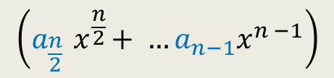




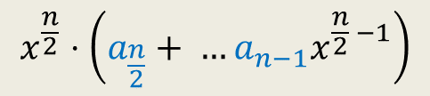


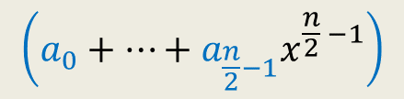



Divide Step
Attempt 1
$$A\left(x\right)=a_{0}+a_{1}x+a_{2}x^{2}+ …a_{n−1}x^{n−1}$$
$$S$$
$$A\left(x\right)= ? + ?$$
Evaluating $A$ at $S$ =
$$\left(a_{0}+…+a_{\frac{n}{2}−1}x^{\frac{n}{2} −1}\right)$$
$$x^{\frac{n}{2}}⋅\left(a_{\frac{n}{2}}+ …a_{n−1}x^{\frac{n}{2} −1}\right)$$
$$\left(a_{\frac{n}{2}}{ x}^{\frac{n}{2}}+ …a_{n−1}x^{n −1}\right)$$
First $\frac{n}{2}$ terms of $A\left(x\right)$
Last $\frac{n}{2}$ terms of $A\left(x\right)$
$$A_{first}\left(x\right)$$
$$A_{second}\left(x\right)$$
Evaluating $A_{first}$ at $S$
Evaluating $A_{second}$ at $S$
Evaluating $x^{\frac{n}{2}}$ at $S$
$+$ O($n log n$) time
O($n log n$) time
$+$ O($n$) time
Notes:
We can evaluate x^{n/2} in log n time for any given value of x: by repeated squaring:
For example, to compute x^1024, we compute and square x^512.
To compute x^512, we compute and square x^128.
To compute x^128, we copute and square x^64
…
To compute x^2, we square x.
So just O(log n) arithmetic operations are needed.

Slide 7

Homework from last class
Show that the algorithm will require $Θ(n^{2})$ time.

Slide 8






The Recursion Tree
points
for
evaluation
$A\left(x\right)=$ $A_{first}$($x$) + $x^{\frac{n}{2}} A_{second}$($x$)
degree
$$A$$
$$<n$$
$$S$$
$$n$$
$$A_{first}$$
$$A_{second}$$
$$<n/2$$
$$S$$
$$n$$
$$<n/4$$
$$S$$
$$n$$
$$<1$$
$$S$$
$$n$$
$n$ polynomials, each to be evaluated at $n$ distinct numbers
$Θ\left(n^{2}\right)time$☹

Slide 9

















Divide Step
Attempt 2
$$A\left(x\right)= ? + ?$$
$A_{even}(x)$= $a_{0}+a_{2}x+ …+a_{n−2}x^{\frac{n}{2}−1}$
$A_{odd}(x)$ = $a_{1}+a_{3}x+ …+a_{n−1}x^{\frac{n}{2}−1}$,
Evaluating $A$ at $S$ =
$$A\left(x\right)=a_{0}+a_{1}x+a_{2}x^{2}+ …a_{n−1}x^{n−1}$$
$$S$$
$$\left(a_{0}+a_{2}x^{2}+…+a_{n−2}x^{n−2}\right)$$
$$(a_{1}x+a_{3}x^{3}+…+a_{n−1}x^{n−1}\text{)}$$
All odd terms of $A\left(x\right)$
All even terms of $A\left(x\right)$
$x⋅(a_{1}+a_{3}x^{2}+…+a_{n−1}x^{n−2}$)
$$a_{2i}{ x}^{2i}$$
$$a_{2i}{ (x^{2})}^{i}$$
$$a_{2i+1}{ (x^{2})}^{i}$$
$$a_{2i+1}{ x}^{2i}$$
$A\left(x\right)=$ $A_{even}$($x^{2}$) + $x A_{odd}$($x^{2}$)
Evaluating $A_{even}$ at ?
$$S^{2}=$$
$$\left\{c^{2} \right| c∈S\}$$
$$S^{2}$$
Evaluating $A_{odd}$ at $S^{2}$
$+$ O($n$) time

Slide 10
The Recursion Tree
points
for
evaluation
$A\left(x\right)=$ $A_{even}$($x^{2}$) + $x A_{odd}$($x^{2}$)
degree
$$A$$
$$<n$$
$$S$$
$$n$$
Question: Is it possible to select $S$ such that
…
$$A_{even}$$
$$A_{odd}$$
$$<n/2$$
$$S^{2}$$
$$n$$
$$<n/4$$
$$S^{4}$$
$$n$$
$$<1$$
$$S^{n}$$
$$n$$
$n$ polynomials, each to be evaluated at $n$ distinct numbers
$Θ\left(n^{2}\right)time$☹
This hurdle is pointing to a very important question whose answer will solve this problem …
Now recall the set $S$
you selected. What is the size of $S^{2}$, $S^{4}$, …, $S^{n}$ ?
$${|S}^{2}|=\frac{n}{2}$$
$${|S}^{4}|=\frac{n}{4}$$
$${|S}^{n}|=1$$

Slide 11
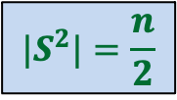



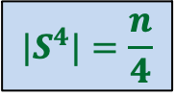
Question
Is it possible to select $S$ such that
…
$$|S^{2}|=\frac{n}{2}$$
$S$ = $\{2,3,9,−2,−3,−9\}$
$${|S}^{4}|=\frac{n}{4}$$
Good start !
But how to satisfy the remaining requirements …
$${|S}^{n}|=1$$

Slide 12
Complex numbers
Recalling elementary facts

Slide 13
Complex numbers
$$\sqrt{a^{2}+b^{2}}$$
$$a+bi$$
$$=r(\cos{φ}+i\sin{φ})$$
$$x_{1} =r_{1}(\cos{φ_{1}}+i\sin{φ_{1}})$$
$$x_{2} =r_{2}(\cos{φ_{2}}+i\sin{φ_{2}})$$
Addition
$x_{1}+x_{2}$ = ?
Multiplication
$x_{1}⋅x_{2}$ = ?
Complex plane
$$b$$
$$r$$
$$φ$$
$$a$$
Vector addition
$$r_{1}r_{2}(\cos{(φ_{1}+φ_{2})}+i\sin{(φ_{1}+φ_{2})})$$
Magnitudes get multiplied &
Arguments get added… beautiful ☺

Slide 14
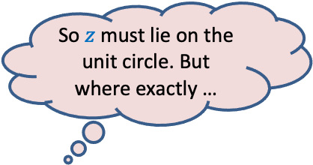

Complex roots of unity
Definition:
A number $z$ is said to be $n$th root of unity
if it satisfies equation.
$$z^{n}=1$$
$$z⋅z⋅z⋅ …⋅z=1$$
Magnitude($z$) = 1
Argument($z$) = ?
$$\{1, ω_{n} ,ω_{n}^{2},ω_{n}^{3},…,ω_{n}^{n−1}\}$$
Complex plane
$$\frac{2π}{n}$$
$$1$$
multiple of $\frac{2π}{n}$
$$R_{n}=$$
Unit circle
So $z$ must lie on the unit circle. But where exactly …
$n^{th}$Principal rool of unity

Slide 15

Complex roots of unity
$$R_{3}$$
What is $\left\{x^{2} \right|x∈R_{3}\}$ ?
$$R_{4}$$
What is $\left\{x^{2} \right|x∈R_{4}\}$ ?
$$ω_{4}^{1}$$
$$ω_{3}^{1}$$
$$ω_{3}^{3}$$
$$ω_{4}^{2}$$
$$ω_{4}^{4}$$
$$ω_{3}^{2}$$
$$ω_{4}^{3}$$
$$R_{3}$$
$$R_{2}$$

Slide 16
Complex roots of unity
Theorem:
If $n$ is odd $\left\{x^{2} \right|x∈R_{n}\}=R_{n}$
If $n$ is even $\left\{x^{2} \right|x∈R_{n}\}=$ $R_{\frac{n}{2}}$
Is it possible to select $S$ such that
…
?
$$S^{2}=\frac{n}{2}$$
$$S^{4}=\frac{n}{4}$$
$$S^{n}=1$$
$$S=R_{n}$$

Slide 17
The Recursion Tree
points
for
evaluation
$A\left(x\right)=$ $A_{even}$($x^{2}$) + $x A_{odd}$($x^{2}$)
degree
$$A$$
$$<n$$
$$R_{n}$$
T($n$) = Time complexity of Evaluating $A\left(x\right)$ on $R_{n}$
= a$n$ + $2$T($\frac{n}{2}$)
$$A_{even}$$
$$A_{odd}$$
$$<n/2$$
$$R_{\frac{n}{2}}$$
$$<n/4$$
$$R_{\frac{n}{4}}$$
$$<1$$
$$R_{1}$$

Slide 18
O($n^{2}$) time
☹
$$A\left(x\right)$$
$$B\left(x\right)$$
Coefficient
represntation
<$a_{0}, a_{1},a_{2},…,a_{n−1}$>
<$b_{0}, b_{1},b_{2},…,b_{n−1}$>
<$c_{0}, c_{1},c_{2},…,c_{2n−2}$>
O($n$ log $n$) time
Done
?
O($n$ log $n$) time
{$\left(r_{0}, A\left(r_{0}\right)\right),…,(r_{2n−2}, A\left(r_{2n−2}\right)$}
{$\left(r_{0}, B\left(r_{0}\right)\right),…,(r_{2n−2}, B\left(r_{2n−2}\right)$}
{$\left(r_{0}, C\left(r_{0}\right)\right),…,(r_{2n−2}, C\left(r_{2n−2}\right)$}
O($n$) time
☺

Slide 19
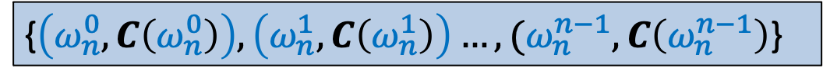
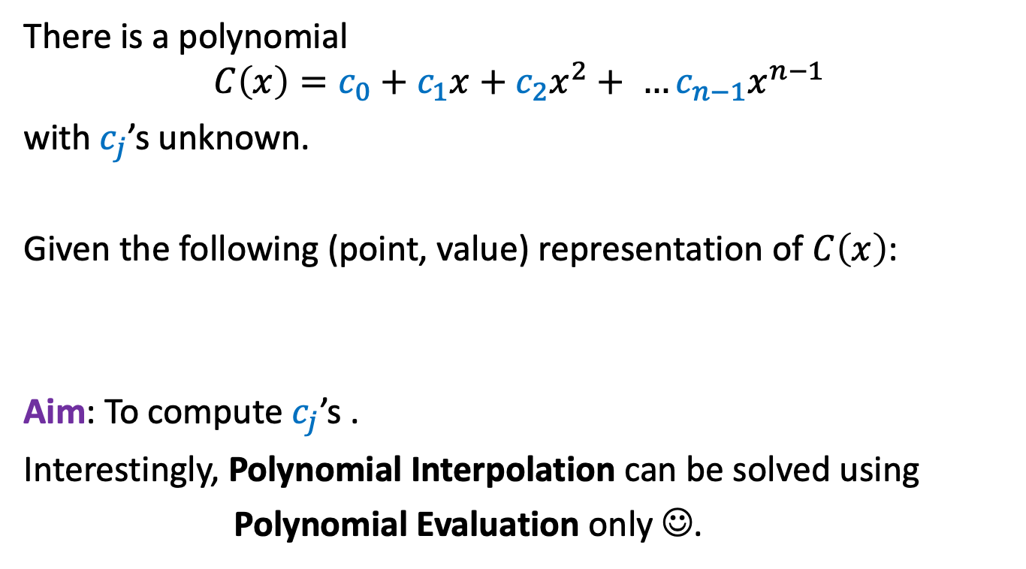
Interpolation
There is a polynomial
$$C\left(x\right)=c_{0}+c_{1}x+c_{2}x^{2}+ …c_{n−1}x^{n−1}$$
with $c_{j}$’s unknown.
Given the following (point, value) representation of $C\left(x\right)$:
Aim: To compute $c_{j}$’s .
Interestingly, Polynomial Interpolation can be solved using
Polynomial Evaluation only ☺.
{$\left(ω_{n}^{0}, C\left(ω_{n}^{0}\right)\right),\left(ω_{n}^{1}, C\left(ω_{n}^{1}\right)\right)…,(ω_{n}^{n−1}, C\left(ω_{n}^{n−1}\right)$}

Slide 20
Interpolation
Can you guess the polynomial whose evaluation will help solve polynomial interpolation ?
Make an obvious guess.

Slide 21
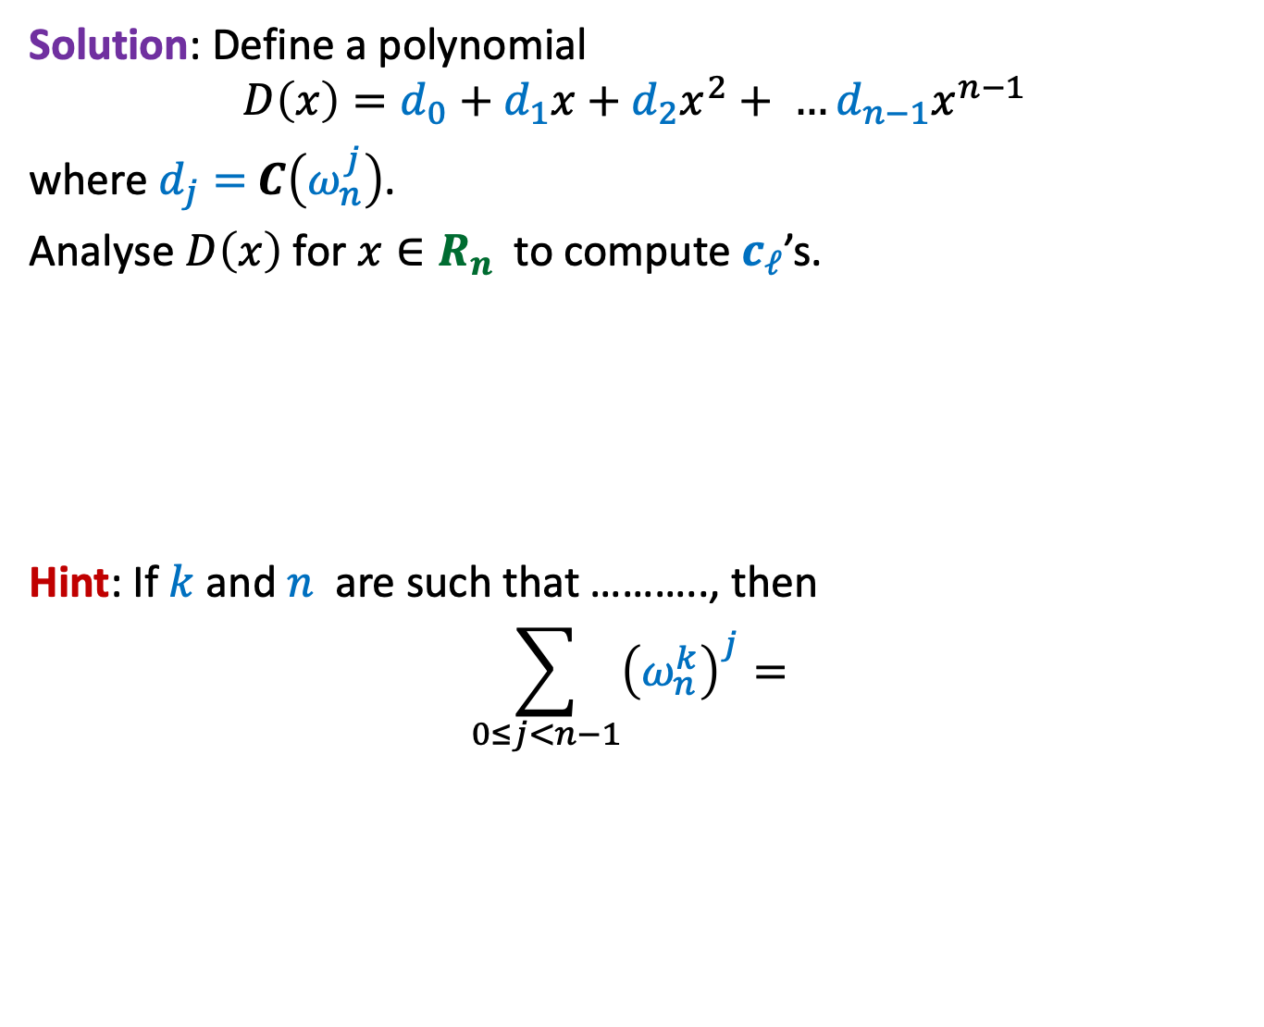
Interpolation
Solution: Define a polynomial
$$D\left(x\right)=d_{0}+d_{1}x+d_{2}x^{2}+ …d_{n−1}x^{n−1}$$
where $d_{j}=$ $C\left(ω_{n}^{j}\right)$.
Analyse $D\left(x\right)$for $x∈R_{n}$ to compute $c_{ℓ}$’s.
Hint: If $k$ and $n$ are such that ……….., then
$$\sum_{0≤j<n−1}{{\left(ω_{n}^{k}\right)}^{j}= }$$
H
O
M
E
W
O
R
k
{$\left(ω_{n}^{0}, C\left(ω_{n}^{0}\right)\right),\left(ω_{n}^{1}, C\left(ω_{n}^{1}\right)\right)…,(ω_{n}^{n−1}, C\left(ω_{n}^{n−1}\right)$}
0

Slide 22
Optional Homework
For those of you, who love competitive programming,
try to write a neat code for the algorithm we discussed for multiplication of two polynomials.
How will you implement complex numbers ?

