Slide 1
Design and Analysis of Algorithms
Algorithms-II : CS345A
Lecture 7
Job scheduling problem
Synchronizing a Circuit problem

Slide 2
What does correctness of an algorithm mean ?
For every possible valid input,
the algorithm must output correct answer.

Slide 3
A Job scheduling problem

Slide 4





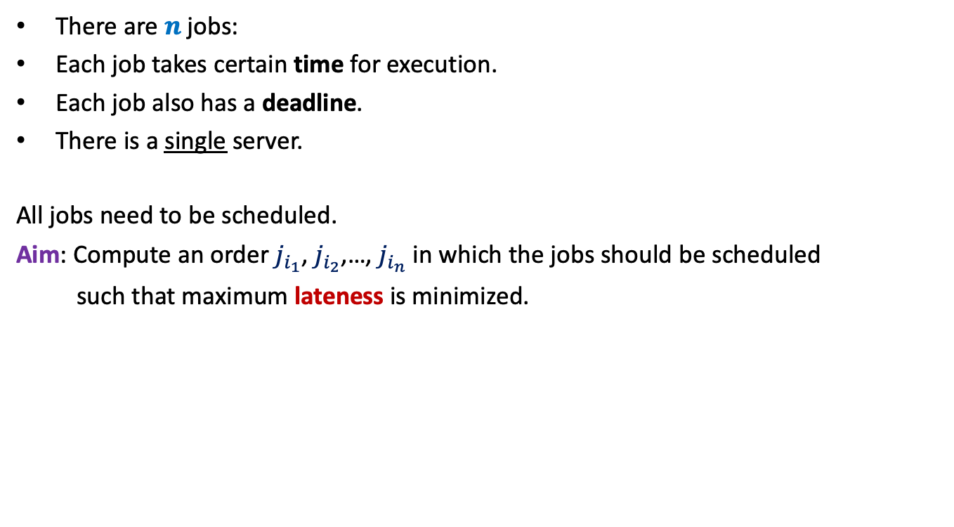








There are $n$ jobs:
Each job takes certain time for execution.
Each job also has a deadline.
There is a single server.
All jobs need to be scheduled.
Aim: Compute an order $j_{i_{1}}$, $j_{i_{2}}$,…, $j_{i_{n}}$ in which the jobs should be scheduled
such that maximum lateness is minimized.
$j_{1}$, $j_{2}$,…, $j_{n}$
Job $j_{i}$ takes $t_{i}$ time
Job $j_{i}$ has deadline $d_{i}$
$$f_{i_{k}}$$
$$d_{i_{k}}$$
$$d_{i_{k}}$$
Lateness of $j_{i_{k}}$
$$j_{i_{1}}$$
$$j_{i_{2}}$$
$$j_{i_{3}}$$
$$j_{i_{k}}$$
$$j_{i_{n}}$$
$$0$$
time

Slide 5

Towards designing an algorithm
Each job $j_{i}$ has two parameters
Time of execution $t_{i}$
Deadline $d_{i}$
Idea 1: Schedule the jobs in the increasing order of Time of execution.
Try to prove correctness
Try to come up with a counter example

Slide 6





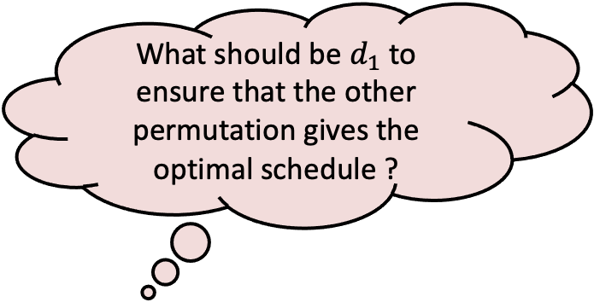


Towards designing a counterexample
What should be $d_{1}$ to ensure that the other permutation gives the optimal schedule ?
$$t_{1}$$
$$j_{1}$$
$$t_{2}$$
$$j_{2}$$
$$d_{2}$$
$$j_{1}$$
$$j_{2}$$
time

Slide 7

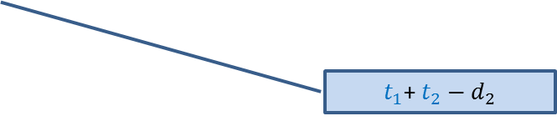

Towards designing a counterexample
Towards designing an algorithm
The job with farther deadline should be scheduled later.
the job with earlier deadline should be scheduled first.
$$t_{1}$$
This counterexample hints at a very important point as well.
$$j_{1}$$
?
$$d_{1}$$
$$t_{2}$$
$t_{1}$+ $t_{2}−d_{1}$
$$j_{2}$$
?
$$d_{2}$$
$t_{1}$+ $t_{2}−d_{2}$
$$j_{1}$$
$$j_{2}$$
time

Slide 8
How to schedule more than 2 jobs ?
time
$$0$$

Slide 9
How to schedule more than 2 jobs ?
Schedule the jobs in increasing order of their deadlines.
Homework:
Write a neat pseudocode of an efficient algorithm for this problem.
Write a formal proof of correctness of the algorithm.
time
$$0$$

Slide 10
Synchronizing a circuit
with minimum delay enhancement

Slide 11
An Electric Circuit
A complete binary tree
Electric signal originates at the root
Signal passing through each edge incurs a delay (a few nano seconds)
Finally signal reaches all the leaves.
Electric signal
6
5
3
2
4
2
2
1
6
2
1
2
3
2
Delay 11 10 14 10 10 11 10 9
14
10

Slide 12
Problem definition
Given:
There is a circuit in the form of a complete binary tree.
Electric signal propagates from root to all leaf nodes.
Each edge has certain delay
The delay in reaching signal to a leaf node =
“sum of delays on all edges on the path from root.”
Objective:
Enhance delay along certain edges so that
The delay on all paths from root to leaf nodes is the same.
Total delay enhancement is minimum.
What is the first step for designing an algorithm ?

Slide 13
Working on an Example

Slide 14
Working on an Example
How to achieve 1st Objective:
Synchronizing all paths from the root?
+4 is necessary and sufficient as well ☺
What algorithm comes to your mind based on this inference ?
Electric signal
Spend some time on this portion to see if you can reduce the total delay ?
Total delay enhancement: 27
6
5
How much enhancement is needed for this edge ?
3
2
4
2
2
1
6
2
1
2
3
2
+3 +4 +4 +3 +4 +5
+4
Delay 11 10 14 10 10 11 10 9
New Delay 14 14 14 14 14 14 14 14
Is this the minimum delay enhancement ?

Slide 15
Working on an Example
What algorithm comes to your mind based on this inference ?
Electric signal
Total delay enhancement: 27
6
5
3
2
4
2
+4
2
1
6
2
1
2
3
2
+3 +4 +4 +4 +3 +1
Delay 11 10 14 10 10 11 10 9
New Delay 14 14 14 14 14 14 14 14
➔ 23

Slide 16
Toward designing an algorithm
Electric signal
Total delay enhancement: 14
6
5
+3
3
+3
2
4
2
+1
2
6
+4
1
1
2
+1
3
2
+1
+1
2
14
11
14
14
14 14 14 14
11
11
Delay 11 10 14 10 10 11 10 9
11
10

Slide 17
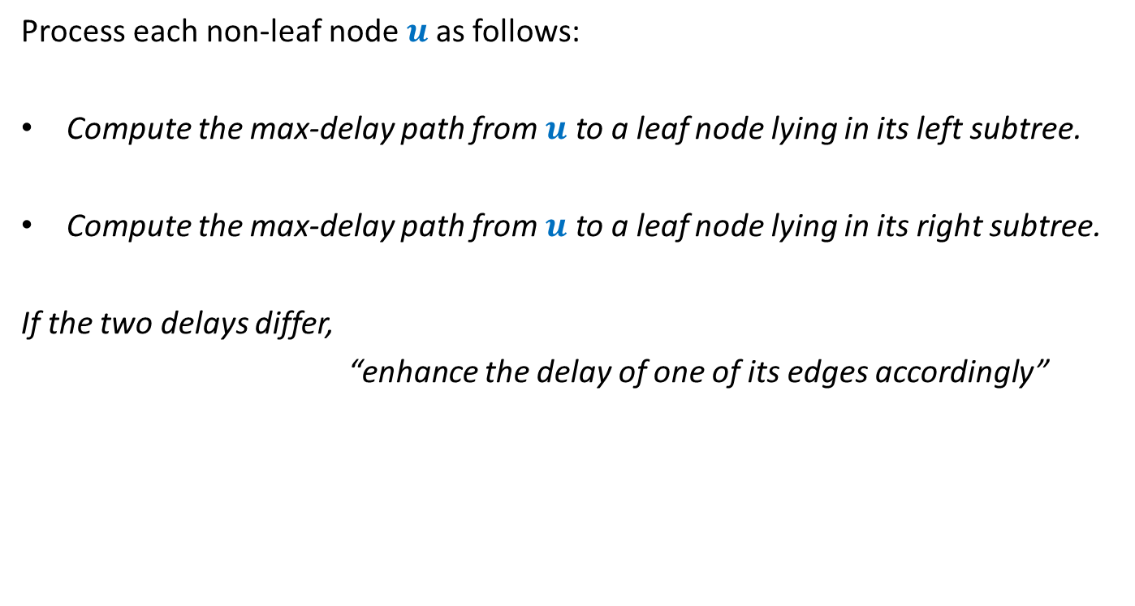
Overview of the proposed algorithm
Process each non-leaf node $u$as follows:
Compute the max-delay path from $u$ to a leaf node lying in its left subtree.
Compute the max-delay path from $u$ to a leaf node lying in its right subtree.
If the two delays differ,
“enhance the delay of one of its edges accordingly”
We need to describe this step more formally. ☺

Slide 18








For each non-leaf node $u$ do the following:
$D_{L}(u)$: max delay along any leftward path
$D_{R}(u)$: max delay along any rightward path
If ($D_{L}\left(u\right)≥D_{R}(u)$)
increase delay of right edge by $D_{L}\left(u\right)$ - $D_{R}\left(u\right)$
Else
increase delay of left edge by $D_{R}\left(u\right)$ - $D_{L}\left(u\right)$
$$γ$$
u
$$α$$
$$β$$
$$+D_{R}\left(u\right)\text{ − }D_{L}\left(u\right)$$
$$+D_{L}\left(u\right)\text{ − }D_{R}\left(u\right)$$
$$D_{L}(u)$$
$$D_{R}(u)$$

Slide 19
Proof of correctness of the algorithm
What assertion suffices as a proof ?

Slide 20
What assertion suffices as a proof ?
Usually it is difficult even to find out the claim whose establishment captures the correctness of the algorithm.☹
In the current algorithm, what might be this claim ?
Let us have a re-look at the algorithm from point of view of a single node .

Slide 21
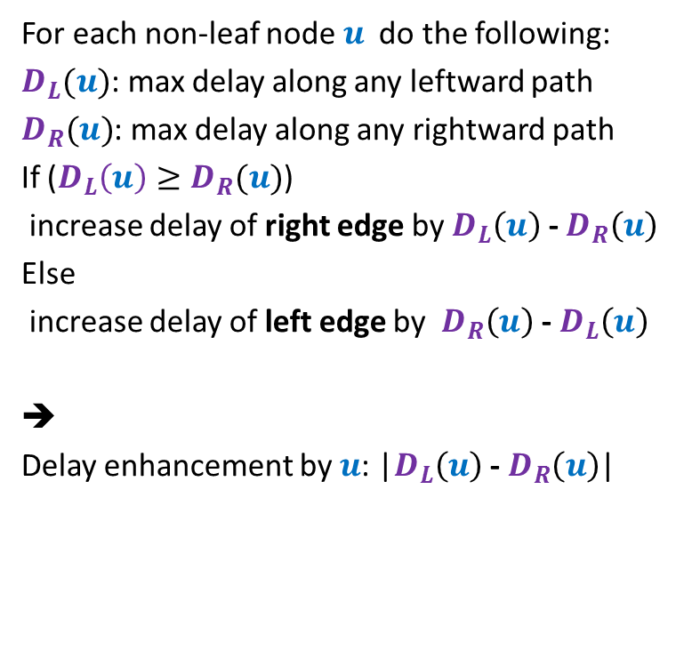



For each non-leaf node $u$ do the following:
$D_{L}(u)$: max delay along any leftward path
$D_{R}(u)$: max delay along any rightward path
If ($D_{L}\left(u\right)≥D_{R}(u)$)
increase delay of right edge by $D_{L}\left(u\right)$ - $D_{R}\left(u\right)$
Else
increase delay of left edge by $D_{R}\left(u\right)$ - $D_{L}\left(u\right)$
➔
Delay enhancement by $u$: |$D_{L}\left(u\right)$ - $D_{R}\left(u\right)$|
$$γ$$
u
$$α$$
$$β$$
$$+D_{L}\left(u\right)\text{ − }D_{R}\left(u\right)$$
$$D_{L}(u)$$
$$D_{R}(u)$$

Slide 22
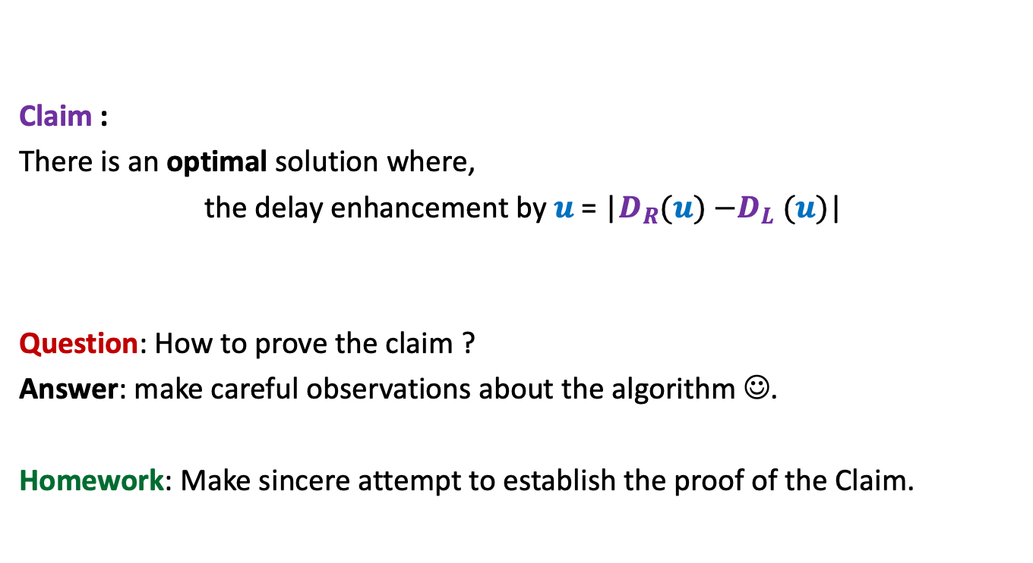
Claim :
There is an optimal solution where,
the delay enhancement by $u$ = |$D_{R}(u){−D}_{L}(u)$|
Question: How to prove the claim ?
Answer: make careful observations about the algorithm ☺.
Homework: Make sincere attempt to establish the proof of the Claim.

