Slide 1
Design and Analysis of Algorithms
Algorithms-II : CS345A
Lecture 8
Proof of correctness of an algorithm - II

Slide 2
New changes in the course
Optional Programming Assignments
Implement the algorithm for polynomial multiplication
5 Quizzes
Date of 5th Quiz ?
Proposal: Saturday, 29th October.
Best 4 out of 5 ?
Decide before 20th August
Will be approved if 80% prefer this change.

Slide 3
Quiz 1
Time: 9:00 AM to 10:45 AM
Date: 20th August, 2022
Venue: L20 and KD101
Seating plan to be announced soon.

Slide 4
Recap of the previous lecture

Slide 5
Synchronizing a circuit
with minimum delay enhancement

Slide 6
An Electric Circuit
A complete binary tree
Electric signal originates at the root
Signal passing through each edge incurs a delay (a few nano seconds)
Finally signal reaches all the leaves.
Electric signal
6
5
3
2
4
2
2
1
6
2
1
2
3
2
Delay 11 10 14 10 10 11 10 9
14
10

Slide 7
Problem definition
Given:
There is a circuit in the form of a complete binary tree.
Electric signal propagates from root to all leaf nodes.
Each edge has certain delay
The delay in reaching signal to a leaf node =
“sum of delays on all edges on the path from root.”
Objective:
Enhance delay along certain edges so that
The delay on all paths from root to leaf nodes is the same.
Total delay enhancement is minimum.

Slide 8
The algorithm
Electric signal
Total delay enhancement: 14
6
5
+3
3
+3
2
4
2
+1
2
6
+4
1
1
2
+1
3
2
+1
+1
2
14
11
14
14
14 14 14 14
11
11
Delay 11 10 14 10 10 11 10 9
11
10

Slide 9








The algorithm
For each non-leaf node $u$ do the following:
$D_{L}(u)$: max delay along any leftward path
$D_{R}(u)$: max delay along any rightward path
If ($D_{L}\left(u\right)≥D_{R}(u)$)
increase delay of right edge by $D_{L}\left(u\right)$ - $D_{R}\left(u\right)$
Else
increase delay of left edge by $D_{R}\left(u\right)$ - $D_{L}\left(u\right)$
$$γ$$
u
$$α$$
$$β$$
$$+D_{R}\left(u\right)\text{ − }D_{L}\left(u\right)$$
$$+D_{L}\left(u\right)\text{ − }D_{R}\left(u\right)$$
$$D_{L}(u)$$
$$D_{R}(u)$$

Slide 10
Proof of correctness of the algorithm
What assertion suffices as a proof ?

Slide 11
What assertion suffices as a proof ?
Usually it is difficult even to find out the claim whose establishment captures the correctness of the algorithm.☹
In the current algorithm, what might be this claim ?
Let us have a re-look at the algorithm from point of view of a single node .

Slide 12
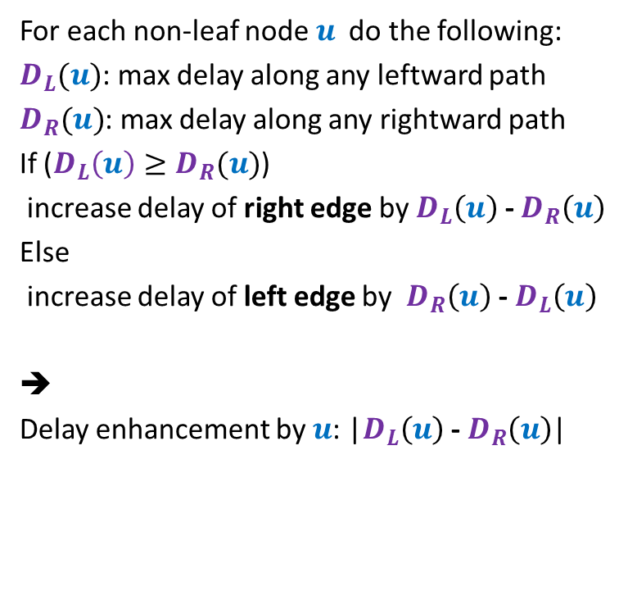



The algorithm
For each non-leaf node $u$ do the following:
$D_{L}(u)$: max delay along any leftward path
$D_{R}(u)$: max delay along any rightward path
If ($D_{L}\left(u\right)≥D_{R}(u)$)
increase delay of right edge by $D_{L}\left(u\right)$ - $D_{R}\left(u\right)$
Else
increase delay of left edge by $D_{R}\left(u\right)$ - $D_{L}\left(u\right)$
➔
Delay enhancement by $u$: |$D_{L}\left(u\right)$ - $D_{R}\left(u\right)$|
$$γ$$
u
$$α$$
$$β$$
$$+D_{L}\left(u\right)\text{ − }D_{R}\left(u\right)$$
$$D_{L}(u)$$
$$D_{R}(u)$$

Slide 13
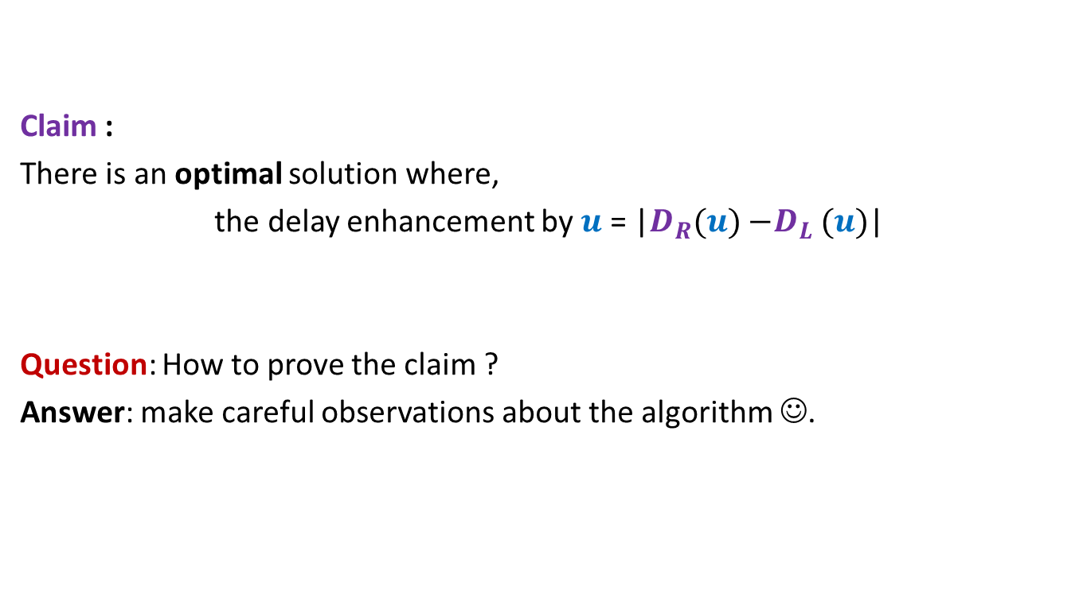
Claim :
There is an optimal solution where,
the delay enhancement by $u$ = |$D_{R}(u){−D}_{L}(u)$|
Question: How to prove the claim ?
Answer: make careful observations about the algorithm ☺.

Slide 14

Claim :
There is an optimal solution where,
the delay enhancement by $u$ = |$D_{R}(u){−D}_{L}(u)$|

Slide 15
Observations about the algorithm

Slide 16

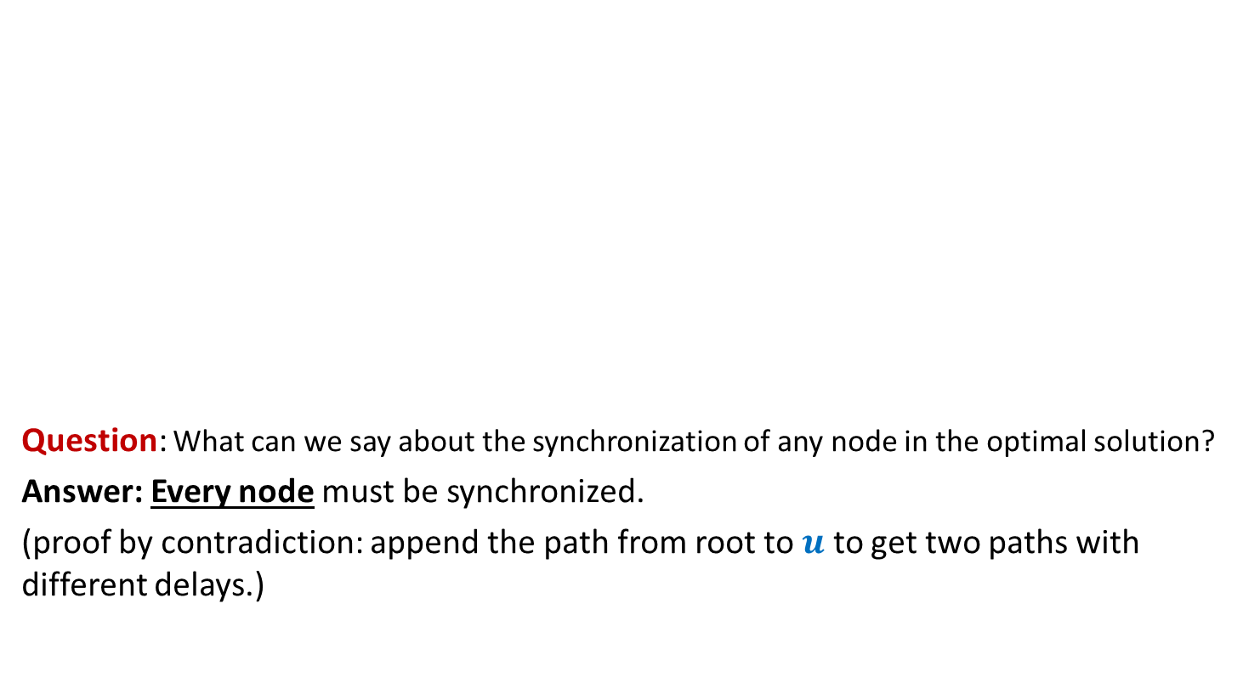


Observation 1
Electric signal
Question: What can we say about the synchronization of any node in the optimal solution?
Answer: Every node must be synchronized.
(proof by contradiction: append the path from root to $u$ to get two paths with different delays.)
$$u$$
$$δ_{1}$$
$$δ_{2}$$

Slide 17
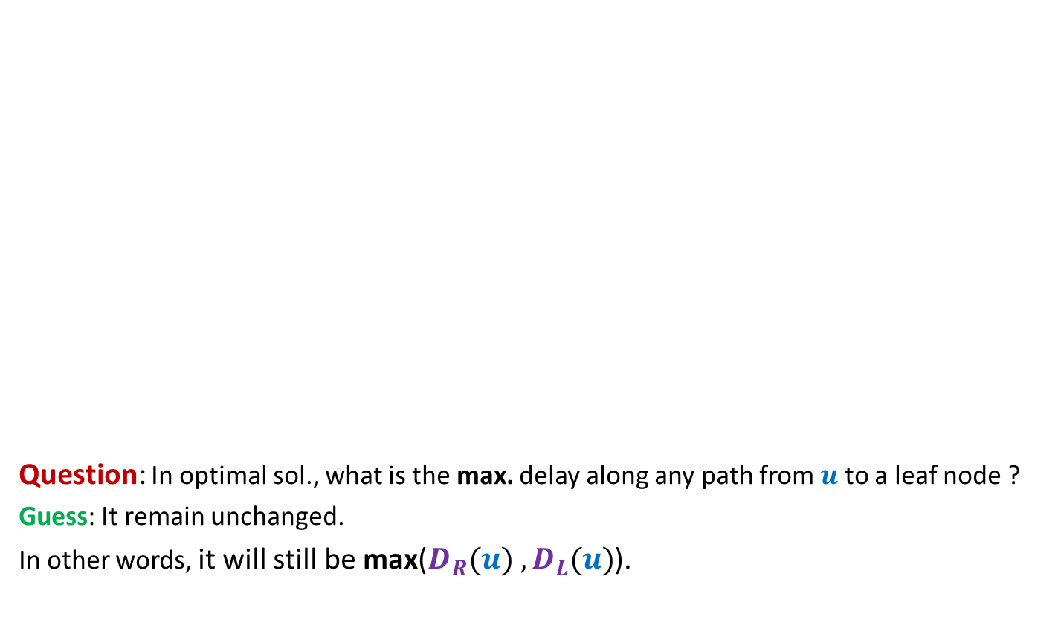
Observation 2
The maximum delay from the root to any leaf node remains unchanged in the optimal solution. What can we say about the maximum delay from any other node to any leaf node in its subtree?
Electric signal
Question: In optimal sol., what is the max. delay along any path from $u$ to a leaf node ?
Guess: It remain unchanged.
In other words, it will still be max($D_{R}(u){ ,D}_{L}(u)$).
$$u$$
6
5
+3
3
+3
2
4
2
+1
2
6
+4
1
1
2
+1
3
2
+1
+1
2
Delay 11 10 14 10 10 11 10 9
New Delay 14 14 14 14 14 14 14 14

Slide 18
Usefulness of the guess

Slide 19
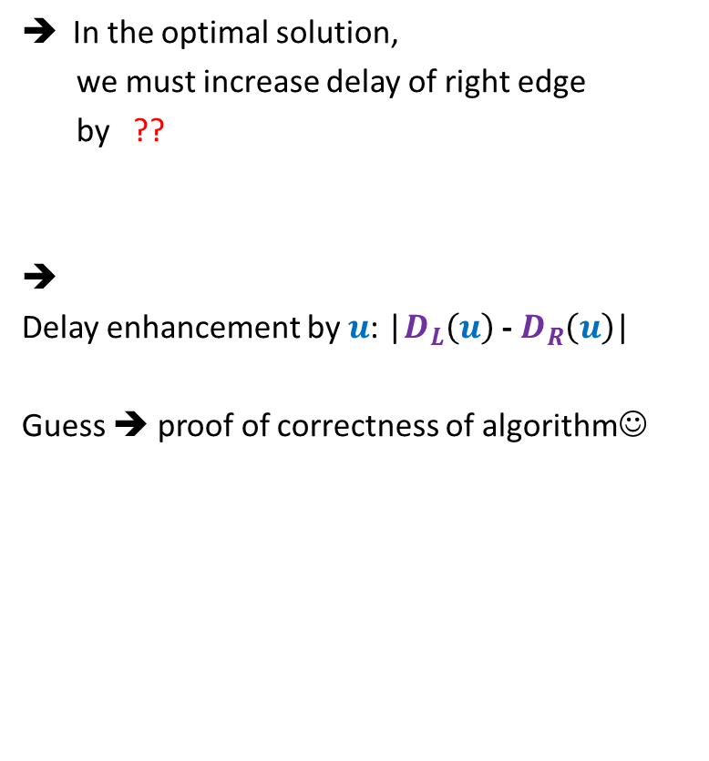



Usefulness of the guess
Suppose $D_{L}(u){≥D}_{R}(u)$
In the optimal solution,
we must increase delay of right edge
by ??
➔
Delay enhancement by $u$: |$D_{L}\left(u\right)$ - $D_{R}\left(u\right)$|
Guess ➔ proof of correctness of algorithm☺
How much enhancement ?
$$γ$$
How much enhancement ?
$D_{L}\left(u\right)$ - $D_{R}\left(u\right)$
u
$$α$$
$$β$$
0
$$+D_{L}\left(u\right)\text{ − }D_{R}\left(u\right)$$
$$D_{L}(u)$$
$$D_{R}(u)$$
unchanged
unchanged

Slide 20

Proving the guess
Guess : In the optimal solution, the delay along any path from $u$ to any leaf node is max($D_{R}(u){ ,D}_{L}(u)$).
Question: How to prove it ?
Answer: By contradiction.

Slide 21

What if the assertion fails at many nodes ?
Consider the lowest node in the tree where it fails.
In particular, any node with no red descendant will suffice.
(can you see why it is difficult to analyze any other “red” nodes ?)
$$u$$

Slide 22



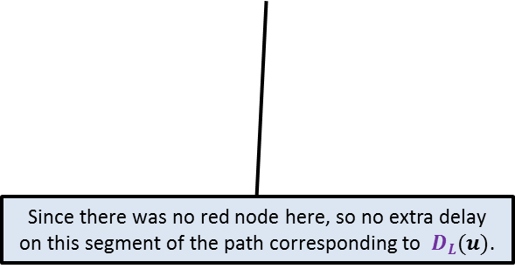


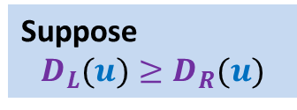



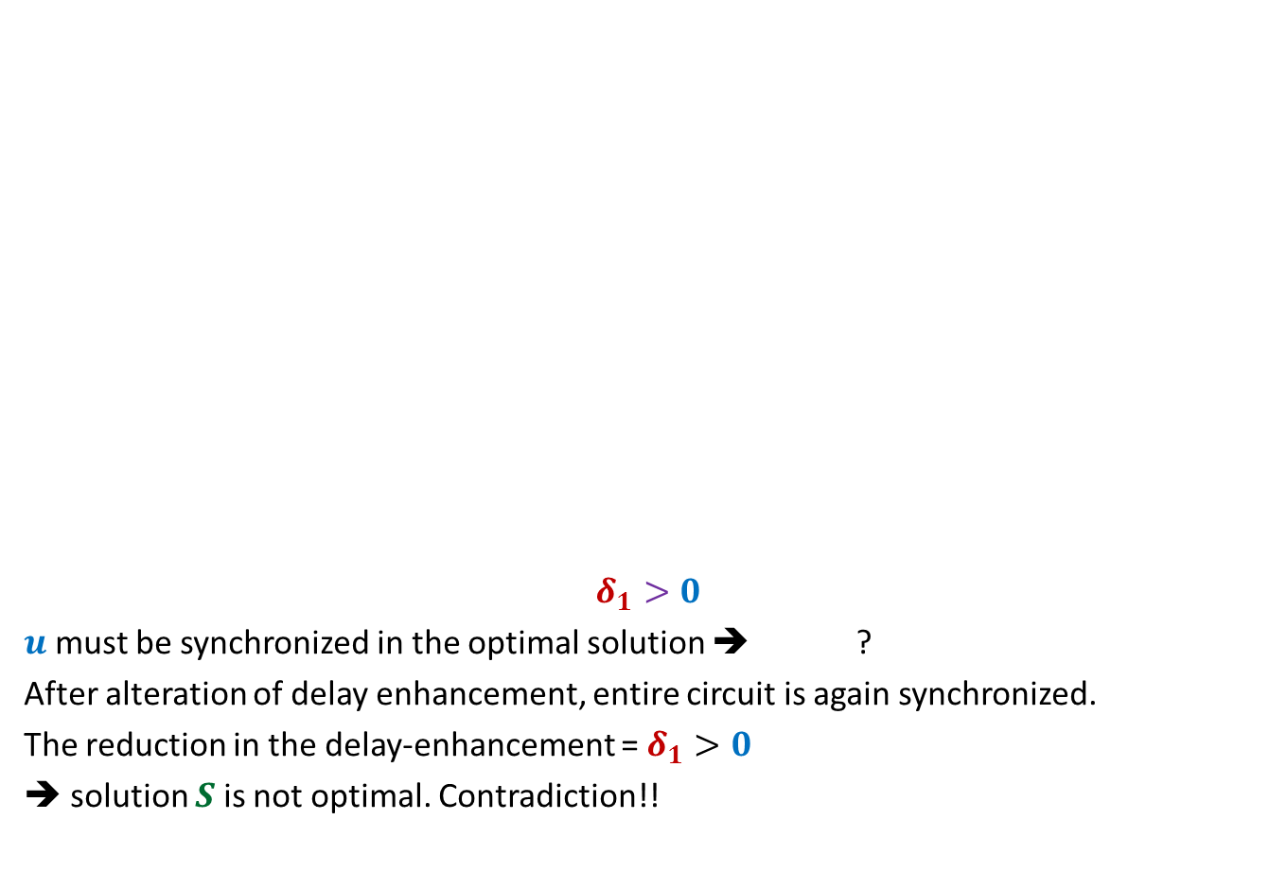













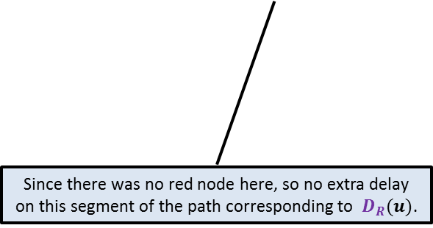
Proof:
the maximum delay on any path from $u$to any of its leaf node
is strictly greater than $D_{L}(u)$in an optimal solution $S$.
Suppose
$$D_{L}(u)≥D_{R}(u)$$
What does it imply ?
$$γ$$
$${+δ}_{3}$$
Can you do some manipulation to reduce the total delay enhancement ?
$$γ$$
What does it imply ?
$${+δ}_{3}$$
$${+δ}_{1}$$
$$u$$
$$u$$
$$δ_{1}>0$$
$u$ must be synchronized in the optimal solution ➔ ?
After alteration of delay enhancement, entire circuit is again synchronized.
The reduction in the delay-enhancement = $δ_{1}>0$
➔ solution $S$is not optimal. Contradiction!!
$$α$$
$${+δ}_{1}$$
$$β$$
$${+δ}_{2}$$
$$α$$
$$β$$
$${+D}_{L}\left(u\right)\text{ − }D_{R}\left(u\right)$$
$$+δ_{2}−δ_{1}$$
$$D_{L}(u)$$
$$D_{R}(u)$$
$$D_{L}(u)$$
$$D_{R}(u)$$
Since there was no red node here, so no extra delay on this segment of the path corresponding to $D_{R}(u)$.
Since there was no red node here, so no extra delay on this segment of the path corresponding to $D_{L}(u)$.
$$D_{L}(u)+δ_{1}=D_{R}(u)+δ_{2}$$

Slide 23
Homework
Design an efficient implementation of the algorithm.

Slide 24

The last 2 problems we discussed
Synchronizing the delays in a circuit
Scheduling jobs to minimize maximum lateness
Electric signal
6
5
3
2
4
2
$$0$$
time
2
1
6
2
1
2
3
2
A local approach
Optimizing a global function

Slide 25
Greedy Algorithms

Slide 26
Huffman Codes
A novel and quite inspiring application of greedy algorithms

Slide 27

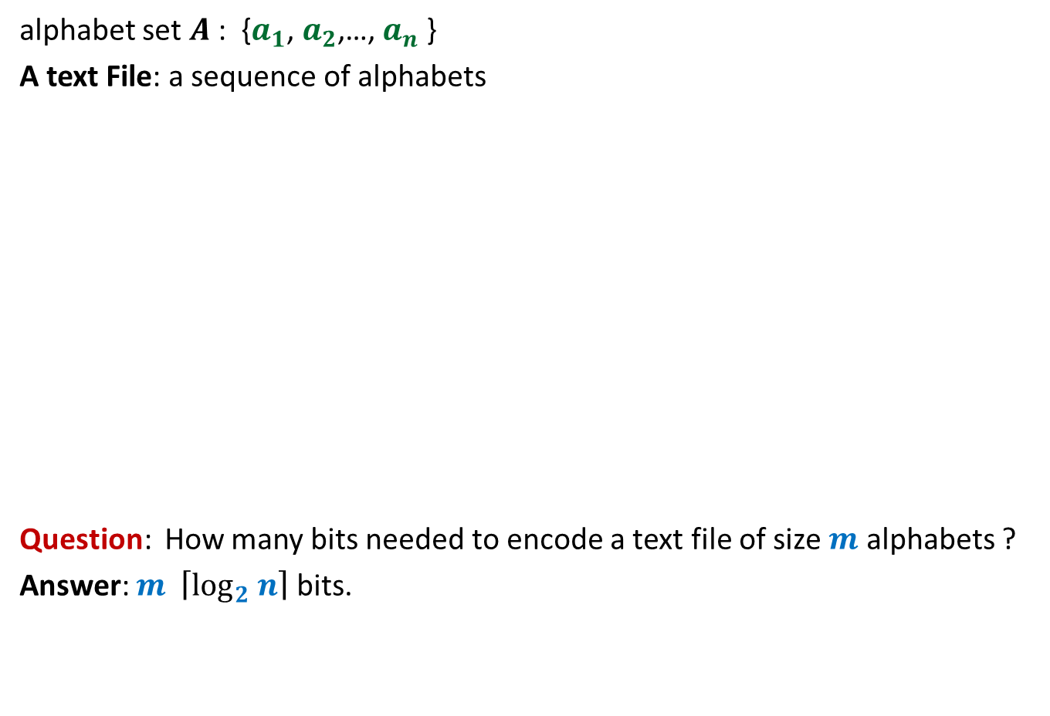
Binary coding
alphabet set $A$: {$a_{1}$, $a_{2}$,…, $a_{n}$ }
A text File: a sequence of alphabets
Question: How many bits needed to encode a text file of size $m$ alphabets ?
Answer: $m \left\lceil \log_{2} n\right\rceil$ bits.
once upon a time …………..
…………………………….
……………………………..
…………………
A text file F
Binary coding of F

Slide 28
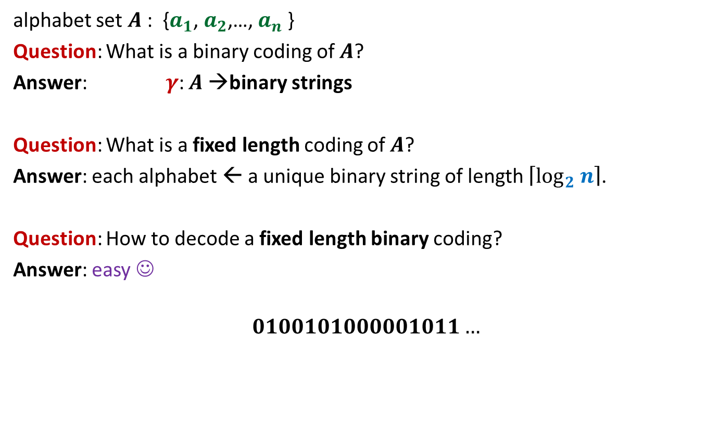
Fixed length coding
alphabet set $A$: {$a_{1}$, $a_{2}$,…, $a_{n}$ }
Question: What is a binary coding of $A$?
Answer: $γ$: $A$→binary strings
Question: What is a fixed length coding of $A$?
Answer: each alphabet ← a unique binary string of length $\left\lceil \log_{2} n\right\rceil$.
Question: How to decode a fixed length binary coding?
Answer: easy ☺
$$0100101000001011…$$

Slide 29
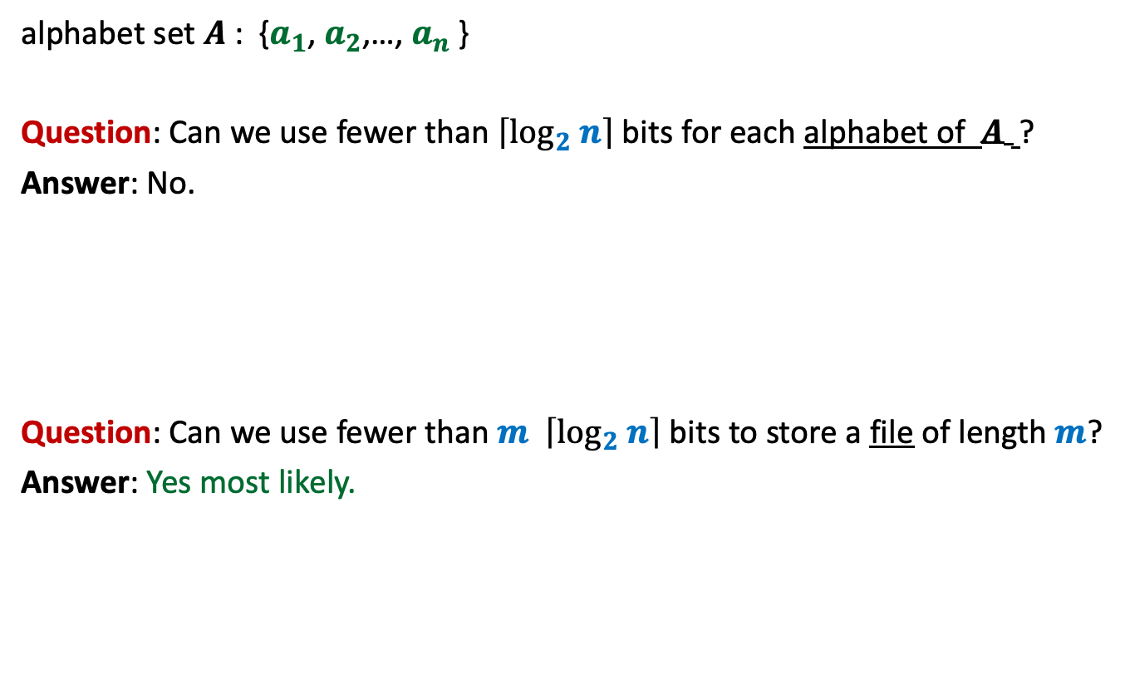
Fixed length coding
alphabet set $A$: {$a_{1}$, $a_{2}$,…, $a_{n}$ }
Question: Can we use fewer than $\left\lceil \log_{2} n\right\rceil$ bits for each alphabet of $A$ ?
Answer: No.
Question: Can we use fewer than $m \left\lceil \log_{2} n\right\rceil$ bits to store a file of length $m$?
Answer: Yes most likely.

Slide 30
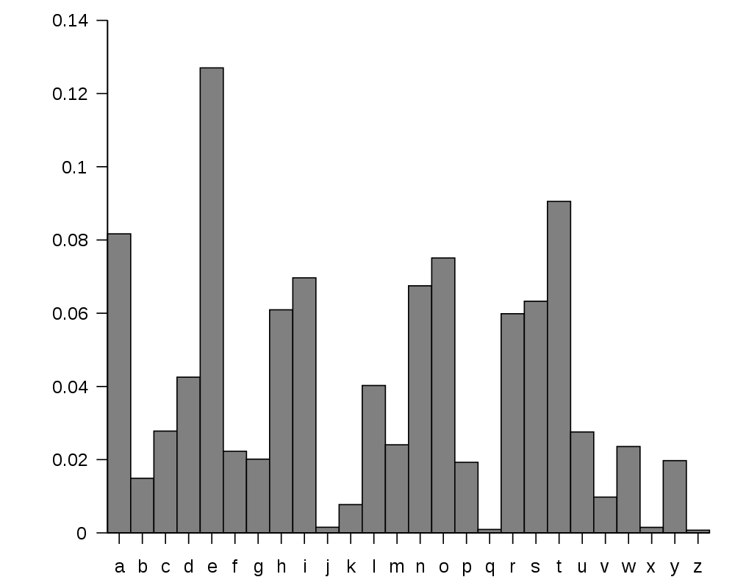
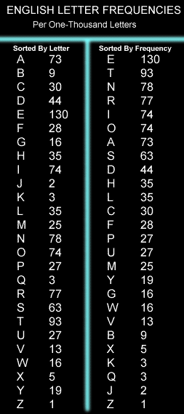
huge variation in the frequency of alphabets in a text.
http://en.wikipedia.org/wiki/Letter_frequency

Slide 31
huge variation in the frequency of alphabets in a text.
Question: How to exploit variation in the frequencies of alphabets ?
Answer:
More frequent alphabets ⬅ coding with shorter bit string
Less frequent alphabets ⬅ coding with longer bit string

Slide 32

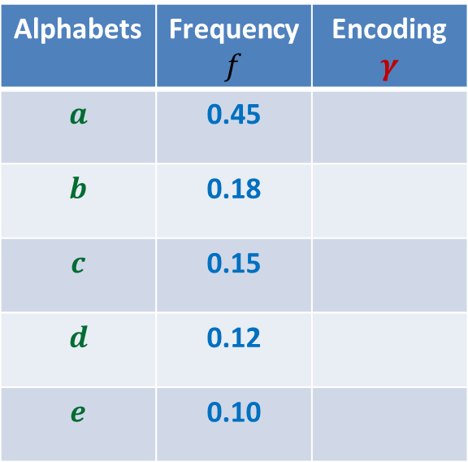

Variable length encoding
Average bit length per symbol using $γ$:
$$ABL\left(γ\right)=\sum_{x∈A}{f\left(x\right).\left|γ\left(x\right)\right|}$$
$=$ $0.45⨯1+0.18⨯2+(0.15+0.12+0.10)⨯3$
$=$ $1.92$
Question: How will you decode 01010111 ?
Answer: $abbe$ or $adae$
Question: What is the source of this ambiguity ?
Answer: $γ\left(b\right)$ is a prefix of $γ\left(d\right)$.
?
?
Alphabets | Frequency $f$ | Encoding $$γ$$
$$a$$ | 0.45
$$b$$ | 0.18
$$c$$ | 0.15
$$d$$ | 0.12
$$e$$ | 0.10
0
10
110
101
111
There is a serious problem with the $γ$encoding. Can you see?
Can we fix it ?

Slide 33

Variable length encoding
Average bit length per alphabet using $γ$:
$$ABL\left(γ\right)=\sum_{x∈A}{f\left(x\right).\left|γ\left(x\right)\right|}$$
$=$ $0.45⨯1+0.18⨯3+(0.15+0.12+0.10)⨯3$
$=$ $2.1$
Alphabets | Frequency $f$ | Encoding $$γ$$
$$a$$ | 0.45
$$b$$ | 0.18
$$c$$ | 0.15
$$d$$ | 0.12
$$e$$ | 0.10
0
100
110
101
111

Slide 34
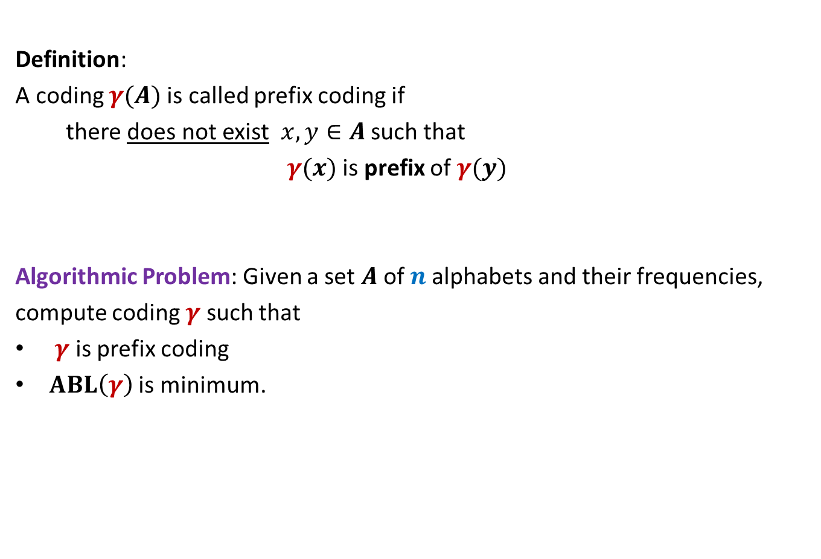
Prefix Coding
Definition:
A coding $γ(A)$is called prefix coding if
there does not exist $x,y∈A$ such that
$γ(x)$ is prefix of $γ(y)$
Algorithmic Problem: Given a set $A$of $n$alphabets and their frequencies,
compute coding $γ$ such that
$γ$ is prefix coding
$ABL\left(γ\right)$ is minimum.

Slide 35

The challenge of the problem
Among all possible binary coding of $A$, how to find the optimal prefix coding ?
It looks too complex ☹

Slide 36
The novel idea of Huffman
?
0
1
0
1
0
1
Binary coding
Labeled
Binary tree

Slide 37
A labeled binary tree
nodes → ?
Code of an alphabet = ?
0
1
0,
00,
001
01,
1,
10,
100,
101
0
1
0
1
0
1
alphabets
Label of path from root

Slide 38
prefix codes and labeled Binary tree

Slide 39
A labeled binary tree
Consider a prefix code 101
0
1
1
0
Visualize a binary tree for the prefix code ?
0
1

Slide 40
A labeled binary tree
0
1
0
1
1
0
0
1
0
1
0
1
0
1

Slide 41
A labeled binary tree
leaf nodes → alphabets
Code of an alphabet =
0
1
01,
001,
0000,
11,
100,
10110,
10111
0
1
1
0
0
1
0
1
0
1
0
1
Label of path from root

Slide 42
Homework
Design an algorithm that given a prefix coding for a set of alphabets, builds the corresponding labeled binary tree.
Ponder over the properties of the labeled binary tree of the optimal prefix coding. Just ask yourself : How will that tree look like ?

