Slide 1
Generative Classification

Slide 2
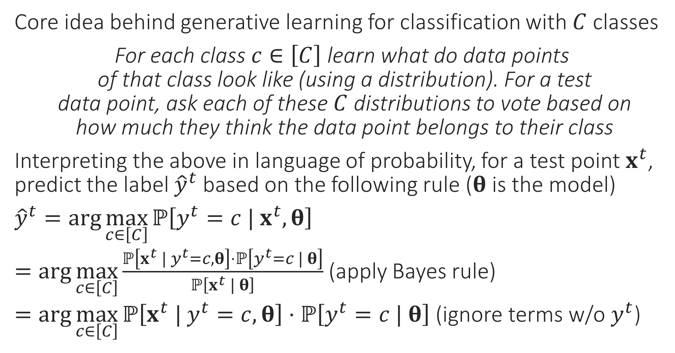
Generative Supervised Learning
“
Core idea behind generative learning for classification with $C$ classes
For each class $c∈\left[C\right]$ learn what do data points of that class look like (using a distribution). For a test data point, ask each of these $C$ distributions to vote based on how much they think the data point belongs to their class
Interpreting the above in language of probability, for a test point $x^{t}$, predict the label ${\hat{y}}^{t}$ based on the following rule ($θ$ is the model)
${\hat{y}}^{t}=\arg{\max_{c∈\left[C\right]}{ℙ\left[y^{t}=c | x^{t},θ\right]}}$
$=\arg{\max_{c∈\left[C\right]}{\frac{ℙ\left[x^{t} | y^{t}=c,θ\right]⋅ℙ\left[y^{t}=c | θ\right]}{ℙ\left[x^{t} | θ\right]}}}$ (apply Bayes rule)
$=\arg{\max_{c∈\left[C\right]}{ℙ\left[x^{t} | y^{t}=c,θ\right]⋅ℙ\left[y^{t}=c | θ\right]}}$ (ignore terms w/o $y^{t}$)
“
Every generative learning algo takes a decision on how to learn these probability distributions from data. Let us see one example of how this can be done

Slide 3
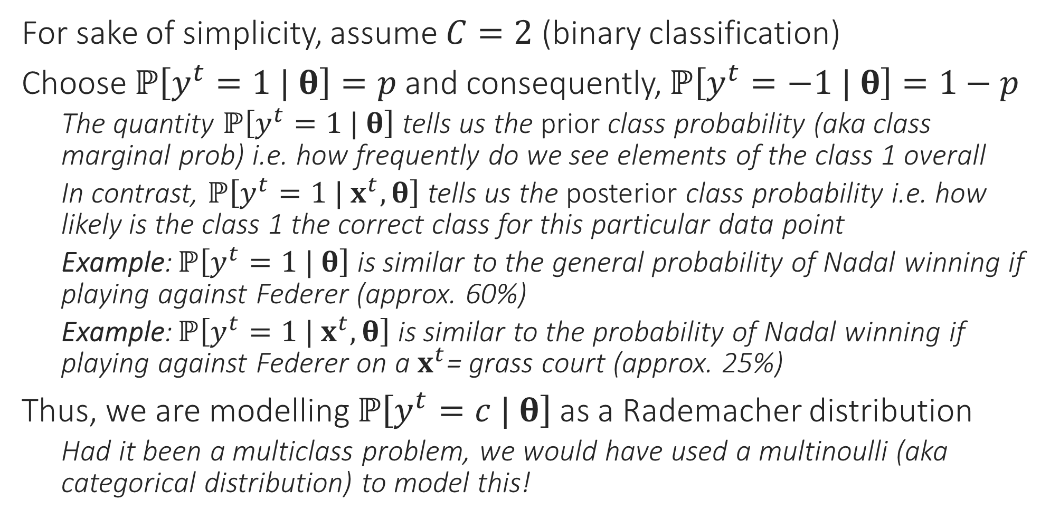
A simple generative model
For sake of simplicity, assume $C=2$ (binary classification)
Choose $ℙ\left[y^{t}=1 | θ\right]=p$ and consequently, $ℙ\left[y^{t}=−1 | θ\right]=1−p$
The quantity $ℙ\left[y^{t}=1 | θ\right]$ tells us the prior class probability (aka class marginal prob) i.e. how frequently do we see elements of the class 1 overall
In contrast, $ℙ\left[y^{t}=1 | x^{t},θ\right]$ tells us the posterior class probability i.e. how likely is the class 1 the correct class for this particular data point
Example: $ℙ\left[y^{t}=1 | θ\right]$ is similar to the general probability of Nadal winning if playing against Federer (approx. 60%)
Example: $ℙ\left[y^{t}=1 | x^{t},θ\right]$ is similar to the probability of Nadal winning if playing against Federer on a $x^{t}$= grass court (approx. 25%)
Thus, we are modelling $ℙ\left[y^{t}=c | θ\right]$ as a Rademacher distribution
Had it been a multiclass problem, we would have used a multinoulli (aka categorical distribution) to model this!

Slide 4
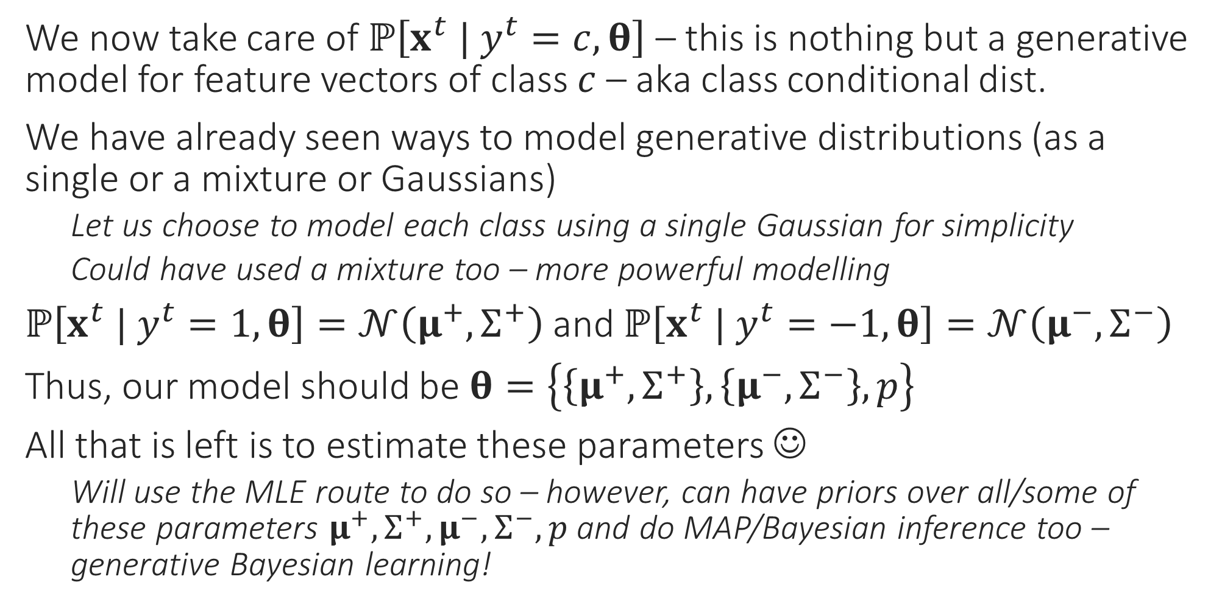
A simple generative model
We now take care of $ℙ\left[x^{t} | y^{t}=c,θ\right]$ – this is nothing but a generative model for feature vectors of class $c$ – aka class conditional dist.
We have already seen ways to model generative distributions (as a single or a mixture or Gaussians)
Let us choose to model each class using a single Gaussian for simplicity
Could have used a mixture too – more powerful modelling
$ℙ\left[x^{t} | y^{t}=1,θ\right]=𝒩\left(μ^{+},Σ^{+}\right)$ and $ℙ\left[x^{t} | y^{t}=−1,θ\right]=𝒩\left(μ^{−},Σ^{−}\right)$
Thus, our model should be $θ=\left\{\left\{μ^{+},Σ^{+}\right\},\left\{μ^{−},Σ^{−}\right\},p\right\}$
All that is left is to estimate these parameters ☺
Will use the MLE route to do so – however, can have priors over all/some of these parameters $μ^{+},Σ^{+},μ^{−},Σ^{−},p$ and do MAP/Bayesian inference too – generative Bayesian learning!

Slide 5
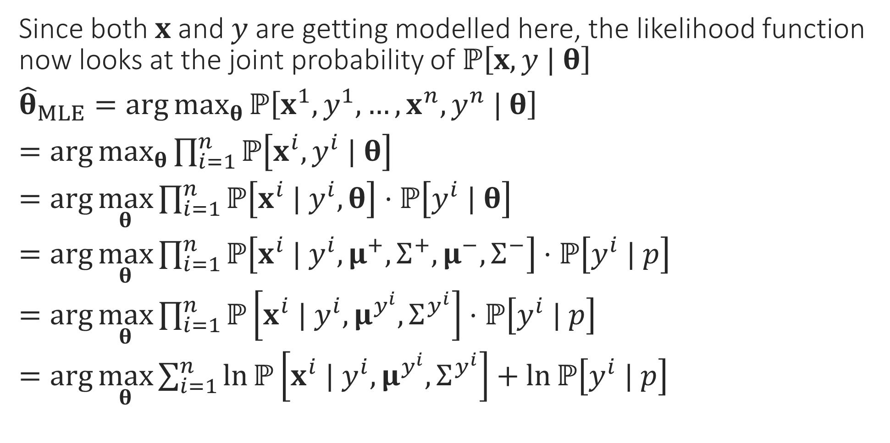
MLE for generative classification
Since both $x$ and $y$ are getting modelled here, the likelihood function now looks at the joint probability of $ℙ\left[x,y | θ\right]$
${\hat{θ}}_{MLE}=\arg{\max_{θ}{ℙ\left[x^{1},y^{1},…,x^{n},y^{n} | θ\right]}}$
$=\arg{\max_{θ}{\prod_{i=1}^{n}{ℙ\left[x^{i},y^{i} | θ\right]}}}$
$=\arg{\max_{θ}{\prod_{i=1}^{n}{ℙ\left[x^{i} | y^{i}, θ\right]⋅ℙ\left[y^{i} | θ\right]}}}$
$=\arg{\max_{θ}{\prod_{i=1}^{n}{ℙ\left[x^{i} | y^{i},μ^{+},Σ^{+},μ^{−},Σ^{−}\right]⋅ℙ\left[y^{i} | p\right]}}}$
$=\arg{\max_{θ}{\prod_{i=1}^{n}{ℙ\left[x^{i} | y^{i},μ^{y^{i}},Σ^{y^{i}}\right]⋅ℙ\left[y^{i} | p\right]}}}$
$=\arg{\max_{θ}{\sum_{i=1}^{n}{\ln{ℙ\left[x^{i} | y^{i},μ^{y^{i}},Σ^{y^{i}}\right]}+\ln{ℙ\left[y^{i} | p\right]}}}}$
Independence
Chain Rule
Get rid of conditioning that does not matter
Get rid of conditioning that does not matter
Take logs

Slide 6
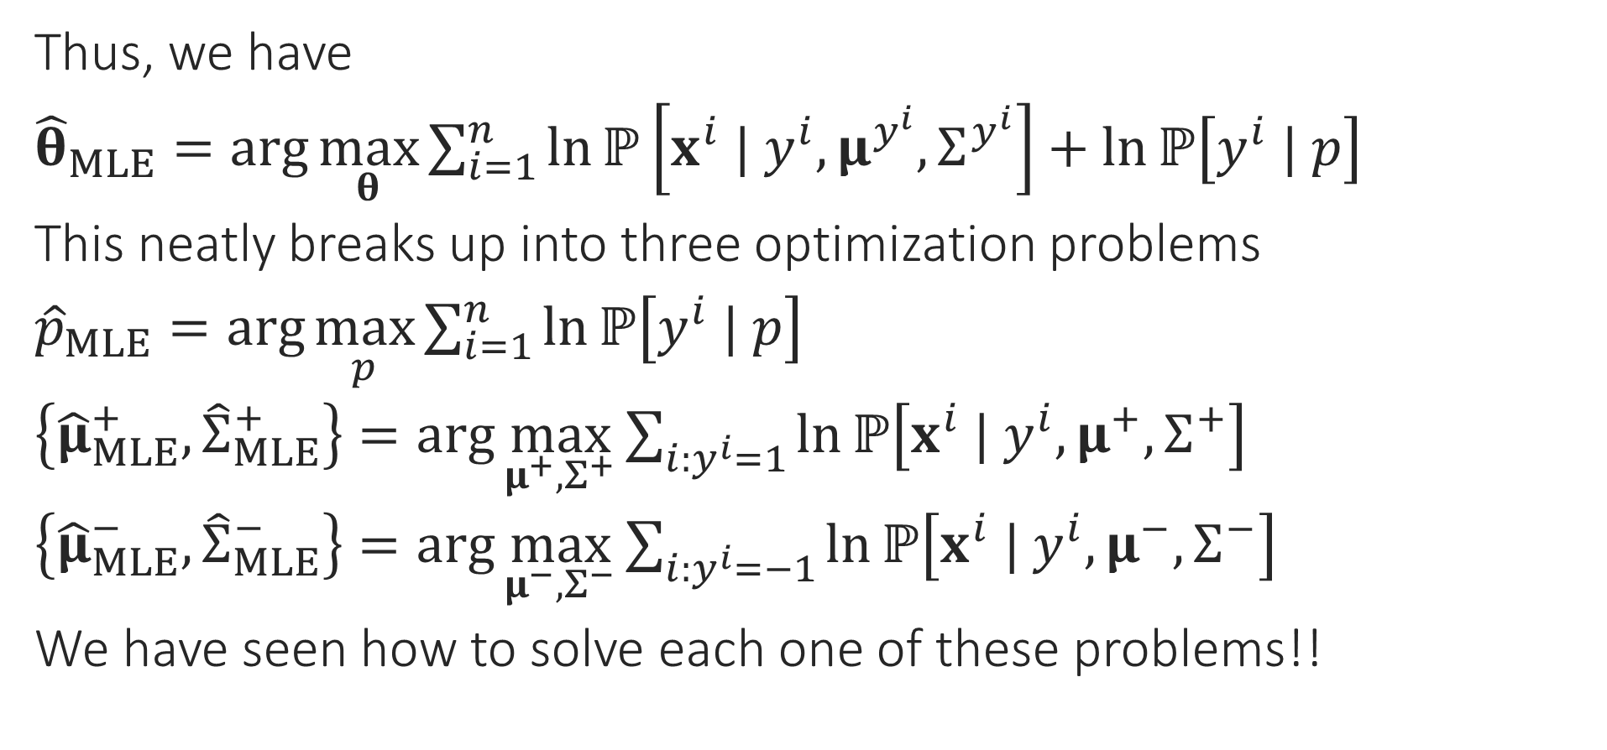
MLE for generative classification
Thus, we have
${\hat{θ}}_{MLE}=\arg{\max_{θ}{\sum_{i=1}^{n}{\ln{ℙ\left[x^{i} | y^{i},μ^{y^{i}},Σ^{y^{i}}\right]}+\ln{ℙ\left[y^{i} | p\right]}}}}$
This neatly breaks up into three optimization problems
${\hat{p}}_{MLE}=\arg{\max_{p}{\sum_{i=1}^{n}{\ln{ℙ\left[y^{i} | p\right]}}}}$
$\left\{{\hat{μ}}_{MLE}^{+},{\hat{Σ}}_{MLE}^{+}\right\}=\arg{\max_{μ^{+},Σ^{+}}{\sum_{i:y^{i}=1}{\ln{ℙ\left[x^{i} | y^{i},μ^{+},Σ^{+}\right]}}}}$
$\left\{{\hat{μ}}_{MLE}^{−},{\hat{Σ}}_{MLE}^{−}\right\}=\arg{\max_{μ^{−},Σ^{−}}{\sum_{i:y^{i}=−1}{\ln{ℙ\left[x^{i} | y^{i},μ^{−},Σ^{−}\right]}}}}$
We have seen how to solve each one of these problems!!

Slide 7
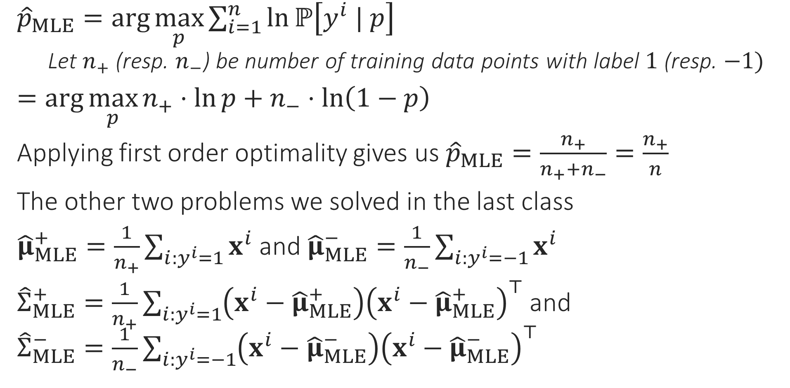
MLE for generative classification
${\hat{p}}_{MLE}=\arg{\max_{p}{\sum_{i=1}^{n}{\ln{ℙ\left[y^{i} | p\right]}}}}$
Let $n_{+}$ (resp. $n_{−}$) be number of training data points with label $1$ (resp. $−1)$
$=\arg{\max_{p}{n_{+}⋅\ln{p}+n_{−}⋅\ln\left(1−p\right)}}$
Applying first order optimality gives us ${\hat{p}}_{MLE}=\frac{n_{+}}{n_{+}+n_{−}}=\frac{n_{+}}{n}$
The other two problems we solved in the last class
${\hat{μ}}_{MLE}^{+}=\frac{1}{n_{+}}\sum_{i:y^{i}=1}{x^{i}}$ and ${\hat{μ}}_{MLE}^{−}=\frac{1}{n_{−}}\sum_{i:y^{i}=−1}{x^{i}}$
${\hat{Σ}}_{MLE}^{+}=\frac{1}{n_{+}}\sum_{i:y^{i}=1}{\left(x^{i}−{\hat{μ}}_{MLE}^{+}\right){\left(x^{i}−{\hat{μ}}_{MLE}^{+}\right)}^{⊤}}$ and ${\hat{Σ}}_{MLE}^{−}=\frac{1}{n_{−}}\sum_{i:y^{i}=−1}{\left(x^{i}−{\hat{μ}}_{MLE}^{−}\right){\left(x^{i}−{\hat{μ}}_{MLE}^{−}\right)}^{⊤}}$

Slide 8
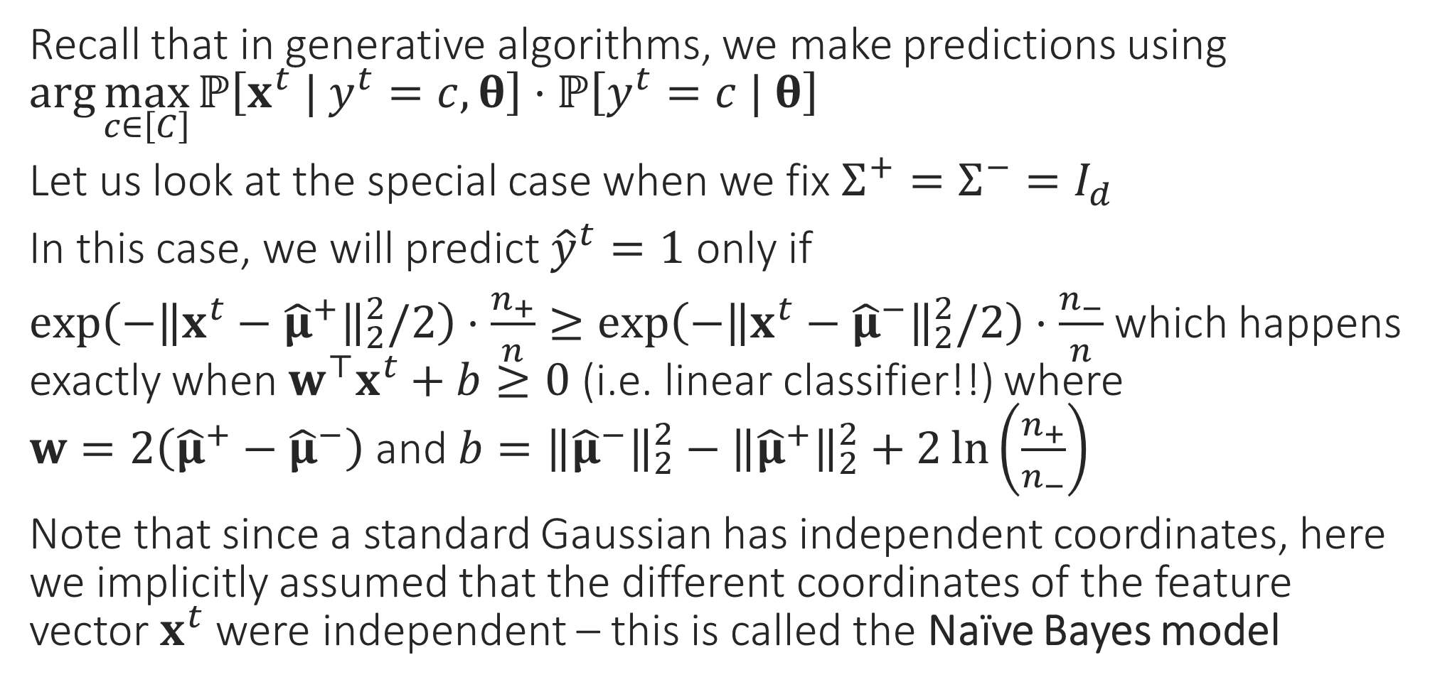
Special Cases – I
Recall that in generative algorithms, we make predictions using $\arg{\max_{c∈\left[C\right]}{ℙ\left[x^{t} | y^{t}=c,θ\right]⋅ℙ\left[y^{t}=c | θ\right]}}$
Let us look at the special case when we fix $Σ^{+}=Σ^{−}=I_{d}$
In this case, we will predict ${\hat{y}}^{t}=1$ only if
$\exp\left(−{\left\|x^{t}−{\hat{μ}}^{+}\right\|}_{2}^{2}/2\right)⋅\frac{n_{+}}{n}≥\exp\left(−{\left\|x^{t}−{\hat{μ}}^{−}\right\|}_{2}^{2}/2\right)⋅\frac{n_{−}}{n}$ which happens exactly when $w^{⊤}x^{t}+b≥0$ (i.e. linear classifier!!) where $w=2\left({\hat{μ}}^{+}−{\hat{μ}}^{−}\right)$ and $b={\left\|{\hat{μ}}^{−}\right\|}_{2}^{2}−{\left\|{\hat{μ}}^{+}\right\|}_{2}^{2}+2\ln\left(\frac{n_{+}}{n_{−}}\right)$
Note that since a standard Gaussian has independent coordinates, here we implicitly assumed that the different coordinates of the feature vector $x^{t}$ were independent – this is called the Naïve Bayes model

Slide 9
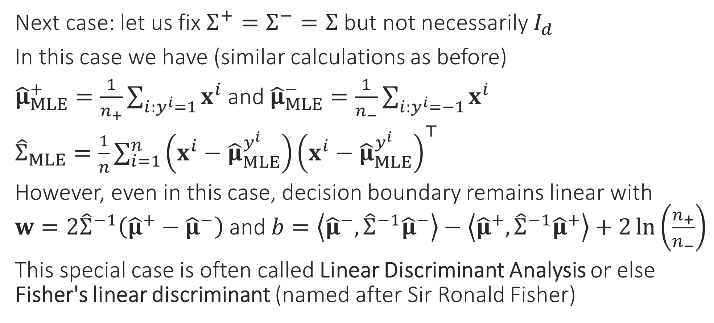
Special Cases – II
Next case: let us fix $Σ^{+}=Σ^{−}=Σ$ but not necessarily $I_{d}$
In this case we have (similar calculations as before)
${\hat{μ}}_{MLE}^{+}=\frac{1}{n_{+}}\sum_{i:y^{i}=1}{x^{i}}$ and ${\hat{μ}}_{MLE}^{−}=\frac{1}{n_{−}}\sum_{i:y^{i}=−1}{x^{i}}$
${\hat{Σ}}_{MLE}=\frac{1}{n}\sum_{i=1}^{n}{\left(x^{i}−{\hat{μ}}_{MLE}^{y^{i}}\right){\left(x^{i}−{\hat{μ}}_{MLE}^{y^{i}}\right)}^{⊤}}$
However, even in this case, decision boundary remains linear with $w=2{\hat{Σ}}^{−1}\left({\hat{μ}}^{+}−{\hat{μ}}^{−}\right)$ and $b=\left\langle {\hat{μ}}^{−},{\hat{Σ}}^{−1}{\hat{μ}}^{−}\right\rangle −\left\langle {\hat{μ}}^{+},{\hat{Σ}}^{−1}{\hat{μ}}^{+}\right\rangle +2\ln\left(\frac{n_{+}}{n_{−}}\right)$
This special case is often called Linear Discriminant Analysis or else Fisher's linear discriminant (named after Sir Ronald Fisher)

Slide 10
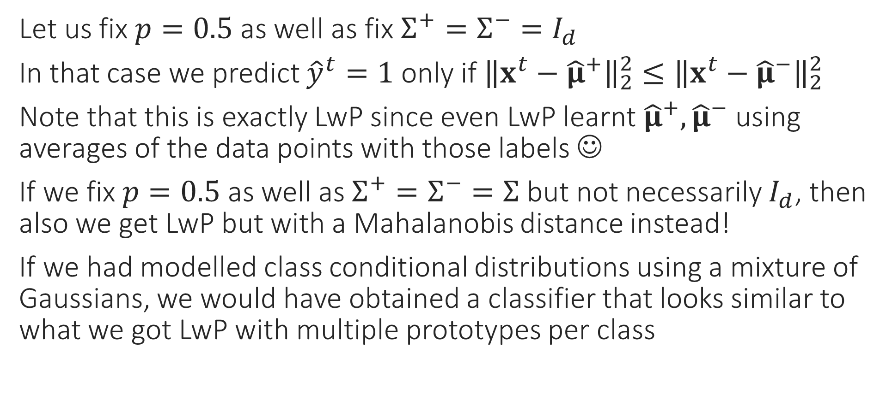
Special Cases – III
Let us fix $p=0.5$ as well as fix $Σ^{+}=Σ^{−}=I_{d}$
In that case we predict ${\hat{y}}^{t}=1$ only if ${\left\|x^{t}−{\hat{μ}}^{+}\right\|}_{2}^{2}≤{\left\|x^{t}−{\hat{μ}}^{−}\right\|}_{2}^{2}$
Note that this is exactly LwP since even LwP learnt ${\hat{μ}}^{+},{\hat{μ}}^{−}$ using averages of the data points with those labels ☺
If we fix $p=0.5$ as well as $Σ^{+}=Σ^{−}=Σ$ but not necessarily $I_{d}$, then also we get LwP but with a Mahalanobis distance instead!
If we had modelled class conditional distributions using a mixture of Gaussians, we would have obtained a classifier that looks similar to what we got LwP with multiple prototypes per class

Slide 11
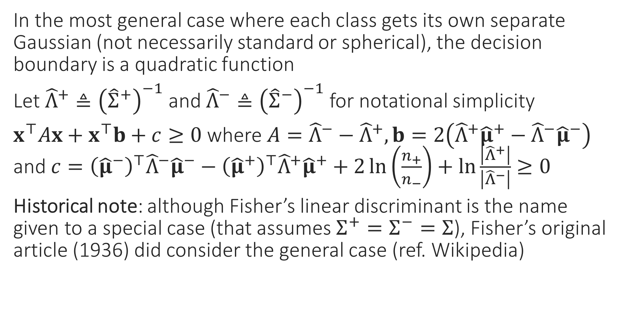
General Case
In the most general case where each class gets its own separate Gaussian (not necessarily standard or spherical), the decision boundary is a quadratic function
Let ${\hat{Λ}}^{+}≜{\left({\hat{Σ}}^{+}\right)}^{−1}$ and ${\hat{Λ}}^{−}≜{\left({\hat{Σ}}^{−}\right)}^{−1}$ for notational simplicity
$x^{⊤}Ax+x^{⊤}b+c≥0$ where $A={\hat{Λ}}^{−}−{\hat{Λ}}^{+},b=2\left({\hat{Λ}}^{+}{\hat{μ}}^{+}−{\hat{Λ}}^{−}{\hat{μ}}^{−}\right)$ and $c={\left({\hat{μ}}^{−}\right)}^{⊤}{\hat{Λ}}^{−}{\hat{μ}}^{−}−{\left({\hat{μ}}^{+}\right)}^{⊤}{\hat{Λ}}^{+}{\hat{μ}}^{+}+2\ln\left(\frac{n_{+}}{n_{−}}\right)+\ln{\frac{\left|{\hat{Λ}}^{+}\right|}{\left|{\hat{Λ}}^{−}\right|}}≥0$
Historical note: although Fisher’s linear discriminant is the name given to a special case (that assumes $Σ^{+}=Σ^{−}=Σ$), Fisher’s original article (1936) did consider the general case (ref. Wikipedia)

Slide 12


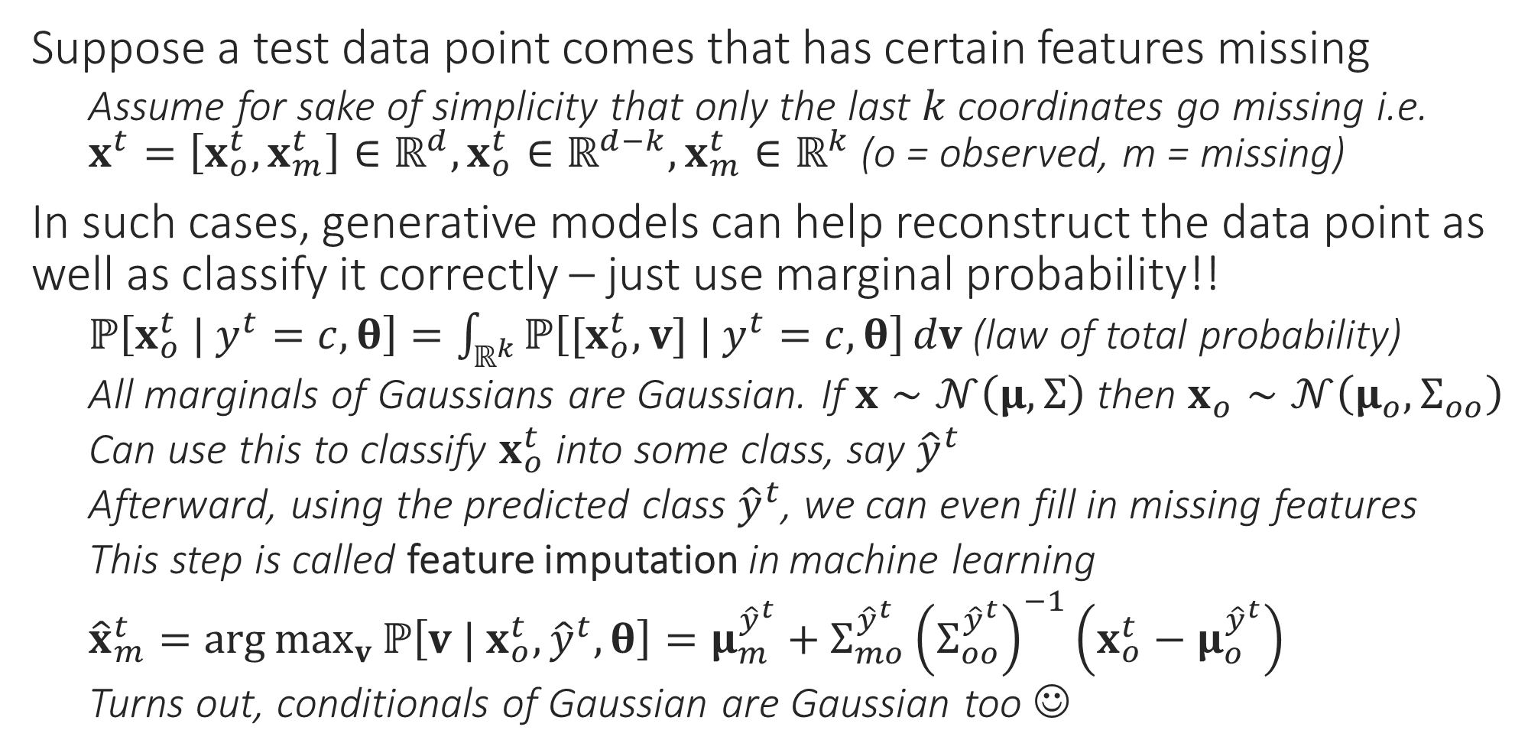
Generative Learning for Missing Data
What if I don’t know which coordinates are missing (e.g. a pixel in an image is white – is it because it was supposed to be white or is it because the color information for that pixel is missing). What can we do then?
Suppose a test data point comes that has certain features missing
Assume for sake of simplicity that only the last $k$ coordinates go missing i.e. $x^{t}=\left[x_{o}^{t},x_{m}^{t}\right]∈ℝ^{d},x_{o}^{t}∈ℝ^{d−k},x_{m}^{t}∈ℝ^{k}$ (o = observed, m = missing)
In such cases, generative models can help reconstruct the data point as well as classify it correctly – just use marginal probability!!
$ℙ\left[x_{o}^{t} | y^{t}=c,θ\right]=\int_{ℝ^{k}}{ℙ\left[{[x}_{o}^{t},v] | y^{t}=c,θ\right]}dv$ (law of total probability)
All marginals of Gaussians are Gaussian. If $x∼𝒩\left(μ,Σ\right)$ then $x_{o}∼𝒩\left(μ_{o},Σ_{oo}\right)$
Can use this to classify $x_{o}^{t}$ into some class, say ${\hat{y}}^{t}$
Afterward, using the predicted class ${\hat{y}}^{t}$, we can even fill in missing features
This step is called feature imputation in machine learning
${\hat{x}}_{m}^{t}=\arg{\max_{v}{ℙ\left[v | x_{o}^{t},{\hat{y}}^{t},θ\right]}}=μ_{m}^{{\hat{y}}^{t}}+Σ_{mo}^{{\hat{y}}^{t}}{\left(Σ_{oo}^{{\hat{y}}^{t}}\right)}^{−1}\left(x_{o}^{t}−μ_{o}^{{\hat{y}}^{t}}\right)$
Turns out, conditionals of Gaussian are Gaussian too ☺
All these questions can be dealt with (to some extent) but require more sophisticated methods. Entire sub-areas of ML e.g. adversarial learning, robust learning are devoted to these
What if my training data is itself incomplete, e.g. has missing features or even completely wrong labels. What if these corruptions are adversarial i.e. the result of mischief designed to make the ML algo fail?

Slide 13
Learning with Kernels
These are learning techniques that involve non-linear models e.g. classifiers with non-linear decision boundaries, regressors that predicts the label using non-linear functions

Slide 14
When should I use kernels?
Kernel methods are a good option to try whenever linear models do a poor job on our data
A non-linear classifier is needed
Linear classifier fits excellently!
All linear classifiers would do horribly!
Even with a few outliers, a linear classifier still fits decently

Slide 15


When should I use kernels?
Kernel methods are a good option to try whenever linear models do a poor job on our data
All linear regressors would do horribly!
A non-linear regressor is needed
Linear regressor fits excellently!
Even with some noise, linear regressor still fits very well!

Slide 16
When should I use kernels?
Kernel methods are a good option to try whenever linear models do a poor job on our data
However, k-means always produces linear cluster assignment boundaries
Non-linear cluster assignment boundaries needed
K-means clusters data very well
K-means would do very badly

Slide 17
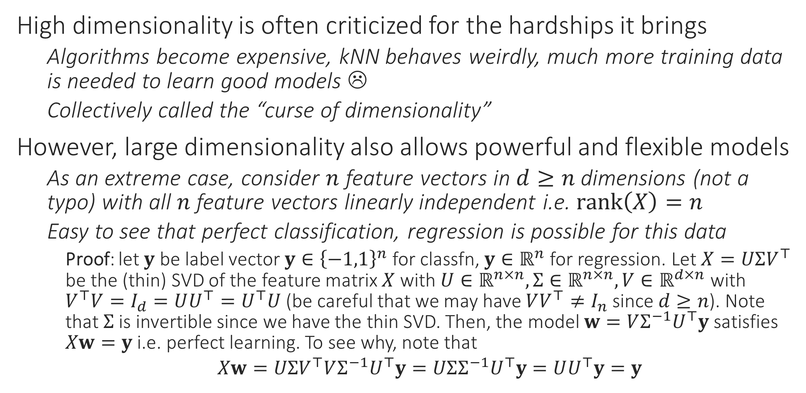
The Blessing of Dimensionality
High dimensionality is often criticized for the hardships it brings
Algorithms become expensive, kNN behaves weirdly, much more training data is needed to learn good models ☹
Collectively called the “curse of dimensionality”
However, large dimensionality also allows powerful and flexible models
As an extreme case, consider $n$ feature vectors in $d≥n$ dimensions (not a typo) with all $n$ feature vectors linearly independent i.e. $rank\left(X\right)=n$
Easy to see that perfect classification, regression is possible for this data
Proof: let $y$ be label vector $y∈{\left\{−1,1\right\}}^{n}$ for classfn, $y∈ℝ^{n}$ for regression. Let $X=UΣV^{⊤}$ be the (thin) SVD of the feature matrix $X$ with $U∈ℝ^{n×n},Σ∈ℝ^{n×n},V∈ℝ^{d×n}$ with $V^{⊤}V=I_{d}=UU^{⊤}=U^{⊤}U$ (be careful that we may have $VV^{⊤}≠I_{n}$ since $d≥n$). Note that $Σ$ is invertible since we have the thin SVD. Then, the model $w=VΣ^{−1}U^{⊤}y$ satisfies $Xw=y$ i.e. perfect learning. To see why, note that
$Xw=UΣV^{⊤}VΣ^{−1}U^{⊤}y=UΣΣ^{−1}U^{⊤}y=UU^{⊤}y=y$

Slide 18

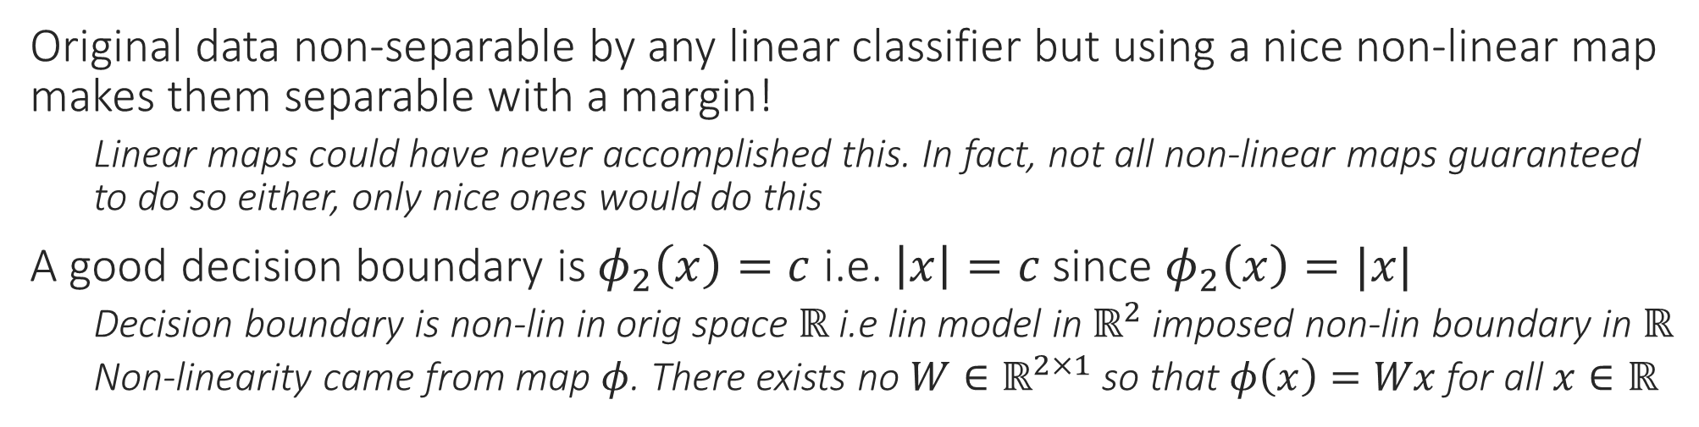
Non-linear Classification
Original data non-separable by any linear classifier but using a nice non-linear map makes them separable with a margin!
Linear maps could have never accomplished this. In fact, not all non-linear maps guaranteed to do so either, only nice ones would do this
A good decision boundary is $φ_{2}\left(x\right)=c$ i.e. $\left|x\right|=c$ since $φ_{2}\left(x\right)=|x|$
Decision boundary is non-lin in orig space $ℝ$ i.e lin model in $ℝ^{2}$ imposed non-lin boundary in $ℝ$
Non-linearity came from map $φ$. There exists no $W∈ℝ^{2×1}$ so that $φ\left(x\right)=Wx$ for all $x∈ℝ$

Slide 19

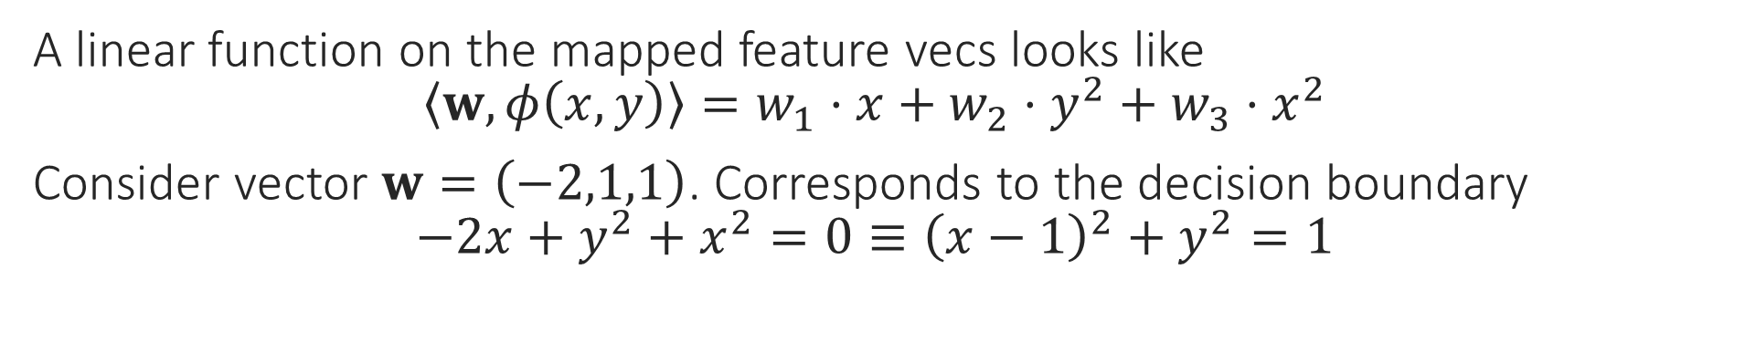
Non-linear Classification
A linear function on the mapped feature vecs looks like $\left\langle w,φ\left(x,y\right)\right\rangle =w_{1}⋅x+w_{2}⋅y^{2}+w_{3}⋅x^{2}$
Consider vector $w=\left(−2,1,1\right)$. Corresponds to the decision boundary $−2x+y^{2}+x^{2}=0≡{\left(x−1\right)}^{2}+y^{2}=1$

Slide 20
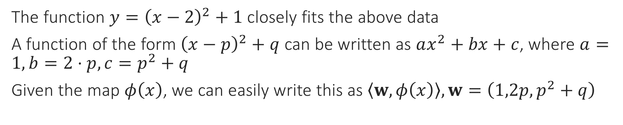
Non-linear Regression
The function $y={\left(x−2\right)}^{2}+1$ closely fits the above data
A function of the form ${\left(x−p\right)}^{2}+q$ can be written as $ax^{2}+bx+c$, where $a=1,b=2⋅p,c=p^{2}+q$
Given the map $φ\left(x\right)$, we can easily write this as $\left\langle w,φ\left(x\right)\right\rangle ,w=\left(1,2p,p^{2}+q\right)$

Slide 21
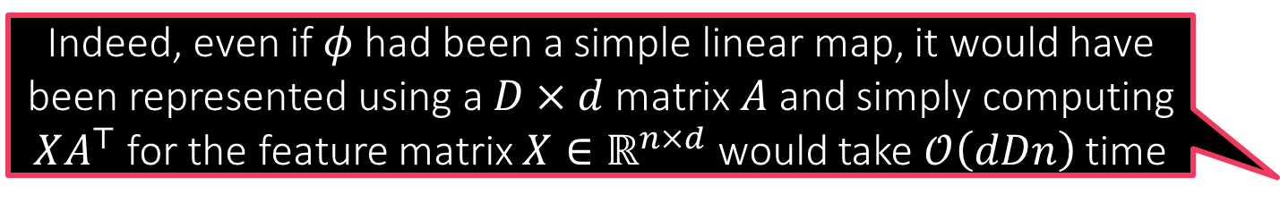
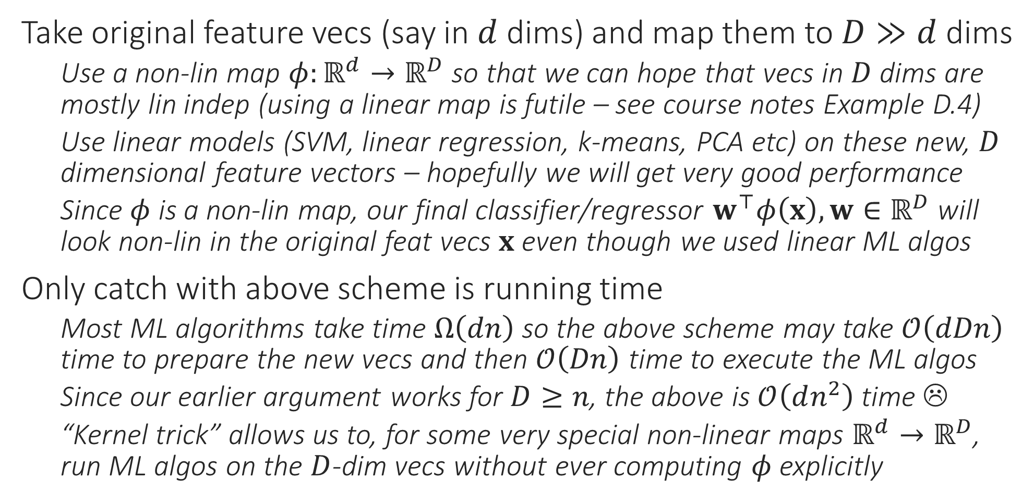
The Kernel Trick
Take original feature vecs (say in $d$ dims) and map them to $D≫d$ dims
Use a non-lin map $φ:ℝ^{d}→ℝ^{D}$ so that we can hope that vecs in $D$ dims are mostly lin indep (using a linear map is futile – see course notes Example D.4)
Use linear models (SVM, linear regression, k-means, PCA etc) on these new, $D$ dimensional feature vectors – hopefully we will get very good performance
Since $φ$ is a non-lin map, our final classifier/regressor $w^{⊤}φ\left(x\right),w∈ℝ^{D}$ will look non-lin in the original feat vecs $x$ even though we used linear ML algos
Only catch with above scheme is running time
Most ML algorithms take time $Ω\left(dn\right)$ so the above scheme may take $𝒪\left(dDn\right)$ time to prepare the new vecs and then $𝒪\left(Dn\right)$ time to execute the ML algos
Since our earlier argument works for $D≥n$, the above is $𝒪\left(dn^{2}\right)$ time ☹
“Kernel trick” allows us to, for some very special non-linear maps $ℝ^{d}→ℝ^{D}$, run ML algos on the $D$-dim vecs without ever computing $φ$explicitly
Indeed, even if $φ$ had been a simple linear map, it would have been represented using a $D×d$ matrix $A$ and simply computing $XA^{⊤}$ for the feature matrix $X∈ℝ^{n×d}$ would take $𝒪\left(dDn\right)$ time

Slide 22
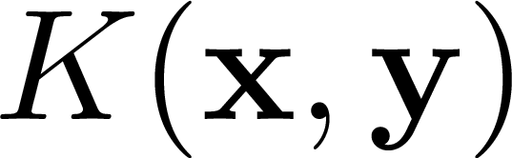
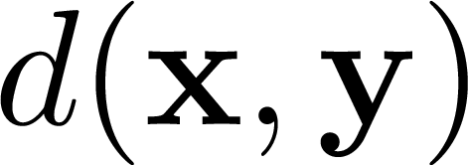
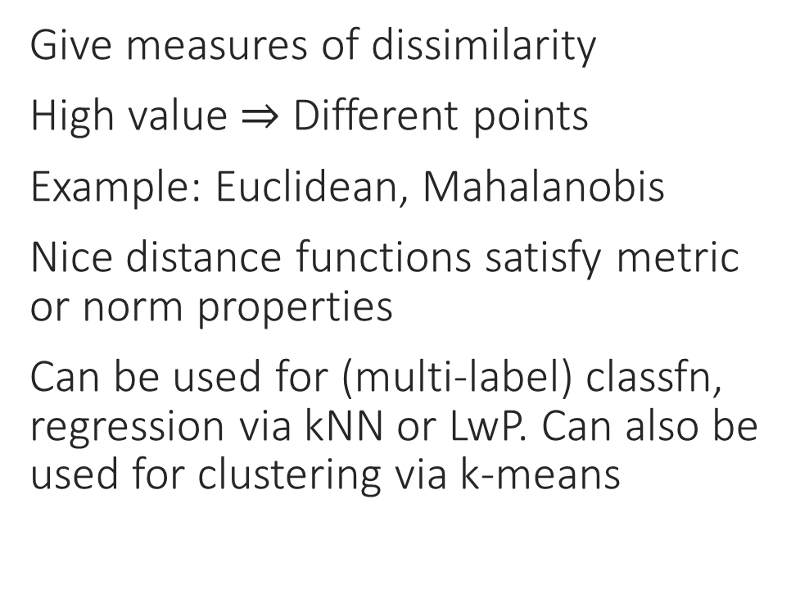
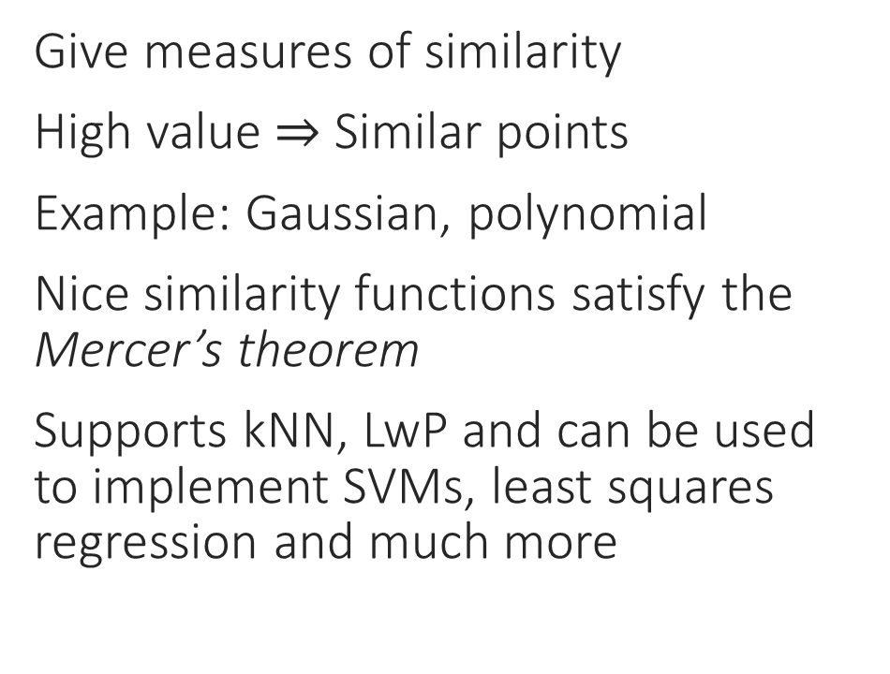
Kernels vs Distance Measures
Kernels
Distance measures
Give measures of similarity
High value $⇒$ Similar points
Example: Gaussian, polynomial
Nice similarity functions satisfy the Mercer’s theorem
Supports kNN, LwP and can be used to implement SVMs, least squares regression and much more
Give measures of dissimilarity
High value $⇒$ Different points
Example: Euclidean, Mahalanobis
Nice distance functions satisfy metric or norm properties
Can be used for (multi-label) classfn, regression via kNN or LwP. Can also be used for clustering via k-means

Slide 23
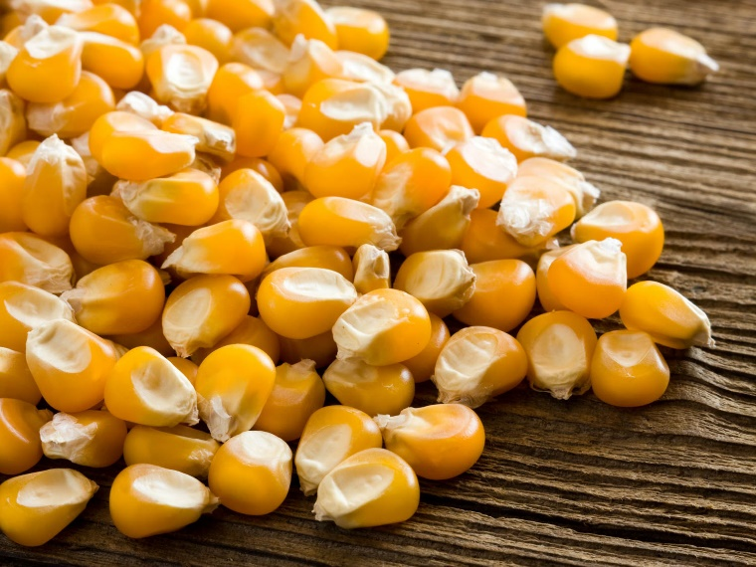
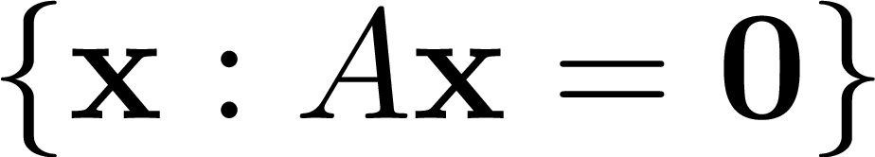

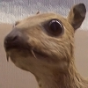


Kernels and Kernels
Kernel of linear transformation
✓
Kernels of corn
$$\left[\begin{matrix}0 & −1 & 0 \\ −1 & 5 & −1 \\ 0 & −1 & 0\end{matrix}\right]$$
Convolution kernels (masks)
OS Kernel

Slide 24

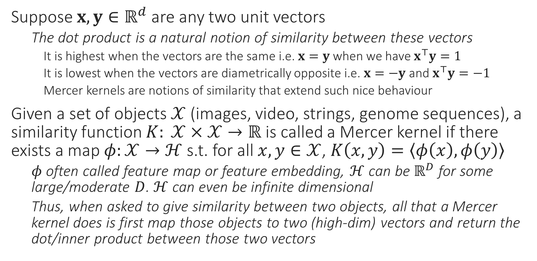
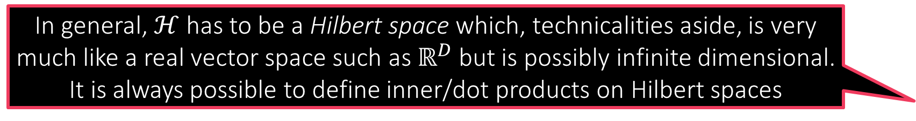
Mercer Kernels
In general, $ℋ$ has to be a Hilbert space which, technicalities aside, is very much like a real vector space such as $ℝ^{D}$ but is possibly infinite dimensional. It is always possible to define inner/dot products on Hilbert spaces
Suppose $x,y∈ℝ^{d}$ are any two unit vectors
The dot product is a natural notion of similarity between these vectors
It is highest when the vectors are the same i.e. $x=y$ when we have $x^{⊤}y=1$
It is lowest when the vectors are diametrically opposite i.e. $x=−y$ and $x^{⊤}y=−1$
Mercer kernels are notions of similarity that extend such nice behaviour
Given a set of objects $𝒳$ (images, video, strings, genome sequences), a similarity function $K: 𝒳×𝒳→ℝ$ is called a Mercer kernel if there exists a map $φ:𝒳→ℋ$ s.t. for all $x,y∈𝒳$, $K\left(x,y\right)=\left\langle φ\left(x\right),φ\left(y\right)\right\rangle$
$φ$ often called feature map or feature embedding, $ℋ$ can be $ℝ^{D}$ for some large/moderate $D$. $ℋ$ can even be infinite dimensional
Thus, when asked to give similarity between two objects, all that a Mercer kernel does is first map those objects to two (high-dim) vectors and return the dot/inner product between those two vectors

