Slide 1
Deep Learning

Slide 2





Doing Deep Learning
Number of hidden layers, number of nodes in hidden layers are treated as hyperparameters
Number of output nodes is decided according to application
Regression: only one node, no activation
Binary classification: only one node with sigmoid activation
Multi-classification: $C$ nodes with softmax activation
Multi-label classification: $L$ nodes each with sigmoid classification
FC Layer
$$w$$
$$φ\left(x,H\right)$$
Hidden Layers
$$H$$
$$x$$

Slide 3


Doing Deep Learning
Final output of NN like $w^{⊤}φ\left(x,H\right)$
Loss function $ℒ\left(w,H\right)=\frac{1}{n}⋅\sum_{i=1}^{n}{ℓ\left(y_{i},w^{⊤}φ\left(x^{i},H\right)\right)}$
Training done using mini-batch SGD
Let’s call $θ≝\left(w,H\right)$
$θ^{t+1}←θ^{t}−∇_{θ}ℒ\left(θ^{t}\right)$
Careful application of chain rule – backprop
Step length chosen using Adam, NAG etc
Regularization done explicitly using regularizers and implicitly using dropout
FC Layer
$$w$$
$$φ\left(x,H\right)$$
Hidden Layers
$$H$$
$$x$$

Slide 4

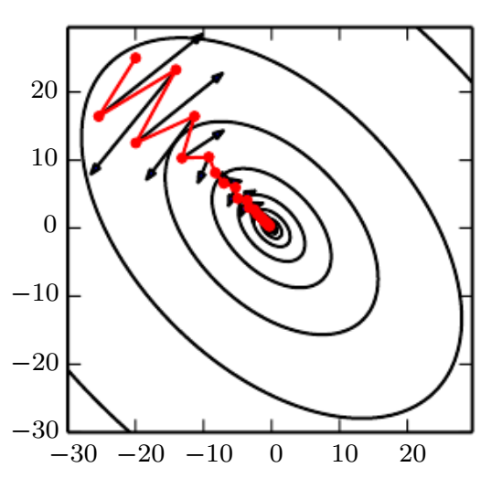

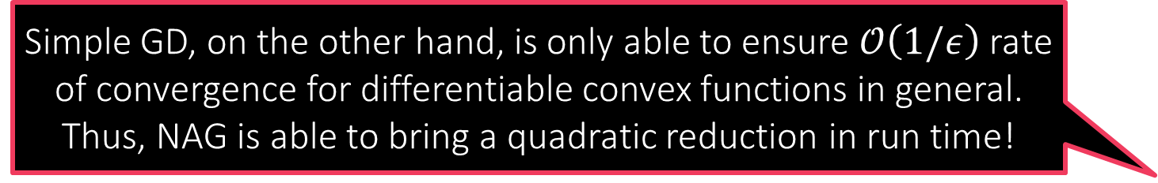
Adaptive Learning Rates
Simple GD, on the other hand, is only able to ensure $𝒪\left(1/ε\right)$ rate of convergence for differentiable convex functions in general. Thus, NAG is able to bring a quadratic reduction in run time!
Adaptive momentum-based methods popular (esp. for deep learning)
GD is known to experience oscillations even in a simple optimization problems such as least squares regression problem
These oscillations waste time and slow progress
Solution: introduce a “velocity” term to prevent GD from changing directions abruptly, thus avoiding oscillations $v^{t}={γ⋅v}^{t−1}+η⋅∇ℒ\left(θ^{t}\right)$ $θ^{t+1}←θ^{t}−v^{t}$
Nesterov’s accelerated gradient (NAG): pioneer method in the area of momentum methods
For differentiable convex problems, NAG ensures $ε$-convergence in just $𝒪\left(\sqrt{1/ε}\right)$ steps hence the name “accelerated” gradient

Slide 5

Adaptive Learning Rates
Adagrad (Duchi et al. 2011) – takes inspiration from Newton’s method
Recall: Newton’s method $θ^{t+1}←θ^{t}−{\left(∇^{2}ℒ\left(θ^{t}\right)\right)}^{−1}∇ℒ\left(θ^{t}\right)$
Key idea: replace $∇^{2}ℒ\left(θ^{t}\right)$ with a diagonal matrix $K^{t}$ – much cheaper
Use past updates to calculate $K^{t}$
$K^{t}=diag\left(k_{1}^{t}, …,k_{d}^{t}\right)$ where $k_{i}^{t}=\sqrt{ε+\sum_{τ=1}^{t}{{\left(g_{i}^{τ}\right)}^{2}}}$
If a coordinate got very vigorous updates in the past $\left|g_{i}^{τ}\right|≫0$, mellow its future updates
Reduces to $η_{t}≈η/t$ if all coordinates got roughly similar gradients in the past since then we would have had $k_{i}^{t}≈𝒪\left(t\right)$ for all $i∈\left[d\right]$
If some coordinate is static, not getting updated at all i.e. $g_{i}^{τ}≡0$ for all $τ$, then $k_{i}^{t}=\sqrt{ε}$ to prevent a divide-by-zero error when we take inverse of $K^{t}$

Slide 6

Adaptive Learning Rates
RMSProp (Hinton 2012) – apply momentum idea to Adagrad
$k_{i}^{t}=k_{i}^{t}=\sqrt{{ε+v}_{i}^{t}}$ where $v_{i}^{t}=γ⋅v_{i}^{t−1}+\left(1−γ\right)⋅{\left(g_{i}^{t}\right)}^{2}$
Adagrad sometimes forces step sizes to go down too much – this avoids that
Adam (Kingma and Ba 2014) – combine NAG and RMS-Prop
$g^{t}={\left(K^{t}\right)}^{−1}u^{t}$ where $K^{t}=diag\left(k_{1}^{t},…,k_{d}^{t}\right)$, $k_{i}^{t}=\sqrt{v_{i}^{t}}+ε$, and $u^{t}=γ_{1}⋅u^{t−1}+\left(1−γ_{1}\right)⋅g^{t}$ $v_{i}^{t}=γ_{2}⋅v_{i}^{t−1}+\left(1−γ_{2}\right)⋅{\left(g_{i}^{t}\right)}^{2}$
Also does some bias corrections (reweighting) on $K^{t}$ and $u^{t}$ (not shown above)
All these methods are readily available in libraries like PyTorch, TF etc

Slide 7

How to prevent overfitting?
Method 1: Regularize the weights
1.1: add an explicit regularization term $\arg{\min_{θ∈ℝ^{d}}{ℒ\left(θ\right)}}+λ⋅{\left\|θ\right\|}_{2}^{2}$
1.2: don’t allow any weight to get big (clip them) $\arg{\min_{{\left\|θ\right\|}_{∞}<r}{ℒ\left(θ\right)}}$
Most libraries implement these strategies themselves e.g. weight clipping
Sometimes even gradient coordinates are clipped to stabilize training
Method 2: Deliberately inject noise into the labels
For binary classification $y^{i}=0→y^{i}=ε$, $y^{i}=1→y^{i}=1−ε$
For regression problems, $y^{i}→y^{i}+ε^{i}$, where $ε^{i}∼𝒩\left(0,σ^{2}\right)$
Unlikely that a NN with limited # of nodes would be able to memorize noise
For NN setting these are just heuristics but when applied to nicer settings (e.g. linear models), label noise can be shown to be equivalent to regularization

Slide 8
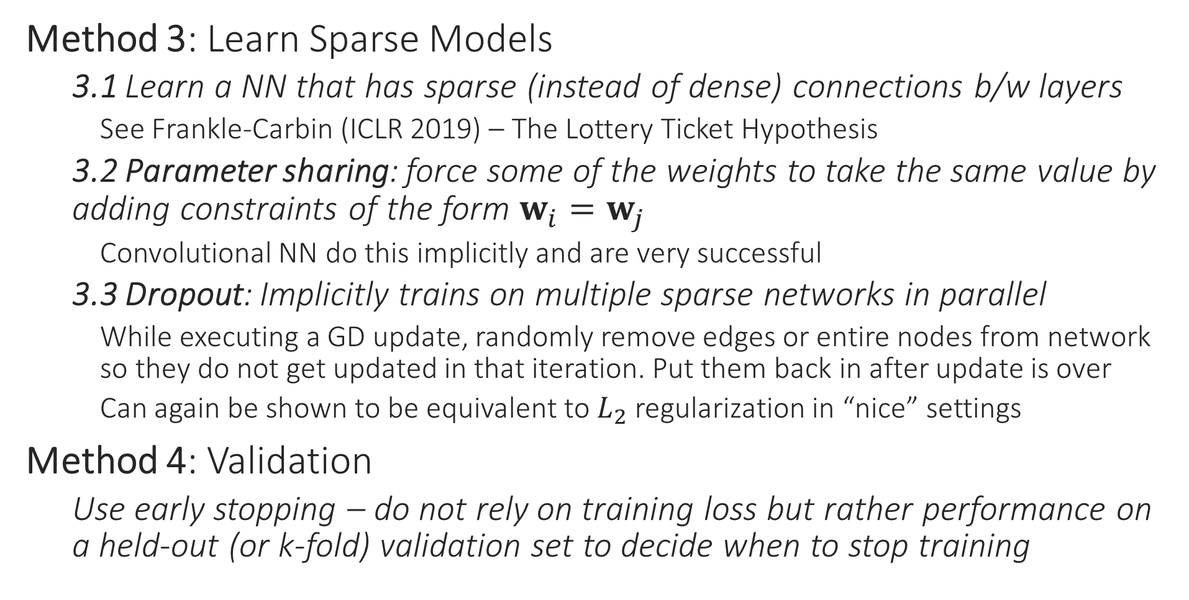
How to prevent overfitting?
Method 3: Learn Sparse Models
3.1 Learn a NN that has sparse (instead of dense) connections b/w layers
See Frankle-Carbin (ICLR 2019) – The Lottery Ticket Hypothesis
3.2 Parameter sharing: force some of the weights to take the same value by adding constraints of the form $w_{i}=w_{j}$
Convolutional NN do this implicitly and are very successful
3.3 Dropout: Implicitly trains on multiple sparse networks in parallel
While executing a GD update, randomly remove edges or entire nodes from network so they do not get updated in that iteration. Put them back in after update is over
Can again be shown to be equivalent to $L_{2}$ regularization in “nice” settings
Method 4: Validation
Use early stopping – do not rely on training loss but rather performance on a held-out (or k-fold) validation set to decide when to stop training

Slide 9
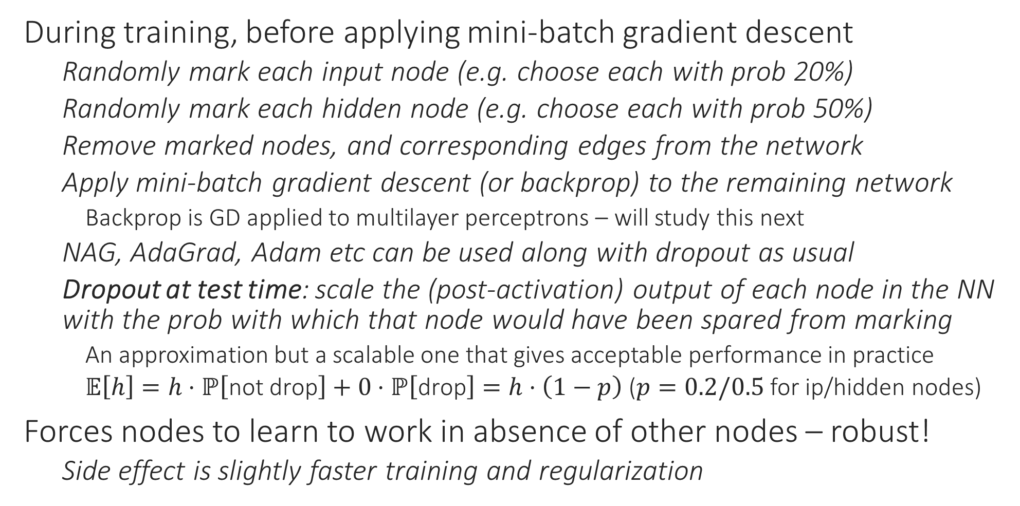
Dropout
During training, before applying mini-batch gradient descent
Randomly mark each input node (e.g. choose each with prob 20%)
Randomly mark each hidden node (e.g. choose each with prob 50%)
Remove marked nodes, and corresponding edges from the network
Apply mini-batch gradient descent (or backprop) to the remaining network
Backprop is GD applied to multilayer perceptrons – will study this next
NAG, AdaGrad, Adam etc can be used along with dropout as usual
Dropout at test time: scale the (post-activation) output of each node in the NN with the prob with which that node would have been spared from marking
An approximation but a scalable one that gives acceptable performance in practice
$𝔼\left[h\right]=h⋅ℙ\left[\text{not} \text{drop}\right]+0⋅ℙ\left[\text{drop}\right]=h⋅\left(1−p\right)$ ($p=0.2/0.5$ for ip/hidden nodes)
Forces nodes to learn to work in absence of other nodes – robust!
Side effect is slightly faster training and regularization

Slide 10
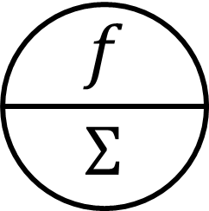



















Dropout at Work
$$id$$
$$id$$
$$id$$
$$id$$
$$id$$
16%
4%
4%
16%
16%
$$id$$
$$x_{1}$$
$$x_{2}$$
$$x_{2}$$
$$x_{1}$$
$$x_{1}$$
$$x_{2}$$
$$x_{1}$$
$$x_{2}$$
$$id$$
$$id$$
$$id$$
$$id$$
$$id$$
4%
4%
4%
4%
28%
$$x_{1}$$
$$x_{2}$$
$$x_{1}$$
$$x_{2}$$
$$x_{1}$$
$$x_{2}$$
In this toy example, 28% NN have no i/p nodes or no path connecting at least one i/p node to the o/p node i.e. cannot apply GD to them. For large networks, it is unlikely that sampling will result in such a disconnected network. In practice a large fraction of nodes do get retained

Slide 11
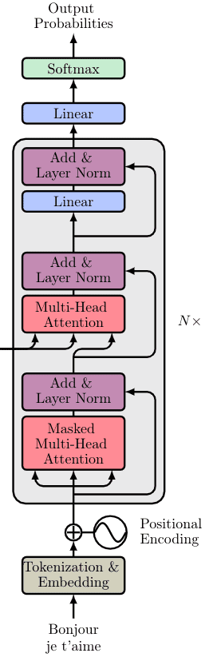
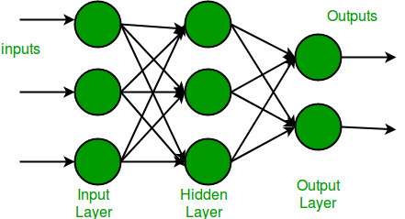
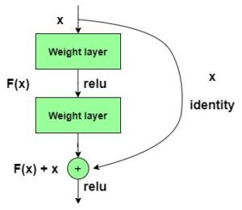
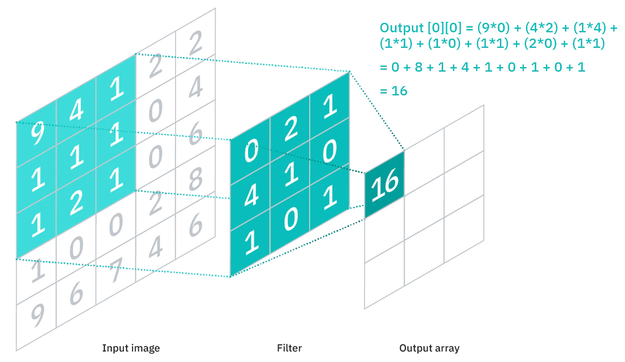

Popular layer types in deep learning
Features $φ\left(x,H\right)$ learnt by a deep network depend on the type of its hidden layers parametrized by $H$
perceptron layer
residual/skip layer
convolutional layer
transformer layer

Slide 12

Popular training strategies - pretraining
Entire network composed of $θ≝\left(w,H\right)$
Get $H$ from some other source
Huggingface, GitHub, previous year CS771 offerings ☺
Ensure $H$ was trained on a similar task as the one we are trying to solve
During train, freeze $H$ and only train $w$ – extremely fast!
Can also train $H$ jointly with $w$ – known as “fine-tuning” of $H$
Train only the top few layers of $H$ for speed
Can also train all layers of $H$ if pretraining task very different

Slide 13
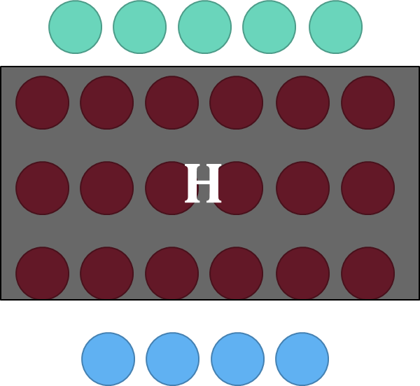





Popular (pre)training strategies – Siamese
Denote $d\left(i,j,H\right)≝$ ${\left\|φ\left(x^{i},H\right) −φ\left(x^{j},H\right) \right\|}_{2}$. Given a $C$-class problem, encourage $d\left(i,j,H\right)→0$ if $y^{i}=y^{j}$ else want $d\left(i,j,H\right)≫0$
Called Siamese models or two-tower models
Let $\left(i,j,k\right)$ be a triplet such that $y^{i}=y^{j}≠y^{k}$
Triplet loss function: ${\left[d\left(i,j,H\right)−d\left(i,k,H\right)+λ\right]}_{+}$
Contrastive loss function: $λ<Λ$
${\left[d\left(i,j,H\right)−λ\right]}_{+}+{\left[Λ−d\left(i,k,H\right)\right]}_{+}$
Popular in vision, recommendation, NLP
$$φ\left(x^{i},H\right)$$
$$φ\left(x^{j},H\right)$$
$$x^{i}$$
$$x^{j}$$

Slide 14

Popular (pre)training strategies – Cloze tasks
Very popular in training language models, graph models
Given an object, hide a portion and ask the NN to retrieve it
“I am wearing a green shirt” → “I am <MASK> a green shirt”
Also known as masked language modelling in NLP literature
Train network parameters $H$ so that
${\left\|φ\left(\text{I} \text{am}\text{ <}\text{MASK}\text{> }\text{a} \text{green} \text{shirt},H\right)−φ\left(\text{wearing},H\right)\right\|}_{2}→0$
Training often proceeds in Siamese style
To train graph models, can train network to predict neighbors

Slide 15
Recommendation Systems

Slide 16
Recommendation Systems
Recommendation Systems are ubiquitous in various fields
Social networks, e-commerce but also medicine, governance, services
RecSys face severe data imbalance as well as gigantic datasets
Extremely lucrative for monetization
Very active area with several conferences publishing works
RecSys, WSDM,ICML, NeurIPS, KDD, WWW
Will look at two approaches
Collaborative Filtering via Matrix Completion
Extreme Multilabel Classification
Will also look at how to perform online recommendations

Slide 17






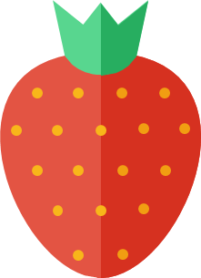






Abstract Problem Statement
There are users …
… and there are items …
Users come to us one at a time in no particular order
… and we need to recommend, to each user, items they will “like”
User tastes expected to be stable but may vary slowing across time

Slide 18
Applications of RecSys
User
sundarbans.com user
reddit.com user
Student
Patient
Search query
Advertiser
Items
sundarbans.com products
Reddit posts
Study material
Medicines
Advertisements
Search query to bid on
“Users” are often in millions and thousands may come each second
“Items” are often in millions and each user likes very few e.g. 5-10 items
Some items are popular but most items liked by very few e.g. 5-10 users

Slide 19
RecSys via Matrix Completion
Formulating recommendation as a matrix completion problem
Solving the problem using alternating optimization
Pros and Cons of this approach

Slide 20
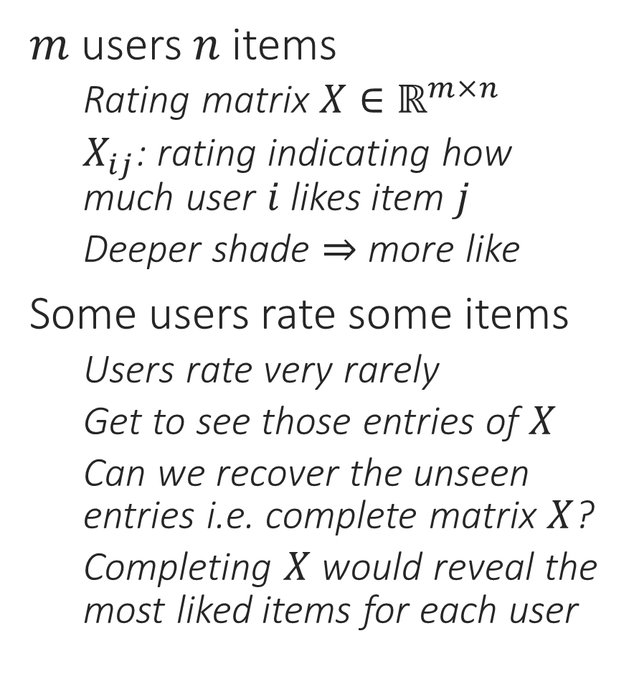
The Matrix Completion Problem
We do not assume we have access to any user/item features in this model (instead we will learn them by modelling them as latent variables). There are other models where we assume we are given user/item features.
$m$ users $n$ items
Rating matrix $X∈ℝ^{m×n}$
$X_{ij}$: rating indicating how much user $i$ likes item $j$
Deeper shade $⇒$ more like
Some users rate some items
Users rate very rarely
Get to see those entries of $X$
Can we recover the unseen entries i.e. complete matrix $X$?
Completing $X$ would reveal the most liked items for each user
?
?
?
?
?
?
?
?
?
?
?
?
?
?
?
?
?
?
?
?
?
?
?
?
?
?
?

Slide 21

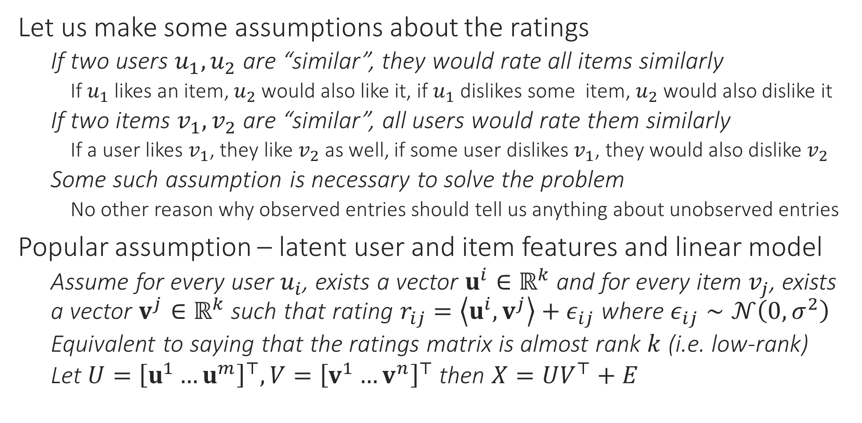
Low-rank Matrix Completion
$k$ is a hyperparameter in this model
Let us make some assumptions about the ratings
If two users $u_{1},u_{2}$ are “similar”, they would rate all items similarly
If $u_{1}$ likes an item, $u_{2}$ would also like it, if $u_{1}$ dislikes some item, $u_{2}$ would also dislike it
If two items $v_{1},v_{2}$ are “similar”, all users would rate them similarly
If a user likes $v_{1}$, they like $v_{2}$ as well, if some user dislikes $v_{1}$, they would also dislike $v_{2}$
Some such assumption is necessary to solve the problem
No other reason why observed entries should tell us anything about unobserved entries
Popular assumption – latent user and item features and linear model
Assume for every user $u_{i}$, exists a vector $u^{i}∈ℝ^{k}$ and for every item $v_{j}$, exists a vector $v^{j}∈ℝ^{k}$ such that rating $r_{ij}=\left\langle u^{i},v^{j}\right\rangle +ε_{ij}$ where $ε_{ij}∼𝒩\left(0,σ^{2}\right)$
Equivalent to saying that the ratings matrix is almost rank $k$ (i.e. low-rank)
Let $U={\left[u^{1}…u^{m}\right]}^{⊤},V={\left[v^{1}…v^{n}\right]}^{⊤}$ then $X=UV^{⊤}+E$

Slide 22

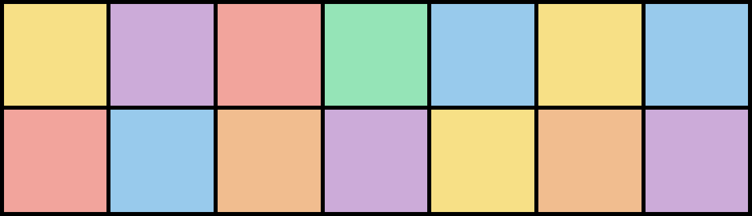
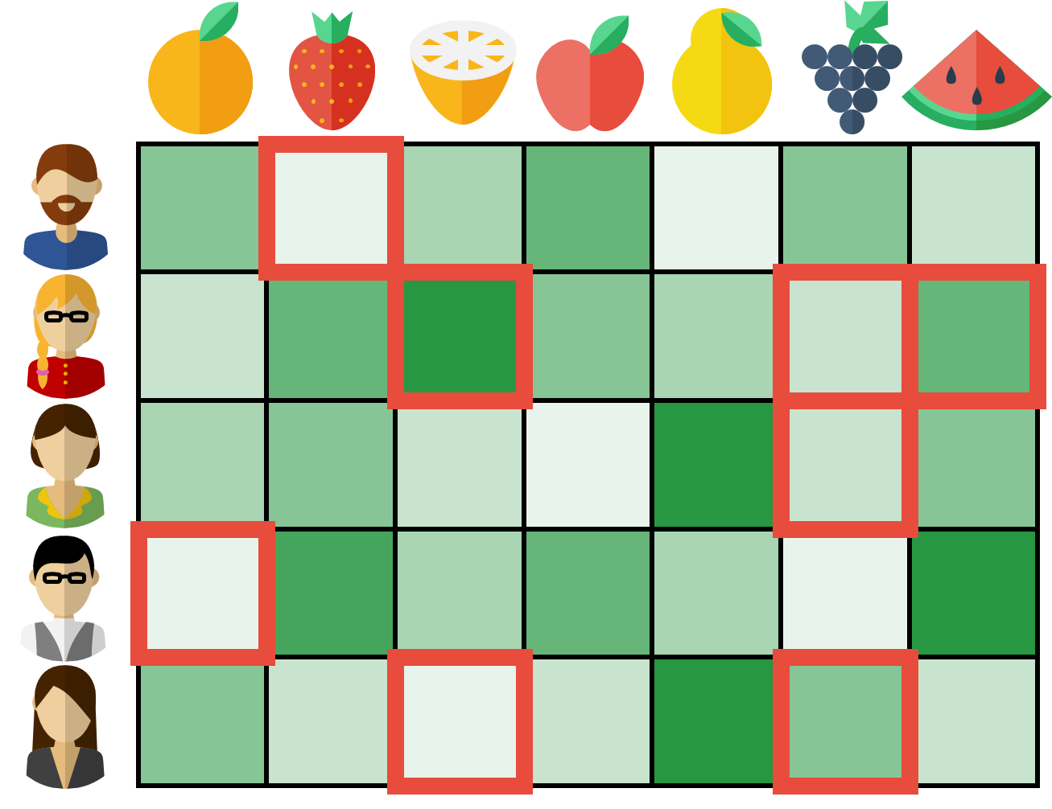

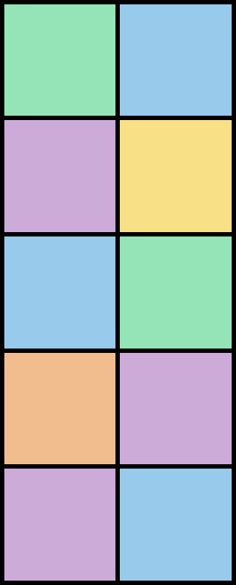





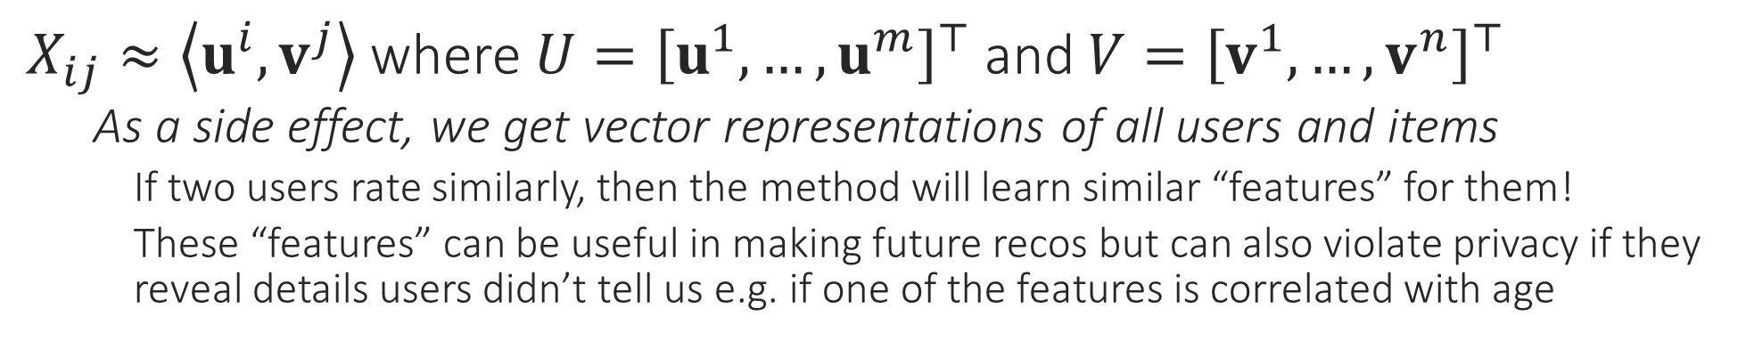
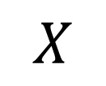
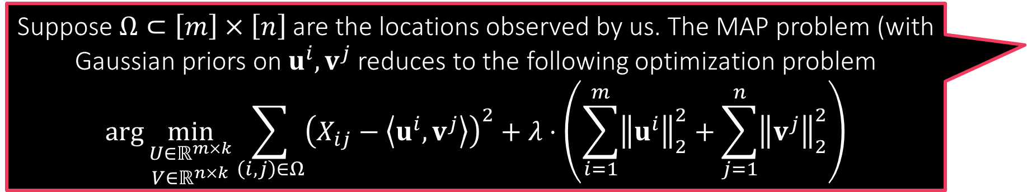
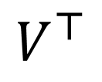
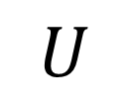

Low-rank Matrix Completion
$$k$$
$$k$$
$$V^{⊤}$$
ITEM FEATURES
Suppose $Ω⊂\left[m\right]×\left[n\right]$ are the locations observed by us. The MAP problem (with Gaussian priors on $u^{i},v^{j}$ reduces to the following optimization problem
$$\arg{\min_{\begin{aligned}U∈ℝ^{m×k} \\ V∈ℝ^{n×k}\end{aligned}}{\sum_{\left(i,j\right)∈Ω}{{\left(X_{ij}−\left\langle u^{i},v^{j}\right\rangle \right)}^{2}}+λ⋅\left(\sum_{i=1}^{m}{{\left\|u^{i}\right\|}_{2}^{2}}+\sum_{j=1}^{n}{{\left\|v^{j}\right\|}_{2}^{2}}\right)}}$$
$$U$$
$$X$$
USER FEATURES
$X_{ij}≈\left\langle u^{i},v^{j}\right\rangle$ where $U={\left[u^{1},…,u^{m}\right]}^{⊤}$ and $V={\left[v^{1},…,v^{n}\right]}^{⊤}$
As a side effect, we get vector representations of all users and items
If two users rate similarly, then the method will learn similar “features” for them!
These “features” can be useful in making future recos but can also violate privacy if they reveal details users didn’t tell us e.g. if one of the features is correlated with age
Alternating minimization is currently one of the fastest ways to solve this problem since if we fix $U$, solving for $V$ is just a bunch of ridge regression problems and vice versa!

Slide 23



AltMin for LRMC
ALTERNATING OPTIMIZATION
Observed locations $Ω$ and values $\left\{X_{ij}:\left(i,j\right)∈Ω\right\}$
Initialize $v^{1,0},v^{2,0},…,v^{n,0}$
For $t=1,2,…$
Update the user vectors for $i=1,…,m$ $u^{i}←{\left(\sum_{j:\left(i,j\right)∈Ω}{v^{j}{\left(v^{j}\right)}^{⊤}}+λ⋅I\right)}^{−1}\left(\sum_{j:\left(i,j\right)∈Ω}{X_{ij}⋅v^{j}}\right)$
Update the item vectors for $j=1,…,n$ $v^{j}←{\left(\sum_{i:\left(i,j\right)∈Ω}{u^{i}{\left(u^{i}\right)}^{⊤}}+λ⋅I\right)}^{−1}\left(\sum_{i:\left(i,j\right)∈Ω}{X_{ij}⋅u^{i}}\right)$
Repeat until convergence
Note: sum only over items that user $i$ rated (small for most users)
Note: sum only over users that rated item $j$ (small for most items)

Slide 24

Interesting Extensions
Can speed AltMin by using SGD to update user and item latent vectors
Would take only $𝒪\left(k\right)$ time per iteration
Suppose ratings are not real numbers but counts or Boolean
Can model ratings using a generalized linear models instead
$ℙ\left[r_{ij} |u^{i},v^{j}\right]∝\exp\left(r_{ij}⋅\left\langle u^{i},v^{j}\right\rangle −A\left(\left\langle u^{i},v^{j}\right\rangle \right)−h(r_{ij})\right)$
The model we studied becomes a special case where $ℙ\left[r_{ij} |u^{i},v^{j}\right]=𝒩\left(\left\langle u^{i},v^{j}\right\rangle ,σ^{2}\right)$
Instead of the alternations being ridge regression problems, they would now become GLM problems e.g. logistic regression problems (for Boolean ratings)
There also exist non-linear extensions to these
Dziugaite and Roy, Neural network matrix factorization, 2015
He et al, Neural collaborative Filtering, WWW 2017

Slide 25
Collaborative Filtering
Pros
Relies purely on behavioural data
Does not require users to submit personal information
Does not require sellers to submit item information
Collaborative method: lazy users benefit from active users
Cons
Relies purely on behavioural data
Cannot utilize user and item information even if present
Expensive to recompute matrix factorization again and again
Adding new users and items not straightforward (cold start problem)

Slide 26
RecSys via Multi-label Learning
Formulating recommendation as a labelling problem
Solving the problem at extremely large scales
Pros and Cons of this approach

Slide 27
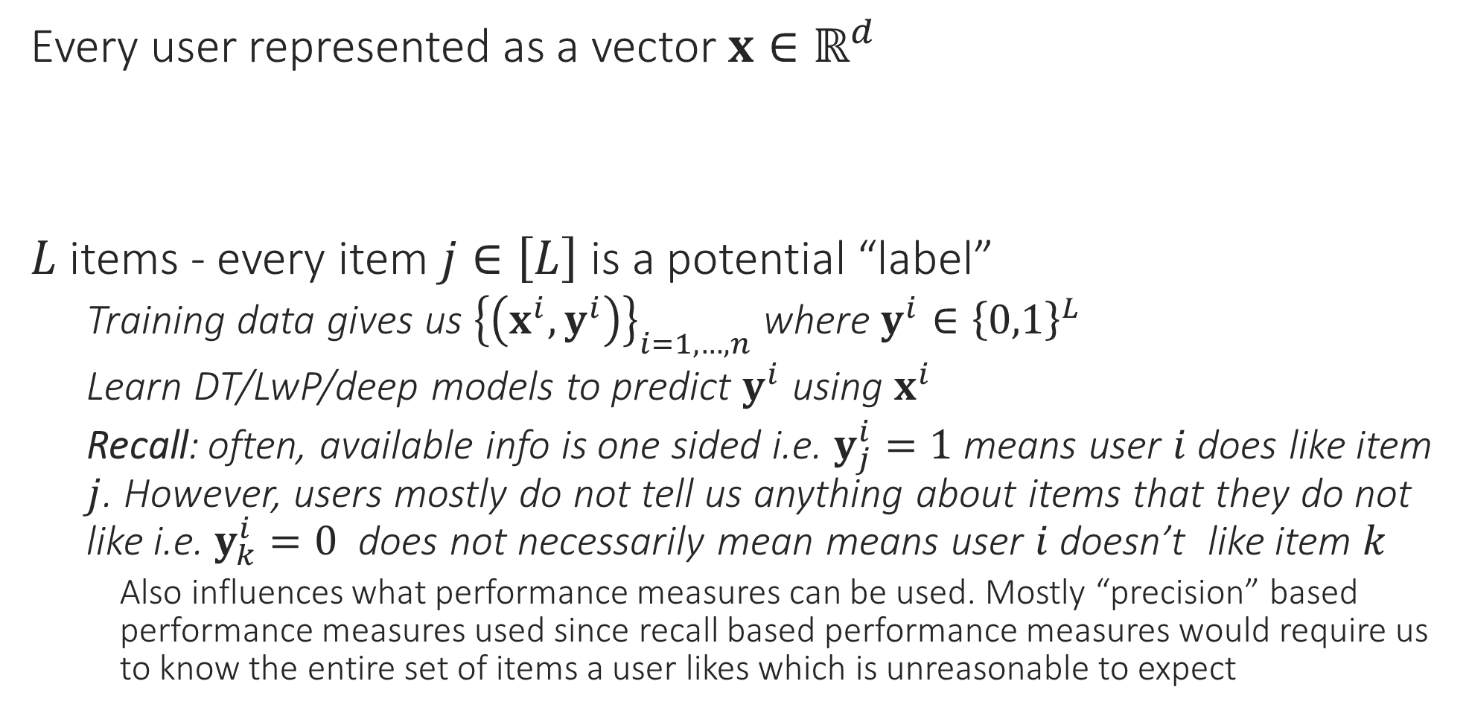
Recommendation as Multi-label Learning
Every user represented as a vector $x∈ℝ^{d}$
$L$ items - every item $j∈\left[L\right]$ is a potential “label”
Training data gives us ${\left\{\left(x^{i},y^{i}\right)\right\}}_{i=1,…,n}$ where $y^{i}∈{\left\{0,1\right\}}^{L}$
Learn DT/LwP/deep models to predict $y^{i}$ using $x^{i}$
Recall: often, available info is one sided i.e. $y_{j}^{i}=1$ means user $i$ does like item $j$. However, users mostly do not tell us anything about items that they do not like i.e. $y_{k}^{i}=0$ does not necessarily mean means user $i$ doesn’t like item $k$
Also influences what performance measures can be used. Mostly “precision” based performance measures used since recall based performance measures would require us to know the entire set of items a user likes which is unreasonable to expect

Slide 28

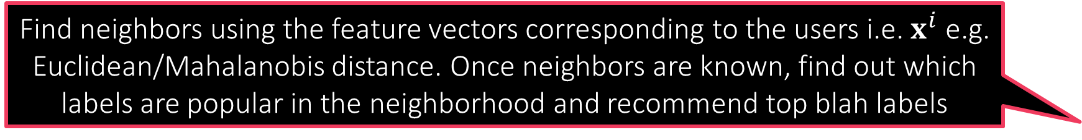
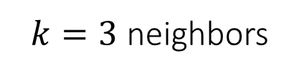
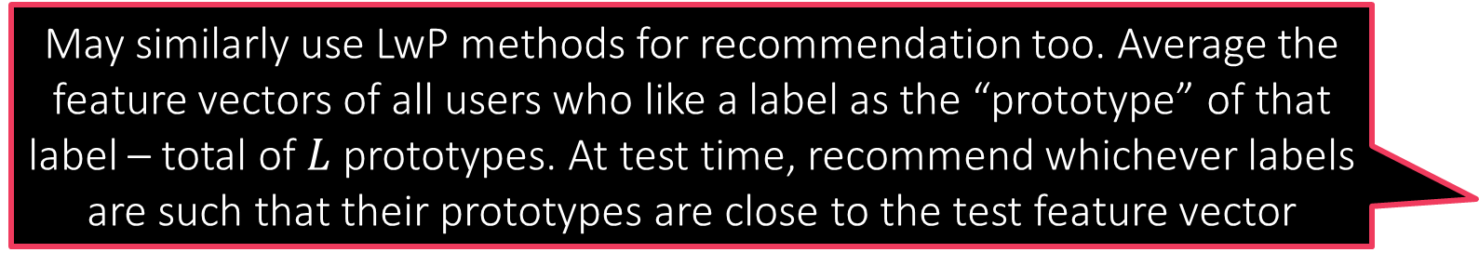
Recommendation using kNN
Find neighbors using the feature vectors corresponding to the users i.e. $x^{i}$ e.g. Euclidean/Mahalanobis distance. Once neighbors are known, find out which labels are popular in the neighborhood and recommend top blah labels
May similarly use LwP methods for recommendation too. Average the feature vectors of all users who like a label as the “prototype” of that label – total of $L$ prototypes. At test time, recommend whichever labels are such that their prototypes are close to the test feature vector
LwP/kNN methods may give better performance for rare labels which have extremely few users liking them
$k=3$ neighbors

Slide 29

Recommendation using DT
Instead of just storing a few active labels at leaves, can store how popular those labels are as well (e.g. count how many times each active label occurred in train points that reached that leaf) – can allow us to rank labels
$$=$$
i.e. …

Slide 30





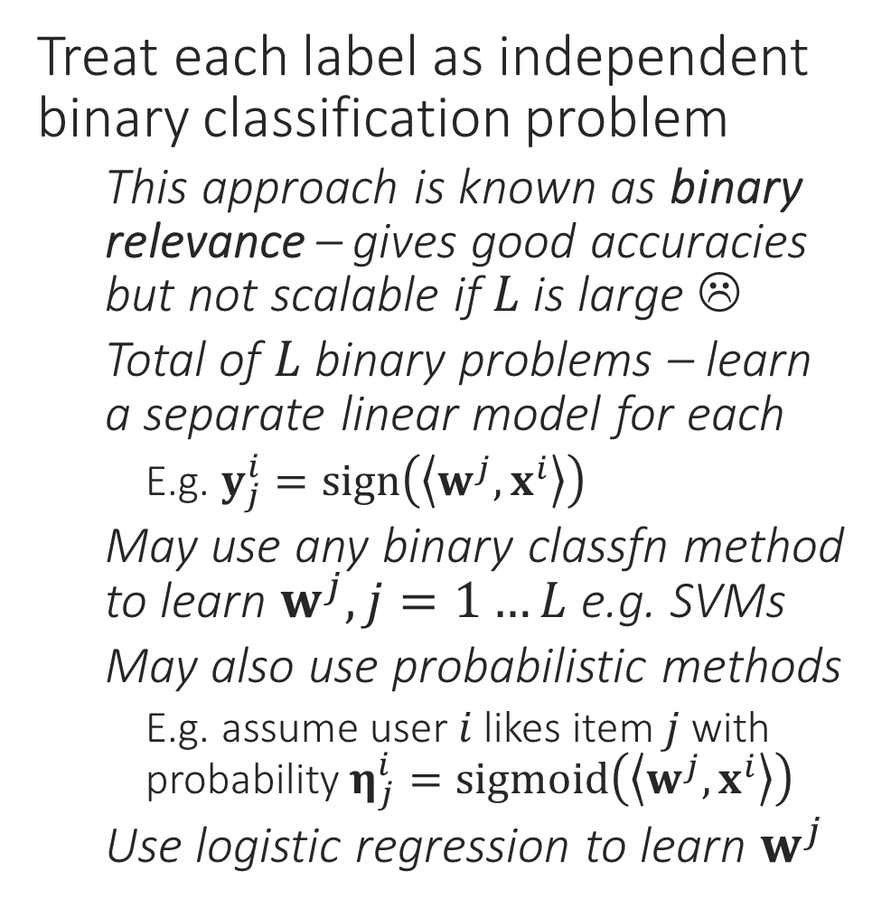
Recommendation using Linear Models
Treat each label as independent binary classification problem
This approach is known as binary relevance – gives good accuracies but not scalable if $L$ is large ☹
Total of $L$ binary problems – learn a separate linear model for each
E.g. $y_{j}^{i}=sign\left(\left\langle w^{j},x^{i}\right\rangle \right)$
May use any binary classfn method to learn $w^{j},j=1…L$ e.g. SVMs
May also use probabilistic methods
E.g. assume user $i$ likes item $j$ with probability $η_{j}^{i}=sigmoid\left(\left\langle w^{j},x^{i}\right\rangle \right)$
Use logistic regression to learn $w^{j}$
$$x^{i}∈ℝ^{d}$$
$$y^{i}∈{\left\{0,1\right\}}^{L}$$
$$η^{i}∈{\left[0,1\right]}^{L}$$

Slide 31
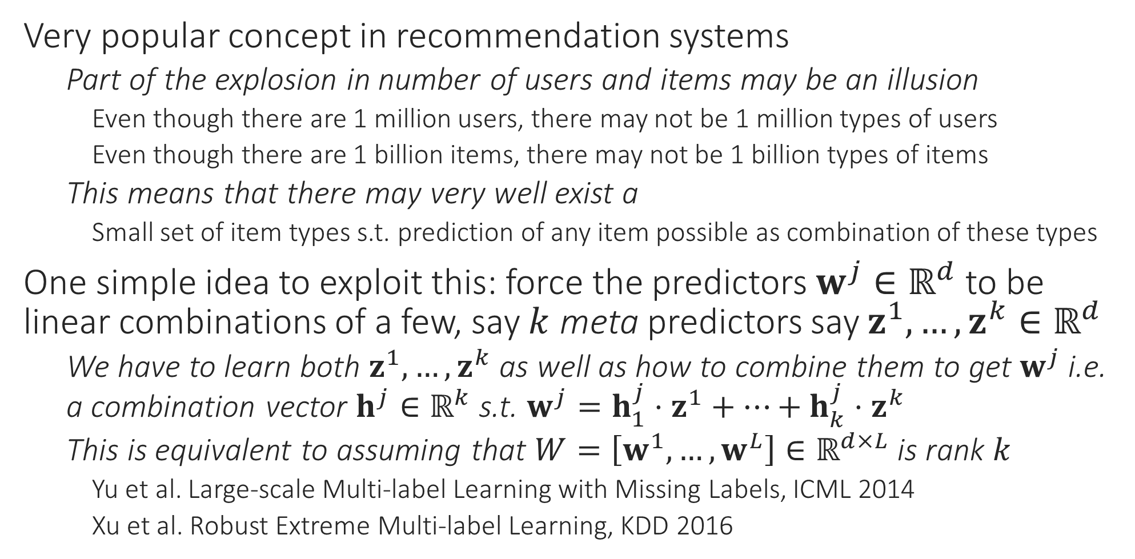
Recommendation using Latent Variables
Very popular concept in recommendation systems
Part of the explosion in number of users and items may be an illusion
Even though there are 1 million users, there may not be 1 million types of users
Even though there are 1 billion items, there may not be 1 billion types of items
This means that there may very well exist a
Small set of item types s.t. prediction of any item possible as combination of these types
One simple idea to exploit this: force the predictors $w^{j}∈ℝ^{d}$ to be linear combinations of a few, say $k$ meta predictors say $z^{1},…,z^{k}∈ℝ^{d}$
We have to learn both $z^{1},…,z^{k}$ as well as how to combine them to get $w^{j}$ i.e. a combination vector $h^{j}∈ℝ^{k}$ s.t. $w^{j}=h_{1}^{j}⋅z^{1}+…+h_{k}^{j}⋅z^{k}$
This is equivalent to assuming that $W=\left[w^{1},…,w^{L}\right]∈ℝ^{d×L}$ is rank $k$
Yu et al. Large-scale Multi-label Learning with Missing Labels, ICML 2014
Xu et al. Robust Extreme Multi-label Learning, KDD 2016

Slide 32



Recommendation using Latent Variables
0
+
1
+
1
+
0

Slide 33
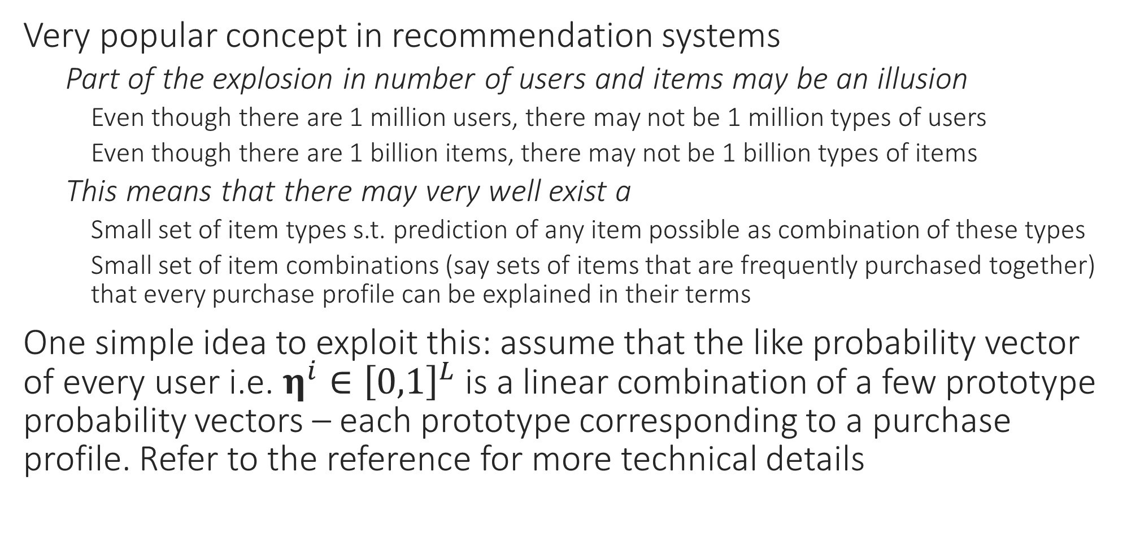
Recommendation using Latent Variables
Very popular concept in recommendation systems
Part of the explosion in number of users and items may be an illusion
Even though there are 1 million users, there may not be 1 million types of users
Even though there are 1 billion items, there may not be 1 billion types of items
This means that there may very well exist a
Small set of item types s.t. prediction of any item possible as combination of these types
Small set of item combinations (say sets of items that are frequently purchased together) that every purchase profile can be explained in their terms
One simple idea to exploit this: assume that the like probability vector of every user i.e. $η^{i}∈{\left[0,1\right]}^{L}$ is a linear combination of a few prototype probability vectors – each prototype corresponding to a purchase profile. Refer to the reference for more technical details

Slide 34




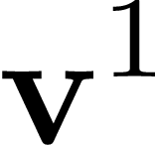
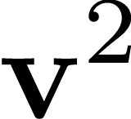
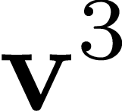
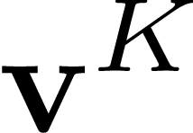

Recommendation using Latent Variables
+
+
+

Slide 35
Extreme Multi-label Classification
Pros
Very powerful – can extend to millions of items and users
State-of-the-art accuracies and very fast training and predictions
Indications that several major commercial systems use this in some form
Can utilize user and item features easily
Can add new users easily
Cons
No explicit collaboration – does not infer similarity of items/users
May pose an issue if user features are not very informative
Not straightforward to add new items
Recommendations can get stale with time
Common trick – retrain models frequently e.g. nightly, monthly

Slide 36

Endsem Exam
Nov 22 (Tuesday), 8AM, L1,2,3,4,5,6,7
Only for registered students (no auditors)
Open notes (handwritten only)
No mobile phones, tablets etc
Bring your institute ID card
Syllabus:
All videos/slides uploaded to YouTube/GitHub by 20th Nov
DS content (slides, code) for DS 1 – 13.
See previous year’s GitHub for practice

