Slide 1
Learning a Linear Classifier

Slide 2

Authentication by Secret Questions
Give me your device ID and answer the following questions
10111100
00110010
10001110
00010100
…
TS271828182845
1
0
1
0
…
SERVER
DEVICE

Slide 3


Physically Unclonable Functions
0.50ms
These tiny differences are difficult to predict or clone
0.55ms
Then these could act as the fingerprints for the devices!

Slide 4
Arbiter PUFs
If the top signal reaches the finish line first, the “answer” to this question is 0, else if the bottom signal reaches first, the “answer” is 1
Question: 1011
1
0
1
1
1
?

Slide 5
Arbiter PUFs
If the top signal reaches the finish line first, the “answer” to this question is 0, else if the bottom signal reaches first, the “answer” is 1
Question: 0110
0
1
1
0
0
?

Slide 6


Linear Models
We have $Δ_{63}=w_{0} ⋅x_{0}+w_{1}⋅x_{1}+…+w_{63}⋅x_{63}+β_{63}=w^{⊤}x+b$
where $x_{i}=d_{i}⋅d_{i+1}⋅…⋅d_{63}$ $w_{0}=α_{0}$ $w_{i}=α_{i}+β_{i−1} \left(for i>0\right)$
If $Δ_{63}<0$, upper signal wins and answer is 0
If $Δ_{63}>0$, lower signal wins and answer is 1
Thus, answer is simply $\frac{sign\left(w^{⊤}x+b\right)+1}{2}$
$$w$$
This is nothing but a linear classifier!

Slide 7


The “best” Linear Classifier
It seems infinitely many classifiers perfectly classify the data. Which one should I choose?
Indeed! Such models would be very brittle and might misclassify test data (i.e. predict the wrong class), even those test data which look very similar to train data
It is better to not select a model whose decision boundary passes very close to a training data point

Slide 8
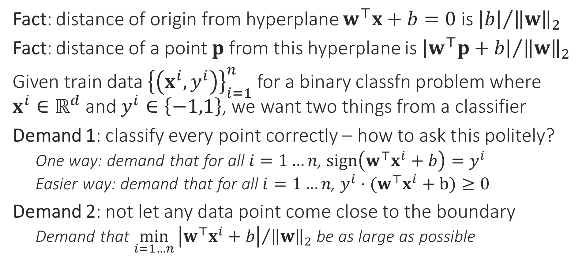
Large Margin Classifiers
Fact: distance of origin from hyperplane $w^{⊤}x+b=0$ is ${\left|b\right|}/{{\left\|w\right\|}_{2}}$
Fact: distance of a point $p$ from this hyperplane is ${\left|w^{⊤}p+b\right|}/{{\left\|w\right\|}_{2}}$
Given train data ${\left\{\left(x^{i},y^{i}\right)\right\}}_{i=1}^{n}$ for a binary classfn problem where $x^{i}∈ℝ^{d}$ and $y^{i}∈\left\{−1,1\right\}$, we want two things from a classifier
Demand 1: classify every point correctly – how to ask this politely?
One way: demand that for all $i=1…n$, $sign\left(w^{⊤}x^{i}+b\right)=y^{i}$
Easier way: demand that for all $i=1…n$, $y^{i}⋅(w^{⊤}x^{i}+b)≥0$
Demand 2: not let any data point come close to the boundary
Demand that $\min_{i=1…n}{{\left|w^{⊤}x^{i}+b\right|}/{{\left\|w\right\|}_{2}}}$ be as large as possible

Slide 9



Support Vector Machines
“
Just a fancy way of saying
Please find me a linear classifier that perfectly classifies the train data while keeping data points as far away from the hyperplane as possible
The mathematical way of writing this request is the following
$\max_{w,b}\left\{\min_{i=1…n}{{\left|w^{⊤}x^{i}+b\right|}/{{\left\|w\right\|}_{2}}}\right\}$
such that $y^{i}⋅(w^{⊤}x^{i}+b)≥0$ for all $i=1…n$
Let us simplify this optimization problem
“
Constraints
Objective
This is known as an optimization problem with an objective and lots of constraints
This looks so complicated, how will I ever find a solution to this optimization problem?

Slide 10
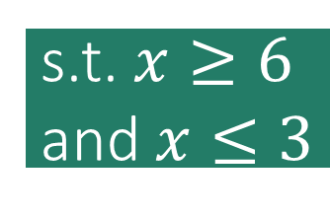
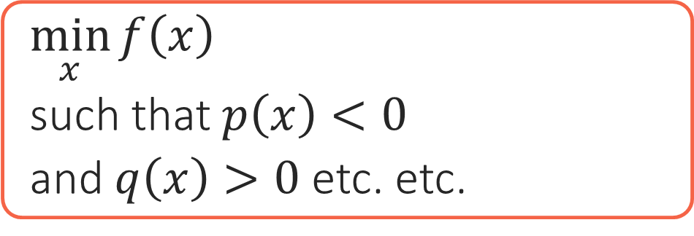

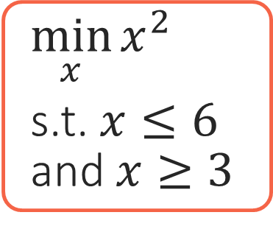
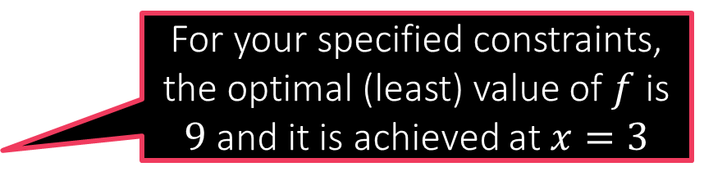

Constrained Optimization 101
Constraints are usually specified using math equations. The set of points that satisfy all the constraints is called the feasible set of the optimization problem
How WE MUST SPEAK TO MS M
How we speak to a human
Objective
Constraints
$\min_{x}{f\left(x\right)}$
such that $p\left(x\right)<0$
and $q\left(x\right)>0$ etc. etc.
I want to find an unknown $x$ that gives me the best value according to this function $f$
Oh! btw, not any $x$ would do! $x$ must satisfy these conditions
All I am saying is, of the values of $x$ that satisfy my conditions, find me the one that gives the best value according to $f$
You optimization problem has no solution since no point satisfies all your constraints ☹
For your specified constraints, the optimal (least) value of $f$ is $9$ and it is achieved at $x=3$
Feasible set is empty!
$\min_{x}{x^{2}}$
s.t. $x≤6$ and $x≥3$
Feasible set is the interval $\left[3,6\right]$
s.t. $x≥6$ and $x≤3$
3 6

Slide 11

Back to SVMs
Assume there do exist params that perfectly classify all train data
Consider one such params $\left(w,b\right)$ which classifies train data perfectly
Now, ${\left|w^{⊤}x^{i}+b\right|}/{{\left\|w\right\|}_{2}}={\left|y^{i}⋅\left(w^{⊤}x^{i}+b\right)\right|}/{{\left\|w\right\|}_{2}}$ as $y^{i}∈\left\{−1,1\right\}$
Thus, geometric margin is same as $\min_{i=1…n}{{\left|y^{i}⋅\left(w^{⊤}x^{i}+b\right)\right|}/{{\left\|w\right\|}_{2}}}=$ $\min_{i=1…n}{{y^{i}⋅\left(w^{⊤}x^{i}+b\right)}/{{\left\|w\right\|}_{2}}}$ since model has perfect classification!
We will use this useful fact to greatly simplify the optimization problem
What if train data is non-linearly separable i.e no linear classifier can perfectly classify it? For example
We will remove this assumption later

Slide 12
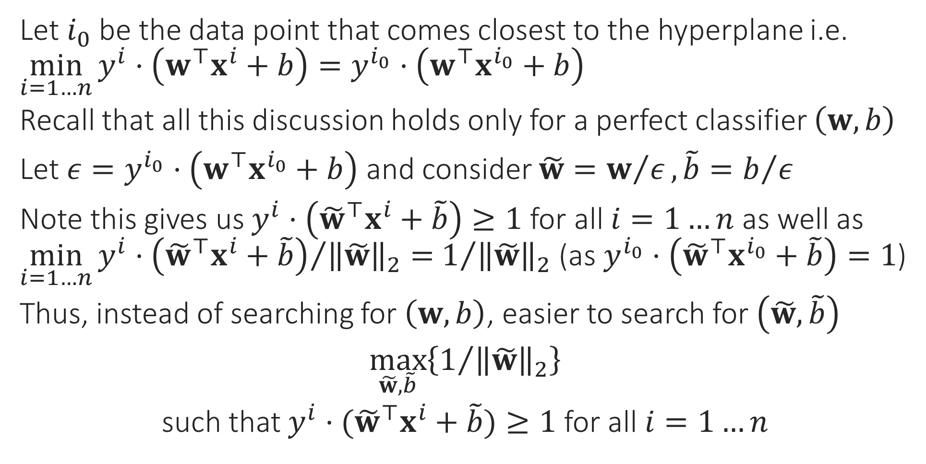


Support Vector Machines
Let $i_{0}$ be the data point that comes closest to the hyperplane i.e. $\min_{i=1…n}{y^{i}⋅\left(w^{⊤}x^{i}+b\right)}=y^{i_{0}}⋅\left(w^{⊤}x^{i_{0}}+b\right)$
Recall that all this discussion holds only for a perfect classifier $\left(w,b\right)$
Let $ε=y^{i_{0}}⋅\left(w^{⊤}x^{i_{0}}+b\right)$ and consider $\tilde{w}=w/ε, \tilde{b}=b/ε$
Note this gives us $y^{i}⋅\left({\tilde{w}}^{⊤}x^{i}+\tilde{b}\right)≥1$ for all $i=1…n$ as well as $\min_{i=1…n}{{y^{i}⋅\left({\tilde{w}}^{⊤}x^{i}+\tilde{b}\right)}/{{\left\|\tilde{w}\right\|}_{2}}}=$ $1/{{\left\|\tilde{w}\right\|}_{2}}$ (as $y^{i_{0}}⋅\left({\tilde{w}}^{⊤}x^{i_{0}}+\tilde{b}\right)=1$)
Thus, instead of searching for $\left(w,b\right)$, easier to search for $\left(\tilde{w},\tilde{b}\right)$
$\max_{\tilde{w},\tilde{b}}\left\{1/{{\left\|\tilde{w}\right\|}_{2}}\right\}$
such that $y^{i}⋅({\tilde{w}}^{⊤}x^{i}+\tilde{b})≥1$ for all $i=1…n$
$${}^{2}$$
$$\min_{\tilde{w},\tilde{b}}\left\{{\left\|\tilde{w}\right\|}_{2}\right\}$$

Slide 13


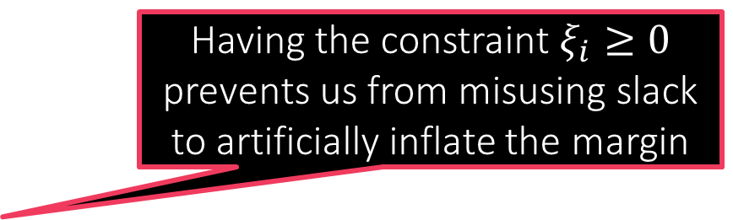

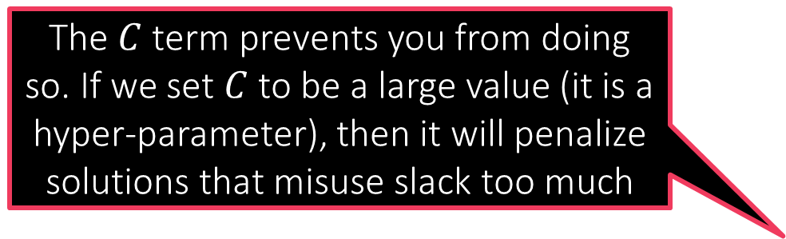
The C-SVM Technique
What prevents me from misusing the slack variables to learn a model that misclassifies every data point?
For linearly separable cases where we suspect a perfect classifier exists
$\min_{\tilde{w},\tilde{b}}{{\frac{1}{2}\left\|\tilde{w}\right\|}_{2}^{2}}$
s.t. $y^{i}⋅({\tilde{w}}^{⊤}x^{i}+\tilde{b})≥1$ for all $i∈\left[n\right]$
If a linear classifier cannot perfectly classify data, then find model using
$\min_{\tilde{w},\tilde{b},\left\{ξ_{i}\right\}}{{\frac{1}{2}\left\|\tilde{w}\right\|}_{2}^{2}+C\sum_{i=1}^{n}{ξ_{i}}}$
s.t. $y^{i}⋅\left({\tilde{w}}^{⊤}x^{i}+\tilde{b}\right)≥1−ξ_{i}$ for all $i∈\left[n\right]$
as well as $ξ_{i}≥0$ for all $i∈\left[n\right]$
The $C$ term prevents you from doing so. If we set $C$ to be a large value (it is a hyper-parameter), then it will penalize solutions that misuse slack too much
Having the constraint $ξ_{i}≥0$ prevents us from misusing slack to artificially inflate the margin
Recall English phrase “cut me some slack”
The $ξ_{i}$ terms are called slack variables. They allow some data points to come close to the hyperplane or be misclassified altogether

Slide 14

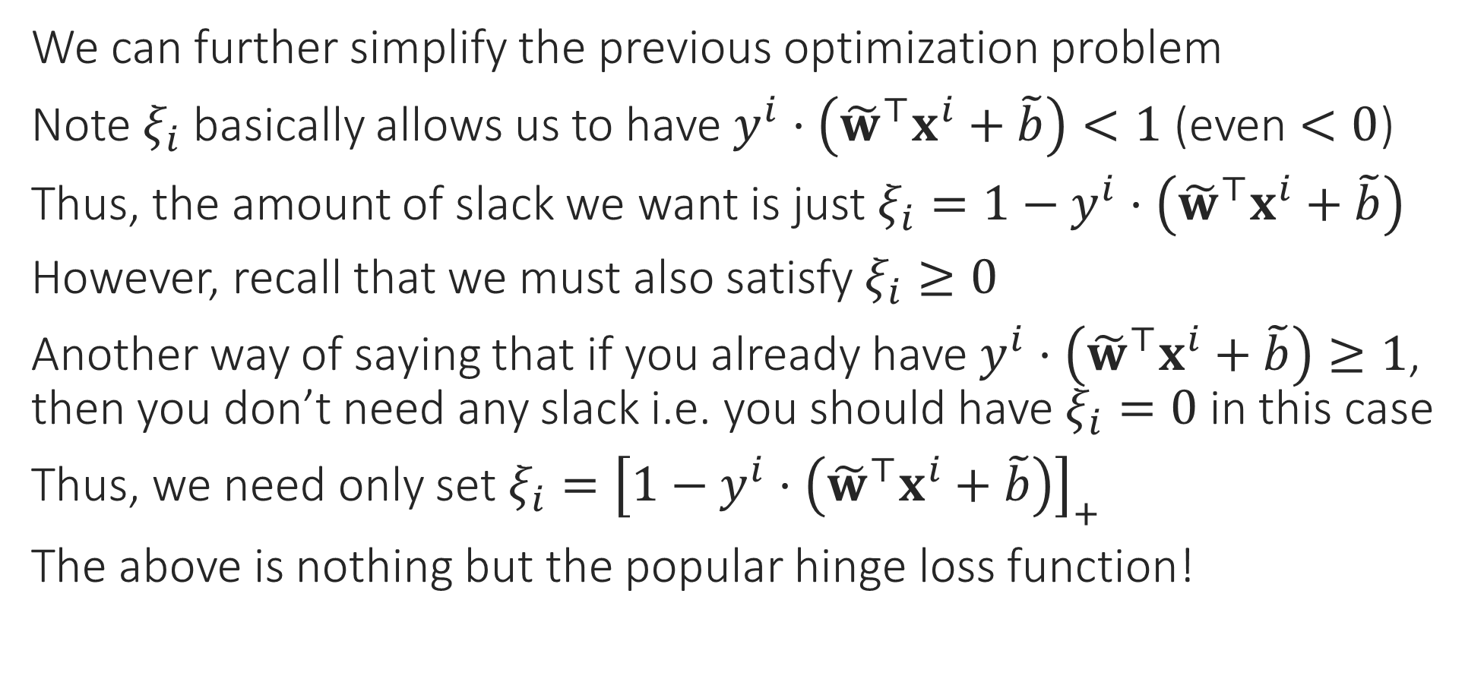
From C-SVM to Loss Functions
We can further simplify the previous optimization problem
Note $ξ_{i}$ basically allows us to have $y^{i}⋅\left({\tilde{w}}^{⊤}x^{i}+\tilde{b}\right)<1$ (even $<0$)
Thus, the amount of slack we want is just $ξ_{i}=1−y^{i}⋅\left({\tilde{w}}^{⊤}x^{i}+\tilde{b}\right)$
However, recall that we must also satisfy $ξ_{i}≥0$
Another way of saying that if you already have $y^{i}⋅\left({\tilde{w}}^{⊤}x^{i}+\tilde{b}\right)≥1$, then you don’t need any slack i.e. you should have $ξ_{i}=0$ in this case
Thus, we need only set $ξ_{i}={\left[1−y^{i}⋅\left({\tilde{w}}^{⊤}x^{i}+\tilde{b}\right)\right]}_{+}$
The above is nothing but the popular hinge loss function!
$${\left[x\right]}_{+}=\max\left\{x,0\right\}$$

Slide 15
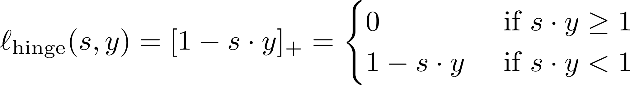

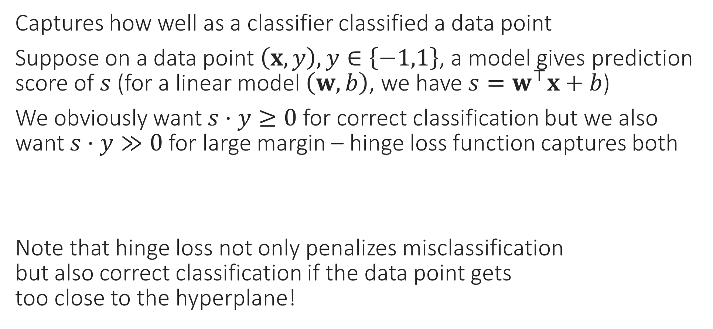
Hinge Loss
Captures how well as a classifier classified a data point
Suppose on a data point $\left(x,y\right), y∈\left\{−1,1\right\}$, a model gives prediction score of $s$ (for a linear model $\left(w,b\right)$, we have $s=w^{⊤}x+b$)
We obviously want $s⋅y≥0$ for correct classification but we also want $s⋅y≫0$ for large margin – hinge loss function captures both
Note that hinge loss not only penalizes misclassification but also correct classification if the data point gets too close to the hyperplane!

Slide 16
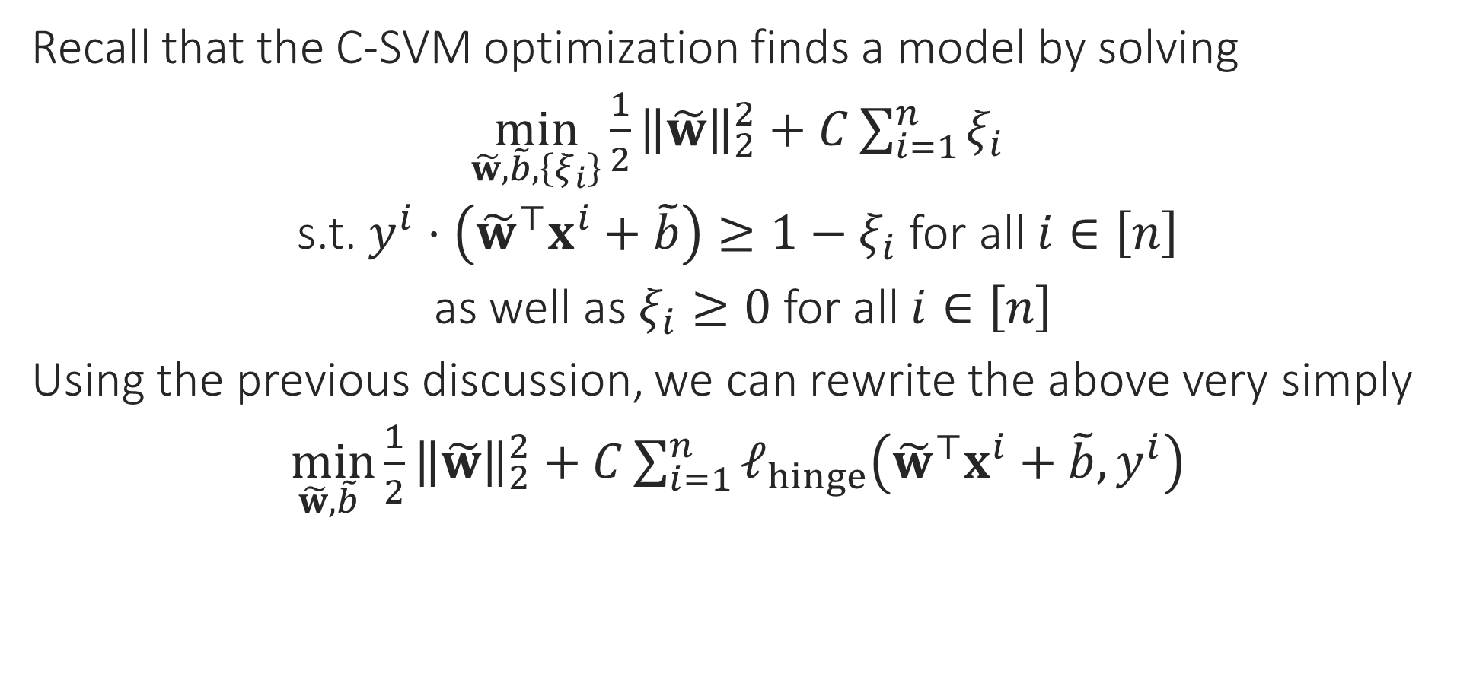
Final Form of C-SVM
Recall that the C-SVM optimization finds a model by solving
$\min_{\tilde{w},\tilde{b},\left\{ξ_{i}\right\}}{{\frac{1}{2}\left\|\tilde{w}\right\|}_{2}^{2}+C\sum_{i=1}^{n}{ξ_{i}}}$
s.t. $y^{i}⋅\left({\tilde{w}}^{⊤}x^{i}+\tilde{b}\right)≥1−ξ_{i}$ for all $i∈\left[n\right]$
as well as $ξ_{i}≥0$ for all $i∈\left[n\right]$
Using the previous discussion, we can rewrite the above very simply
$\min_{\tilde{w},\tilde{b} }{{\frac{1}{2}\left\|\tilde{w}\right\|}_{2}^{2}+C\sum_{i=1}^{n}{ℓ_{hinge}\left({\tilde{w}}^{⊤}x^{i}+\tilde{b},y^{i}\right)}}$

Slide 17



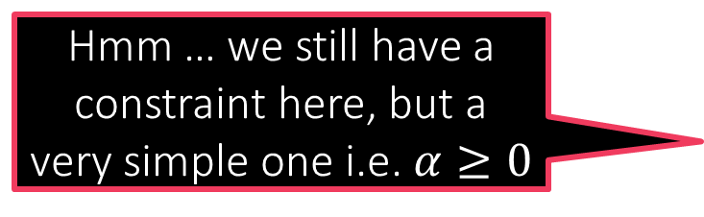

Constrained Optimization
Creating a Dual Problem
Suppose we wish to solve $\min_{x∈ℝ^{d}}{f\left(x\right)}+r\left(x\right)$ s.t. $g\left(x\right)≤0$
Trick: sneak this constraint into the objective
Construct a barrier (indicator) fn $r\left(x\right)$ so that $r\left(x\right)=0$ if $g\left(x\right)≤0$ and $r\left(x\right)=∞$ otherwise, and simply solve
Easy to see that both problems have the same solution
One very elegant way to construct such a barrier is the following $r\left(x\right)=\max_{α≥0}{α⋅g\left(x\right)}$
Thus, we want to solve $\min_{x∈ℝ^{d}}\left\{f\left(x\right)+\max_{α≥0}{α⋅g\left(x\right)}\right\}$
Hmm … we still have a constraint here, but a very simple one i.e. $α≥0$
Let us see how to handle multiple constraints and equality constraints
Same as $\min_{x∈ℝ^{d}}\left\{\max_{α≥0} \left\{f\left(x\right)+α⋅g\left(x\right)\right\}\right\}$

Slide 18

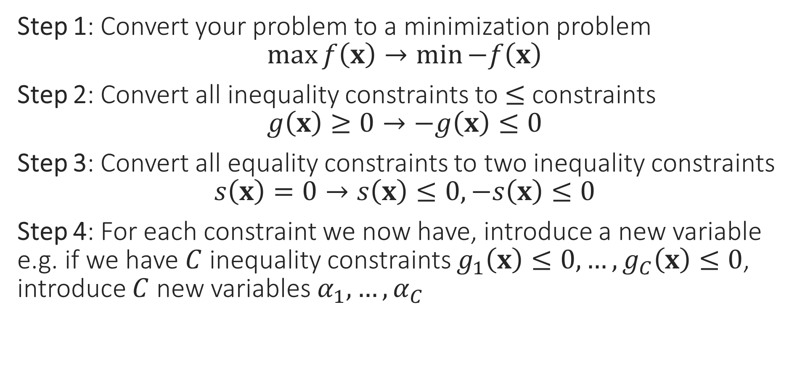

A few Cleanup Steps
Step 1: Convert your problem to a minimization problem $\max{f\left(x\right)}→\min{−f\left(x\right)}$
Step 2: Convert all inequality constraints to $≤$ constraints $g\left(x\right)≥0→−g\left(x\right)≤0$
Step 3: Convert all equality constraints to two inequality constraints $s\left(x\right)=0→s\left(x\right)≤0,−s\left(x\right)≤0$
Step 4: For each constraint we now have, introduce a new variable e.g. if we have $C$ inequality constraints $g_{1}\left(x\right)≤0,…,g_{C}\left(x\right)≤0$, introduce $C$ new variables $α_{1},…,α_{C}$
These new variables are called dual variables or sometimes even called Lagrange multipliers
The variables of the original optimization problem, e.g. $x$in this case, are called the primal variables by comparison

Slide 19

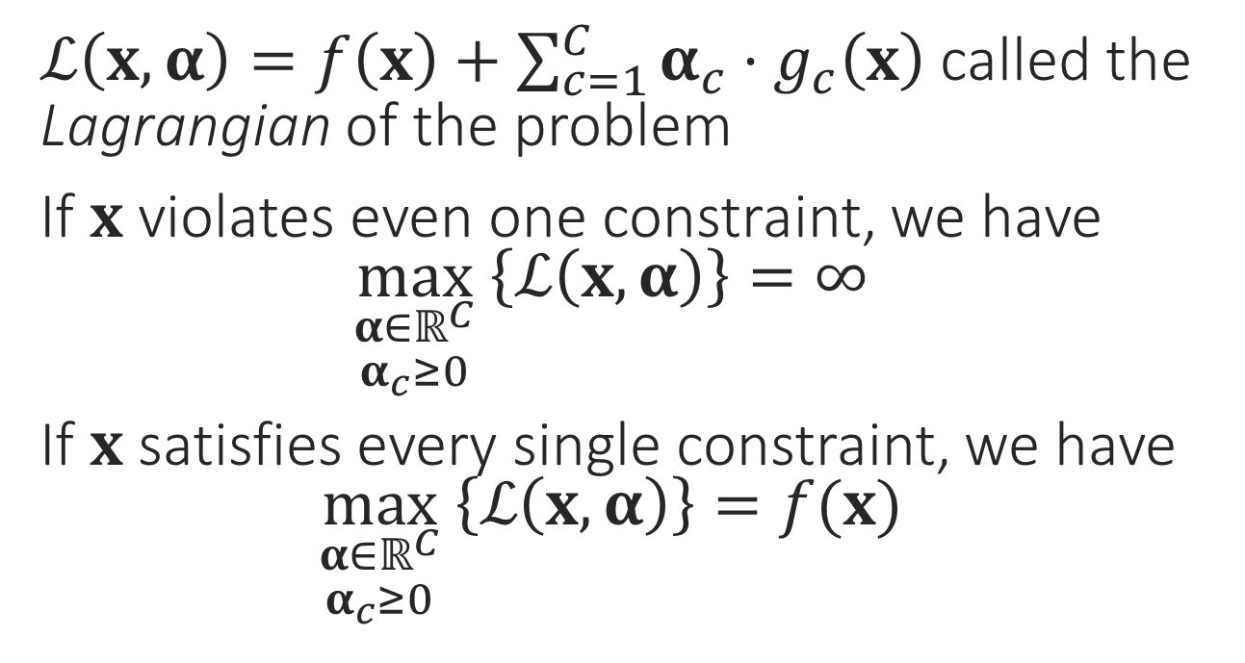

The Lagrangian
$\min_{x}{f\left(x\right)}$
s.t. $g_{1}\left(x\right)≤0$
$g_{2}\left(x\right)≤0$ $$⋮$$ $g_{C}\left(x\right)≤0$
$ℒ\left(x,α\right)=f\left(x\right)+\sum_{c=1}^{C}{α_{c}⋅g_{c}\left(x\right)}$ called the Lagrangian of the problem
If $x$ violates even one constraint, we have $\max_{\begin{aligned}α∈ℝ^{C} \\ α_{c}≥0\end{aligned}} \left\{ℒ\left(x,α\right)\right\}=∞$
If $x$ satisfies every single constraint, we have $\max_{\begin{aligned}α∈ℝ^{C} \\ α_{c}≥0\end{aligned}} \left\{ℒ\left(x,α\right)\right\}=f(x)$
This is just a nice way of rewriting the above problem
$$\min_{x∈ℝ^{d}}\left\{\max_{\begin{aligned}α∈ℝ^{C} \\ α_{c}≥0\end{aligned}} \left\{f\left(x\right)+\sum_{c=1}^{C}{α_{c}⋅g_{c}\left(x\right)}\right\}\right\}$$

Slide 20
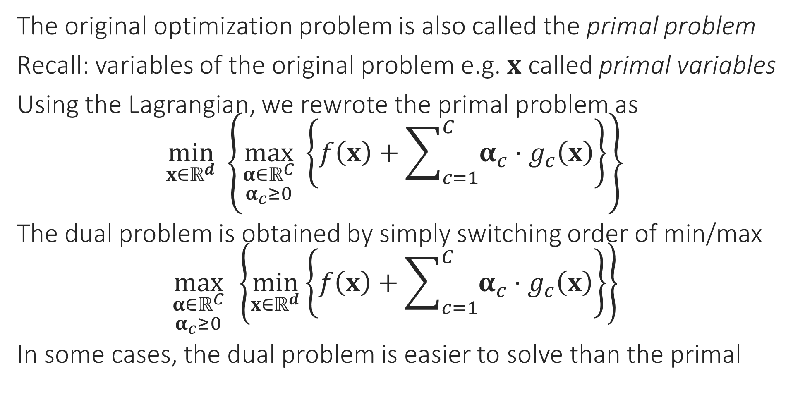
The Dual Problem
The original optimization problem is also called the primal problem
Recall: variables of the original problem e.g. $x$ called primal variables
Using the Lagrangian, we rewrote the primal problem as $\min_{x∈ℝ^{d}}\left\{\max_{\begin{aligned}α∈ℝ^{C} \\ α_{c}≥0\end{aligned}} \left\{f\left(x\right)+\sum_{c=1}^{C}{α_{c}⋅g_{c}\left(x\right)}\right\}\right\}$
The dual problem is obtained by simply switching order of min/max $\max_{\begin{aligned}α∈ℝ^{C} \\ α_{c}≥0\end{aligned}}\left\{\min_{x∈ℝ^{d}}\left\{f\left(x\right)+\sum_{c=1}^{C}{α_{c}⋅g_{c}\left(x\right)}\right\}\right\}$
In some cases, the dual problem is easier to solve than the primal

Slide 21
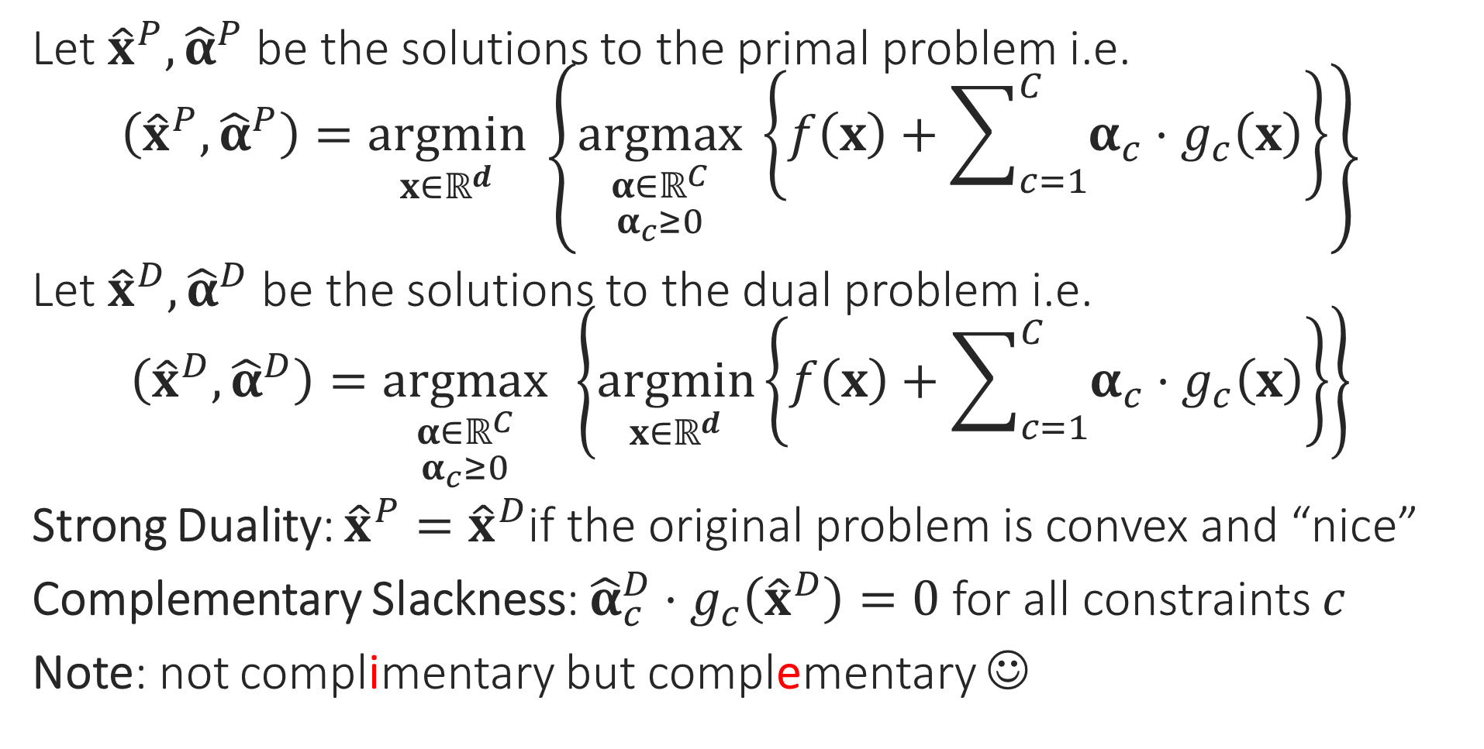
Duality
Let ${\hat{x}}^{P},{\hat{α}}^{P}$ be the solutions to the primal problem i.e. $\left({\hat{x}}^{P},{\hat{α}}^{P}\right)=\underset{x∈ℝ^{d}}{argmin}\left\{\underset{\begin{aligned}α∈ℝ^{C} \\ α_{c}≥0\end{aligned}}{argmax} \left\{f\left(x\right)+\sum_{c=1}^{C}{α_{c}⋅g_{c}\left(x\right)}\right\}\right\}$
Let ${\hat{x}}^{D},{\hat{α}}^{D}$ be the solutions to the dual problem i.e. $\left({\hat{x}}^{D},{\hat{α}}^{D}\right)=\underset{\begin{aligned}α∈ℝ^{C} \\ α_{c}≥0\end{aligned}}{argmax}\left\{\underset{x∈ℝ^{d}}{argmin}\left\{f\left(x\right)+\sum_{c=1}^{C}{α_{c}⋅g_{c}\left(x\right)}\right\}\right\}$
Strong Duality: ${\hat{x}}^{P}={\hat{x}}^{D}$if the original problem is convex and “nice”
Complementary Slackness: ${\hat{α}}_{c}^{D}⋅g_{c}\left({\hat{x}}^{D}\right)=0$ for all constraints $c$
Note: not complimentary but complementary ☺

Slide 22
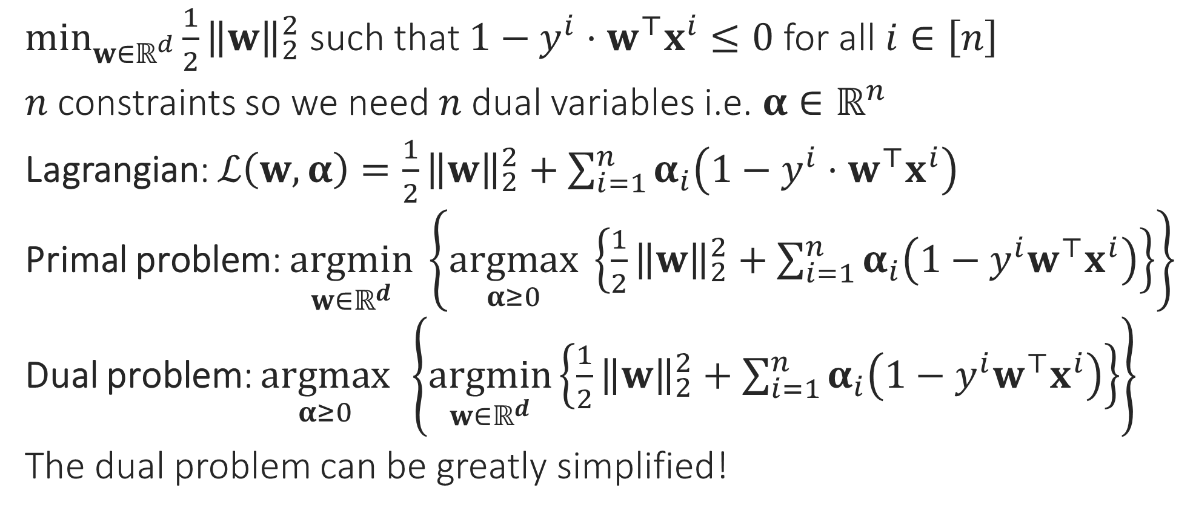
Hard SVM without a bias
$\min_{w∈ℝ^{d}}{\frac{1}{2}{\left\|w\right\|}_{2}^{2}}$ such that $1−y^{i}⋅w^{⊤}x^{i}≤0$ for all $i∈\left[n\right]$
$n$ constraints so we need $n$ dual variables i.e. $α∈ℝ^{n}$
Lagrangian: $ℒ\left(w,α\right)=\frac{1}{2}{\left\|w\right\|}_{2}^{2}+\sum_{i=1}^{n}{α_{i}\left(1−y^{i}⋅w^{⊤}x^{i}\right)}$
Primal problem: $\underset{w∈ℝ^{d}}{argmin}\left\{\underset{α≥0}{argmax} \left\{\frac{1}{2}{\left\|w\right\|}_{2}^{2}+\sum_{i=1}^{n}{α_{i}\left(1−y^{i}w^{⊤}x^{i}\right)}\right\}\right\}$
Dual problem: $\underset{α≥0}{argmax}\left\{\underset{w∈ℝ^{d}}{argmin}\left\{\frac{1}{2}{\left\|w\right\|}_{2}^{2}+\sum_{i=1}^{n}{α_{i}\left(1−y^{i}w^{⊤}x^{i}\right)}\right\}\right\}$
The dual problem can be greatly simplified!

Slide 23
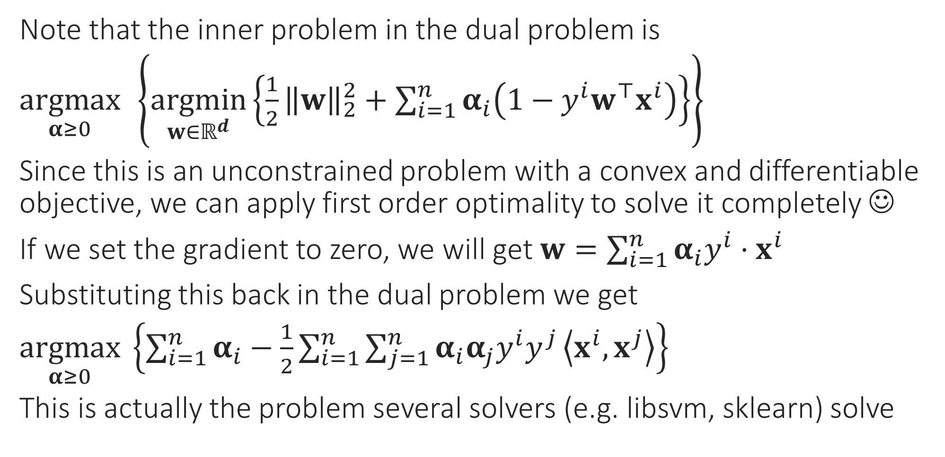

Simplifying the Dual Problem
Once you get optimal values of $α$, use $w=\sum_{i=1}^{n}{α_{i}y^{i}⋅x^{i}}$ to get optimal value of $w$
Note that the inner problem in the dual problem is
$\underset{α≥0}{argmax}\left\{\underset{w∈ℝ^{d}}{argmin}\left\{\frac{1}{2}{\left\|w\right\|}_{2}^{2}+\sum_{i=1}^{n}{α_{i}\left(1−y^{i}w^{⊤}x^{i}\right)}\right\}\right\}$
Since this is an unconstrained problem with a convex and differentiable objective, we can apply first order optimality to solve it completely ☺
If we set the gradient to zero, we will get $w=\sum_{i=1}^{n}{α_{i}y^{i}⋅x^{i}}$
Substituting this back in the dual problem we get
$\underset{α≥0}{argmax} \left\{\sum_{i=1}^{n}{α_{i}}−\frac{1}{2}\sum_{i=1}^{n}{\sum_{j=1}^{n}{α_{i}α_{j}y^{i}y^{j}}\left\langle x^{i},x^{j}\right\rangle }\right\}$
This is actually the problem several solvers (e.g. libsvm, sklearn) solve

Slide 24

Support Vectors
Support Vectors!!
Recall: we have $α_{i}$ for every data point
After solving the dual problem, the data points for which $α_{i}≠0$: Support Vectors
Usually we have $≪n$ support vectors
Recall: complementary slackness tells us that $α_{i}\left(1−y^{i}w^{⊤}x^{i}\right)=0$ i.e. only those data points can become SVs for which $y^{i}w^{⊤}x^{i}=1$ i.e. at margin
The reason these are called support vectors has to do with a mechanical interpretation of these objects – need to look at CSVM to understand that

Slide 25

Dual for CSVM
Similar calculations (see course notes for a derivation) show that if we have a bias term $b$ as well as slack variables, then the dual looks like
$\underset{α∈ℝ^{n}}{argmax} \left\{\sum_{i=1}^{n}{α_{i}}−\frac{1}{2}\sum_{i=1}^{n}{\sum_{j=1}^{n}{α_{i}α_{j}y^{i}y^{j}}\left\langle x^{i},x^{j}\right\rangle }\right\}$ s.t. $α_{i}∈\left[0,C\right]$, and $\sum_{i=1}^{n}{α_{i}}y^{i}=0$
Reason for the name “SVM”: imagine that each data point $i$ is applying a force $α_{i}$ on the hyperplane in the direction $y^{i}$
Then the total force on the hyperplane is equal to zero since $\sum_{i=1}^{n}{α_{i}}y^{i}=0$
Also, the condition $w=\sum_{i=1}^{n}{α_{i}y^{i}⋅x^{i}}$ can be interpreted to mean that the total torque on the hyperplane is zero as well
Thus, support vectors mechanically support the hyperplane (don’t let it shift or rotate around), hence their name ☺

Slide 26
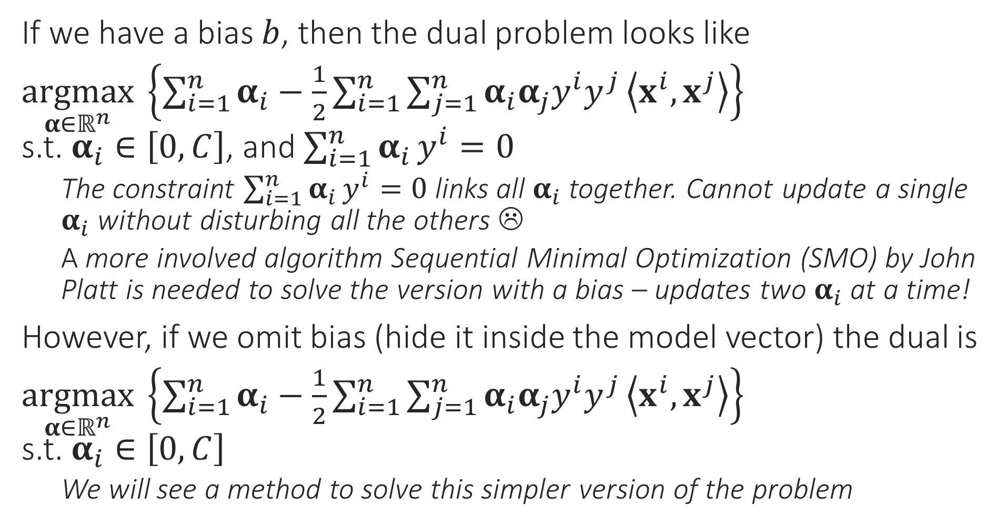
CSVM Dual Problem
If we have a bias $b$, then the dual problem looks like
$\underset{α∈ℝ^{n}}{argmax} \left\{\sum_{i=1}^{n}{α_{i}}−\frac{1}{2}\sum_{i=1}^{n}{\sum_{j=1}^{n}{α_{i}α_{j}y^{i}y^{j}}\left\langle x^{i},x^{j}\right\rangle }\right\}$ s.t. $α_{i}∈\left[0,C\right]$, and $\sum_{i=1}^{n}{α_{i}}y^{i}=0$
The constraint $\sum_{i=1}^{n}{α_{i}}y^{i}=0$ links all $α_{i}$ together. Cannot update a single $α_{i}$ without disturbing all the others ☹
A more involved algorithm Sequential Minimal Optimization (SMO) by John Platt is needed to solve the version with a bias – updates two $α_{i}$ at a time!
However, if we omit bias (hide it inside the model vector) the dual is
$\underset{α∈ℝ^{n}}{argmax} \left\{\sum_{i=1}^{n}{α_{i}}−\frac{1}{2}\sum_{i=1}^{n}{\sum_{j=1}^{n}{α_{i}α_{j}y^{i}y^{j}}\left\langle x^{i},x^{j}\right\rangle }\right\}$ s.t. $α_{i}∈\left[0,C\right]$
We will see a method to solve this simpler version of the problem

