Slide 1
My first Solver

Slide 2

Authentication by Secret Questions
Give me your device ID and answer the following questions
10111100
00110010
10001110
00010100
…
TS271828182845
1
0
1
0
…
SERVER
DEVICE

Slide 3


Linear Models
We have $Δ_{63}=w_{0} ⋅x_{0}+w_{1}⋅x_{1}+…+w_{63}⋅x_{63}+β_{63}=w^{⊤}x+b$
where $x_{i}=d_{i}⋅d_{i+1}⋅…⋅d_{63}$ $w_{0}=α_{0}$ $w_{i}=α_{i}+β_{i−1} \left(for i>0\right)$
If $Δ_{63}<0$, upper signal wins and answer is 0
If $Δ_{63}>0$, lower signal wins and answer is 1
Thus, answer is simply $\frac{sign\left(w^{⊤}x+b\right)+1}{2}$
$$w$$
This is nothing but a linear classifier!

Slide 4
The “best” Linear Classifier

Slide 5
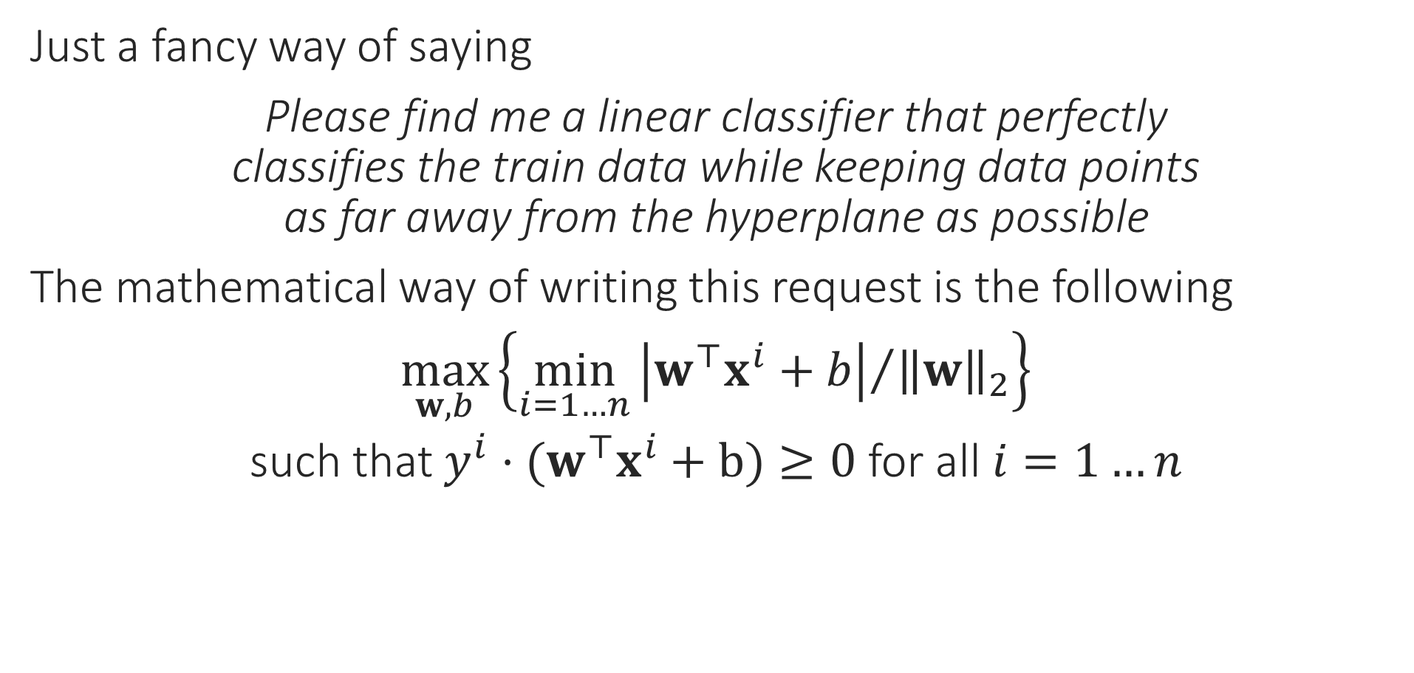
Support Vector Machines
“
Just a fancy way of saying
Please find me a linear classifier that perfectly classifies the train data while keeping data points as far away from the hyperplane as possible
The mathematical way of writing this request is the following
$\max_{w,b}\left\{\min_{i=1…n}{{\left|w^{⊤}x^{i}+b\right|}/{{\left\|w\right\|}_{2}}}\right\}$
such that $y^{i}⋅(w^{⊤}x^{i}+b)≥0$ for all $i=1…n$
“
Constraints
Objective

Slide 6
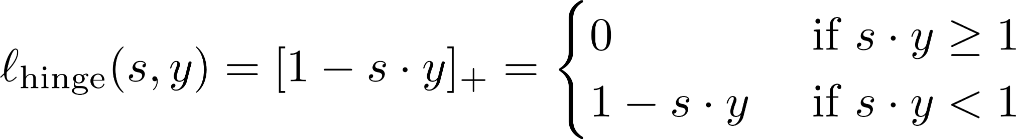

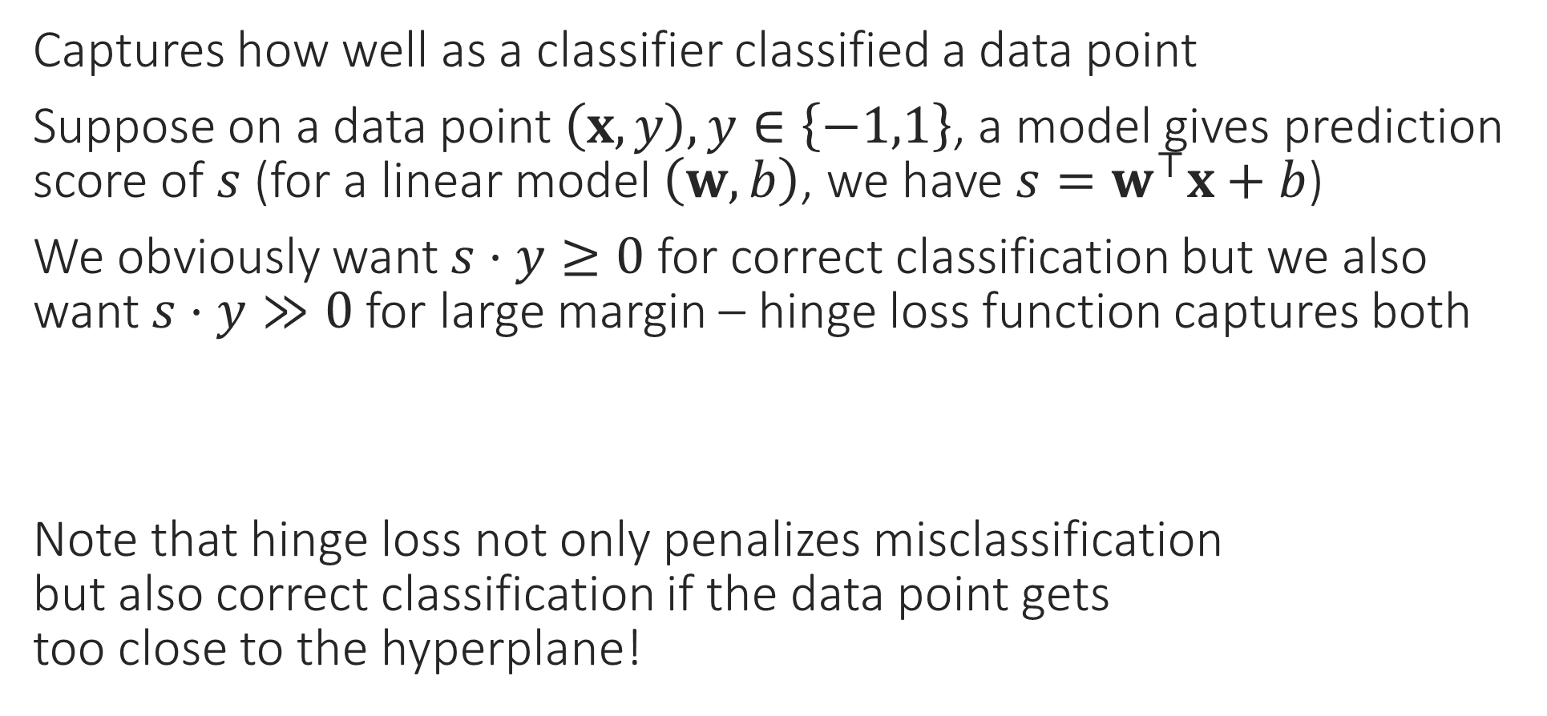
Hinge Loss
Captures how well as a classifier classified a data point
Suppose on a data point $\left(x,y\right), y∈\left\{−1,1\right\}$, a model gives prediction score of $s$ (for a linear model $\left(w,b\right)$, we have $s=w^{⊤}x+b$)
We obviously want $s⋅y≥0$ for correct classification but we also want $s⋅y≫0$ for large margin – hinge loss function captures both
Note that hinge loss not only penalizes misclassification but also correct classification if the data point gets too close to the hyperplane!

Slide 7
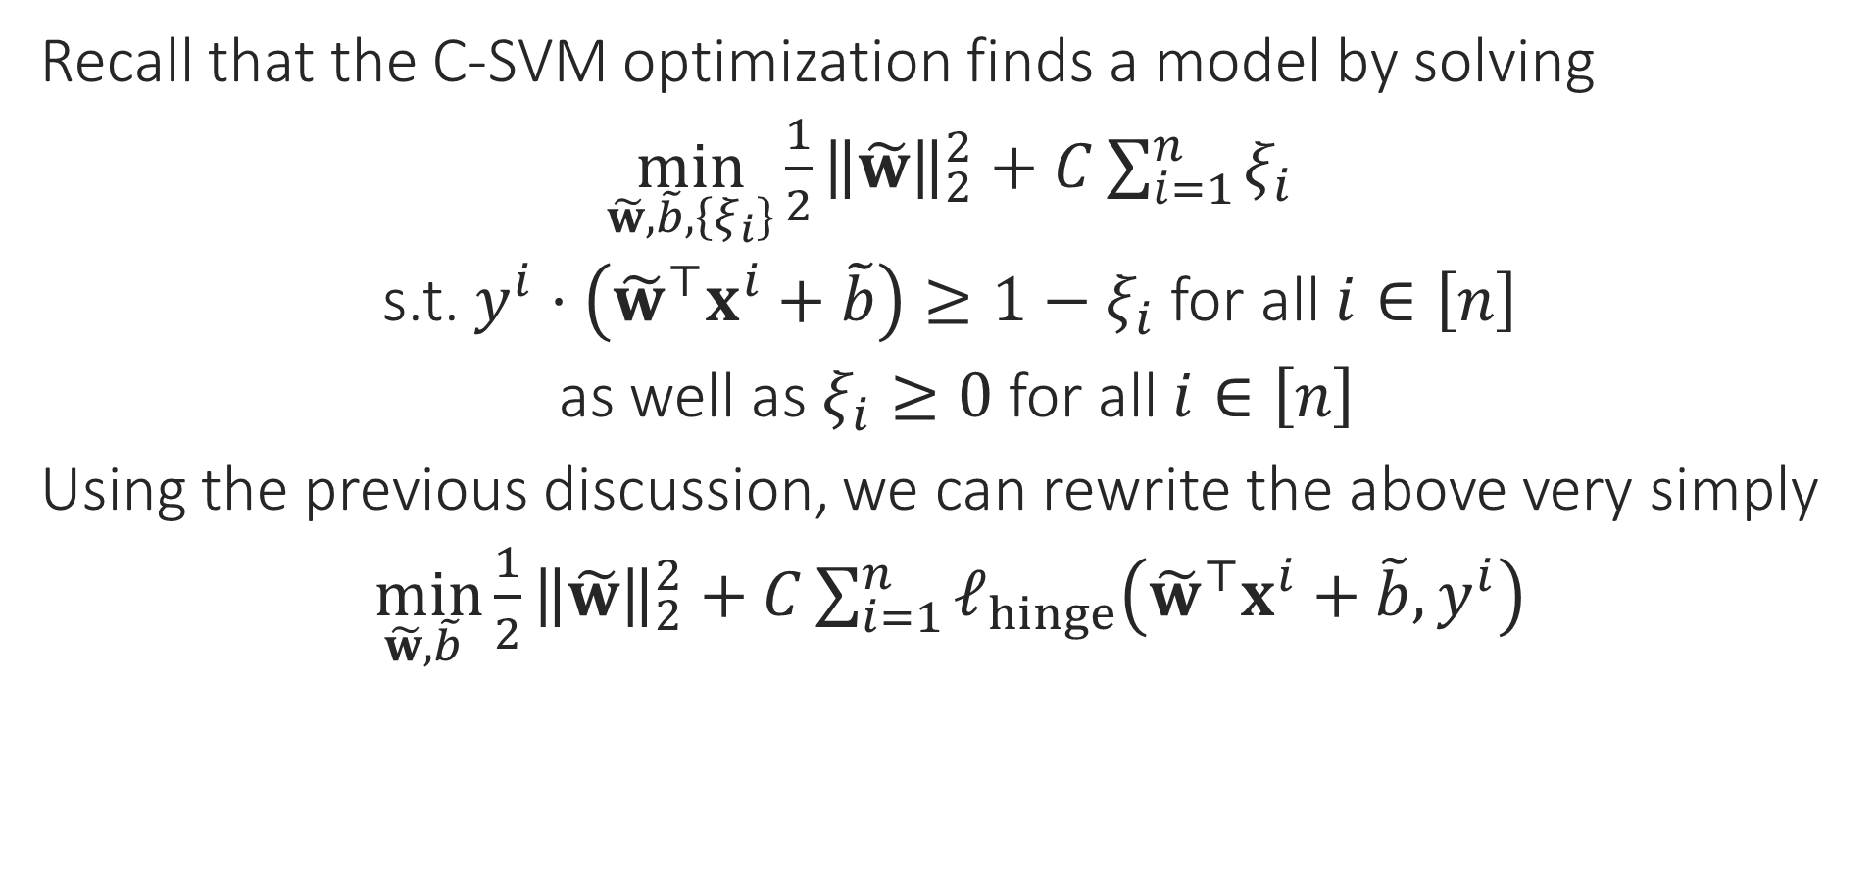
Final Form of C-SVM
Recall that the C-SVM optimization finds a model by solving
$\min_{\tilde{w},\tilde{b},\left\{ξ_{i}\right\}}{{\frac{1}{2}\left\|\tilde{w}\right\|}_{2}^{2}+C\sum_{i=1}^{n}{ξ_{i}}}$
s.t. $y^{i}⋅\left({\tilde{w}}^{⊤}x^{i}+\tilde{b}\right)≥1−ξ_{i}$ for all $i∈\left[n\right]$
as well as $ξ_{i}≥0$ for all $i∈\left[n\right]$
Using the previous discussion, we can rewrite the above very simply
$\min_{\tilde{w},\tilde{b} }{{\frac{1}{2}\left\|\tilde{w}\right\|}_{2}^{2}+C\sum_{i=1}^{n}{ℓ_{hinge}\left({\tilde{w}}^{⊤}x^{i}+\tilde{b},y^{i}\right)}}$

Slide 8
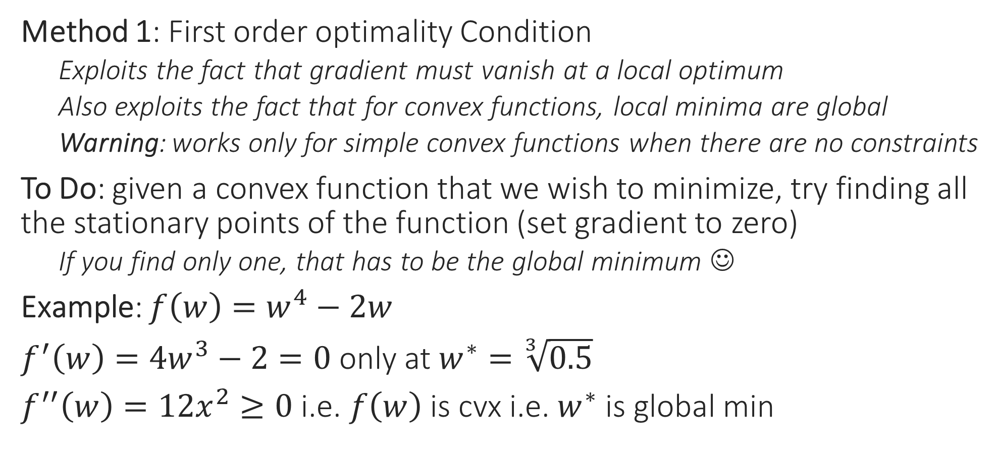
Use Calculus for Optimization
Method 1: First order optimality Condition
Exploits the fact that gradient must vanish at a local optimum
Also exploits the fact that for convex functions, local minima are global
Warning: works only for simple convex functions when there are no constraints
To Do: given a convex function that we wish to minimize, try finding all the stationary points of the function (set gradient to zero)
If you find only one, that has to be the global minimum ☺
Example: $f\left(w\right)=w^{4}−2w$
$f^{′}\left(w\right)=4w^{3}−2=0$ only at $w^{∗}=\sqrt[3]{0.5}$
$f^{′′}\left(w\right)=12x^{2}≥0$ i.e. $f\left(w\right)$ is cvx i.e. $w^{∗}$ is global min

Slide 9


Use Calculus for Optimization
Method 2: Perform (sub)gradient descent
Recall that direction opposite to gradient offers steepest descent
(SUB)GRADIENT DESCENT
Given: obj. func. $f:ℝ^{d}→ℝ$ to minimize
Initialize $w^{0}∈ℝ^{d}$
For $t=0, 1, …$
Obtain a (sub)gradient $g^{t}∈∂f\left(w^{t}\right)$
Choose a step length $η_{t}$
Update $w^{t+1}←w^{t}−η_{t}⋅g^{t}$
Repeat until convergence
How to initialize $w^{0}$?
How to choose $η_{t}$
Often called “step length” or “learning rate”
What is convergence?
How to decide if we have converged?

Slide 10
Gradient Descent (GD)
Choose step length carefully else may overshoot the global minimum even with great initialization
Move opposite to the gradients
Also, initialization may affect result
Our initialization was such that we converged to a local minimum
This time initialization was really nice!
Global minimum
With convex fns, all local minima are global minima and can afford to be less carefull with initialization
Still need to be careful with step lengths otherwise may overshoot global minima

Slide 11







Constrained Optimization
Method 3: Creating a Dual Problem
Suppose we wish to solve $\min_{x∈ℝ^{d}}{f\left(x\right)}+r\left(x\right)$ s.t. $g\left(x\right)≤0$
Trick: sneak this constraint into the objective
Construct a barrier (indicator) fn $r\left(x\right)$ so that $r\left(x\right)=0$ if $g\left(x\right)≤0$ and $r\left(x\right)=∞$ otherwise, and simply solve
Easy to see that both problems have the same solution
One very elegant way to construct such a barrier is the following $r\left(x\right)=\max_{α≥0}{α⋅g\left(x\right)}$
Thus, we want to solve $\min_{x∈ℝ^{d}}\left\{f\left(x\right)+\max_{α≥0}{α⋅g\left(x\right)}\right\}$
Hmm … we still have a constraint here, but a very simple one i.e. $α≥0$
Let us see how to handle multiple constraints and equality constraints
Same as $\min_{x∈ℝ^{d}}\left\{\max_{α≥0} \left\{f\left(x\right)+α⋅g\left(x\right)\right\}\right\}$

Slide 12

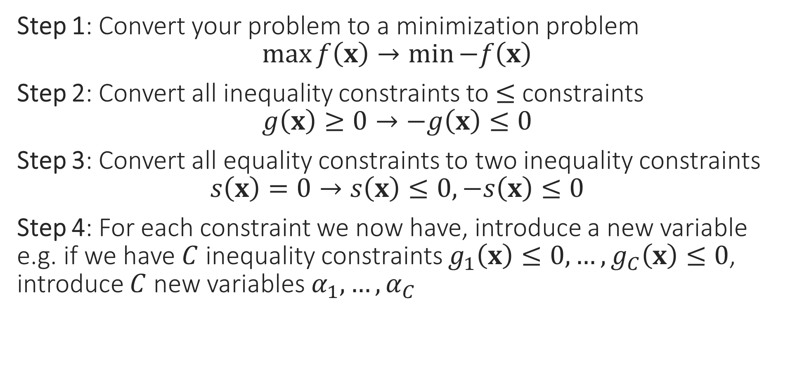

A few Cleanup Steps
Step 1: Convert your problem to a minimization problem $\max{f\left(x\right)}→\min{−f\left(x\right)}$
Step 2: Convert all inequality constraints to $≤$ constraints $g\left(x\right)≥0→−g\left(x\right)≤0$
Step 3: Convert all equality constraints to two inequality constraints $s\left(x\right)=0→s\left(x\right)≤0,−s\left(x\right)≤0$
Step 4: For each constraint we now have, introduce a new variable e.g. if we have $C$ inequality constraints $g_{1}\left(x\right)≤0,…,g_{C}\left(x\right)≤0$, introduce $C$ new variables $α_{1},…,α_{C}$
These new variables are called dual variables or sometimes even called Lagrange multipliers
The variables of the original optimization problem, e.g. $x$in this case, are called the primal variables by comparison

Slide 13

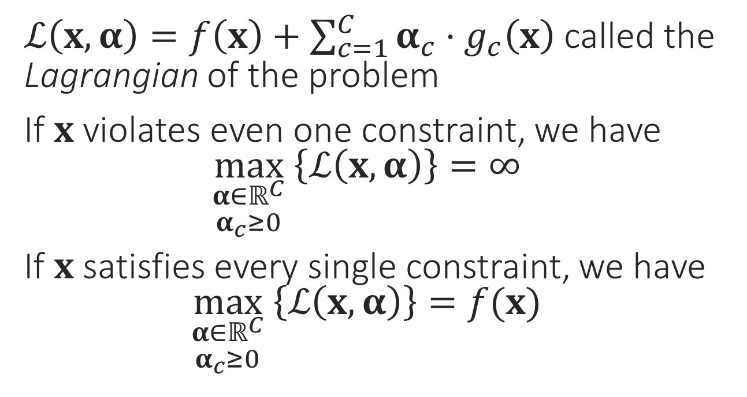

The Lagrangian
$\min_{x}{f\left(x\right)}$
s.t. $g_{1}\left(x\right)≤0$
$g_{2}\left(x\right)≤0$ $$⋮$$ $g_{C}\left(x\right)≤0$
$ℒ\left(x,α\right)=f\left(x\right)+\sum_{c=1}^{C}{α_{c}⋅g_{c}\left(x\right)}$ called the Lagrangian of the problem
If $x$ violates even one constraint, we have $\max_{\begin{aligned}α∈ℝ^{C} \\ α_{c}≥0\end{aligned}} \left\{ℒ\left(x,α\right)\right\}=∞$
If $x$ satisfies every single constraint, we have $\max_{\begin{aligned}α∈ℝ^{C} \\ α_{c}≥0\end{aligned}} \left\{ℒ\left(x,α\right)\right\}=f(x)$
This is just a nice way of rewriting the above problem
$$\min_{x∈ℝ^{d}}\left\{\max_{\begin{aligned}α∈ℝ^{C} \\ α_{c}≥0\end{aligned}} \left\{f\left(x\right)+\sum_{c=1}^{C}{α_{c}⋅g_{c}\left(x\right)}\right\}\right\}$$

Slide 14
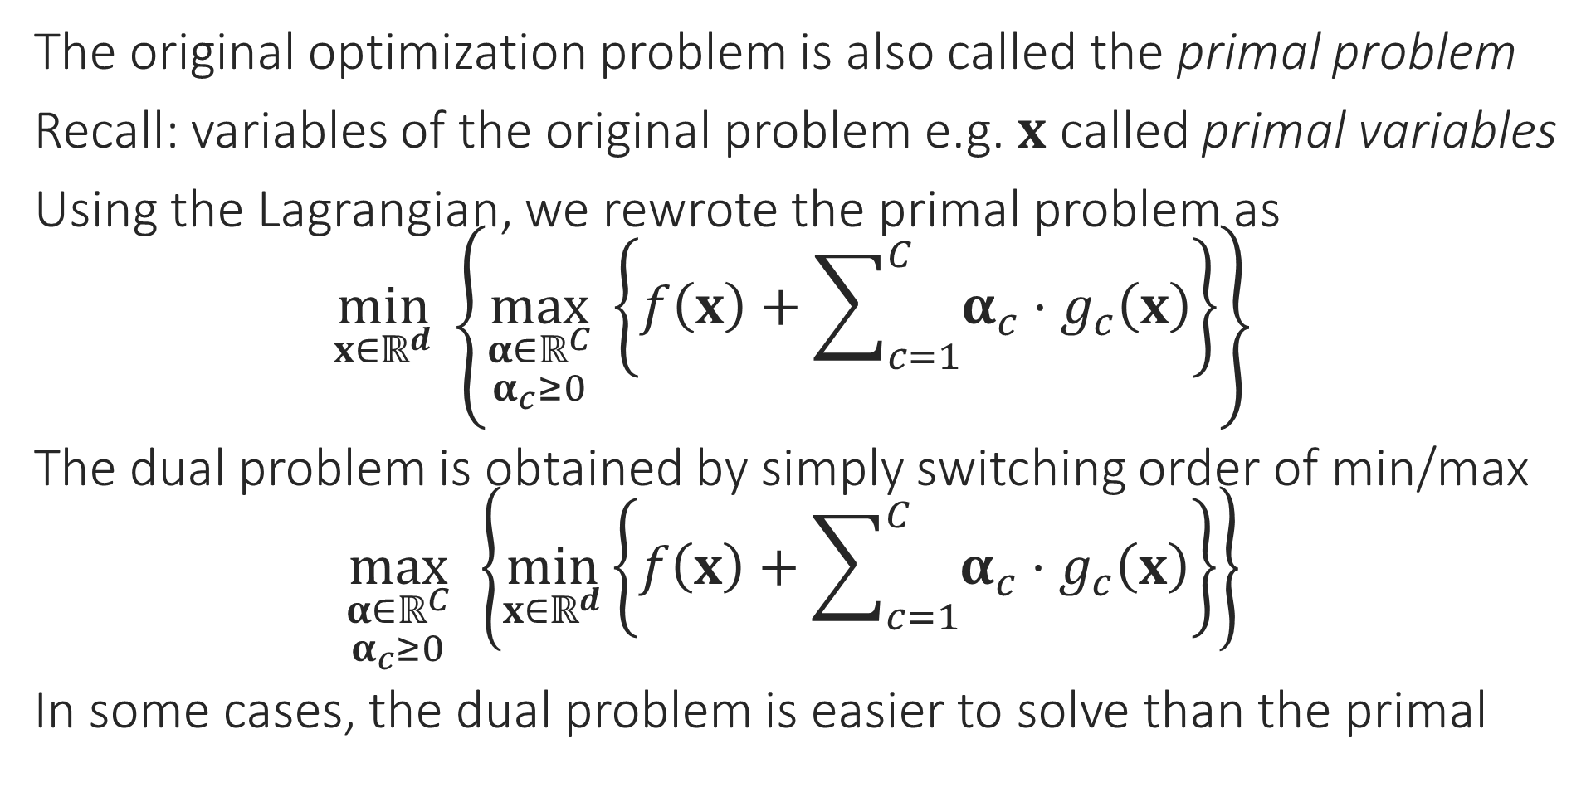
The Dual Problem
The original optimization problem is also called the primal problem
Recall: variables of the original problem e.g. $x$ called primal variables
Using the Lagrangian, we rewrote the primal problem as $\min_{x∈ℝ^{d}}\left\{\max_{\begin{aligned}α∈ℝ^{C} \\ α_{c}≥0\end{aligned}} \left\{f\left(x\right)+\sum_{c=1}^{C}{α_{c}⋅g_{c}\left(x\right)}\right\}\right\}$
The dual problem is obtained by simply switching order of min/max $\max_{\begin{aligned}α∈ℝ^{C} \\ α_{c}≥0\end{aligned}}\left\{\min_{x∈ℝ^{d}}\left\{f\left(x\right)+\sum_{c=1}^{C}{α_{c}⋅g_{c}\left(x\right)}\right\}\right\}$
In some cases, the dual problem is easier to solve than the primal

Slide 15
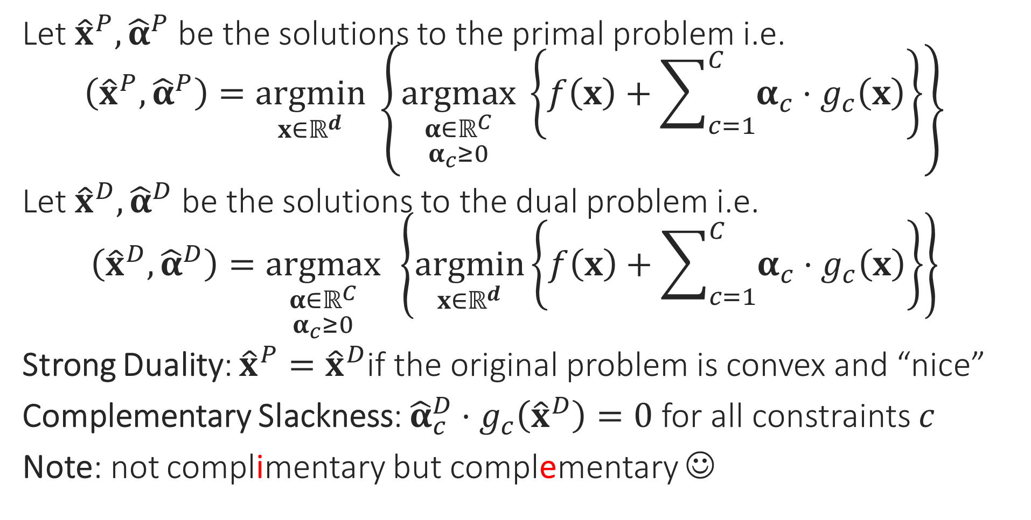
Duality
Let ${\hat{x}}^{P},{\hat{α}}^{P}$ be the solutions to the primal problem i.e. $\left({\hat{x}}^{P},{\hat{α}}^{P}\right)=\underset{x∈ℝ^{d}}{argmin}\left\{\underset{\begin{aligned}α∈ℝ^{C} \\ α_{c}≥0\end{aligned}}{argmax} \left\{f\left(x\right)+\sum_{c=1}^{C}{α_{c}⋅g_{c}\left(x\right)}\right\}\right\}$
Let ${\hat{x}}^{D},{\hat{α}}^{D}$ be the solutions to the dual problem i.e. $\left({\hat{x}}^{D},{\hat{α}}^{D}\right)=\underset{\begin{aligned}α∈ℝ^{C} \\ α_{c}≥0\end{aligned}}{argmax}\left\{\underset{x∈ℝ^{d}}{argmin}\left\{f\left(x\right)+\sum_{c=1}^{C}{α_{c}⋅g_{c}\left(x\right)}\right\}\right\}$
Strong Duality: ${\hat{x}}^{P}={\hat{x}}^{D}$if the original problem is convex and “nice”
Complementary Slackness: ${\hat{α}}_{c}^{D}⋅g_{c}\left({\hat{x}}^{D}\right)=0$ for all constraints $c$
Note: not complimentary but complementary ☺

Slide 16
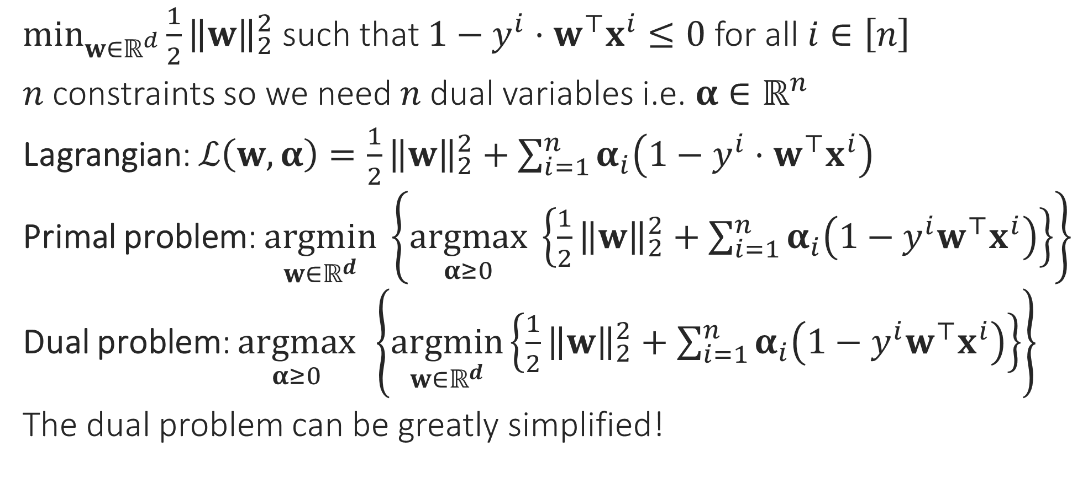
Hard SVM without a bias
$\min_{w∈ℝ^{d}}{\frac{1}{2}{\left\|w\right\|}_{2}^{2}}$ such that $1−y^{i}⋅w^{⊤}x^{i}≤0$ for all $i∈\left[n\right]$
$n$ constraints so we need $n$ dual variables i.e. $α∈ℝ^{n}$
Lagrangian: $ℒ\left(w,α\right)=\frac{1}{2}{\left\|w\right\|}_{2}^{2}+\sum_{i=1}^{n}{α_{i}\left(1−y^{i}⋅w^{⊤}x^{i}\right)}$
Primal problem: $\underset{w∈ℝ^{d}}{argmin}\left\{\underset{α≥0}{argmax} \left\{\frac{1}{2}{\left\|w\right\|}_{2}^{2}+\sum_{i=1}^{n}{α_{i}\left(1−y^{i}w^{⊤}x^{i}\right)}\right\}\right\}$
Dual problem: $\underset{α≥0}{argmax}\left\{\underset{w∈ℝ^{d}}{argmin}\left\{\frac{1}{2}{\left\|w\right\|}_{2}^{2}+\sum_{i=1}^{n}{α_{i}\left(1−y^{i}w^{⊤}x^{i}\right)}\right\}\right\}$
The dual problem can be greatly simplified!

Slide 17
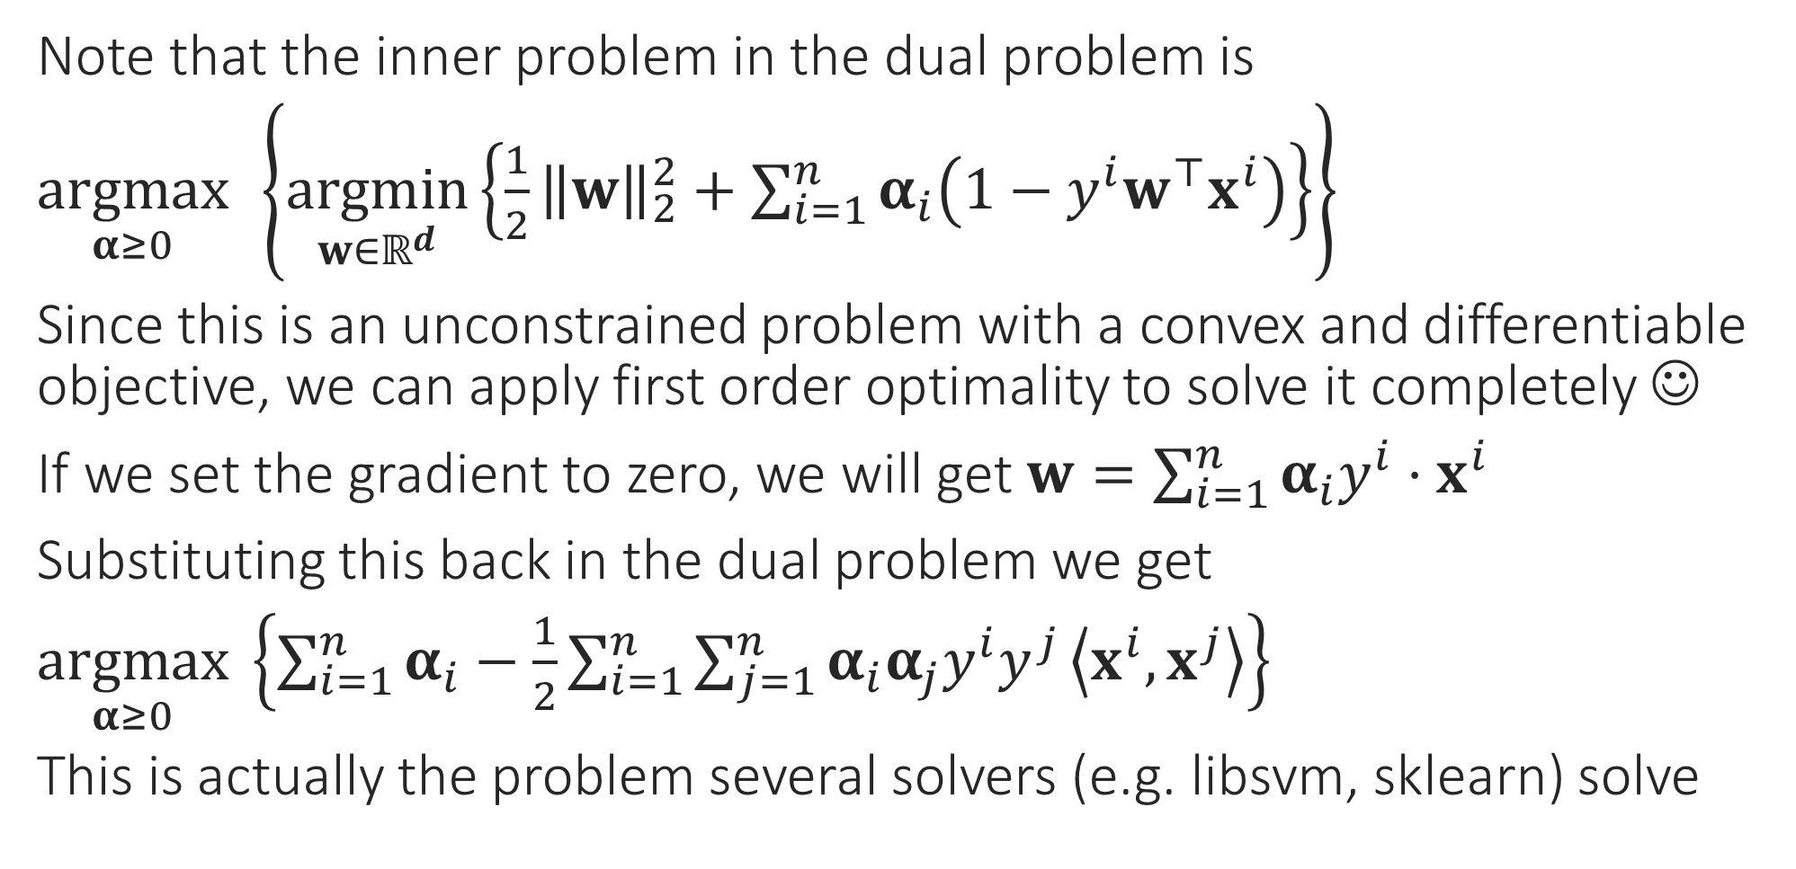

Simplifying the Dual Problem
Once you get optimal values of $α$, use $w=\sum_{i=1}^{n}{α_{i}y^{i}⋅x^{i}}$ to get optimal value of $w$
Note that the inner problem in the dual problem is
$\underset{α≥0}{argmax}\left\{\underset{w∈ℝ^{d}}{argmin}\left\{\frac{1}{2}{\left\|w\right\|}_{2}^{2}+\sum_{i=1}^{n}{α_{i}\left(1−y^{i}w^{⊤}x^{i}\right)}\right\}\right\}$
Since this is an unconstrained problem with a convex and differentiable objective, we can apply first order optimality to solve it completely ☺
If we set the gradient to zero, we will get $w=\sum_{i=1}^{n}{α_{i}y^{i}⋅x^{i}}$
Substituting this back in the dual problem we get
$\underset{α≥0}{argmax} \left\{\sum_{i=1}^{n}{α_{i}}−\frac{1}{2}\sum_{i=1}^{n}{\sum_{j=1}^{n}{α_{i}α_{j}y^{i}y^{j}}\left\langle x^{i},x^{j}\right\rangle }\right\}$
This is actually the problem several solvers (e.g. libsvm, sklearn) solve

Slide 18

Support Vectors
Support Vectors!!
Recall: we have $α_{i}$ for every data point
After solving the dual problem, the data points for which $α_{i}≠0$: Support Vectors
Usually we have $≪n$ support vectors
Recall: complementary slackness tells us that $α_{i}\left(1−y^{i}w^{⊤}x^{i}\right)=0$ i.e. only those data points can become SVs for which $y^{i}w^{⊤}x^{i}=1$ i.e. at margin
The reason these are called support vectors has to do with a mechanical interpretation of these objects – need to look at CSVM to understand that

Slide 19

Dual for CSVM
Similar calculations (see course notes for a derivation) show that if we have a bias term $b$ as well as slack variables, then the dual looks like
$\underset{α∈ℝ^{n}}{argmax} \left\{\sum_{i=1}^{n}{α_{i}}−\frac{1}{2}\sum_{i=1}^{n}{\sum_{j=1}^{n}{α_{i}α_{j}y^{i}y^{j}}\left\langle x^{i},x^{j}\right\rangle }\right\}$ s.t. $α_{i}∈\left[0,C\right]$, and $\sum_{i=1}^{n}{α_{i}}y^{i}=0$
Reason for the name “SVM”: imagine that each data point $i$ is applying a force $α_{i}$ on the hyperplane in the direction $y^{i}$
Then the total force on the hyperplane is equal to zero since $\sum_{i=1}^{n}{α_{i}}y^{i}=0$
Also, the condition $w=\sum_{i=1}^{n}{α_{i}y^{i}⋅x^{i}}$ can be interpreted to mean that the total torque on the hyperplane is zero as well
Thus, support vectors mechanically support the hyperplane (don’t let it shift or rotate around), hence their name ☺

Slide 20
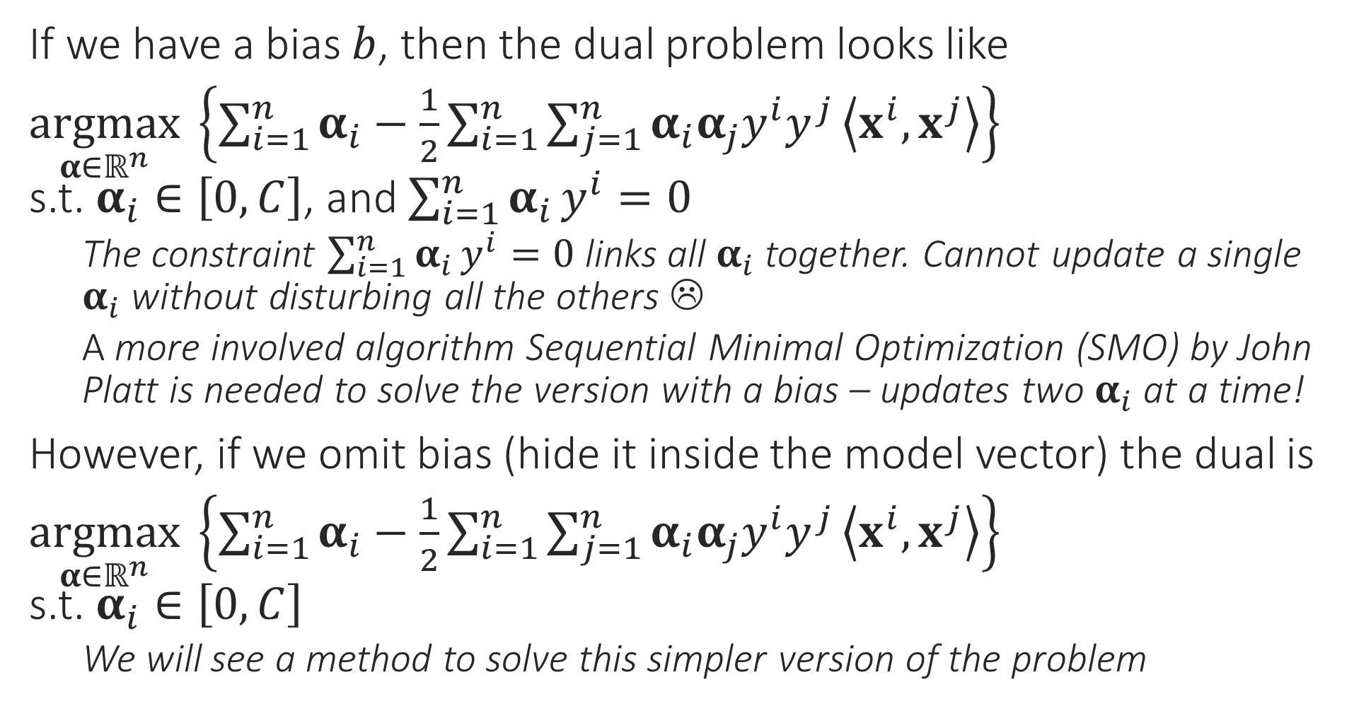
CSVM Dual Problem
If we have a bias $b$, then the dual problem looks like
$\underset{α∈ℝ^{n}}{argmax} \left\{\sum_{i=1}^{n}{α_{i}}−\frac{1}{2}\sum_{i=1}^{n}{\sum_{j=1}^{n}{α_{i}α_{j}y^{i}y^{j}}\left\langle x^{i},x^{j}\right\rangle }\right\}$ s.t. $α_{i}∈\left[0,C\right]$, and $\sum_{i=1}^{n}{α_{i}}y^{i}=0$
The constraint $\sum_{i=1}^{n}{α_{i}}y^{i}=0$ links all $α_{i}$ together. Cannot update a single $α_{i}$ without disturbing all the others ☹
A more involved algorithm Sequential Minimal Optimization (SMO) by John Platt is needed to solve the version with a bias – updates two $α_{i}$ at a time!
However, if we omit bias (hide it inside the model vector) the dual is
$\underset{α∈ℝ^{n}}{argmax} \left\{\sum_{i=1}^{n}{α_{i}}−\frac{1}{2}\sum_{i=1}^{n}{\sum_{j=1}^{n}{α_{i}α_{j}y^{i}y^{j}}\left\langle x^{i},x^{j}\right\rangle }\right\}$ s.t. $α_{i}∈\left[0,C\right]$
We will see a method to solve this simpler version of the problem

Slide 21

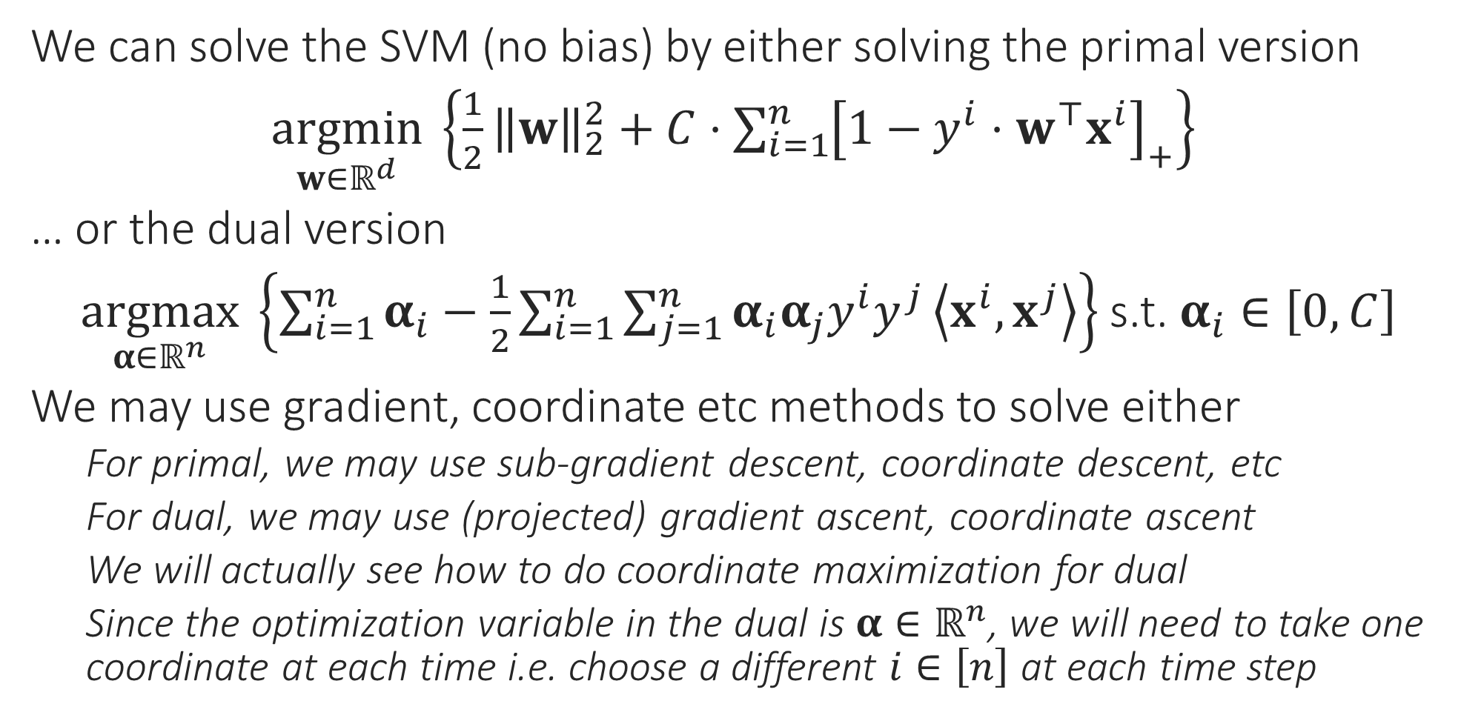
Solvers for the SVM problem
Sub-gradient since the primal objective is convex but non-differentiable
We can solve the SVM (no bias) by either solving the primal version
$\underset{w∈ℝ^{d}}{argmin} \left\{\frac{1}{2}{\left\|w\right\|}_{2}^{2}+C⋅\sum_{i=1}^{n}{{\left[1−y^{i}⋅w^{⊤}x^{i}\right]}_{+}}\right\}$
… or the dual version
$\underset{α∈ℝ^{n}}{argmax} \left\{\sum_{i=1}^{n}{α_{i}}−\frac{1}{2}\sum_{i=1}^{n}{\sum_{j=1}^{n}{α_{i}α_{j}y^{i}y^{j}}\left\langle x^{i},x^{j}\right\rangle }\right\}$ s.t. $α_{i}∈\left[0,C\right]$
We may use gradient, coordinate etc methods to solve either
For primal, we may use sub-gradient descent, coordinate descent, etc
For dual, we may use (projected) gradient ascent, coordinate ascent
We will actually see how to do coordinate maximization for dual
Since the optimization variable in the dual is $α∈ℝ^{n}$, we will need to take one coordinate at each time i.e. choose a different $i∈\left[n\right]$ at each time step
Yes, coordinate ascent in the dual looks a lot like stochastic gradient descent in the primal! Both work with a single data point at a time
Projected since we have a constraint (albeit a simple one) in the dual
Does this mean I need to choose one data point at each time step?

Slide 22
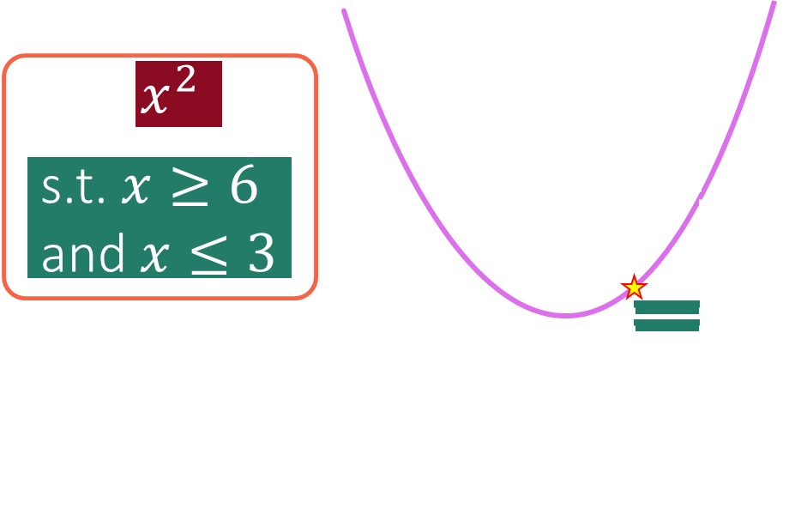

SDCM for the CSVM Problem
Warning: in general, finding an unconstrained solution and doing a projection step does not give a true solution
$\underset{α∈ℝ^{n}}{argmax} \left\{\sum_{i=1}^{n}{α_{i}}−\frac{1}{2}\sum_{i=1}^{n}{\sum_{j=1}^{n}{α_{i}α_{j}y^{i}y^{j}}\left\langle x^{i},x^{j}\right\rangle }\right\}$ s.t. $α_{i}∈\left[0,C\right]$ for all $i∈\left[n\right]$
Concentrating on just the terms that involve $α_{i}$ we get
$\underset{α_{i}∈ℝ}{argmax} \left\{α_{i}−\frac{1}{2}α_{i}^{2}{\left\|x^{i}\right\|}_{2}^{2}−α_{i}y^{i}⋅\sum_{j≠i}{α_{j}y^{j}}\left\langle x^{i},x^{j}\right\rangle \right\}$ s.t. $α_{i}∈\left[0,C\right]$
Renaming $x=α_{i}, q={\left\|x^{i}\right\|}_{2}^{2},p=y^{i}⋅\sum_{j≠i}{α_{j}y^{j}}\left\langle x^{i},x^{j}\right\rangle$, we get
$\arg{\min_{x}{\frac{1}{2}qx^{2}−x(1−p)}}$ s.t. $x∈\left[0,C\right]$
Solution is very simple: find unrestricted minimum i.e. $\tilde{x}=\left(1−p\right)/q$
If $\tilde{x}∈\left[0,C\right]$, solution is $\tilde{x}$ elif $\tilde{x}<0$, solution is $0$, else solution is $C$
Indeed! In this special case, our objective had a nice property called unimodality which is why this trick works – it won’t work in general

Slide 23
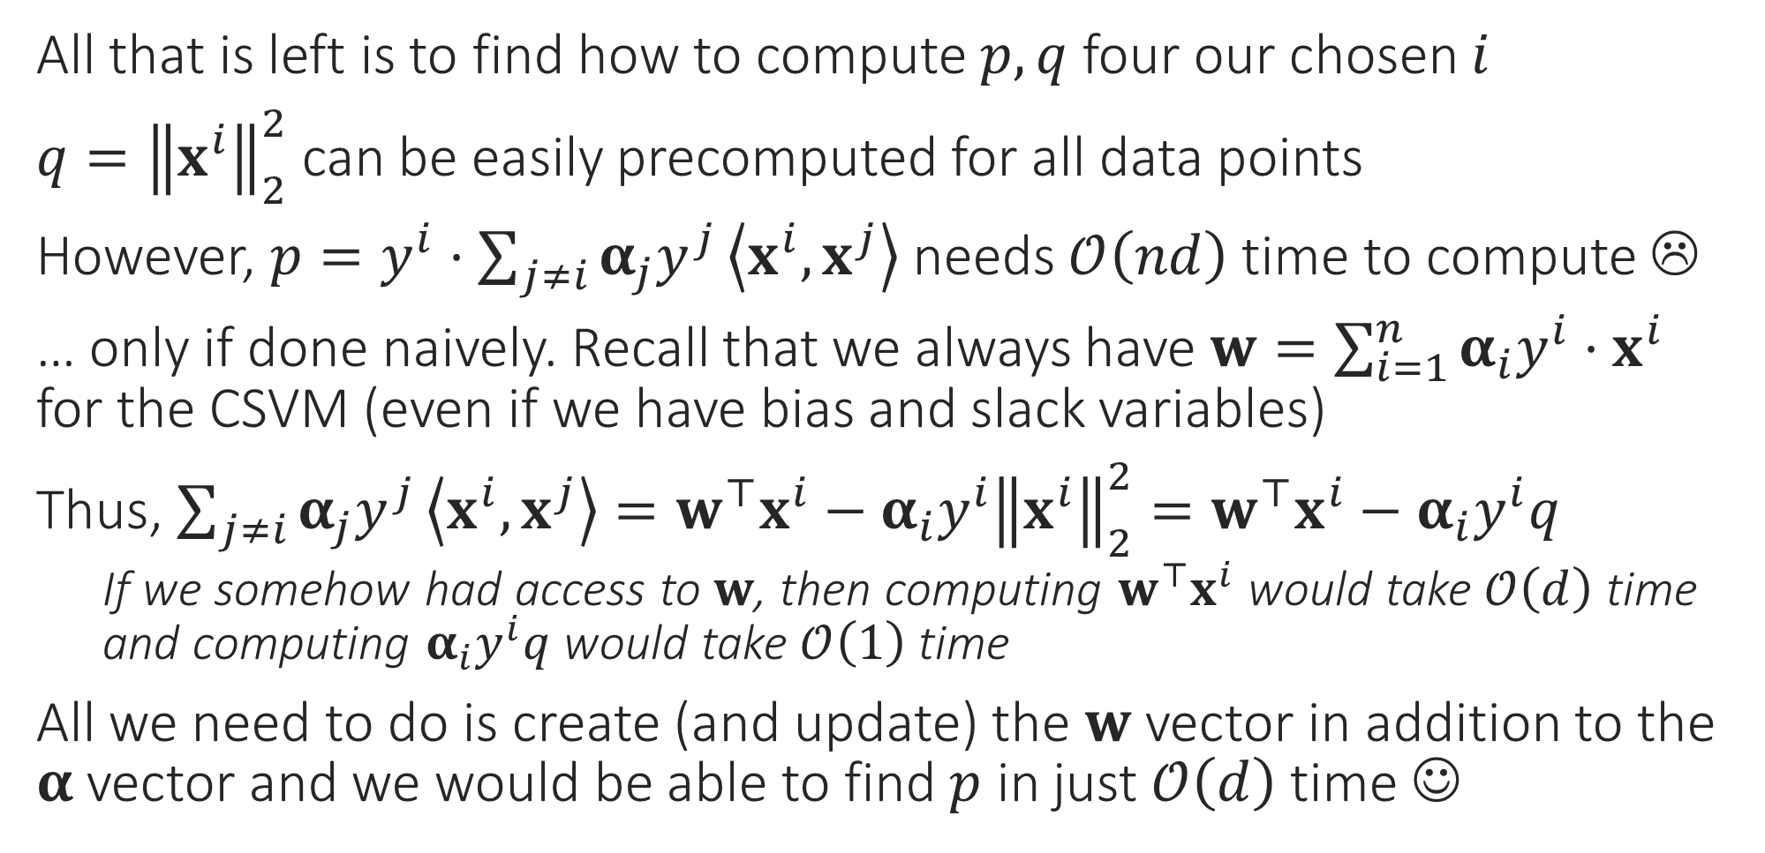
Speeding up SDCM computations
All that is left is to find how to compute $p,q$ four our chosen $i$
$q={\left\|x^{i}\right\|}_{2}^{2}$ can be easily precomputed for all data points
However, $p=y^{i}⋅\sum_{j≠i}{α_{j}y^{j}}\left\langle x^{i},x^{j}\right\rangle$ needs $𝒪\left(nd\right)$ time to compute ☹
… only if done naively. Recall that we always have $w=\sum_{i=1}^{n}{α_{i}y^{i}⋅x^{i}}$ for the CSVM (even if we have bias and slack variables)
Thus, $\sum_{j≠i}{α_{j}y^{j}}\left\langle x^{i},x^{j}\right\rangle =w^{⊤}x^{i}−α_{i}y^{i}{\left\|x^{i}\right\|}_{2}^{2}=w^{⊤}x^{i}−α_{i}y^{i}q$
If we somehow had access to $w$, then computing $w^{⊤}x^{i}$ would take $𝒪\left(d\right)$ time and computing $α_{i}y^{i}q$ would take $𝒪\left(1\right)$ time
All we need to do is create (and update) the $w$ vector in addition to the $α$ vector and we would be able to find $p$ in just $𝒪\left(d\right)$ time ☺

Slide 24


Which Method to Choose?
Can you work out the details on how to implement stochastic primal coordinate descent in $𝒪\left(n\right)$ time per update?
Gradient Methods
Primal Gradient Descent: $𝒪\left(nd\right)$ time per update
Dual Gradient Ascent: $𝒪\left(nd\right)$ time per update
Stochastic Gradient Methods
Stochastic Primal Gradient Descent: $𝒪\left(d\right)$ time per update
Stochastic Dual Gradient Ascent: $𝒪\left(n\right)$ time per update
Coordinate Methods: (take $𝒪\left(nd\right)$ time per update if done naively)
Stochastic Primal Coordinate Descent: $𝒪\left(n\right)$ time per update
Stochastic Dual Coordinate Maximization: $𝒪\left(d\right)$ time per update
Case 1: $n≫d$: use SDCM or SPGD ($𝒪\left(d\right)$ time per update)
Case 2: $d≫n$: use SDGA or SPCD ($𝒪\left(n\right)$ time per update)
Be careful not to get confused with similar sounding terms. Coordinate Ascent takes a small step along one of the coordinates to increase the objective a bit. Coordinate Maximization instead tries to completely maximize the objective along a coordinate
Also be careful that some books/papers may call a method as “Coordinate Ascent” even when it is really doing Coordinate Maximization. The terminology is unfortunately a bit non-standard

