Slide 1
Optimization for ML

Slide 2


Use Calculus for Optimization
Method 2: Perform (sub)gradient descent
Recall that direction opposite to gradient offers steepest descent
(SUB)GRADIENT DESCENT
Given: obj. func. $f:ℝ^{d}→ℝ$ to minimize
Initialize $w^{0}∈ℝ^{d}$
For $t=0, 1, …$
Obtain a (sub)gradient $g^{t}∈∂f\left(w^{t}\right)$
Choose a step length $η_{t}$
Update $w^{t+1}←w^{t}−η_{t}⋅g^{t}$
Repeat until convergence
How to initialize $w^{0}$?
How to choose $η_{t}$
Often called “step length” or “learning rate”
What is convergence?
How to decide if we have converged?

Slide 3

Non-differentiable Functions
The hinge loss function is not differentiable everywhere ☹
Can we define some form of gradient for non-diff functions as well?
Yes, if a function is convex, then no matter if it is non-differentiable, a notion of gradient called subgradient can always be defined for it
For convex differentiable functions, the gradient defines a tangent hyperplane at every point and the function must lie above this plane
Subgradients exploit and generalize this property ☺
Point of non-differentiability

Slide 4


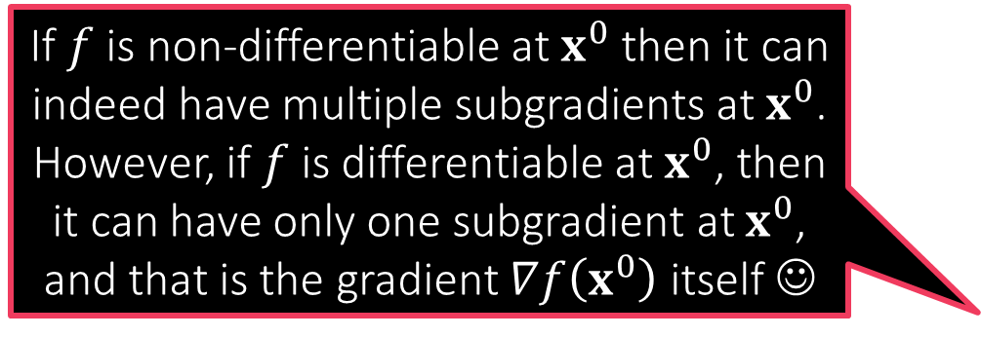

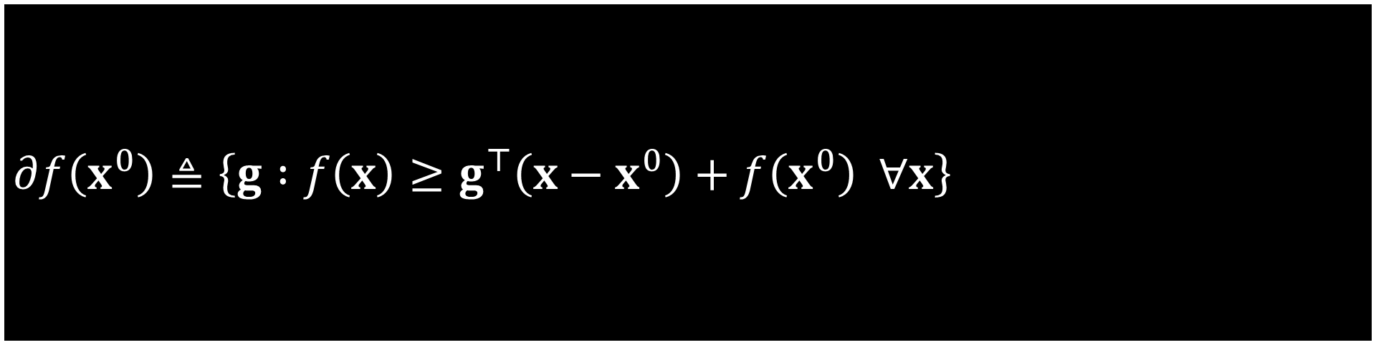
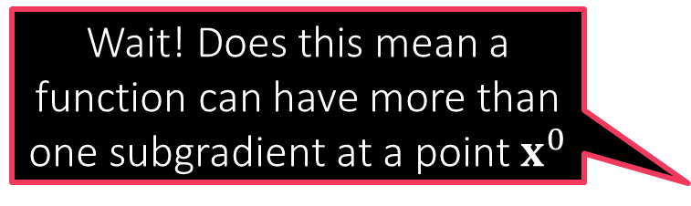
Subgradients and the subdifferential
How can I find out the subgradients of a function?
Wait! Does this mean a function can have more than one subgradient at a point $x^{0}$
Tangents of a convex differentiable function $f:ℝ^{d}→ℝ$ are uniquely linked to its gradients
The tangent at $x^{0}$ is the hyperplane $∇f{\left(x^{0}\right)}^{⊤}\left(x−x^{0}\right)+f\left(x^{0}\right)$
Convex functions lie above all tangents $f\left(x\right)≥∇f{\left(x^{0}\right)}^{⊤}\left(x−x^{0}\right)+f\left(x^{0}\right)$
Trick: turn the definition around and say that gradient at $x^{0}$ is a vector $g$ so that the hyperplane $g^{⊤}\left(x−x^{0}\right)+f\left(x^{0}\right)=0$ is tangent to $f$ at $x^{0}$
Subgradients: given a (possibly non-differentiable but convex) function $f:ℝ^{d}→ℝ$ and a point $x^{0}$, any vector $g$ that satisfies $f\left(x\right)≥g^{⊤}\left(x−x^{0}\right)+f\left(x^{0}\right)$ is called a subgradient of $f$ at $x^{0}$
Subdifferential: the set of all subgradients of $f$ at a point $x^{0}$ is known as the subdifferential of $f$ at $x^{0}$ and denoted by $∂f\left(x^{0}\right)$
If $f$ is non-differentiable at $x^{0}$ then it can indeed have multiple subgradients at $x^{0}$. However, if $f$ is differentiable at $x^{0}$, then it can have only one subgradient at $x^{0}$, and that is the gradient $∇f\left(x^{0}\right)$ itself ☺
$$∂f\left(x^{0}\right)≜\left\{g :f\left(x\right)≥g^{⊤}\left(x−x^{0}\right)+f\left(x^{0}\right) ∀x\right\}$$

Slide 5


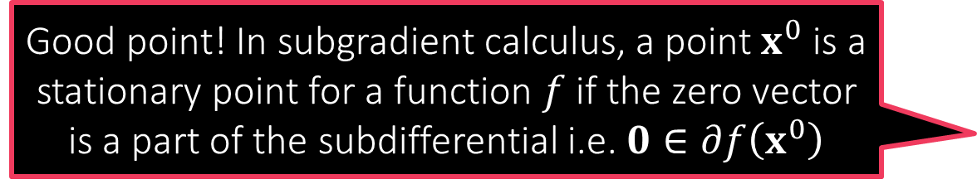



Subgradient Calculus
What about stationary points?
Good point! In subgradient calculus, a point $x^{0}$ is a stationary point for a function $f$ if the zero vector is a part of the subdifferential i.e. $0∈∂f\left(x^{0}\right)$
Gradient Calculus
$∇\left(c⋅f\right)\left(x\right)=c⋅∇f\left(x\right)$
$∇\left(f+g\right)\left(x\right)=∇f\left(x\right)+∇g\left(x\right)$
$∇f\left(a^{⊤}x+b\right)=f^{′}\left(a^{⊤}x+b\right)⋅a$
No counterpart in general
Subgradient Calculus
$∂\left(c⋅f\right)\left(x\right)=c⋅∂f\left(x\right)$
$=\left\{c⋅v :v∈∂f\left(x\right)\right\}$
$∂\left(f+g\right)\left(x\right)=∂f\left(x\right)+∂g\left(x\right)$
$=\left\{u+v :u∈∂f\left(x\right),v∈∂g\left(x\right)\right\}$
$∂f\left(a^{⊤}x+b\right)=∂f\left(a^{⊤}x+b\right)⋅a$
$=\left\{c⋅a :c∈∂f\left(a^{⊤}x+b\right)\right\}$
$h\left(x\right)=\max{ \left\{f\left(x\right),g\left(x\right)\right\}}$
Scaling Rule
Sum Rule
Chain Rule
Max Rule
$$x∈ℝ^{d},a∈ℝ^{d},b,c∈ℝ$$
Local minima/maxima must be stationary in this sense even for non-differentiable functions
If $f\left(x^{0}\right)>g\left(x^{0}\right),∂h\left(x^{0}\right)=∂f\left(x^{0}\right)$. If $g\left(x^{0}\right)>f\left(x^{0}\right),∂h\left(x^{0}\right)=∂g\left(x^{0}\right)$
If $f\left(x^{0}\right)=g\left(x^{0}\right), ∂h\left(x^{0}\right)=\{λu+\left(1−λ\right)v :u∈∂f\left(x^{0}\right),v∈∂g\left(x^{0}\right),λ∈\left[0,1\right]\}$

Slide 6
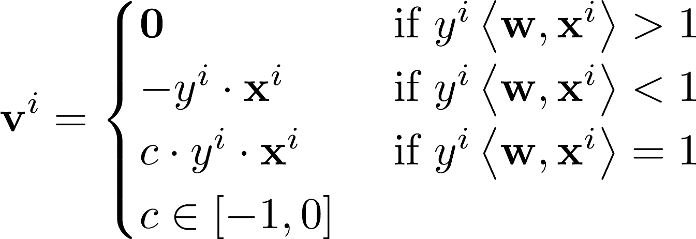

Example: subgradient for hinge loss
$ℓ_{hinge}\left(x\right)=\max\left\{1−x,0\right\}=\max{ \left\{f\left(x\right),g\left(x\right)\right\}}$
$ℓ_{hinge}$ is differentiable at all points except $x=1$
Thus, $∂ℓ_{hinge}\left(x\right)=ℓ_{hinge}^{′}\left(x\right)$ if $x≠1$
At $x=1$ use subdifferential calculus
$f\left(x\right)=1−x$ (differentiable) i.e. $∂f\left(x\right)=f^{′}\left(x\right)=−1$
$g\left(x\right)=0$ (differentiable) i.e. $∂g\left(x\right)=g^{′}\left(x\right)=0$
Thus, $∂ℓ_{hinge}\left(1\right)=\left\{λ⋅\left(−1\right)+\left(1−λ\right)⋅0 :λ∈\left[0,1\right]\right\}=\left[−1,0\right]$
Applying subgradient chain rule gives us

Slide 7
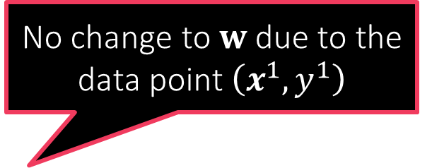

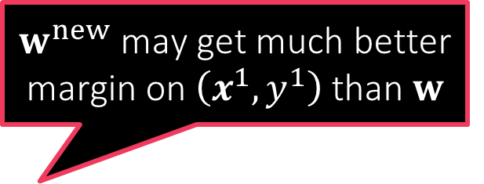
Behind the scenes in GD for SVM
So gradient descent, although a mathematical tool from calculus, actually tries very actively to make the model perform better on all data points
$f\left(w\right)=\frac{1}{2}{\left\|w\right\|}_{2}^{2}+C⋅{\sum_{i=1}^{n}{\left[1−y^{i}⋅w^{⊤}x^{i}\right]}}_{+}$ (ignore bias $b$ for now)
$∇f\left(w\right)=w+C⋅\sum_{i=1}^{n}{g^{i}y^{i}⋅x^{i}}$, where $g^{i}∈∂ℓ_{hinge}\left(y^{i}⋅w^{⊤}x^{i}\right)$
$w^{new}=w−η⋅∇f\left(w\right)=\left(1−η\right)⋅w−ηC⋅\sum_{i=1}^{n}{g^{i}y^{i}⋅x^{i}}$
Assume $n=1$ for a moment for sake of understanding
$w^{new}=\left(1−η\right)⋅w−ηC⋅g^{1}y^{1}⋅x^{1}$
Small $η$: $\left(1−η\right)$ is large $⇒$ do not change $w$ too much!
Large $η$: Feel free to change $w$ as much as the gradient dictates
If $w$ does well on $\left(x^{1},y^{1}\right)$, say $y^{1}⋅w^{⊤}x^{1}>1$, then $g^{1}=0$
If $w$ does badly on $\left(x^{1},y^{1}\right)$, say $y^{1}⋅w^{⊤}x^{1}<0$, then $g^{1}=−1$
$w^{new}=\left(1−η\right)⋅w+ηC⋅y^{1}⋅x^{1}$
$y^{1}⋅{\left(w^{new}\right)}^{⊤}⋅x^{1}={\left(1−η\right)y}^{1}⋅w^{⊤}x^{1}+ηC⋅{\left\|x^{1}\right\|}_{2}^{2}$
No change to $w$ due to the data point $\left(x^{1},y^{1}\right)$
$w^{new}$ may get much better margin on $\left(x^{1},y^{1}\right)$ than $w$

Slide 8
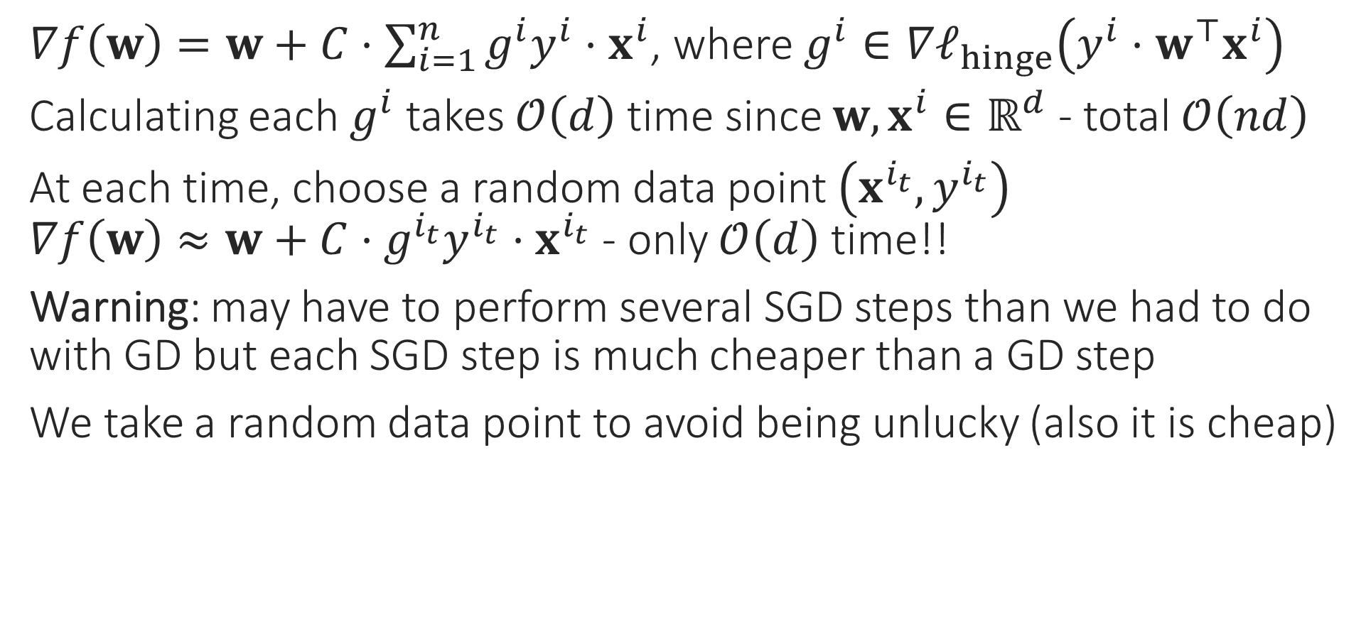
Stochastic Gradient Method
$∇f\left(w\right)=w+C⋅\sum_{i=1}^{n}{g^{i}y^{i}⋅x^{i}}$, where $g^{i}∈∇ℓ_{hinge}\left(y^{i}⋅w^{⊤}x^{i}\right)$
Calculating each $g^{i}$ takes $𝒪\left(d\right)$ time since $w,x^{i}∈ℝ^{d}$ - total $𝒪\left(nd\right)$
At each time, choose a random data point $\left(x^{i_{t}},y^{i_{t}}\right)$ $∇f\left(w\right)≈w+C⋅g^{i_{t}}y^{i_{t}}⋅x^{i_{t}}$ - only $𝒪\left(d\right)$ time!!
Warning: may have to perform several SGD steps than we had to do with GD but each SGD step is much cheaper than a GD step
We take a random data point to avoid being unlucky (also it is cheap)
Do we really need to spend so much time on just one update?
Initially, all we need is a general direction in which to move
Especially in the beginning, when we are far away from the optimum!
No, SGD gives a cheaper way to perform gradient descent

Slide 9
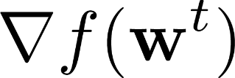
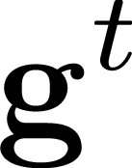
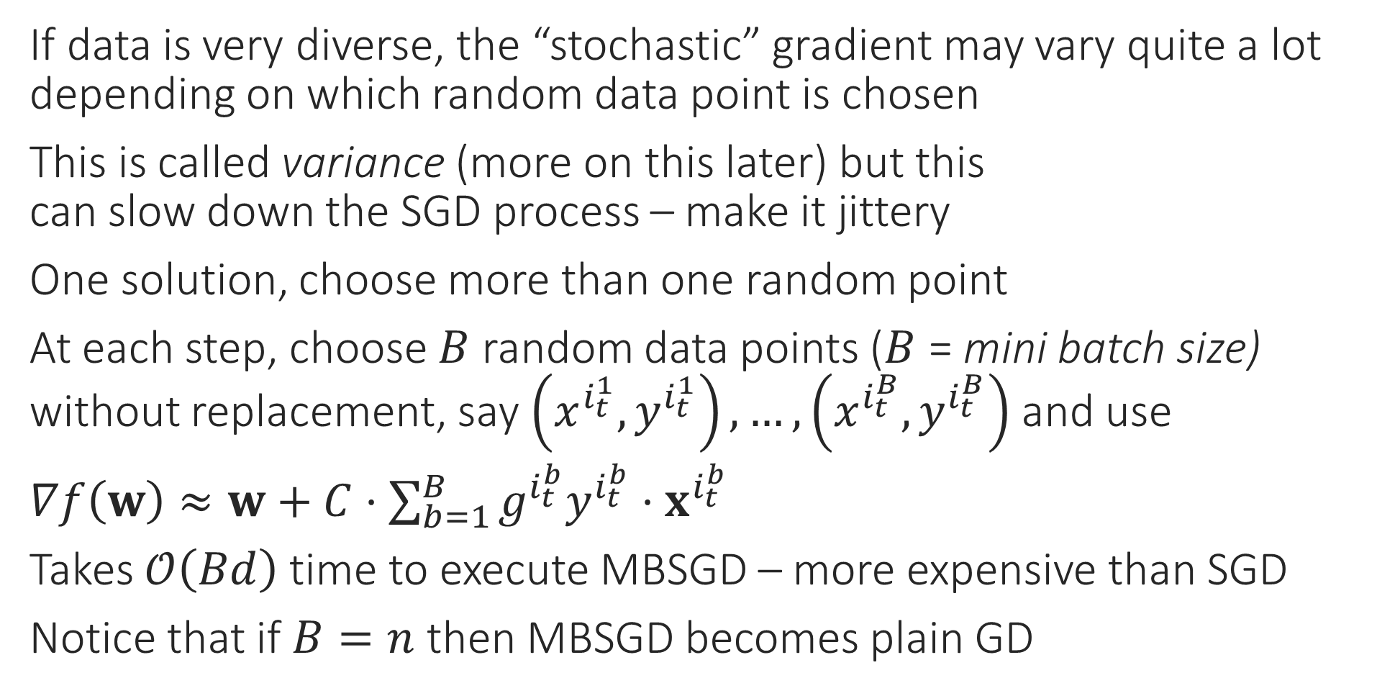
Mini-batch SGD
If data is very diverse, the “stochastic” gradient may vary quite a lot depending on which random data point is chosen
This is called variance (more on this later) but this can slow down the SGD process – make it jittery
One solution, choose more than one random point
At each step, choose $B$ random data points ($B$ = mini batch size) without replacement, say $\left(x^{i_{t}^{1}},y^{i_{t}^{1}}\right),…,\left(x^{i_{t}^{B}},y^{i_{t}^{B}}\right)$ and use
$∇f\left(w\right)≈w+C⋅\sum_{b=1}^{B}{g^{i_{t}^{b}}y^{i_{t}^{b}}⋅x^{i_{t}^{b}}}$
Takes $𝒪\left(Bd\right)$ time to execute MBSGD – more expensive than SGD
Notice that if $B=n$ then MBSGD becomes plain GD

Slide 10



Coordinate Descent
Sometimes we are able to optimize completely along a given variable (even if constraints are there) – called coordinate minimization (CM)
Similar to GD except only one coordinate is changed in a single step
E.g. $\min_{x∈ℝ^{d}}{f\left(x\right)}$ s.t. $x∈𝒞$ with $∇_{j}f\left(x\right)=\frac{∂f}{∂x_{j}}$ as $j$th partial derivative
CCD: choose coordinate cyclically i.e. $j_{t}=1,2,…,d,1,2,…,d,…$
SCD: choose $j_{t}$ randomly
Block CD: choose a small set of coordinates at each $t$ to update
Randperm: permute coordinates randomly and choose them in that order. Once the list is over, choose a new random permutation and start over (very effective)
COORDINATE DESCENT
1. For $t=0,1,…$
Select a coordinate $j_{t}∈\left[d\right]$
Let $u_{j_{t}}^{t+1}←x_{j_{t}}^{t}−η_{t}⋅∇_{j_{t}}f\left(x^{t}\right)$
Let $u_{j}^{t+1}←x_{j}^{t}$ for $j≠j_{t}$
Repeat until convergence

Slide 11



Which Method to Choose?
Can you work out the details on how to implement stochastic primal coordinate descent in $𝒪\left(n\right)$ time per update?
Gradient Methods
Primal Gradient Descent: $𝒪\left(nd\right)$ time per update
Dual Gradient Ascent: $𝒪\left(nd\right)$ time per update
Stochastic Gradient Methods
Stochastic Primal Gradient Descent: $𝒪\left(d\right)$ time per update
Stochastic Dual Gradient Ascent: $𝒪\left(n\right)$ time per update
Coordinate Methods: (take $𝒪\left(nd\right)$ time per update if done naively)
Stochastic Primal Coordinate Descent: $𝒪\left(n\right)$ time per update
Stochastic Dual Coordinate Maximization: $𝒪\left(d\right)$ time per update
Case 1: $n≫d$: use SDCM or SPGD ($𝒪\left(d\right)$ time per update)
Case 2: $d≫n$: use SDGA or SPCD ($𝒪\left(n\right)$ time per update)
Be careful not to get confused with similar sounding terms. Coordinate Ascent takes a small step along one of the coordinates to increase the objective a bit. Coordinate Maximization instead tries to completely maximize the objective along a coordinate
Also be careful that some books/papers may call a method as “Coordinate Ascent” even when it is really doing Coordinate Maximization. The terminology is unfortunately a bit non-standard

Slide 12
Practical Issues with GD Variants
How to initialize?
How to decide convergence?
How to decide step lengths?

Slide 13
How to Initialize?
Initializing close to the global optimum is obviously preferable ☺
Easier said than done. In some applications however, we may have such initialization e.g. someone may have a model they trained on different data
For convex functions, bad initialization may mean slow convergence, but if step lengths are nice then GD should converge eventually
For non-convex functions (e.g. while training deepnets), bad initialization may mean getting stuck at a very bad saddle point
Random restarts most common solution to overcome this problem
For some nice non-convex problems, we do know very good ways to provably initialize close to the global optimum (e.g. collaborative filtering in recommendation systems) – details beyond scope of CS771

Slide 14
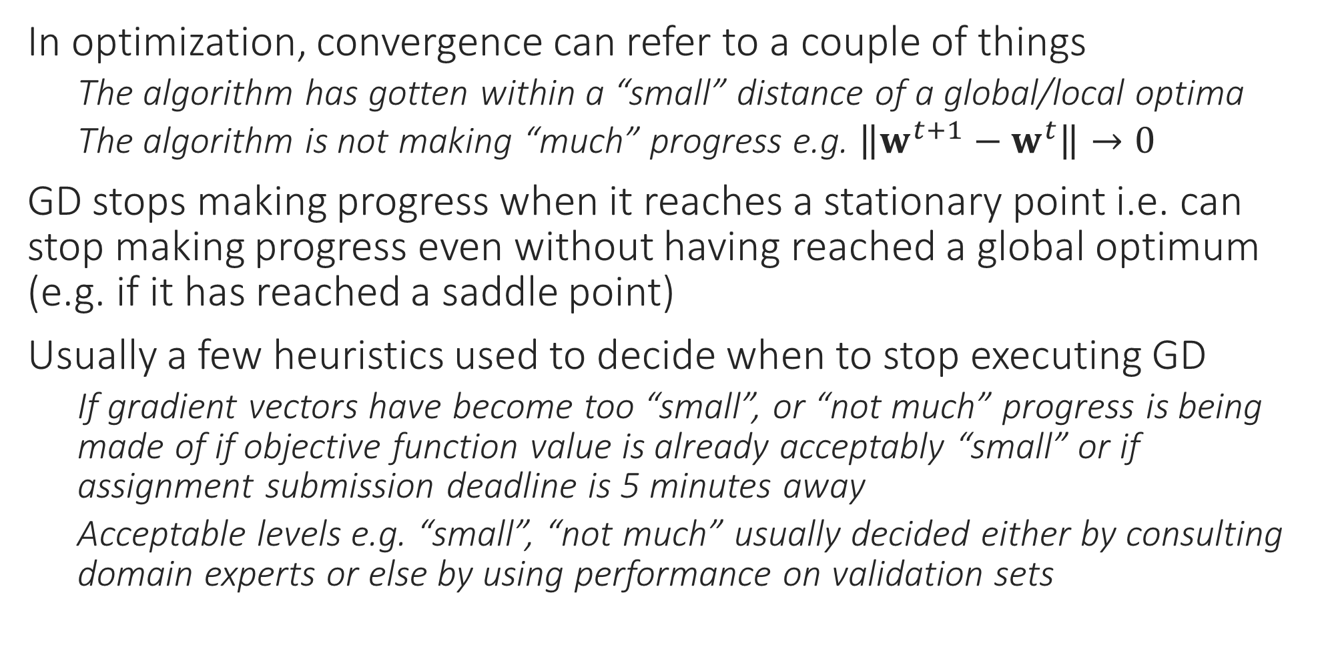
How to decide Convergence?
In optimization, convergence can refer to a couple of things
The algorithm has gotten within a “small” distance of a global/local optima
The algorithm is not making “much” progress e.g. $\left\|w^{t+1}−w^{t}\right\|→0$
GD stops making progress when it reaches a stationary point i.e. can stop making progress even without having reached a global optimum (e.g. if it has reached a saddle point)
Usually a few heuristics used to decide when to stop executing GD
If gradient vectors have become too “small”, or “not much” progress is being made of if objective function value is already acceptably “small” or if assignment submission deadline is 5 minutes away
Acceptable levels e.g. “small”, “not much” usually decided either by consulting domain experts or else by using performance on validation sets

Slide 15
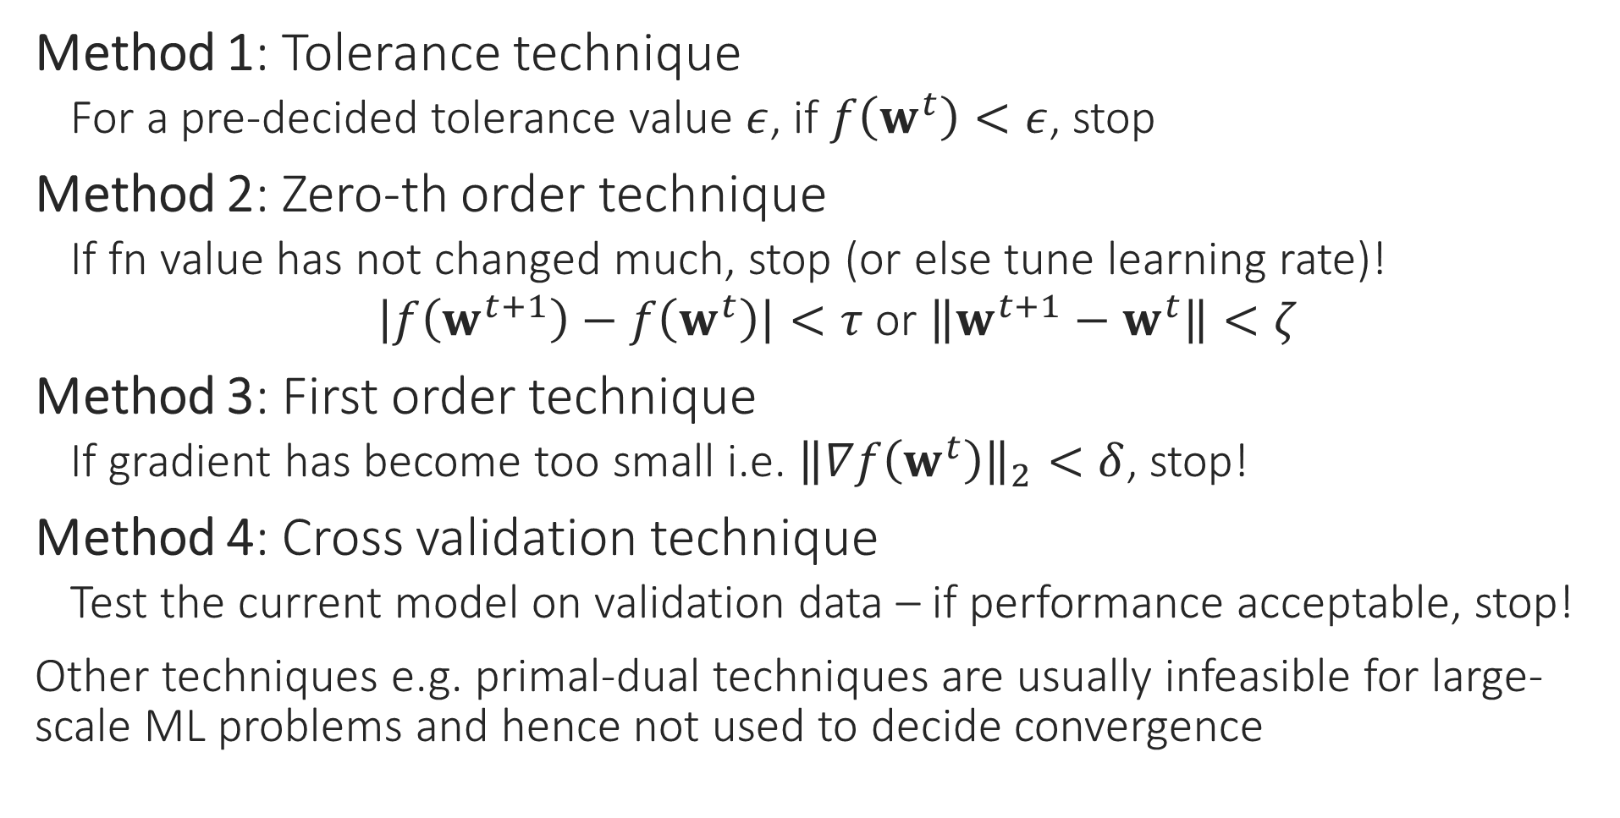
How to detect convergence
Method 1: Tolerance technique
For a pre-decided tolerance value $ε$, if $f\left(w^{t}\right)<ε$, stop
Method 2: Zero-th order technique
If fn value has not changed much, stop (or else tune learning rate)!
$\left|f\left(w^{t+1}\right)−f\left(w^{t}\right)\right|<τ$ or $\left\|w^{t+1}−w^{t}\right\|<ζ$
Method 3: First order technique
If gradient has become too small i.e. ${\left\|∇f\left(w^{t}\right)\right\|}_{2}<δ$, stop!
Method 4: Cross validation technique
Test the current model on validation data – if performance acceptable, stop!
Other techniques e.g. primal-dual techniques are usually infeasible for large-scale ML problems and hence not used to decide convergence

Slide 16
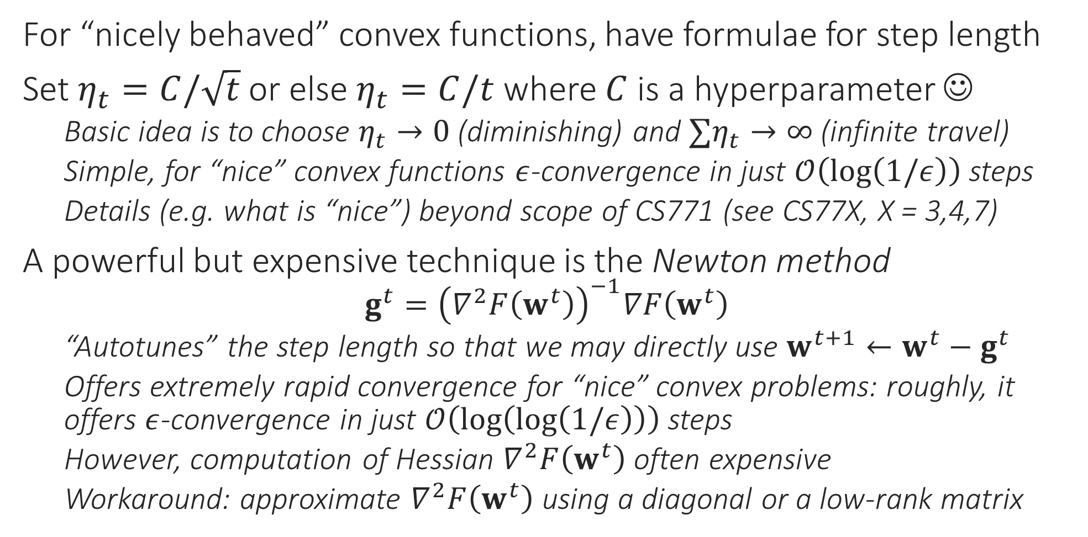
How to choose Step Length?
For “nicely behaved” convex functions, have formulae for step length
Set $η_{t}=C/\sqrt{t}$ or else $η_{t}=C/t$ where $C$ is a hyperparameter ☺
Basic idea is to choose $η_{t}→0$ (diminishing) and $∑η_{t}→∞$ (infinite travel)
Simple, for “nice” convex functions $ε$-convergence in just $𝒪\left(\log\left(1/ε\right)\right)$ steps
Details (e.g. what is “nice”) beyond scope of CS771 (see CS77X, X = 3,4,7)
A powerful but expensive technique is the Newton method
$$g^{t}={\left(∇^{2}F\left(w^{t}\right)\right)}^{−1}∇F\left(w^{t}\right)$$
“Autotunes” the step length so that we may directly use $w^{t+1}←w^{t}−g^{t}$
Offers extremely rapid convergence for “nice” convex problems: roughly, it offers $ε$-convergence in just $𝒪\left(\log\left(\log\left(1/ε\right)\right)\right)$ steps
However, computation of Hessian $∇^{2}F\left(w^{t}\right)$ often expensive
Workaround: approximate $∇^{2}F\left(w^{t}\right)$ using a diagonal or a low-rank matrix

Slide 17
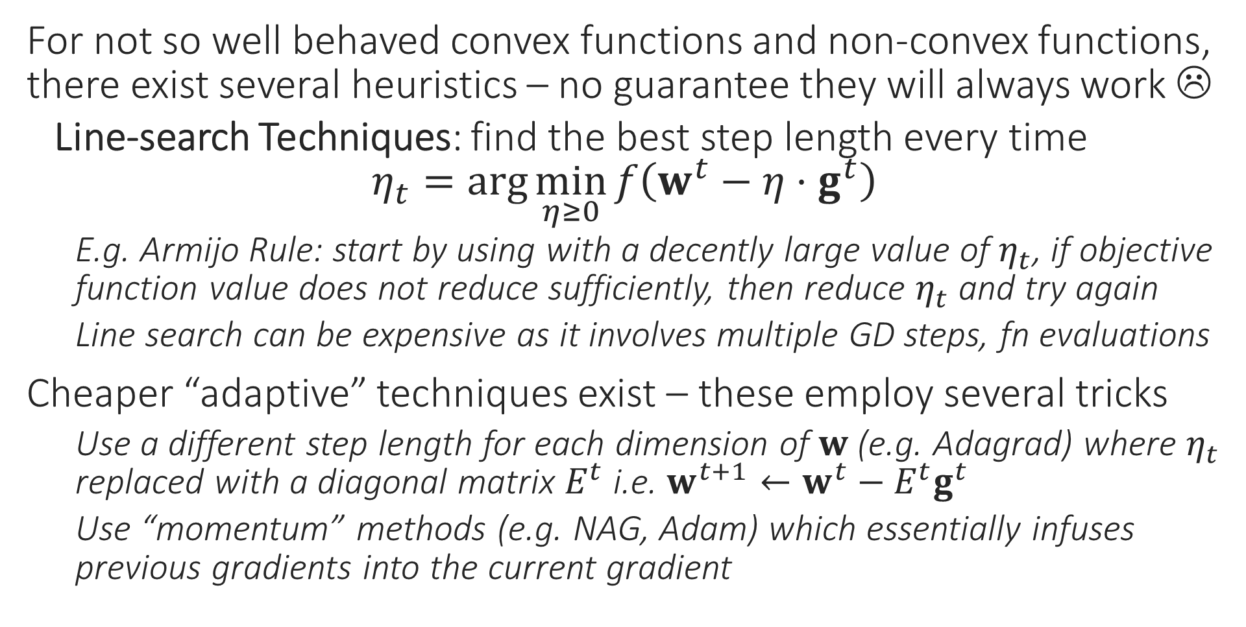
How to choose Step Length?
For not so well behaved convex functions and non-convex functions, there exist several heuristics – no guarantee they will always work ☹
Line-search Techniques: find the best step length every time $η_{t}=\arg{\min_{η≥0}{f\left(w^{t}−η⋅g^{t}\right)}}$
E.g. Armijo Rule: start by using with a decently large value of $η_{t}$, if objective function value does not reduce sufficiently, then reduce $η_{t}$ and try again
Line search can be expensive as it involves multiple GD steps, fn evaluations
Cheaper “adaptive” techniques exist – these employ several tricks
Use a different step length for each dimension of $w$ (e.g. Adagrad) where $η_{t}$ replaced with a diagonal matrix $E^{t}$ i.e. $w^{t+1}←w^{t}−E^{t}g^{t}$
Use “momentum” methods (e.g. NAG, Adam) which essentially infuses previous gradients into the current gradient

Slide 18
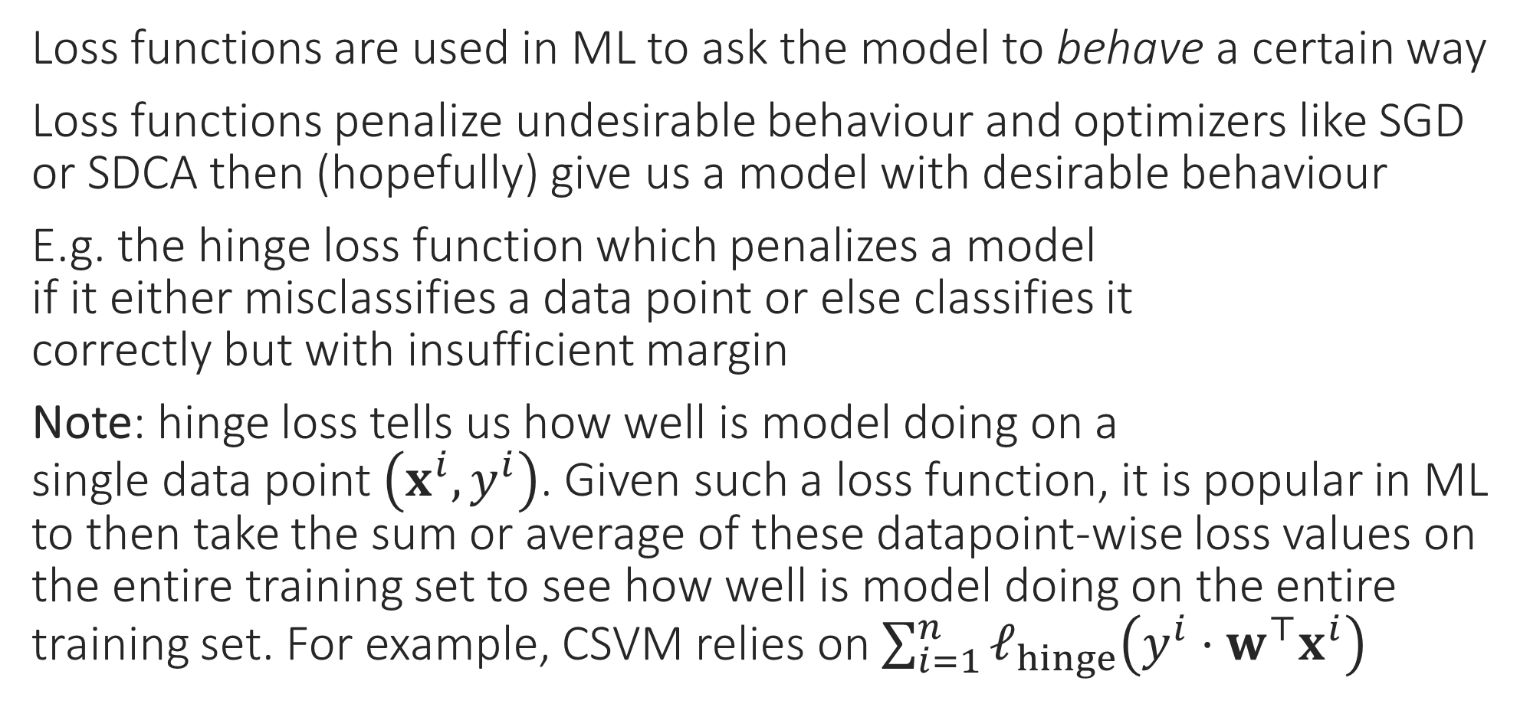

Loss Functions
Loss functions are used in ML to ask the model to behave a certain way
Loss functions penalize undesirable behaviour and optimizers like SGD or SDCA then (hopefully) give us a model with desirable behaviour
E.g. the hinge loss function which penalizes a model if it either misclassifies a data point or else classifies it correctly but with insufficient margin
Note: hinge loss tells us how well is model doing on a single data point $\left(x^{i},y^{i}\right)$. Given such a loss function, it is popular in ML to then take the sum or average of these datapoint-wise loss values on the entire training set to see how well is model doing on the entire training set. For example, CSVM relies on $\sum_{i=1}^{n}{ℓ_{hinge}\left(y^{i}⋅w^{⊤}x^{i}\right)}$
$$ℓ_{hinge}\left(y^{i}⋅w^{⊤}x^{i}\right)={\left[1−y^{i}⋅w^{⊤}x^{i}\right]}_{+}$$

Slide 19
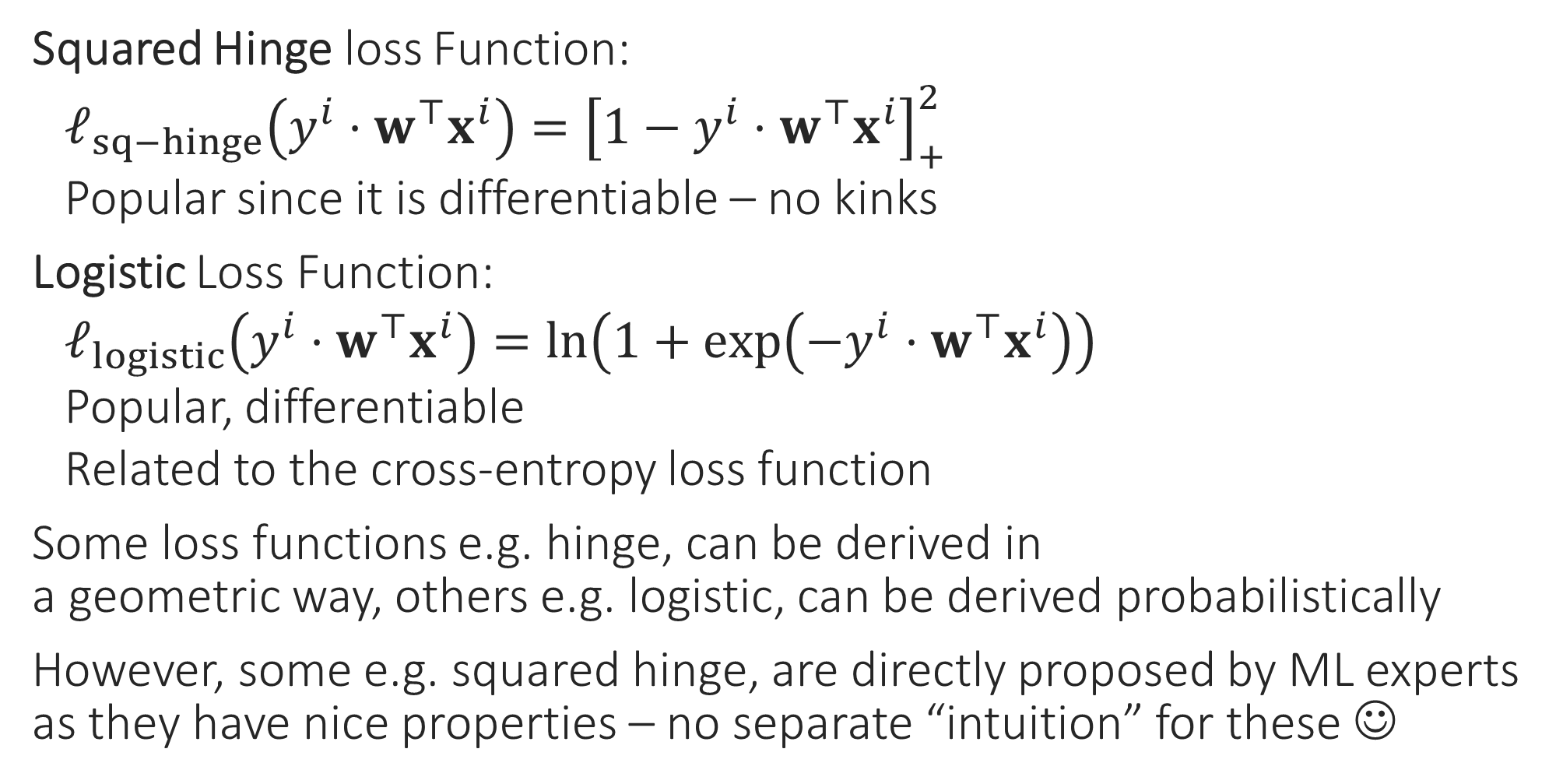
Other Classification Loss Functions
Squared Hinge loss Function:
$ℓ_{sq−hinge}\left(y^{i}⋅w^{⊤}x^{i}\right)={\left[1−y^{i}⋅w^{⊤}x^{i}\right]}_{+}^{2}$
Popular since it is differentiable – no kinks
Logistic Loss Function:
$ℓ_{logistic}\left(y^{i}⋅w^{⊤}x^{i}\right)=\ln\left(1+\exp\left(−y^{i}⋅w^{⊤}x^{i}\right)\right)$
Popular, differentiable
Related to the cross-entropy loss function
Some loss functions e.g. hinge, can be derived in a geometric way, others e.g. logistic, can be derived probabilistically
However, some e.g. squared hinge, are directly proposed by ML experts as they have nice properties – no separate “intuition” for these ☺

Slide 20
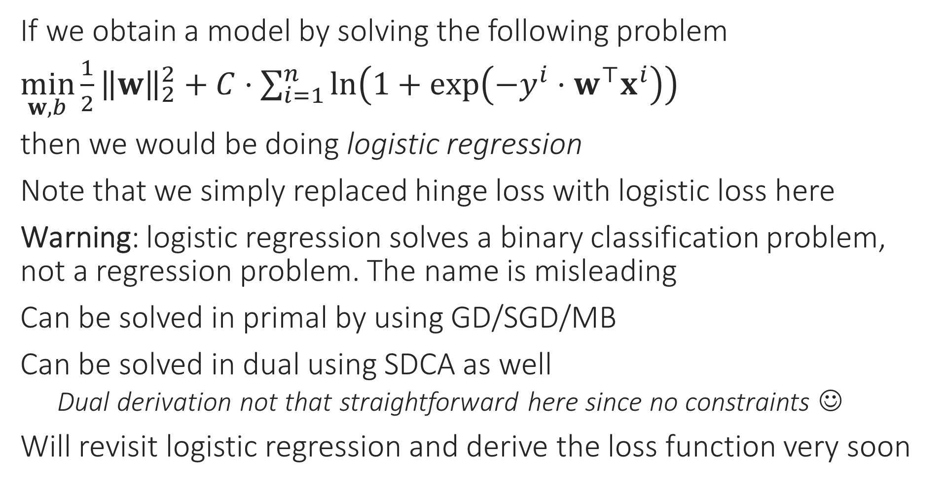
Logistic Regression
If we obtain a model by solving the following problem
$\min_{w,b}{\frac{1}{2}{\left\|w\right\|}_{2}^{2}}+C⋅\sum_{i=1}^{n}{\ln\left(1+\exp\left(−y^{i}⋅w^{⊤}x^{i}\right)\right)}$
then we would be doing logistic regression
Note that we simply replaced hinge loss with logistic loss here
Warning: logistic regression solves a binary classification problem, not a regression problem. The name is misleading
Can be solved in primal by using GD/SGD/MB
Can be solved in dual using SDCA as well
Dual derivation not that straightforward here since no constraints ☺
Will revisit logistic regression and derive the loss function very soon

Slide 21
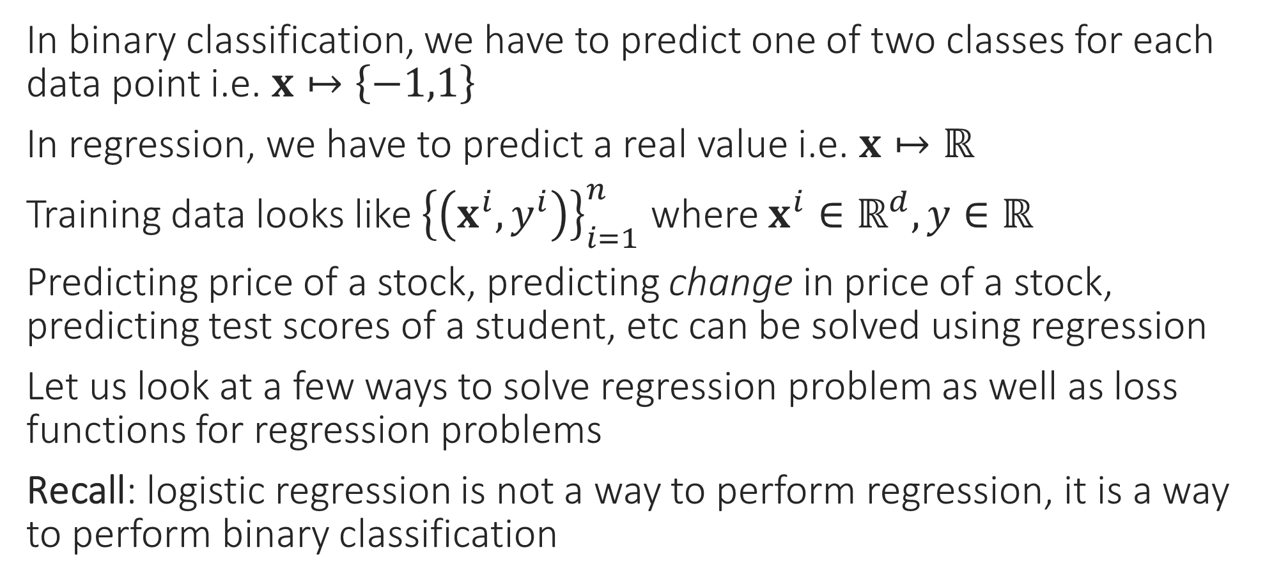
Regression Problems
In binary classification, we have to predict one of two classes for each data point i.e. $x↦\left\{−1,1\right\}$
In regression, we have to predict a real value i.e. $x↦ℝ$
Training data looks like ${\left\{\left(x^{i},y^{i}\right)\right\}}_{i=1}^{n}$ where $x^{i}∈ℝ^{d},y∈ℝ$
Predicting price of a stock, predicting change in price of a stock, predicting test scores of a student, etc can be solved using regression
Let us look at a few ways to solve regression problem as well as loss functions for regression problems
Recall: logistic regression is not a way to perform regression, it is a way to perform binary classification

Slide 22

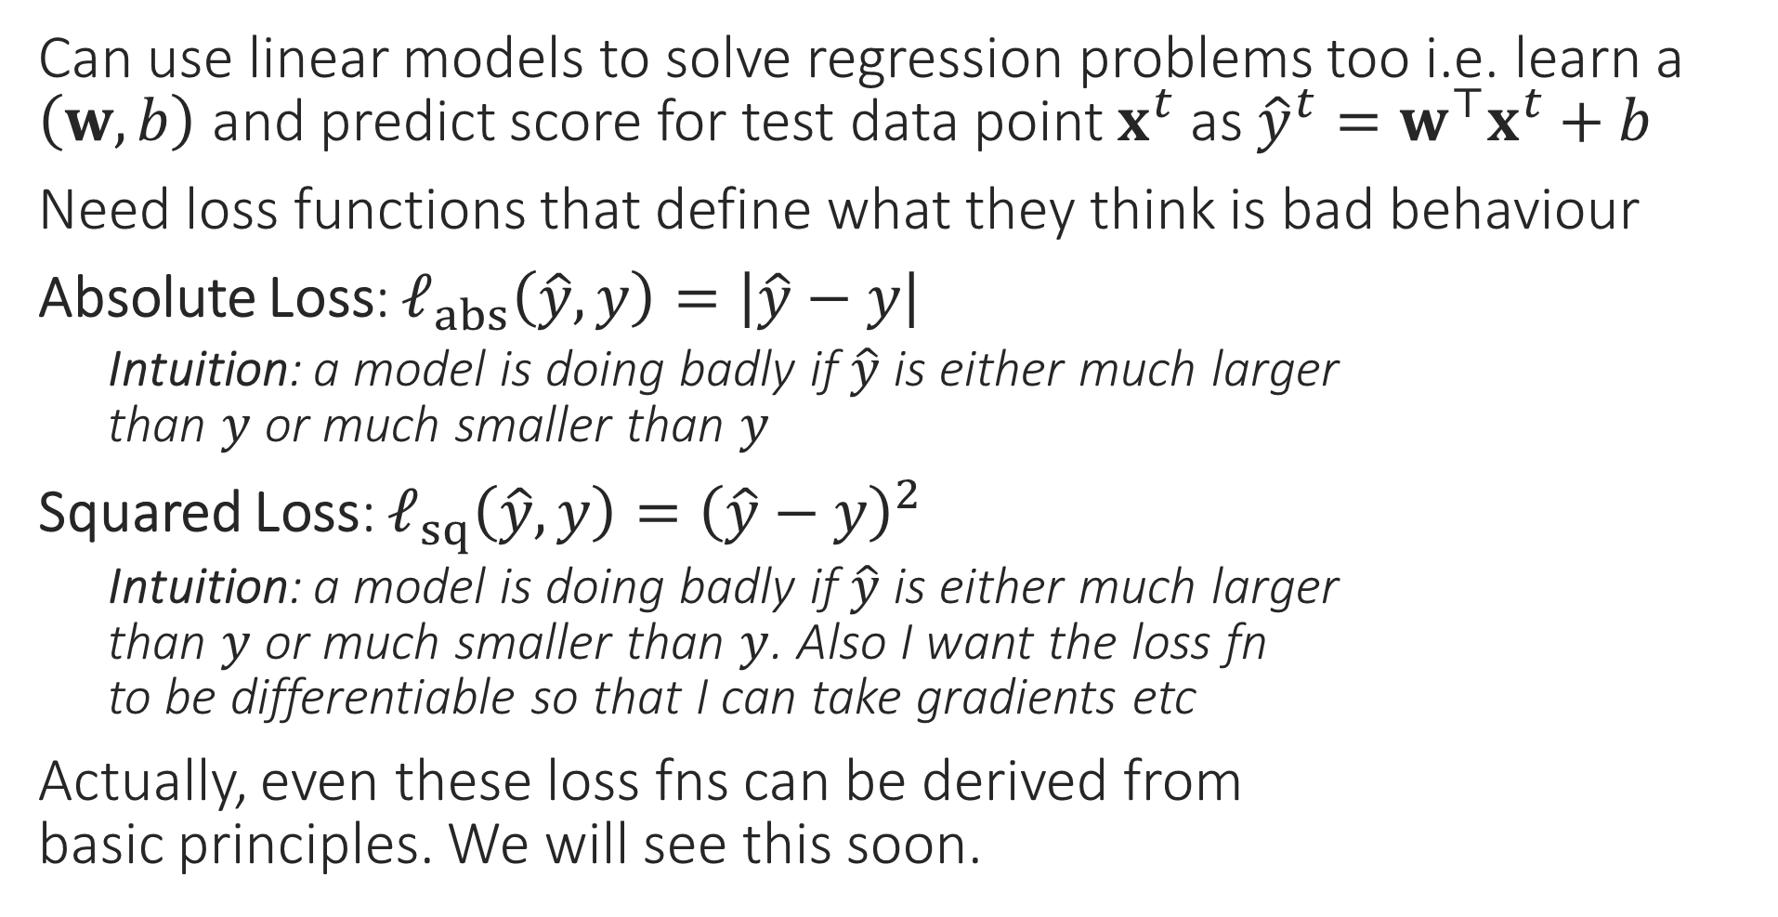
Loss Functions for Regression Problems
Can use linear models to solve regression problems too i.e. learn a $\left(w,b\right)$ and predict score for test data point $x^{t}$ as ${\hat{y}}^{t}=w^{⊤}x^{t}+b$
Need loss functions that define what they think is bad behaviour
Absolute Loss: $ℓ_{abs}\left(\hat{y},y\right)=\left|\hat{y}−y\right|$
Intuition: a model is doing badly if $\hat{y}$ is either much larger than $y$ or much smaller than $y$
Squared Loss: $ℓ_{sq}\left(\hat{y},y\right)={\left(\hat{y}−y\right)}^{2}$
Intuition: a model is doing badly if $\hat{y}$ is either much larger than $y$ or much smaller than $y$. Also I want the loss fn to be differentiable so that I can take gradients etc
Actually, even these loss fns can be derived from basic principles. We will see this soon.

Slide 23
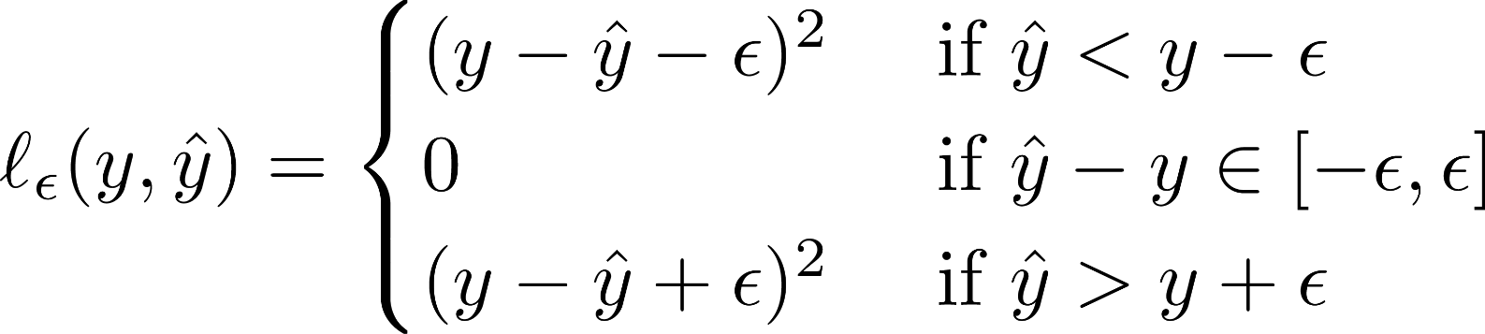
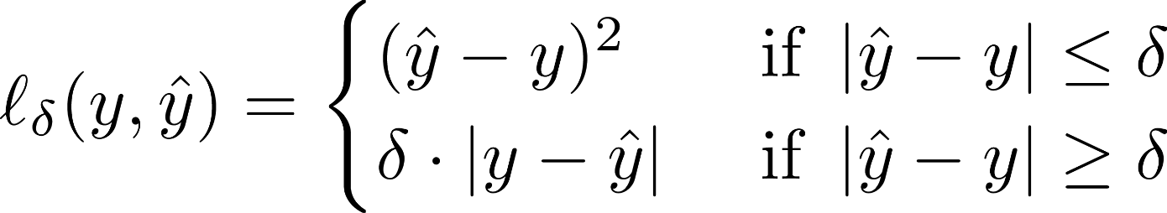

Loss Functions for Regression Problems
Loss functions have to be chosen according to needs of the problem and experience. Eg. Huber loss popular if some data points are corrupted. However, some loss functions are very popular in ML for various reasons e.g. hinge/cross entropy for binary classification, squared for regression
Vapnik’s $ε$-insensitive Loss:
Intuition: if a model is doing slightly badly, don’t penalize it at all, else penalize it as squared loss. Ensure a differentiable fn
Huber Loss:
Intuition: if a model is doing slightly badly, penalize it as squared loss, if doing very badly, penalize it as absolute loss. Also, please ensure a differentiable fn
Indeed, notice that the Huber loss function penalizes large deviations less strictly that the squared loss function (the purple curve is much below the dotted red curve). Doing so may be a good idea in corrupted data settings since it tells the optimizer to not worry too much about corrupted points

Slide 24
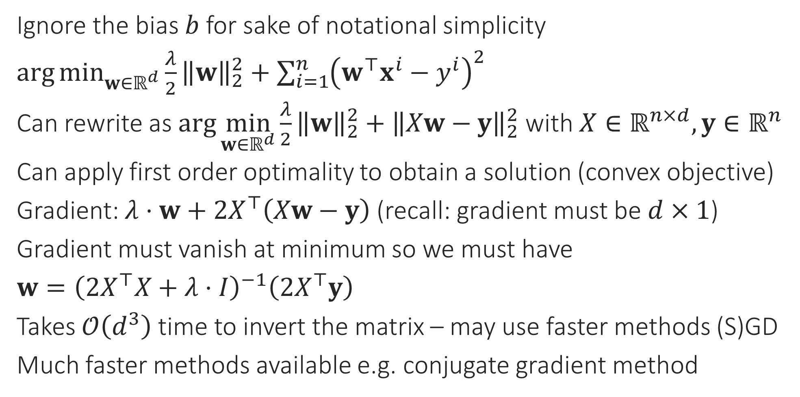

Ridge Regression
Ridge regression uses least squares loss and $L_{2}$ regularization. However the term “least squares regression” is often used to refer to ridge regression ☺
Ignore the bias $b$ for sake of notational simplicity
$\arg{\min_{w∈ℝ^{d}}{\frac{λ}{2}{\left\|w\right\|}_{2}^{2}}+\sum_{i=1}^{n}{{\left(w^{⊤}x^{i}−y^{i}\right)}^{2}}}$
Can rewrite as $\arg{\min_{w∈ℝ^{d}}{\frac{λ}{2}{\left\|w\right\|}_{2}^{2}}+{\left\|Xw−y\right\|}_{2}^{2}}$ with $X∈ℝ^{n×d},y∈ℝ^{n}$
Can apply first order optimality to obtain a solution (convex objective)
Gradient: $λ⋅w+2X^{⊤}\left(Xw−y\right)$ (recall: gradient must be $d×1$)
Gradient must vanish at minimum so we must have
$w={\left(2X^{⊤}X+λ⋅I\right)}^{−1}\left(2X^{⊤}y\right)$
Takes $𝒪\left(d^{3}\right)$ time to invert the matrix – may use faster methods (S)GD
Much faster methods available e.g. conjugate gradient method
Could have used $\arg{\min_{w∈ℝ^{d}}{\frac{1}{2}{\left\|w\right\|}_{2}^{2}}+C⋅\sum_{i=1}^{n}{{\left(w^{⊤}x^{i}−y^{i}\right)}^{2}}}$ too but it is customary in regression to write the optimization problem a bit differently
Even here, we may use dual methods like SDCA (liblinear etc do indeed use them) but yet again, deriving the dual is not as straightforward here since there are no constraints in the original problem
If we want to use fancier loss functions like Vapnik’s loss function, then cannot apply first order optimality, need to use SGD, SDCA etc methods

Slide 25
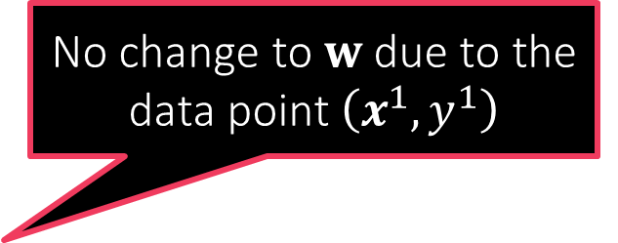
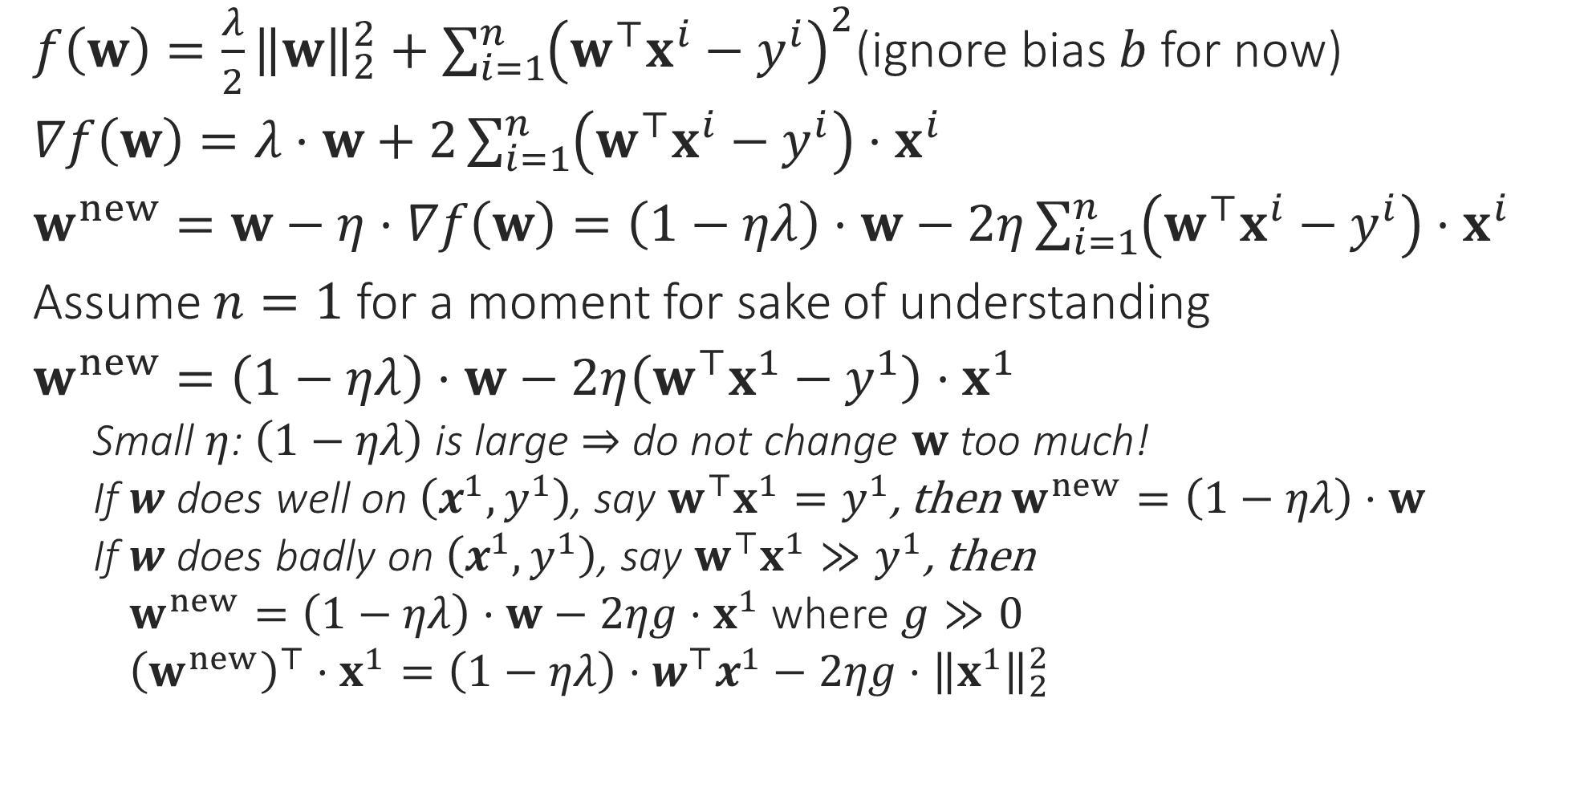

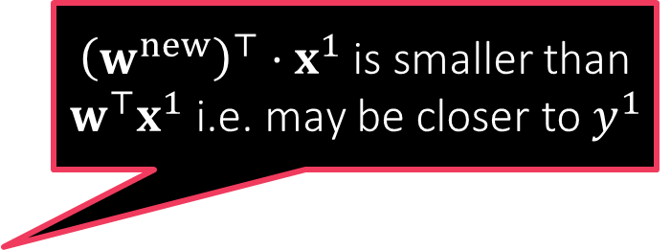
Behind the scenes: GD for Ridge Regression
$f\left(w\right)=\frac{λ}{2}{\left\|w\right\|}_{2}^{2}+\sum_{i=1}^{n}{{\left(w^{⊤}x^{i}−y^{i}\right)}^{2}}$(ignore bias $b$ for now)
$∇f\left(w\right)=λ⋅w+2\sum_{i=1}^{n}{\left(w^{⊤}x^{i}−y^{i}\right)⋅x^{i}}$
$w^{new}=w−η⋅∇f\left(w\right)=\left(1−ηλ\right)⋅w−2η\sum_{i=1}^{n}{\left(w^{⊤}x^{i}−y^{i}\right)⋅x^{i}}$
Assume $n=1$ for a moment for sake of understanding
$w^{new}=\left(1−ηλ\right)⋅w−2η\left(w^{⊤}x^{1}−y^{1}\right)⋅x^{1}$
Small $η$: $\left(1−ηλ\right)$ is large $⇒$ do not change $w$ too much!
If $w$ does well on $\left(x^{1},y^{1}\right)$, say $w^{⊤}x^{1}=y^{1}$, then $w^{new}=\left(1−ηλ\right)⋅w$
If $w$ does badly on $\left(x^{1},y^{1}\right)$, say $w^{⊤}x^{1}≫y^{1}$, then
$w^{new}=\left(1−ηλ\right)⋅w−2ηg⋅x^{1}$ where $g≫0$
${\left(w^{new}\right)}^{⊤}⋅x^{1}=\left(1−ηλ\right)⋅w^{⊤}x^{1}−2ηg⋅{\left\|x^{1}\right\|}_{2}^{2}$
GD and other optimization techniques merely try to obtain models that obey the rules of good behaviour as encoded in the loss function
No change to $w$ due to the data point $\left(x^{1},y^{1}\right)$
${\left(w^{new}\right)}^{⊤}⋅x^{1}$ is smaller than $w^{⊤}x^{1}$ i.e. may be closer to $y^{1}$
If $w^{⊤}x^{1}≪y^{1}$, GD will try to increase the value

Slide 26
Regularization
Makes sense since regularization is supposed to protect us from data issues
An umbrella term used in ML to describe a whole family of steps taken to prevent ML algos from suffering from problems in data
These help ML algos offer stable behaviour even if data misbehaves
In an ideal world where data is perfectly clean and there is plenty of data available, there would be no need for any regularization!
How to do regularization is often decided without looking at data
However, regularization usually involves its own hyperparameters that need to be tuned using data itself (using validation techniques)
In general, regularization techniques prevent the model from just blindly doing well on data (since data cannot be trusted)
Frequently, regularization can also make the optimization problem well-posed and the solution unique – this helps optimizers (SGD etc) immensely
So regularization can be somewhat data dependent

Slide 27

Assignment groups
Register your assignment groups today
https://forms.gle/ZPjRWFTxFJ6RGUJd7
Deadline: Saturday 27 Aug, 8PM, IST
Fill in this form even if you have not been able to find a group yet
Each group should fill-in this form once
Auditors are not allowed in groups
Updated list of students
https://web.cse.iitk.ac.in/users/purushot/courses/ml/2022-23-a/material/enrollment.pdf

Slide 28

Quiz 1
August 31 (Wednesday), 6PM, L18,L19
Only for registered students (no auditors)
Open notes (handwritten only)
No mobile phones, tablets etc
Bring your institute ID card
If you don’t bring it you will have to spend precious time waiting to get verified
Syllabus:
All videos/slides uploaded to YouTube/GitHub by 28th Aug
DS content (slides, code) for DS 1, 2, 3, 4
See previous year’s GitHub for practice

