Slide 1
Multiclass Learning

Slide 2

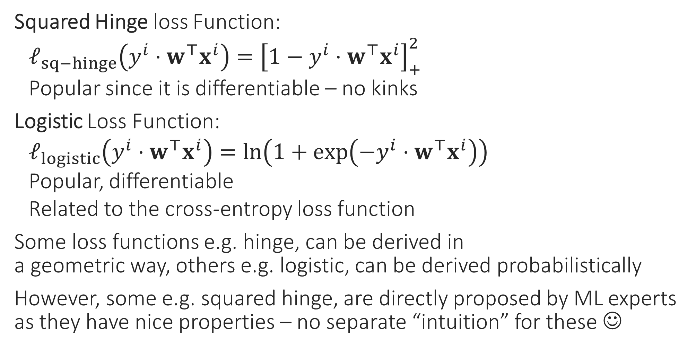
Classification Loss Functions
Squared Hinge loss Function:
$ℓ_{sq−hinge}\left(y^{i}⋅w^{⊤}x^{i}\right)={\left[1−y^{i}⋅w^{⊤}x^{i}\right]}_{+}^{2}$
Popular since it is differentiable – no kinks
Logistic Loss Function:
$ℓ_{logistic}\left(y^{i}⋅w^{⊤}x^{i}\right)=\ln\left(1+\exp\left(−y^{i}⋅w^{⊤}x^{i}\right)\right)$
Popular, differentiable
Related to the cross-entropy loss function
Some loss functions e.g. hinge, can be derived in a geometric way, others e.g. logistic, can be derived probabilistically
However, some e.g. squared hinge, are directly proposed by ML experts as they have nice properties – no separate “intuition” for these ☺

Slide 3

Multiclass Classification
Sometimes aka multiclassification
Can be solved using linear models too!
Trick is to reduce to binary classification
If there are $C$ classes, then train $C$ linear models, each trained to identify one class
E.g. $C=3$ {dog, horse, fish}. Train model1 to say yes to dog images but no to horse and no to fish images, similarly model2, 3
Called the OVA method (one-vs-all)
At test time, just ask all three models and hope that only one of them says yes ☺

Slide 4
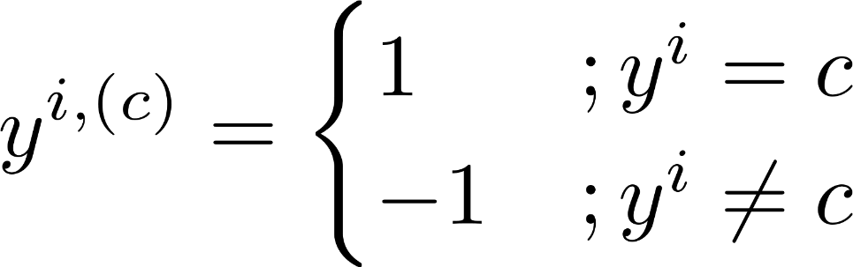
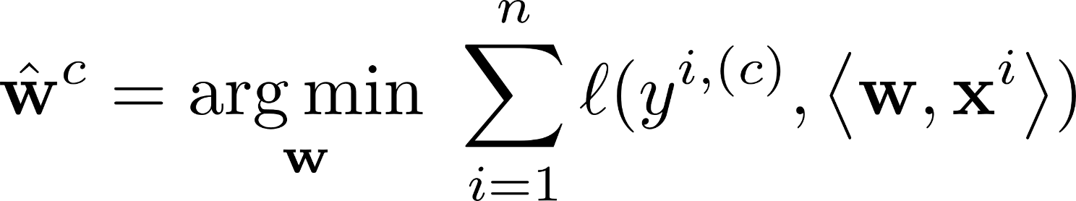
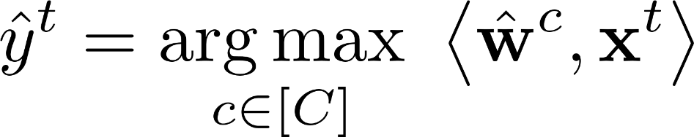
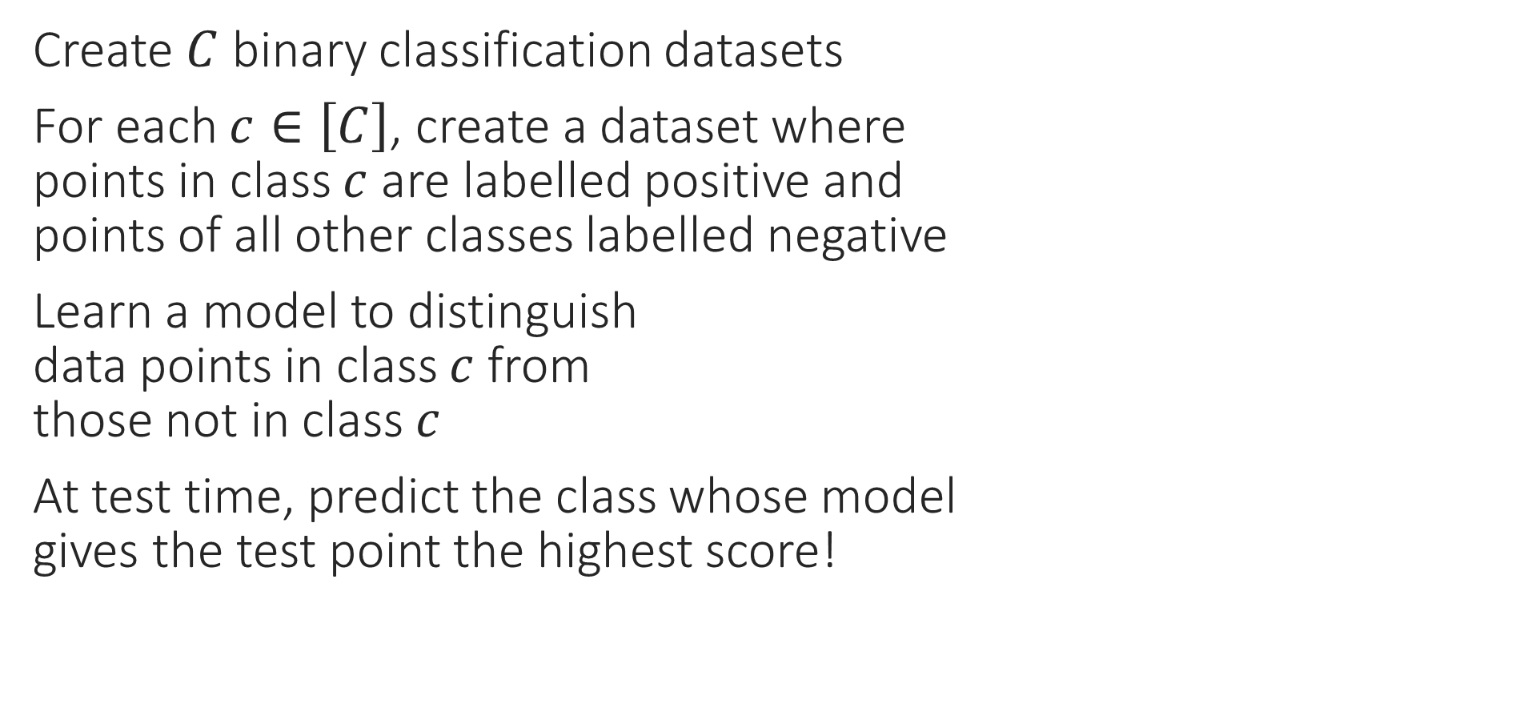

OVA – Reduce to $C$ binary problems
Create $C$ binary classification datasets
For each $c∈\left[C\right]$, create a dataset where points in class $c$ are labelled positive and points of all other classes labelled negative
Learn a model to distinguish data points in class $c$ from those not in class $c$
At test time, predict the class whose model gives the test point the highest score!

Slide 5
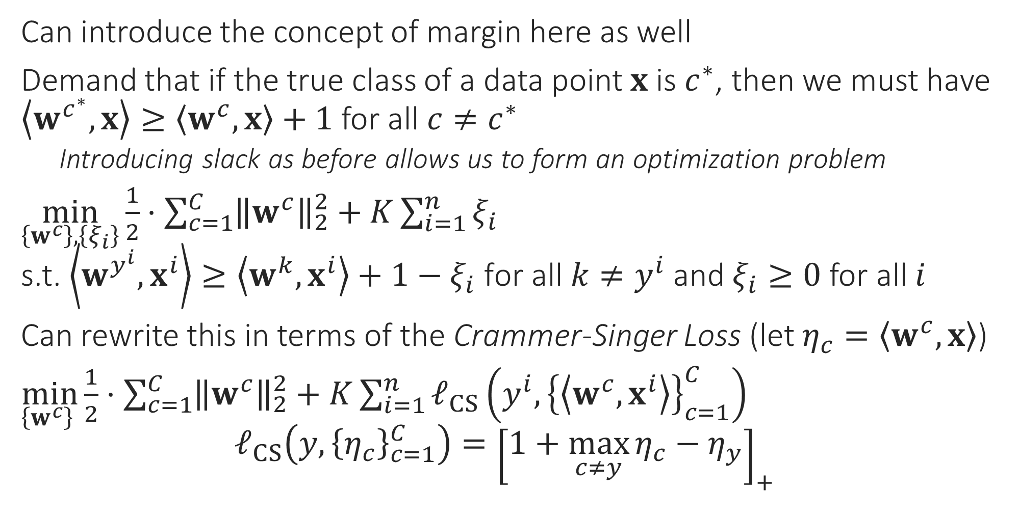

OVA – Learn the $C$ models together
Can introduce the concept of margin here as well
Demand that if the true class of a data point $x$ is $c^{∗}$, then we must have $\left\langle w^{c^{∗}},x\right\rangle ≥\left\langle w^{c},x\right\rangle +1$ for all $c≠c^{∗}$
Introducing slack as before allows us to form an optimization problem
$\min_{\left\{w^{c}\right\},\left\{ξ_{i}\right\}}{\frac{1}{2}⋅\sum_{c=1}^{C}{{\left\|w^{c}\right\|}_{2}^{2}}}+K\sum_{i=1}^{n}{ξ_{i}}$ s.t. $\left\langle w^{y^{i}},x^{i}\right\rangle ≥\left\langle w^{k},x^{i}\right\rangle +1−ξ_{i} \text{for} \text{all} k≠y^{i}$ and $ξ_{i}≥0$ for all $i$
Can rewrite this in terms of the Crammer-Singer Loss (let $η_{c}=\left\langle w^{c},x\right\rangle$)
$\min_{\left\{w^{c}\right\} }{\frac{1}{2}⋅\sum_{c=1}^{C}{{\left\|w^{c}\right\|}_{2}^{2}}}+K\sum_{i=1}^{n}{ℓ_{CS}\left(y^{i},{\left\{\left\langle w^{c},x^{i}\right\rangle \right\}}_{c=1}^{C}\right)}$ $ℓ_{CS}\left(y,{\left\{η_{c}\right\}}_{c=1}^{C}\right)={\left[1+\max_{c≠y}{η_{c}}−η_{y}\right]}_{+}$

Slide 6
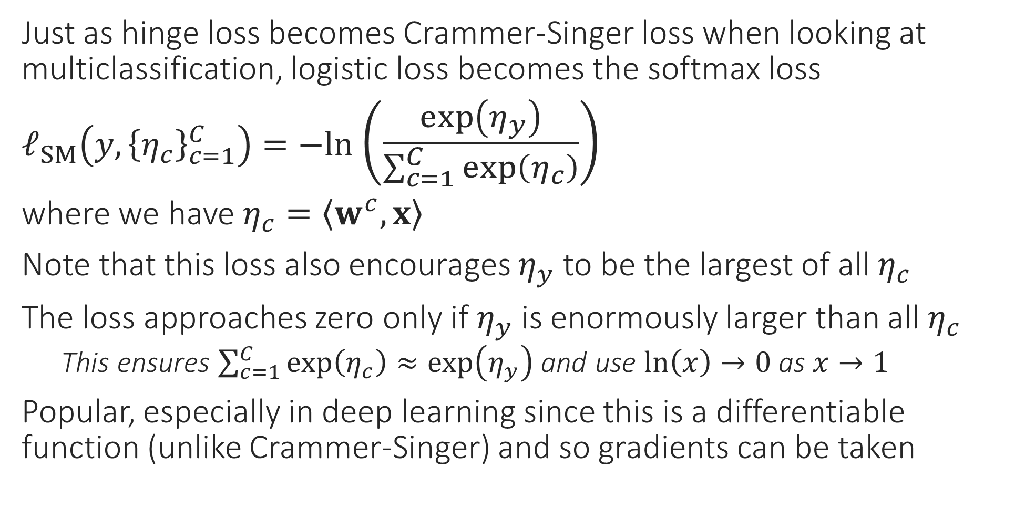
OVA via Softmax
Just as hinge loss becomes Crammer-Singer loss when looking at multiclassification, logistic loss becomes the softmax loss
$ℓ_{SM}\left(y,{\left\{η_{c}\right\}}_{c=1}^{C}\right)=−ln$ $\left(\frac{\exp\left(η_{y}\right)}{\sum_{c=1}^{C}{\exp\left(η_{c}\right)}}\right)$
where we have $η_{c}=\left\langle w^{c},x\right\rangle$
Note that this loss also encourages $η_{y}$ to be the largest of all $η_{c}$
The loss approaches zero only if $η_{y}$ is enormously larger than all $η_{c}$
This ensures $\sum_{c=1}^{C}{\exp\left(η_{c}\right)}≈\exp\left(η_{y}\right)$ and use $\ln\left(x\right)→0$ as $x→1$
Popular, especially in deep learning since this is a differentiable function (unlike Crammer-Singer) and so gradients can be taken

Slide 7

Multiclassification – popular techniques
OVA: convert multiclassification into several binary problems
Can be slow if $C≫1$ but ways exist to speed things up
Crammer Singer present in liblinear, sklearn. Softmax popular in deep learning
Output Codes: convert multiclassification into regression problems
Represent each class $c∈\left[C\right]$ using a $k$-dim vector $v_{c}∈ℝ^{k}$.
Solve $k$ regression problems on the data, essentially trying to predict $v_{1}$ for data points that belong to class 1, $v_{2}$ for data points that belong to class 2 etc
At test time, predict $k$ numbers for the test point, think of this as a $k$-dim vector and see if this vector is closest to $v_{1}$ or $v_{2}$ or etc …
Want $k$ to be small for sake of speed but cannot have very small $k$. The whole purpose of having $k>1$ is to account for regression mistakes
Decision Trees: very popular especially if number of classes $C≫1$

Slide 8
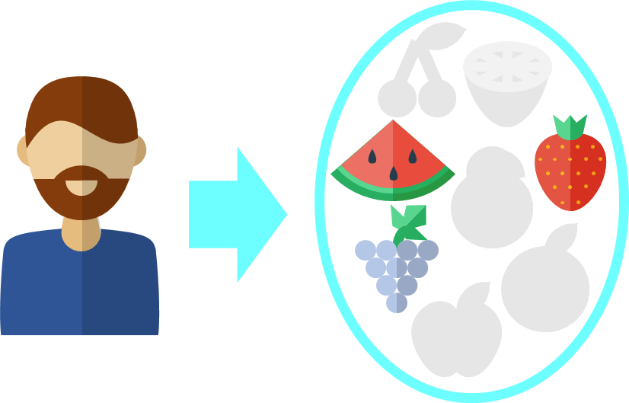
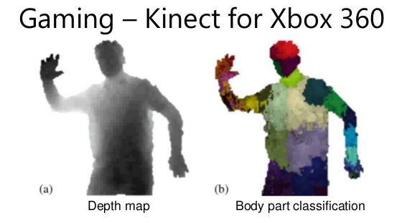
Decision Trees
Recommendation Systems
Can handle non-numeric features easily
Very popular in ML – classification, recsys
Extremely fast at making predictions
Easy to interpret by humans too
Model size can be large
Can give good train perf. but bad test perf. (known as overfitting)

Slide 9



Decision Trees for Classification
Repeatedly partition feature space $ℝ^{d}$
For test data point, much faster to find out which partition is it in which it lies
Can consider assigning the test point, the label of other points in its partition
Can be easily extended to binary, multi-class and multi-label classification problems!
However, if your partitions are fine enough, this will happen very rarely and not hurt performance too much!
What about points like this? The nearest neighbours are lying in another partition ☹
Yes, decision trees may not always give you the exact neighbors for points lying at boundary of a partition

Slide 10
Building Decision Trees
Root
Yes
X < 5.5
No
Internal Node
Y > 10.5
Y > 9
1 2 3 4 5 6 7 8 9 10 11 12
Internal Node
X < 11.5
X < 8.5
Internal Node
Y > 2.5
Y > 5.5
1 2 3 4 5 6 7 8 9 10 11 12 13 14
Leaf
X < 12
Leaf
Leaf
Leaf

Slide 11


Decision Trees – all shapes and sizes
This DT is balanced – all leaf nodes are at same depth from the root
The previous DT was very imbalanced and considered bad in general
May prune the tree to make it more shallow as well. Also possible to have DT with more than 2 children per internal node
Imbalanced DTs may
offer very poor
Prediction accuracy
as well as take as long as
kNN to make a prediction.
Imagine a DT which is just a
chain of nodes. With $n$ data points, there would be $𝒪\left(n\right)$ chain: some predictions will take $𝒪\left(n\right)$ time ☹. With a balanced DT, every prediction takes at most $𝒪(\log{n})$ time ☺☺

Slide 12
Regression with Decision Trees
To perform real valued regression, may simply use average score at a leaf node to predict scores for test data points

Slide 13


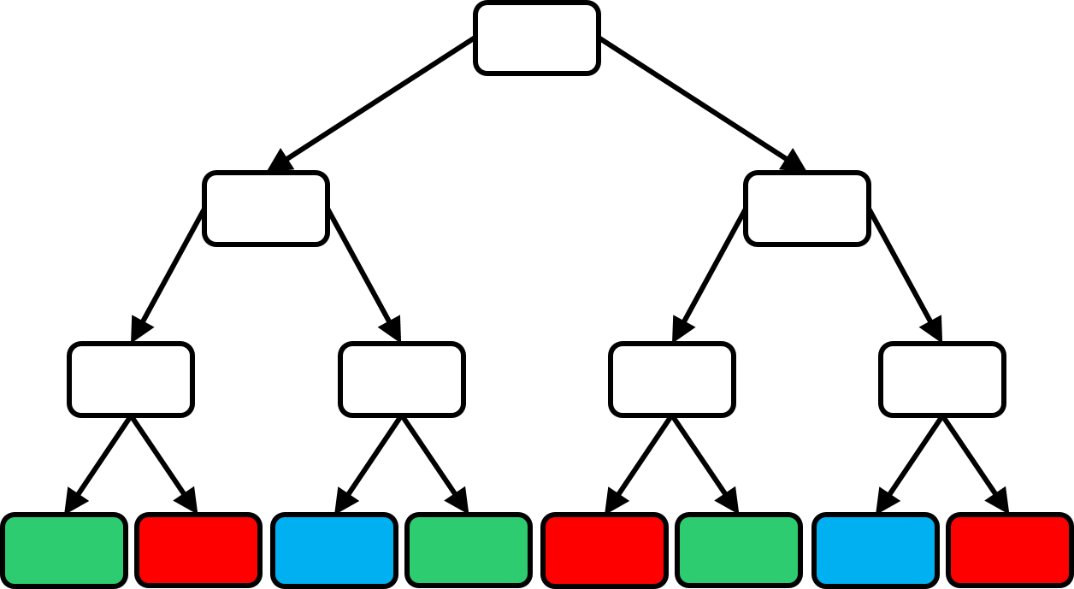
How to learn a DT?
How many children should a node have?
How to send data points to children?
When to stop splitting and make the node a leaf?
What to do at a leaf?
How many trees to train?

Slide 14
What to do at a leaf?
Cheapest thing to do would be to store the majority color (label) at a leaf. A slightly more informative (more expensive as well) thing can be to store how many training points of each color (label) reached that leaf
Can take any (complicated) action at a leaf
Why not call another machine learning algorithm?
For speed, keep leaf action simple
Simplest action – constant prediction
Such a DT will encode a piecewise constant prediction function

Slide 15
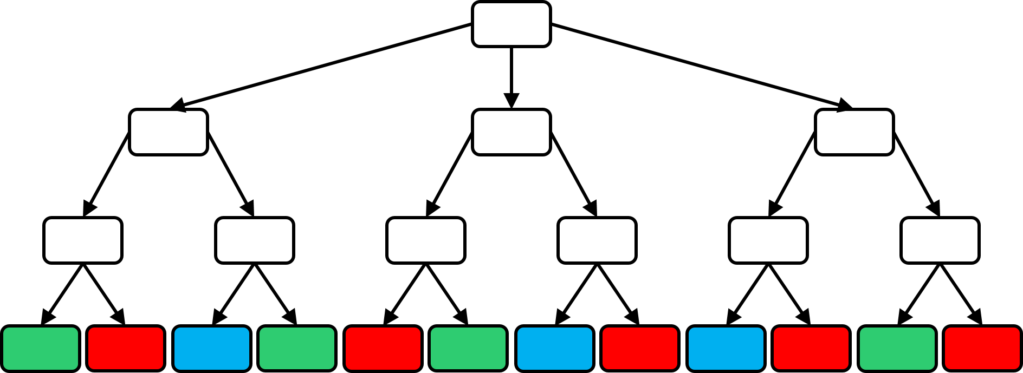



How to split a node into children nodes?
In principle there is no restriction (e.g. can even use a deep net to split a node). However, in practice we use a simple ML algo like linear to split nodes. This is because the usefulness of DTs largely comes from being able to rapidly send a test data point to a leaf
Notice, splitting a node is a classification problem in itself! Binary if two children, multiclass if more than 2 children
Can we use any classification technique to split a node or are there some restrictions?
Oh! So we are using a simple ML technique such as binary classification to learn a DT!

Slide 16



Splitting a Node – some lessons
Various notions of purity exist – entropy and Gini index for classification problems, variance for regression problems
Recall, one of the goals of DT is to speed up kNN prediction time
Thus, node splitting algorithm must be super fast otherwise no benefit of using DT – may just as well do NN directly
Often people carefully choose just a single feature and split a node based on that e.g. (age $<$ 25 go left, age $≥$ 25 go right)
Such “simple classifiers” are often called decision stumps
Making sure that the split is balanced (e.g. roughly half the data points go left and right) is also important to ensure that the tree is balanced. However, ensuring balance is often tricky
Pure nodes are very convenient. We can make them leaves right away and not have to worry about splitting them ☺
A child node is completely pure if it contains training data of only one class.
How do I decide whether to use age or gender? Even if using age, how do I decide whether to threshold at 25 or 65?
Usually, people go over all available features and all possible thresholds (can be slow if not done cleverly) and choose a feature and a threshold for that feature so that the child nodes that are created are as pure as possible

Slide 17
Purifying Decision Stumps
Purest Horizontal Split
Purest Vertical Split
Left Right
Left Right
Search purest horizontal split by going over all possible thresholds and checking
Two possible splitting directions. Let us choose the one that gives us purer children
Purest vertical split is more pure – use it!

Slide 18
Node splitting via linear classifiers

Slide 19
One Final Recap

Slide 20
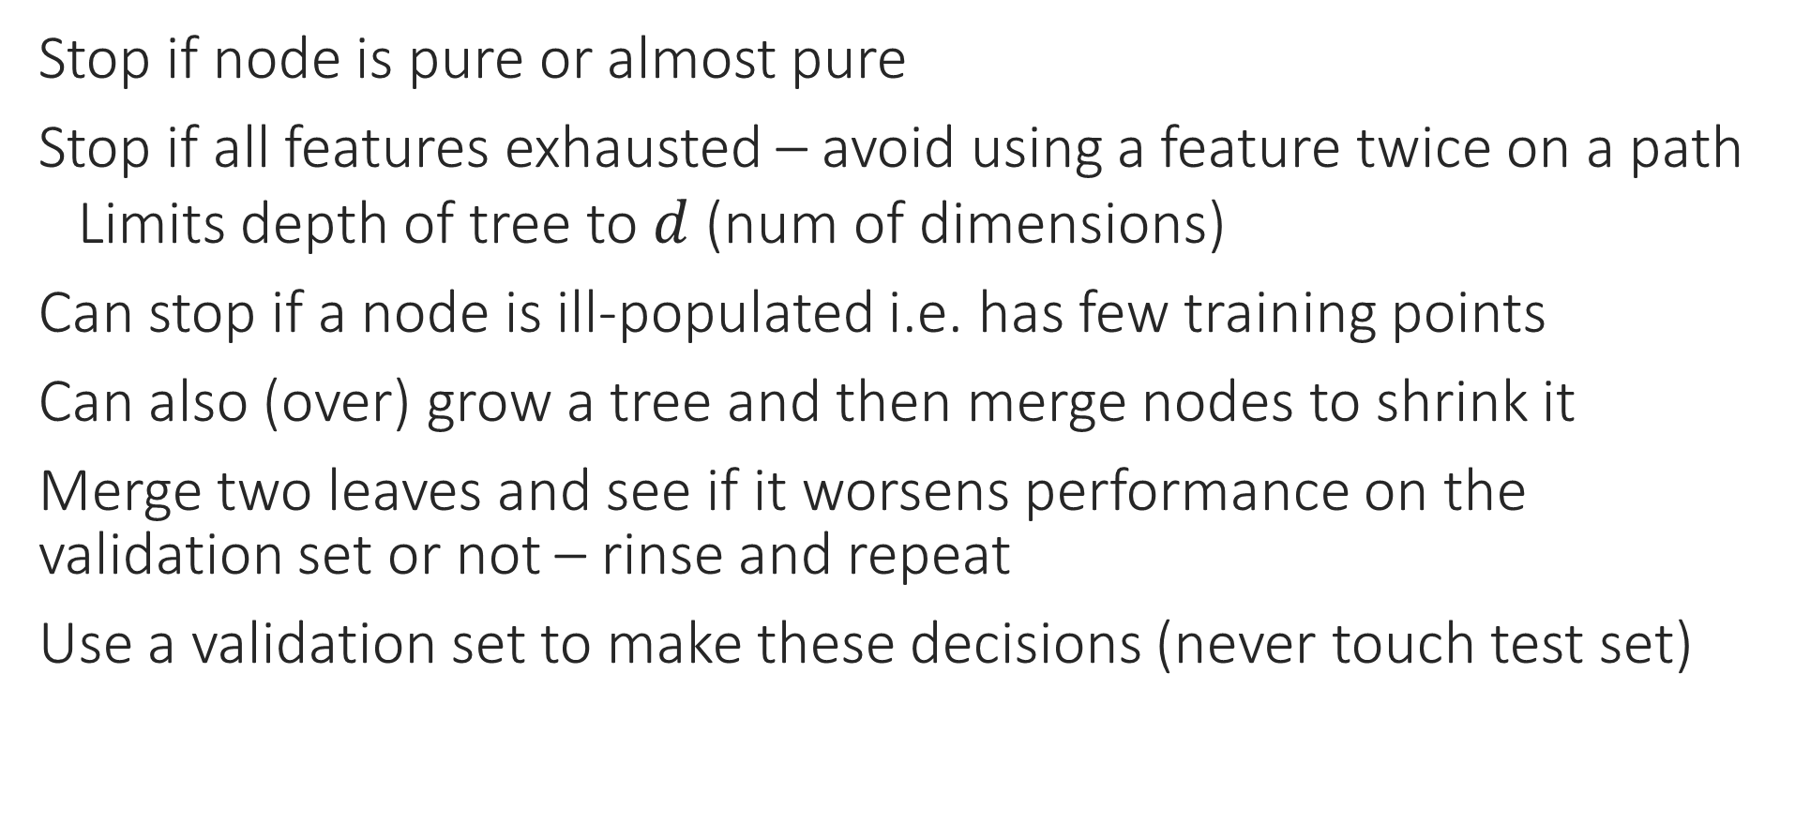
Pruning Strategies
Stop if node is pure or almost pure
Stop if all features exhausted – avoid using a feature twice on a path
Limits depth of tree to $d$ (num of dimensions)
Can stop if a node is ill-populated i.e. has few training points
Can also (over) grow a tree and then merge nodes to shrink it
Merge two leaves and see if it worsens performance on the validation set or not – rinse and repeat
Use a validation set to make these decisions (never touch test set)

Slide 21
Decision Trees - Lessons
Very fast at making predictions (if tree is reasonably balanced)
Can handle discrete data (even non numeric data) as well – e.g. can have a stump as: blood group AB or O go left, else go right
SVM, RR etc have difficulty with such non-numeric and discrete data since difficult to define distance and averages with them (however, there are workarounds to do SVM etc with discrete data as well)
Tons of DT algorithms – both classical (ID3, C4.5) as well as recent (GBDT, LPSR, Parabel) – DTs are versatile and very useful
Reason: DT learning is an NP hard problem ☹
If you think you have a better way of splitting nodes or handling leaf nodes, it might be the next big thing in DT learning ☺

