Slide 1
Playing Hangman

Slide 2


Uncertainty
Imagine a language where the letter “#” appears in every word. Guessing # gives us no useful information
To win at hangman, we must ask questions that eliminate wrong answers quickly
4096
2048
2048
1024
1024
1024
1024
10 levels later …
Similarly, very rare letters are not very good either – they will occasionally help us identify the word very quickly but will mostly cause us to make a mistake.
…
1
1
1
1
1
1
1
1
1
1
1
1
1
1
1
1

Slide 3
Uncertainty Reduction – Hangman
amid, baby, back, bake, bike, book, bump, burn, cave, chip, cook, damp, duck, dump, fade, good, have, high, hook, jazz, jump, kick, maid, many, mind, monk, much, must, paid, pain, park, pick, pine, pipe, pond, pony, pump, push, quick, quid, quit, sail, same, save, sight, size, stay, study, stuff, suffer, sway, tail, twin, wage, wake, wall, warn, wave, weak, wear, whip, wife, will, wind, wine, wing, wipe, wise, wish, with, wood, wound, year
Start State
amid
hook
sail
year
Goal States
…
amid, baby, back, bake, bike, book, bump, burn, cave, chip, cook, damp, duck, dump, fade, good, have, high, hook, jazz, jump, kick, maid, many, mind, monk, much, must, paid, pain, park, pick, pine, pipe, pond, pony,
pump, push, quick, quid, quit, sail, same, save, sight, size, stay, study, stuff, suffer, sway, tail, twin, wage, wake, wall, warn, wave, weak, wear, whip, wife, will, wind, wine, wing, wipe, wise, wish, with, wood, wound, year
Good Question
amid
baby, back, bake, bike, book, bump, burn, cave, chip, cook, damp, duck, dump, fade, good, have, high, hook, jazz, jump, kick, maid, many, mind, monk, much, must, paid, pain, park, pick, pine, pipe, pond, pony, pump, push, quick, quid, quit, sail, same, save, sight, size, stay, study, stuff, suffer, sway, tail, twin, wage, wake, wall, warn, wave, weak, wear, whip, wife, will, wind, wine, wing, wipe, wise, wish, with, wood, wound, year
Bad Question

Slide 4

Uncertainty Reduction – Classification
I can see that we wish to go from uncertain start state to goal states where we are certain about a prediction – but how we define a good question is still a big vague
Start State
Goal States
…
Good Question
Bad Question

Slide 5

Entropy is a measure of Uncertainty
Notions of entropy exist for real-valued cases as well but they involve probability density functions so skipping for now
If we have a set of $n$ words, then that set has an entropy of $\log_{2}{n}$
Larger sets have larger entropy and a set with a single word has $0$ entropy
Makes sense since we have no uncertainty if only a single word is possible
More generally, if there is a set $S$ of $n$ elements of $C$ types with $n_{c}$ elements of type $c$, then its entropy is defined as $H\left(S\right)≝−\sum_{c∈\left[C\right]}{\frac{n_{c}}{n}\log_{2}\left(\frac{n_{c}}{n}\right)}=−\sum_{c∈\left[C\right]}{p_{c}\log_{2}{p_{c}}}$
where $p_{c}$ is proportion of elements of type $c$ (or class $c$) in multiclass cases
The earlier example is a special case where each word is its own “type” i.e., there are $C=n$ “types” with $n_{c}=1$ for all $c$
A pure set e.g., $p=\left[0,1,0,0,…,0\right]$ has $0$ entropy whereas a set with same number of elements of each class i.e., $p=\left[\frac{1}{C},\frac{1}{C},…,\frac{1}{C}\right]$ has $\log_{2}{C}$ entropy

Slide 6

What is a good question?
No single criterion – depends on the application
ID3 (iterative dichotomizer 3 by Ross Quinlan) suggests that a good question is one that reduces confusion the most i.e., reduces entropy the most
Suppose asking a question splits a set $S$ into $K$ subsets $S_{1},…,S_{K}$
Note that $S_{i}∩S_{j}=φ$ if $i≠j$ and $\bigcup_{k∈\left[K\right]}{S_{k}}=S$
Let us denote $n_{k}≝\left|S_{k}\right|$ – note that $\sum_{k∈\left[K\right]}{n_{k}}=n≝\left|S\right|$
Then the entropy of this collection of sets is defined to be $\sum_{k∈\left[K\right]}{\frac{n_{k}}{n}⋅H\left(S_{k}\right)}$
Can interpret this as “average” or “weighted” entropy since a $\frac{n_{k}}{n}$fraction of points will land up in the set $S_{k}$ where the entropy is $H\left(S_{k}\right)$

Slide 7
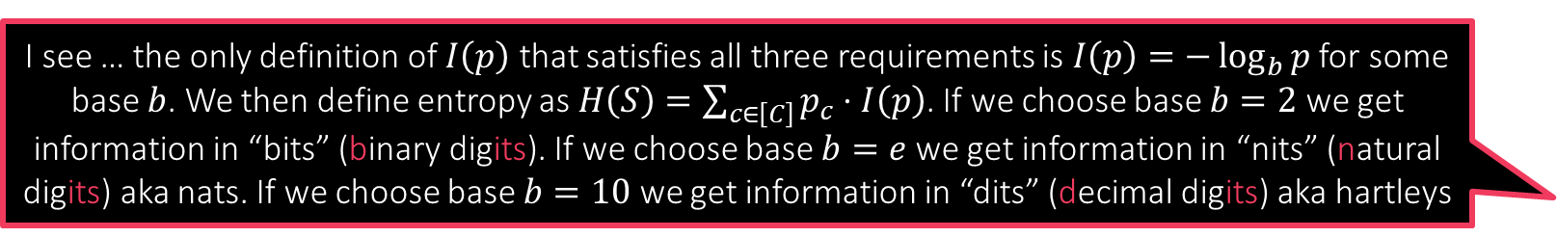
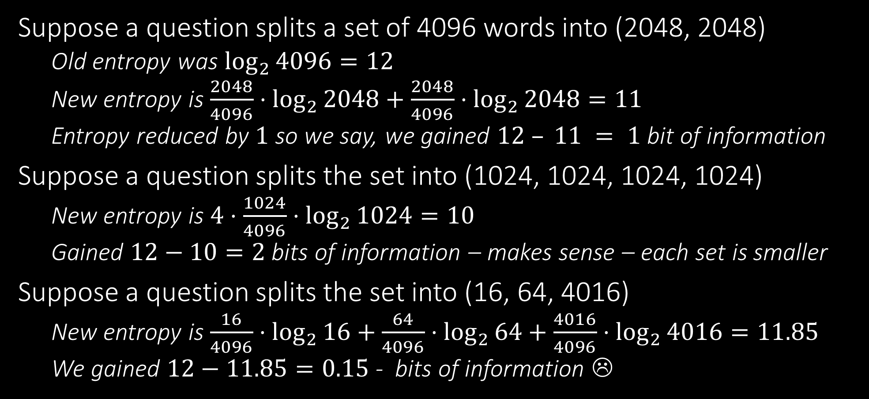
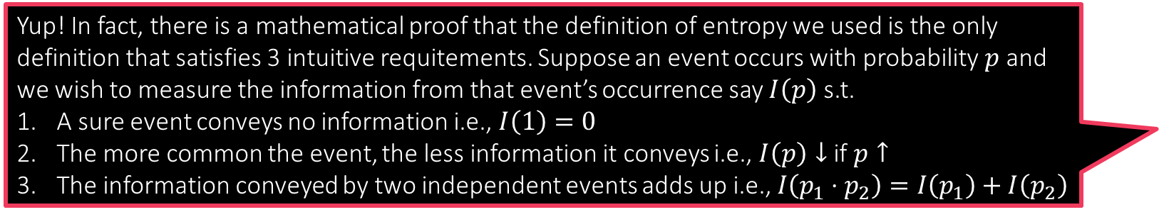
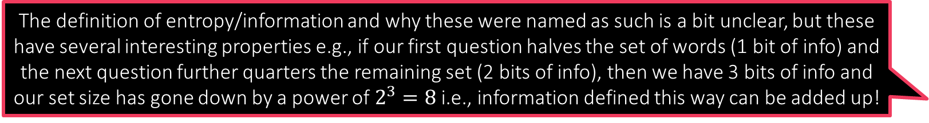
A good question for Hangman
The definition of entropy/information and why these were named as such is a bit unclear, but these have several interesting properties e.g., if our first question halves the set of words (1 bit of info) and the next question further quarters the remaining set (2 bits of info), then we have 3 bits of info and our set size has gone down by a power of $2^{3}=8$ i.e., information defined this way can be added up!
Suppose a question splits a set of 4096 words into (2048, 2048)
Old entropy was $\log_{2}{4096}=12$
New entropy is $\frac{2048}{4096}⋅\log_{2}{2048}+\frac{2048}{4096}⋅\log_{2}{2048}=11$
Entropy reduced by $1$ so we say, we gained $12 – 11 = 1$bit of information
Suppose a question splits the set into (1024, 1024, 1024, 1024)
New entropy is $4⋅\frac{1024}{4096}⋅\log_{2}{1024}=10$
Gained $12−10=2$ bits of information – makes sense – each set is smaller
Suppose a question splits the set into (16, 64, 4016)
New entropy is $\frac{16}{4096}⋅\log_{2}{16}+\frac{64}{4096}⋅\log_{2}{64}+\frac{4016}{4096}⋅\log_{2}{4016}=11.85$
We gained $12−11.85=0.15$ - bits of information ☹
Yup! In fact, there is a mathematical proof that the definition of entropy we used is the only definition that satisfies 3 intuitive requitements. Suppose an event occurs with probability $p$ and we wish to measure the information from that event’s occurrence say $I\left(p\right)$ s.t.
A sure event conveys no information i.e., $I\left(1\right)=0$
The more common the event, the less information it conveys i.e., $I\left(p\right)↓$ if $p↑$
The information conveyed by two independent events adds up i.e., $I\left(p_{1}⋅p_{2}\right)=I\left(p_{1}\right)+I\left(p_{2}\right)$
I see … the only definition of $I\left(p\right)$ that satisfies all three requirements is $I\left(p\right)=−\log_{b}{p}$ for some base $b$. We then define entropy as $H\left(S\right)=\sum_{c∈\left[C\right]}{p_{c}⋅I\left(p\right)}$. If we choose base $b=2$ we get information in “bits” (binary digits). If we choose base $b=e$ we get information in “nits” (natural digits) aka nats. If we choose base $b=10$ we get information in “dits” (decimal digits) aka hartleys

Slide 8

The ID3 Algorithm
Given a test data point, we go down the tree using the splitting criteria till we reach a leaf where we use the leaf action to make our prediction
With $T$ as set of all train points, create a root node $r$ and call train($r,T$)
Train(node $n$, set $S$)
If $S$ is sufficiently pure or sufficiently small, make $n$ a leaf, decide a simple leaf action (e.g., most popular class, label popularity vector, etc.) and return
Else, out of available choices, choose the splitting criteria (e.g. a single feature) that causes maximum information gain i.e., reduces entropy the most
Split $S$ along that criteria to get $S_{1},…,S_{K}$ partition of $S$ (e.g. if that feature takes $K$ distinct values)
Create $K$ child nodes $c_{k},k∈\left[K\right]$ and call train($c_{k},S_{k}$)
There are several augmentations to this algorithm e.g. C4.5, C5.0 that allow handing real-valued features, missing features, boosting etc
Note: ID3 will not ensure a balanced tree but usually balance is decent

Slide 9
Careful use of DTs
DTs can be tweaked to give very high training accuracies
Can badly overfit to training data if grown too large
Choice of decision stumps is critical
PUF problem: a single linear model works
DT will struggle and eventually overfit if we insist that questions used to split the DT nodes use a single feature
However, if we allow node questions to be a general linear model, root node itself can purify the data completely ☺

Slide 10
Probabilistic ML

Slide 11

Probabilistic ML
Till now we have looked at ML techniques that assign a label for every data point (the label is from the set $\left\{−1,+1\right\}$ for binary classification, $\left[C\right]$ for multiclass classification with $C$ classes, $ℝ$ for regression etc)
Examples include DT, linear models
Probabilistic ML techniques, given a data point, do not output a single label, they instead output a distribution over all possible labels
For binary classification, output a PMF over $\left\{−1,1\right\}$, for multiclassification, output a PMF over $\left\{1,2,…,C\right\}$, for regression, output a PDF over $ℝ$
The probability mass/density of a label in the output PMF/PDF indicates how likely does the ML model think that label is the correct one for that data point
Note: the algorithm is allowed to output a possibly different PMF/PDF for every data point. However, the support of these PMFs/PDFs is always the set of all possible labels (i.e., even very unlikely labels are included in the support)

Slide 12
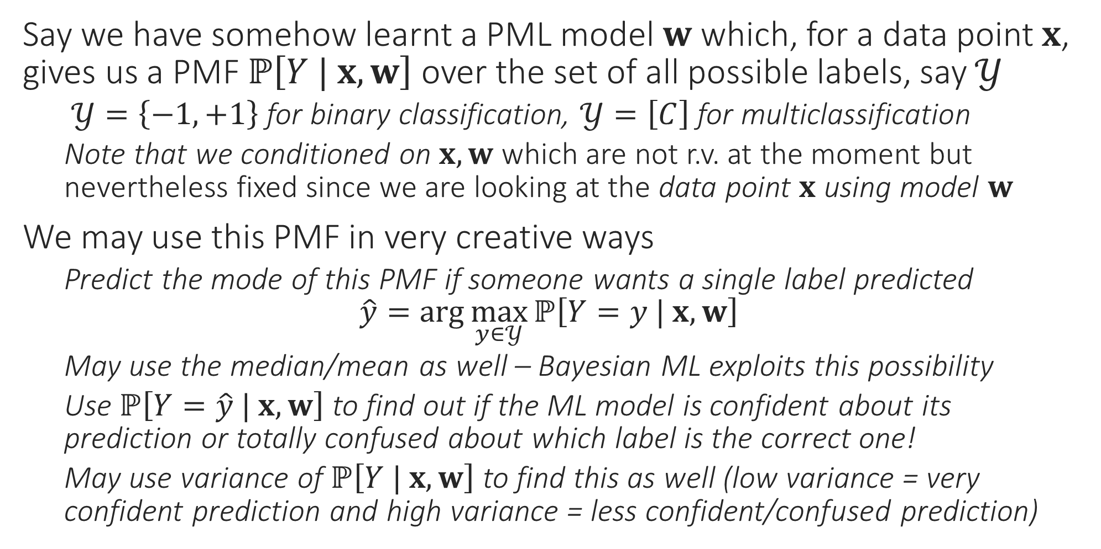
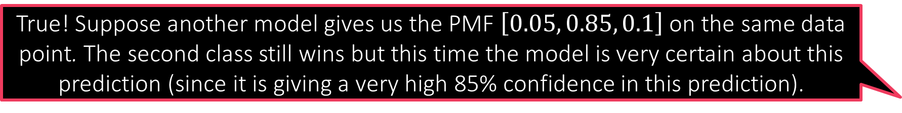
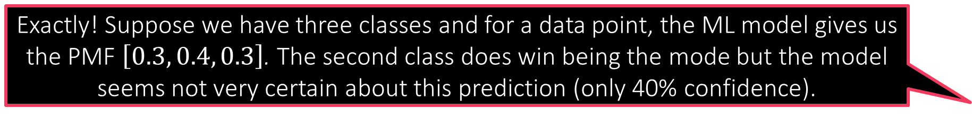
Probabilistic ML for Classification
Exactly! Suppose we have three classes and for a data point, the ML model gives us the PMF $\left[0.3, 0.4, 0.3\right]$. The second class does win being the mode but the model seems not very certain about this prediction (only 40% confidence).
Say we have somehow learnt a PML model $w$ which, for a data point $x$, gives us a PMF $ℙ\left[Y | x, w\right]$ over the set of all possible labels, say $𝒴$
$𝒴=\left\{−1,+1\right\}$ for binary classification, $𝒴=\left[C\right]$ for multiclassification
Note that we conditioned on $x, w$ which are not r.v. at the moment but nevertheless fixed since we are looking at the data point $x$ using model $w$
We may use this PMF in very creative ways
Predict the mode of this PMF if someone wants a single label predicted $\hat{y}=\arg{\max_{y∈𝒴}{ℙ\left[Y=y | x, w\right]}}$
May use the median/mean as well – Bayesian ML exploits this possibility
Use $ℙ\left[Y=\hat{y} | x, w\right]$ to find out if the ML model is confident about its prediction or totally confused about which label is the correct one!
May use variance of $ℙ\left[Y | x, w\right]$ to find this as well (low variance = very confident prediction and high variance = less confident/confused prediction)
True! Suppose another model gives us the PMF $\left[0.05, 0.85, 0.1\right]$ on the same data point. The second class still wins but this time the model is very certain about this prediction (since it is giving a very high 85% confidence in this prediction).
I could not agree more. However, in many ML applications (e.g. active learning) if we find that the model is making unsure predictions, we can switch to another model or just ask a human to step in. Thus, confidence info can be used fruitfully
Warning! Just because a prediction is made with more confidence does not mean it must be correct!

Slide 13
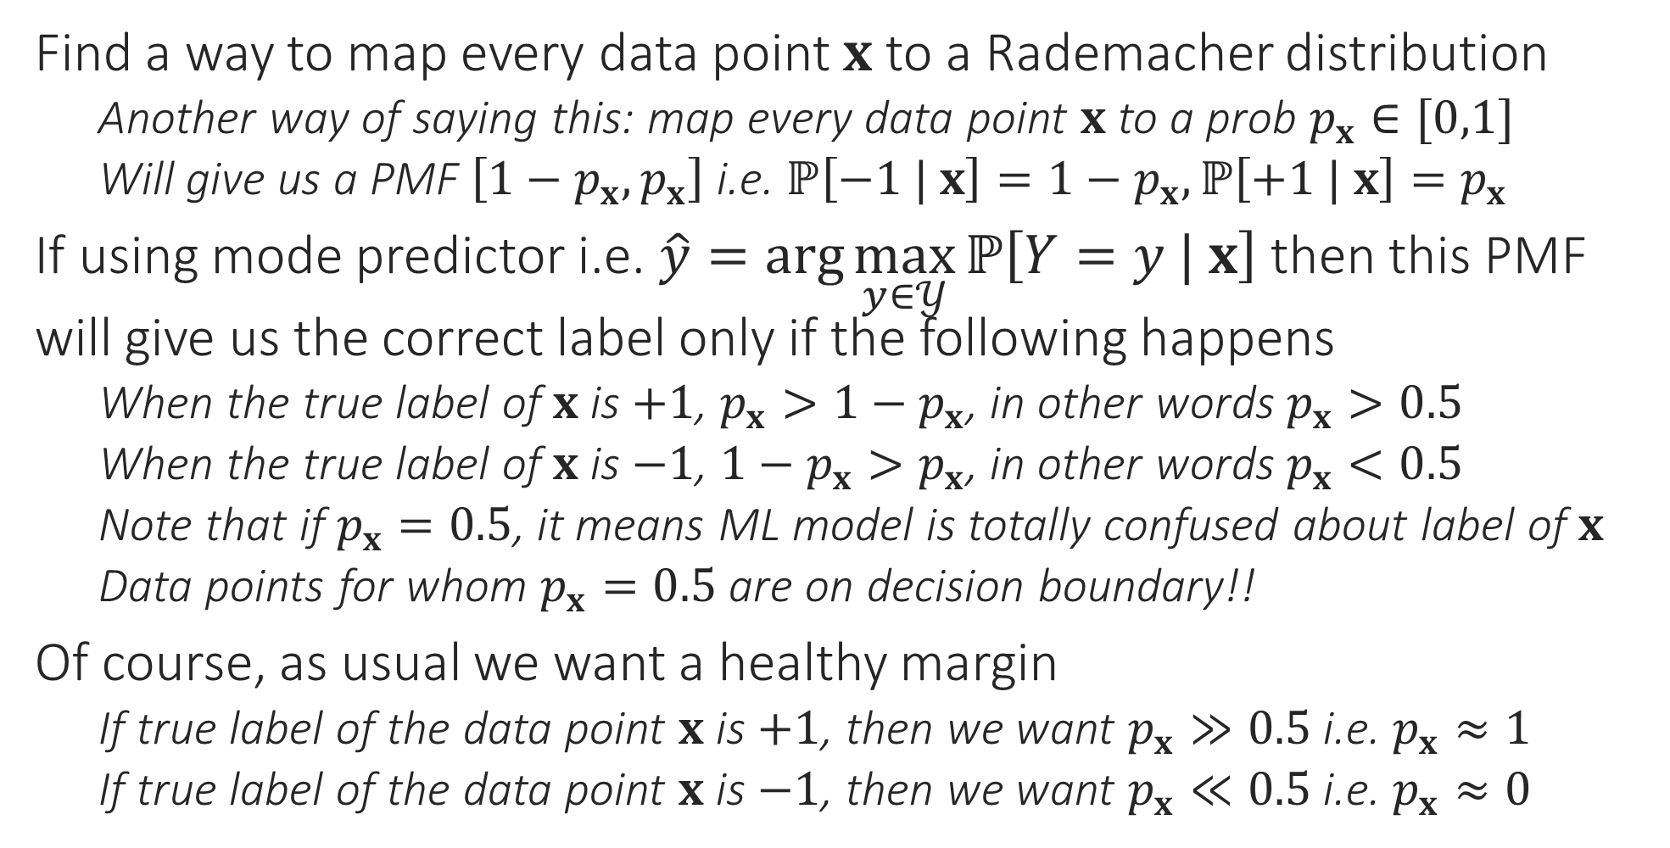
Probabilistic Binary Classification
Find a way to map every data point $x$ to a Rademacher distribution
Another way of saying this: map every data point $x$ to a prob $p_{x}∈[0,1]$
Will give us a PMF $\left[1−p_{x},p_{x}\right]$ i.e. $ℙ\left[−1 | x\right]=1−p_{x},ℙ\left[+1 | x\right]=p_{x}$
If using mode predictor i.e. $\hat{y}=\arg{\max_{y∈𝒴}{ℙ\left[Y=y | x\right]}}$ then this PMF will give us the correct label only if the following happens
When the true label of $x$ is $+1$, $p_{x}>1−p_{x}$, in other words $p_{x}>0.5$
When the true label of $x$ is $−1$, ${1−p}_{x}>p_{x}$, in other words $p_{x}<0.5$
Note that if $p_{x}=0.5$, it means ML model is totally confused about label of $x$
Data points for whom $p_{x}=0.5$ are on decision boundary!!
Of course, as usual we want a healthy margin
If true label of the data point $x$ is $+1$, then we want $p_{x}≫0.5$ i.e. $p_{x}≈1$
If true label of the data point $x$ is $−1$, then we want $p_{x}≪0.5$ i.e. $p_{x}≈0$

Slide 14


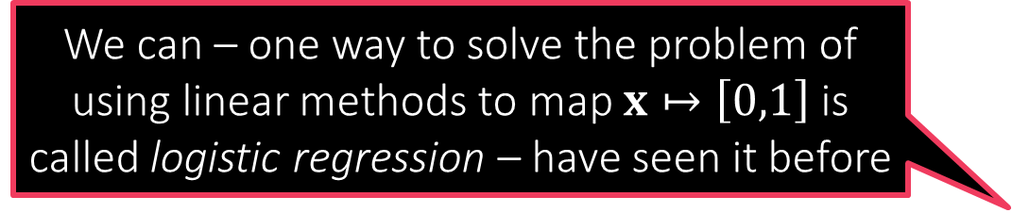
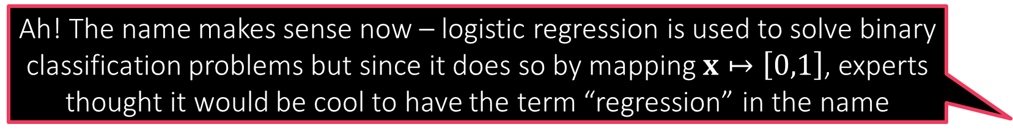
Probabilistic Binary Classification
So can we never use linear models to do probabilistic ML?
How to map feature vectors $x$ to probability values $p_{x}∈[0,1]$?
Could treat it as a regression problem since prob values $∈ℝ$ after all
Will need to modify the training set a bit to do this (basically change all $−1$ labels to $0$ since we want $p_{x}=0$ if the label is $−1$
Could use DT etc to solve this regression problem
Using linear models to do this presents a challenge
If we learn a linear model $w$ using ridge regression it may happen that for some data point $x$, we have $w^{⊤}x<0$ or else $w^{⊤}x>1$
$p_{x}$ wont make sense in this case – not a valid PMF!!
DT doesn’t suffer from this problem since it always predict a $p_{x}∈[0,1]$
DT uses averages of a bunch of train labels to obtain test prediction – the average of a bunch of 0s and 1s is always a value in the range $\left[0,1\right]$
We can – one way to solve the problem of using linear methods to map $x↦\left[0,1\right]$ is called logistic regression – have seen it before
Yes, but there is a trick involved. Let us take a look at it
Ah! The name makes sense now – logistic regression is used to solve binary classification problems but since it does so by mapping $x↦\left[0,1\right]$, experts thought it would be cool to have the term “regression” in the name

Slide 15

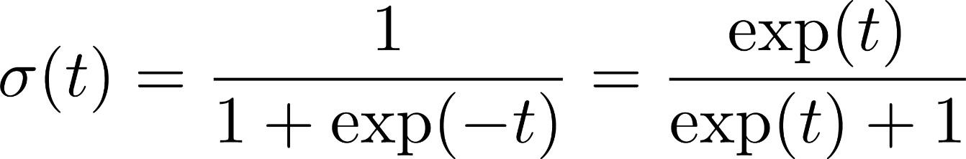
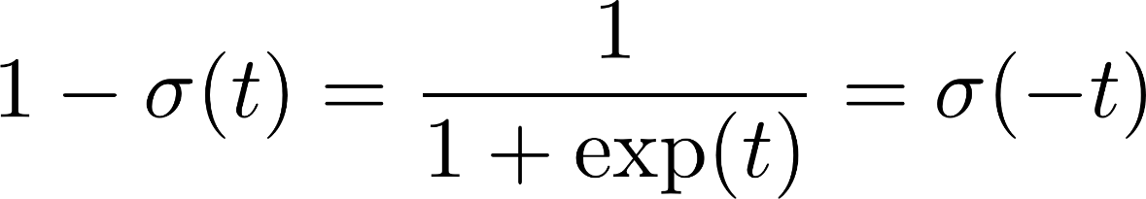
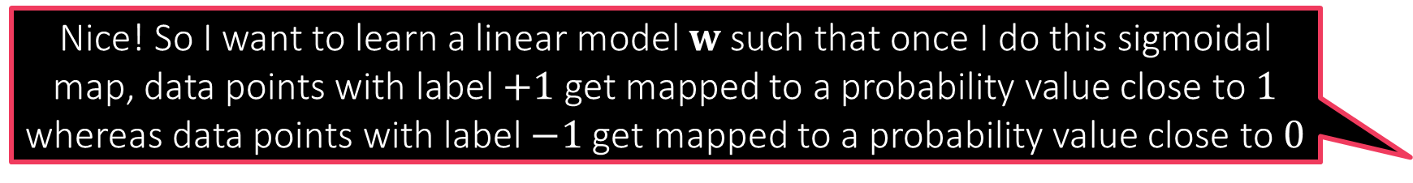

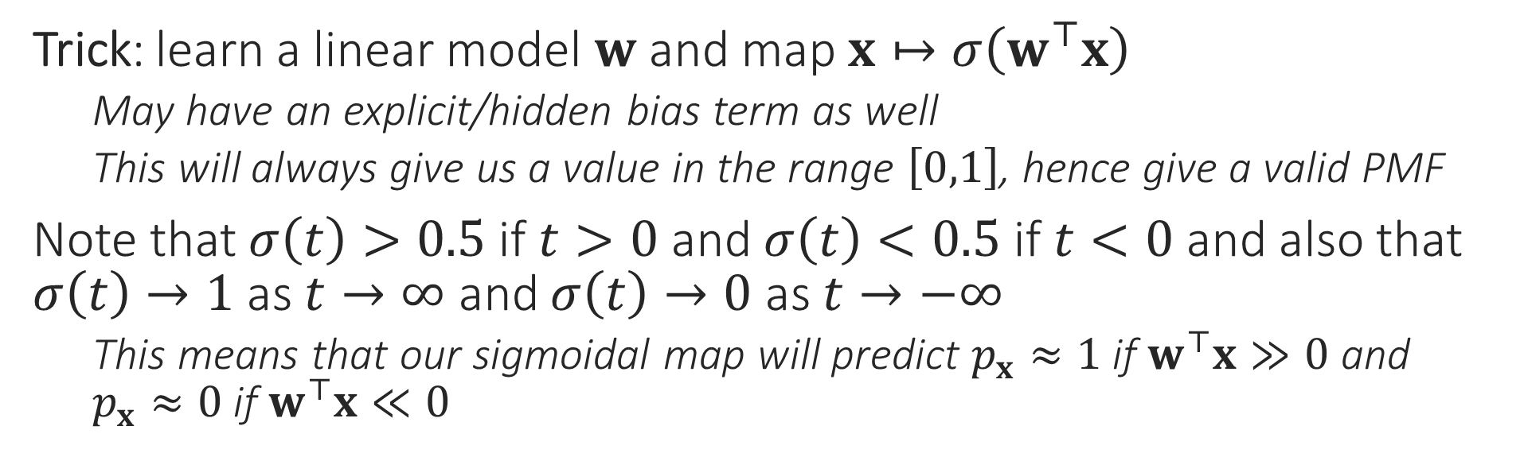
Sigmoid Function
Nice! So I want to learn a linear model $w$ such that once I do this sigmoidal map, data points with label $+1$ get mapped to a probability value close to $1$ whereas data points with label $−1$ get mapped to a probability value close to $0$
1
0.5
There are several other such wrapper/quashing/link/activation functions which do similar jobs e.g. tanh, ramp, ReLU
0
Trick: learn a linear model $w$ and map $x↦σ\left(w^{⊤}x\right)$
May have an explicit/hidden bias term as well
This will always give us a value in the range $\left[0,1\right]$, hence give a valid PMF
Note that $σ\left(t\right)>0.5$ if $t>0$ and $σ\left(t\right)<0.5$ if $t<0$ and also that $σ\left(t\right)→1$ as $t→∞$ and $σ\left(t\right)→0$ as $t→−∞$
This means that our sigmoidal map will predict $p_{x}≈1$ if $w^{⊤}x≫0$ and $p_{x}≈0$ if $w^{⊤}x≪0$
How do I learn such a model $w$?

Slide 16
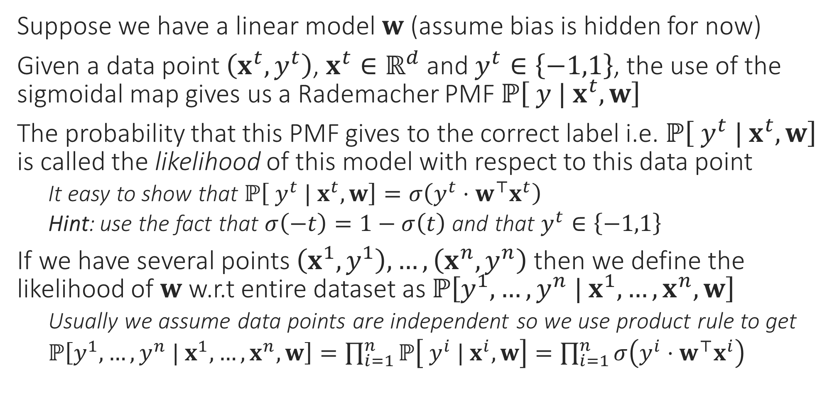
Likelihood
Data might not actually be independent e.g. my visiting a website may not be independent from my friend visiting the same website if I have found an offer on that website and posted about it on social website. However, often we nevertheless assume independence to make life simple
Suppose we have a linear model $w$ (assume bias is hidden for now)
Given a data point $\left(x^{t},y^{t}\right)$, $x^{t}∈ℝ^{d}$ and $y^{t}∈\left\{−1,1\right\}$, the use of the sigmoidal map gives us a Rademacher PMF $ℙ\left[ y | x^{t},w\right]$
The probability that this PMF gives to the correct label i.e. $ℙ\left[ y^{t} | x^{t},w\right]$ is called the likelihood of this model with respect to this data point
It easy to show that $ℙ\left[ y^{t} | x^{t},w\right]=σ\left(y^{t}⋅w^{⊤}x^{t}\right)$
Hint: use the fact that $σ\left(−t\right)=1−σ\left(t\right)$ and that $y^{t}∈\left\{−1,1\right\}$
If we have several points $\left(x^{1},y^{1}\right),…,\left(x^{n},y^{n}\right)$ then we define the likelihood of $w$ w.r.t entire dataset as $ℙ\left[y^{1},…,y^{n} | x^{1},…,x^{n},w\right]$
Usually we assume data points are independent so we use product rule to get
$ℙ\left[y^{1},…,y^{n} | x^{1},…,x^{n},w\right]=\prod_{i=1}^{n}{ℙ\left[ y^{i} | x^{i},w\right]}=\prod_{i=1}^{n}{σ\left(y^{i}⋅w^{⊤}x^{i}\right)}$

Slide 17
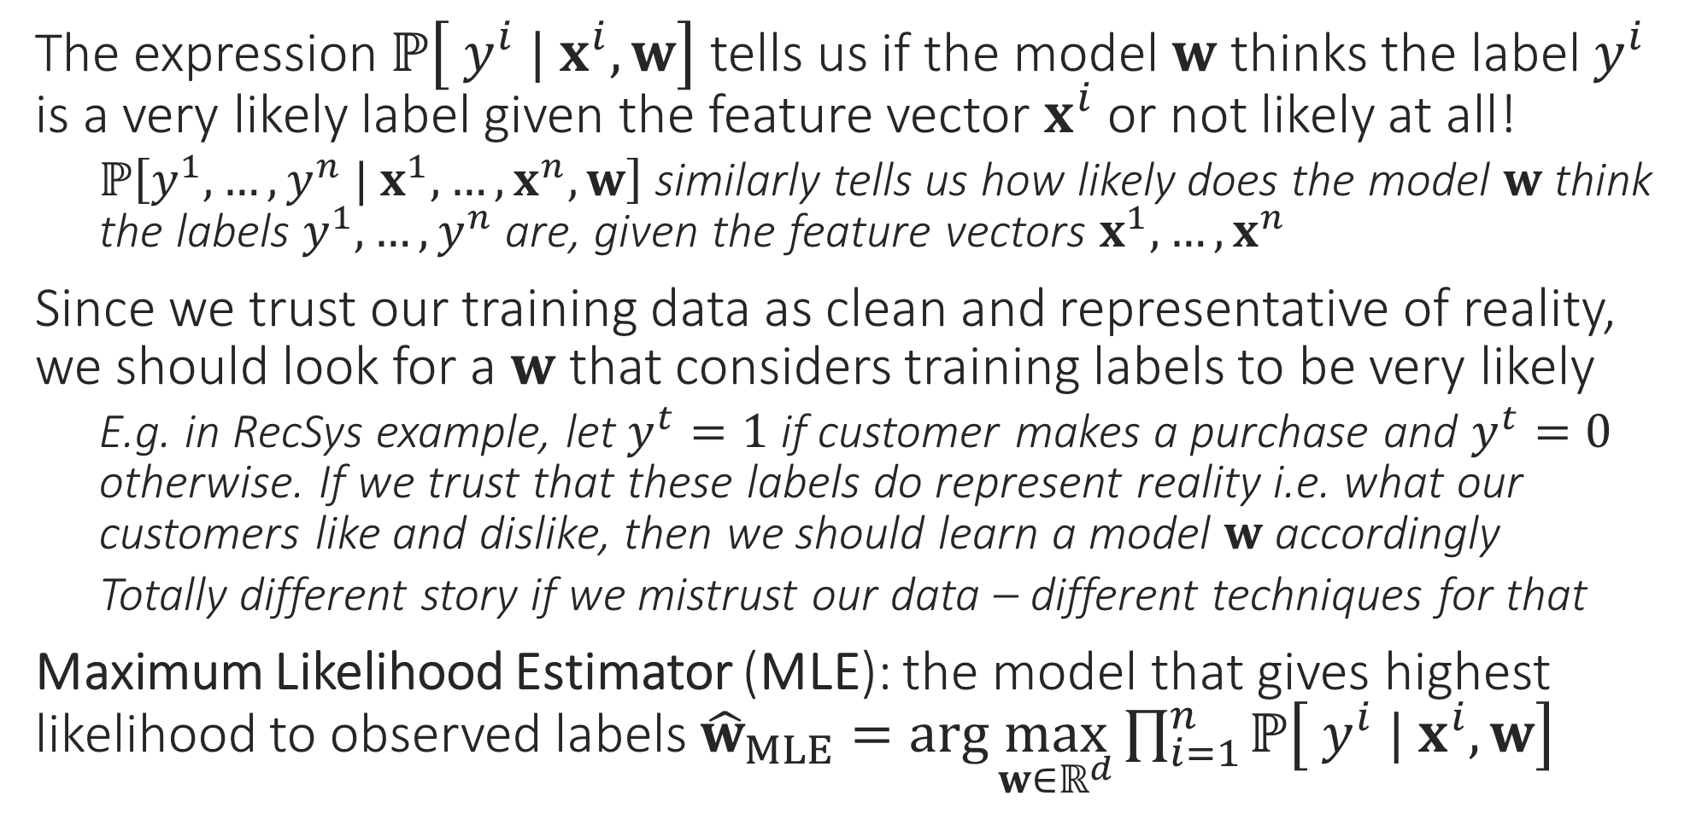
Maximum Likelihood
The expression $ℙ\left[ y^{i} | x^{i},w\right]$ tells us if the model $w$ thinks the label $y^{i}$ is a very likely label given the feature vector $x^{i}$ or not likely at all!
$ℙ\left[y^{1},…,y^{n} | x^{1},…,x^{n},w\right]$ similarly tells us how likely does the model $w$ think the labels $y^{1},…,y^{n}$ are, given the feature vectors $x^{1},…,x^{n}$
Since we trust our training data as clean and representative of reality, we should look for a $w$ that considers training labels to be very likely
E.g. in RecSys example, let $y^{t}=1$ if customer makes a purchase and $y^{t}=0$ otherwise. If we trust that these labels do represent reality i.e. what our customers like and dislike, then we should learn a model $w$ accordingly
Totally different story if we mistrust our data – different techniques for that
Maximum Likelihood Estimator (MLE): the model that gives highest likelihood to observed labels ${\hat{w}}_{MLE}=\arg{\max_{w∈ℝ^{d}}{\prod_{i=1}^{n}{ℙ\left[ y^{i} | x^{i},w\right]}}}$

Slide 18
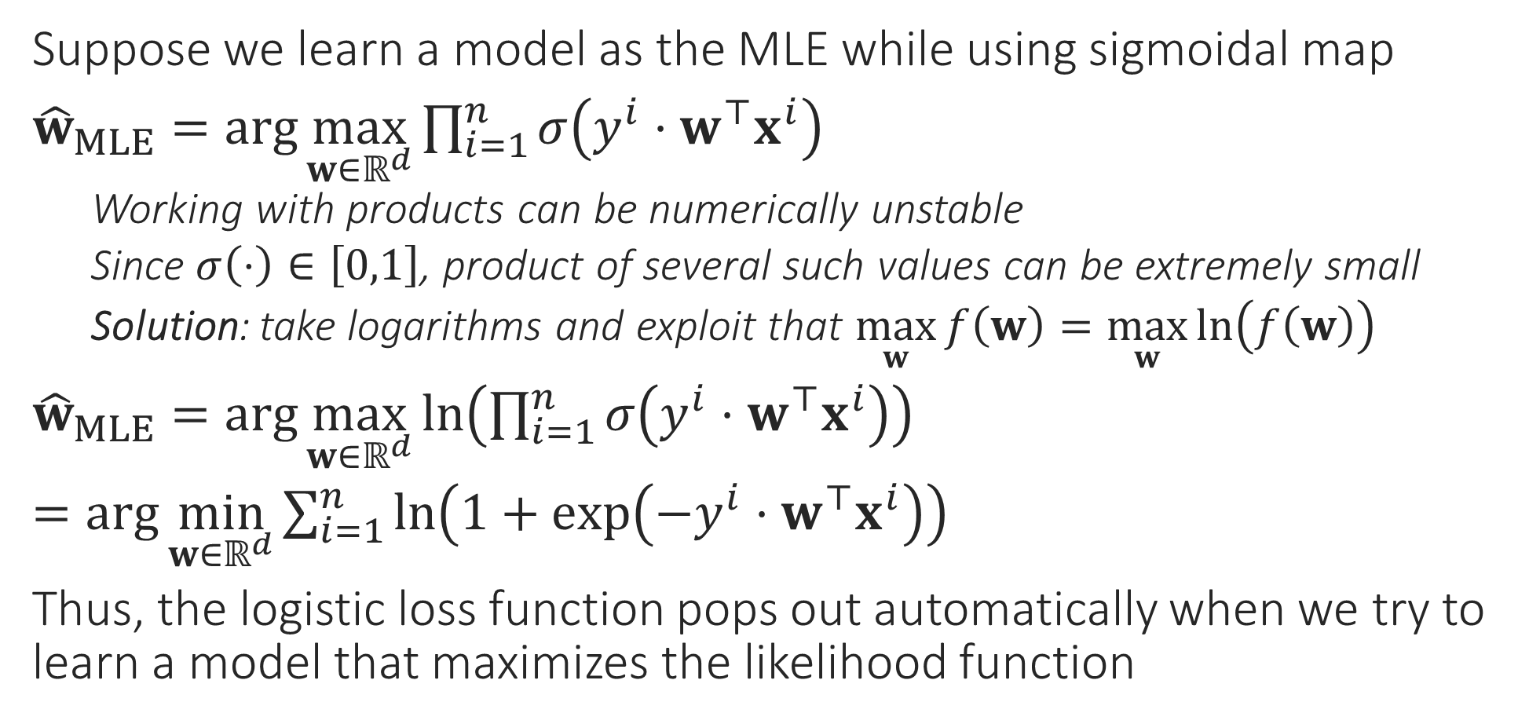
Logistic Regression
Suppose we learn a model as the MLE while using sigmoidal map
${\hat{w}}_{MLE}=\arg{\max_{w∈ℝ^{d}}{\prod_{i=1}^{n}{σ\left(y^{i}⋅w^{⊤}x^{i}\right)}}}$
Working with products can be numerically unstable
Since $σ\left(⋅\right)∈\left[0,1\right]$, product of several such values can be extremely small
Solution: take logarithms and exploit that $\max_{w}{f\left(w\right)}=\max_{w}{\ln\left(f\left(w\right)\right)}$
${\hat{w}}_{MLE}=\arg{\max_{w∈ℝ^{d}}{\ln\left(\prod_{i=1}^{n}{σ\left(y^{i}⋅w^{⊤}x^{i}\right)}\right)}}$
$=\arg{\min_{w∈ℝ^{d}}{\sum_{i=1}^{n}{\ln\left(1+\exp\left(−y^{i}⋅w^{⊤}x^{i}\right)\right)}}}$
Thus, the logistic loss function pops out automatically when we try to learn a model that maximizes the likelihood function
Also called negative log-likelihood

Slide 19


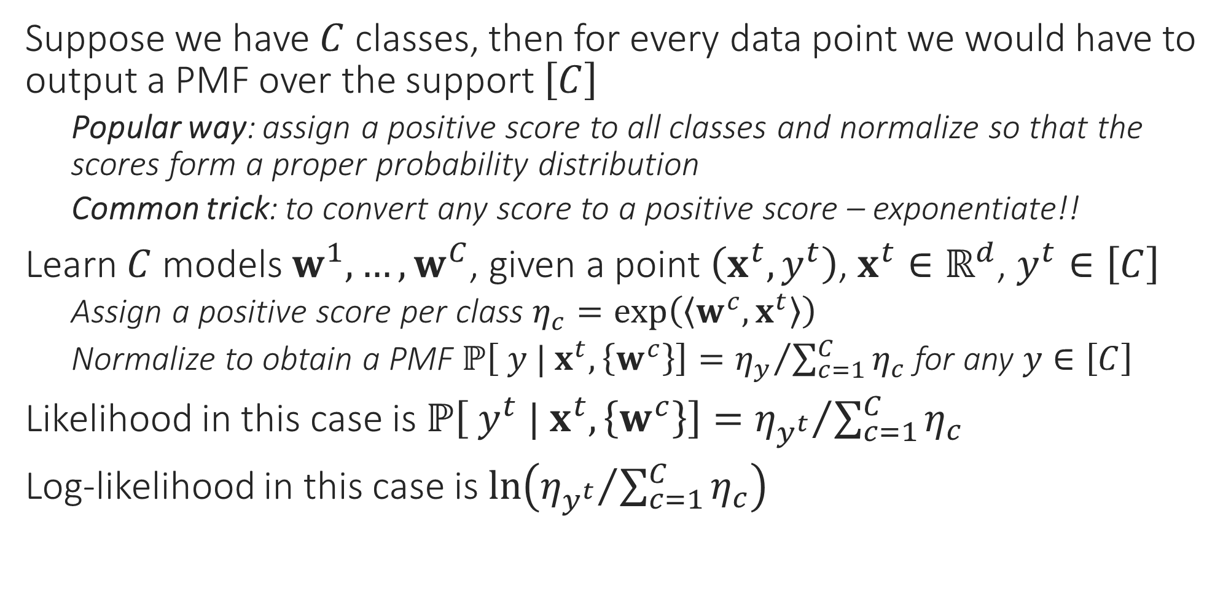
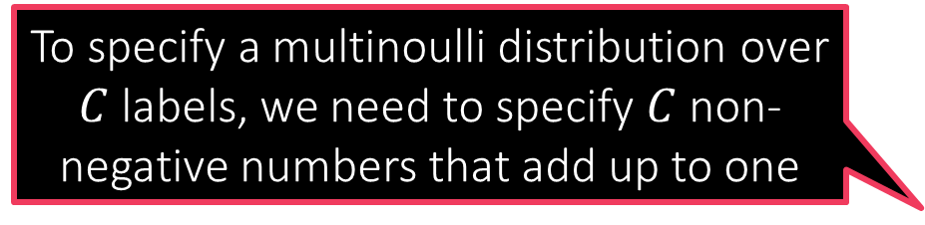
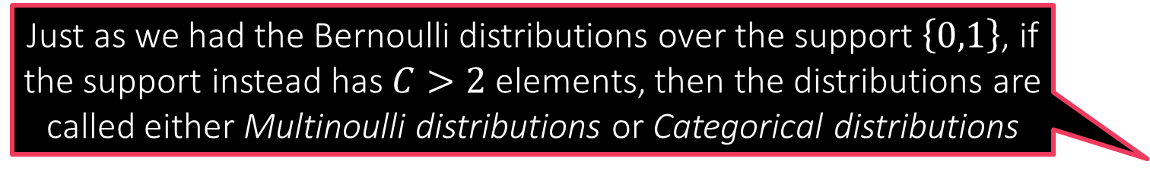
Probabilistic Multiclassification
Just as we had the Bernoulli distributions over the support $\left\{0,1\right\}$, if the support instead has $C>2$ elements, then the distributions are called either Multinoulli distributions or Categorical distributions
Suppose we have $C$ classes, then for every data point we would have to output a PMF over the support $\left[C\right]$
Popular way: assign a positive score to all classes and normalize so that the scores form a proper probability distribution
Common trick: to convert any score to a positive score – exponentiate!!
Learn $C$ models $w^{1},…,w^{C}$, given a point $\left(x^{t},y^{t}\right)$, $x^{t}∈ℝ^{d}$, $y^{t}∈\left[C\right]$
Assign a positive score per class $η_{c}=\exp\left(\left\langle w^{c},x^{t}\right\rangle \right)$
Normalize to obtain a PMF $ℙ\left[ y | x^{t},\left\{w^{c}\right\}\right]={η_{y}}/{\sum_{c=1}^{C}{η_{c}}}$ for any $y∈\left[C\right]$
Likelihood in this case is $ℙ\left[ y^{t} | x^{t},\left\{w^{c}\right\}\right]={η_{y^{t}}}/{\sum_{c=1}^{C}{η_{c}}}$
Log-likelihood in this case is $\ln\left({η_{y^{t}}}/{\sum_{c=1}^{C}{η_{c}}}\right)$
To specify a multinoulli distribution over $C$ labels, we need to specify $C$ non-negative numbers that add up to one

Slide 20



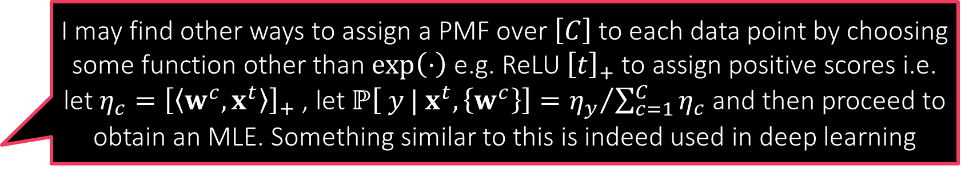
Softmax Regression
I may find other ways to assign a PMF over $\left[C\right]$ to each data point by choosing some function other than $\exp\left(⋅\right)$ e.g. ReLU ${\left[t\right]}_{+}$ to assign positive scores i.e. let $η_{c}={\left[\left\langle w^{c},x^{t}\right\rangle \right]}_{+}$ , let $ℙ\left[ y | x^{t},\left\{w^{c}\right\}\right]={η_{y}}/{\sum_{c=1}^{C}{η_{c}}}$ and then proceed to obtain an MLE. Something similar to this is indeed used in deep learning
If we now want to learn the MLE, we would have to find
$\left\{{\hat{w}}_{MLE}^{1},…,{\hat{w}}_{MLE}^{C}\right\}=\arg{\max_{w^{1},…,w^{C}∈ℝ^{d}}{\prod_{i=1}^{n}{ℙ\left[ y^{i} | x^{i},w\right]}}}$
$=\arg{\max_{w^{1},…,w^{C}∈ℝ^{d}}{\prod_{i=1}^{n}{{η_{y^{t}}^{i}}/{\sum_{c=1}^{C}{η_{c}^{i}}}}}}$ where $η_{c}^{i}=\exp\left(\left\langle w^{c},x^{i}\right\rangle \right)$
Using the negative log-likelihood for numerical stability
$=\arg{\min_{w^{1},…,w^{C}∈ℝ^{d}}{\sum_{i=1}^{n}{−\ln\left({η_{y^{t}}^{i}}/{\sum_{c=1}^{C}{η_{c}^{i}}}\right)}}}$
Note: this is nothing but the softmax loss function we saw earlier, also known as the cross entropy loss function
Reason for the name: it corresponds to something known as the cross entropy between the PMF given by the model and the true label of the data point
It should be noted that this is not the only way to do probabilistic multiclassification. It is just that this way is simple to understand, implement and hence popular
However, be warned that generating a PMF using DT need not necessarily be an MLE since we have not explicitly maximized any likelihood function here
I could do also DT and invoke the “probability as proportions” interpretation to assign a test data point to a PMF that simply gives the proportion of each label in the leaf of that data point!!

Slide 21
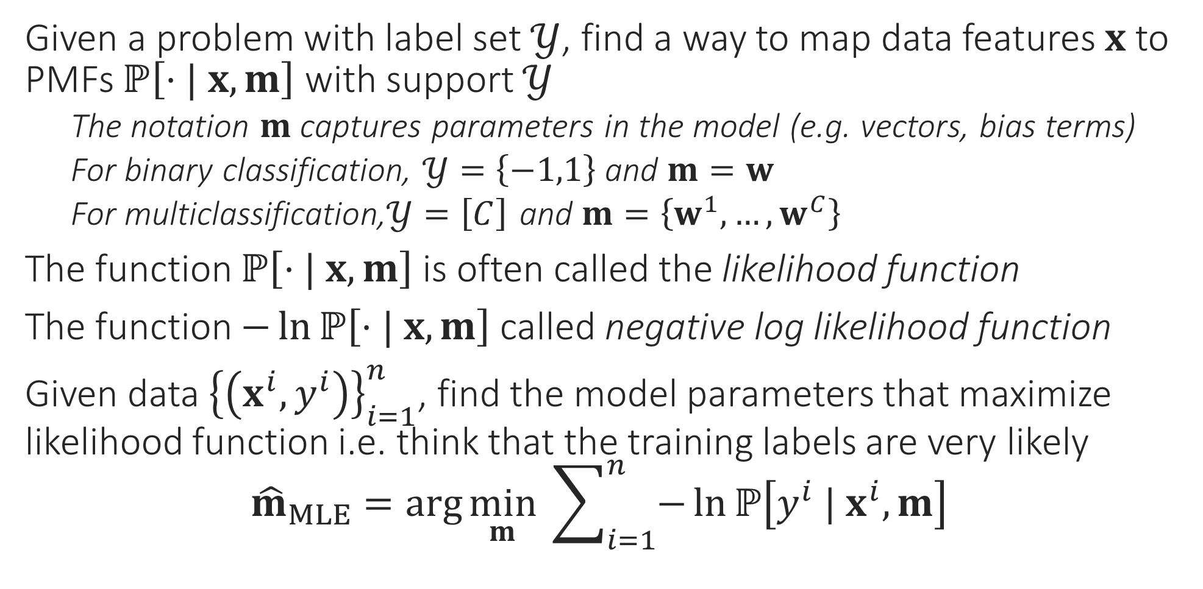
General Recipe for MLE Algorithms
Given a problem with label set $𝒴$, find a way to map data features $x$ to PMFs $ℙ\left[⋅| x, m\right]$ with support $𝒴$
The notation $m$ captures parameters in the model (e.g. vectors, bias terms)
For binary classification, $𝒴=\left\{−1,1\right\}$ and $m=w$
For multiclassification,$𝒴=\left[C\right]$ and $m=\left\{w^{1},…,w^{C}\right\}$
The function $ℙ\left[⋅| x, m\right]$ is often called the likelihood function
The function $−\ln{ℙ\left[⋅| x, m\right]}$ called negative log likelihood function
Given data ${\left\{\left(x^{i},y^{i}\right)\right\}}_{i=1}^{n}$, find the model parameters that maximize likelihood function i.e. think that the training labels are very likely ${\hat{m}}_{MLE}=\arg{\min_{m}{ \sum_{i=1}^{n}{−\ln{ℙ\left[y^{i} | x^{i}, m\right]}}}}$

