Slide 1
Probabilistic Regularization?

Slide 2
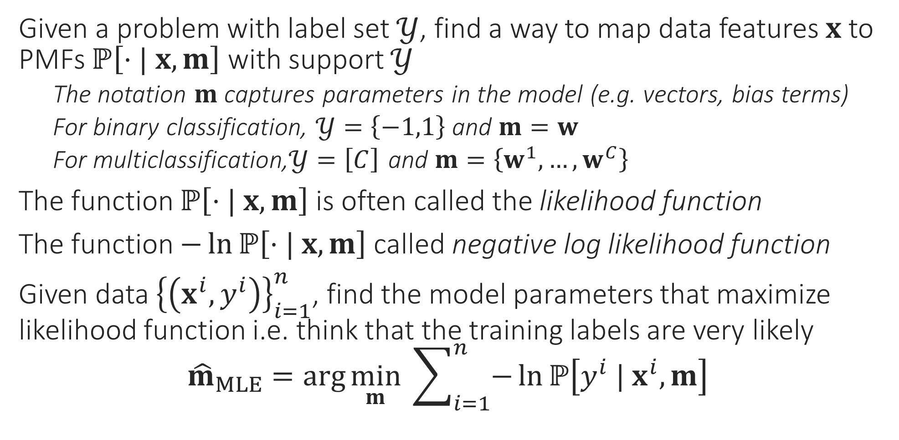
General Recipe for MLE Algorithms
Given a problem with label set $𝒴$, find a way to map data features $x$ to PMFs $ℙ\left[⋅| x, m\right]$ with support $𝒴$
The notation $m$ captures parameters in the model (e.g. vectors, bias terms)
For binary classification, $𝒴=\left\{−1,1\right\}$ and $m=w$
For multiclassification,$𝒴=\left[C\right]$ and $m=\left\{w^{1},…,w^{C}\right\}$
The function $ℙ\left[⋅| x, m\right]$ is often called the likelihood function
The function $−\ln{ℙ\left[⋅| x, m\right]}$ called negative log likelihood function
Given data ${\left\{\left(x^{i},y^{i}\right)\right\}}_{i=1}^{n}$, find the model parameters that maximize likelihood function i.e. think that the training labels are very likely ${\hat{m}}_{MLE}=\arg{\min_{m}{ \sum_{i=1}^{n}{−\ln{ℙ\left[y^{i} | x^{i}, m\right]}}}}$

Slide 3




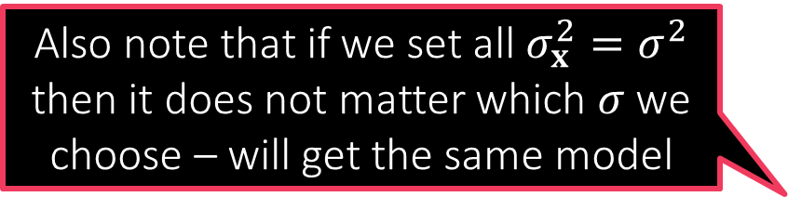
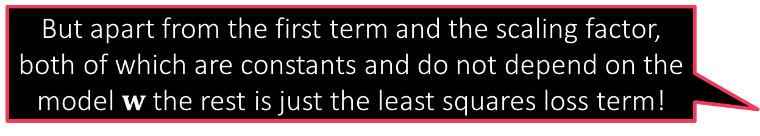
Probabilistic Regression
But apart from the first term and the scaling factor, both of which are constants and do not depend on the model $w$ the rest is just the least squares loss term!
In order to perform probabilistic regression I have to assign a label distribution over all $ℝ$ for every data point $x$ using a PDF
Suppose I decide to do that using a Gaussian distribution – need to decide on a mean $μ_{x}$ and a variance $σ_{x}^{2}>0$
Popular choice: Let $μ_{x}=w^{⊤}x$ and $σ_{x}^{2}=σ^{2}$ i.e. $𝒩\left(⋅| w^{⊤}x,σ^{2}\right)$
We can also choose a different $σ$ for every data point – more complicated
Likelihood function w.r.t a data point $\left(x^{i},y^{i}\right)$ then becomes $𝒩\left(y^{i} | w^{⊤}x^{i},σ^{2}\right)=\frac{1}{\sqrt{2πσ^{2}}}\exp\left(−{\left(y^{i}−w^{⊤}x^{i}\right)}^{2}/{2σ}^{2}\right)$
Negative log likelihood w.r.t a set of data points ${\left\{\left(x^{i},y^{i}\right)\right\}}_{i=1}^{n}$ $\frac{n}{2}ln\left(2πσ^{2}\right)+\frac{1}{2σ^{2}}\sum_{i=1}^{n}{{\left(y^{i}−w^{⊤}x^{i}\right)}^{2}}$
The MLE with respect to the Gaussian likelihood indeed the minimizes least squares loss
Also note that if we set all $σ_{x}^{2}=σ^{2}$ then it does not matter which $σ$ we choose – will get the same model
$$\min_{w∈ℝ^{d}}{}$$

Slide 4





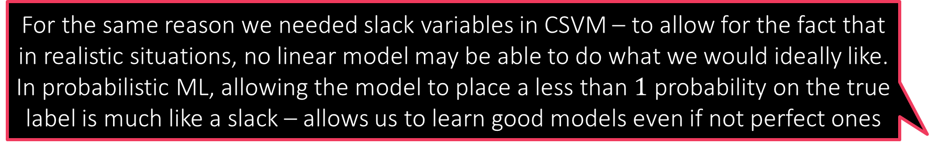
Probabilistic Regression
Be warned though – the $σ$ we chose will start mattering the moment we add regularization! It is just that in these simple cases it does not matter. $σ$ is usually treated like a hyperparameter and tuned.
Suppose I decide to use a Laplacian distribution instead and choose $μ_{x}=w^{⊤}x$ and $σ_{x}=σ$ i.e. $Lap\left(⋅| w^{⊤}x,σ\right)$
Likelihood function w.r.t a data point $\left(x^{i},y^{i}\right)$ then becomes $Lap\left(y^{i} | w^{⊤}x^{i},σ\right)=\frac{1}{2σ}\exp\left(−\left|y^{i}−w^{⊤}x\right|/σ\right)$
Negative log likelihood w.r.t a set of data points ${\left\{\left(x^{i},y^{i}\right)\right\}}_{i=1}^{n}$ $\min_{w∈ℝ^{d}}{ n⋅ln\left(σ\right)+\frac{1}{σ}\sum_{i=1}^{n}{\left|y^{i}−w^{⊤}x^{i}\right|}}=\min_{w∈ℝ^{d}}{ \sum_{i=1}^{n}{\left|y^{i}−w^{⊤}x^{i}\right|}}$
Thus, if we change the likelihood function to use the Laplacian distribution instead, the MLE ends up minimizing absolute loss!
As before, does not matter which $σ$ we choose
So I am a bit confused. All MLEs (classification/regression) demand a model that places maximum probability on the true label. Why don’t we just ask the model to predict the true label itself?
That is like asking the PMF/PDF to place probability $1$ on the true label and $0$ everywhere else – why can’t we do just that?
For the same reason we needed slack variables in CSVM – to allow for the fact that in realistic situations, no linear model may be able to do what we would ideally like. In probabilistic ML, allowing the model to place a less than $1$ probability on the true label is much like a slack – allows us to learn good models even if not perfect ones

Slide 5
Probabilistic Regularization??
We have seen that MLE often reduces to loss minimization e.g. logistic regression/least squares regression but without regularization terms ☹
Even probabilistic methods can do regularization by way of priors
Recall: regularization basically tells us which kinds of models we prefer
L2 regularization means we prefer models with small L2 norm
L1 regularization means we prefer models with small L1 norm/sparse models
In the language of probability, the most direct way of specifying such a preference is by specifying a probability distribution itself
Prior: a probability distribution over all possible models
Just like we usually decide regularization before seeing any data, prior distribution also does not consider/condition on, any data
But our models are vectors right? Can we have probability distribution over vectors as well?
Of course we can. But first, let us see the basic operations in a toy 1D setting before getting into the complications of vector-valued r.v.s

Slide 6


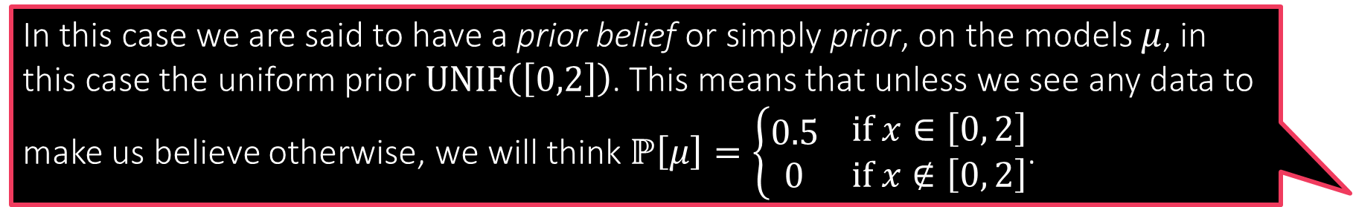
Can you Guess the Mean?
In this case we are said to have a prior belief or simply prior, on the models $μ$, in this case the uniform prior $UNIF\left(\left[0,2\right]\right)$. This means that unless we see any data to make us believe otherwise, we will think $ℙ\left[μ\right]=\left\{\begin{aligned}0.5 \\ 0\end{aligned} \begin{matrix}if x∈\left[0, 2\right] \\ if x∉\left[0, 2\right]\end{matrix}\right.$.
There is a Gaussian with unknown mean but known variance (for sake of simplicity) from which we receive $n$ independent samples $x_{1},x_{2},…,x_{n}∼𝒩\left(μ^{∗},1\right)$
Can we estimate the “model” $μ^{∗}$ from these samples?
Likelihood function: for a candidate model $μ$ and sample $x_{i}$ $ℙ\left[x_{i} | μ,1\right]=\frac{1}{\sqrt{2π}}\exp\left(−{\left(x_{i}−μ\right)}^{2}/2\right)$
MLE: $\arg{\max_{μ∈ℝ}{\prod_{i=1}^{n}{ℙ\left[x_{i} | μ,1\right]}}}=\arg{\min_{μ∈ℝ}{\sum_{i=1}^{n}{{\left(x_{i}−μ\right)}^{2}}}}$
Suppose we believe (e.g. someone tells us) even before the samples have been presented that $μ^{∗}$ definitely lies in the interval $\left[0,2\right]$ (but could otherwise be any value within that interval)
What happens we do see some data, namely the actual samples from the distribution?
We use the samples and the rules of probability to update our beliefs about what $μ$ can and cannot be. Let us see how to do this

Slide 7
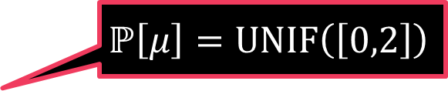
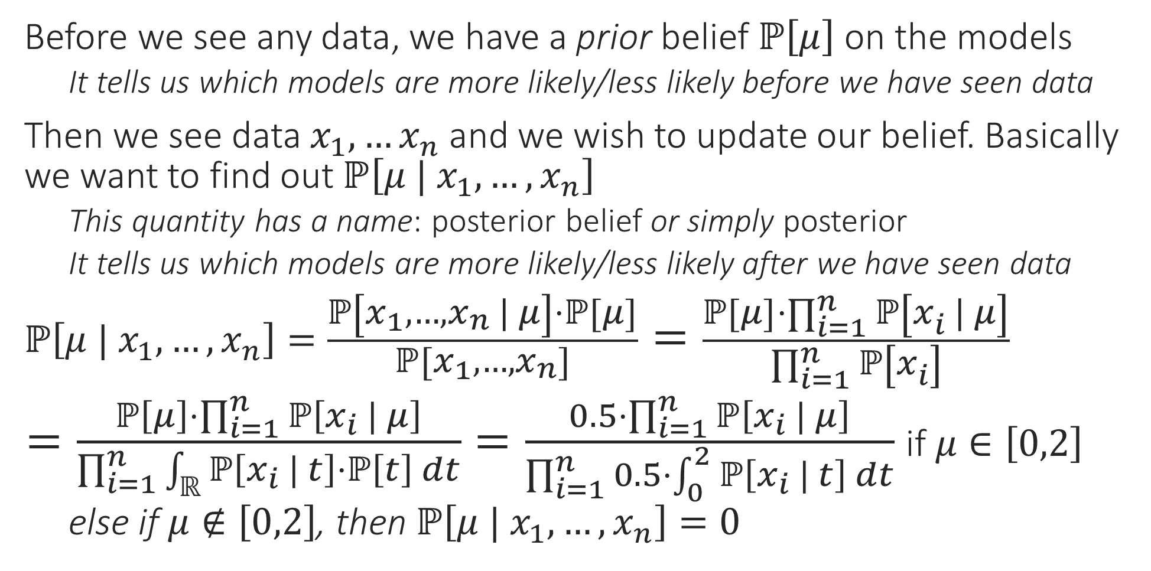
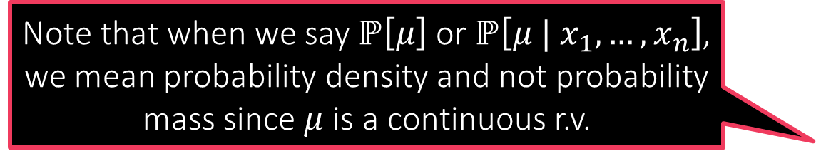
Posterior
Before we see any data, we have a prior belief $ℙ\left[μ\right]$ on the models
It tells us which models are more likely/less likely before we have seen data
Then we see data $x_{1},…x_{n}$ and we wish to update our belief. Basically we want to find out $ℙ\left[μ | x_{1},…,x_{n}\right]$
This quantity has a name: posterior belief or simply posterior
It tells us which models are more likely/less likely after we have seen data
$ℙ\left[μ | x_{1},…,x_{n}\right]=\frac{ℙ\left[x_{1},…,x_{n} | μ\right]⋅ℙ\left[μ\right]}{ℙ\left[x_{1},…,x_{n}\right]}=\frac{ℙ\left[μ\right]⋅\prod_{i=1}^{n}{ℙ\left[x_{i} | μ\right]}}{\prod_{i=1}^{n}{ℙ\left[x_{i}\right]}}$
$=\frac{ℙ\left[μ\right]⋅\prod_{i=1}^{n}{ℙ\left[x_{i} | μ\right]}}{\prod_{i=1}^{n}{\int_{ℝ}{ℙ\left[x_{i} | t\right]⋅ℙ\left[t\right] dt}}}=\frac{0.5⋅\prod_{i=1}^{n}{ℙ\left[x_{i} | μ\right]}}{\prod_{i=1}^{n}{0.5⋅\int_{0}^{2}{ℙ\left[x_{i} | t\right] dt}}}$ if $μ∈\left[0,2\right]$
else if $μ∉\left[0,2\right]$, then $ℙ\left[μ | x_{1},…,x_{n}\right]=0$
Note that when we say $ℙ\left[μ\right]$ or $ℙ\left[μ | x_{1},…,x_{n}\right]$, we mean probability density and not probability mass since $μ$ is a continuous r.v.
Bayes Rule
Samples are independent
Law of total probability
$$ℙ\left[μ\right]=UNIF\left(\left[0,2\right]\right)$$

Slide 8


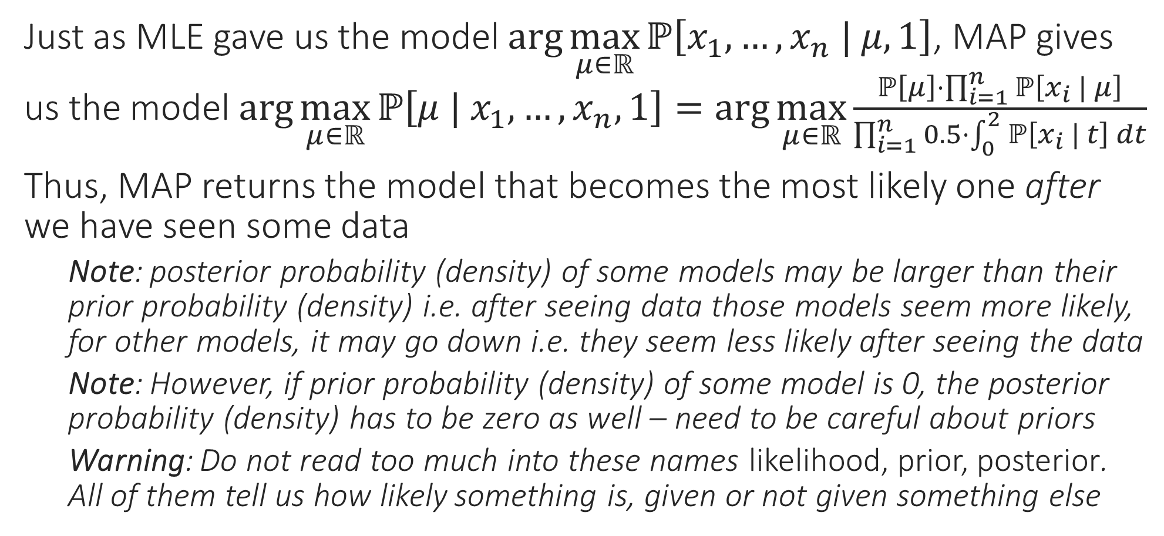

Maximum a Posteriori (MAP) Estimate
It is better to choose priors that do not completely exclude some models by giving them 0 probability (as we did)
Just as MLE gave us the model $\arg{\max_{μ∈ℝ}{ℙ\left[x_{1},…,x_{n} | μ,1\right]}}$, MAP gives us the model $\arg{\max_{μ∈ℝ}{ℙ\left[μ | x_{1},…,x_{n},1\right]}}=\arg{\max_{μ∈ℝ}}\frac{ℙ\left[μ\right]⋅\prod_{i=1}^{n}{ℙ\left[x_{i} | μ\right]}}{\prod_{i=1}^{n}{0.5⋅\int_{0}^{2}{ℙ\left[x_{i} | t\right] dt}}}$
Thus, MAP returns the model that becomes the most likely one after we have seen some data
Note: posterior probability (density) of some models may be larger than their prior probability (density) i.e. after seeing data those models seem more likely, for other models, it may go down i.e. they seem less likely after seeing the data
Note: However, if prior probability (density) of some model is 0, the posterior probability (density) has to be zero as well – need to be careful about priors
Warning: Do not read too much into these names likelihood, prior, posterior. All of them tell us how likely something is, given or not given something else
True! Even in general, if your priors are bad, or too strong, then you may end up getting funny models as a result of doing MAP estimation
Indeed! For example if we were wrong and $μ^{∗}$ was actually not $∈\left[0,2\right]$ then not matter how many samples we see, we will never estimate $μ^{∗}$ correctly!!

Slide 9
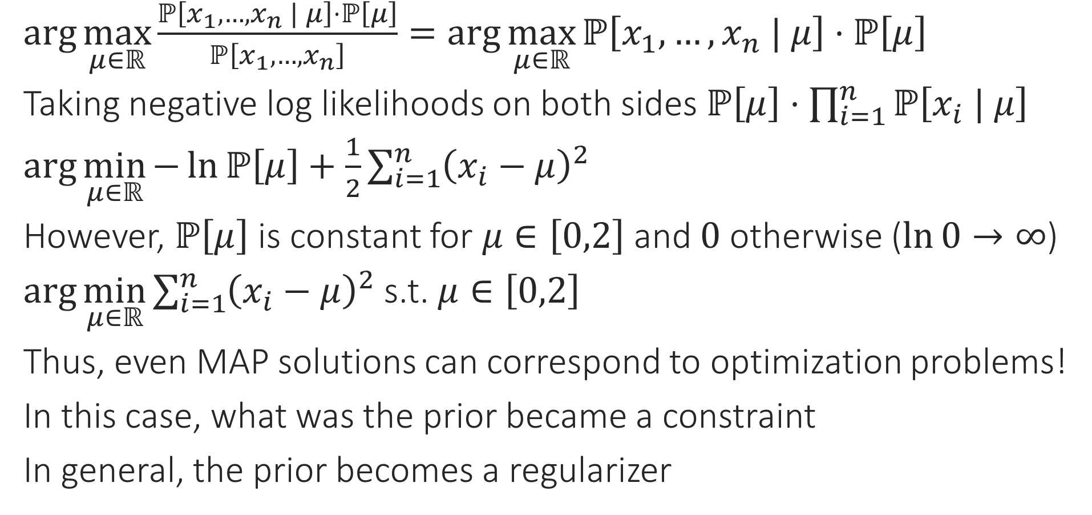
MAP vs Regularization
$\arg{\max_{μ∈ℝ}{\frac{ℙ\left[x_{1},…,x_{n} | μ\right]⋅ℙ\left[μ\right]}{ℙ\left[x_{1},…,x_{n}\right]}}}=\arg{\max_{μ∈ℝ}{ℙ\left[x_{1},…,x_{n} | μ\right]⋅ℙ\left[μ\right]}}$
Taking negative log likelihoods on both sides $ℙ\left[μ\right]⋅\prod_{i=1}^{n}{ℙ\left[x_{i} | μ\right]}$
$\arg{\min_{μ∈ℝ}{−\ln{ℙ\left[μ\right]}+\frac{1}{2}\sum_{i=1}^{n}{{\left(x_{i}−μ\right)}^{2}}}}$
However, $ℙ\left[μ\right]$ is constant for $μ∈\left[0,2\right]$ and $0$ otherwise ($\ln{0}→∞$)
$\arg{\min_{μ∈ℝ}{\sum_{i=1}^{n}{{\left(x_{i}−μ\right)}^{2}}}}$ s.t. $μ∈\left[0,2\right]$
Thus, even MAP solutions can correspond to optimization problems!
In this case, what was the prior became a constraint
In general, the prior becomes a regularizer

Slide 10


MAP vs Regularization
Similarly, had we used a Laplacian prior, we would have obtained L1 regularization instead
Consider the same problem as before but a different prior
This time we do not believe $μ$ must have been in the interval $\left[0,2\right]$ but a much milder prior that $μ$ is not too large in magnitude
A good way to express this is to use a Gaussian prior $ℙ\left[μ\right]=𝒩\left(μ ; 0,σ^{2}\right)=\frac{1}{\sqrt{2πσ^{2}}}\exp\left(−\frac{μ^{2}}{2σ^{2}}\right)$
MAP: $\arg{\min_{μ∈ℝ}{−\ln{ℙ\left[μ\right]}+\frac{1}{2}\sum_{i=1}^{n}{{\left(x_{i}−μ\right)}^{2}}}}$
$=\arg{\min_{μ∈ℝ}{\frac{μ^{2}}{{2σ}^{2}}+\frac{1}{2}\sum_{i=1}^{n}{{\left(x_{i}−μ\right)}^{2}}}}=\arg{\min_{μ∈ℝ}{\frac{μ^{2}}{σ^{2}}+\sum_{i=1}^{n}{{\left(x_{i}−μ\right)}^{2}}}}$
Thus, a Gaussian prior gave us L2 regularization!
Note: $σ$ effecitely dictates the regularization constant – not useless!!
Note: this is basically ridge regression except in one dimension!!
The regularization constant is dictated by the strength of the regularization. Be careful not to have strong priors (uninformed strong opinions are bad in real life too ☺)

Slide 11
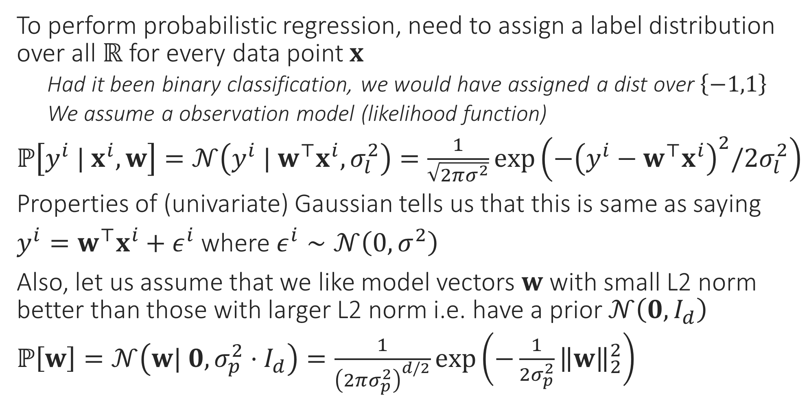
Probabilistic Regression Revisited
To perform probabilistic regression, need to assign a label distribution over all $ℝ$ for every data point $x$
Had it been binary classification, we would have assigned a dist over $\left\{−1,1\right\}$
We assume a observation model (likelihood function)
$ℙ\left[y^{i} | x^{i},w\right]=𝒩\left(y^{i} | w^{⊤}x^{i},σ_{l}^{2}\right)=\frac{1}{\sqrt{2πσ^{2}}}\exp\left(−{\left(y^{i}−w^{⊤}x^{i}\right)}^{2}/{2σ}_{l}^{2}\right)$
Properties of (univariate) Gaussian tells us that this is same as saying
$y^{i}=w^{⊤}x^{i}+ε^{i}$ where $ε^{i}∼𝒩\left(0,σ^{2}\right)$
Also, let us assume that we like model vectors $w$ with small L2 norm better than those with larger L2 norm i.e. have a prior $𝒩\left(0,I_{d}\right)$
$ℙ\left[w\right]=𝒩\left(w| 0,σ_{p}^{2}⋅I_{d}\right)=\frac{1}{{\left(2πσ_{p}^{2}\right)}^{d/2}}\exp\left(−\frac{1}{2σ_{p}^{2}}{\left\|w\right\|}_{2}^{2}\right)$

Slide 12

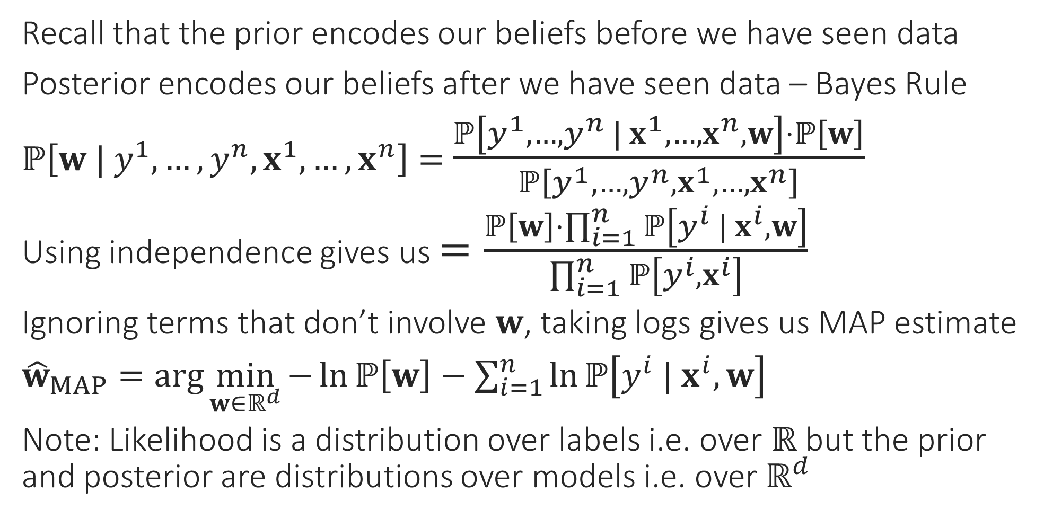
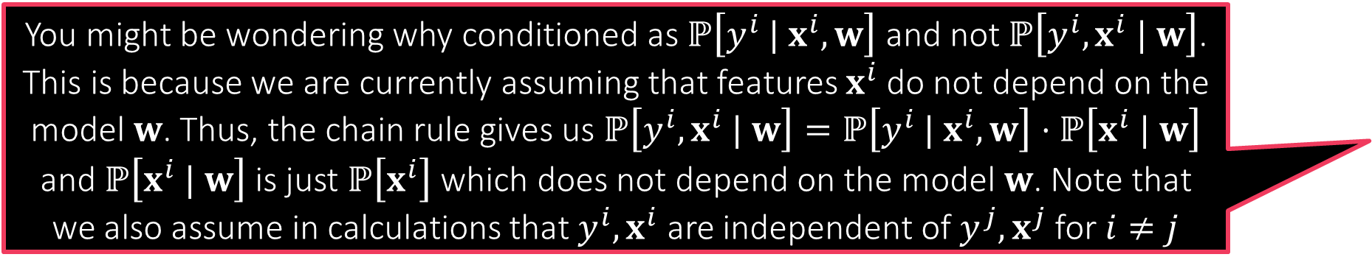
Probabilistic Regression Revisited
You might be wondering why conditioned as $ℙ\left[y^{i} | x^{i},w\right]$ and not $ℙ\left[y^{i},x^{i} | w\right]$. This is because we are currently assuming that features $x^{i}$ do not depend on the model $w$. Thus, the chain rule gives us $ℙ\left[y^{i},x^{i} | w\right]=ℙ\left[y^{i} | x^{i},w\right]⋅ℙ\left[x^{i} | w\right]$ and $ℙ\left[x^{i} | w\right]$ is just $ℙ\left[x^{i}\right]$ which does not depend on the model $w$. Note that we also assume in calculations that $y^{i},x^{i}$ are independent of $y^{j},x^{j}$ for $i≠j$
Recall that the prior encodes our beliefs before we have seen data
Posterior encodes our beliefs after we have seen data – Bayes Rule
$ℙ\left[w | y^{1},…,y^{n},x^{1},…,x^{n}\right]=$ $\frac{ℙ\left[y^{1},…,y^{n} | x^{1},…,x^{n},w\right]⋅ℙ\left[w\right]}{ℙ\left[y^{1},…,y^{n},x^{1},…,x^{n}\right]}$
Using independence gives us $=\frac{ℙ\left[w\right]⋅\prod_{i=1}^{n}{ℙ\left[y^{i} | x^{i},w\right]}}{\prod_{i=1}^{n}{ℙ\left[y^{i}, x^{i}\right]}}$
Ignoring terms that don’t involve $w$, taking logs gives us MAP estimate
${\hat{w}}_{MAP}=\arg{\min_{w∈ℝ^{d}}{−\ln{ℙ\left[w\right]}−\sum_{i=1}^{n}{\ln{ℙ\left[y^{i} | x^{i},w\right]}}}}$
Note: Likelihood is a distribution over labels i.e. over $ℝ$ but the prior and posterior are distributions over models i.e. over $ℝ^{d}$
We will soon study “generative” models where the features $x^{i}$ themselves would become random variables dependent on a (more complicated) model

Slide 13
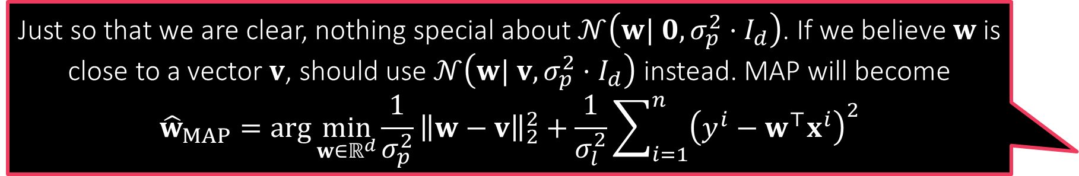

MAP for Probabilistic Regression
Just so that we are clear, nothing special about $𝒩\left(w| 0,σ_{p}^{2}⋅I_{d}\right)$. If we believe $w$ is close to a vector $v$, should use $𝒩\left(w| v,σ_{p}^{2}⋅I_{d}\right)$ instead. MAP will become
$${\hat{w}}_{MAP}=\arg{\min_{w∈ℝ^{d}}{\frac{1}{σ_{p}^{2}}}{\left\|w−v\right\|}_{2}^{2}+\frac{1}{σ_{l}^{2}}\sum_{i=1}^{n}{{\left(y^{i}−w^{⊤}x^{i}\right)}^{2}}}$$
For Gaussian likelihood $𝒩\left(y^{i} | w^{⊤}x^{i},σ_{l}^{2}\right)$ and Gaussian prior $𝒩\left(w| 0,σ_{p}^{2}⋅I_{d}\right)$ we get ${\hat{w}}_{MAP}=\arg{\min_{w∈ℝ^{d}}{\frac{1}{σ_{p}^{2}}}{\left\|w\right\|}_{2}^{2}+\frac{1}{σ_{l}^{2}}\sum_{i=1}^{n}{{\left(y^{i}−w^{⊤}x^{i}\right)}^{2}}}$
Be careful, there are two variance terms here $σ_{l},σ_{p}$
The above is $\arg{\min_{w∈ℝ^{d}}{{\left(\frac{σ_{l}}{σ_{p}}\right)}^{2}⋅}{\left\|w\right\|}_{2}^{2}+\sum_{i=1}^{n}{{\left(y^{i}−w^{⊤}x^{i}\right)}^{2}}}$ i.e. ridge regression
Thus, $σ_{l},σ_{p}$ together decide the regularization constant
There is a multivariate version of the Laplace distribution too!
Using it as a prior with $μ=0$ (the zero vector) will give us LASSO!
Warning: expression for the Laplace PDF for general covariance is a bit tricky) $ℒ\left(w | μ,σ\right)=\frac{1}{{\left(2σ\right)}^{d}}\exp\left(−\frac{{\left\|w−μ\right\|}_{1}}{σ}\right)$

Slide 14
Bayesian Learning
Before we started doing probabilistic ML, we used to output a single label. With PML we started giving a distribution over labels instead
However, we still do so using a single model
In MLE we use the model with highest likelihood function value to do so
In MAP we use the mode of the posterior distribution to do so
In Bayesian learning, we take this philosophy further – instead of trusting a single model, we place partial trust, possibly over all models
Models with high posterior probability (density) value get high trust
Models with low posterior probability (density) value get low trust
We use Bayes rule yet again to perform these calculations

Slide 15
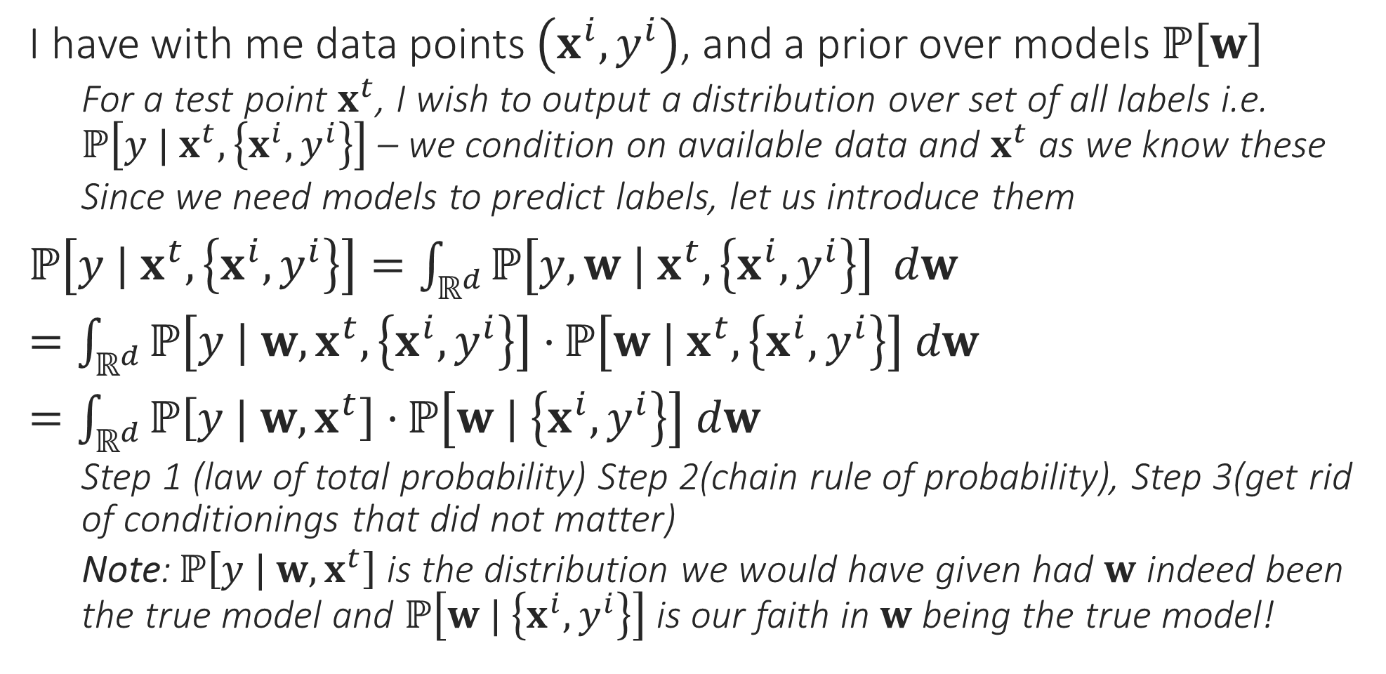
From PML to BML
I have with me data points $\left(x^{i},y^{i}\right)$, and a prior over models $ℙ\left[w\right]$
For a test point $x^{t}$, I wish to output a distribution over set of all labels i.e. $ℙ\left[y | x^{t},\left\{x^{i},y^{i}\right\}\right]$ – we condition on available data and $x^{t}$ as we know these
Since we need models to predict labels, let us introduce them
$ℙ\left[y | x^{t},\left\{x^{i},y^{i}\right\}\right]=\int_{ℝ^{d}}{ℙ\left[y,w | x^{t},\left\{x^{i},y^{i}\right\}\right]} dw$
$=\int_{ℝ^{d}}{ℙ\left[y | w, x^{t},\left\{x^{i},y^{i}\right\}\right]⋅}ℙ\left[w | x^{t},\left\{x^{i},y^{i}\right\}\right] dw$
$=\int_{ℝ^{d}}{ℙ\left[y | w, x^{t}\right]⋅}ℙ\left[w | \left\{x^{i},y^{i}\right\}\right] dw$
Step 1 (law of total probability) Step 2(chain rule of probability), Step 3(get rid of conditionings that did not matter)
Note: $ℙ\left[y | w, x^{t}\right]$ is the distribution we would have given had $w$ indeed been the true model and $ℙ\left[w | \left\{x^{i},y^{i}\right\}\right]$ is our faith in $w$ being the true model!

Slide 16
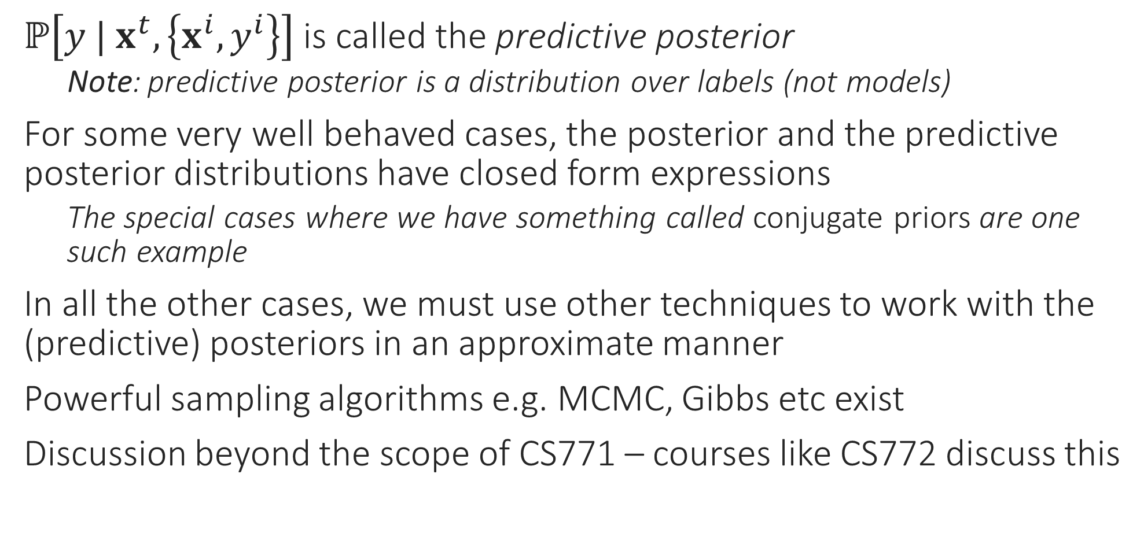
BML Trivia
$ℙ\left[y | x^{t},\left\{x^{i},y^{i}\right\}\right]$ is called the predictive posterior
Note: predictive posterior is a distribution over labels (not models)
For some very well behaved cases, the posterior and the predictive posterior distributions have closed form expressions
The special cases where we have something called conjugate priors are one such example
In all the other cases, we must use other techniques to work with the (predictive) posteriors in an approximate manner
Powerful sampling algorithms e.g. MCMC, Gibbs etc exist
Discussion beyond the scope of CS771 – courses like CS772 discuss this

Slide 17

Bayesian Regression
Suppose we have Gaussian likelihood $𝒩\left(y^{i} | w^{⊤}x^{i},σ_{l}^{2}\right)$ and Gaussian prior $𝒩\left(w| 0,σ_{p}^{2}⋅I_{d}\right)$, then we have $ℙ\left[w | \left\{x^{i},y^{i}\right\}\right]=𝒩\left(w;\hat{μ},\hat{Σ}\right)$
$\hat{μ}={\left(X^{⊤}X+{\left(\frac{σ_{l}}{σ_{p}}\right)}^{2}⋅I_{d}\right)}^{−1}⋅X^{⊤}y$ and $\hat{Σ}=\frac{1}{σ_{p}^{2}}{\left(X^{⊤}X+{\left(\frac{σ_{l}}{σ_{p}}\right)}^{2}⋅I_{d}\right)}^{−1}$
Note that the $\hat{μ}$ is simply the MAP solution – makes sense since MAP is the mode of the posterior and for Gaussian, mean is mode
Predictive Posterior: $ℙ\left[y | x,\left\{\left\{x^{i},y^{i}\right\}\right\}\right]=𝒩\left(y;{\hat{μ}}_{x},{\hat{σ}}_{x}^{2}\right)$ where
${\hat{μ}}_{x}={\hat{μ}}^{⊤}x$ and ${\hat{σ}}_{x}^{2}=σ_{l}^{2}+x^{⊤}\hat{Σ}x$
Note: in this case, variance of the predicted distribution ${\hat{σ}}_{x}^{2}$ depends on the point itself – can deduce if the prediction is confident or not!

Slide 18
Conjugate Priors
Bayesian Logistic Regression or Softmax Regression is not nearly as pretty – no closed form solutions for posterior or predictive posterior
However, some likelihood-prior pairs are special
Always yield a posterior that is of the same family as the prior
Such pairs of distributions are called conjugate pairs
The prior in such cases is said to be conjugate to the likelihood
Gaussian-Gaussian is one example – warning: one Gaussian is a likelihood over reals, the other Gaussian is a prior over models (i.e. vectors)
Other conjugate pairs exist too
Discussion beyond the scope of CS771 – courses like CS772 discuss this

Slide 19
Generative ML

Slide 20
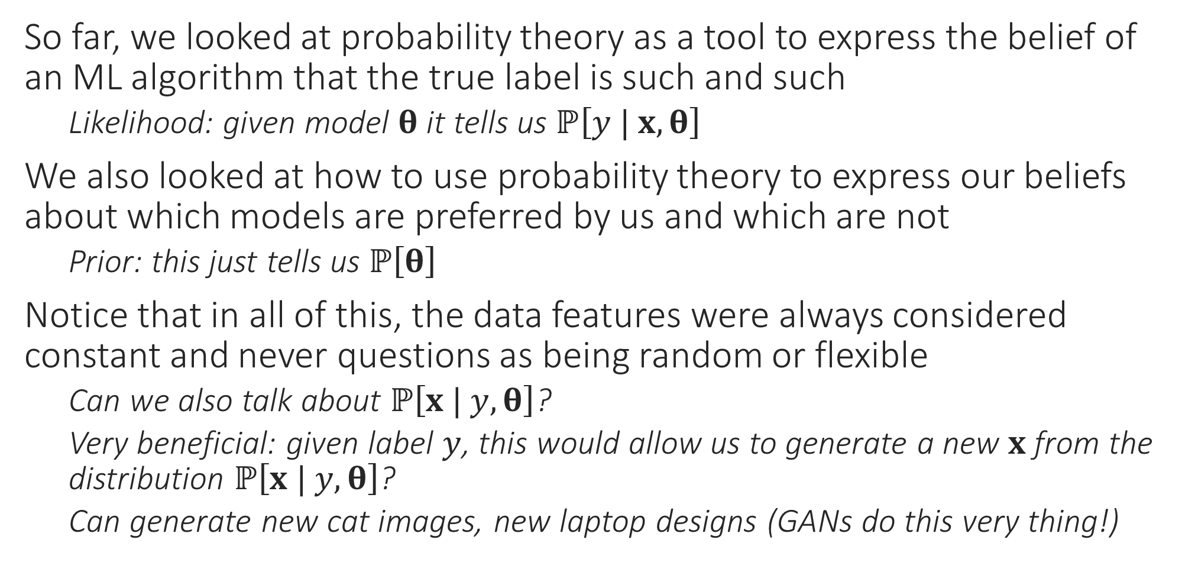
Generative Models
So far, we looked at probability theory as a tool to express the belief of an ML algorithm that the true label is such and such
Likelihood: given model $θ$ it tells us $ℙ\left[y | x,θ\right]$
We also looked at how to use probability theory to express our beliefs about which models are preferred by us and which are not
Prior: this just tells us $ℙ\left[θ\right]$
Notice that in all of this, the data features were always considered constant and never questions as being random or flexible
Can we also talk about $ℙ\left[x | y, θ\right]$?
Very beneficial: given label $y$, this would allow us to generate a new $x$ from the distribution $ℙ\left[x | y, θ\right]$?
Can generate new cat images, new laptop designs (GANs do this very thing!)

Slide 21
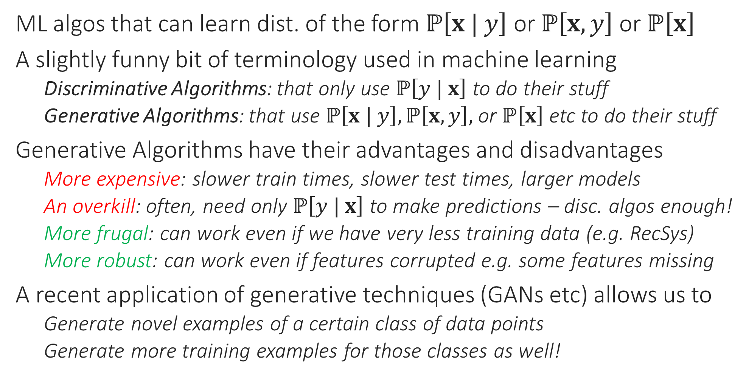
Generative Algorithms
ML algos that can learn dist. of the form $ℙ\left[x | y\right]$ or $ℙ\left[x,y\right]$ or $ℙ\left[x\right]$
A slightly funny bit of terminology used in machine learning
Discriminative Algorithms: that only use $ℙ\left[y | x\right]$ to do their stuff
Generative Algorithms: that use $ℙ\left[x | y\right],ℙ\left[x,y\right],$ or $ℙ\left[x\right]$ etc to do their stuff
Generative Algorithms have their advantages and disadvantages
More expensive: slower train times, slower test times, larger models
An overkill: often, need only $ℙ\left[y | x\right]$ to make predictions – disc. algos enough!
More frugal: can work even if we have very less training data (e.g. RecSys)
More robust: can work even if features corrupted e.g. some features missing
A recent application of generative techniques (GANs etc) allows us to
Generate novel examples of a certain class of data points
Generate more training examples for those classes as well!

Slide 22
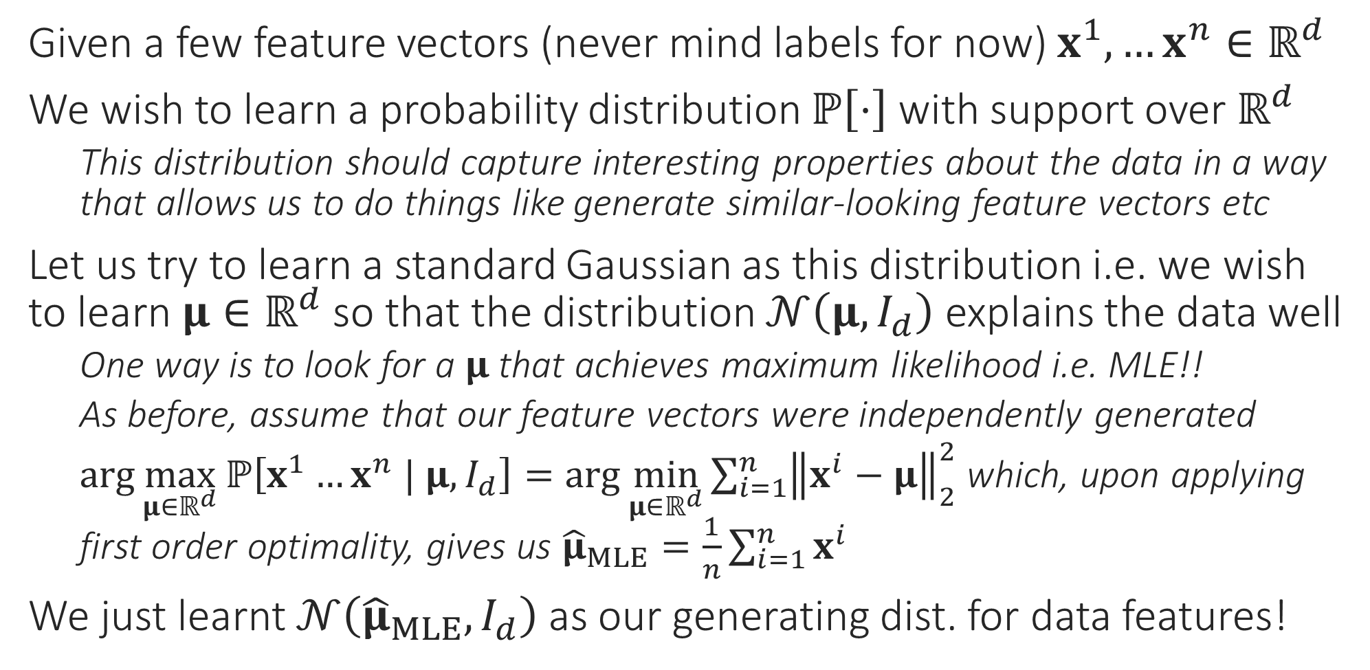
A very simple generative model
Given a few feature vectors (never mind labels for now) $x^{1},…x^{n}∈ℝ^{d}$
We wish to learn a probability distribution $ℙ\left[⋅\right]$ with support over $ℝ^{d}$
This distribution should capture interesting properties about the data in a way that allows us to do things like generate similar-looking feature vectors etc
Let us try to learn a standard Gaussian as this distribution i.e. we wish to learn $μ∈ℝ^{d}$ so that the distribution $𝒩\left(μ,I_{d}\right)$ explains the data well
One way is to look for a $μ$ that achieves maximum likelihood i.e. MLE!!
As before, assume that our feature vectors were independently generated
$\arg{\max_{μ∈ℝ^{d}}{ℙ\left[x^{1}…x^{n} | μ,I_{d}\right]}}=\arg{\min_{μ∈ℝ^{d}}{\sum_{i=1}^{n}{{\left\|x^{i}−μ\right\|}_{2}^{2}}}}$ which, upon applying first order optimality, gives us ${\hat{μ}}_{MLE}=\frac{1}{n}\sum_{i=1}^{n}{x^{i}}$
We just learnt $𝒩\left({\hat{μ}}_{MLE},I_{d}\right)$ as our generating dist. for data features!

Slide 23
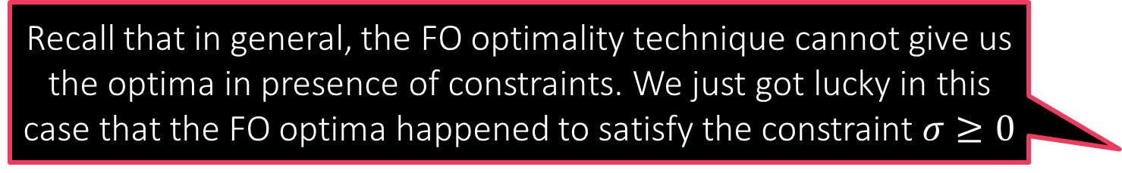
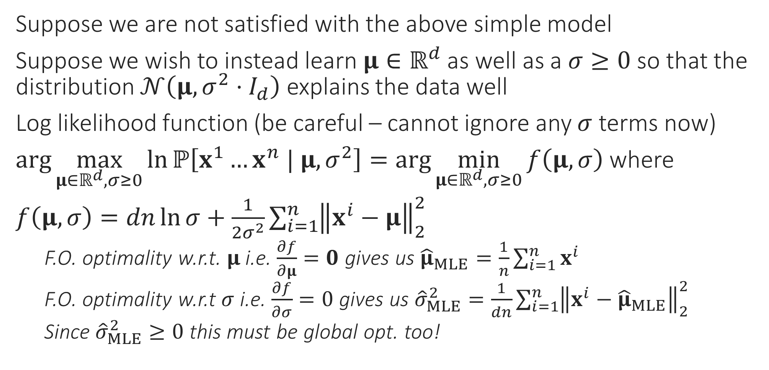
A more powerful generative model
Recall that in general, the FO optimality technique cannot give us the optima in presence of constraints. We just got lucky in this case that the FO optima happened to satisfy the constraint $σ≥0$
Suppose we are not satisfied with the above simple model
Suppose we wish to instead learn $μ∈ℝ^{d}$ as well as a $σ≥0$ so that the distribution $𝒩\left(μ,{σ^{2}⋅I}_{d}\right)$ explains the data well
Log likelihood function (be careful – cannot ignore any $σ$ terms now)
$\arg{\max_{μ∈ℝ^{d},σ≥0}{\ln{ℙ\left[x^{1}…x^{n} | μ,σ^{2}\right]}}}=\arg{\min_{μ∈ℝ^{d},σ≥0}{f\left(μ,σ\right)}}$ where
$f\left(μ,σ\right)=dn\ln{σ}+\frac{1}{2σ^{2}}\sum_{i=1}^{n}{{\left\|x^{i}−μ\right\|}_{2}^{2}}$
F.O. optimality w.r.t. $μ$ i.e. $\frac{∂f}{∂μ}=0$ gives us ${\hat{μ}}_{MLE}=\frac{1}{n}\sum_{i=1}^{n}{x^{i}}$
F.O. optimality w.r.t $σ$ i.e. $\frac{∂f}{∂σ}=0$ gives us ${\hat{σ}}_{MLE}^{2}=\frac{1}{dn}\sum_{i=1}^{n}{{\left\|x^{i}−{\hat{μ}}_{MLE}\right\|}_{2}^{2}}$
Since ${\hat{σ}}_{MLE}^{2}≥0$ this must be global opt. too!

Slide 24
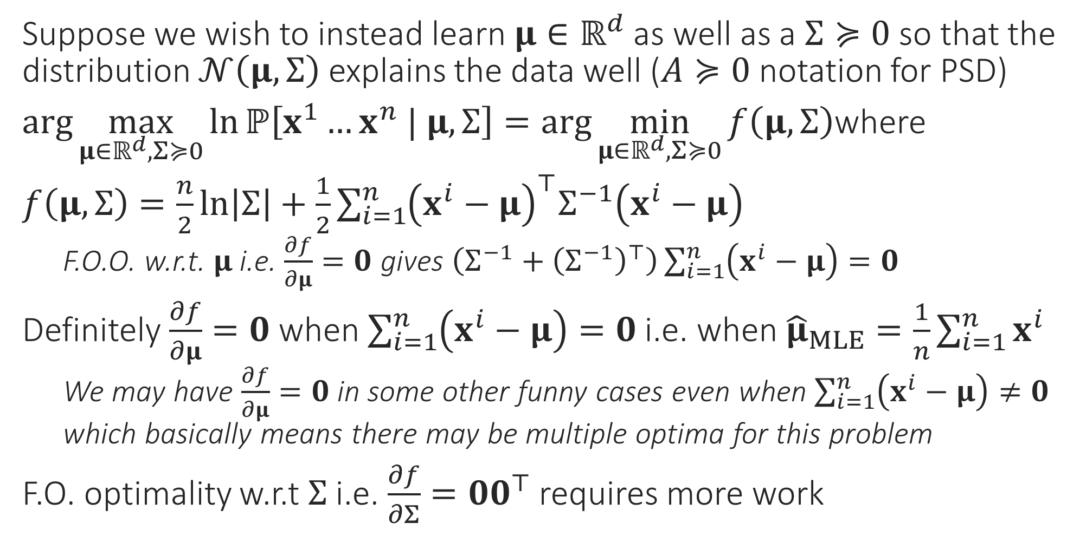
A still more powerful generative model
Suppose we wish to instead learn $μ∈ℝ^{d}$ as well as a $Σ≽0$ so that the distribution $𝒩\left(μ,Σ\right)$ explains the data well ($A≽0$ notation for PSD)
$\arg{\max_{μ∈ℝ^{d},Σ≽0}{\ln{ℙ\left[x^{1}…x^{n} | μ,Σ\right]}}}=\arg{\min_{μ∈ℝ^{d},Σ≽0}{f\left(μ,Σ\right)}}$where
$f\left(μ,Σ\right)=\frac{n}{2}\ln\left|Σ\right|+\frac{1}{2}\sum_{i=1}^{n}{{\left(x^{i}−μ\right)}^{⊤}Σ^{−1}\left(x^{i}−μ\right)}$
F.O.O. w.r.t. $μ$ i.e. $\frac{∂f}{∂μ}=0$ gives $\left(Σ^{−1}+{\left(Σ^{−1}\right)}^{⊤}\right)\sum_{i=1}^{n}{\left(x^{i}−μ\right)}=0$
Definitely $\frac{∂f}{∂μ}=0$ when $\sum_{i=1}^{n}{\left(x^{i}−μ\right)}=0$ i.e. when ${\hat{μ}}_{MLE}=\frac{1}{n}\sum_{i=1}^{n}{x^{i}}$
We may have $\frac{∂f}{∂μ}=0$ in some other funny cases even when $\sum_{i=1}^{n}{\left(x^{i}−μ\right)}≠0$ which basically means there may be multiple optima for this problem
F.O. optimality w.r.t $Σ$ i.e. $\frac{∂f}{∂Σ}={00}^{⊤}$ requires more work

Slide 25
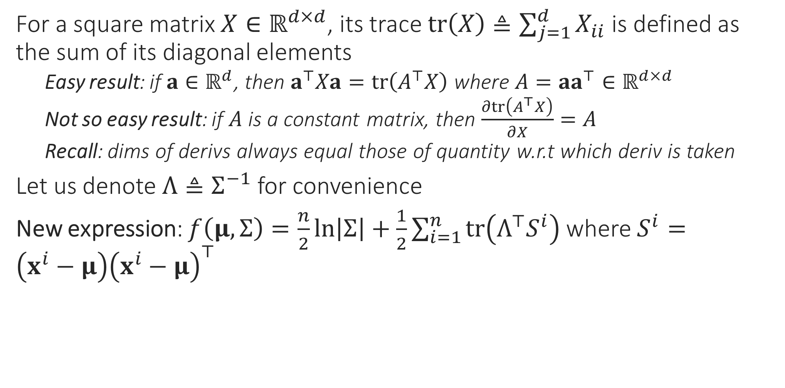
A still more powerful generative model
For a square matrix $X∈ℝ^{d×d}$, its trace $tr\left(X\right)≜\sum_{j=1}^{d}{X_{ii}}$ is defined as the sum of its diagonal elements
Easy result: if $a∈ℝ^{d}$, then $a^{⊤}Xa=tr\left(A^{⊤}X\right)$ where $A=aa^{⊤}∈ℝ^{d×d}$
Not so easy result: if $A$ is a constant matrix, then $\frac{∂tr\left(A^{⊤}X\right)}{∂X}=A$
Recall: dims of derivs always equal those of quantity w.r.t which deriv is taken
Let us denote $Λ≜Σ^{−1}$ for convenience
New expression: $f\left(μ,Σ\right)=\frac{n}{2}\ln\left|Σ\right|+\frac{1}{2}\sum_{i=1}^{n}{tr\left(Λ^{⊤}S^{i}\right)}$ where $S^{i}=\left(x^{i}−μ\right){\left(x^{i}−μ\right)}^{⊤}$

Slide 26
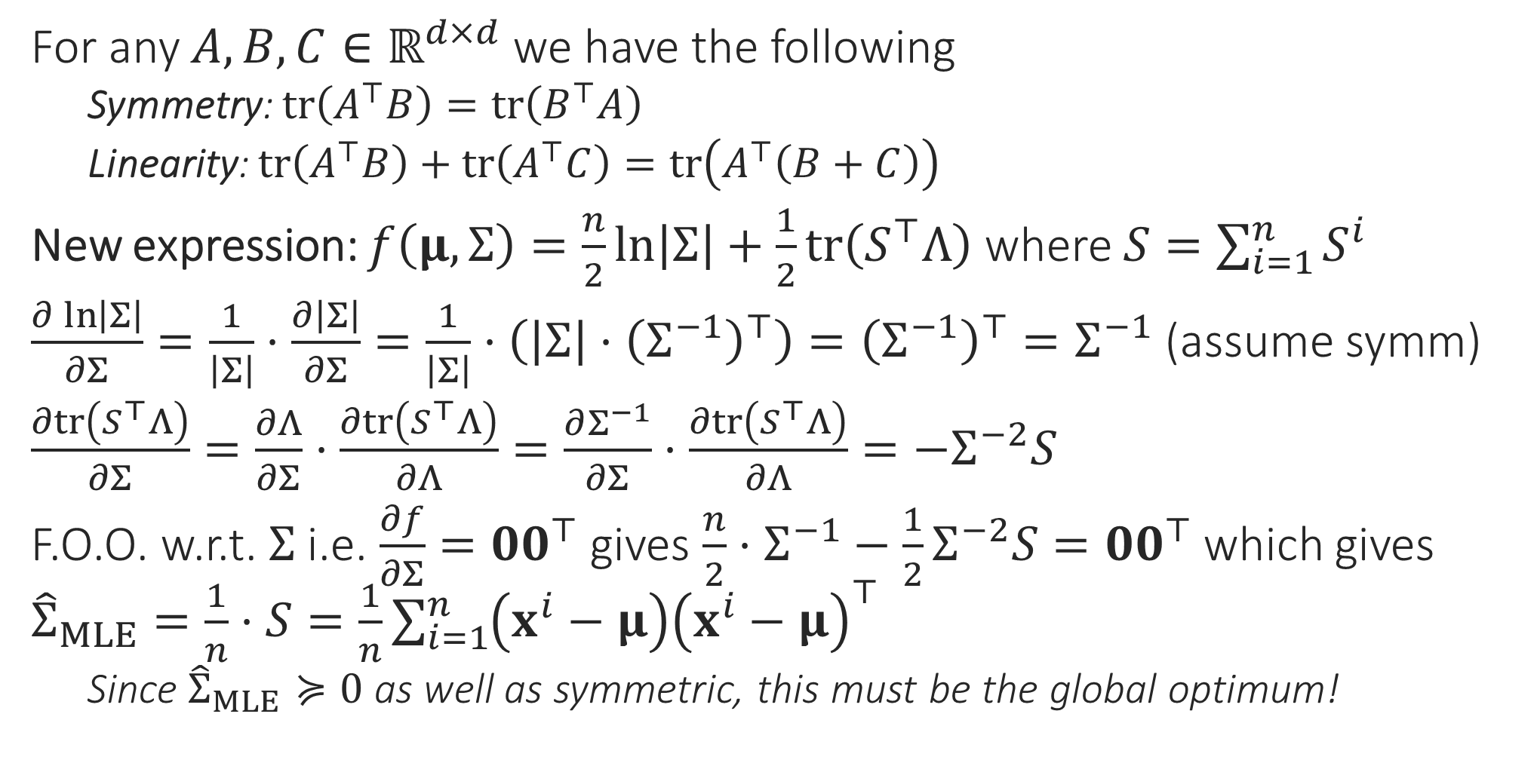
A still more powerful generative model
See “The Matrix Cookbook” (reference section on course webpage) for these results
For any $A,B,C∈ℝ^{d×d}$ we have the following
Symmetry: $tr\left(A^{⊤}B\right)=tr\left(B^{⊤}A\right)$
Linearity: $tr\left(A^{⊤}B\right)+tr\left(A^{⊤}C\right)=tr\left(A^{⊤}\left(B+C\right)\right)$
New expression: $f\left(μ,Σ\right)=\frac{n}{2}\ln\left|Σ\right|+\frac{1}{2}tr\left(S^{⊤}Λ\right)$ where $S=\sum_{i=1}^{n}{S^{i}}$
$\frac{∂\ln\left|Σ\right|}{∂Σ}=\frac{1}{\left|Σ\right|}⋅\frac{∂\left|Σ\right|}{∂Σ}=\frac{1}{\left|Σ\right|}⋅\left(\left|Σ\right|⋅{\left(Σ^{−1}\right)}^{⊤}\right)={\left(Σ^{−1}\right)}^{⊤}=Σ^{−1}$ (assume symm)
$\frac{∂tr\left(S^{⊤}Λ\right)}{∂Σ}=\frac{∂Λ}{∂Σ}⋅\frac{∂tr\left(S^{⊤}Λ\right)}{∂Λ}=\frac{∂Σ^{−1}}{∂Σ}⋅\frac{∂tr\left(S^{⊤}Λ\right)}{∂Λ}=−Σ^{−2}S$
F.O.O. w.r.t. $Σ$ i.e. $\frac{∂f}{∂Σ}=00^{⊤}$ gives $\frac{n}{2}⋅Σ^{−1}−\frac{1}{2}Σ^{−2}S={00}^{⊤}$ which gives ${\hat{Σ}}_{MLE}=\frac{1}{n}⋅S=\frac{1}{n}\sum_{i=1}^{n}{\left(x^{i}−μ\right){\left(x^{i}−μ\right)}^{⊤}}$
Since ${\hat{Σ}}_{MLE}≽0$ as well as symmetric, this must be the global optimum!

Slide 27
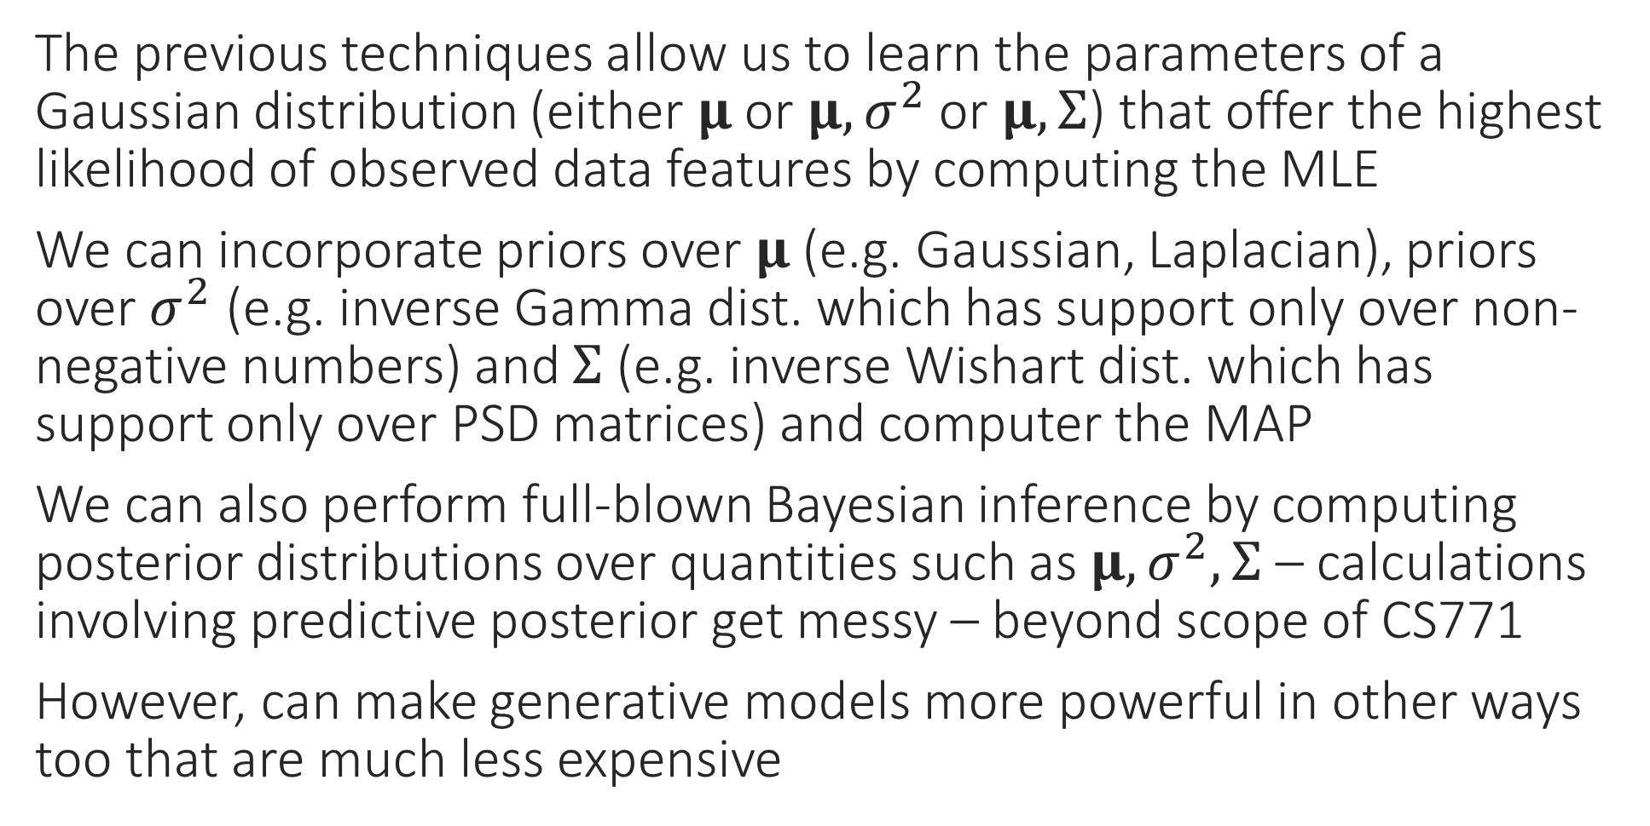
MAP, Bayesian Generative Models?
The previous techniques allow us to learn the parameters of a Gaussian distribution (either $μ$ or $μ,σ^{2}$ or $μ,Σ$) that offer the highest likelihood of observed data features by computing the MLE
We can incorporate priors over $μ$ (e.g. Gaussian, Laplacian), priors over $σ^{2}$ (e.g. inverse Gamma dist. which has support only over non-negative numbers) and $Σ$ (e.g. inverse Wishart dist. which has support only over PSD matrices) and computer the MAP
We can also perform full-blown Bayesian inference by computing posterior distributions over quantities such as $μ,σ^{2},Σ$ – calculations involving predictive posterior get messy – beyond scope of CS771
However, can make generative models more powerful in other ways too that are much less expensive

