Slide 1
Computer Networks I Multiplexing
Amitangshu Pal
Computer Science and Engineering
IIT Kanpur

Slide 2
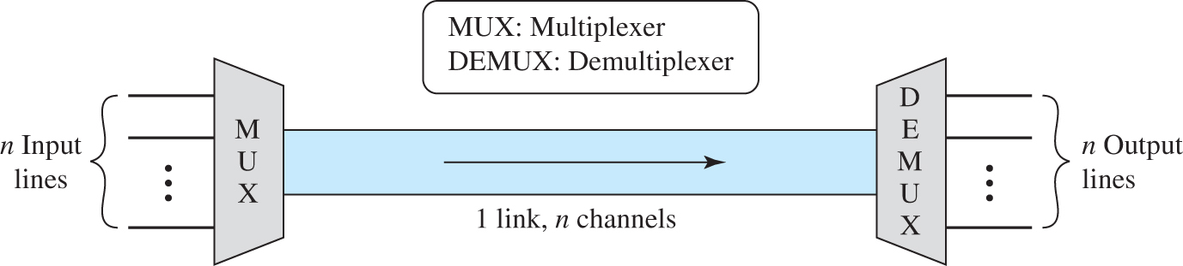
Multiplexing
Multiplexing is the set of techniques that allows the simultaneous transmission of multiple signals across a single data link
Multiplexer (MUX): A device that combines several signals into a single signal
Demultiplexer (DEMUX): A device that performs the inverse operation
Notes:
Let me first give a brief introduction of WOBAN architecture and the motivation of using WOBAN as an access technology. There are two main types of popular access networks. 1. Optical access networks where from CO optical fibers are pulled to ONUs located at every homes, premises or offices, which basically work as gateways for Internet access to the users. The popular access technology of this access networks is PON. The advantage of this access is that it provides high bandwidth and fast Internet service. The limitation is that it needs fiber to penetrate in each and every premises which make this scheme very costly. Also there is a limitation of maximum fiber length.
Another popular access networks is wireless access. Popular technology of this type are WiFi and WiMAX. The advantage of these access technology is that this is flexible and cost effective scheme. But the limitation is that when the hop of hops increase a lot, real time multi-media traffic suffers a lot.
Let me first give a brief introduction of WOBAN architecture and the motivation of using WOBAN as an access technology. There are two main types of popular access networks. First is the optical access such as passive optical networks (PON), which provides fast Internet service because of high bandwidth. But it requires fiber to be penetrated from central office to all residential complex, offices and premises which make the scheme highly costly. Another popular access technology is wireless access, which is flexible and cost-efficient, but does not function well when the number of hops increases.

Slide 3
Multiplexing
Multiplexing
Frequency-division multiplexing
Wavelength-division multiplexing
Time-division multiplexing
Analog
Analog
Digital
Notes:
Let me first give a brief introduction of WOBAN architecture and the motivation of using WOBAN as an access technology. There are two main types of popular access networks. 1. Optical access networks where from CO optical fibers are pulled to ONUs located at every homes, premises or offices, which basically work as gateways for Internet access to the users. The popular access technology of this access networks is PON. The advantage of this access is that it provides high bandwidth and fast Internet service. The limitation is that it needs fiber to penetrate in each and every premises which make this scheme very costly. Also there is a limitation of maximum fiber length.
Another popular access networks is wireless access. Popular technology of this type are WiFi and WiMAX. The advantage of these access technology is that this is flexible and cost effective scheme. But the limitation is that when the hop of hops increase a lot, real time multi-media traffic suffers a lot.
Let me first give a brief introduction of WOBAN architecture and the motivation of using WOBAN as an access technology. There are two main types of popular access networks. First is the optical access such as passive optical networks (PON), which provides fast Internet service because of high bandwidth. But it requires fiber to be penetrated from central office to all residential complex, offices and premises which make the scheme highly costly. Another popular access technology is wireless access, which is flexible and cost-efficient, but does not function well when the number of hops increases.

Slide 4
Frequency Division Multiplexing

Slide 5
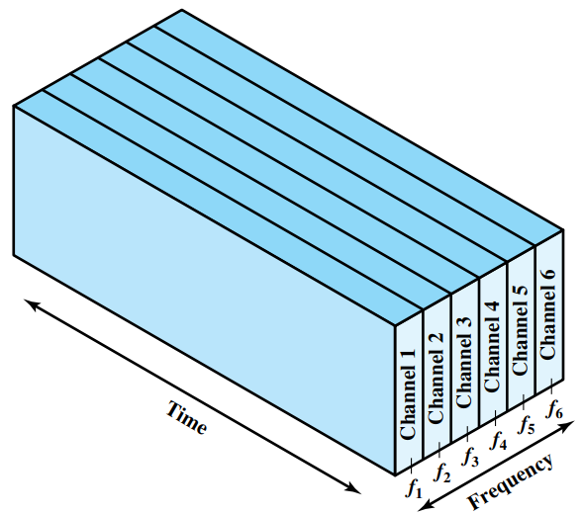
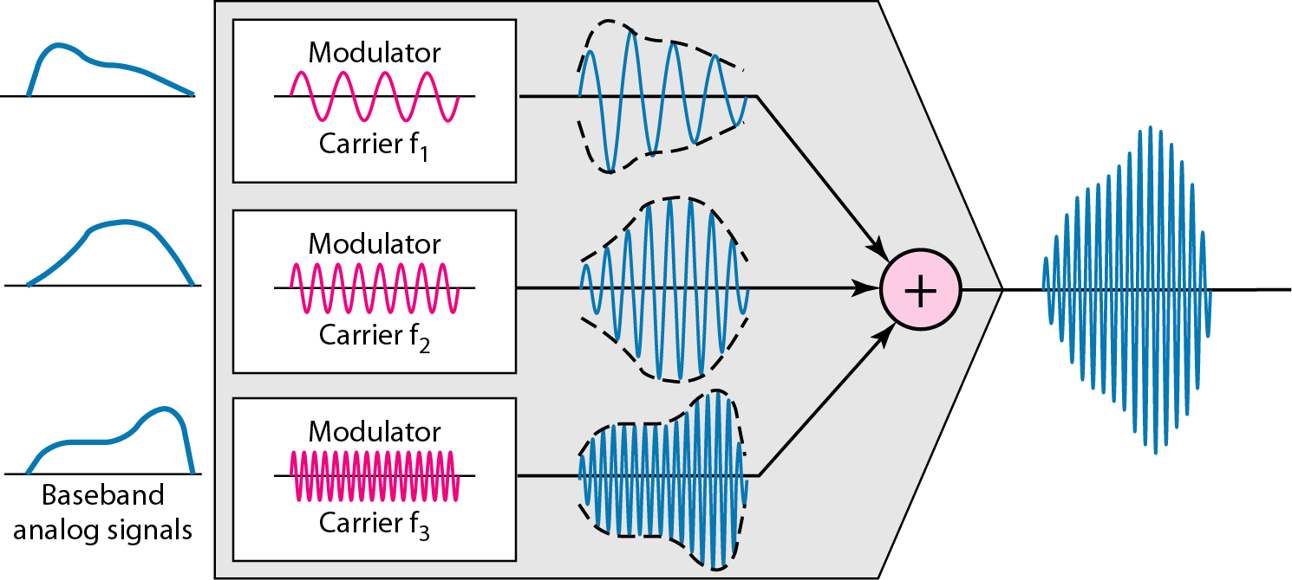
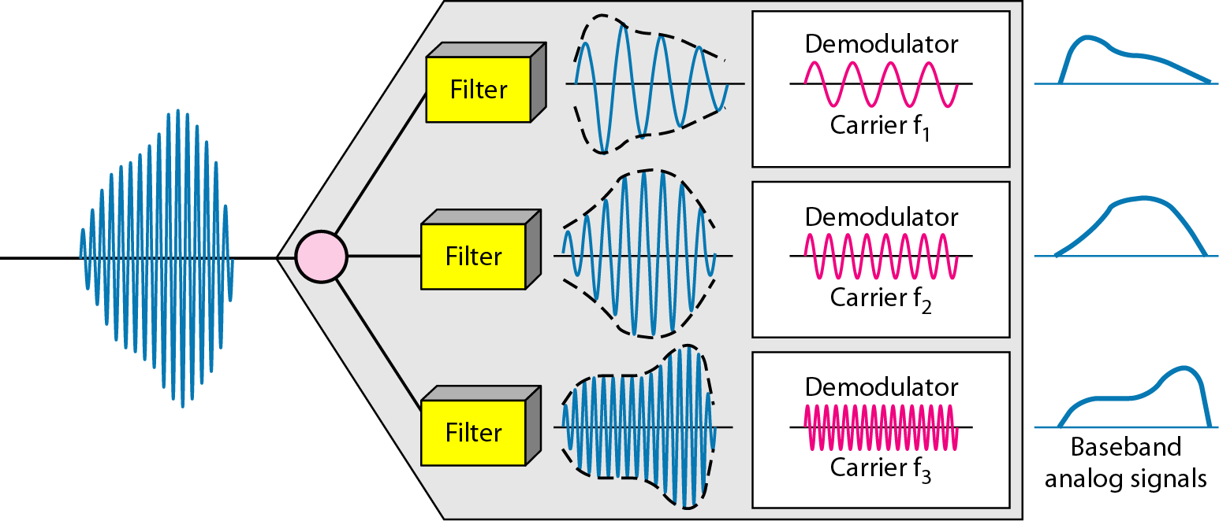
FDM
Each signal is allocated a different frequency band
Usually used with analog signals
Modulation equipment is needed to move each signal to
the required frequency band (channel)
Multiple carriers are used, each is called sub-carrier
Notes:
Let me first give a brief introduction of WOBAN architecture and the motivation of using WOBAN as an access technology. There are two main types of popular access networks. 1. Optical access networks where from CO optical fibers are pulled to ONUs located at every homes, premises or offices, which basically work as gateways for Internet access to the users. The popular access technology of this access networks is PON. The advantage of this access is that it provides high bandwidth and fast Internet service. The limitation is that it needs fiber to penetrate in each and every premises which make this scheme very costly. Also there is a limitation of maximum fiber length.
Another popular access networks is wireless access. Popular technology of this type are WiFi and WiMAX. The advantage of these access technology is that this is flexible and cost effective scheme. But the limitation is that when the hop of hops increase a lot, real time multi-media traffic suffers a lot.
Let me first give a brief introduction of WOBAN architecture and the motivation of using WOBAN as an access technology. There are two main types of popular access networks. First is the optical access such as passive optical networks (PON), which provides fast Internet service because of high bandwidth. But it requires fiber to be penetrated from central office to all residential complex, offices and premises which make the scheme highly costly. Another popular access technology is wireless access, which is flexible and cost-efficient, but does not function well when the number of hops increases.

Slide 6
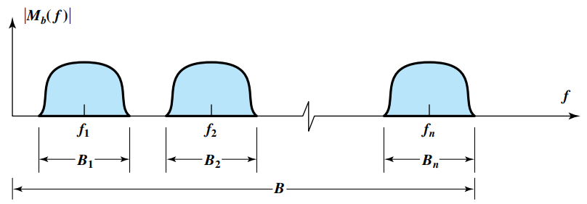
FDM
Notes:
Let me first give a brief introduction of WOBAN architecture and the motivation of using WOBAN as an access technology. There are two main types of popular access networks. 1. Optical access networks where from CO optical fibers are pulled to ONUs located at every homes, premises or offices, which basically work as gateways for Internet access to the users. The popular access technology of this access networks is PON. The advantage of this access is that it provides high bandwidth and fast Internet service. The limitation is that it needs fiber to penetrate in each and every premises which make this scheme very costly. Also there is a limitation of maximum fiber length.
Another popular access networks is wireless access. Popular technology of this type are WiFi and WiMAX. The advantage of these access technology is that this is flexible and cost effective scheme. But the limitation is that when the hop of hops increase a lot, real time multi-media traffic suffers a lot.
Let me first give a brief introduction of WOBAN architecture and the motivation of using WOBAN as an access technology. There are two main types of popular access networks. First is the optical access such as passive optical networks (PON), which provides fast Internet service because of high bandwidth. But it requires fiber to be penetrated from central office to all residential complex, offices and premises which make the scheme highly costly. Another popular access technology is wireless access, which is flexible and cost-efficient, but does not function well when the number of hops increases.

Slide 7
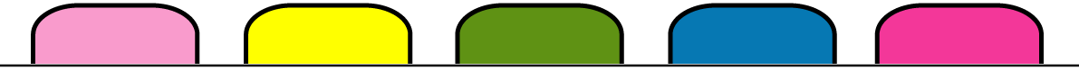
FDM
Five channels, each with a 100-KHz bandwidth, are to be multiplexed together. What is the minimum bandwidth of the link if there is a need for a guard band of 10 KHz between the channels to prevent interference?
Notes:
Let me first give a brief introduction of WOBAN architecture and the motivation of using WOBAN as an access technology. There are two main types of popular access networks. 1. Optical access networks where from CO optical fibers are pulled to ONUs located at every homes, premises or offices, which basically work as gateways for Internet access to the users. The popular access technology of this access networks is PON. The advantage of this access is that it provides high bandwidth and fast Internet service. The limitation is that it needs fiber to penetrate in each and every premises which make this scheme very costly. Also there is a limitation of maximum fiber length.
Another popular access networks is wireless access. Popular technology of this type are WiFi and WiMAX. The advantage of these access technology is that this is flexible and cost effective scheme. But the limitation is that when the hop of hops increase a lot, real time multi-media traffic suffers a lot.
Let me first give a brief introduction of WOBAN architecture and the motivation of using WOBAN as an access technology. There are two main types of popular access networks. First is the optical access such as passive optical networks (PON), which provides fast Internet service because of high bandwidth. But it requires fiber to be penetrated from central office to all residential complex, offices and premises which make the scheme highly costly. Another popular access technology is wireless access, which is flexible and cost-efficient, but does not function well when the number of hops increases.

Slide 8
Wavelength Division Multiplexing

Slide 9
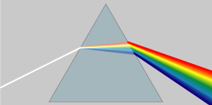
WDM
WDM is conceptually the same as FDM
Multiplexing and demultiplexing involve light
signals transmitted through fiber-optic channels
Combining and splitting of light sources can be handled by a prism
Src:https://commons.wikimedia.org/wiki/File:Prism_rainbow_schema.png
Notes:
Let me first give a brief introduction of WOBAN architecture and the motivation of using WOBAN as an access technology. There are two main types of popular access networks. 1. Optical access networks where from CO optical fibers are pulled to ONUs located at every homes, premises or offices, which basically work as gateways for Internet access to the users. The popular access technology of this access networks is PON. The advantage of this access is that it provides high bandwidth and fast Internet service. The limitation is that it needs fiber to penetrate in each and every premises which make this scheme very costly. Also there is a limitation of maximum fiber length.
Another popular access networks is wireless access. Popular technology of this type are WiFi and WiMAX. The advantage of these access technology is that this is flexible and cost effective scheme. But the limitation is that when the hop of hops increase a lot, real time multi-media traffic suffers a lot.
Let me first give a brief introduction of WOBAN architecture and the motivation of using WOBAN as an access technology. There are two main types of popular access networks. First is the optical access such as passive optical networks (PON), which provides fast Internet service because of high bandwidth. But it requires fiber to be penetrated from central office to all residential complex, offices and premises which make the scheme highly costly. Another popular access technology is wireless access, which is flexible and cost-efficient, but does not function well when the number of hops increases.

Slide 10
Time Division Multiplexing

Slide 11
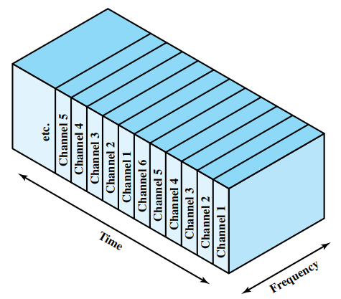
TDM
User takes turns
Each one periodically get the entire bandwidth
TDM:
Synchronous TDM
Asynchronous TDM
Notes:
Let me first give a brief introduction of WOBAN architecture and the motivation of using WOBAN as an access technology. There are two main types of popular access networks. 1. Optical access networks where from CO optical fibers are pulled to ONUs located at every homes, premises or offices, which basically work as gateways for Internet access to the users. The popular access technology of this access networks is PON. The advantage of this access is that it provides high bandwidth and fast Internet service. The limitation is that it needs fiber to penetrate in each and every premises which make this scheme very costly. Also there is a limitation of maximum fiber length.
Another popular access networks is wireless access. Popular technology of this type are WiFi and WiMAX. The advantage of these access technology is that this is flexible and cost effective scheme. But the limitation is that when the hop of hops increase a lot, real time multi-media traffic suffers a lot.
Let me first give a brief introduction of WOBAN architecture and the motivation of using WOBAN as an access technology. There are two main types of popular access networks. First is the optical access such as passive optical networks (PON), which provides fast Internet service because of high bandwidth. But it requires fiber to be penetrated from central office to all residential complex, offices and premises which make the scheme highly costly. Another popular access technology is wireless access, which is flexible and cost-efficient, but does not function well when the number of hops increases.

Slide 12
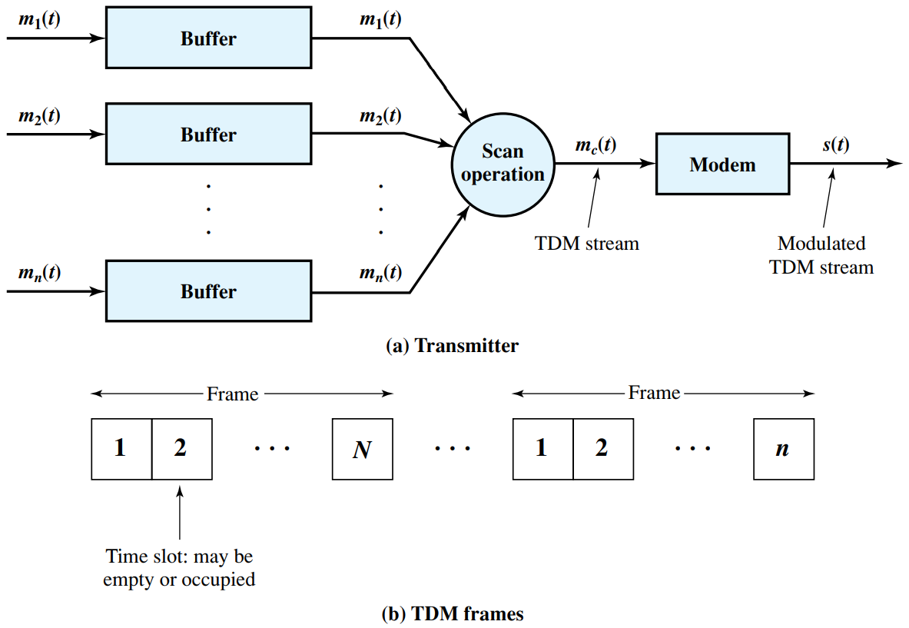
Synchronous TDM
Multiplexer allocates exactly the same time slot to each device at all times, whether or not a device has anything to transmit
Data rate of the link is n times faster
Notes:
Let me first give a brief introduction of WOBAN architecture and the motivation of using WOBAN as an access technology. There are two main types of popular access networks. 1. Optical access networks where from CO optical fibers are pulled to ONUs located at every homes, premises or offices, which basically work as gateways for Internet access to the users. The popular access technology of this access networks is PON. The advantage of this access is that it provides high bandwidth and fast Internet service. The limitation is that it needs fiber to penetrate in each and every premises which make this scheme very costly. Also there is a limitation of maximum fiber length.
Another popular access networks is wireless access. Popular technology of this type are WiFi and WiMAX. The advantage of these access technology is that this is flexible and cost effective scheme. But the limitation is that when the hop of hops increase a lot, real time multi-media traffic suffers a lot.
Let me first give a brief introduction of WOBAN architecture and the motivation of using WOBAN as an access technology. There are two main types of popular access networks. First is the optical access such as passive optical networks (PON), which provides fast Internet service because of high bandwidth. But it requires fiber to be penetrated from central office to all residential complex, offices and premises which make the scheme highly costly. Another popular access technology is wireless access, which is flexible and cost-efficient, but does not function well when the number of hops increases.

Slide 13
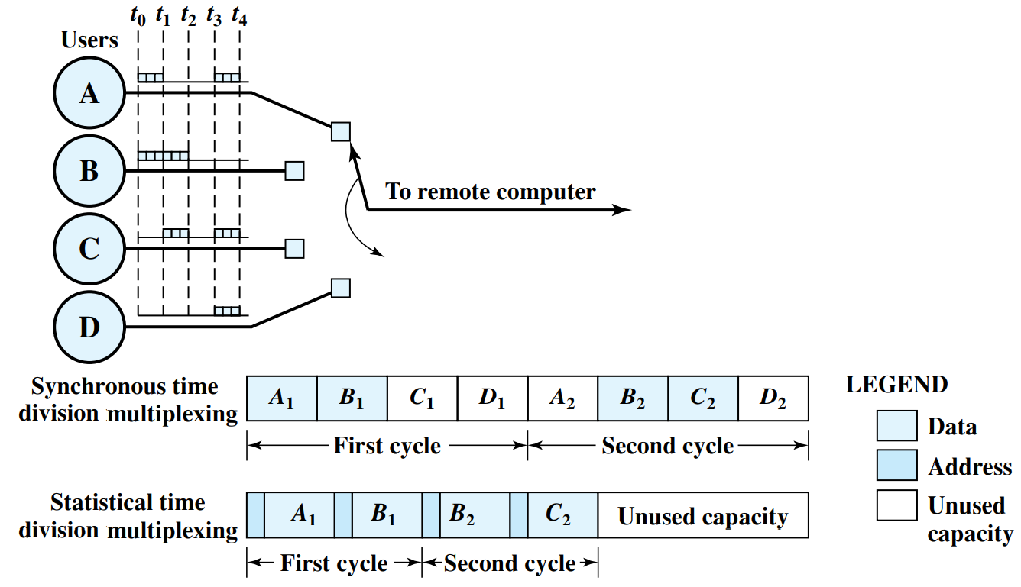
Statistical TDM
In synchronous TDM it is often the case that many of the time slots in a frame are wasted
Asynchronous time-division multiplexing, or statistical time-division multiplexing, is designed to avoid this type of waste
Notes:
Let me first give a brief introduction of WOBAN architecture and the motivation of using WOBAN as an access technology. There are two main types of popular access networks. 1. Optical access networks where from CO optical fibers are pulled to ONUs located at every homes, premises or offices, which basically work as gateways for Internet access to the users. The popular access technology of this access networks is PON. The advantage of this access is that it provides high bandwidth and fast Internet service. The limitation is that it needs fiber to penetrate in each and every premises which make this scheme very costly. Also there is a limitation of maximum fiber length.
Another popular access networks is wireless access. Popular technology of this type are WiFi and WiMAX. The advantage of these access technology is that this is flexible and cost effective scheme. But the limitation is that when the hop of hops increase a lot, real time multi-media traffic suffers a lot.
Let me first give a brief introduction of WOBAN architecture and the motivation of using WOBAN as an access technology. There are two main types of popular access networks. First is the optical access such as passive optical networks (PON), which provides fast Internet service because of high bandwidth. But it requires fiber to be penetrated from central office to all residential complex, offices and premises which make the scheme highly costly. Another popular access technology is wireless access, which is flexible and cost-efficient, but does not function well when the number of hops increases.

Slide 14
Statistical TDM
Line data rate can be lower than input lines rates
Overhead per slot for statistical TDM because each slot carries an address as well as data
May have problems during peak periods
Must buffer inputs
Notes:
Let me first give a brief introduction of WOBAN architecture and the motivation of using WOBAN as an access technology. There are two main types of popular access networks. 1. Optical access networks where from CO optical fibers are pulled to ONUs located at every homes, premises or offices, which basically work as gateways for Internet access to the users. The popular access technology of this access networks is PON. The advantage of this access is that it provides high bandwidth and fast Internet service. The limitation is that it needs fiber to penetrate in each and every premises which make this scheme very costly. Also there is a limitation of maximum fiber length.
Another popular access networks is wireless access. Popular technology of this type are WiFi and WiMAX. The advantage of these access technology is that this is flexible and cost effective scheme. But the limitation is that when the hop of hops increase a lot, real time multi-media traffic suffers a lot.
Let me first give a brief introduction of WOBAN architecture and the motivation of using WOBAN as an access technology. There are two main types of popular access networks. First is the optical access such as passive optical networks (PON), which provides fast Internet service because of high bandwidth. But it requires fiber to be penetrated from central office to all residential complex, offices and premises which make the scheme highly costly. Another popular access technology is wireless access, which is flexible and cost-efficient, but does not function well when the number of hops increases.

Slide 15
Code Division Multiple Access

Slide 16


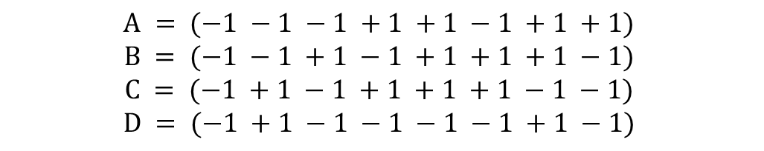
CDMA
$$A = (−1 −1 −1 +1 +1 −1 +1 +1)$$
$$B = (−1 −1 +1 −1 +1 +1 +1 −1)$$
$$C = (−1 +1 −1 +1 +1 +1 −1 −1)$$
$$D = (−1 +1 −1 −1 −1 −1 +1 −1)$$
All chip sequences are orthogonal
$$S•T=\frac{1}{m}\sum_{i=1}^{m}{S_{i}T_{i}=0}$$
$$S•\overline{T}=0$$
$$S•S=\frac{1}{m}\sum_{i=1}^{m}{S_{i}S_{i}=\frac{1}{m}\sum_{i=1}^{m}{S_{i}^{2}=\frac{1}{m}\sum_{i=1}^{m}{{\left(±1\right)}^{2}=1}}}$$

Slide 17
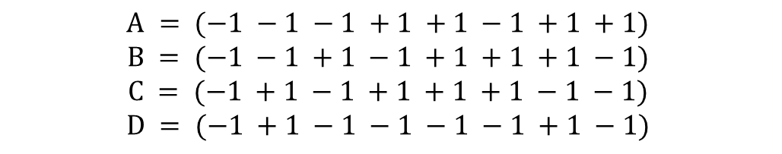
CDMA
$$A = (−1 −1 −1 +1 +1 −1 +1 +1)$$
$$B = (−1 −1 +1 −1 +1 +1 +1 −1)$$
$$C = (−1 +1 −1 +1 +1 +1 −1 −1)$$
$$D = (−1 +1 −1 −1 −1 −1 +1 −1)$$
X = A+ $\overline{B}$+C = (-1 +1 -3 +3 +1 -1 -1 +1)

Slide 18
CDMA
$$A = (−1 −1 −1 +1 +1 −1 +1 +1)$$
$$B = (−1 −1 +1 −1 +1 +1 +1 −1)$$
$$C = (−1 +1 −1 +1 +1 +1 −1 −1)$$
$$D = (−1 +1 −1 −1 −1 −1 +1 −1)$$
X = A+B+$\overline{C}$+D = (-2 -2 0 -2 0 -2 +4 0)

Slide 19
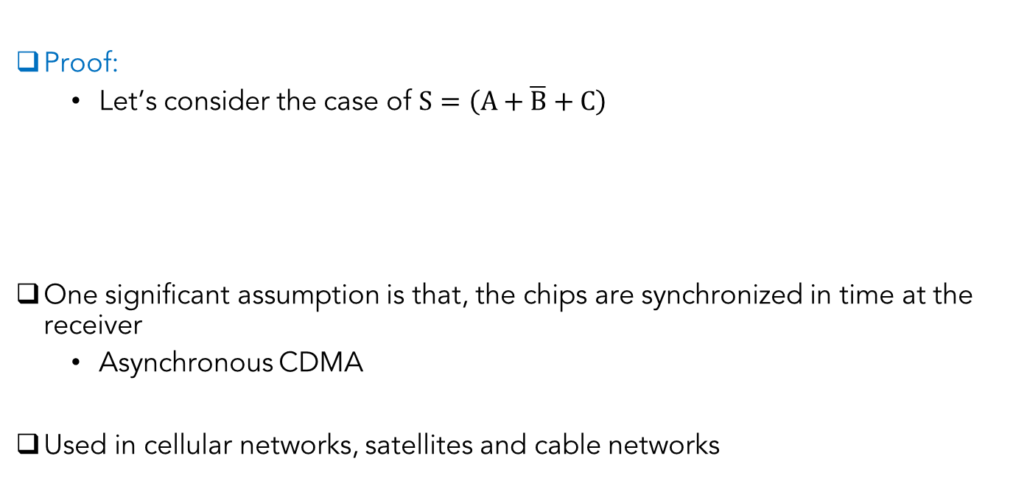
CDMA
Proof:
Let’s consider the case of $S=\left(A+\overline{B}+C\right)$
One significant assumption is that, the chips are synchronized in time at the receiver
Asynchronous CDMA
Used in cellular networks, satellites and cable networks
$S•C=\left(A+\overline{B}+C\right)•C=A•C+\overline{B}•C+C•C$
$$= 0+0+1 = 1$$

Slide 20
Summary
Different multiplexing techniques discussed:
Frequency division multiplexing
Wavelength division multiplexing
Time division multiplexing
Synchronous TDM
Asynchronous TDM

