Slide 1
Computer Networks I Error Detection (Cyclic Redundancy Check)
Amitangshu Pal
Computer Science and Engineering
IIT Kanpur

Slide 2
Error Detection
Error detection
Parity check
Internet checksum
Cyclic redundancy check
Notes:
Let me first give a brief introduction of WOBAN architecture and the motivation of using WOBAN as an access technology. There are two main types of popular access networks. 1. Optical access networks where from CO optical fibers are pulled to ONUs located at every homes, premises or offices, which basically work as gateways for Internet access to the users. The popular access technology of this access networks is PON. The advantage of this access is that it provides high bandwidth and fast Internet service. The limitation is that it needs fiber to penetrate in each and every premises which make this scheme very costly. Also there is a limitation of maximum fiber length.
Another popular access networks is wireless access. Popular technology of this type are WiFi and WiMAX. The advantage of these access technology is that this is flexible and cost effective scheme. But the limitation is that when the hop of hops increase a lot, real time multi-media traffic suffers a lot.
Let me first give a brief introduction of WOBAN architecture and the motivation of using WOBAN as an access technology. There are two main types of popular access networks. First is the optical access such as passive optical networks (PON), which provides fast Internet service because of high bandwidth. But it requires fiber to be penetrated from central office to all residential complex, offices and premises which make the scheme highly costly. Another popular access technology is wireless access, which is flexible and cost-efficient, but does not function well when the number of hops increases.

Slide 3
Cyclic Redundancy Check
One of the most powerful error-detecting codes
Two equivalent ways of presenting CRC:
Modulo 2 arithmetic
Polynomials

Slide 4
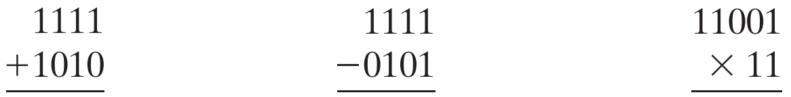
Cyclic Redundancy Check
One of the most powerful error-detecting codes
Modulo 2 arithmetic:
Uses binary addition with no carries
Based on exclusive-OR (XOR) operation

Slide 5
Cyclic Redundancy Check
Given a block of bits, the transmitter generates a frame check sequence (FCS), such that
The resulting frame is exactly divisible by some predetermined number
Receiver divides the incoming frame by that number
If there is no remainder, assume there is no error

Slide 6
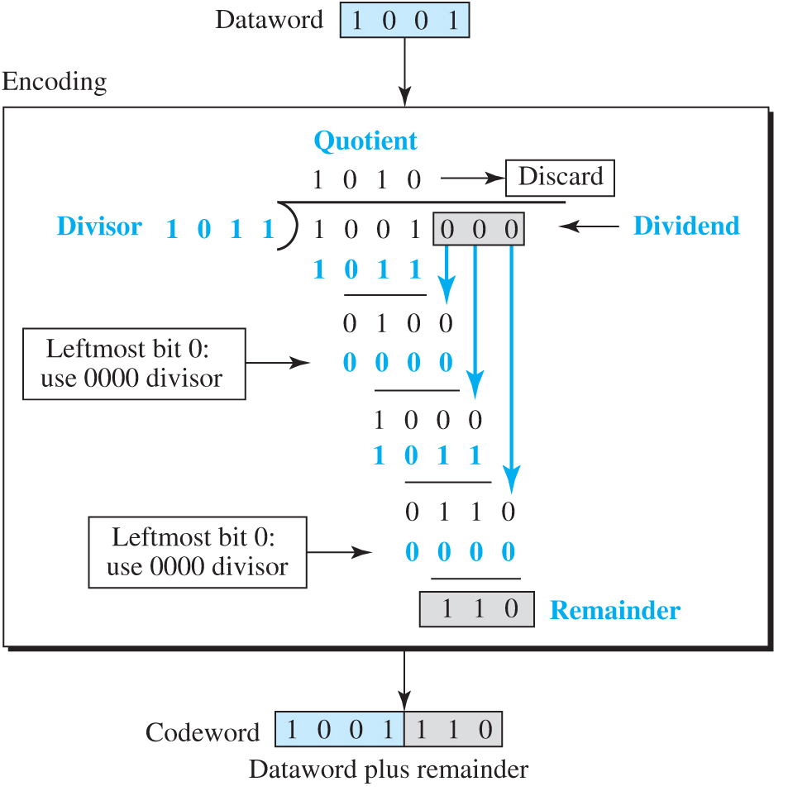
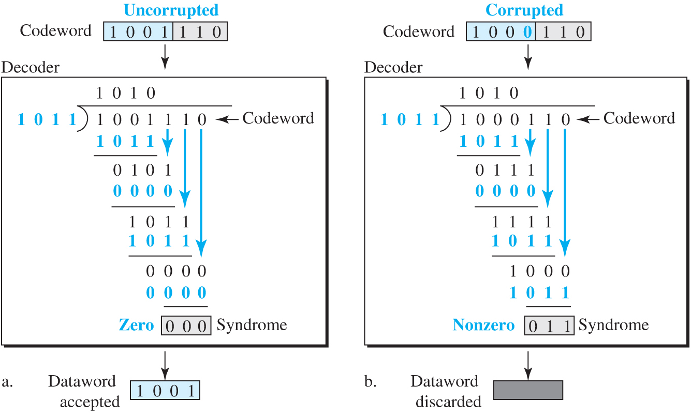
Cyclic Redundancy Check

Slide 7
Cyclic Redundancy Check

Slide 8

Cyclic Redundancy Check
One of the most powerful error-detecting codes
Polynomials:
Represent bit-strings as polynomials
110001 can be represented as $x^{5}+x^{4}+1$

Slide 9
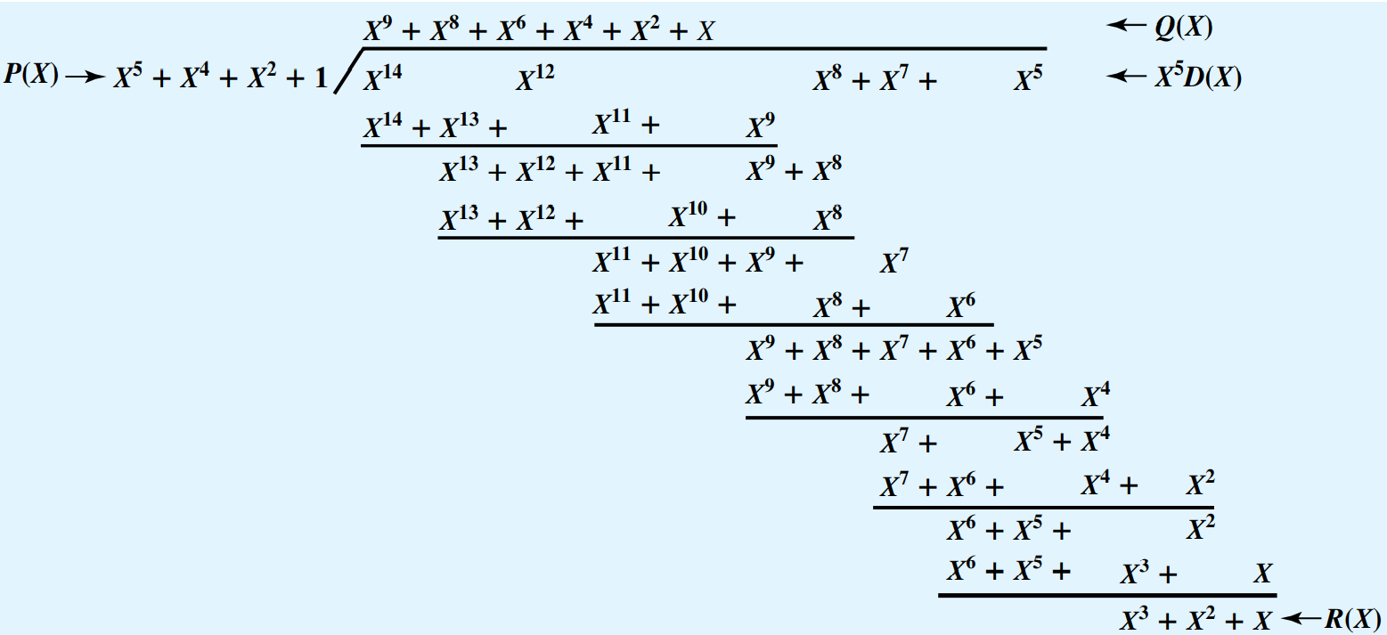
Cyclic Redundancy Check

Slide 10
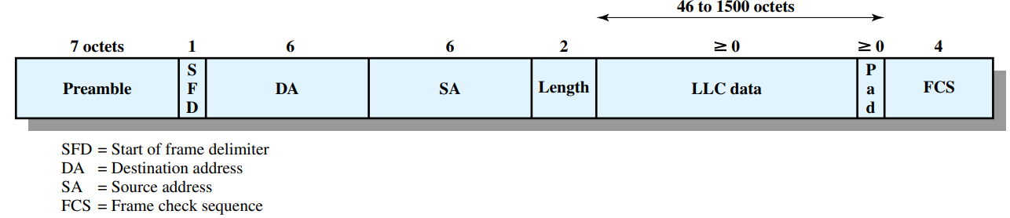
Cyclic Redundancy Check
Name | Binary | Application
CRC-8 | 100000111 | ATM header
CRC-10 | 11000110101 | ATM AAL
CRC-16 | 10001000000100001 | HDLC
CRC-32 | 100000100110000010001110110110111 | LANs

Slide 11
Summary
Cyclic redundancy check
Modulo 2 arithmetic
Polynomials

