Slide 1
Computer Networks I Error Correction
Amitangshu Pal
Computer Science and Engineering
IIT Kanpur

Slide 2
Error Correction
Backward error correction: Correction of detected errors usually requires data blocks to be retransmitted
Not appropriate for some wireless applications:
The bit error rate (BER) on a wireless link can be quite high, which would result in a large number of retransmissions
Propagation delay is very long compared to the transmission time of a single frame

Slide 3
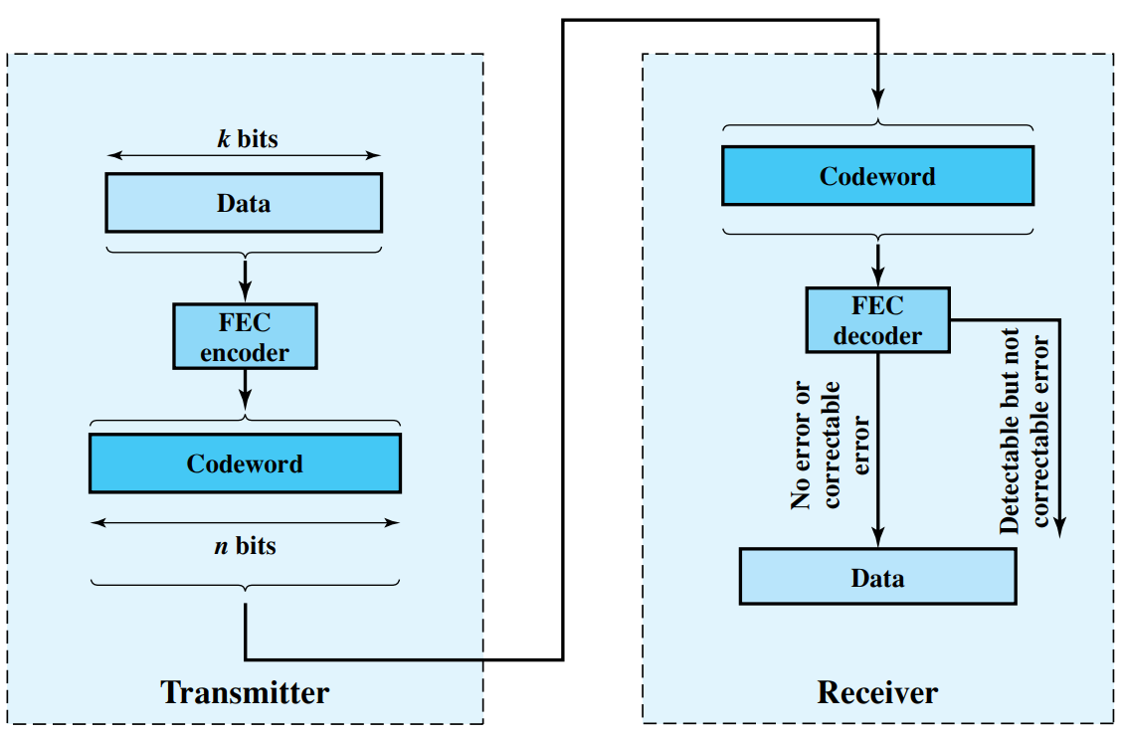
Error Correction
Forward error correction: Need to correct errors on basis of bits received

Slide 4
Error Correction
Hamming distance:
d(v₁, v₂) – Hamming distance in between any two binary sequences v₁ and v₂
d(v₁, v₂) is the number of bits in which v₁ and v₂ disagree

Slide 5
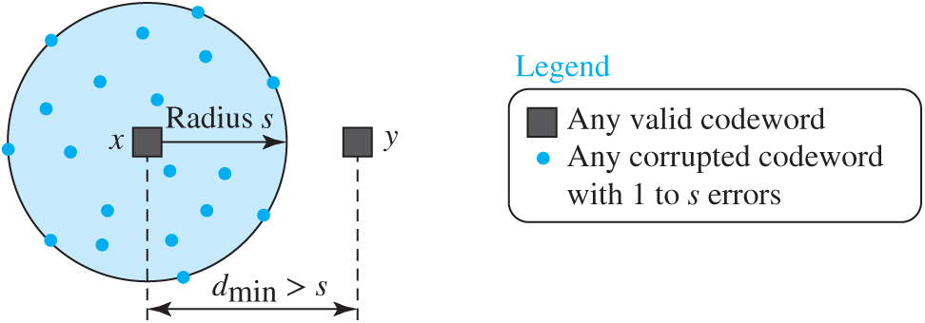

Error Correction
Codeword of $n$ bits = $m$ message bits +$r$check bits
Valid/legal and invalid/illegal codeword:
Total possible codewords with $n$ bits is $2^{n}$
All $2^{m}$ data messages are legal → each one of them has 1 legal codeword
All remaining codewords are invalid
0000000000
0000011111
1111100000
1111111111

Slide 6
Error Correction
Given an algorithm for calculating the check bits
We can construct the list of valid codewords
Hamming distance of the code: Smallest Hamming distance in between any two valid codewords
0000000000
0000011111
1111100000
1111111111

Slide 7

Error Correction
To detect $s$ bit errors, we need a distance $s+1$ code
With such a code, there is no way that a $s$ single bit error can change a valid codeword to another valid codeword

Slide 8

Error Correction
To correct $s$ bit errors, we need a distance $2s+1$ code
With such a code, the legal codewords are so far apart that even $s$ changes, the original codeword is still closer, than any other codeword

Slide 9

Error Correction
To correct $s$ bit errors, we need a distance $2s+1$ code
Original codeword can be uniquely detected based on the assumption that a larger number of errors are less likely → time consuming search

Slide 10
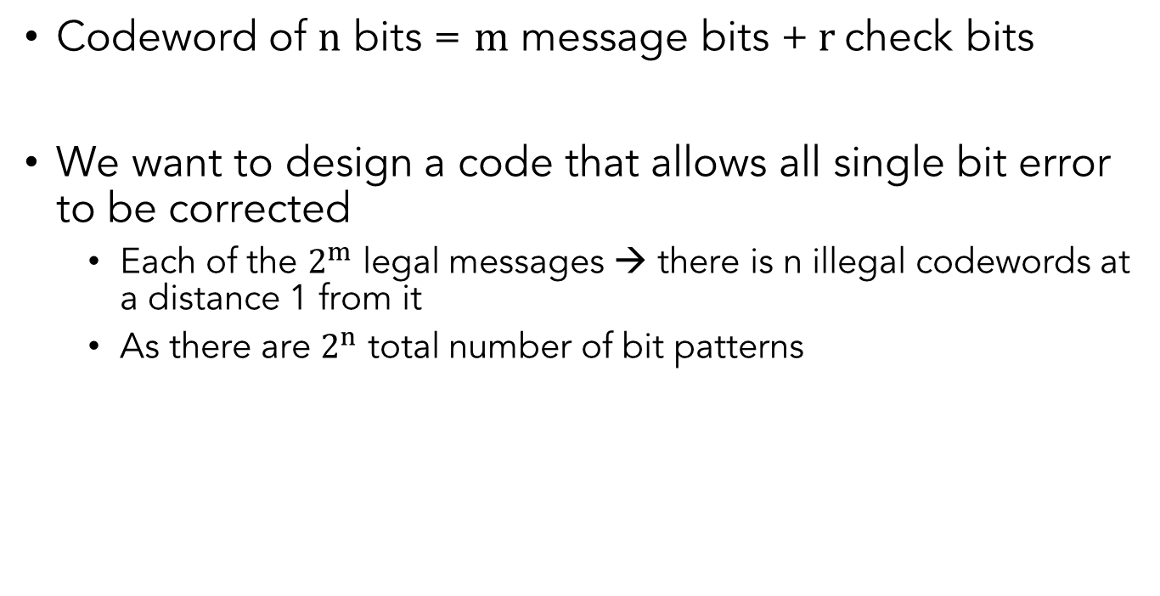
Error Correction
Codeword of $n$ bits = $m$ message bits +$r$check bits
We want to design a code that allows all single bit error to be corrected
Each of the $2^{m}$ legal messages → there is n illegal codewords at a distance 1 from it
As there are $2^{n}$ total number of bit patterns
$$2^{m}\left(n+1\right)≤2^{n} ∴n+1≤2^{n−m}=2^{r} ∴m+r+1≤2^{r}$$

Slide 11
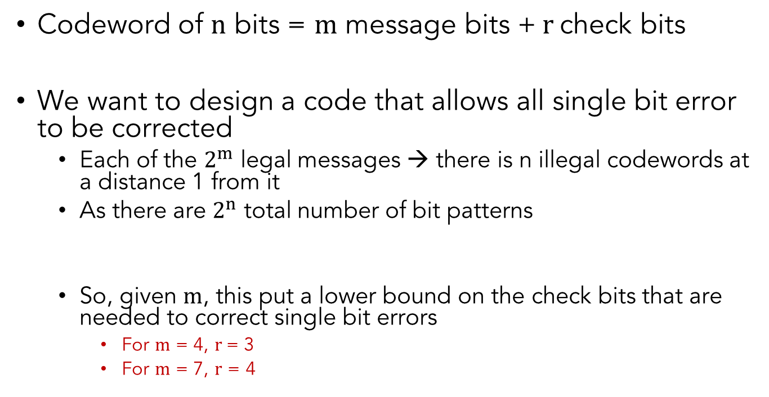
Error Correction
Codeword of $n$ bits = $m$ message bits +$r$check bits
We want to design a code that allows all single bit error to be corrected
Each of the $2^{m}$ legal messages → there is n illegal codewords at a distance 1 from it
As there are $2^{n}$ total number of bit patterns
So, given $m$, this put a lower bound on the check bits that are needed to correct single bit errors
For $m$ = 4, $r$= 3
For $m$ = 7, $r$ = 4
$$2^{m}\left(n+1\right)≤2^{n} ∴n+1≤2^{n−m}=2^{r} ∴m+r+1≤2^{r}$$

Slide 12
Hamming Code
M7
M6
M5
P4
M3
P2
P1

Slide 13
Hamming Code
M7
M6
M5
P4
M3
P2
P1

Slide 14
Error Correction Codes
Convolution codes: GSM mobile phone system, satellite communications, 802.11
Reed-Solomon code: DSL, data over cable, satellite communications, CDs
Low-density parity check: Digital video broadcasting, Ethernet, 802.11

Slide 15
Summary
Different error correction techniques discussed:
Backward error correction
Forward error correction
Hamming distance
Hamming code

