Slide 1
Computer Networks I Data Link Control Protocols (Error Control)
Amitangshu Pal
Computer Science and Engineering
IIT Kanpur

Slide 2
Error Control
Two types of error
Lost frame: A frame fails to arrive at the other end
Damaged frame: A frame arrives at the destination, but few bits are damaged
Automatic Repeat Request (ARQ):
Stop-and-wait ARQ
Go-back-N ARQ
Selective-reject ARQ

Slide 3
Stop-and-Wait ARQ

Slide 4
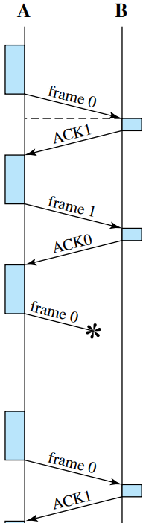
Stop-and-Wait ARQ
Based on Stop-and-Wait flow control
Source:
Source transmits single frame, waits for an ACK
It also starts a timer and maintains the copy
If ACK received, stop timer and transmit next frame
Sender has timeout → if no ACK within timeout, retransmit
Destination:
Destination sends ACK if frame received correctly (with no errors)
If frame received is damaged, discard it

Slide 5
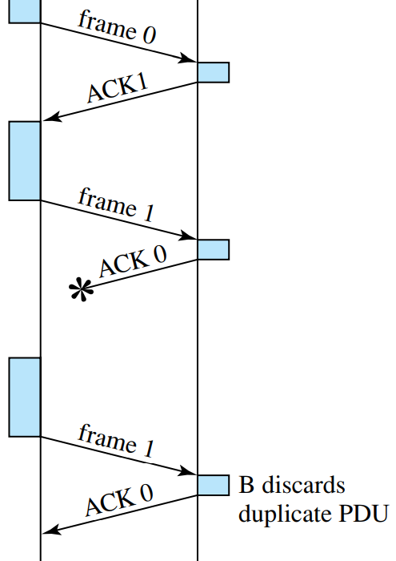
Stop-and-Wait ARQ
If ACK is damaged, transmitter will not recognize
Transmitter will retransmit after the timeout
Receiver gets two copies of frame
Solution: use 1-bit frame SEQ number and ACK0 / ACK1
Stop-and-Wait ARQ is simple, but inefficient

Slide 6
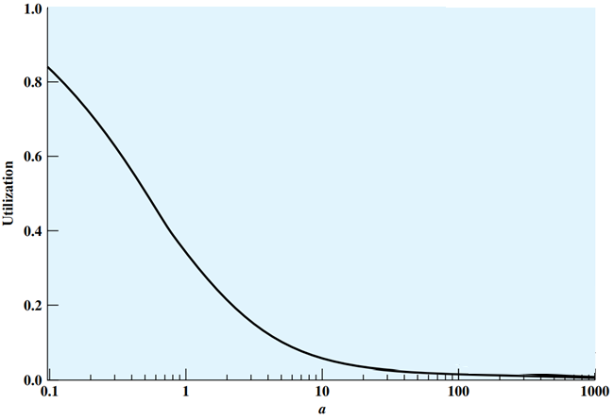


Stop-and-Wait ARQ
$$a= \frac{t_{prop}}{t_{frame}}$$

Slide 7
Go-Back-N ARQ

Slide 8
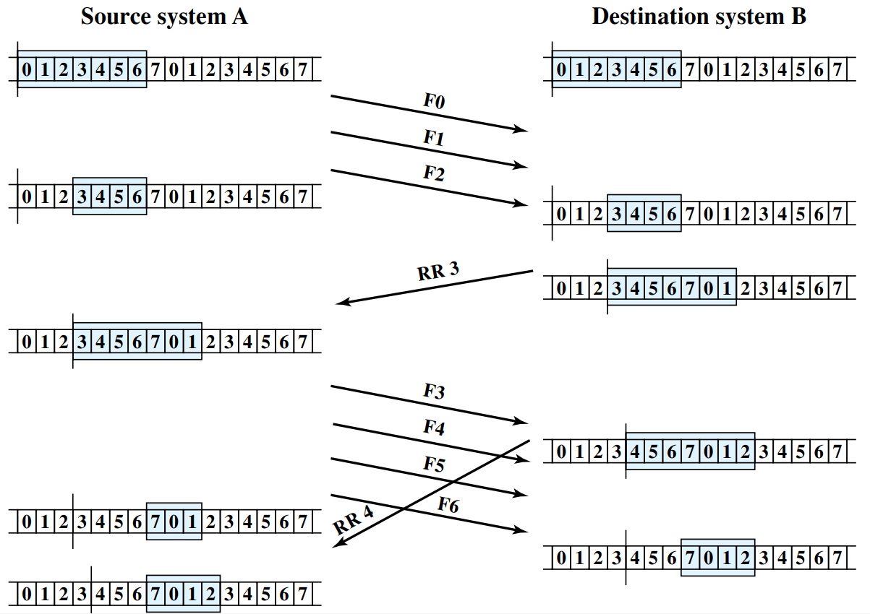
Sliding Window Flow Control: Example

Slide 9
Go-Back-N ARQ
Based on Sliding Window flow control → Most commonly used error control
Source:
Sender must go back and retransmit that frame and all subsequent frames
If no ACK received from Destination after timeout, the Source may send an ACKRequest or RR (with P bit = 1)
Alternately the sender can retransmit the previous frame asked by the receiver
Destination:
If no error, the destination will ACK incoming frames as in sliding window
RR=receive ready, or piggybacked acknowledgment with sequence number of next expected frame
If the destination station detects an error in a frame, it may send a negative acknowledgment
REJ=reject with sequence number of next expected frame
Destination will discard that frame and all future frames until the frame in error is received correctly
Upon receipt of ACKRequest, the Destination sends a normal ACK

Slide 10
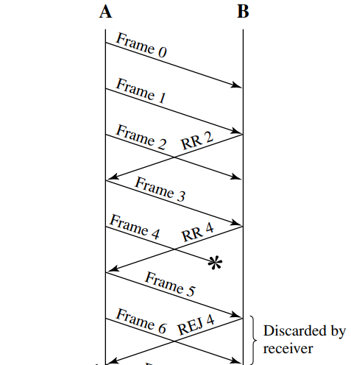
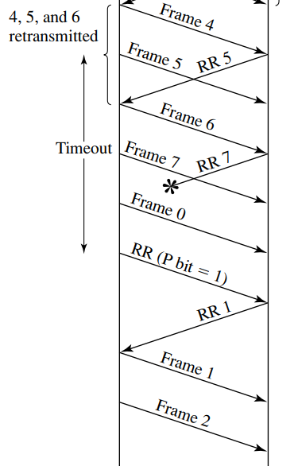
Go-Back-N ARQ

Slide 11
Go-Back-N ARQ
A k-bit sequence number provides a sequence number range of 2^{k}
However the maximum window size is limited to 2^{k} - 1
As a case of 3-bit sequence number (i.e. sequence number space is 8)
Suppose sender sends frame 0 and gets back an RR 1
Then sends frames 1, 2, 3, 4, 5, 6, 7, 0 and gets another RR 1
This could mean that all eight frames were received correctly and the RR 1 is a cumulative acknowledgment
It could also mean that all eight frames were damaged or lost in transit, and the receiving station is repeating its previous RR 1
The problem is avoided if the maximum window size is limited to 7, i.e. 2³ - 1
Max window size = 2^{k} – 1 (for a k-bit sequence number)

Slide 12
Selective Reject ARQ

Slide 13
Selective Reject ARQ
Also called selective retransmission
Only rejected or timeout frames are retransmitted
Subsequent frames are accepted by the receiver and buffered
Pros:
Minimizes retransmission
Cons:
Receiver must maintain large enough buffer to store out-of-order frames
More complex logic in transmitter
Less widely used
Useful for satellite links with long propagation delays

Slide 14
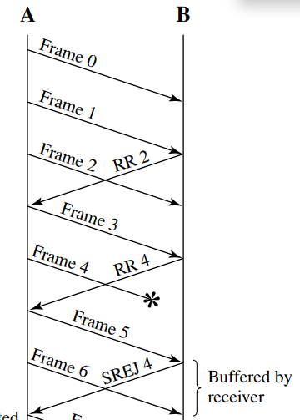
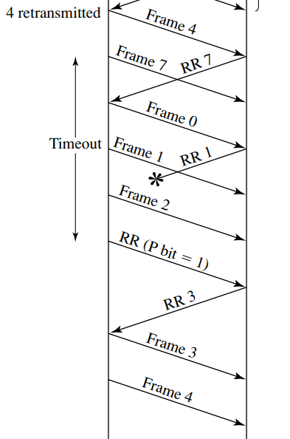
Selective Reject ARQ

Slide 15
Selective Reject ARQ
Window size is more restrictive for selective-reject than for go-back-N
Consider the case of a 3-bit sequence number size for selective-reject
Sender sends frames 0 through 6
Receiver receives all seven frames and cumulatively acknowledges with RR 7
Because of a noise burst, the RR 7 is lost
Sender times out and retransmits frame 0
Receiver has already advanced its receive window to accept frames 7, 0, 1, 2, 3, 4, and 5
It assumes that frame 7 has been lost and that this is a new frame 0, which it accepts
The problem is that there is an overlap in between the sending and receiving window
To overcome the problem, the maximum window size should be no more than half the range of sequence numbers
Max window size = 2^{k-1} (for a k-bit sequence number)

Slide 16

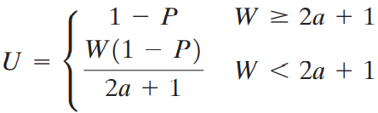
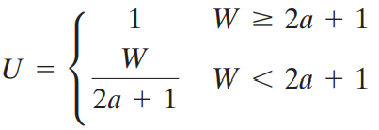
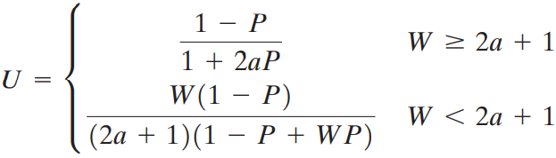
Comparison
Error control
Flow control
Stop and Wait
Stop and Wait
Selective Reject
Sliding Window
Go-back N

Slide 17
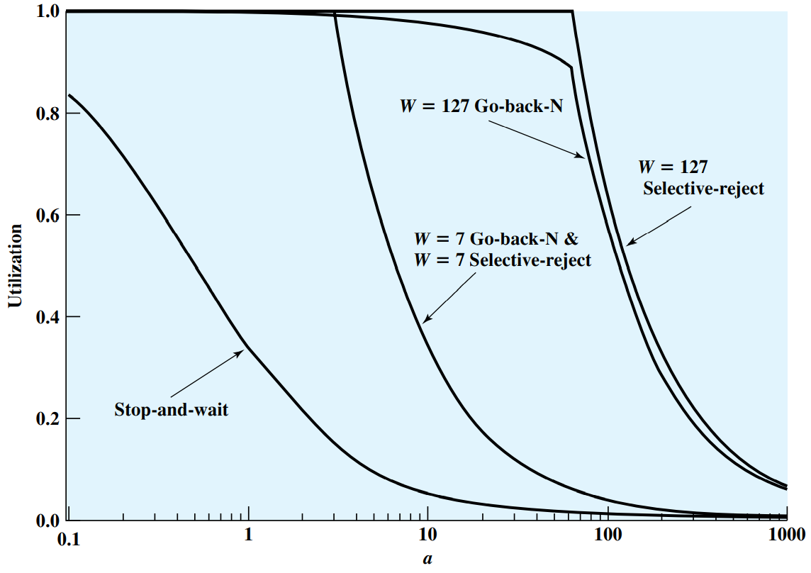
Comparison

Slide 18
Summary
Error control in Link Layer:
Stop and wait
Selective reject
Go-back N

