Slide 1
Computer Networks I Data Link Control Protocols (Medium Access Control Protocols) (Channel Partitioning, Taking Turns)
Amitangshu Pal
Computer Science and Engineering
IIT Kanpur

Slide 2
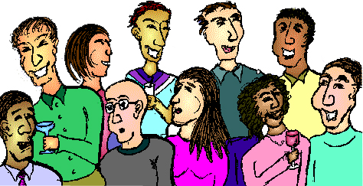








Multiple access links, protocols
Two types of “links”:
Point-to-point
Point-to-point link between Ethernet switch, host
Broadcast (shared wire or medium)
Old-school Ethernet
802.11 wireless LAN, 4G/5G, satellite
humans at a cocktail party
(shared air, acoustical)
shared wire (e.g.,
cabled Ethernet)
shared radio: 4G/5G
shared radio: WiFi
shared radio: satellite

Slide 3
Multiple access protocols
Single shared broadcast channel
Two or more simultaneous transmissions by nodes:
Collision if node receives two or more signals at the same time
Multiple access protocol
Distributed algorithm that determines how nodes share channel, i.e., determine when node can transmit
Communication about channel sharing must use channel itself!
no out-of-band channel for coordination

Slide 4
An ideal multiple access protocol
Given: multiple access channel (MAC) of rate R bps
Desired rate:
1. When one node wants to transmit, it can send at rate R
2. When M nodes want to transmit, each can send at average rate R/M
3. Fully decentralized:
No special node to coordinate transmissions
No synchronization of clocks, slots
4. Simple

Slide 5
MAC protocols: taxonomy
Three broad classes:
Channel partitioning
Divide channel into smaller “pieces” (time slots, frequency, code)
Allocate piece to node for exclusive use
Taking turns”
Nodes take turns, but nodes with more to send can take longer turns
Random access
Use randomization for handling collisions
“Recover” from collisions

Slide 6
Channel partitioning protocols: TDMA
TDMA: Time division multiple access
Access to channel in “rounds”
Each station gets fixed length slot (length = packet transmission time) in each round
Unused slots go idle
Example: 6-station scenario, 1,3,4 have packets to send, slots 2,5,6 idle
6-slot
frame
6-slot
frame
1
3
4
1
3
4

Slide 7
Channel partitioning protocols: FDMA
FDMA: Frequency division multiple access
Channel spectrum divided into frequency bands
Each station assigned fixed frequency band
Unused transmission time in frequency bands go idle
Example: 6-station scenario, 1,3,4 have packet to send, frequency bands 2,5,6 idle
time
frequency bands
FDM cable

Slide 8
MAC protocols: taxonomy
Three broad classes:
Channel partitioning
Divide channel into smaller “pieces” (time slots, frequency, code)
Allocate piece to node for exclusive use
Taking turns”
Nodes take turns, but nodes with more to send can take longer turns
Random access
Use randomization for handling collisions
“Recover” from collisions

Slide 9

“Taking turns” MAC protocols
Polling:
Centralized controller “invites” other nodes to transmit in turn
Typically used with “dumb” devices
Concerns:
Polling overhead
Latency
Single point of failure (master)
Bluetooth uses polling
data
poll
centralized controller
data
client devices

Slide 10
“Taking turns” MAC protocols
T
Token passing:
Control token message explicitly passed from one node to next, sequentially
Transmit while holding token
Concerns:
Token overhead
Latency
Single point of failure (token)
(nothing
to send)
T
data

Slide 11
Summary
Multiple Access Control:
Channel partitioning, by time, frequency or code
TDMA, FDMA
Taking turns
Polling from central site, token passing

