Slide 1
Computer Networks Data Link Control Protocols (Multiple Access Control Protocols) (Random Access Protocols: CSMA)
Amitangshu Pal
Computer Science and Engineering
IIT Kanpur

Slide 2
MAC protocols: taxonomy
Three broad classes:
Channel partitioning
Divide channel into smaller “pieces” (time slots, frequency, code)
Allocate piece to node for exclusive use
Taking turns”
Nodes take turns, but nodes with more to send can take longer turns
Random access
Use randomization for handling collisions
“Recover” from collisions

Slide 3
Pure ALOHA vs Slotted ALOHA
Efficiency
Offered traffic per slot

Slide 4

CSMA (carrier sense multiple access)
Simple CSMA: listen before transmit
If channel sensed idle: transmit entire frame
If channel sensed busy: defer transmission
Human analogy: don’t interrupt others!
humans at a cocktail party
(shared air, acoustical)

Slide 5
CSMA (carrier sense multiple access)
1-persistent CSMA:
If channel sensed idle: transmit with probability 1
If channel sensed busy: continuously sense → transmit immediately when channel becomes idle
If collision: wait for a random time, then start sensing
Nonpersistent CSMA:
If channel sensed busy: do no sense continuously → wait for a random amount of time and then sense again
Better channel utilization → longer delay than 1-persistant CSMA
p-persistent CSMA:
If channel sensed idle: transmit with probability p

Slide 6
CSMA (carrier sense multiple access)
Efficiency
Offered traffic per slot

Slide 7
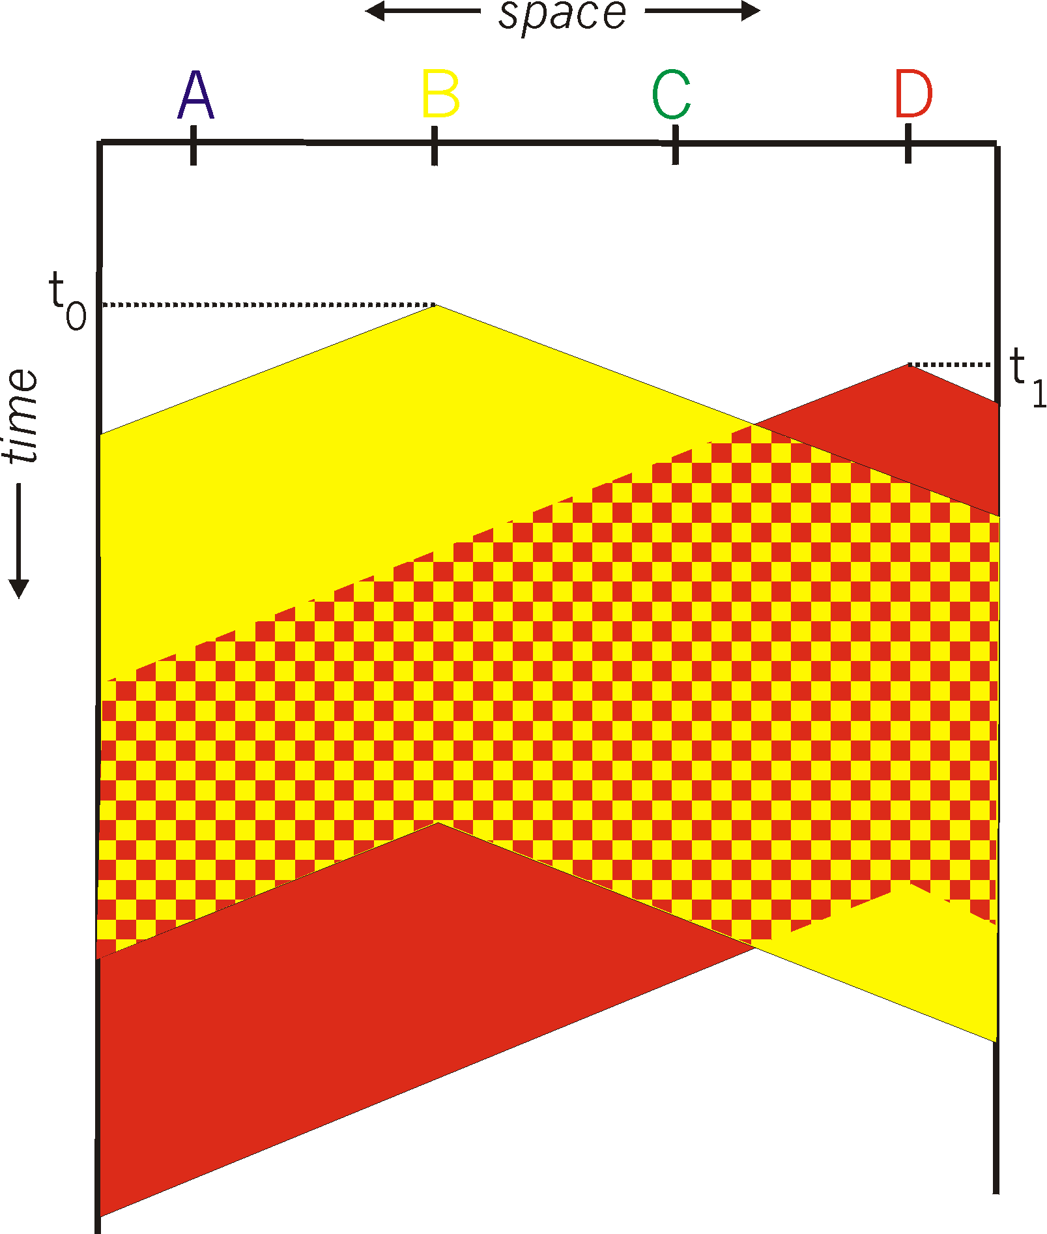

CSMA: collisions
spatial layout of nodes
Collisions can still occur with carrier sensing:
Propagation delay means two nodes may not hear each other’s just-started transmission
Distance & propagation delay play role in in determining collision probability
Collision: entire packet transmission time wasted

Slide 8
CSMA (carrier sense multiple access)
Simple CSMA: listen before transmit:
If channel sensed idle: transmit entire frame
If channel sensed busy: defer transmission
Human analogy: don’t interrupt others!
CSMA/CD: CSMA with collision detection
Collisions detected within short time
Colliding transmissions aborted, reducing channel wastage
Collision detection easy in wired, difficult with wireless
Human analogy: the polite conversation

Slide 9
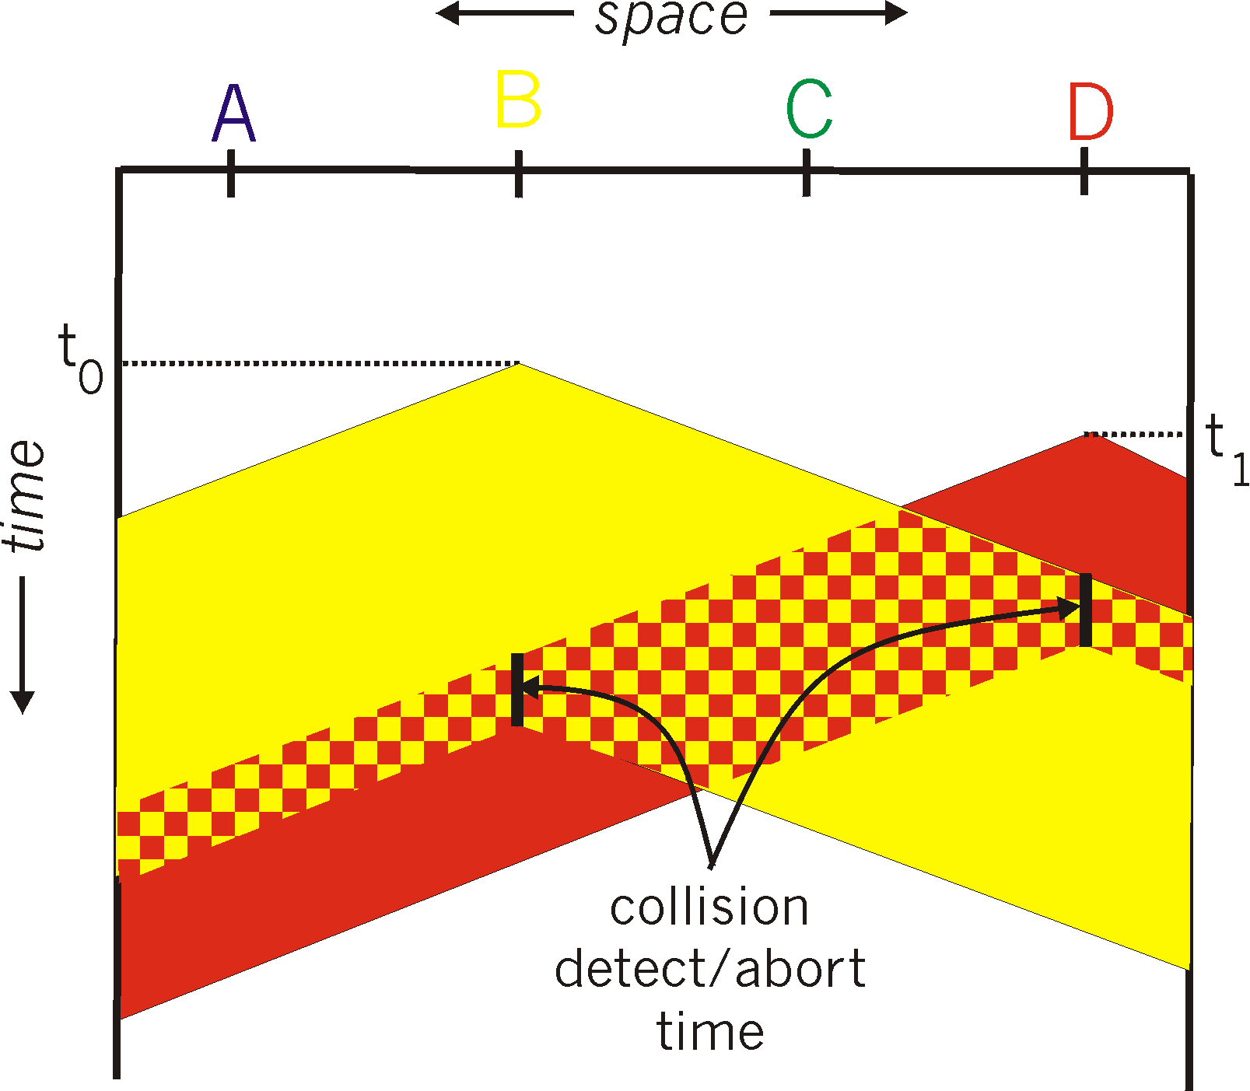
CSMA/CD
spatial layout of nodes
CSMA/CD reduces the amount of time wasted in collisions
Transmission aborted on collision detection

Slide 10
Ethernet CSMA/CD algorithm
Ethernet receives datagram from network layer, creates frame
If Ethernet senses channel:
If idle: start frame transmission.
If busy: wait until channel idle, then transmit
If entire frame transmitted without collision - done!
If another transmission detected while sending: abort, send jam signal
After aborting, enter binary (exponential) backoff:
After m-th collision, chooses K at random from {0,1,2, …, 2^{m}-1}
Wait for K slots, return step 2
More collisions: longer backoff interval

Slide 11
Ethernet: unreliable, connectionless
Connectionless: No handshaking between sending and receiving NICs
Unreliable: Receiving NIC doesn’t send ACKs or NAKs to sending NIC
Data in dropped frames may be recovered by the higher layer protocols (e.g., TCP), otherwise dropped data lost
Ethernet’s MAC protocol: 1-persistant CSMA/CD with binary backoff

Slide 12
Wireless ≠CSMA/CD
Transmitter cannot send/listen concurrently

Slide 13
Wireless ≠CSMA/CD
Nodes have different coverage areas
Hidden terminal problem and Exposed terminal problem

Slide 14
CSMA/CA: MACA → IEEE 802.11
MACA: Sender and receiver uses a short handshake before transmitting
IEEE 802.11 uses a refinement of MACA
802.11: CSMA - sense before transmitting
802.11: no collision detection!
Goal: avoid collisions: CSMA/CollisionAvoidance
Hidden and exposed station problems are alleviated using RTS/CTS exchanges
In 802.11 RTS/CTS is optional

Slide 15
CSMA/CA: IEEE 802.11
802.11 sender
1. If sense channel idle for DIFS then
transmit entire frame (no CD)
sender
receiver
2. If sense channel busy then
start random backoff time in range (0, w-1), w = CW_{min}
timer counts down while channel idle
transmit when timer expires
if no ACK, increase random backoff interval (double w upto CW_{max}), repeat 2
DIFS
data
SIFS
ACK
802.11 receiver
If frame received OK
return ACK after SIFS (ACK needed due to hidden terminal problem)

Slide 16
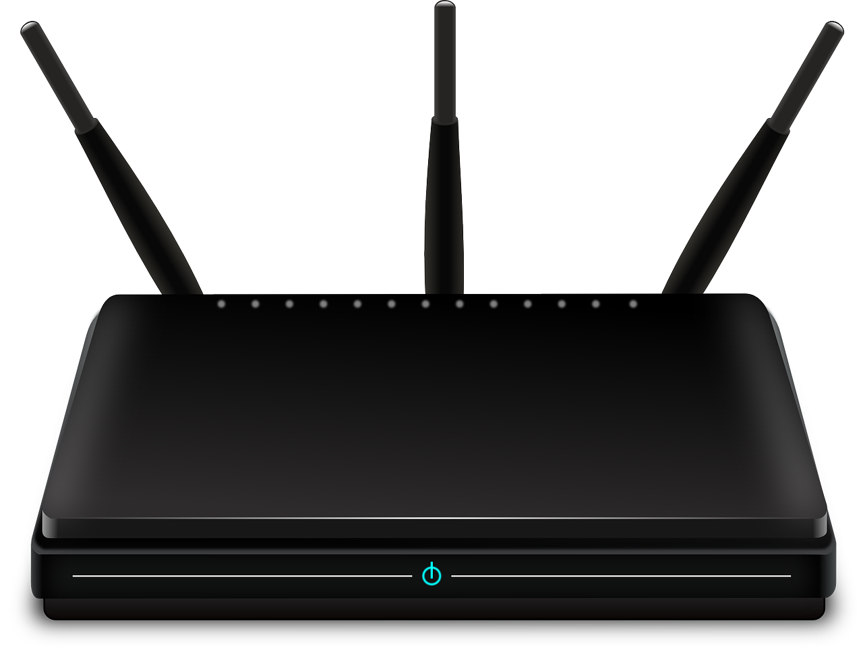
CSMA/CA: IEEE 802.11
A
RTS
B
C
D
CTS
Silenced

Slide 17
CSMA/CA: IEEE 802.11
A
DATA
B
C
D
ACK
Silenced

Slide 18
CSMA/CA: IEEE 802.11
A
RTS
B
C
D
CTS
Not silenced

Slide 19
CSMA/CA: IEEE 802.11
Sender first transmits small request-to-send (RTS) packet to the receiver
Receiver replies with clear-to-send CTS in response to RTS
Sender transmits data frame
Nodes receiving CTS defer transmissions
Nodes receiving RTS → defer one CTS time
Nodes receiving RTS but not CTS, free to send
RTS/CTS may still collide, but less likely (as they’re short)
RTS/CTS exchange does not entirely solve the hidden and exposed station problem

Slide 20
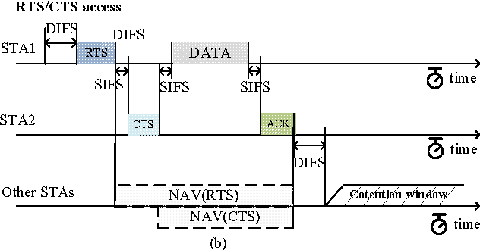
CSMA/CA: IEEE 802.11
Src:https://www.researchgate.net/publication/26429569_Autonomous_Power_Control_MAC_Protocol_for_Mobile_Ad_Hoc_Networks/figures?lo=1

Slide 21
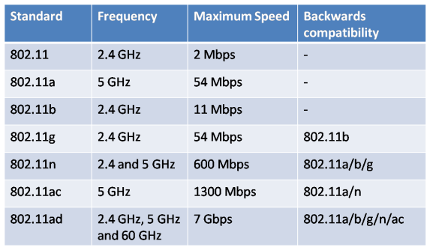
IEEE 802.11 Wireless LAN
Src: https://networkustad.com/2019/11/16/ieee-802-11-standards/

Slide 22
MAC protocols: Comparison
Three broad classes:
Channel partitioning
Share channel efficiently and fairly at high load
Inefficient at low load: delay in channel access, 1/N bandwidth allocated even if only 1 active node!
Taking turns
Look for best of both worlds
Single point of failure
Random access
Efficient at low load: single node can fully utilize channel
High load: collision overhead

Slide 23
Summary
Random access based MAC protocols:
CSMA
CSMA/CD
CSMA/CA
Comparison of the MAC protocols

