Slide 1
Computer Networks I
Introduction and Background
Amitangshu Pal
Computer Science and Engineering
IIT Kanpur

Slide 2
Data → Communications → Networking
Data: Information being shared, e.g. text, numbers, images, audio, video
Communications: Exchange of data between two or more devices via some transmission medium
  Transmits signals in a reliable and efficient and efficient manner
  Focuses on individual links
  Key objectives: Delivery, Accuracy and Timeliness
Networking: Communications across a set of links
  Wide Area Networks (WAN)
  Local Area Networks (LAN)
  Metropolitan Area Networks (MAN)
  The Internet

Slide 3
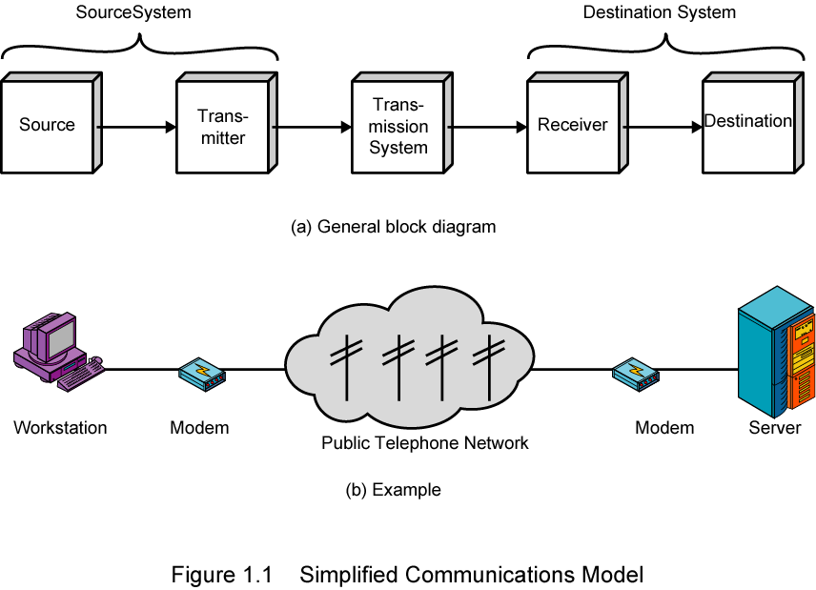
Simplified Communications Model

Slide 4
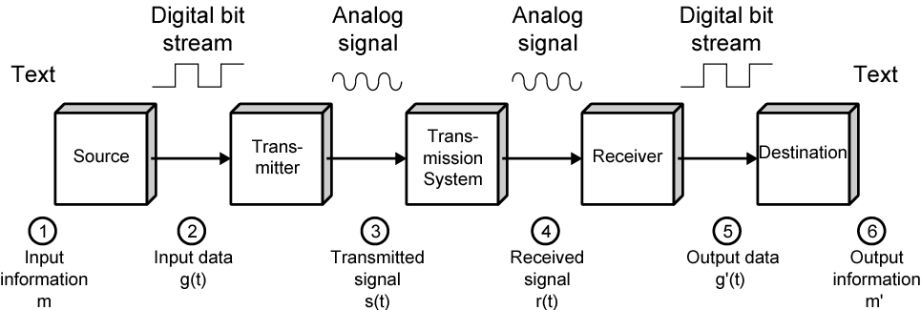
Simplified Communications Model
  Source: Device that generates data to be transmitted.
  Transmitter: Converts data from source into transmittable signals.
  Transmission system: Carries data from source to the destination.
  Receiver: Converts received signal into data.
  Destination: Takes and uses incoming data.

Slide 5
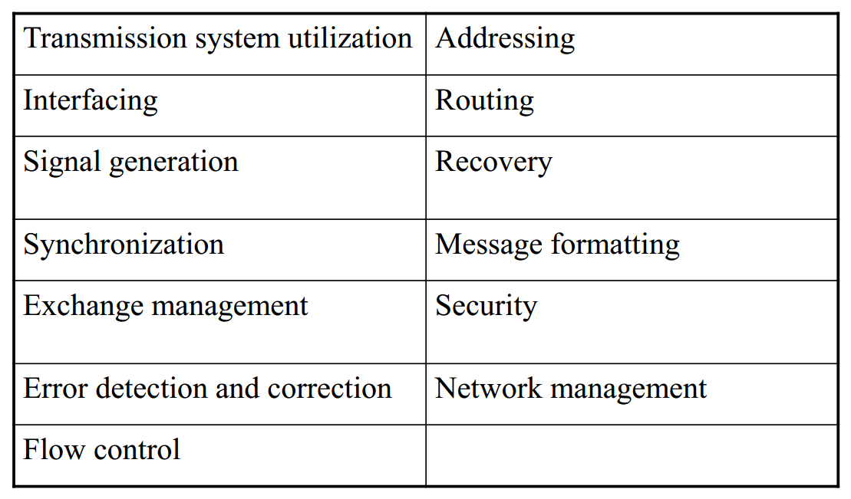
Communication Tasks
Notes:
10/01/2023 19:56
© 2007 Microsoft Corporation. All rights reserved. Microsoft, Windows, Windows Vista and other product names are or may be registered trademarks and/or trademarks in the U.S. and/or other countries.
The information herein is for informational purposes only and represents the current view of Microsoft Corporation as of the date of this presentation. Because Microsoft must respond to changing market conditions, it should not be interpreted to be a commitment on the part of Microsoft, and Microsoft cannot guarantee the accuracy of any information provided after the date of this presentation.
MICROSOFT MAKES NO WARRANTIES, EXPRESS, IMPLIED OR STATUTORY, AS TO THE INFORMATION IN THIS PRESENTATION.
5

Slide 6
Transmission Line
Transmission line is the key part of communications system
Link between the transmitter and the receiver
  Wired transmission: Fiber Optic Transmission
  Wireless Transmission
Needs to provide required capacity, with acceptable reliability at minimum cost
Example: Want to transfer 50 GB of data from A to B
  Bluetooth: 1Mbps data transfer → 400000 seconds
  WiFi: 54Mbps data transfer → 7407 seconds
  LAN Cable: 1Gbps data transfer → 400 seconds
Notes:
10/01/2023 19:56
© 2007 Microsoft Corporation. All rights reserved. Microsoft, Windows, Windows Vista and other product names are or may be registered trademarks and/or trademarks in the U.S. and/or other countries.
The information herein is for informational purposes only and represents the current view of Microsoft Corporation as of the date of this presentation. Because Microsoft must respond to changing market conditions, it should not be interpreted to be a commitment on the part of Microsoft, and Microsoft cannot guarantee the accuracy of any information provided after the date of this presentation.
MICROSOFT MAKES NO WARRANTIES, EXPRESS, IMPLIED OR STATUTORY, AS TO THE INFORMATION IN THIS PRESENTATION.
6

Slide 7
Local Area Networks
Small coverage area, e.g. building, campus
Owned and operated by organization owing end-devices
Higher data rate compared to WANs
Example technologies: Ethernet, Wireless LAN
Notes:
10/01/2023 19:56
© 2007 Microsoft Corporation. All rights reserved. Microsoft, Windows, Windows Vista and other product names are or may be registered trademarks and/or trademarks in the U.S. and/or other countries.
The information herein is for informational purposes only and represents the current view of Microsoft Corporation as of the date of this presentation. Because Microsoft must respond to changing market conditions, it should not be interpreted to be a commitment on the part of Microsoft, and Microsoft cannot guarantee the accuracy of any information provided after the date of this presentation.
MICROSOFT MAKES NO WARRANTIES, EXPRESS, IMPLIED OR STATUTORY, AS TO THE INFORMATION IN THIS PRESENTATION.
7

Slide 8
Wide Area Networks
Span a large geographical area
Carries data of multiple organizations
Technologies used:
  Circuit Switching
  Packet Switching
  Frame Relay
  Asynchronous Transfer Mode (ATM)
Metropolitan Area Network (MAN):
  Middle ground between LAN and WAN
Notes:
10/01/2023 19:56
© 2007 Microsoft Corporation. All rights reserved. Microsoft, Windows, Windows Vista and other product names are or may be registered trademarks and/or trademarks in the U.S. and/or other countries.
The information herein is for informational purposes only and represents the current view of Microsoft Corporation as of the date of this presentation. Because Microsoft must respond to changing market conditions, it should not be interpreted to be a commitment on the part of Microsoft, and Microsoft cannot guarantee the accuracy of any information provided after the date of this presentation.
MICROSOFT MAKES NO WARRANTIES, EXPRESS, IMPLIED OR STATUTORY, AS TO THE INFORMATION IN THIS PRESENTATION.
8

Slide 9
The Internet
Origins
  Evolved from US Department of Defense research network, APRANET in 1969
  Standardization of the Internet suite of protocols: TCP/IP
What is The Internet?
  Interconnection of networks
  Although network technologies differ, any computer can communicate with any other computer
Notes:
10/01/2023 19:56
© 2007 Microsoft Corporation. All rights reserved. Microsoft, Windows, Windows Vista and other product names are or may be registered trademarks and/or trademarks in the U.S. and/or other countries.
The information herein is for informational purposes only and represents the current view of Microsoft Corporation as of the date of this presentation. Because Microsoft must respond to changing market conditions, it should not be interpreted to be a commitment on the part of Microsoft, and Microsoft cannot guarantee the accuracy of any information provided after the date of this presentation.
MICROSOFT MAKES NO WARRANTIES, EXPRESS, IMPLIED OR STATUTORY, AS TO THE INFORMATION IN THIS PRESENTATION.
9

Slide 10
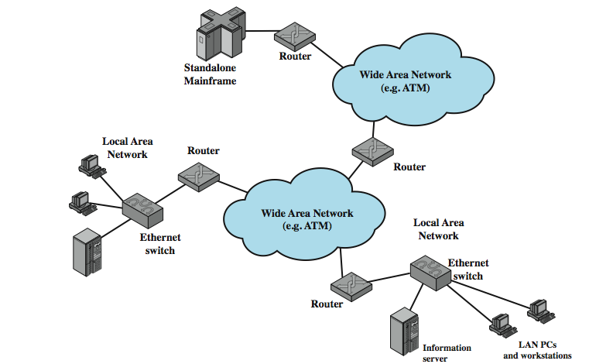
The Internet
Notes:
10/01/2023 19:56
© 2007 Microsoft Corporation. All rights reserved. Microsoft, Windows, Windows Vista and other product names are or may be registered trademarks and/or trademarks in the U.S. and/or other countries.
The information herein is for informational purposes only and represents the current view of Microsoft Corporation as of the date of this presentation. Because Microsoft must respond to changing market conditions, it should not be interpreted to be a commitment on the part of Microsoft, and Microsoft cannot guarantee the accuracy of any information provided after the date of this presentation.
MICROSOFT MAKES NO WARRANTIES, EXPRESS, IMPLIED OR STATUTORY, AS TO THE INFORMATION IN THIS PRESENTATION.
10

Slide 11

















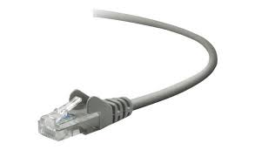



The Internet: a “nuts and bolts” view
Billions of connected computing devices:
  hosts = end systems
  running network apps at Internet’s “edge”
mobile network
national or global ISP
Switches/routers: forward packets (chunks of data)
local or regional ISP
Internet
Communication links
  fiber, copper, radio, satellite
  transmission rate: bandwidth
home network
content
provider
network
datacenter
network
Networks
  collection of devices, routers, links: managed by an organization
enterprise
network
Notes:
10/01/2023 19:56
© 2007 Microsoft Corporation. All rights reserved. Microsoft, Windows, Windows Vista and other product names are or may be registered trademarks and/or trademarks in the U.S. and/or other countries.
The information herein is for informational purposes only and represents the current view of Microsoft Corporation as of the date of this presentation. Because Microsoft must respond to changing market conditions, it should not be interpreted to be a commitment on the part of Microsoft, and Microsoft cannot guarantee the accuracy of any information provided after the date of this presentation.
MICROSOFT MAKES NO WARRANTIES, EXPRESS, IMPLIED OR STATUTORY, AS TO THE INFORMATION IN THIS PRESENTATION.
11

Slide 12
Network Edge and Network Core
Network edge:
End systems/hosts: data producers and consumers
Clients and servers
Servers often in data centers
Access networks, physical media: wired, wireless communication links
mobile network
national or global ISP
local or regional ISP
home network
content
provider
network
datacenter
network
enterprise
network
Notes:
10/01/2023 19:56
© 2007 Microsoft Corporation. All rights reserved. Microsoft, Windows, Windows Vista and other product names are or may be registered trademarks and/or trademarks in the U.S. and/or other countries.
The information herein is for informational purposes only and represents the current view of Microsoft Corporation as of the date of this presentation. Because Microsoft must respond to changing market conditions, it should not be interpreted to be a commitment on the part of Microsoft, and Microsoft cannot guarantee the accuracy of any information provided after the date of this presentation.
MICROSOFT MAKES NO WARRANTIES, EXPRESS, IMPLIED OR STATUTORY, AS TO THE INFORMATION IN THIS PRESENTATION.
12

Slide 13
Network Edge and Network Core
Network edge:
End systems/hosts: data producers and consumers
Clients and servers
Servers often in data centers
Access networks, physical media: wired, wireless communication links
mobile network
national or global ISP
local or regional ISP
home network
content
provider
network
datacenter
network
Network core:
Interconnected routers
Forms the backbone of the Internet
enterprise
network
Notes:
10/01/2023 19:56
© 2007 Microsoft Corporation. All rights reserved. Microsoft, Windows, Windows Vista and other product names are or may be registered trademarks and/or trademarks in the U.S. and/or other countries.
The information herein is for informational purposes only and represents the current view of Microsoft Corporation as of the date of this presentation. Because Microsoft must respond to changing market conditions, it should not be interpreted to be a commitment on the part of Microsoft, and Microsoft cannot guarantee the accuracy of any information provided after the date of this presentation.
MICROSOFT MAKES NO WARRANTIES, EXPRESS, IMPLIED OR STATUTORY, AS TO THE INFORMATION IN THIS PRESENTATION.
13

Slide 14
Internet structure: a “network of networks”
…
Tier3
ISP
…
Tier3
ISP
Tier3
ISP
Tier3
ISP
Tier3
ISP
Tier3
ISP
Tier1 ISP
Tier3
ISP
…
Tier2 ISP
…
Tier3
ISP
Tier1 ISP
Tier3
ISP
Tier1 ISP
Tier3
ISP
Tier3
ISP
Tier3
ISP
Tier2 ISP
…
Tier3
ISP
Tier3
ISP
Tier3
ISP
Tier3
ISP
…
Notes:
10/01/2023 19:56
© 2007 Microsoft Corporation. All rights reserved. Microsoft, Windows, Windows Vista and other product names are or may be registered trademarks and/or trademarks in the U.S. and/or other countries.
The information herein is for informational purposes only and represents the current view of Microsoft Corporation as of the date of this presentation. Because Microsoft must respond to changing market conditions, it should not be interpreted to be a commitment on the part of Microsoft, and Microsoft cannot guarantee the accuracy of any information provided after the date of this presentation.
MICROSOFT MAKES NO WARRANTIES, EXPRESS, IMPLIED OR STATUTORY, AS TO THE INFORMATION IN THIS PRESENTATION.
14

Slide 15
Tier-1 ISP: e.g., Sprint
to/from backbone
…
peering
…
…
…
…
to/from customers

Slide 16
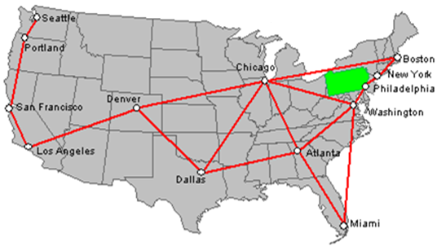
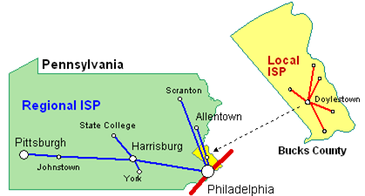
Internet structure: a “network of networks”
Src: https://encyclopedia2.thefreedictionary.com/Internet+servicec
Notes:
10/01/2023 19:56
© 2007 Microsoft Corporation. All rights reserved. Microsoft, Windows, Windows Vista and other product names are or may be registered trademarks and/or trademarks in the U.S. and/or other countries.
The information herein is for informational purposes only and represents the current view of Microsoft Corporation as of the date of this presentation. Because Microsoft must respond to changing market conditions, it should not be interpreted to be a commitment on the part of Microsoft, and Microsoft cannot guarantee the accuracy of any information provided after the date of this presentation.
MICROSOFT MAKES NO WARRANTIES, EXPRESS, IMPLIED OR STATUTORY, AS TO THE INFORMATION IN THIS PRESENTATION.
16

