Slide 1
Computer Networks Hubs and Switches
Amitangshu Pal
Computer Science and Engineering
IIT Kanpur

Slide 2


Hubs vs Switches
S₄
S₁
S₃
A
S₂
D
F
I
B
C
E
G
H

Slide 3
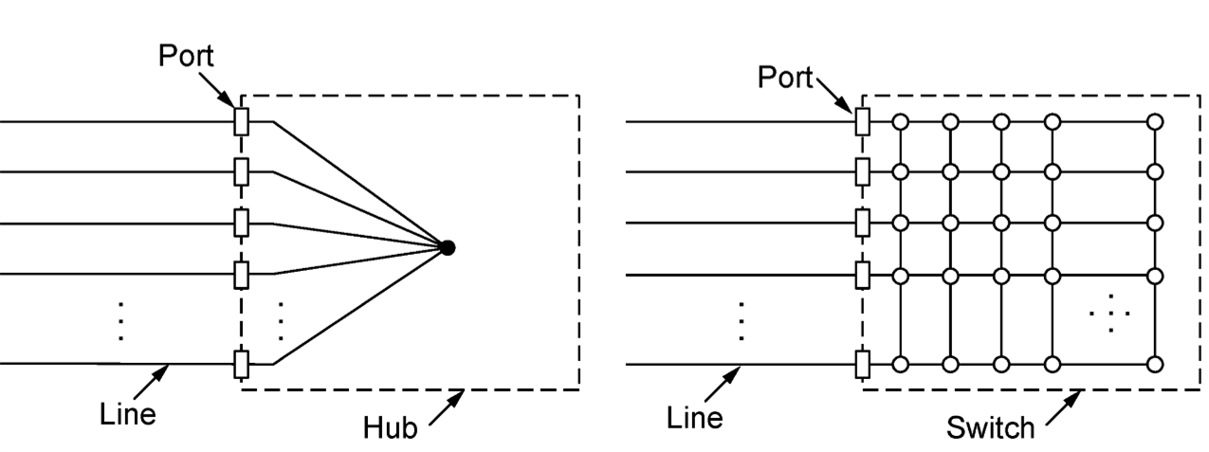
Hubs vs Switches

Slide 4


Hubs
Bits coming from one link is repeated to all other links
No frame buffering
No CSMA/CD at hub
One large collision domain
A
C’
B
1
2
6
3
5
4
B’
C
A’
Hub: A-to-A’ and B-to-B’ cannot transmit simultaneously

Slide 5
Switches
Hosts have dedicated, direct connection to switch
Switches buffer packets
Ethernet protocol used on each incoming link, so:
No collisions; full duplex
Each link is its own collision domain
A
C’
B
1
2
6
3
5
4
B’
C
A’
Switching: A-to-A’ and B-to-B’ can transmit simultaneously, without collisions
Hubs vs switch: https://community.fs.com/blog/do-you-know-the-differences-between-hubs-switches-and-routers.html

Slide 6
Cut-through Switches
Switches start forwarding the frames just after reading the destination address
Slightly reduces the latency
A
C’
B
1
2
6
3
5
4
B’
C
A’
type
preamble
dest.
address
source
address
data (payload)
CRC

Slide 7
Switches vs. routers
application
transport
network
link
physical
datagram
Both are store-&-forward:
Routers: network-layer devices (examine network-layer headers)
Switches: link-layer devices (examine link-layer headers)
frame
link
physical
frame
switch
network
link
physical
datagram
application
transport
network
link
physical
frame

Slide 8
Switches vs. routers
application
transport
network
link
physical
datagram
Both have forwarding tables:
Routers: compute tables using routing algorithms, IP addresses
Switches: learn forwarding table using flooding, learning, MAC addresses
frame
link
physical
frame
switch
network
link
physical
datagram
application
transport
network
link
physical
frame

Slide 9
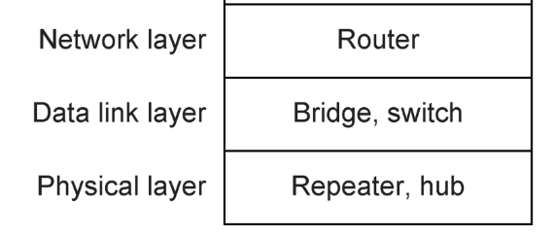
Hubs vs Switches vs Routers

Slide 10
Summary
Hubs and switches:
Hubs
Switches
Cut-through switches
Routers

