Slide 1
Computer Networks Circuit Switching and Packet Switching
Amitangshu Pal
Computer Science and Engineering
IIT Kanpur

Slide 2
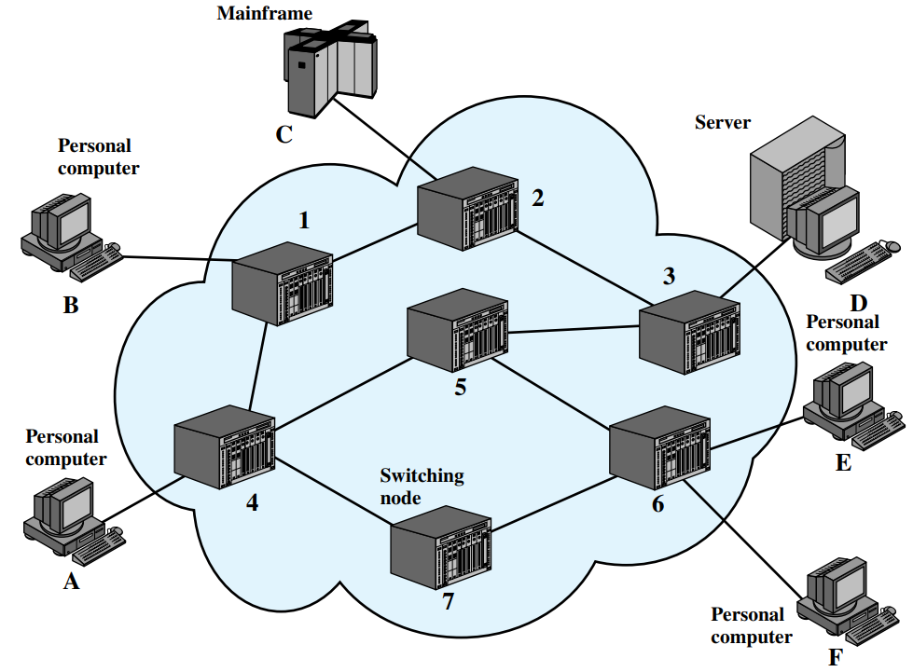
Simple Switched Network
Two types of switching:
Circuit switching
Packet switching
Notes:
Let me first give a brief introduction of WOBAN architecture and the motivation of using WOBAN as an access technology. There are two main types of popular access networks. 1. Optical access networks where from CO optical fibers are pulled to ONUs located at every homes, premises or offices, which basically work as gateways for Internet access to the users. The popular access technology of this access networks is PON. The advantage of this access is that it provides high bandwidth and fast Internet service. The limitation is that it needs fiber to penetrate in each and every premises which make this scheme very costly. Also there is a limitation of maximum fiber length.
Another popular access networks is wireless access. Popular technology of this type are WiFi and WiMAX. The advantage of these access technology is that this is flexible and cost effective scheme. But the limitation is that when the hop of hops increase a lot, real time multi-media traffic suffers a lot.
Let me first give a brief introduction of WOBAN architecture and the motivation of using WOBAN as an access technology. There are two main types of popular access networks. First is the optical access such as passive optical networks (PON), which provides fast Internet service because of high bandwidth. But it requires fiber to be penetrated from central office to all residential complex, offices and premises which make the scheme highly costly. Another popular access technology is wireless access, which is flexible and cost-efficient, but does not function well when the number of hops increases.

Slide 3
Circuit Switching

Slide 4
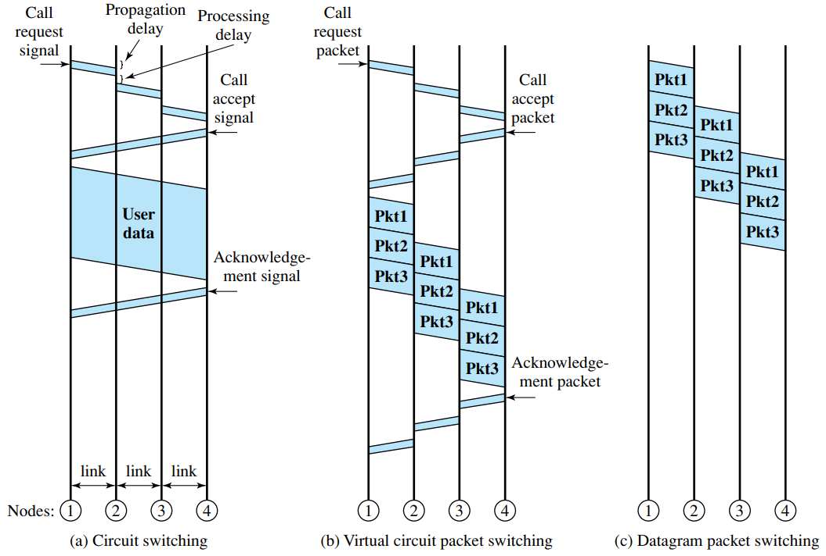
Circuit Switching
Dedicated communication path between two stations
Three phases
Circuit establish
Data transfer
Circuit disconnect
Must have enough channel capacity to establish connection
Notes:
Let me first give a brief introduction of WOBAN architecture and the motivation of using WOBAN as an access technology. There are two main types of popular access networks. 1. Optical access networks where from CO optical fibers are pulled to ONUs located at every homes, premises or offices, which basically work as gateways for Internet access to the users. The popular access technology of this access networks is PON. The advantage of this access is that it provides high bandwidth and fast Internet service. The limitation is that it needs fiber to penetrate in each and every premises which make this scheme very costly. Also there is a limitation of maximum fiber length.
Another popular access networks is wireless access. Popular technology of this type are WiFi and WiMAX. The advantage of these access technology is that this is flexible and cost effective scheme. But the limitation is that when the hop of hops increase a lot, real time multi-media traffic suffers a lot.
Let me first give a brief introduction of WOBAN architecture and the motivation of using WOBAN as an access technology. There are two main types of popular access networks. First is the optical access such as passive optical networks (PON), which provides fast Internet service because of high bandwidth. But it requires fiber to be penetrated from central office to all residential complex, offices and premises which make the scheme highly costly. Another popular access technology is wireless access, which is flexible and cost-efficient, but does not function well when the number of hops increases.

Slide 5
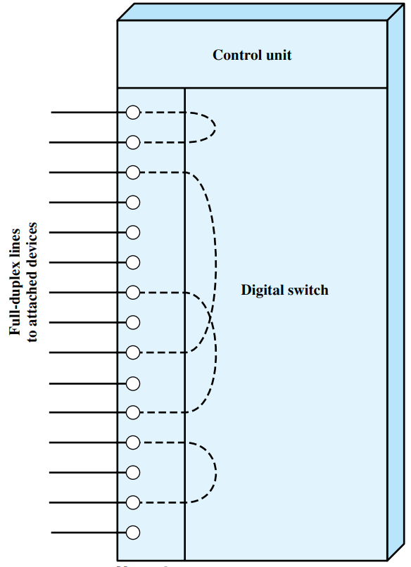
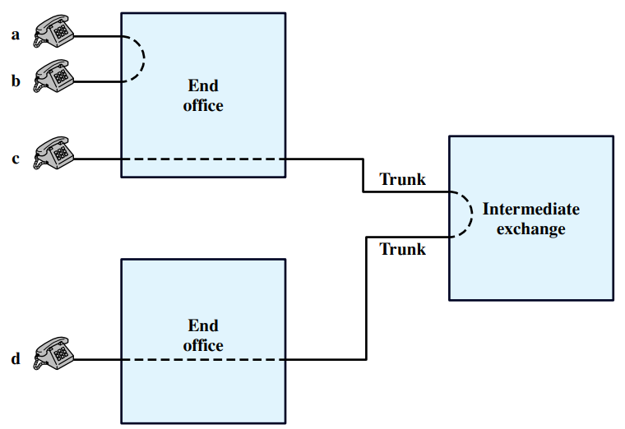
Circuit Switching
Notes:
Let me first give a brief introduction of WOBAN architecture and the motivation of using WOBAN as an access technology. There are two main types of popular access networks. 1. Optical access networks where from CO optical fibers are pulled to ONUs located at every homes, premises or offices, which basically work as gateways for Internet access to the users. The popular access technology of this access networks is PON. The advantage of this access is that it provides high bandwidth and fast Internet service. The limitation is that it needs fiber to penetrate in each and every premises which make this scheme very costly. Also there is a limitation of maximum fiber length.
Another popular access networks is wireless access. Popular technology of this type are WiFi and WiMAX. The advantage of these access technology is that this is flexible and cost effective scheme. But the limitation is that when the hop of hops increase a lot, real time multi-media traffic suffers a lot.
Let me first give a brief introduction of WOBAN architecture and the motivation of using WOBAN as an access technology. There are two main types of popular access networks. First is the optical access such as passive optical networks (PON), which provides fast Internet service because of high bandwidth. But it requires fiber to be penetrated from central office to all residential complex, offices and premises which make the scheme highly costly. Another popular access technology is wireless access, which is flexible and cost-efficient, but does not function well when the number of hops increases.

Slide 6
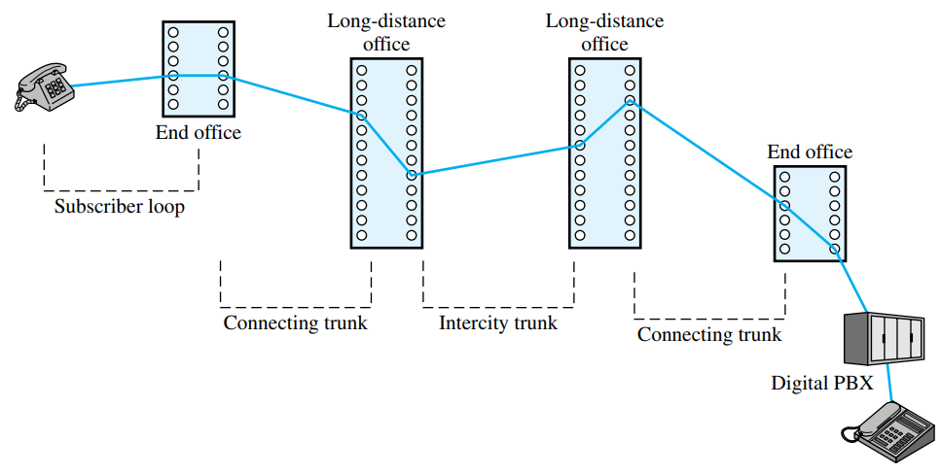
Circuit Switching
Notes:
Let me first give a brief introduction of WOBAN architecture and the motivation of using WOBAN as an access technology. There are two main types of popular access networks. 1. Optical access networks where from CO optical fibers are pulled to ONUs located at every homes, premises or offices, which basically work as gateways for Internet access to the users. The popular access technology of this access networks is PON. The advantage of this access is that it provides high bandwidth and fast Internet service. The limitation is that it needs fiber to penetrate in each and every premises which make this scheme very costly. Also there is a limitation of maximum fiber length.
Another popular access networks is wireless access. Popular technology of this type are WiFi and WiMAX. The advantage of these access technology is that this is flexible and cost effective scheme. But the limitation is that when the hop of hops increase a lot, real time multi-media traffic suffers a lot.
Let me first give a brief introduction of WOBAN architecture and the motivation of using WOBAN as an access technology. There are two main types of popular access networks. First is the optical access such as passive optical networks (PON), which provides fast Internet service because of high bandwidth. But it requires fiber to be penetrated from central office to all residential complex, offices and premises which make the scheme highly costly. Another popular access technology is wireless access, which is flexible and cost-efficient, but does not function well when the number of hops increases.

Slide 7
Circuit Switching
Inefficiency
Channel capacity is dedicated for the whole duration of a connection
If no data, capacity is wasted
Delay
Long initial delay: circuit establishment takes time
Low data delay: after the circuit establishment, information is transmitted at a fixed data rate with no delay other than the propagation delay
The delay at each node is negligible
Developed for voice traffic (public telephone network)
For voice connections, the resulting circuit will enjoy a high percentage of utilization because most of the time one party or the other is talking
Notes:
Let me first give a brief introduction of WOBAN architecture and the motivation of using WOBAN as an access technology. There are two main types of popular access networks. 1. Optical access networks where from CO optical fibers are pulled to ONUs located at every homes, premises or offices, which basically work as gateways for Internet access to the users. The popular access technology of this access networks is PON. The advantage of this access is that it provides high bandwidth and fast Internet service. The limitation is that it needs fiber to penetrate in each and every premises which make this scheme very costly. Also there is a limitation of maximum fiber length.
Another popular access networks is wireless access. Popular technology of this type are WiFi and WiMAX. The advantage of these access technology is that this is flexible and cost effective scheme. But the limitation is that when the hop of hops increase a lot, real time multi-media traffic suffers a lot.
Let me first give a brief introduction of WOBAN architecture and the motivation of using WOBAN as an access technology. There are two main types of popular access networks. First is the optical access such as passive optical networks (PON), which provides fast Internet service because of high bandwidth. But it requires fiber to be penetrated from central office to all residential complex, offices and premises which make the scheme highly costly. Another popular access technology is wireless access, which is flexible and cost-efficient, but does not function well when the number of hops increases.

Slide 8
Switches: Blocking and Non-Blocking
Blocking
A network is unable to connect stations because all paths are in use
Used on voice systems
Short duration calls
Non-blocking
Permits all stations to connect (in pairs) at once
Used for some data connections
Notes:
Let me first give a brief introduction of WOBAN architecture and the motivation of using WOBAN as an access technology. There are two main types of popular access networks. 1. Optical access networks where from CO optical fibers are pulled to ONUs located at every homes, premises or offices, which basically work as gateways for Internet access to the users. The popular access technology of this access networks is PON. The advantage of this access is that it provides high bandwidth and fast Internet service. The limitation is that it needs fiber to penetrate in each and every premises which make this scheme very costly. Also there is a limitation of maximum fiber length.
Another popular access networks is wireless access. Popular technology of this type are WiFi and WiMAX. The advantage of these access technology is that this is flexible and cost effective scheme. But the limitation is that when the hop of hops increase a lot, real time multi-media traffic suffers a lot.
Let me first give a brief introduction of WOBAN architecture and the motivation of using WOBAN as an access technology. There are two main types of popular access networks. First is the optical access such as passive optical networks (PON), which provides fast Internet service because of high bandwidth. But it requires fiber to be penetrated from central office to all residential complex, offices and premises which make the scheme highly costly. Another popular access technology is wireless access, which is flexible and cost-efficient, but does not function well when the number of hops increases.

Slide 9
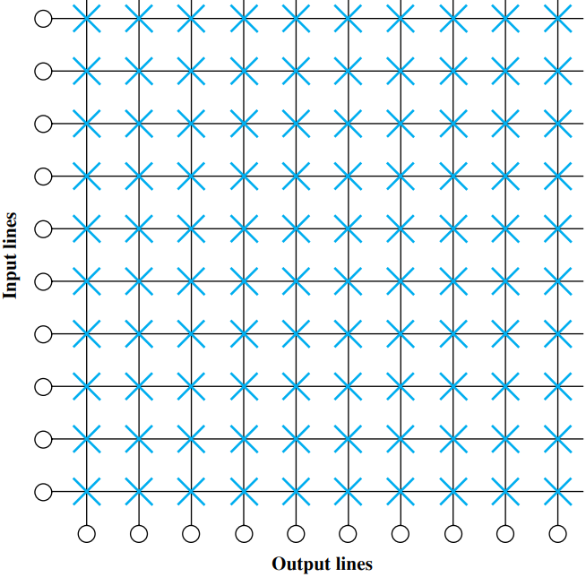
Switches: Crossbar
Total number of crosspoints is N²
Notes:
Let me first give a brief introduction of WOBAN architecture and the motivation of using WOBAN as an access technology. There are two main types of popular access networks. 1. Optical access networks where from CO optical fibers are pulled to ONUs located at every homes, premises or offices, which basically work as gateways for Internet access to the users. The popular access technology of this access networks is PON. The advantage of this access is that it provides high bandwidth and fast Internet service. The limitation is that it needs fiber to penetrate in each and every premises which make this scheme very costly. Also there is a limitation of maximum fiber length.
Another popular access networks is wireless access. Popular technology of this type are WiFi and WiMAX. The advantage of these access technology is that this is flexible and cost effective scheme. But the limitation is that when the hop of hops increase a lot, real time multi-media traffic suffers a lot.
Let me first give a brief introduction of WOBAN architecture and the motivation of using WOBAN as an access technology. There are two main types of popular access networks. First is the optical access such as passive optical networks (PON), which provides fast Internet service because of high bandwidth. But it requires fiber to be penetrated from central office to all residential complex, offices and premises which make the scheme highly costly. Another popular access technology is wireless access, which is flexible and cost-efficient, but does not function well when the number of hops increases.

Slide 10
Switches: Crossbar
Number of crosspoints grows as square of number of stations
Loss of crosspoint prevents connection
Non-blocking
Notes:
Let me first give a brief introduction of WOBAN architecture and the motivation of using WOBAN as an access technology. There are two main types of popular access networks. 1. Optical access networks where from CO optical fibers are pulled to ONUs located at every homes, premises or offices, which basically work as gateways for Internet access to the users. The popular access technology of this access networks is PON. The advantage of this access is that it provides high bandwidth and fast Internet service. The limitation is that it needs fiber to penetrate in each and every premises which make this scheme very costly. Also there is a limitation of maximum fiber length.
Another popular access networks is wireless access. Popular technology of this type are WiFi and WiMAX. The advantage of these access technology is that this is flexible and cost effective scheme. But the limitation is that when the hop of hops increase a lot, real time multi-media traffic suffers a lot.
Let me first give a brief introduction of WOBAN architecture and the motivation of using WOBAN as an access technology. There are two main types of popular access networks. First is the optical access such as passive optical networks (PON), which provides fast Internet service because of high bandwidth. But it requires fiber to be penetrated from central office to all residential complex, offices and premises which make the scheme highly costly. Another popular access technology is wireless access, which is flexible and cost-efficient, but does not function well when the number of hops increases.

Slide 11
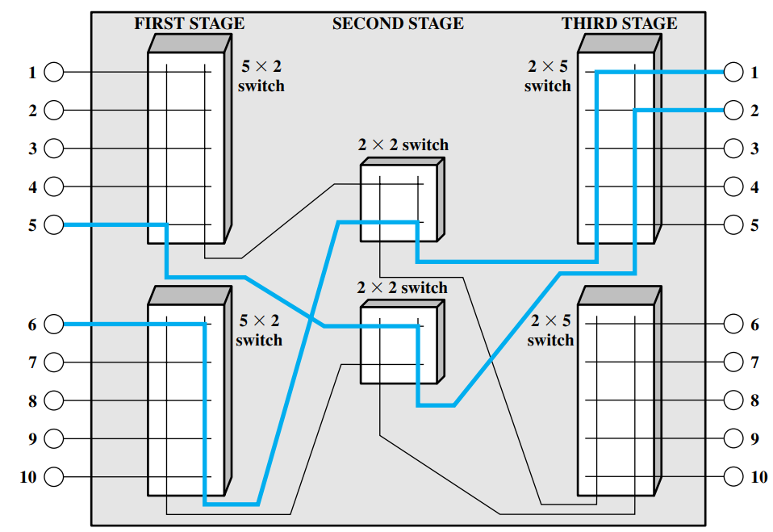
Switches: Multistage Switch
Notes:
Let me first give a brief introduction of WOBAN architecture and the motivation of using WOBAN as an access technology. There are two main types of popular access networks. 1. Optical access networks where from CO optical fibers are pulled to ONUs located at every homes, premises or offices, which basically work as gateways for Internet access to the users. The popular access technology of this access networks is PON. The advantage of this access is that it provides high bandwidth and fast Internet service. The limitation is that it needs fiber to penetrate in each and every premises which make this scheme very costly. Also there is a limitation of maximum fiber length.
Another popular access networks is wireless access. Popular technology of this type are WiFi and WiMAX. The advantage of these access technology is that this is flexible and cost effective scheme. But the limitation is that when the hop of hops increase a lot, real time multi-media traffic suffers a lot.
Let me first give a brief introduction of WOBAN architecture and the motivation of using WOBAN as an access technology. There are two main types of popular access networks. First is the optical access such as passive optical networks (PON), which provides fast Internet service because of high bandwidth. But it requires fiber to be penetrated from central office to all residential complex, offices and premises which make the scheme highly costly. Another popular access technology is wireless access, which is flexible and cost-efficient, but does not function well when the number of hops increases.

Slide 12
Switches: Multistage Switch
Reduced number of crosspoints
More than one path through network
Increased reliability
More complex control
May be blocking
Notes:
Let me first give a brief introduction of WOBAN architecture and the motivation of using WOBAN as an access technology. There are two main types of popular access networks. 1. Optical access networks where from CO optical fibers are pulled to ONUs located at every homes, premises or offices, which basically work as gateways for Internet access to the users. The popular access technology of this access networks is PON. The advantage of this access is that it provides high bandwidth and fast Internet service. The limitation is that it needs fiber to penetrate in each and every premises which make this scheme very costly. Also there is a limitation of maximum fiber length.
Another popular access networks is wireless access. Popular technology of this type are WiFi and WiMAX. The advantage of these access technology is that this is flexible and cost effective scheme. But the limitation is that when the hop of hops increase a lot, real time multi-media traffic suffers a lot.
Let me first give a brief introduction of WOBAN architecture and the motivation of using WOBAN as an access technology. There are two main types of popular access networks. First is the optical access such as passive optical networks (PON), which provides fast Internet service because of high bandwidth. But it requires fiber to be penetrated from central office to all residential complex, offices and premises which make the scheme highly costly. Another popular access technology is wireless access, which is flexible and cost-efficient, but does not function well when the number of hops increases.

Slide 13
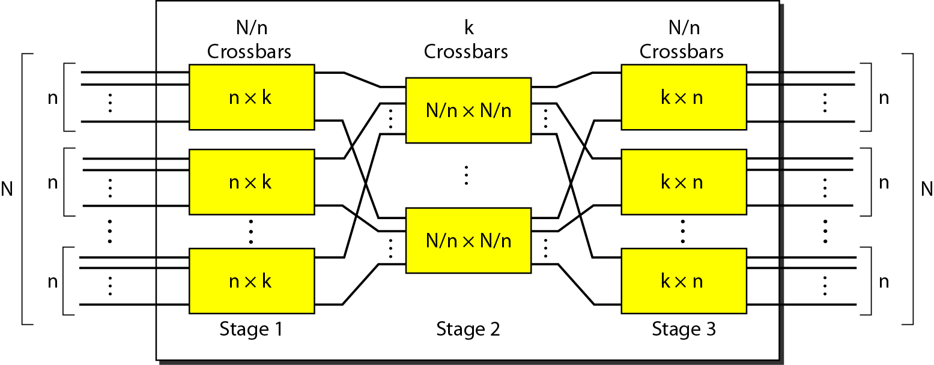
Switches: Multistage Switch
Total number of crosspoints is 2kN + k(N/n)²
Notes:
Let me first give a brief introduction of WOBAN architecture and the motivation of using WOBAN as an access technology. There are two main types of popular access networks. 1. Optical access networks where from CO optical fibers are pulled to ONUs located at every homes, premises or offices, which basically work as gateways for Internet access to the users. The popular access technology of this access networks is PON. The advantage of this access is that it provides high bandwidth and fast Internet service. The limitation is that it needs fiber to penetrate in each and every premises which make this scheme very costly. Also there is a limitation of maximum fiber length.
Another popular access networks is wireless access. Popular technology of this type are WiFi and WiMAX. The advantage of these access technology is that this is flexible and cost effective scheme. But the limitation is that when the hop of hops increase a lot, real time multi-media traffic suffers a lot.
Let me first give a brief introduction of WOBAN architecture and the motivation of using WOBAN as an access technology. There are two main types of popular access networks. First is the optical access such as passive optical networks (PON), which provides fast Internet service because of high bandwidth. But it requires fiber to be penetrated from central office to all residential complex, offices and premises which make the scheme highly costly. Another popular access technology is wireless access, which is flexible and cost-efficient, but does not function well when the number of hops increases.

Slide 14
Switches: Example
Design a three-stage, 200 × 200 switch (N = 200) with k = 4 and n = 20
Total number of crosspoints is 2kN + k(N/n)²
Notes:
Let me first give a brief introduction of WOBAN architecture and the motivation of using WOBAN as an access technology. There are two main types of popular access networks. 1. Optical access networks where from CO optical fibers are pulled to ONUs located at every homes, premises or offices, which basically work as gateways for Internet access to the users. The popular access technology of this access networks is PON. The advantage of this access is that it provides high bandwidth and fast Internet service. The limitation is that it needs fiber to penetrate in each and every premises which make this scheme very costly. Also there is a limitation of maximum fiber length.
Another popular access networks is wireless access. Popular technology of this type are WiFi and WiMAX. The advantage of these access technology is that this is flexible and cost effective scheme. But the limitation is that when the hop of hops increase a lot, real time multi-media traffic suffers a lot.
Let me first give a brief introduction of WOBAN architecture and the motivation of using WOBAN as an access technology. There are two main types of popular access networks. First is the optical access such as passive optical networks (PON), which provides fast Internet service because of high bandwidth. But it requires fiber to be penetrated from central office to all residential complex, offices and premises which make the scheme highly costly. Another popular access technology is wireless access, which is flexible and cost-efficient, but does not function well when the number of hops increases.

Slide 15
Packet Switching

Slide 16
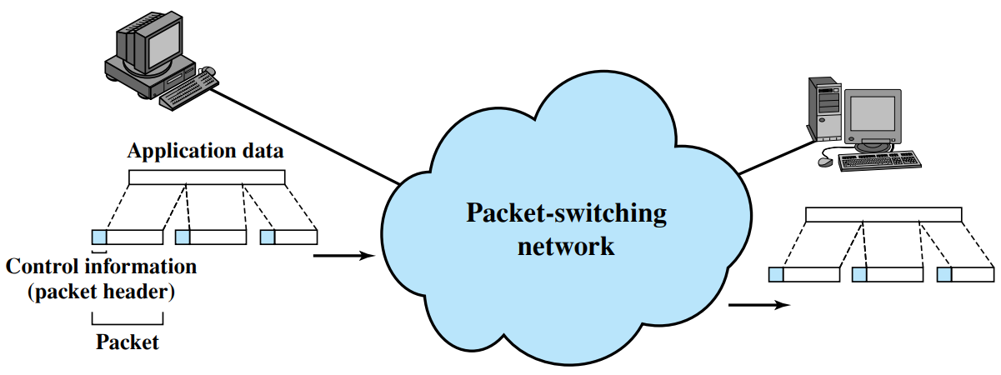
Packet Switching
Notes:
Let me first give a brief introduction of WOBAN architecture and the motivation of using WOBAN as an access technology. There are two main types of popular access networks. 1. Optical access networks where from CO optical fibers are pulled to ONUs located at every homes, premises or offices, which basically work as gateways for Internet access to the users. The popular access technology of this access networks is PON. The advantage of this access is that it provides high bandwidth and fast Internet service. The limitation is that it needs fiber to penetrate in each and every premises which make this scheme very costly. Also there is a limitation of maximum fiber length.
Another popular access networks is wireless access. Popular technology of this type are WiFi and WiMAX. The advantage of these access technology is that this is flexible and cost effective scheme. But the limitation is that when the hop of hops increase a lot, real time multi-media traffic suffers a lot.
Let me first give a brief introduction of WOBAN architecture and the motivation of using WOBAN as an access technology. There are two main types of popular access networks. First is the optical access such as passive optical networks (PON), which provides fast Internet service because of high bandwidth. But it requires fiber to be penetrated from central office to all residential complex, offices and premises which make the scheme highly costly. Another popular access technology is wireless access, which is flexible and cost-efficient, but does not function well when the number of hops increases.

Slide 17
Packet Switching
Data transmitted in small packets
Longer messages split into series of packets
Each packet contains a portion of user data plus some control info
Control info: Routing (addressing) info
Packets are received, stored briefly (buffered) and past on to the next node
Store and forward
Notes:
Let me first give a brief introduction of WOBAN architecture and the motivation of using WOBAN as an access technology. There are two main types of popular access networks. 1. Optical access networks where from CO optical fibers are pulled to ONUs located at every homes, premises or offices, which basically work as gateways for Internet access to the users. The popular access technology of this access networks is PON. The advantage of this access is that it provides high bandwidth and fast Internet service. The limitation is that it needs fiber to penetrate in each and every premises which make this scheme very costly. Also there is a limitation of maximum fiber length.
Another popular access networks is wireless access. Popular technology of this type are WiFi and WiMAX. The advantage of these access technology is that this is flexible and cost effective scheme. But the limitation is that when the hop of hops increase a lot, real time multi-media traffic suffers a lot.
Let me first give a brief introduction of WOBAN architecture and the motivation of using WOBAN as an access technology. There are two main types of popular access networks. First is the optical access such as passive optical networks (PON), which provides fast Internet service because of high bandwidth. But it requires fiber to be penetrated from central office to all residential complex, offices and premises which make the scheme highly costly. Another popular access technology is wireless access, which is flexible and cost-efficient, but does not function well when the number of hops increases.

Slide 18
Packet Switching
Line efficiency
Single node to node link can be shared by many packets over time
Packets queued and transmitted as fast as possible
Packets are accepted even when network is busy
Delivery may slow down
Two types:
Datagram packet switching
Virtual circuit packet switching
Notes:
Let me first give a brief introduction of WOBAN architecture and the motivation of using WOBAN as an access technology. There are two main types of popular access networks. 1. Optical access networks where from CO optical fibers are pulled to ONUs located at every homes, premises or offices, which basically work as gateways for Internet access to the users. The popular access technology of this access networks is PON. The advantage of this access is that it provides high bandwidth and fast Internet service. The limitation is that it needs fiber to penetrate in each and every premises which make this scheme very costly. Also there is a limitation of maximum fiber length.
Another popular access networks is wireless access. Popular technology of this type are WiFi and WiMAX. The advantage of these access technology is that this is flexible and cost effective scheme. But the limitation is that when the hop of hops increase a lot, real time multi-media traffic suffers a lot.
Let me first give a brief introduction of WOBAN architecture and the motivation of using WOBAN as an access technology. There are two main types of popular access networks. First is the optical access such as passive optical networks (PON), which provides fast Internet service because of high bandwidth. But it requires fiber to be penetrated from central office to all residential complex, offices and premises which make the scheme highly costly. Another popular access technology is wireless access, which is flexible and cost-efficient, but does not function well when the number of hops increases.

Slide 19
Datagram Packet Switching
Each packet treated independently
Packets can take any route
Packets may arrive out of order
Packets may go missing
Up to receiver to re-order packets and
recover from missing packets
Notes:
Let me first give a brief introduction of WOBAN architecture and the motivation of using WOBAN as an access technology. There are two main types of popular access networks. 1. Optical access networks where from CO optical fibers are pulled to ONUs located at every homes, premises or offices, which basically work as gateways for Internet access to the users. The popular access technology of this access networks is PON. The advantage of this access is that it provides high bandwidth and fast Internet service. The limitation is that it needs fiber to penetrate in each and every premises which make this scheme very costly. Also there is a limitation of maximum fiber length.
Another popular access networks is wireless access. Popular technology of this type are WiFi and WiMAX. The advantage of these access technology is that this is flexible and cost effective scheme. But the limitation is that when the hop of hops increase a lot, real time multi-media traffic suffers a lot.
Let me first give a brief introduction of WOBAN architecture and the motivation of using WOBAN as an access technology. There are two main types of popular access networks. First is the optical access such as passive optical networks (PON), which provides fast Internet service because of high bandwidth. But it requires fiber to be penetrated from central office to all residential complex, offices and premises which make the scheme highly costly. Another popular access technology is wireless access, which is flexible and cost-efficient, but does not function well when the number of hops increases.

Slide 20
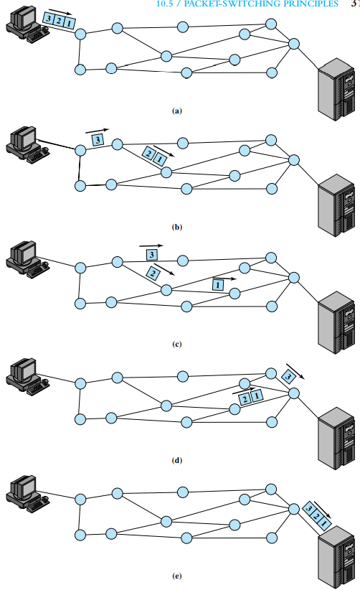
Datagram Packet Switching
Notes:
Let me first give a brief introduction of WOBAN architecture and the motivation of using WOBAN as an access technology. There are two main types of popular access networks. 1. Optical access networks where from CO optical fibers are pulled to ONUs located at every homes, premises or offices, which basically work as gateways for Internet access to the users. The popular access technology of this access networks is PON. The advantage of this access is that it provides high bandwidth and fast Internet service. The limitation is that it needs fiber to penetrate in each and every premises which make this scheme very costly. Also there is a limitation of maximum fiber length.
Another popular access networks is wireless access. Popular technology of this type are WiFi and WiMAX. The advantage of these access technology is that this is flexible and cost effective scheme. But the limitation is that when the hop of hops increase a lot, real time multi-media traffic suffers a lot.
Let me first give a brief introduction of WOBAN architecture and the motivation of using WOBAN as an access technology. There are two main types of popular access networks. First is the optical access such as passive optical networks (PON), which provides fast Internet service because of high bandwidth. But it requires fiber to be penetrated from central office to all residential complex, offices and premises which make the scheme highly costly. Another popular access technology is wireless access, which is flexible and cost-efficient, but does not function well when the number of hops increases.

Slide 21
Virtual Circuit Packet Switching
Preplanned route established before any packets sent
Call request and call accept packets establish connection (handshake)
Each packet contains a virtual circuit identifier instead of destination address
No routing decisions required for each packet
Clear request to drop circuit
Not a dedicated path
Notes:
Let me first give a brief introduction of WOBAN architecture and the motivation of using WOBAN as an access technology. There are two main types of popular access networks. 1. Optical access networks where from CO optical fibers are pulled to ONUs located at every homes, premises or offices, which basically work as gateways for Internet access to the users. The popular access technology of this access networks is PON. The advantage of this access is that it provides high bandwidth and fast Internet service. The limitation is that it needs fiber to penetrate in each and every premises which make this scheme very costly. Also there is a limitation of maximum fiber length.
Another popular access networks is wireless access. Popular technology of this type are WiFi and WiMAX. The advantage of these access technology is that this is flexible and cost effective scheme. But the limitation is that when the hop of hops increase a lot, real time multi-media traffic suffers a lot.
Let me first give a brief introduction of WOBAN architecture and the motivation of using WOBAN as an access technology. There are two main types of popular access networks. First is the optical access such as passive optical networks (PON), which provides fast Internet service because of high bandwidth. But it requires fiber to be penetrated from central office to all residential complex, offices and premises which make the scheme highly costly. Another popular access technology is wireless access, which is flexible and cost-efficient, but does not function well when the number of hops increases.

Slide 22
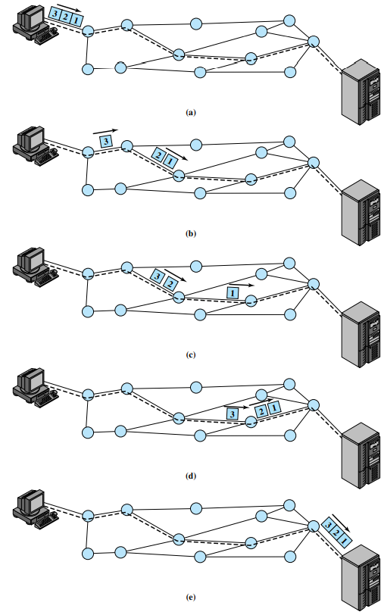
Virtual Circuit Packet Switching
Notes:
Let me first give a brief introduction of WOBAN architecture and the motivation of using WOBAN as an access technology. There are two main types of popular access networks. 1. Optical access networks where from CO optical fibers are pulled to ONUs located at every homes, premises or offices, which basically work as gateways for Internet access to the users. The popular access technology of this access networks is PON. The advantage of this access is that it provides high bandwidth and fast Internet service. The limitation is that it needs fiber to penetrate in each and every premises which make this scheme very costly. Also there is a limitation of maximum fiber length.
Another popular access networks is wireless access. Popular technology of this type are WiFi and WiMAX. The advantage of these access technology is that this is flexible and cost effective scheme. But the limitation is that when the hop of hops increase a lot, real time multi-media traffic suffers a lot.
Let me first give a brief introduction of WOBAN architecture and the motivation of using WOBAN as an access technology. There are two main types of popular access networks. First is the optical access such as passive optical networks (PON), which provides fast Internet service because of high bandwidth. But it requires fiber to be penetrated from central office to all residential complex, offices and premises which make the scheme highly costly. Another popular access technology is wireless access, which is flexible and cost-efficient, but does not function well when the number of hops increases.

Slide 23
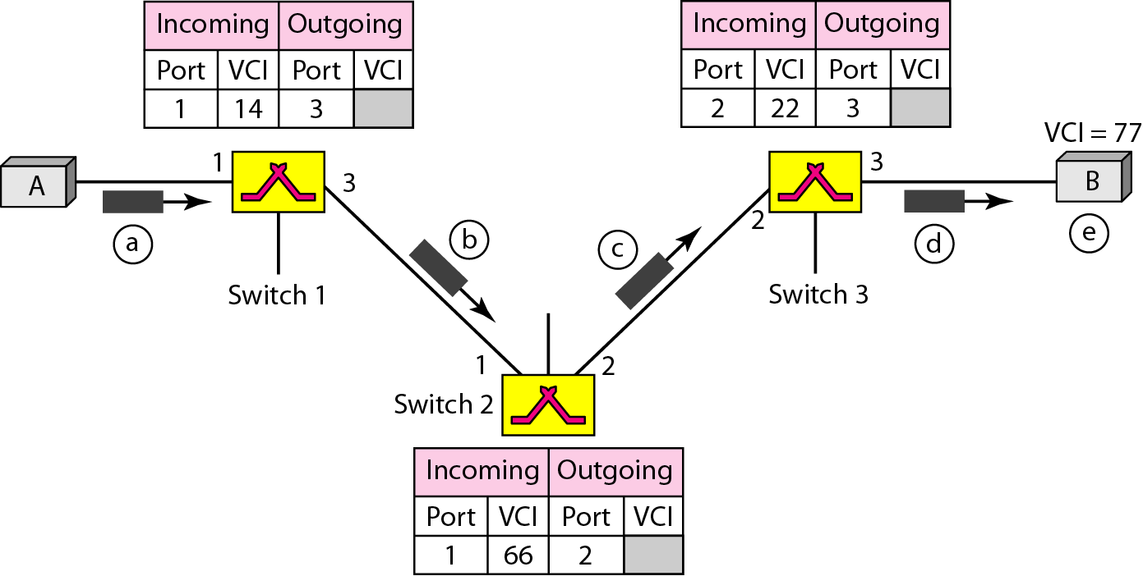
Virtual Circuit Packet Switching: Setup Reqst
Notes:
Let me first give a brief introduction of WOBAN architecture and the motivation of using WOBAN as an access technology. There are two main types of popular access networks. 1. Optical access networks where from CO optical fibers are pulled to ONUs located at every homes, premises or offices, which basically work as gateways for Internet access to the users. The popular access technology of this access networks is PON. The advantage of this access is that it provides high bandwidth and fast Internet service. The limitation is that it needs fiber to penetrate in each and every premises which make this scheme very costly. Also there is a limitation of maximum fiber length.
Another popular access networks is wireless access. Popular technology of this type are WiFi and WiMAX. The advantage of these access technology is that this is flexible and cost effective scheme. But the limitation is that when the hop of hops increase a lot, real time multi-media traffic suffers a lot.
Let me first give a brief introduction of WOBAN architecture and the motivation of using WOBAN as an access technology. There are two main types of popular access networks. First is the optical access such as passive optical networks (PON), which provides fast Internet service because of high bandwidth. But it requires fiber to be penetrated from central office to all residential complex, offices and premises which make the scheme highly costly. Another popular access technology is wireless access, which is flexible and cost-efficient, but does not function well when the number of hops increases.

Slide 24
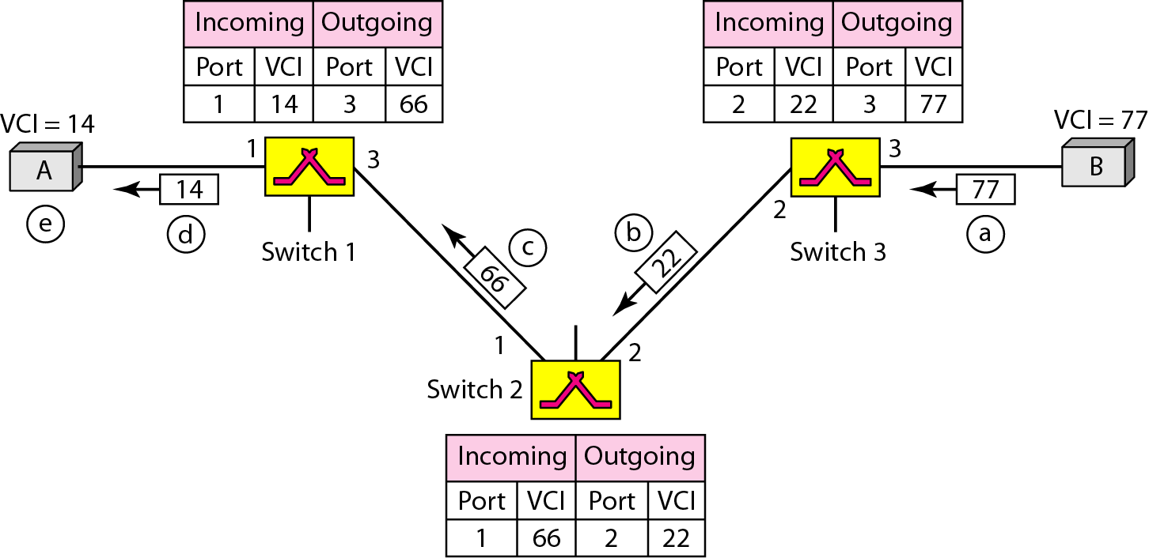
Virtual Circuit Packet Switching: Setup Ack
Notes:
Let me first give a brief introduction of WOBAN architecture and the motivation of using WOBAN as an access technology. There are two main types of popular access networks. 1. Optical access networks where from CO optical fibers are pulled to ONUs located at every homes, premises or offices, which basically work as gateways for Internet access to the users. The popular access technology of this access networks is PON. The advantage of this access is that it provides high bandwidth and fast Internet service. The limitation is that it needs fiber to penetrate in each and every premises which make this scheme very costly. Also there is a limitation of maximum fiber length.
Another popular access networks is wireless access. Popular technology of this type are WiFi and WiMAX. The advantage of these access technology is that this is flexible and cost effective scheme. But the limitation is that when the hop of hops increase a lot, real time multi-media traffic suffers a lot.
Let me first give a brief introduction of WOBAN architecture and the motivation of using WOBAN as an access technology. There are two main types of popular access networks. First is the optical access such as passive optical networks (PON), which provides fast Internet service because of high bandwidth. But it requires fiber to be penetrated from central office to all residential complex, offices and premises which make the scheme highly costly. Another popular access technology is wireless access, which is flexible and cost-efficient, but does not function well when the number of hops increases.

Slide 25
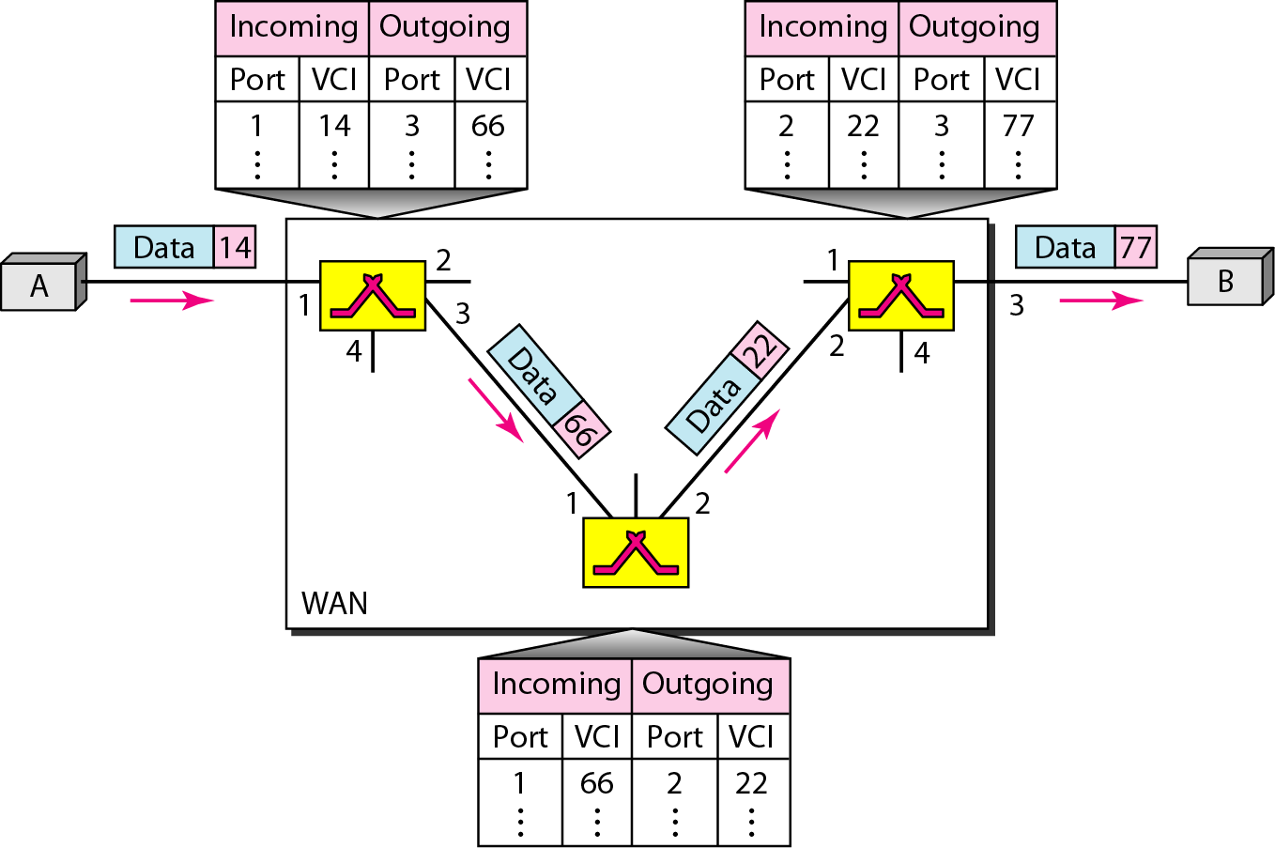
Virtual Circuit Packet Switching: Data Trans
Notes:
Let me first give a brief introduction of WOBAN architecture and the motivation of using WOBAN as an access technology. There are two main types of popular access networks. 1. Optical access networks where from CO optical fibers are pulled to ONUs located at every homes, premises or offices, which basically work as gateways for Internet access to the users. The popular access technology of this access networks is PON. The advantage of this access is that it provides high bandwidth and fast Internet service. The limitation is that it needs fiber to penetrate in each and every premises which make this scheme very costly. Also there is a limitation of maximum fiber length.
Another popular access networks is wireless access. Popular technology of this type are WiFi and WiMAX. The advantage of these access technology is that this is flexible and cost effective scheme. But the limitation is that when the hop of hops increase a lot, real time multi-media traffic suffers a lot.
Let me first give a brief introduction of WOBAN architecture and the motivation of using WOBAN as an access technology. There are two main types of popular access networks. First is the optical access such as passive optical networks (PON), which provides fast Internet service because of high bandwidth. But it requires fiber to be penetrated from central office to all residential complex, offices and premises which make the scheme highly costly. Another popular access technology is wireless access, which is flexible and cost-efficient, but does not function well when the number of hops increases.

Slide 26
Datagram vs Virtual Packet Switching
Virtual circuits
Packets are forwarded more quickly
No routing decisions to make
Less reliable
Loss of a node looses all circuits through that node
Datagram
No call setup phase
Better if few packets
More flexible
Routing can be used to avoid congested nodes/links
Notes:
Let me first give a brief introduction of WOBAN architecture and the motivation of using WOBAN as an access technology. There are two main types of popular access networks. 1. Optical access networks where from CO optical fibers are pulled to ONUs located at every homes, premises or offices, which basically work as gateways for Internet access to the users. The popular access technology of this access networks is PON. The advantage of this access is that it provides high bandwidth and fast Internet service. The limitation is that it needs fiber to penetrate in each and every premises which make this scheme very costly. Also there is a limitation of maximum fiber length.
Another popular access networks is wireless access. Popular technology of this type are WiFi and WiMAX. The advantage of these access technology is that this is flexible and cost effective scheme. But the limitation is that when the hop of hops increase a lot, real time multi-media traffic suffers a lot.
Let me first give a brief introduction of WOBAN architecture and the motivation of using WOBAN as an access technology. There are two main types of popular access networks. First is the optical access such as passive optical networks (PON), which provides fast Internet service because of high bandwidth. But it requires fiber to be penetrated from central office to all residential complex, offices and premises which make the scheme highly costly. Another popular access technology is wireless access, which is flexible and cost-efficient, but does not function well when the number of hops increases.

Slide 27
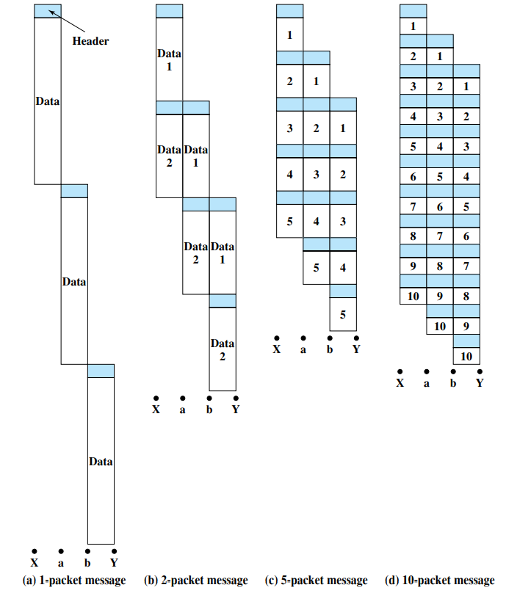
Packet Size
Notes:
Let me first give a brief introduction of WOBAN architecture and the motivation of using WOBAN as an access technology. There are two main types of popular access networks. 1. Optical access networks where from CO optical fibers are pulled to ONUs located at every homes, premises or offices, which basically work as gateways for Internet access to the users. The popular access technology of this access networks is PON. The advantage of this access is that it provides high bandwidth and fast Internet service. The limitation is that it needs fiber to penetrate in each and every premises which make this scheme very costly. Also there is a limitation of maximum fiber length.
Another popular access networks is wireless access. Popular technology of this type are WiFi and WiMAX. The advantage of these access technology is that this is flexible and cost effective scheme. But the limitation is that when the hop of hops increase a lot, real time multi-media traffic suffers a lot.
Let me first give a brief introduction of WOBAN architecture and the motivation of using WOBAN as an access technology. There are two main types of popular access networks. First is the optical access such as passive optical networks (PON), which provides fast Internet service because of high bandwidth. But it requires fiber to be penetrated from central office to all residential complex, offices and premises which make the scheme highly costly. Another popular access technology is wireless access, which is flexible and cost-efficient, but does not function well when the number of hops increases.

Slide 28
Event Timing
Notes:
Let me first give a brief introduction of WOBAN architecture and the motivation of using WOBAN as an access technology. There are two main types of popular access networks. 1. Optical access networks where from CO optical fibers are pulled to ONUs located at every homes, premises or offices, which basically work as gateways for Internet access to the users. The popular access technology of this access networks is PON. The advantage of this access is that it provides high bandwidth and fast Internet service. The limitation is that it needs fiber to penetrate in each and every premises which make this scheme very costly. Also there is a limitation of maximum fiber length.
Another popular access networks is wireless access. Popular technology of this type are WiFi and WiMAX. The advantage of these access technology is that this is flexible and cost effective scheme. But the limitation is that when the hop of hops increase a lot, real time multi-media traffic suffers a lot.
Let me first give a brief introduction of WOBAN architecture and the motivation of using WOBAN as an access technology. There are two main types of popular access networks. First is the optical access such as passive optical networks (PON), which provides fast Internet service because of high bandwidth. But it requires fiber to be penetrated from central office to all residential complex, offices and premises which make the scheme highly costly. Another popular access technology is wireless access, which is flexible and cost-efficient, but does not function well when the number of hops increases.

Slide 29
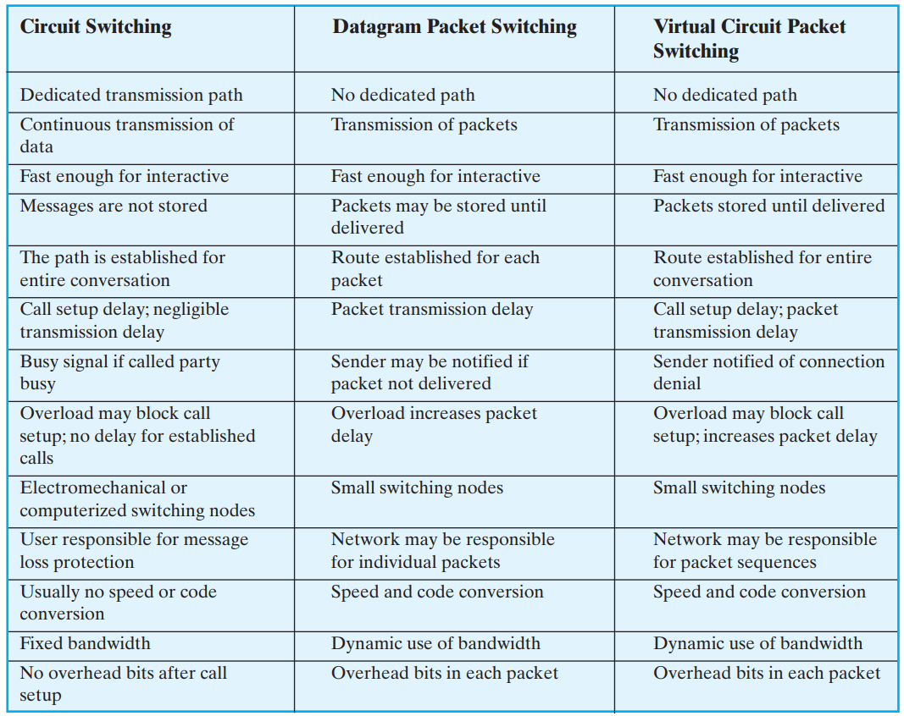
Comparison
Circuit switching vs Packet switching
Notes:
Let me first give a brief introduction of WOBAN architecture and the motivation of using WOBAN as an access technology. There are two main types of popular access networks. 1. Optical access networks where from CO optical fibers are pulled to ONUs located at every homes, premises or offices, which basically work as gateways for Internet access to the users. The popular access technology of this access networks is PON. The advantage of this access is that it provides high bandwidth and fast Internet service. The limitation is that it needs fiber to penetrate in each and every premises which make this scheme very costly. Also there is a limitation of maximum fiber length.
Another popular access networks is wireless access. Popular technology of this type are WiFi and WiMAX. The advantage of these access technology is that this is flexible and cost effective scheme. But the limitation is that when the hop of hops increase a lot, real time multi-media traffic suffers a lot.
Let me first give a brief introduction of WOBAN architecture and the motivation of using WOBAN as an access technology. There are two main types of popular access networks. First is the optical access such as passive optical networks (PON), which provides fast Internet service because of high bandwidth. But it requires fiber to be penetrated from central office to all residential complex, offices and premises which make the scheme highly costly. Another popular access technology is wireless access, which is flexible and cost-efficient, but does not function well when the number of hops increases.

Slide 30
Summary
Circuit switching
Packet switching
Datagram packet switching
Virtual circuit packet switching
Comparison of circuit switching and packet switching

