Slide 1
Computer Networks Network Layer - Introduction
Amitangshu Pal
Computer Science and Engineering
IIT Kanpur

Slide 2








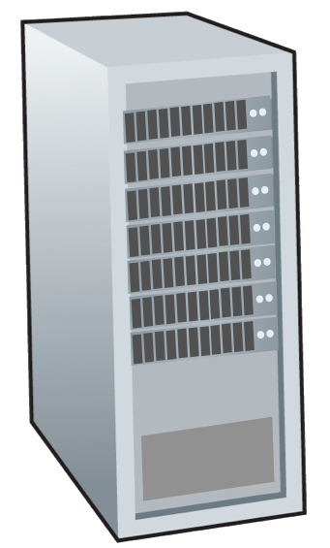







Network-layer services and protocols
Transport segment from sending to receiving host
Sender: encapsulates segments into datagrams, passes to link layer
Receiver: delivers segments to transport layer protocol
Network layer protocols in every Internet device: hosts, routers
Routers:
examines header fields in all IP datagrams passing through it
moves datagrams from input ports to output ports to transfer datagrams along end-end path
mobile network
national or global ISP
application
transport
network
link
physical
network
link
physical
network
link
physical
network
link
physical
network
link
physical
network
link
physical
datacenter
network
application
transport
network
link
physical
enterprise
network

Slide 3
Why do we need Network Layer?
We can build networks with switches, which can exchange messages in between the hosts
Scalability
Routing table size will be huge
Heterogeneity
Should work on Ethernet, 802.11, Token ring
Traffic management
Routing flexibility, bandwidth management etc.

Slide 4
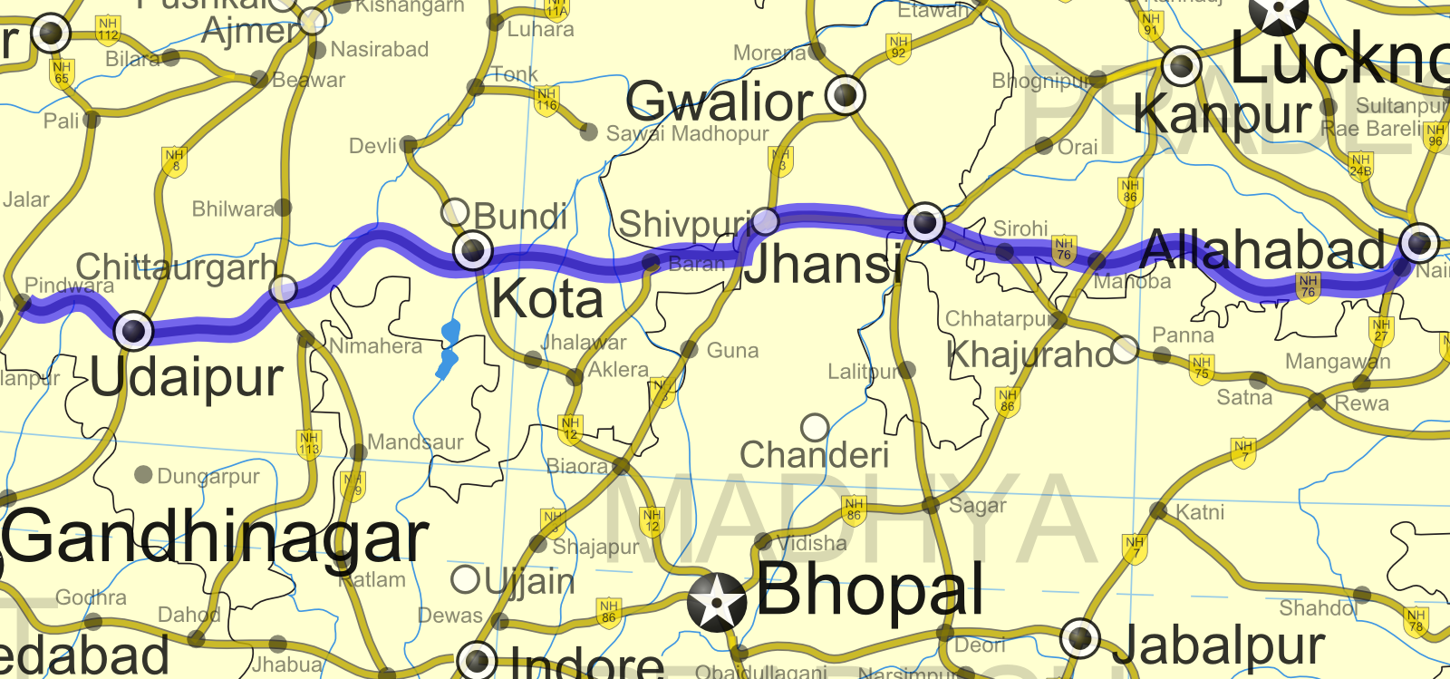
Two key network-layer functions
Network-layer functions:
Forwarding: Move packets from a router’s input link to appropriate router output link
Routing: Determine route taken by packets from source to destination
Src: https://commons.wikimedia.org/wiki/File:National_Highway_76_%28India%29.png

Slide 5
Network Layer: Data plane, Control plane
Data plane:
Local, per-router function
Determines how datagram arriving on router input port is forwarded to router output port
Control plane
Network-wide logic
Determines how datagram is routed among routers along end-end path from source host to destination host
Two control-plane approaches:
Traditional routing algorithms: implemented in routers
Software-defined networking (SDN): implemented in (remote) servers
Values in arriving
packet header
0111
1
3
2

Slide 6

Traditional per-router control plane
Individual routing algorithm components in each and every router interact in the control plane
Routing
Algorithm
control
plane
data
plane
values in arriving
packet header
0111
1
3
2

Slide 7
Software-Defined Networking Control Plane
Remote controller computes, installs forwarding tables in routers
Remote Controller
control
plane
data
plane
CA
values in arriving
packet header
CA
CA
CA
CA
0111
1
3
2

Slide 8
Network services
Store-and-Forward Packet Switching
Connectionless Service – Datagrams
Packets are forwarded using the destination address
Different packets take different paths
Example: Internet protocol (IP)

Slide 9
Network services
Store-and-Forward Packet Switching
Connection-Oriented – Virtual Circuits
Packet is forwarded along a virtual circuit using tag
Virtual circuit is set up ahead of time
Example: ATM, frame relay, MPLS

Slide 10
Comparison of Datagrams and VC
Issue | Datagram network | Virtual-circuit network
Circuit setup | Not needed | Required
Addressing | Each packet contains the full source & destination address | Each packet contains a short VC number
Routing | Each packet is routed independently | Route chosen when VC is set up; all packets follow it
Effect of router failures | Less severe, except for packets lost during the crash | More severe, all VCs that passed through the failed router are terminated
Quality of service | Difficult | Easy if enough resources can be allocated in advance for each VC

Slide 11
Internet Protocol (IP) service model
Network
Architecture
Internet
Protocol (IP)
ATM
ATM
Internet
Internet
Quality of Service (QoS) Guarantees ?
Service
Model
best effort
Constant Bit Rate
Available Bit Rate
Intserv Guaranteed
(RFC 1633)
Diffserv (RFC 2475)
Bandwidth
none
Constant rate
Guaranteed min
yes
possible
Loss
no
yes
no
yes
possibly
Order
no
yes
yes
yes
possibly
Timing
no
yes
no
yes
no
IP “best effort” service model
No guarantees on:
successful datagram delivery to destination
timing or order of delivery
bandwidth available to end-end flow

Slide 12
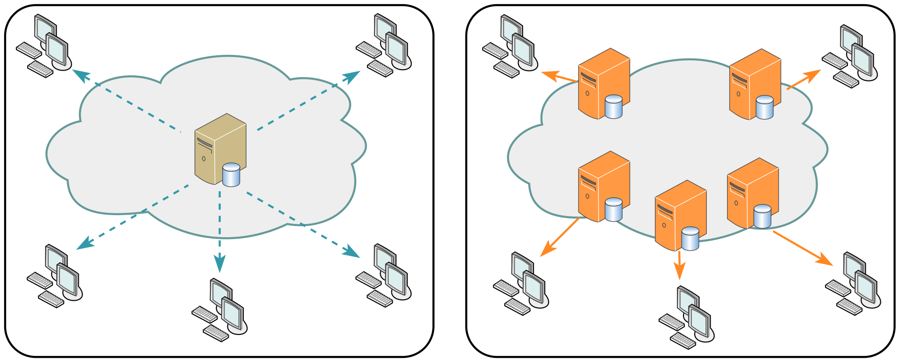
Why best-effort service?
Simplicity of mechanism has allowed Internet to be widely deployed adopted
Sufficient provisioning of bandwidth allows performance of real-time applications (e.g., interactive voice, video) to be “good enough” for “most of the time”
Replicated, application-layer distributed services (datacenters, content distribution networks) connecting close to clients’ networks, allow services to be provided from multiple locations
Reliability and congestion control may be implemented by the upper layers
Src: https://commons.wikimedia.org/wiki/File:NCDN_-_CDN.svg

Slide 13
Summary
Network layer services and functions:
Forwarding vs Routing
Data plane vs Control plane
Network services
Connectionless Service – Datagrams
Connection-Oriented – Virtual Circuits

