Slide 1
Computer Networks Router Architecture and Scheduling
Amitangshu Pal
Computer Science and Engineering
IIT Kanpur

Slide 2
Router Architecture

Slide 3
Router architecture overview
routing, management
control plane (software)
operates in millisecond
time frame
routing
processor
forwarding data plane (hardware) operates in nanosecond timeframe
high-speed
switching
fabric
router input ports
router output ports

Slide 4
Input port functions
routing
processor
lookup,
forwarding
queueing
line
termination
link
layer
protocol
(receive)
switch
fabric
high-speed
switching
fabric
Physical layer:
Bit-level reception
router input ports
router output ports
Link layer:
e.g., Ethernet
Decentralized switching:
Using header field values, lookup output port using forwarding table in input port memory (“match plus action”)
Goal: complete input port processing at ‘line speed’
Input port queuing: if datagrams arrive faster than forwarding rate into switch fabric

Slide 5
Switching fabrics
Transfer packet from input link to appropriate output link
Switching rate: rate at which packets can be transfer from inputs to outputs
Often measured as multiple of input/output line rate
N inputs: switching rate N times line rate desirable
R
(rate: NR, ideally)
R
. . .
. . .
N input ports
high-speed
switching
fabric
N output ports
R
R

Slide 6
Switching fabrics
Transfer packet from input link to appropriate output link
Switching rate: rate at which packets can be transfer from inputs to outputs
Often measured as multiple of input/output line rate
N inputs: switching rate N times line rate desirable
Three major types of switching fabrics:
memory
Memory
Bus
Interconnection
network

Slide 7
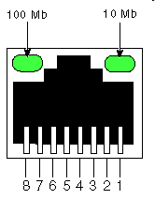
Switching via memory
First generation routers:
Traditional computers with switching under direct control of CPU
Packet copied to system’s memory
Speed limited by memory bandwidth (2 bus crossings per datagram)
input
port
(e.g.,
Ethernet)
output
port
(e.g.,
Ethernet)
memory
system bus

Slide 8
Switching via a bus
Datagram from input port memory to output port memory via a shared bus
Bus contention: switching speed limited by bus bandwidth
32 Gbps bus, Cisco 5600: sufficient speed for access routers

Slide 9
Switching via interconnection network
Crossbar, Clos networks, other interconnection nets initially developed to connect processors in multiprocessor computer architecture
Multistage switch: nxn switch from multiple stages of smaller switches
3x3 crossbar
3x3 crossbar
Exploiting parallelism:
Fragment datagram into fixed length cells on entry
Switch cells through the fabric, reassemble datagram at exit
8x8 multistage switch
built from smaller-sized switches

Slide 10
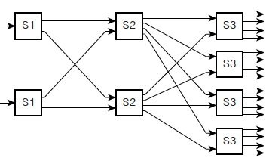
Switching via interconnection network
Scaling, using multiple switching “planes” in parallel:
Speedup, scaleup via parallelism
Cisco CRS router:
Basic unit: 8 switching planes
Each plane: 3-stage interconnection network
up to 100’s Tbps switching capacity
fabric plane 0
fabric plane 1
fabric plane 2
. . .
. . .
fabric plane 3
. . .
. . .
fabric plane 4
. . .
. . .
fabric plane 5
. . .
. . .
fabric plane 6
. . .
. . .
fabric plane 7
. . .
. . .
. . .
. . .
. . .
. . .
Cisco CRS router: https://nexstor.com/wp-content/uploads/2018/05/cisco-crs-1-multishelf-system-datasheet.pdf

Slide 11
Output port functions
routing
processor
high-speed
switching
fabric
datagram
buffer
queueing
switch
fabric
(rate: NR)
link
layer
protocol
(send)
line
termination
R
router input ports
router output ports

Slide 12
Queuing, Buffer management and Scheduling

Slide 13
Input port queuing
If switch fabric slower than input ports combined → queueing may occur at input queues
Queueing delay and loss due to input buffer overflow!
Head-of-the-Line (HOL) blocking: Queued datagram at front of queue prevents others in queue from moving forward
switch
fabric
switch
fabric
Output port contention: only one red datagram can be transferred. lower red packet is blocked
One packet time later: green packet experiences HOL blocking

Slide 14
Output port queuing
datagram
buffer
queueing
switch
fabric
(rate: NR)
link
layer
protocol
(send)
line
termination
R
Buffering required when datagrams arrive from fabric faster than link transmission rate
Drop policy: which datagrams to drop if no free buffers?
Datagrams can be lost due to congestion, lack of buffers
Priority scheduling – who gets best performance
Scheduling discipline chooses among queued datagrams for transmission

Slide 15
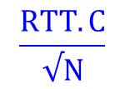
How much buffering?
Too much buffering will reduce packet loss, but can increase delays
Long RTTs: poor performance for real-time apps, sluggish TCP response
RFC 3439 rule of thumb: average buffering equal to “typical” RTT times link capacity C
e.g., RTT = 250 msec, C = 10 Gbps link → 2.5 Gbit buffer
Delay-bandwidth product
More recent recommendation: with N flows, buffering equal to
$$\frac{RTT.C}{√N}$$
Notes:
You might think that more buffering is a good thing. Buffering is a bit like salt—just the right amount of salt makes food better, but too much makes it inedible!

Slide 16
Buffer Management
Buffer management:
Drop: which packet to add, drop when buffers are full
Tail drop: drop arriving packet
Priority: drop/remove on priority basis
switch
fabric
datagram
buffer
queueing
scheduling
link
layer
protocol
(send)
line
termination
R
Abstraction: queue
Marking: which packets to mark to signal congestion (i.e. ECN)
R
packet
departures
packet
arrivals
queue
(waiting area)
link
(server)

Slide 17
Packet Scheduling: FCFS
Packet scheduling: deciding which packet to send next on link
First come, first served
Priority based
Round robin
Weighted fair queueing
FCFS: packets transmitted in order of arrival to output port
also known as: First-in-first-out (FIFO)
Abstraction: queue
R
packet
departures
packet
arrivals
queue
(waiting area)
link
(server)

Slide 18
Scheduling policies: Priority Based
Priority based scheduling:
Arriving traffic classified, queued by class
Any header fields can be used for classification
high priority queue
arrivals
classify
link
departures
low priority queue
2
1
3
4
5
Send packet from highest priority queue that has buffered packets
FCFS within priority class
arrivals
packet in service
1
3
2
4
5
departures
1
3
2
4
5

Slide 19
Scheduling policies: round robin
Round Robin (RR) scheduling:
Arriving traffic classified, queued by class
Any header fields can be used for classification
Server cyclically, repeatedly scans class queues, sending one complete packet from each class (if available) in turn
R
classify
arrivals
link
departures

Slide 20
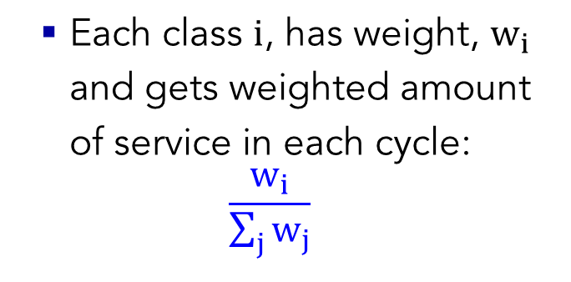
Scheduling policies: Weighted Fair Queueing
Weighted Fair Queuing (WFQ):
Generalized Round Robin
Each class $i$, has weight, $w_{i}$ and gets weighted amount of service in each cycle:
$$\frac{w_{i}}{\sum_{j}{w_{j}}}$$
w₁
w₂
R
classify
arrivals
link
departures
w₃
Minimum bandwidth guarantee (per-traffic-class)

Slide 21
Summary
Router architecture, queuing and packet scheduling:
Router architecture
Input ports
High speed fabric
Out ports
Packet scheduling
FCFS
Priority based
Round robin
Weighted fair queuing

