Slide 1
Computer Networks II IP Forwarding and Address Allocation
Amitangshu Pal
Computer Science and Engineering
IIT Kanpur

Slide 2
IP forwarding

Slide 3

Package Forwarding in a Postal System
Postal analogy:
6 packages need to be sent in these addresses
UP, Prayagraj, Barrister Mullah Colony, Swati
UP, Kanpur, Kalyanpur, Amit
West Bengal, Kharagpur, Inda, Manoj
West Bengal, Durgapur, Mahatma Gandhi Rd, Prakash
Maharashtra, Pune, Shivaji Nagar, Vivek
Maharashtra, Nasik, Old Agra Road, Anand
Src: https://pxhere.com/en/photo/1625663
Destination prefix | Next hop
UP | Lucknow flight
West Bengal | Kolkata flight
Maharashtra | Mumbai flight

Slide 4

IP Forwarding
IP addresses on a network belongs to the same prefix
Nodes use a forwarding table that lists the prefixes and the corresponding next hop/link interface
Improves scalability → reduces the forwarding table size
subnet 223.1.1.0/24
223.1.1.1
subnet 223.1.2.0/24
223.1.2.1
223.1.1.2
223.1.1.4
223.1.2.9
223.1.1.3
223.1.3.27
223.1.2.2
Prefix | Next hop/interface
223.1.1.0/24 | 223.1.1.4
223.1.2.0/24 | 223.1.2.9
223.1.3.0/24 | 223.1.3.27
subnet
223.1.3.0/24
223.1.3.1
223.1.3.2

Slide 5
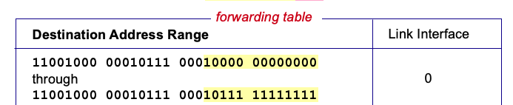

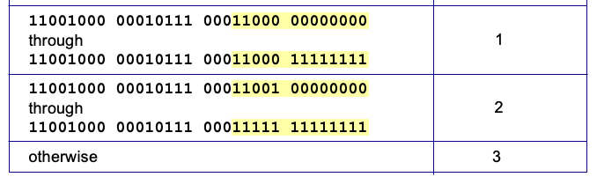
IP Forwarding
3
But what happens if ranges don’t divide up so nicely?
Notes:
Text for this animation:
This all works out pretty nice and looks pretty simple!
But of course the devil is in the details, as the saying goes.
What happens, for example, when a subset of addresses say in this first range should go to say interface 3, rather than interface 0. Well, of course we could split the first address range into multiple pieces, and add in this new subrange with its new destination output port. But it turns out there’s a much simpler and elegant way to do this. Known as longest prefix matching.

Slide 6
Longest Prefix Matching
Prefixes in a forwarding table might overlap
200.23.31.255
Longest prefix match
When looking for forwarding table entry for given destination address, use longest address prefix (most specific entry) that matches destination address
200.23.24.255
Destination Address Range
11001000 00010111 00010
11001000 00010111 00011000
11001000 00010111 00011
otherwise
Link interface
0
1
2
3
200.23.24.0
***
********
********
200.23.23.255
***
********
Examples:
11001000 00010111 00010110 10100001
which interface?
200.23.16.0
11001000 00010111 00011000 10101010
which interface?

Slide 7
Longest Prefix Matching
Prefixes in a forwarding table might overlap
200.23.31.255
Longest prefix match
When looking for forwarding table entry for given destination address, use longest address prefix (most specific entry) that matches destination address
200.23.24.255
Destination Address Range
11001000 00010111 00010
11001000 00010111 00011000
11001000 00010111 00011
otherwise
Link interface
0
1
2
3
200.23.24.0
***
********
********
match!
200.23.23.255
***
********
Examples:
11001000 00010111 00010110 10100001
which interface?
200.23.16.0
11001000 00010111 00011000 10101010
which interface?

Slide 8
Longest Prefix Matching
Prefixes in a forwarding table might overlap
200.23.31.255
Longest prefix match
When looking for forwarding table entry for given destination address, use longest address prefix (most specific entry) that matches destination address
200.23.24.255
Destination Address Range
11001000 00010111 00010
11001000 00010111 00011000
11001000 00010111 00011
otherwise
Link interface
0
1
2
3
200.23.24.0
***
********
********
200.23.23.255
***
********
match!
Examples:
11001000 00010111 00010110 10100001
which interface?
200.23.16.0
11001000 00010111 00011000 10101010
which interface?

Slide 9
Longest Prefix Matching
Prefixes in a forwarding table might overlap
200.23.31.255
Longest prefix match
When looking for forwarding table entry for given destination address, use longest address prefix (most specific entry) that matches destination address
200.23.24.255
Destination Address Range
11001000 00010111 00010
11001000 00010111 00011000
11001000 00010111 00011
otherwise
Link interface
0
1
2
3
200.23.24.0
***
********
********
200.23.23.255
***
********
match!
Examples:
11001000 00010111 00010110 10100001
which interface?
200.23.16.0
11001000 00010111 00011000 10101010
which interface?

Slide 10
Package Forwarding in a Postal System
Postal analogy:
6 packages need to be sent in these addresses
UP, Prayagraj, Barrister Mullah Colony, Swati
UP, Kanpur, Kalyanpur, Amit
West Bengal, Kharagpur, Inda, Manoj
West Bengal, Durgapur, Mahatma Gandhi Rd, Prakash
Maharashtra, Pune, Shivaji Nagar, Vivek
Maharashtra, Nasik, Old Agra Road, Anand
Src: https://pxhere.com/en/photo/1625663
Destination prefix | Next hop
UP | Lucknow flight
UP, Prayagraj | Prayagraj flight
West Bengal | Kolkata flight
Maharashtra | Mumbai flight

Slide 11
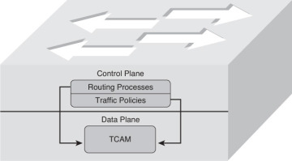
Longest Prefix Matching
Longest prefix matching: Often performed using ternary content addressable memories (TCAMs)
Content addressable: Present address to TCAM → retrieve address in one clock cycle, regardless of table size
Cisco Catalyst: ~1M routing table entries in TCAM
Src: https://www.ciscopress.com/articles/article.asp?p=2264831&seqNum=2

Slide 12
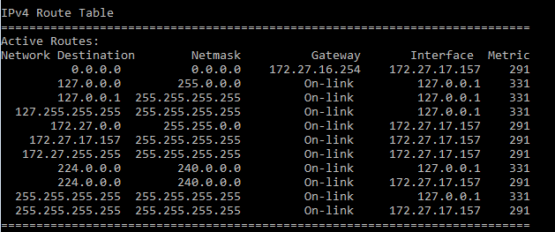
Host Forwarding
Hosts send the remote traffic to its nearest router
0.0.0.0/0 includes all IP addresses
Prefix | Next hop
My network prefix | Send directly to that destination
0.0.0.0/0 | Send to the router

Slide 13
How To Obtain IP Address?

Slide 14
IP Addresses: How to Get One?
That’s actually two questions:
How does a host get IP address within its network (host part of address)?
How does a network get IP address for itself (network part of address)
How does host get IP address?
Hard-coded by sysadmin in config file (e.g., /etc/rc.config in UNIX)
DHCP: Dynamic Host Configuration Protocol: dynamically get address from as server
“Plug-and-play”

Slide 15




DHCP Client-Server Scenario
Typically, DHCP server will be co-located in router, serving all subnets to which router is attached
DHCP server
223.1.1.1
223.1.2.1
223.1.1.2
223.1.2.5
223.1.1.4
223.1.2.9
223.1.1.3
223.1.3.27
arriving DHCP client needs
address in this network
223.1.2.2
223.1.3.1
223.1.3.2

Slide 16


DHCP Client-Server Scenario
DHCP server: 223.1.2.5
DHCP discover
Arriving client
src : 0.0.0.0, 68
dest.: 255.255.255.255,67
yiaddr: 0.0.0.0
transaction ID: 654
Broadcast: is there a DHCP server out there?
DHCP offer
src: 223.1.2.5, 67
dest: 255.255.255.255, 68
yiaddrr: 223.1.2.4
transaction ID: 654
lifetime: 3600 secs
Broadcast: I’m a DHCP server! Here’s an IP address you can use
The first two steps can be skipped “if a client remembers and wishes to reuse a previously allocated network address” [RFC 2131]
DHCP request
src: 0.0.0.0, 68
dest:: 255.255.255.255, 67
yiaddrr: 223.1.2.4
transaction ID: 655
lifetime: 3600 secs
Broadcast: OK. I would like to use this IP address!
DHCP ACK
src: 223.1.2.5, 67
dest: 255.255.255.255, 68
yiaddrr: 223.1.2.4
transaction ID: 655
lifetime: 3600 secs
Broadcast: OK. You’ve got that IP address!

Slide 17
DHCP: Dynamic Host Configuration Protocol
DHCP overview:
Host broadcasts DHCP discover msg [optional]
DHCP server responds with DHCP offer msg [optional]
Host requests IP address: DHCP request msg
DHCP server sends address: DHCP ack msg

Slide 18
DHCP: More Than IP Addresses
DHCP can return more than just allocated IP address on subnet:
Address of first-hop router for client
Name and IP address of DNS sever
Network mask (indicating network versus host portion of address)

Slide 19


DHCP Example
Connecting laptop will use DHCP to get IP address, address of first-hop router, address of DNS server
DHCP
DHCP
UDP
IP
Eth
Phy
DHCP
DHCP
DHCP
DHCP REQUEST message encapsulated in UDP, encapsulated in IP, encapsulated in Ethernet
DHCP
DHCP
DHCP
UDP
IP
Eth
Phy
168.1.1.1
Ethernet frame broadcast (dest: FFFFFFFFFFFF) on LAN, received at router running DHCP server
DHCP
DHCP
DHCP
DHCP
router with DHCP
server built into
router
Ethernet demux’ed to IP demux’ed, UDP demux’ed to DHCP

Slide 20
DHCP Example
DHCP
UDP
IP
Eth
Phy
DCP server formulates DHCP ACK containing client’s IP address, IP address of first-hop router for client, name & IP address of DNS server
DHCP
DHCP
DHCP
DHCP
Encapsulated DHCP server reply forwarded to client, demuxing up to DHCP at client
DHCP
DHCP
UDP
IP
Eth
Phy
DHCP
DHCP
Client now knows its IP address, name and IP address of DNS server, IP address of its first-hop router
DHCP
Router with DHCP
server built into
router
DHCP

Slide 21
How Does Networks Get IP addresses?
Q: How does network get subnet part of IP address?
A: Gets allocated portion of its provider ISP’s address space
ISP's block 11001000 00010111 00010000 00000000 200.23.16.0/20
ISP can then allocate out its address space in 8 blocks:
Organization 0 11001000 00010111 00010000 00000000 200.23.16.0/23
Organization 1 11001000 00010111 00010010 00000000 200.23.18.0/23
Organization 2 11001000 00010111 00010100 00000000 200.23.20.0/23
... ….. …. ….
Organization 7 11001000 00010111 00011110 00000000 200.23.30.0/23

Slide 22
Hierarchical Addressing: Route Aggregation
Hierarchical addressing allows efficient advertisement of routing information:
Organization 0
200.23.16.0/23
Organization 1
“Send me anything
with addresses
beginning
200.23.16.0/20”
200.23.18.0/23
Organization 2
.
200.23.20.0/23
.
ISP-A
.
.
Internet
.
Organization 7
.
200.23.30.0/23
ISP-B
“Send me anything
with addresses
beginning
199.31.0.0/16”

Slide 23
Hierarchical Addressing: More Specific Routes
Organization 1 moves from ISP-A to ISP-B
ISP-B now advertises a more specific route to Organization 1
200.23.31.255
Organization 0
200.23.19.255
200.23.16.0/23
Organization 1
“Send me anything
with addresses
beginning
200.23.16.0/20”
200.23.18.0/23
Organization 2
.
200.23.20.0/23
.
ISP-A
200.23.18.0
.
.
Internet
.
Organization 7
.
200.23.30.0/23
200.23.16.0
ISP-B
“Send me anything
with addresses
beginning
199.31.0.0/16”
Organization 1
200.23.18.0/23
“or 200.23.18.0/23”

Slide 24
Hierarchical Addressing: More Specific Routes
Organization 1 moves from ISP-A to ISP-B
ISP-B now advertises a more specific route to Organization 1
200.23.31.255
Organization 0
200.23.19.255
200.23.16.0/23
“Send me anything
with addresses
beginning
200.23.16.0/20”
Organization 2
.
200.23.20.0/23
.
ISP-A
200.23.18.0
.
.
Internet
.
Organization 7
.
200.23.30.0/23
“Send me anything
with addresses
beginning
199.31.0.0/16”
200.23.16.0
ISP-B
Organization 1
200.23.18.0/23
“or 200.23.18.0/23”

Slide 25
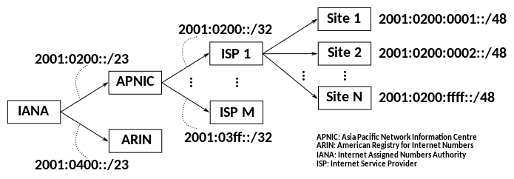
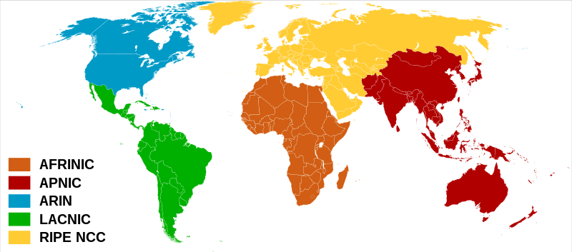
How ISPs Get IP Addresses?
ICANN: Internet Corporation for Assigned Names and Numbers http://www.icann.org/
Allocates IP addresses, through 5 regional registries (RRs) (who may then allocate to local registries)
Manages DNS root zone, including delegation of individual TLD (.com, .edu , …) management
Src: https://commons.wikimedia.org/wiki/File:IPv6_Prefix_Assignment_Example-en.svg
Src: https://commons.wikimedia.org/wiki/File:Regional_Internet_Registries_world_map.svg

Slide 26
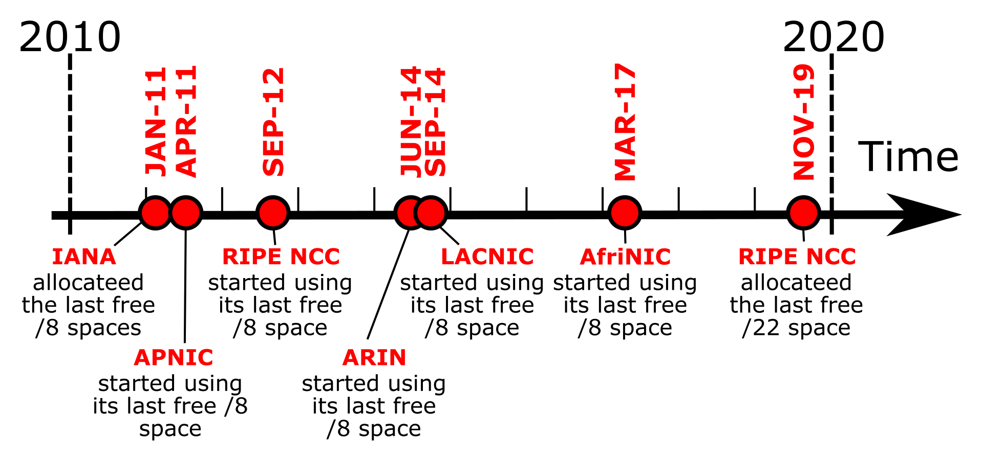
IPv4 Addressing: Concluding Remarks
Are there enough 32-bit IP addresses?
ICANN allocated last chunk of IPv4 addresses to RRs in 2011
NAT helps IPv4 address space exhaustion
IPv6 has 128-bit address space
Src: https://commons.wikimedia.org/wiki/File:IPv4_IANA_and_RIR_exhaustion_time_line-en.svg

