Slide 1
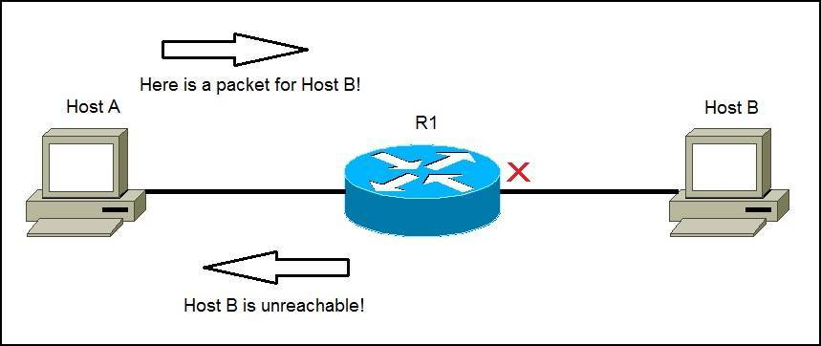
Computer Networks II Internet Control Message Protocol (ICMP)
Amitangshu Pal
Computer Science and Engineering
IIT Kanpur

Slide 2
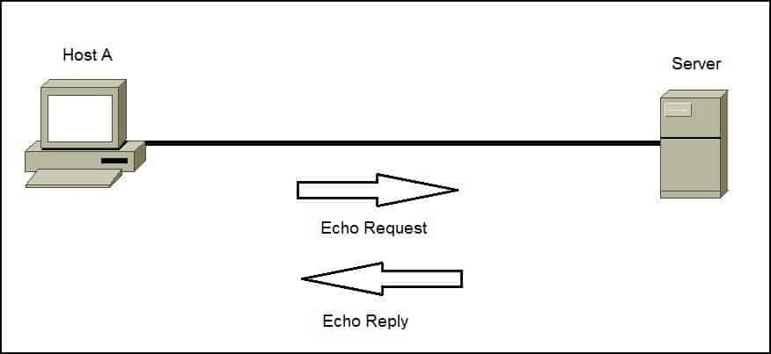
ICMP: Internet Control Message Protocol
Used by hosts and routers to communicate network-level information
Error reporting: unreachable host, network, port, protocol
Diagnostic purposes: echo request/reply (used by ping)
Src: https://study-ccna.com/icmp-internet-control-message-protocol/

Slide 3

ICMP: Internet Control Message Protocol
ICMP message: Type, code, checksum
In case of error message it also contains the IP header + first 8 bytes of IP datagram causing error
Sender of the IP datagram can infer the problem
Type Code Description
0 0 echo reply (ping)
3 0 dest. network unreachable
3 1 dest host unreachable
3 2 dest protocol unreachable
3 dest port unreachable
3 4 fragmentation required, DF set
3 6 dest network unknown
3 7 dest host unknown
4 0 source quench (congestion
control - not used)
8 0 echo request (ping)
9 0 route advertisement
10 0 router discovery
11 0 TTL expired
12 0 bad IP header
Src: https://commons.wikimedia.org/wiki/File:ICMP_header_-_General-en.svg

Slide 4
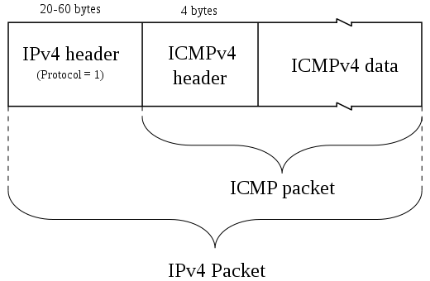
ICMP: Internet Control Message Protocol
ICMP messages carried in IP datagrams
Protocol number = 1
Src: https://commons.wikimedia.org/wiki/File:ICMP_header_-_General-en.svg
Src: https://commons.wikimedia.org/wiki/File:ICMPv4_encapsulation-en.svg

Slide 5
IP Datagram Format
32 bits
IP protocol version number
head.
len
type of
service
total datagram
length (bytes)
header length(bytes)
ver
length
“type” of service:
diffserv (0:5)
ECN (6:7)
16-bit identifier
flgs
fragment
offset
fragmentation/
reassembly
time to
live
upper
layer
header
checksum
header checksum
TTL: remaining max hops
(decremented at each router)
source IP address
32-bit source IP address
destination IP address
Maximum length: 64K bytes
Typically: 1500 bytes or less
upper layer protocol (e.g., TCP or UDP)
32-bit destination IP address
options (if any)
e.g., timestamp, record route taken
payload data
(variable length,
typically a TCP
or UDP segment)

Slide 6
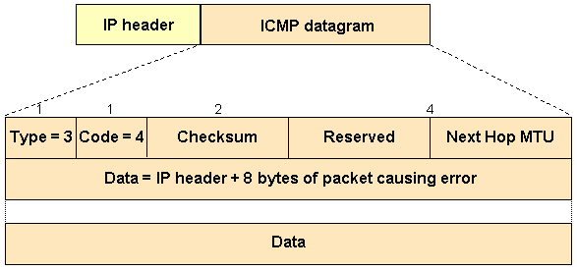
MTU Discovery and ICMP
Fragmentation is often undesirable
More overhead for the routers
Solution: discover the MTU that will fit for all the links
Implemented using ICMP (type 3, code 4) → DF bit is set to 1
Src: https://www.cisco.com/c/en/us/support/docs/ip/generic-routing-encapsulation-gre/25885-pmtud-ipfrag.html

Slide 7

Traceroute and ICMP
3 probes
3 probes
3 probes
Source sends sets of UDP segments to destination
1st set has TTL =1, 2nd set has TTL=2, etc.
Destination port is set to an unlikely number
Datagram in n-th set arrives to n-th router:
Router discards datagram and sends source ICMP message (type 11, code 0)
ICMP message possibly includes name of router & IP address
Stopping criteria:
UDP segment eventually arrives at destination host
Destination returns ICMP “port unreachable” message (type 3, code 3)
Source stops
When ICMP message arrives at source: record RTTs

Slide 8
Summary
Internet Control Message Protocol:
ICMP message format
MTU discovery and ICMP
Traceroute and ICMP

