Slide 1
Computer Networks Inter-AS Routing Border Gateway Protocol (BGP)
Amitangshu Pal
Computer Science and Engineering
IIT Kanpur

Slide 2
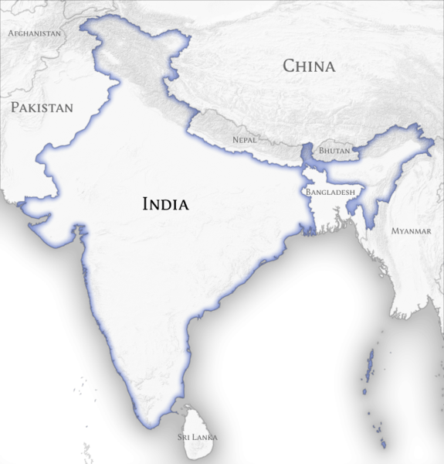
Inter-AS and Intra-AS Routing
AS: controlled by a single administrative entity, i.e. an ISP
Tier3
ISP
Tier3
ISP
Tier3
ISP
Tier3
ISP
Tier3
ISP
Tier3
ISP
Tier1 ISP
Tier3
ISP
…
Tier2 ISP
…
Tier3
ISP
Tier1 ISP
Tier3
ISP
Tier1 ISP
Tier3
ISP
Tier3
ISP
Tier3
ISP
Tier2 ISP
…
Tier3
ISP
Tier3
ISP
Tier3
ISP
Tier3
ISP
…
Src:https://commons.wikimedia.org/wiki/File:India_and_Neighbouring_Countries_Map_(official_borders).png

Slide 3
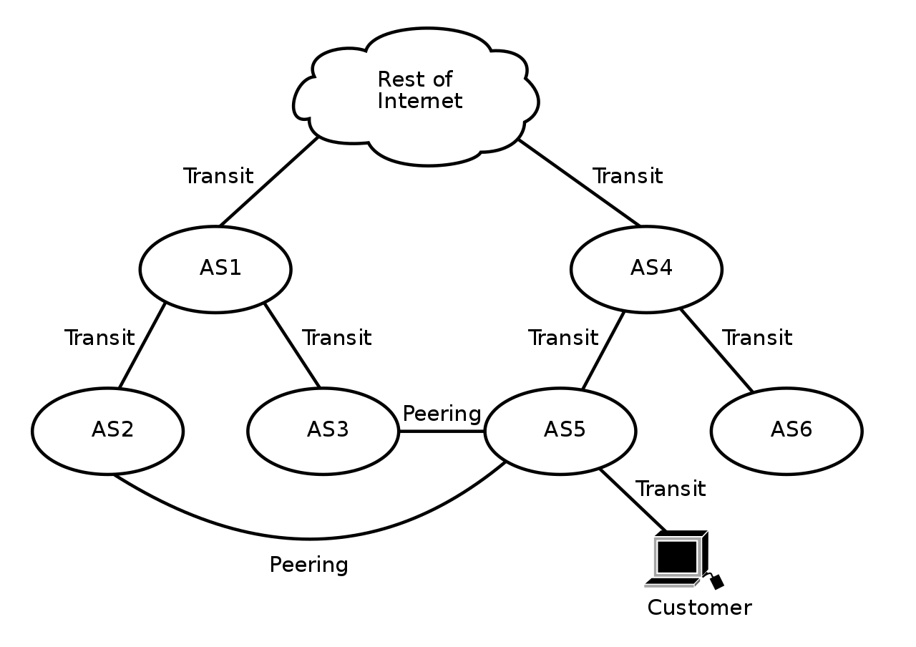
Inter-AS Routing: BGP
BGP (Border Gateway Protocol): the de facto inter-domain routing protocol
“Glue that holds the Internet together”
Allows subnet to advertise its existence, and the destinations it can reach, to rest of Internet
Relations among the ASes depend on multiple factors → competitions, politics, economy etc.
Transmit: One AS pays another one for access to the Internet
Peer: Two ASes exchange traffic between their users freely, and for mutual benefit
Src: https://fr.wikipedia.org/wiki/Peering#/media/Fichier:AS-interconnection.svg

Slide 4
Inter-AS Routing: BGP
BGP provides each AS a means to:
eBGP: obtain subnet reachability information from neighboring ASes
iBGP: propagate reachability information to all AS-internal routers.
Determine “good” routes to other networks based on reachability information and policy
2b
2a
∂
1b
2c
3b
2d
∂
1a
1c
3a
3c
AS 2
1d
3d
AS 1
eBGP connectivity
AS 3
Logical iBGP connectivity
1c
Gateway routers run both eBGP and iBGP protocols

Slide 5
BGP and Policy Based Path Advertisement

Slide 6
BGP Path Advertisement
BGP session: two BGP routers (“peers”) exchange BGP messages over semi-permanent TCP connection (port 179):
Advertising paths to different destination network prefixes (BGP is a “path vector” protocol)
BGP sessions do not correspond to physical links
When AS3 gateway 3a advertises path AS3,X to AS2 gateway 2c:
AS3 promises to AS2 it will forward datagrams towards X
AS 3
3b
AS 1
1b
3a
3c
1a
1c
AS 2
2b
3d
1d
2a
2c
BGP advertisement:
AS3, X
X
2d

Slide 7
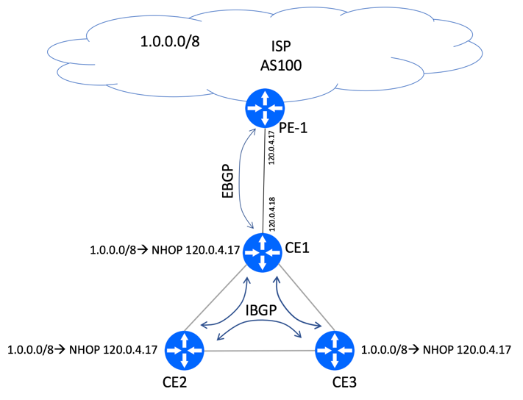
BGP Path Advertisement
Route advertisement contain an IP prefix + attributes
Prefix: destination being advertised
Two important attributes:
AS-PATH: list of ASes through which prefix advertisement has passed (AS50, AS76)
NEXT-HOP: indicates the router interface that begins the AS-PATH
The intra-AS routing protocol will determine the least-cost paths to all subnets attached to the routers in the AS, including the subnet for the link between CE1 and PE-1
Src: http://bgphelp.com/2017/03/05/bgp-next-hop-self-explained/

Slide 8
BGP Path Advertisement
Policy-based advertisement:
Import policy: Gateway receiving route advertisement uses import policy to accept/decline path (e.g., never route through AS Y).
Export policy: AS policy also determines whether to advertise path to other other neighboring ASes
AS 3
3b
AS 1
1b
3a
3c
1a
1c
AS 2
2b
3d
1d
2a
2c
BGP advertisement:
AS3, X
2d

Slide 9
BGP Path Advertisement
AS 3
3b
AS 1
1b
3a
3c
1a
1c
AS 2
2b
3d
X
1d
2a
2c
AS3, X
AS2,AS3,X
2d
AS2 router 2c receives path advertisement AS3,X (via eBGP) from AS3 router 3a
Based on AS2 policy, AS2 router 2c accepts path AS3,X, propagates (via iBGP) to all AS2 routers → import policy
Based on AS2 policy, AS2 router 2a advertises (via eBGP) path AS2, AS3, X to AS1 router 1c → export policy

Slide 10
BGP: Achieving Policy via Advertisements
A,B,C are provider networks
x,w,y are customer (of provider networks)
x is dual-homed: attached to two networks
A,w
B
x
Provider
w
A
network
Legend:
C
y
Customer
A,w
network:
ISP only wants to route traffic to/from its customer networks (does not want to carry transit traffic between other ISPs – a typical “real world” policy)
A advertises path Aw to B and to C
B chooses not to advertise BAw to C
B gets no “revenue” for routing CBAw, since none of C, A, w are B’s customers
C does not learn about CBAw path
C will route CAw (not using B) to get to w

Slide 11
BGP: Achieving Policy via Advertisements
A,B,C are provider networks
x,w,y are customer (of provider networks)
x is dual-homed: attached to two networks
B
x
Provider
w
A
network
Legend:
C
y
Customer
network:
ISP only wants to route traffic to/from its customer networks (does not want to carry transit traffic between other ISPs – a typical “real world” policy)
Policy to enforce: x does not want to route from B to C via x
So x will not advertise to B a route to C

Slide 12
BGP and Policy Based Routing

Slide 13
BGP Route Selection
Router may learn about more than one route to destination AS, selects route based on:
Local preference value attribute: policy decision
Set by the import policy
Shortest AS-PATH
Included in the route advertisement
Closest NEXT-HOP router: Hot potato routing
Based on intra-domain routing protocol (i.e. OSPF)
Additional criteria (like smallest NEXT-HOP router id etc.)
AS 2
2b
112
AS1,AS3,X
2a
2c
AS4,AS5,X
201
263
2d
OSPF link weights

Slide 14
BGP Route Selection
AS 3
3b
AS 1
1b
AS3,X
3a
3c
AS3,X
1a
AS3,X
1c
AS 2
2b
3d
X
AS3,X
1d
2a
2c
AS3, X
AS2,AS3,X
2d
Gateway router may learn about multiple paths to destination:
AS1 gateway router 1c learns path AS2,AS3,X from 2a
AS1 gateway router 1c learns path AS3,X from 3a
Based on policy, AS1 gateway router 1c chooses path AS3,X and advertises path within AS1 via iBGP

Slide 15
BGP Route Selection
AS 3
3b
AS 1
1b
AS3,X
3a
3c
1
AS3,X
1a
AS3,X
1c
AS 2
3d
X
2
AS3,X
2b
2
1d
1
AS3, X
AS2,AS3,X
2a
2c
2d
Dest
Interface
1a, 1b, 1d learn via iBGP from 1c: “path to X goes through 1c”
…
…
At 1d: OSPF intra-domain routing: to get to 1c, use interface 1
1c
1
X
1
At 1d: to get to X, use interface 1
…
…

Slide 16
BGP Route Selection
AS 3
3b
AS 1
1b
3a
3c
1
1a
1c
AS 2
2b
3d
X
2
1d
2a
2c
2d
Dest
Interface
…
…
1a, 1b, 1d learn via iBGP from 1c: “path to X goes through 1c”
1c
2
At 1d: OSPF intra-domain routing: to get to 1c, use interface 1
X
2
…
…
At 1d: to get to X, use interface 1
At 1a: OSPF intra-domain routing: to get to 1c, use interface 2
At 1a: to get to X, use interface 2

Slide 17
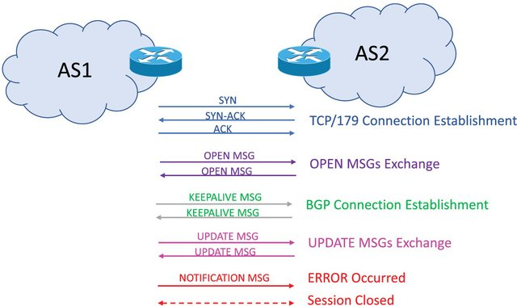
BGP Messages
BGP messages exchanged between peers over TCP connection
BGP messages:
OPEN: opens TCP connection to remote BGP peer and authenticates sending BGP peer
UPDATE: advertises new path (or withdraws old)
KEEPALIVE: keeps connection alive in absence of UPDATES; also ACKs OPEN request
NOTIFICATION: reports errors in previous msg; also used to close connection
Src: https://onlinelibrary.wiley.com/doi/10.1002/dac.5266?af=R

Slide 18
Inter-AS vs Intra-AS Routing
Inter-AS: admin wants control over how its traffic routed, who routes through its network
Policy dominates over performance
Intra-AS: single admin, so policy less of an issue → can focus on performance

