Slide 1
Computer Networks Transport Layer - Introduction
Application
Transport
Network
Link
Physical
Amitangshu Pal
Computer Science and Engineering
IIT Kanpur

Slide 2








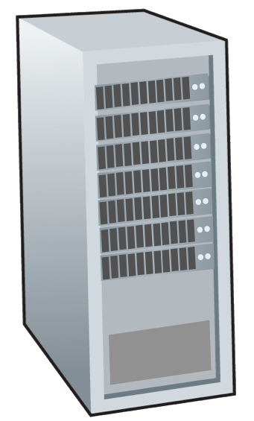







Transport Layer Services and Protocols
Provide logical communication between application processes running on different hosts
application
transport
network
data link
physical
mobile network
national or global ISP
Transport protocols actions in end systems:
Sender: breaks application messages into segments, passes to network layer
Receiver: reassembles segments into messages, passes to application layer
logical end-end transport
local or regional ISP
home network
content
provider
network
application
transport
network
data link
physical
datacenter
network
Two transport protocols available to Internet applications
TCP, UDP
enterprise
network
Notes:
By logical communication , we
mean that from an application’s perspective, it is as if the hosts running the processes
were directly connected; in reality, the hosts may be on opposite sides of the
planet, connected via numerous routers and a wide range of link types. Application
processes use the logical communication provided by the transport layer to send
messages to each other, free from the worry of the details of the physical infrastructure
used to carry these messages.
Let’s look at each of these three (logical communications, actions,

Slide 3
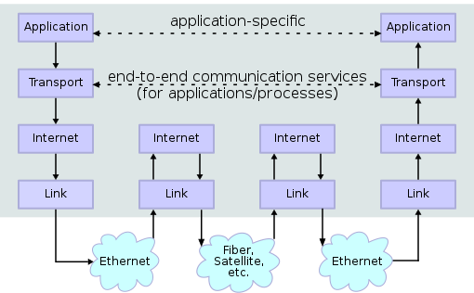
Transport vs Network Layer Services
Network layer: host-to-host delivery
Transport layer: logical communication between processes
relies on, enhances, network layer services
Src: https://commons.wikimedia.org/wiki/File:IP_stack_connections_(corrected).svg

Slide 4

Sockets
Socket: door between application process and end-end-transport protocol
An application process can send/receive messages to/from another application process via a socket
Application
Socket
Application
controlled by
app developer
process
process
Transport
Transport
Network
Network
controlled
by OS
Link
Internet
Link
Physical
Physical

Slide 5
Transport Layer Actions
Sender:
application
application
is passed an application-layer message
app. msg
determines segment header fields values
T_{h}
transport
app. msg
transport
T_{h}
network (IP)
creates segment
network (IP)
link
passes segment to IP
link
physical
physical

Slide 6
Transport Layer Actions
Receiver:
application
receives segment from IP
application
checks header values
transport
transport
app. msg
extracts application-layer message
network (IP)
demultiplexes message up to application via socket
network (IP)
link
link
physical
physical
app. msg
T_{h}

Slide 7
Two Principal Internet Transport Protocols
application
transport
network
data link
physical
TCP: Transmission Control Protocol
reliable, in-order delivery
congestion control
flow control
connection setup
UDP: User Datagram Protocol
unreliable, unordered delivery
no-frills extension of “best-effort” IP
mobile network
national or global ISP
logical end-end transport
local or regional ISP
home network
content
provider
network
application
transport
network
data link
physical
datacenter
network
enterprise
network

Slide 8
Multiplexing and Demultiplexing

Slide 9
Multiplexing/demultiplexing
Multiplexing at sender:
Demultiplexing at receiver:
Handle data from multiple
sockets, add transport header (later used for demultiplexing)
Use header info to deliver
received segments to correct
socket
Application
Application
P1
P2
Application
Socket
P3
Transport
P4
Process
Transport
Network
Transport
Network
Link
Network
Link
Physical
Link
Physical
Physical

Slide 10
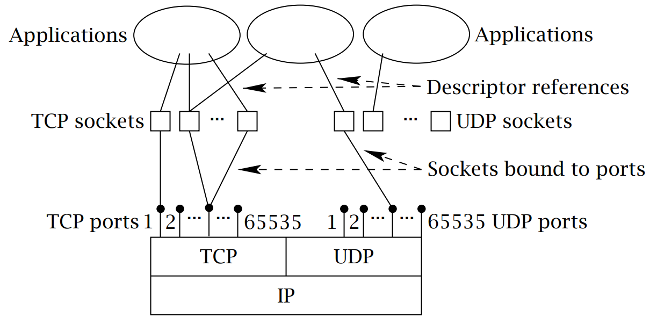
How Demultiplexing Works
Host receives IP datagrams
Each datagram has source IP address, destination IP address
Each datagram carries one transport-layer segment
Each segment has source, destination port number
Host uses IP addresses & port numbers to direct segment to appropriate socket
Src: https://linuxwheel.com/chapter-5-fundamentals-of-tcp-ip-transport-and-application/
Source port #
Dest port #
Other header fields
Application data
TCP/UDP segment format

Slide 11
Connectionless Demultiplexing
When creating datagram to send into UDP socket, must specify
Destination IP address
Destination port #
When host receives UDP segment:
checks destination port # in segment
directs UDP segment to socket with that port #
IP datagrams with same dest. port #, but different source IP addresses and/or source port numbers will be directed to same socket at dest

Slide 12
Connectionless Demultiplexing
DatagramSocket serverSocket = new DatagramSocket (6428)
DatagramSocket mySocket2 = new DatagramSocket (9157)
DatagramSocket mySocket1 = new DatagramSocket (5775)
Application
Application
P1
Application
P3
P4
Transport
Transport
Network
Transport
Network
Link
Network
Link
Physical
Link
Physical
Physical
Source port: 6428
Dest port: 9157
Source port: 6428
Dest port: 5775
Source port: 9157
Dest port: 6428
Source port: 5775
Dest port: 6428

Slide 13
Connection-Oriented Demultiplexing
TCP socket identified by 4-tuple:
Source IP address
Source port number
Dest IP address
Dest port number
Demux: receiver uses all four values to direct segment to appropriate socket
Server host may support many simultaneous TCP sockets:
Each socket identified by its own 4-tuple
Web servers have different sockets for each connecting client

Slide 14
Connection-Oriented Demultiplexing
Application
Application
P4
P5
P6
Application
P3
P2
P3
Transport
Transport
Network
Transport
Network
Link
Network
Link
Physical
Link
Physical
Server: IP address B
Physical
Host: IP address A
source IP,port: A,9157
dest IP, port: B,80
Host: IP address C
source IP,port: C,5775
dest IP,port: B,80
Three segments, all destined to IP address: B,
dest port: 80 are demultiplexed to different sockets
source IP,port: C,9157
dest IP,port: B,80

Slide 15
Summary
Transport layer protocols:
Multiplexing, demultiplexing
UDP: Demultiplexing using destination IP address and port number
TCP: Demultiplexing using 4-tuple: source and destination IP addresses, and port numbers

